Slide 1


Junior Post Secondary Timeline Presentation
What do I do now????

Slide 2


Post secondary options
Get a job, technical school, community college, university, liberal arts school? There are so many options!
If you are unsure what direction you are
going in after high school, check out our
College and Career Planning Link on our web
page. It is a great place to start researching
options.
This presentation will focus on the planning process
for four year universities/colleges. However, some of
the information pertains to community college and
technical schools. For example: financial aid and
scholarships.

Slide 3

Are you organized???
What are you doing for planning over the summer???

Slide 4



If you are applying to a college/university have you made a list of the colleges you will be applying to?
Tips for Creating a College List
Once you create a list you should be aware of the timeline for applying to that college. On the counseling web page there is an example of a College Comparison Sheet.
Once you have a college list you should make a plan to visit the colleges you are most interested it. If you can’t visit you can always schedule a phone conference with an admissions representative and a virtual tour.
College Virtual Tours
Arizona Colleges Virtual Tours
Also be aware of the colleges coming to BCHS in the fall and sign up to visit with the admission representatives. You can find an updated list here, in FALL 2020.
4

Slide 5
What about college entrance exam testing???

Slide 6



ACT and SAT have been making plans for testing to resume as soon as STAY AT HOME orders are lifted. They update their web pages frequently with the latest information. If you have not taken the SAT or ACT please don’t worry, colleges are being flexible and expect that tests scores will arrive later than usual.
ACT
SAT
What about community college? Do I need to test? We encourage students to test, many scholarships will ask for a test score to qualify.
6

Slide 7
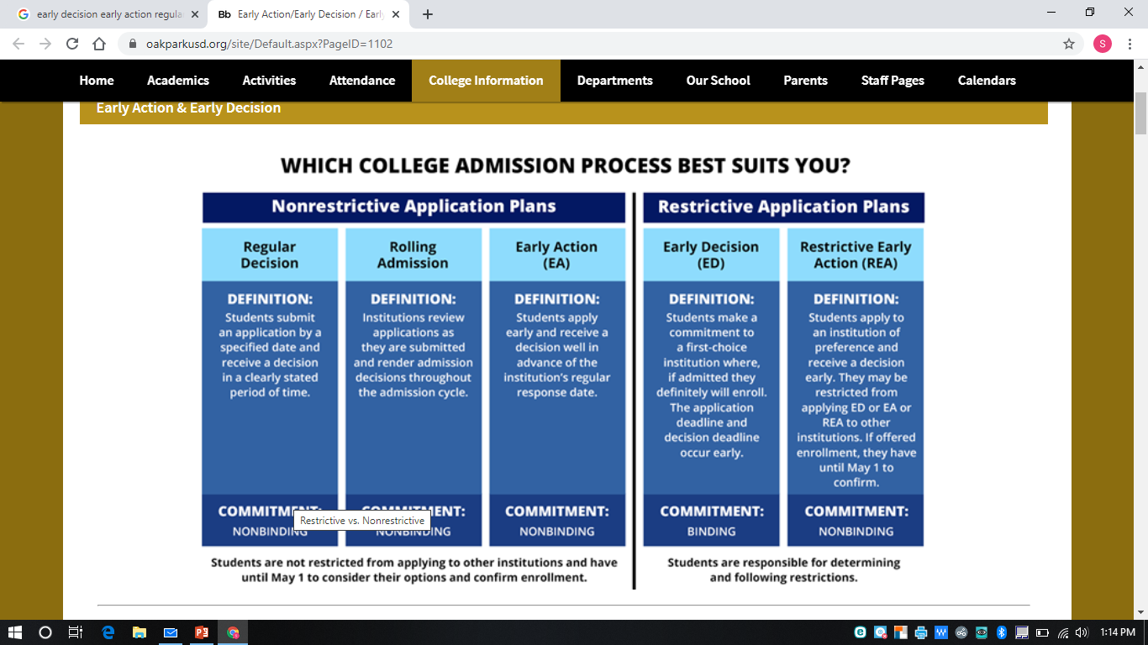

Be Aware of Deadlines!
When is the application deadline and what do you have to submit? If you filled out the college list spreadsheet you should be aware of all deadlines.
Most colleges have a web page for freshmen applicants, on this web page you will find the steps to apply along with important dates. Below are the links to our in state universities.
ASU
UofA
NAU
7

Slide 8



APPLYING OUT OF STATE??
Is the college/university you applying to part of the Common Application? It is usually posted on the schools web page or you can check HERE.
You can start filling out the common application this summer. It can take some time so best to get started before school starts in August. You can create an account HERE, to get started!
If you do start this summer be sure to ROLL OVER your account in the FALL so you do not loose the work you completed.
You will have to write a college essay for our in state honors colleges and the common application. It is helpful to have a few resources to support you with this process. You are able to see the essay prompts for the common application and our honors colleges on their web page. Be aware that they may not have updated the prompt to the current application year.
The College Essay Guy is a wonderful resource for you to assist with your college essay. You can also view the College Essay Workshop, that was presented to students. That may assist you in getting your essay started.
8

Slide 9


REMEMBER….
Our in state universities will ask that
you self report you grades. You can
find your grades on power school, but
you have to log on to the website on a
desk top.
Our in state universities want you to apply directly through their web page! The application fee is less and you are not required to write an essay! Only if you apply to the honors college will you be asked to write an essay.
9

Slide 10

PLEASE REMEMBER HOW TO REQUEST YOUR TRANSCRIPT……
To request an official transcript for a college,
college coach, scholarship, etc. or if you need
an unofficial transcript you can request it on
through PARCHMENT on our web page
You will have to create an account which is easy
just skip over the profile section you do not need to
do that. There is a fee of $3.95 for the official
transcript, but there is NO fee for the unofficial
transcript.

Slide 11

FINANCIAL AID
OCTOBER 1, 2020 IS THE DAY THAT YOU CAN FILL OUT THE Free Application for Federal Student Aid (FAFSA)
You and your parent/guardian will need to create an account. By filling out the FAFSA you MAY qualify for loans,
scholarships and/or work study. Colleges encourages all students to fill out the FAFSA.
You can also find more information on our web page. Financial Aid

Slide 12


What about scholarships???
12

Slide 13

It is always a good idea to apply for scholarships you
know you have a chance of receiving. We encourage all
students to apply for our local scholarships. Below are a
Few tips on what you should know about scholarships.
There is a scholarship board in the counseling office
that is updated with scholarships throughout the
the school year.
Pay attention to the announcements, we share
what scholarships are available for students to
apply for.
3. Pay attention to FLEX times so you know when the
scholarship workshops are offered.
Visit our web page.
5. Visit colleges financial aid and scholarship pages,
don’t hesitate to e-mail or call the college to ask
questions.
6. Reach out to your counselor with any concerns or
questions. We are here to support you!

Slide 14


Interview with an University of Redlands current student.
Type of school: Small Liberal Arts school
Location: Redlands, California
Size: 2,527

Slide 15

Remember your counselors are here to guide and support you throughout your post secondary planning process so reach out to us!
Counselor Contact Information

