Slide 1
Local Scholarship workshop

Slide 2

Today’s Agenda
Scholarships Tips
Letter and Essay Tips
Local Scholarships
Work on Applications, browsing more scholarships, or getting organized

Slide 3
Scholarship tips
Never Pay for Scholarship Information
Get Organized
Create a separate professional email
Censor Social Media
Dedicate allotted time
Start local and work out from there
Do not avoid lower $$ or extra requirements
University Scholarship Portals
FAFSA https://studentaid.gov/h/apply-for-aid/fafsa

Slide 4
Letters and essays
Letters of Recommendation
  At least one should come from a core teacher within the last year.
  Think of who would have a good story to tell.
Essays
  Make it a goal to stand out, what sets you apart?
  Allow personality to shine through (impactful story that reflects your values)
  Avoid cliché openers (Quotes, Dictionary, First sentence spoilers)
  How to answer “Why do you need financial aid”?

Slide 5
Local Scholarships

Slide 6

Anthem Cares Through Service
Up to five $2,000 scholarships for Anthem Students attending a University or Community College
3.0 GPA
Able to prove financial need
200 word essay and two references
Why do you want to further your education after high school and what do you plan to study or accomplish?
Due Date: April 19th, 2024

Slide 7

Daisy Mountain firefighters charities
Up to two $1,500 scholarships to BCHS students
3.0 GPA
No Financial Need requirement (No interest in fire science required)
Must have community service or volunteer hours
250-500 word essay and two letters of recommendation
Describe how volunteer or community service has shaped who you are today and what it has taught you.
Due Date: April 28th, 2024
Public Safety Scholarship (Child of an active or deceased public safety personnel within Maricopa County)
Online Application LINK: https://firefighterscharities.org/scholarship/

Slide 8

Daisy Mountain Rock and Mineral club scholarship
$1500 scholarship to a BCHS student (1 applicant last year)
No GPA or Financial need requirement
Application and 1 recommendation form
Must have an interest in pursuing something in the field of Geoscience. i.e. Environmental Engineering, Geology, Hydrology, Anthropology, Civil Engineering, etc..
Due Date: April 1st 2024
Link: https://www.dmrmc.com/

Slide 9

Rotary club of Anthem
Up to five $1,000 scholarships to Anthem students
No GPA or Financial Need component
Some community service hours
(350 Word essay) Describe how the things you will think, say, or do in your chosen career and how it will be beneficial to individuals, families, and the community
Due Date: April 15, 2024
Link: https://portal.clubrunner.ca/1691/

Slide 10
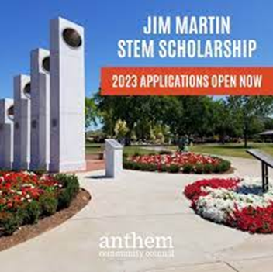
Jim Martin Stem Scholarship
Two $1,000 scholarships to Anthem students
3.0 GPA
Active in community service
Demonstrated excellence in mathematics (Engineering is a bonus)
Acceptance into a post-secondary institution with the intent to major in science, technology, engineering, or mathematics
3 Short essay responses (300 words each)
Due Date: April 12, 2024

Slide 11

Arizona Community foundation
1 application for over 100 Arizona scholarships
All requirements will vary
Attending University, Community College, or Trade School
Due Date: Various Due Dates, submit application as soon as possible
Link: https://www.azfoundation.org/scholarship-seekers/

Slide 12
Time to Work!
Start completing applications
Browse more scholarships: https://www.dvusd.org/Page/84028
Login to your Major Clarity app, click “Financial Resources” to explore scholarships.
Login to your University account and access the scholarship portal
Start applying to the Local scholarships
Additional Scholarship Search: https://studentscholarships.org/scholarships.php
Create Application Organizer https://www.collegexpress.com/articles-and-advice/financial-aid/blog/scholarship-search-spreadsheet-template/

