Slide 1

Freshmen Course Registration Presentation
Class of 2027

Slide 2


Who is my counselor?
Graduation requirements.
West Mec and CTE Programs.
New science standards and options.
Choose courses for your sophomore year.
Notes:
Today we will briefly review information that will get you started on thinking about your high school academic plan and how that will impact the choices you will have after graduating from high school. We want all students to have options after graduation and are here to support you throughout your four years at Boulder Creek.
We will discuss,
WHO IS MY COUNSELOR AND WHAT DO THEY DO???
SHARE WHY YOUR FRESHMEN YEAR IS IMPORTANT AND WILL IMPACT YOUR PLANS AFTER HIGH SCHOOL.
GO OVER POST SECONDARY OPTIONS
SHARE HOW WE AS COUNSELOR WILL HELP YOU PLAN YOUR HIGH SCHOOL CLASSES SO YOU ARE PREPARED FOR YOU POST SECONDARY EDUCATION AND SHARE WHAT GRADUATING SENIORS WISH THEY WOULD HAVE KNOWN AS A FRESHMEN.

Slide 3
Who is my counselor?
Counselors are assigned students by last name
My Last Name Begins with… | Counselor | E-mail
A, B, COW | Ms. Chazan | Denise.Chazan@dvusd.org
COR, D, E, F, G, HES | Mr. Sheets | Dennis.Sheets@dvusd.org
HET, I, J, K, L, MC | Mrs. Mohr | Heather.Mohr@dvusd.org
ME, N, O, P, Q, R, SE | Ms. Sherrod | Patricia.Sherrod@dvusd.org
SH, T, U, V, W, X, Y, Z | Ms. LoDolce | Kippi.Lodolce@dvusd.org
HS Transition and Gifted Support | Ms. Heid | Alyssa.heid@dvusd.org
Boulder Creek Counseling Webpage

Slide 4

Counseling Support Staff
Position | Staff | E-mail
Counseling Secretary | Mrs. Shaba | Mary.Shaba@dvusd.org
Registered Clerk | Mrs. Ferguson | Gina.Ferguson@dvusd.org
Boulder Creek Counseling Webpage

Slide 5

Resources
College Planning
Virtual College Visits
Credit Retrieval
Transcripts
Military
West Mec/CTE Programs
Career Exploration
Newsletter
Scholarship
AP and Dual Enrollment
Boulder Creek Counseling Webpage

Slide 6
IMPORTANT TERMS TO UNDERSTAND IN HIGH SCHOOL
Grade Point Average (GPA)
Each class earns points:
A=4 points
B=3 points
C=2 points
D=1 point
HONORS & AP classes earn more points:
A=5 points
B=4 points
C=3 points
D=1 point
To determine your GPA, add points for
each grade and divide by the number
of classes (it’s a simple averaging problem).
GPA determines your class rank
and is used to meet college admissions
requirements.
Semester:
18 week period, half of the school year
Transcript:
The official record of the high school
classes you have taken & the grades
earned.
Note: Colleges, universities, scholarships, and even employers ask for a copy of your transcript.
Four Year Plan/ECAP:
A carefully laid out plan of high school
courses you intend to take based on your
career goals.
Credit Retrieval/Recovery:
Re-taking a course you failed

Slide 7

Graduation Requirements
How many credits do you need to graduate?
What credits do I need?
English – 4 credits
Math – 4 credits
Science – 3 credits
Social Studies – 3 credits
PE (.5 cr) & Health (.5 cr) – 1 credit
CTE or Fine Art – 1 credit
Electives – 6 credits
22

Slide 8




IN-STATE UNIVERSITY ENTRANCE REQUIREMENTS
4 cr English Language Arts
4 cr Math
3 cr Science
2 cr Soc Studies
1 cr Fine Arts or CTE
2 cr World Language
*If applying out of state, be sure you have a fine art credit and check the school’s admission requirements.
Notes:
To apply to our in state universities you must have completed the following courses and remember your Grade Point Average is important!
4 cr English Language Arts
4 cr Math
3 cr Science
2 cr Soc Studies
1 cr Fine Arts/CTE
2 cr World Language

Slide 9
Outline of Graduation Requirements
(9th - 12th)
FRESHMAN YEAR (6 credits) ELA 1-2 (gen ed or honors) Algebra 1-2 (gen ed or honors) Biology (gen ed or honors) PE and Health Elective Elective
SOPHOMORE YEAR (6 credits) ELA 3-4 (gen ed , honors, or AP Seminar) Geometry 1-2 (gen ed or honors) Earth Sci or Environmental Sci World History 1-2 (gen ed or AP) Elective Elective
JUNIOR YEAR (6 credits) ELA 5-6 (gen ed, dual enrollment or AP) Algebra 3-4 (gen ed or honors) Lab Science (see junior course list) US History 1-2 (gen ed or AP) Elective Elective
SENIOR YEAR (4 credits) ELA 7-8 (gen ed, dual enrollment or AP) Senior Math (see senior course list) US Government & Economics (gen ed or AP) Elective
22 Credits to Graduate

Slide 10

Repeat A Class
All Core Courses (ELA, Math, Science & Social Studies) are part of the graduation requirements and must be repeated until a passing grade is achieved.
A Failed Elective may be replaced with a different elective to meet graduation requirement of 22 total credits.
Passing ALL classes will keep you on track for graduation!

Slide 11

How can I make up a class or improve a grade?
If you would like to make up a class or take it for grade improvement, see your COUNSELOR first! We want to make sure you are taking the correct class and that DVUSD will accept the credit.

Slide 12

Deer Valley Credit Retrieval and Improvement Programs
DV Pathways
Aspire (DV Online Program)
1-2 sessions each semester and 1 session in the summer
Small class size
DVUSD Approved
Short-term commitment to earn credit
  Seven week enrollment
  Monday - Thursday
  Block Schedule
Free
1 session each semester and in the summer
Schedule flexibility
Variety of course selections
Cost $200 per class

Slide 13

Career & Technical Education (CTE) and West Mec Programs
Decide what program you are interested in and research it.
CTE
West Mec

Slide 14


Advanced Placement (AP) vs Gen Ed
AP and Gen Ed Information
What’s right for me?

Slide 15

World History
World History | Advanced Placement (AP) World History
This is a requirement for graduation | Highly motivated, willing to accept a challenge! “B” or higher in ELA Honors “A” in ELA (lexile 1100 or higher) Strong work ethic and excellent time management skills! Expect 1 -2 hours of homework 5-6 nights a week You will read 1 chapter a week 1 Primary Source per week Writing tests at least once a week (Heavily focused on writing)

Slide 16

English Language Arts (ELA)
ELA 3-4 | ELA 3-4 Honors | AP Seminar
This is a requirement for graduation. | Advanced level ELA course. “B” or higher in ELA Honors “A” in ELA (lexile 1100 or higher) | Reading and analyzing novels, plays, and short stories. 2 essays and 2 presentations Writing rhetorical analysis, arguments, and synthesis essays. Team and individual projects and presentations. End of course exam “B” or higher in ELA Honors “A” in ELA (lexile 1100 or higher)
Notes:
AP Seminar is the first course of two for the AP Capstone Diploma Program. To receive Capstone, student must a score 3+ for AP Seminar, AP Research, and 4 other AP classes.

Slide 17
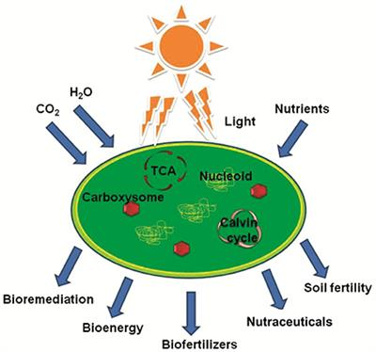


Science Options
Students must take Environmental OR Earth Science by the end of your Junior Year
Chemistry or Chemistry Honors
(read below)
Earth
or
Earth Honors
Environmental
If you select Chemistry/Chemistry Honors for your Sophomore year, you must complete Earth or Environmental Science by the end of Junior year, or you can take Honors Earth Science course with Aspire (DV online program) which meets the science requirement if you have a goal of taking another science Junior year, such as Anatomy/Physiology, AP Bio, Physics or etc.
New Science Standards

Slide 18
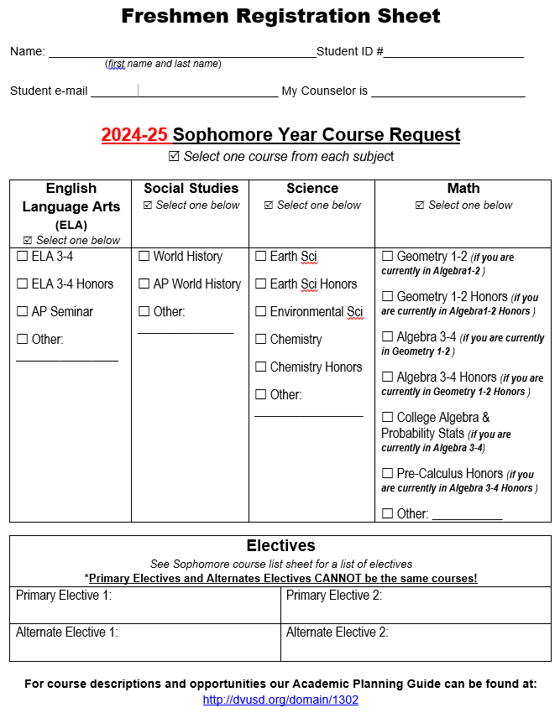
Course Registration Sheet for Sophomore Year
Fill-in your first and last name, student ID #, student email, and counselor’s name.
Select classes for:
  ELA
  Social Studies
  Science
  Math
  2 Electives
  2 Alternate Electives (electives and alternate electives cannot be the same)
List of Sophomore Courses

Slide 19

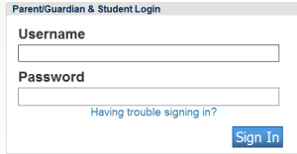
Courses Registration for Your Sophomore Year
Electronic Course Request Process Instructions
Log onto Powerschools (https://ps.dvusd.org) from the browser. Don’t use the app.
Sign in using your Powerschool username and password.

Slide 20
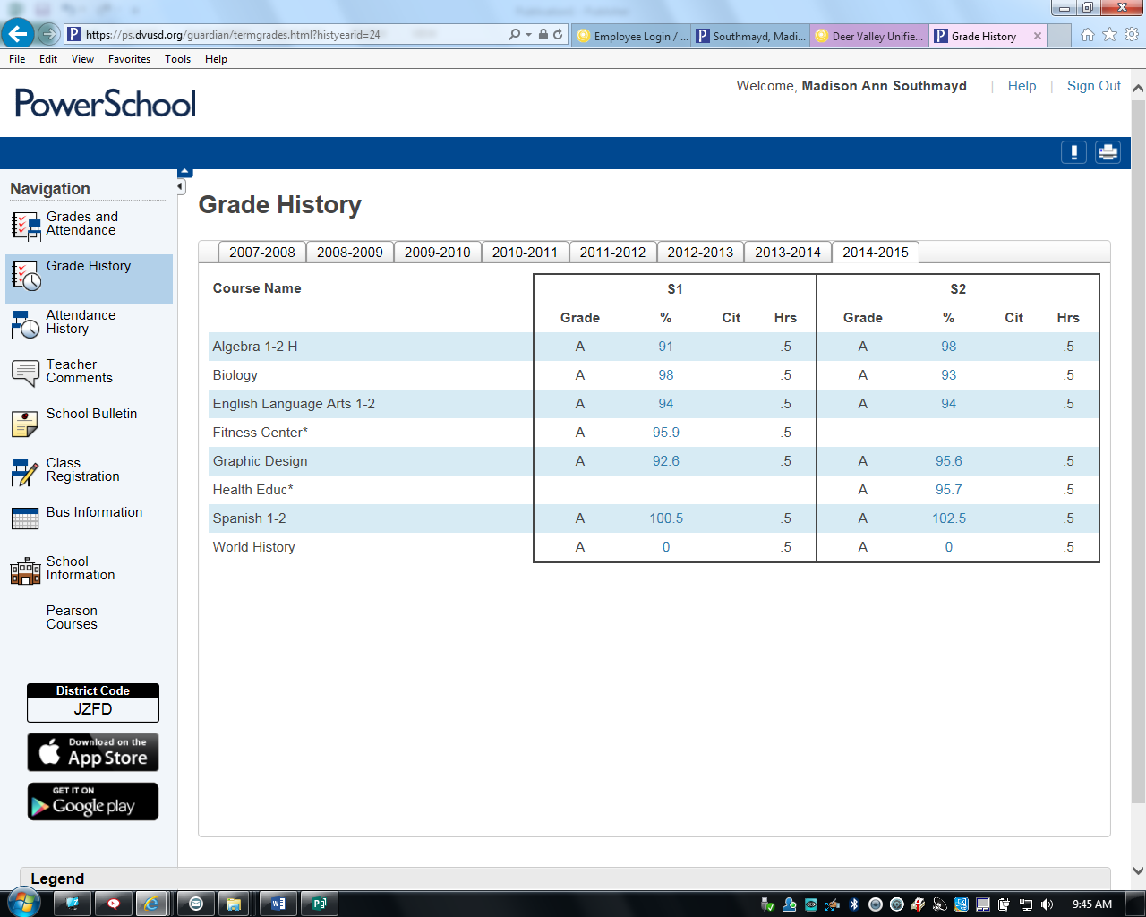

Slide 21

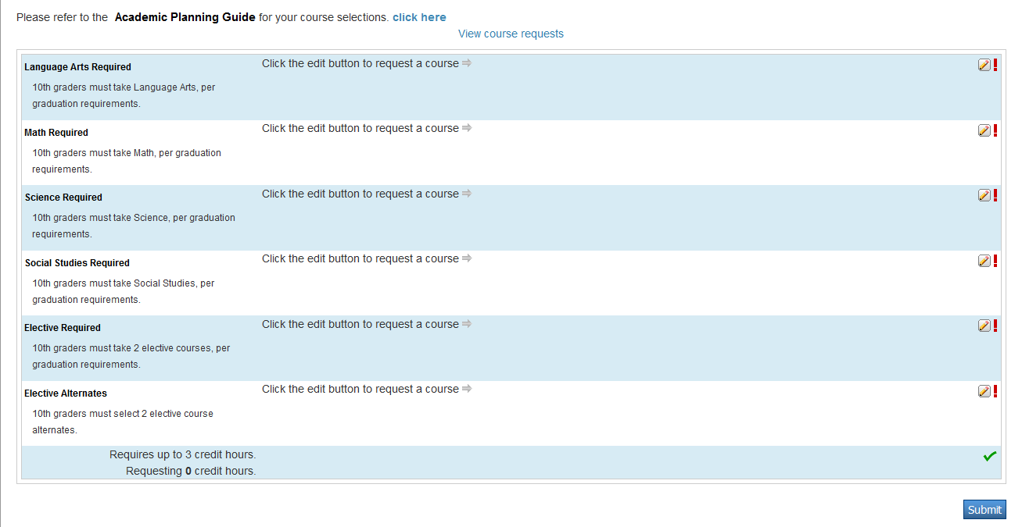
Click on the Class Registration link
To select your classes, you will click on the pencil icon and choose courses for each subject area.
pencil icon

Slide 22
Follow the directions of each course group. All red ! must be gone before you can select the “Submit” button to finish the process.
Submit

Slide 23


Video Tutorial https://vimeo.com/110188954
If you have questions after you have viewed the tutorial and have tried to input your classes, please e-mail your counselor. We are happy to help you with the process.

Slide 24

To assist you with your career search, click HERE.
Career Exploration

Slide 25

Please visit the counseling website for information and opportunities.
Thanks
Boulder Creek Counseling Webpage

