Slide 1

Freshmen Unit Presentation
Hello Jags
Class of 2027

Slide 2





What does it mean to be a JAG?
P R I D E
P being prepared
R being respectful
I having integrity
D being disciplined
E everyone united

Slide 3


ICEBREAKER
Getting to Know You
Divided up into groups and find 2-4 things everyone in your group has in common (Can’t say all freshman, all live in Arizona, or all go to Boulder Creek).
A group member will present the 2-4 things after 2-3 minutes.

Slide 4


Who is my counselor and what do they do?
Resources on the counseling web page.
Graduation requirements.
Options you will have after high school.
Major Clarity (Personality & Learning Assessments).
Get to know your school activity.
Preparing for upcoming course registration.
Notes:
Today we will briefly review information that will get you started on thinking about your high school academic plan and how that will impact the choices you will have after graduating from high school. We want all students to have options after graduation and are here to support you throughout your four years at Boulder Creek.
We will discuss,
WHO IS MY COUNSELOR AND WHAT DO THEY DO???
SHARE WHY YOUR FRESHMEN YEAR IS IMPORTANT AND WILL IMPACT YOUR PLANS AFTER HIGH SCHOOL.
GO OVER POST SECONDARY OPTIONS
SHARE HOW WE AS COUNSELOR WILL HELP YOU PLAN YOUR HIGH SCHOOL CLASSES SO YOU ARE PREPARED FOR YOU POST SECONDARY EDUCATION AND SHARE WHAT GRADUATING SENIORS WISH THEY WOULD HAVE KNOWN AS A FRESHMEN.

Slide 5
Who is my counselor?
Counselors are assigned students by last name
My Last Name Begins with… | Counselor | E-mail
A, B, COW | Ms. Chazan | Denise.Chazan@dvusd.org
COX, D, E, F, G, HES | Mr. Sheets | Dennis.Sheets@dvusd.org
HET, I, J, K, L, MC | Ms. Mohr | Heather.Mohr@dvusd.org
ME, N, O, P, Q, R, SE | Ms. Sherrod | Patricia.Sherrod@dvusd.org
SH, T, U, V, W, X, Y, Z | Ms. LoDolce | Kippi.Lodolce@dvusd.org
HS Transition and Gifted Support | Ms. Heid | Alyssa.heid@dvusd.org
Boulder Creek Counseling Webpage

Slide 6

Counseling Support Staff
Position | Staff | E-mail
Counseling Secretary | Mrs. Shaba | Mary.Shaba@dvusd.org
Registered Clerk | Mrs. Ferguson | Gina.Ferguson@dvusd.org
Wellness Counselor | Mrs. Buczek | Angie.Buczek-cw@dvusd.org
Boulder Creek Counseling Webpage

Slide 7


What does my counselor do?
Provides Guidance Curriculum relating to your four year high school and post secondary plans.
Individual Planning (college/career, personal, academic)
Addresses crisis issues
Works with parents, teachers,
and other staff/community
members to advocate for students.
Notes:
Often times student wonder how counselors spend their day and want to know how we assist students. Counselors wear many hats and are your go to person when you don’t know what to do or where to go for support. We work hard to provide guidance curriculum that will benefit you during and after high school, meet with you individually for college/career planning, address personal and crisis situations when needed, work with parents, teachers and other staff and community member to advocate for our students.

Slide 8

How do I see my counselor?
Boulder Creek Counseling Webpage
E-mail
Visit the counseling office to request a meeting.
  Before/after school or during lunch to request a meeting.
Call
Notes:
Often times student wonder how counselors spend their day and want to know how we assist students. Counselors wear many hats and are your go to person when you don’t know what to do or where to go for support. We work hard to provide guidance curriculum that will benefit you during and after high school, meet with you individually for college/career planning, address personal and crisis situations when needed, work with parents, teachers and other staff and community member to advocate for our students.

Slide 9

Resources
Boulder Creek Counseling Webpage
College Planning
Virtual College Visits
Credit Retrieval
Transcripts
Military
West Mec/CTE Programs
Career Exploration
Newsletter
Scholarship
AP and Dual Enrollment

Slide 10


School Clubs & Activities
CLICK HERE TO
Benefits
BC Clubs and Activities
Gain teamwork and leadership experience
Looks good on college applications and resumes
Improves academics and test scores
Exploring new interests/hobbies
Creating friendships
Gaming Club
NHS
Interact Club
Mountain Bike Club
Golf
Football
Basketball
Cheer

Slide 11

Outline of Graduation Requirements
(9th - 12th)
22 Credits for Graduation Requirements
FRESHMAN YEAR (6 credits) ELA 1-2 (gen ed or honors) Algebra 1-2 (gen ed or honors) Biology (gen ed or honors) PE and Health Elective Elective
SOPHOMORE YEAR (6 credits) ELA 3-4 (gen ed, honors, AP Seminar) Geometry 1-2 (gen ed or honors) Earth Sci, Chemistry or Environmental Sci World History 1-2 (gen ed or AP) Elective Elective
JUNIOR YEAR (6 credits) ELA 5-6 (gen ed, dual enrollment or AP) Algebra 3-4 (gen ed or honors) Lab Science (see junior course list) US History 1-2 (gen ed or AP) Elective Elective
SENIOR YEAR (4 credits) ELA 7-8 (gen ed, dual enrollment or AP) Senior Math (see senior course list) US Government & Economics (gen ed or AP) Elective

Slide 12








Options after High School

Slide 13

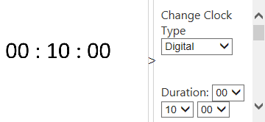
Log in using the Clever App
Complete your Personality and Learning Style Assessments

Slide 14
How Well Do you Know Your School
What is the name of the school mascot?
A) Bear
B) Jaguar
C) Cougar
B
2. What are the school colors?
A) Black and Orange
B) Red and Green
C) Red and Black
C

Slide 15
How Well Do you Know Your School
3. What is the principal’s name?
A) Mr. Sheets
B) Ms. Behrens
C) Ms. Sutton
C
4. Which days are flex time?
A) Tuesday and Thursday
B) Monday and Wednesday
C) Thursday and Saturday
A

Slide 16
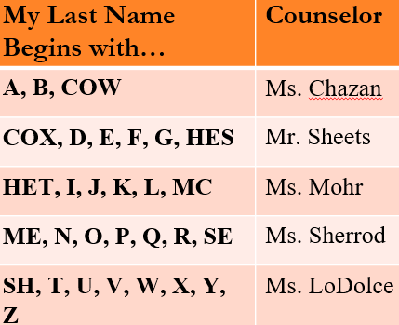
How Well Do you Know Your School
5. Where is the counselor’s office?
A) In the library
B) In the Admin Building
C) In the cafeteria
B
6. Who is your counselor ?
A) Ms. Chazan
B) Mr. Sheets
C) Ms. Mohr
D) Ms. Sherrod
E) Ms. LoDolce

Slide 17

Course Registration
We will be back in December for course registration.
SOPHOMORE COURSES
COURSE DESCRIPTION

Slide 18
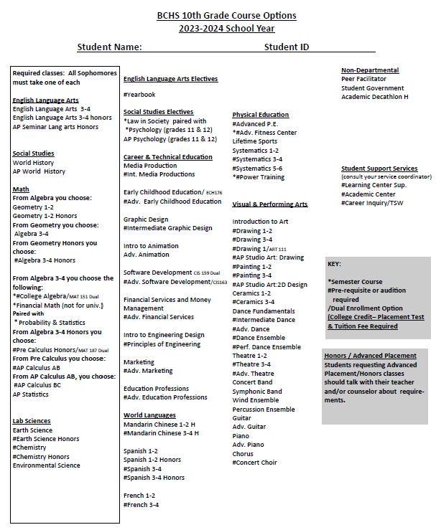
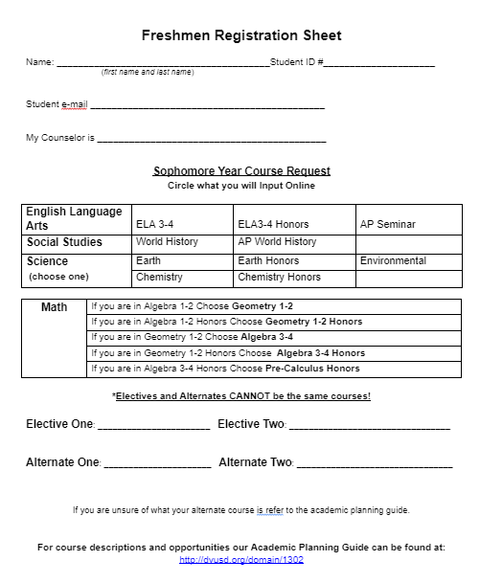
Course List & Registration Form
Counselors will be back in December for course registration. Please review and discuss your options with parents/guardians, teachers, and counselors.

Slide 19

Please visit the counseling website for information and opportunities.
Thanks
Boulder Creek Counseling Webpage

