Slide 1


SOPHOMORE
Guidance Session

Slide 2

What to expect today…..
Who is my counselor?
How to stay connected with counseling
CTE and West Mec Opportunities
Science Course Sequence
Registration for courses your junior high school year.

Slide 3
Allow us to introduce ourselves…
Students with last names A-COW ~ Ms. Chazan
Students with last names COX-HES ~ Mr. Sheets
Students with last names HET-MC ~ Ms. Mohr
Students with last names ME-SE ~ Ms. Sherrod
Students with last names SH-Z ~ Ms. LoDolce
Transition and Gifted- Ms. Heid
Mary Shaba: Counselor Secretary
Gina Ferguson: Registrar Clerk
Counselor E-mails

Slide 4
CTE: Career & Technical Education
Why CTE or West-Mec?
Our CTE/West-Mec programs provide a faster way forward

Slide 5


Slide 6




Career & Technical Education
BCHS | BGHS | DVHS | MRHS | SDOHS | Aspire Online
Animation Early Childhood Education Engineering Finance Graphic Design Media Productions Software & App Design Esucation Professions | Architectural Drafting Business Operations Culinary Arts Graphic Design Finance Marketing Media Productions Software & App Design | Air Force JROTC Graphic Design Hospitality Management Marketing Nursing Services Software & App Design Sports Medicine Stagecraft | Animation Biomedical Science Education Professions Engineering Graphic Design Journalism and Digital Communication Marketing Media Production Software & App Design | Accounting Air Force JROTC Early Childhood Education Graphic Design Interior Design Journalism and Digital Communication Marketing Media Production Software & App Design Sports Medicine Stagecraft | Accounting Business Operations
BCHS | BGHS | DVHS | MRHS | SDOHS
Animation Early Childhood Education Engineering Finance Graphic Design Media Productions Software & App Design | Architectural Drafting Business Operations Culinary Arts Graphic Design Finance Marketing Media Productions Software & App Design | Air Force JROTC Graphic Design Hospitality Management Marketing Nursing Services Software & App Design Sports Medicine Stagecraft | Animation Biomedical Science Education Professions Engineering Graphic Design Journalism and Digital Communication Marketing Media Production Software & App Design | Accounting Air Force JROTC Early Childhood Education Graphic Design Interior Design Journalism and Digital Communication Marketing Media Production Software & App Design Sports Medicine Stagecraft

Slide 7
Steps to apply to CTE programs and what you need to know:
Decide what program you are interested in and research it.
  Are my grades sufficient for the program I am interested in?
  How many elective credits will this program provide me with?
Determine the cost of the program.
Determine if you have transportation to attend the program. Transportation is not provided.
Items needed to apply.
    Fill out the application which you can find here: CTE Programs
    Bring completed application to your counselor for DVUSD CTE Programs
      If applying for a West Mec program, provide your counselor with your travel form as well.

Slide 8


West-Mec www.West-Mec.EDU
Health Science | Information Technology | Human Services | Architecture & Construction | Science, Technology & Math | Manufacturing | Transportation, Distribution & Logistics
Dental Assisting Biomedical Science Medical Assisting Pharmacy Technician Physical Therapy Technician Veterinary Sciences | Coding IT Security | Aesthetician Culinary Principles Hair Styling | Air Conditioning Electrical Trade Specialty General Construction Technician | Energy & Industrial Technology Environmental Sustainability | Precision Machinery Welding Technology | Automotive Collision Technology Automotive Technology Aviation Maintenance Technology Avionics/Drone Electronics Medium/Heavy Diesel Technology Powersports Technology
Health Science | Information Technology |  |  | SDOHS

Slide 9
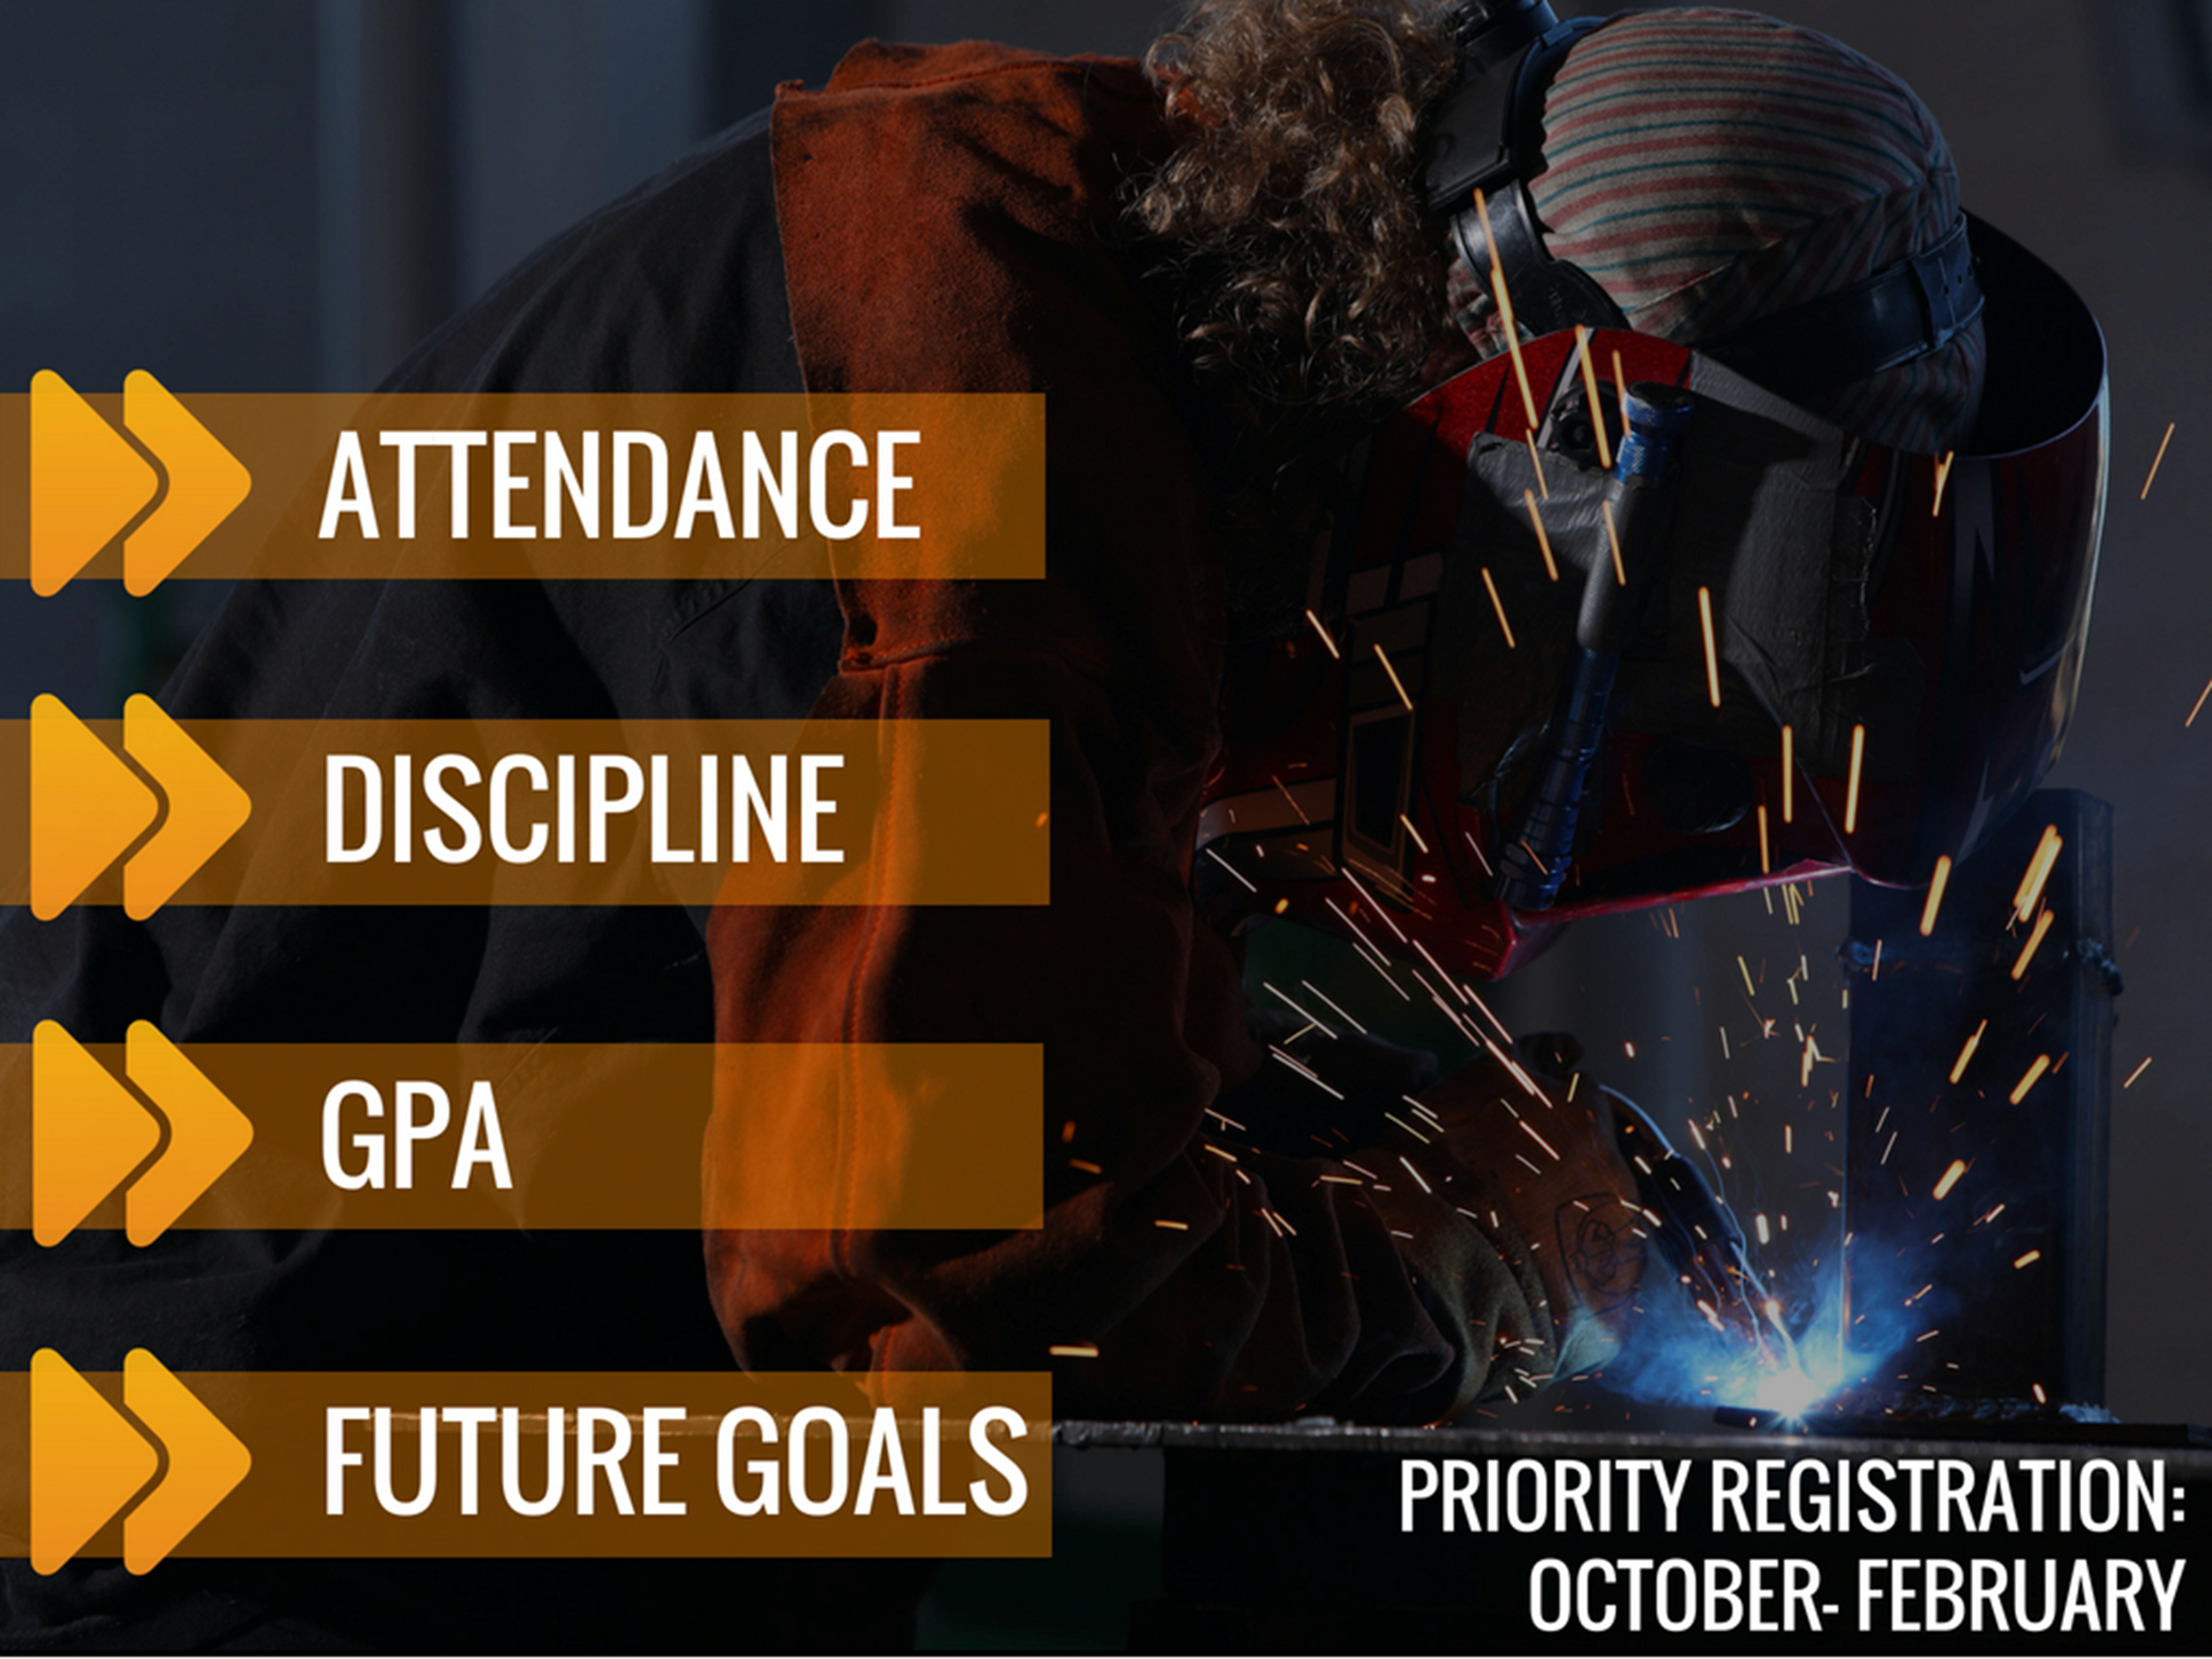

Slide 10
WEST-MEC APPLICATION
~Please see your counselor for information on West-Mec if you need help applying on the West mec website
~If you have already applied, be sure to get your application to your counselor for submittal
~Consider start and end times of West Mec programs and how it will effect your core classes

Slide 11


You need 22 credits to graduate
Class of 2026!!
High School Requirements
COLLEGE/UNIVERSITY REQUIREMENTS
  4 credits of English Language Arts
  4 credits of Math
  3 credits of Lab Science (1 must be Biology)
  .5 credit of Health & .5 credit of P.E.
  3 credits of Social Studies
  1 credit of CTE OR Fine Arts
  6 credits of Elective
  4 credits of English Language Arts
  4 credits of Math
  3 credits of Lab Science
  2 credits of Social Studies
  1 credit of CTE OR Fine Arts
  2 credits of the SAME World Language
  *Be sure to check University admission requirements! They may need a 3rd year of World Language or a fine art? Just a few examples.
Notes:
Students, your counselors want to take one more opportunity to remind you of the credit requirements for graduation. Remember that 22 credits are needed to graduate from BCHS, but you must also have met all of the course requirements as well. Your counselor will review your credits with you during your individual ECAP meeting; however, if at any point you have a question about taking classes online or outside of BCHS, please make sure to check with your counselor prior to enrolling to ensure you will receive credit. We cannot accept credits from schools that are not accredited.

Slide 12

☺ Reminders ☺
If you need credit recovery please see your counselor to discuss options.
-Pathways
-Online (Aspire)
If you would like to make up a class or take it for grade improvement, see your COUNSELOR first! We want to make sure you are taking the correct class and that DVUSD will accept the credit.

Slide 13

What are three differences between AP and Dual??
AP or DUAL

Slide 14
Rio Salado Dual Enrollment | Advanced Placement
COST: $97.00 Per Credit Hour Plus a $15.00 registration fee. | COST: $102.00 Per Test taken
College Credit: In-State transfers-check on intended major Out-of-State varies, check with school you plan to attend. | College Credit: Score a 3, 4, or 5 to earn credit. The score depends on school and major.
Academic Requirement: Must have a 2.6 GPA in ELA and a 3.0 GPA in math to enroll. If you do not have the required GPA you will have to take the ED Ready test online through Rio Salado Community College. Payment will be due during Fall/Spring semester of class. | Academic Requirement: Highly motivated honors level students May have summer reading/activity required Follows true college curricula
Represents the rigor of the community college curricula | Represents the rigor and expectation of university curricula
How will it transfer to community college/university: Visit the community college/university website you plan to attend Go to www.aztransfer.com | How will it transfer to community college/university: Visit the community college/university website you plan to attend Go to www.aztransfer.com

Slide 15

SCIENCE COURSE SELECTION
Freshmen Year: Biology or Biology Honors
Sophomore Year: Earth, Earth Honors, Environmental, Chemistry, or Chemistry Honors
Junior Year: Chemistry, Chemistry Honors, Earth, Earth Honors, Environmental, AP Environmental, Anatomy & Physiology, Physics Honors, AP Physics C (Calculus based), AP Biology

Slide 16
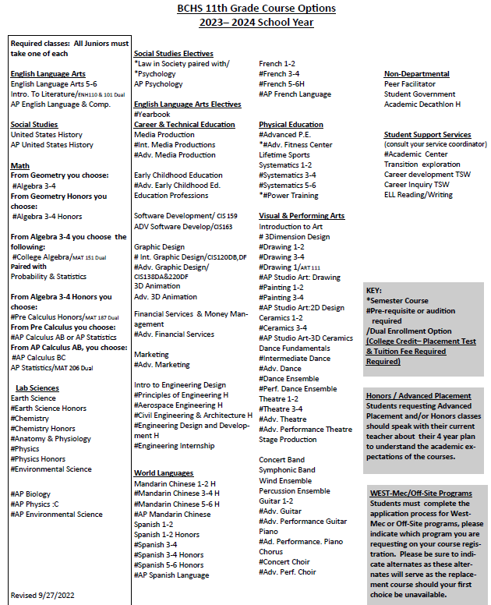

Slide 17
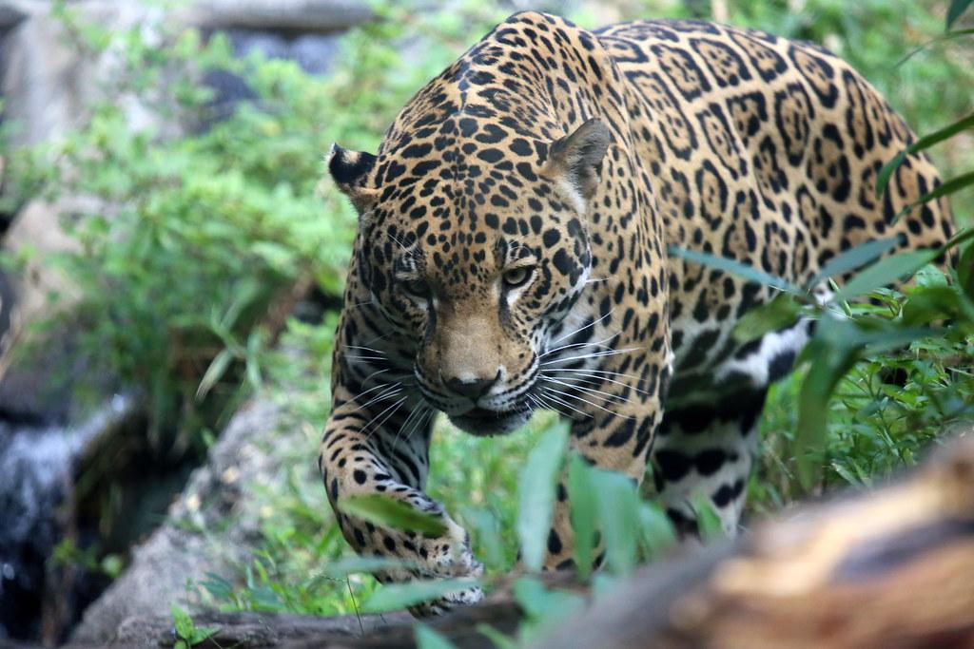
Next Steps
-You will get a pass for your individual ECAP meeting with your counselor
-You will pick your courses with your counselors for next year
-Be thinking of what questions you have for your individual meeting
-Must come at the time on your pass due to scheduling

