Slide 1


Senior Meeting
Class of 2024
Notes:
Good morning SENIORS, Class of 2016! There are 167 school days until graduation! From your entire Counseling Department, we just want to say Congratulations… you made it to the beginning of what will be a very exciting and very busy year. We wanted to make sure that you have all of the information you need to successfully navigate this, your final year of high school before you move on to University, Community College, Trade School, Military, or the World of Work.

Slide 2

Agenda
Objectives:
  TSW review crucial information regarding senior year.
  TSW establish a “for now” career goal and educational plan.
Reminders
  Graduation requirements
  Important Contacts
  Upcoming SAT & ACT dates and information
Senior information
  Alternatives to College
  College Admissions and Applications
  Sending Scores and Transcripts
  Letters of Recommendation
  Scholarships and Financial Aid
  Salary Game and Major Clarity

Slide 3

Want to see your counselor?
If you would like to meet with your counselor please send us an e-mail. In your e-mail let us know what information you are looking for and the best time to see you.
  A-Cow Ms. Chazan Denise.Chazan@dvusd.org
  Cox-Hes Mr. Sheets dennis.sheets@dvusd.org
  Het-Mc Ms. Mohr Heather.Mohr@dvusd.org
  Me-Se Ms. Sherrod patricia.Sherrod@dvusd.org
  Sh-Z Ms. Lodolce Kippi.Lodolce@dvusd.org
  Gifted Ms. Heid Alyssa.Heid@dvusd.org

Slide 4

Graduation Requirements
Students need 22 credits to graduate from BCHS in May 2024
  4 credits of English Language Arts
  4 credits of Math
  3 credits of Science
  3 credits of Social Studies (World History, US History, Gov/Econ)
  1 credit Health/PE
  1 credit Fine Art or CTE
  6 credits of other electives
  _____________________________
  22 Total
  If you are applying to a university or college, 2 of your electives must be 2 years of the same World Language for most universities.
Notes:
Listed on the slide are the requirements to graduate from Boulder Creek. They are also printed on your transcript.

Slide 5

Joining the Workforce
Networking in the circles where you want to be
Practice Interviewing Interview Tips and Tricks
What sets you apart?
Build a resume on Major Clarity “Resume Builder”
Clean up your social media accounts
Be the best employee possible Strategies for being the best employee possible

Slide 6


Certification Programs
Streamlined path to achieve your professional goals
Areas include:
  IT Security, Automotive Mechanic, Website Developer, Real Estate Agent, Dental Assistant, HVAC Technician, Precision Manufacturer, Welding Technology, etc…
Typically less than 12 month programs focused on core competencies needed for entry level positions
On Campus https://west-mec.edu/career-training-adult-education/ or https://www.maricopa.edu/degrees-certificates or online https://www.accreditedschoolsonline.org/online-degrees/certificate/ options available.

Slide 7





Military
Branches
  Army https://www.goarmy.com/
  Navy https://www.navy.com/
  Marines https://www.marines.com/
  Air Force https://www.airforce.com/
  Coast Guard https://www.gocoastguard.com/
Major benefits while serving the country
  Tuition assistance and advanced technical training
  Health Care / Dental Care
  Food and Housing
  Various Free Programs and Discounts
  *** ASVAB will be offered on campus February 22nd ***
  ASVAB Registration

Slide 8




Community College Information
  Great way to get your career path established or earn your Associates Degree at an affordable rate. You can transfer to a 4 year University afterwards to pursue Bachelor’s Degree if needed. Check out Degree Pathways @ https://curriculum.maricopa.edu/transfer-partners/preparation/degree-pathways
  Bachelor’s Degree Programs:
  Elem Ed, Early Childhood, Data Analytics, Public Safety, Nursing
  Begin communication with a Community College Advisor during the spring
  PVCC –Ivette Quintero - Ivette.quintero@paradisevalley.edu
  GCC - Ivy Jane Avanzado - Ivyjane.avanzado@gccaz.edu
  Rio Salado-A. Delacruz - http://arturo.delacruz@riosalado.edu/
  - Maricopa Community College Full Tuition Presidents Scholarship – https://www.maricopa.edu/students/academic-support/honors-program
Notes:
We have a very large percentage of our Boulder Creek Graduates who will attend one of the Maricopa Community Colleges straight after graduation with the plan to transfer after two years. While the timeline to apply is not as rigid as applying to university, there are still some items that will require your attention. First, you should take the ACCUPLACER during your senior year so that you will be placed appropriately in your college classes and allowing yourself time to re-test if you do not achieve the score you want the first time you take it is important.
You can take the ACCUPLACER on any of the Maricopa Community College campuses in the testing center. We recommend researching your transfer plan on aztransfer.com and meeting with a Community College Advisor in the spring to map our your classes.
The Maricopa Community College President’s scholarship is also a great opportunity for our students who are in the top 15% of their class or score very well on their Placement Tests. This scholarship will pay your tuition for four consecutive semesters so make sure you talk to your counselor if this sounds like an option for you.

Slide 9




Virtual Tours & College Contacts
Go to College Visits on our Counseling Homepage to take virtual tours of our in state Universities and register for virtual and on campus visits from other schools.
Public University Night: Thursday, August 24th 6-8pm @ Mtn. Ridge
TRI University Events: https://visit.asu.edu/tri-university
NAU - Jacob Rardin - Jacob.Rardin@nau.edu - 928-523-9269
UofA - Brandon Hardy - bhardy1@arizona.edu - 602-827-2196
ASU - Katarina Kunert - ASUKatarinaKunert@asu.edu 602-543-0003
GCU - Katherine Magnuson - Katherine.magnuson@gcu.edu – 480-658-6746
Additional Rep information: Counseling / College Events (dvusd.org)

Slide 10

College Applications: Fall Timeline
Most applications are live NOW
Applying early will increase your chances for scholarships and other opportunities.
  University of Arizona: www.arizona.edu
  Northern Arizona University: www.nau.edu
  Grand Canyon University: www.gcu.edu
  Embry-Riddle Aeronautical University: www.erau.edu
  Arizona State University: www.asu.edu
    Barrett Honors College 1st deadline: November 15th. Students must already be accepted to ASU before they can apply to Barrett.
Out of State Common App: https://www.commonapp.org/
Notes:
Students who are applying to University… this information is very important for you. Most applications are live NOW so NOW is a great time to start working on applying to college. Listed on this slide are the websites for our local universities. A side note regarding Arizona State University Barrett Honors College that we want to make sure all students understand is that students have to be accepted into ASU before they can begin applying to Barrett and since the priority deadline for Barrett is November 15th, we want to make sure our students are already applying to ASU so that they can have sufficient time to get the Barrett application submitted. Don’t wait till the last minute for this or any other application!

Slide 11

Applying to college: What do I need?
All Colleges and Universities want
  Apply using ONLINE application
  SAT and/or ACT scores (Optional)
  Application fee – varies from approximately $50-$100 per application
  Transcript (Self Report Grades)
Some colleges want
  Letter(s) of Recommendation
  Essay(s)
  Resume
Notes:
A little more on applying to University that we want to go over with students. If you are applying to a University, all schools will want: Your online application, an SAT or ACT score, an application fee, and an official High School Transcript. In addition to those items, some colleges will also want letters of recommendation, an essay or essays, and possibly even a resume. It is your responsibility students to know what your college wants and to give yourself enough time to gather all of the necessary application components. Do not assume that all colleges want the same thing, especially when it comes to essays and recommendations. There will be a lot of variation from college to college in terms of what they are looking for.

Slide 12


SAT & ACT
Fall Dates and Information
SAT Register online at: Collegeboard | ACT Register online at: ACT
Cost: $60.00 | Cost: $68.00 without writing $93.00 with writing
Test Date: 8/26/2023 10/07/2023 11/04/2023 12/02/2023 3/09/2024 5/04/2024 6/01/2024 | Test Date: 9/09/2023 10/28/2023 12/09/2023 2/10/2024 4/13/2024 6/08/2024 7/13/2024
 | *students are encouraged to check with the colleges they are applying to, to see if they require the writing for ACT
Notes:
Seniors, if you have not already taken the SAT or ACT or you would like to improve your score, both tests are offered multiple times throughout the fall. To register for the SAT, you need to go to collegeboard.org and pick your test date and location. SAT II subject tests are available on all three test dates this fall. To register for the ACT, you need to go to ACT.org and pick your test date and location. Students are highly encouraged to take the ACT WITH writing to use for College Admissions purposes. Students on Free or Reduced lunch should meet with the counselor to obtain a fee waiver. If you are not sure if you need to take the SAT or ACT or which one you should take or re-take, that would also be a great conversation to have with your counselor as well.

Slide 13
How do I send my scores?
  Students are responsible for sending their SAT and ACT scores to colleges. Counselors do not send official scores on behalf of students.
  Send official SAT scores directly from your CollegeBoard account. The first four reports ordered are free if they are ordered within 9 days of the test date then CollegeBoard charges $12 per report sent.
  Send official ACT scores directly from ACT account. ACT charges $16 per report sent. Allow at least two weeks for processing once the report is ordered.
Notes:
Students, it is your responsibility to send your official SAT or ACT scores to your colleges. Boulder Creek does NOT send official scores to colleges for you because the colleges will not accept them from us. You will send your SAT scores from your CollegeBoard account and your ACT scores from your ACT account. If you wait until after you have already tested, CollegeBoard or ACT will charge you to send your scores so it is definitely a benefit to indicate the schools you want your scores sent to before you test on your registration to save you and your parents some money. You need to allow a couple of weeks for your scores to arrive at the universities so do not wait until the week before your application is due to send your scores. Be proactive, don’t wait, get your scores where they need to be on time!

Slide 14

How do I send my transcript?
Go to :https://www.parchment.com/u/registration/83147/account and request an official transcript electronically. Sending one official transcript typically costs $4.15
Notes:
You will notice on this slide the picture of the snail carrying mail… Please let this serve as a visual for you when you are requesting your transcripts to be sent to colleges. As soon as you know where you are applying to college, come to the Counseling office, fill out a “yellow” request card and let us know where you want us to send your transcript. I recommend doing this 4 weeks before the application deadline so that you know they will definitely arrive on time.

Slide 15
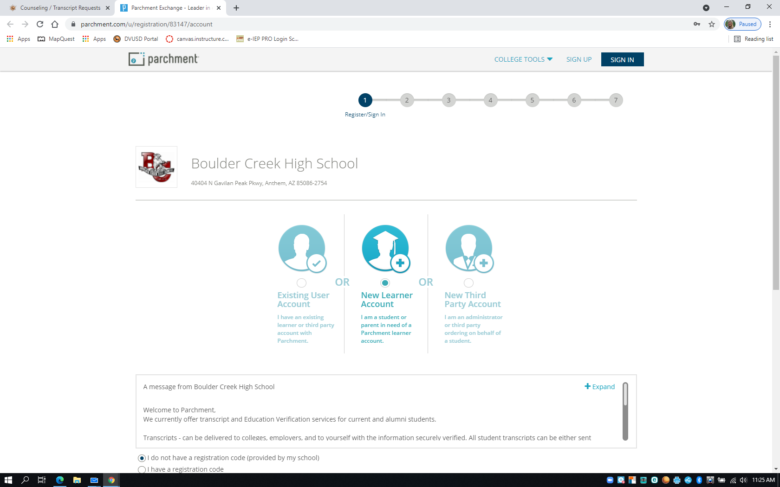
Go to BCHS website, quick link to counseling,
Click on transcript request.
Sign up as new learner by creating an account with personal email and create password.
Request official transcript to be sent to University or College of choice.
Pay fee of $4.15
Registration Code: 030581

Slide 16

How do I request a Counselor Letter of Recommendation?
  Students are responsible for asking their Teacher(s) and Counselor for letters of recommendation and providing them with necessary information.
  It is the students’ responsibility to know if the college they are applying to requires both a teacher and a counselor letter.
  The deadline to request a Counselor Letter of Recommendation for any Early Decision/Early Action college is October 1st, and November 1st for Regular Decision.
  Students must complete a Senior Brag Sheet – available in the Counseling Office or @ https://www.dvusd.org/Page/48850
Notes:
Students applying to schools or scholarships that require a letter of recommendation, here is the process for requesting a letter at Boulder Creek. First, research the schools you are applying to to find out what letters they want. Do they want a Counselor AND a Teacher or two Teachers… do they want a Core Teacher’s recommendation… or will they accept and employer or coach’s recommendation? Like I said, there will be a lot of variation in terms of what they will accept or even read. Some colleges won’t accept or read recommendations so don’t assume anything.
It is the student’s responsibility to not only ask the teacher or counselor far in advance for a letter of rec, but also to provide that teacher or counselor with information about you so that we can write a great letter. Students asking for a Counselor Letter of Rec need to complete our departments’ “Counselor Questionnaire” that can be obtained by emailing your counselor or coming into the office to pick one up.
Students applying Early Decision or Early Action need to request their letter before October 1st and by Novemeber 1st for Regular Decision applications. Students there is nothing worse than getting a request for a letter the day before Christmas Break or during Christmas Break because there is no way for us to give you a quality letter if you don’t give us enough time to work on it.

Slide 17

Scholarships and Financial Aid
FAFSA – Students and their families should complete the Free Application for Federal Student Aid beginning October 1st of their senior year ONLINE at: FAFSA Application
Research hundreds of local scholarship opportunities on the Deer Valley Unified Scholarship Website at: http://www.dvusd.org/Page/14817
Major Clarity Scholarship Search (Click on “Financial Resources”)
Local Scholarship Workshop in March during Flex Time
Notes:
A great resource that we encourage all of our students to visit is the Deer Valley Scholarship web page that can be accessed through the district web page. This is a database that contains hundreds of local scholarship opportunities and is a great place for students to start looking for money for college. Students and families will also be highly encouraged to fill out the FAFSA after January 1st this year to apply for federal financial aid and may also be required to complete the CSS Profile. Check with your school to see what financial aid information they want as it varies school to school. We also recommend researching scholarships offered by each school you are applying to so that you can see if you will be eligible to apply for additional monies for college. Applying for scholarships is a lot of work, but will be worth it in the end when your parents and you aren’t writing a check for thousands of dollars to cover your college education.

Slide 18




University | Scholarships * SAT / ACT test scores are not required for 2024 incoming freshman for initial evaluation. Scholarship numbers are estimates based on prior year’s information.
 | President’s Scholarship: 3.8 GPA with 30 ACT / 1400 SAT = $8,000 Provost Scholarship : 3.7 GPA with 27 ACT / 1280 SAT = $7,000 Dean’s Scholarship : 3.4 GPA with 26 ACT / 1240 SAT = $5,000 University Scholarship : 3.3 GPA with 25 ACT / 1200 SAT = $ 2,000 Obama Scholarship : For students w/financial need, complete FAFSA by Jan 1st
 | *Wildcat Excellence: 4.0 GPA = $12,500 3.90-3.99 GPA = $10,000 3.75-3.89 GPA = $8,000 3.50 -3.74 GPA = $5,000 3.25-3.49 GPA = $3,000 3.0 -3.24 GPA = $ 2,000 2.75-2.99 GPA = $750
 | Lumberjack Scholarship: 3.75 – 4.0 GPA = Full Tuition *President’s Scholarship: 3.5-3.74 GPA = $9,000 *Dean’s with Distinction Scholarship: 3.4 – 3.49 GPA = $6,500 *Dean’s Scholarship: 3.0 – 3.39 = $5,000 * Opportunity Scholarship: Admitted – 2.99 GPA = $2,500
 | Chancellor: 4.0 GPA = $9,050 President: 3.9+ GPA or 31 ACT/1410 SAT= $7,050 Provost: 3.7-3.89 GPA or 27 ACT/1295 SAT = $6,050 Dean: 3.5-3.69 GPA or 24 ACT / 1170 SAT = $5,050 Faculty: 3.3-3.49 GPA or 22 ACT / 1030 SAT = $4,050 Antelope: 3.0-3.29 GPA or 19 ACT/ 1000 SAT = $2,550

Slide 19


https://www.questbridge.org/
Match with over 40 prestigious Universities for a scholarship worth over $200,000.
Criteria:
Top 10% of graduating class
SAT 1260 , or ACT 27
Proof of financial need
77% of finalists are 1st generation college students

Slide 20

Over $100,000 for students attending one of the 3 major Arizona Universities
Requirements
  3.0 cumulative GPA, 1100 SAT or 22 ACT score
  1st generation college student
  Completed FAFSA and demonstrates financial need
  Application opens in October: https://dorrancescholarship.org/application

Slide 21

Over $130,000 for students attending one of the 3 major Arizona Universities
Two funded study abroad experiences
Requirements
  3.5 unweighted GPA
  Rank in top 5% of graduating class
  Participate and demonstrate leadership in a variety of extracurricular activities
  Application opens in mid-September: https://flinn.org/flinn-scholars/

Slide 22

Guess That Salary!

Slide 23

Registered Nurse
Associates Degree (2 year Degree)
provide and coordinate patient care, educate patients and the public about various health conditions, and provide advice and emotional support to patients and their families
$77,000

Slide 24

Lawyer
Doctoral Degree (8 year Degree)
Advise and represent clients in criminal or civil proceedings
and in other legal matters. Communicate with clients,
colleagues, judges, and others involved in a case. Conduct
research and analysis of legal issues.
$146,000

Slide 25

HVAC Technician
H.S. Diploma / Certification Program (6-15 months)
An HVAC Technician's job is to install and repair various air quality systems. They locate maintenance problems on equipment and conduct warranty services quickly in case of emergency repairs for certain items like furnaces or water heaters.
$52,000

Slide 26
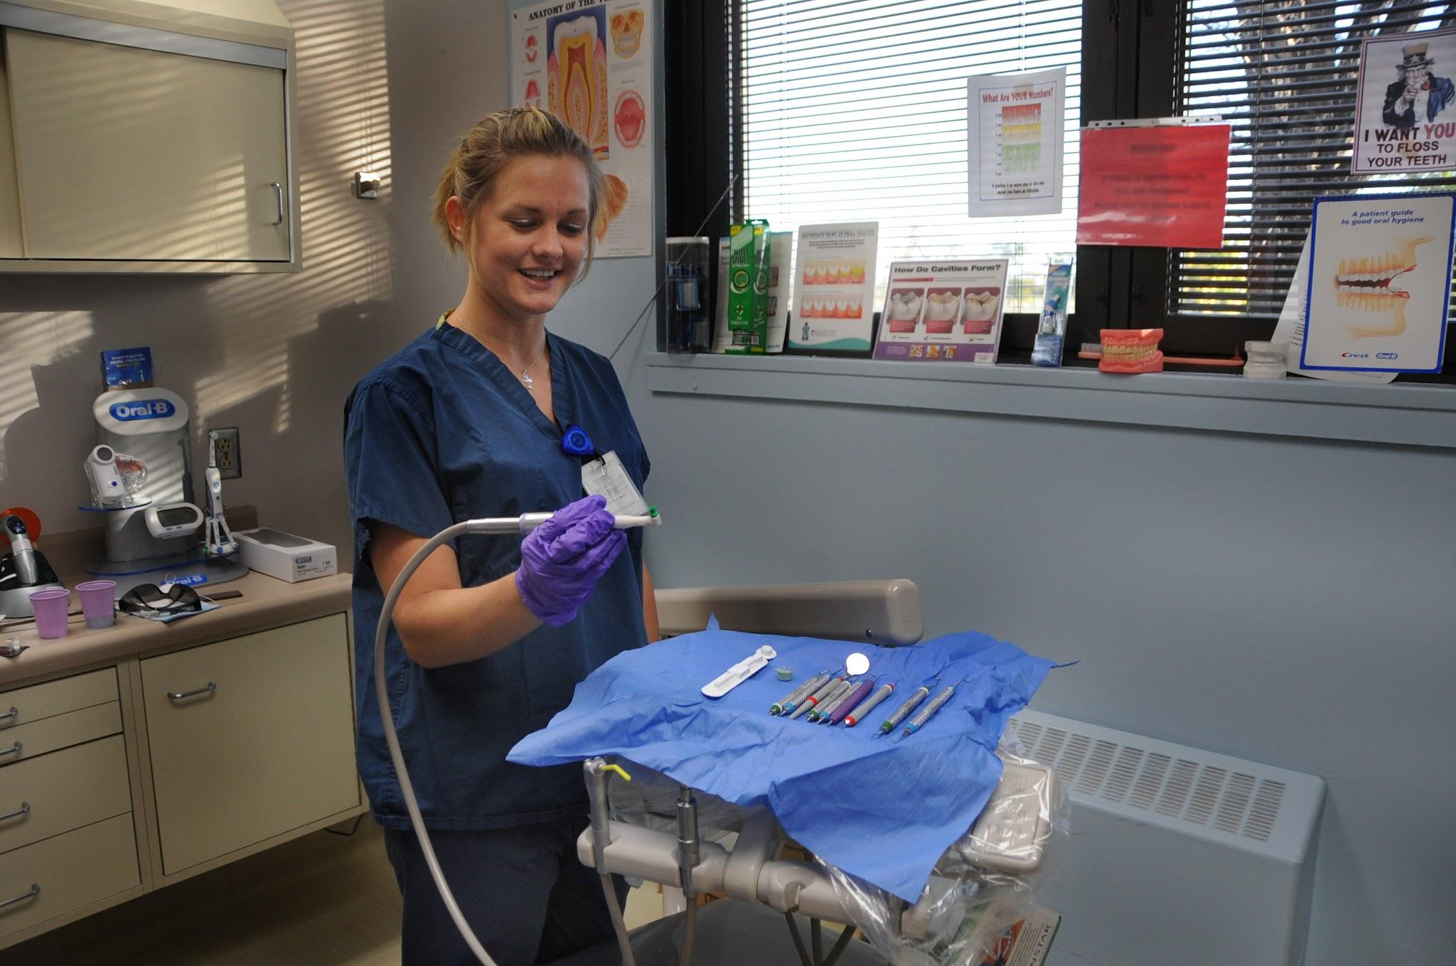
Dental Hygenist
Associates Degree (2 years)
Dental hygienists typically do the following: Remove tartar, stains, and plaque from teeth. Apply sealants and fluorides to help protect teeth. Take and develop dental x rays. Assess patients' oral health and report findings to dentists.
$86,000

Slide 27

Oncologist
Doctorate Degree (13-14 years:
Undergrad, Med-School, Residency,
Fellowship)
An oncologist is a doctor who treats cancer and provides medical care for a person diagnosed with cancer. An oncologist may also be called a cancer specialist. The field of oncology has 3 major areas based on treatments: medical oncology, radiation oncology, and surgical oncology.
$328,000

Slide 28

Flight Attendant
High School Diploma
The Flight Attendant is responsible for ensuring the
safety, security, and comfort of airline passengers.
The Flight Attendant provides customer service while
creating a welcoming environment for passengers before, during, and at the conclusion of each flight.
$65,000

Slide 29

Fast Food Cook
No Formal Education Required
Prepares batches of food that are cooked to order or kept warm until ordered and sold; this may include such food items as hamburgers or fried chicken. Operates large-volume cooking equipment such as griddles, grills, or deep fryers. Prepares, washes, and cuts food to be cooked.
$23,000

Slide 30

Information Security
Analyst
Bachelor’s Degree (4 years)
Information security analysts install software, such as firewalls, to protect computer networks. Information security analysts plan and carry out security measures to protect an organization's computer networks and systems.
$90,000

Slide 31

Plumber
High School Diploma
Installing, maintaining and repairing plumbing systems and fixtures. Fitting and repairing various household appliances. Cutting, welding and assembling pipes, tubes, fittings, and fixtures. Inspecting and testing plumbing systems for safety, functionality, and code compliance.
$57,000

Slide 32

Human Resource
Manager
Bachelor’s Degree (4 years)
Human resources managers plan, coordinate,
and direct the administrative functions of an organization. They oversee the recruiting, interviewing, and hiring of new staff; consult with top executives on strategic planning; and serve as a link between an organization's management and its employees.
$126,000

Slide 33

What is my plan after school?
What kind of job do I need to survive with my desired lifestyle?
Click the “Cost of Living” link on the Counseling webpage under “Senior ECAP Information”

Slide 34

Log in using the Clever App
Complete your Personality and Learning Style Assessments if not already completed
Search for Careers of interest under “Career Exploration” based on your FIT Scores.
Go to “My Career Plan” and submit at least 1 “for now” career that is of interest and submit your signature.
Click the tab “Education Goals” next to “Career Goals” and enter your current post-secondary plan and submit your signature.

Slide 35
Want to see your counselor?
If you would like to meet with your counselor please send us an e-mail. In your e-mail let us know what information you are looking for and the best time to see you.
  A-Cow Ms. Chazan Denise.Chazan@dvusd.org
  Cox-Hes Mr. Sheets dennis.sheets@dvusd.org
  Het-Mc Ms. Mohr Heather.Mohr@dvusd.org
  Me-Se Ms. Sherrod patricia.Sherrod@dvusd.org
  Sh-Z Ms. Lodolce Kippi.Lodolce@dvusd.org
  Gifted Ms. Heid Alyssa.Heid@dvusd.org

Slide 36

Transcript Credit Check Activity
You have been given your transcript and a credit check sheet
Go over your transcript and check the boxes of the courses you have completed with a passing grade
Be sure to make notes if you need to make up any classes (what is your plan?)
What information is on your transcript? GPA, Class Rank, did you pass the civics test?
Notes:
Printed on the right hand side of your transcript is a blank credit check worksheet. We want you to go through your transcript and put check marks in the blanks that you have earned credit for. Each blank needs a check mark in it by the end of this year to graduate from Boulder Creek. We will give you about 5 minutes now to complete this activity. Please keep this transcript as it has all of your personal information on it and on the back side has some great resources for you to share with your parents and keep handy for the year.

