Slide 1
Junior Presentation
I am a Junior! Now what?

Slide 2
Meeting with your counselor….
At the end of October, counselors will be meeting with each Junior individually to discuss post-secondary plans and senior year schedule.
In preparation for your meeting please review the following slides, it is best to review before your meeting.
Counselors will begin meeting with Juniors the week of October 24, 2022. Please understand that we have large case loads and it will take about a month to see all our students.

Slide 3
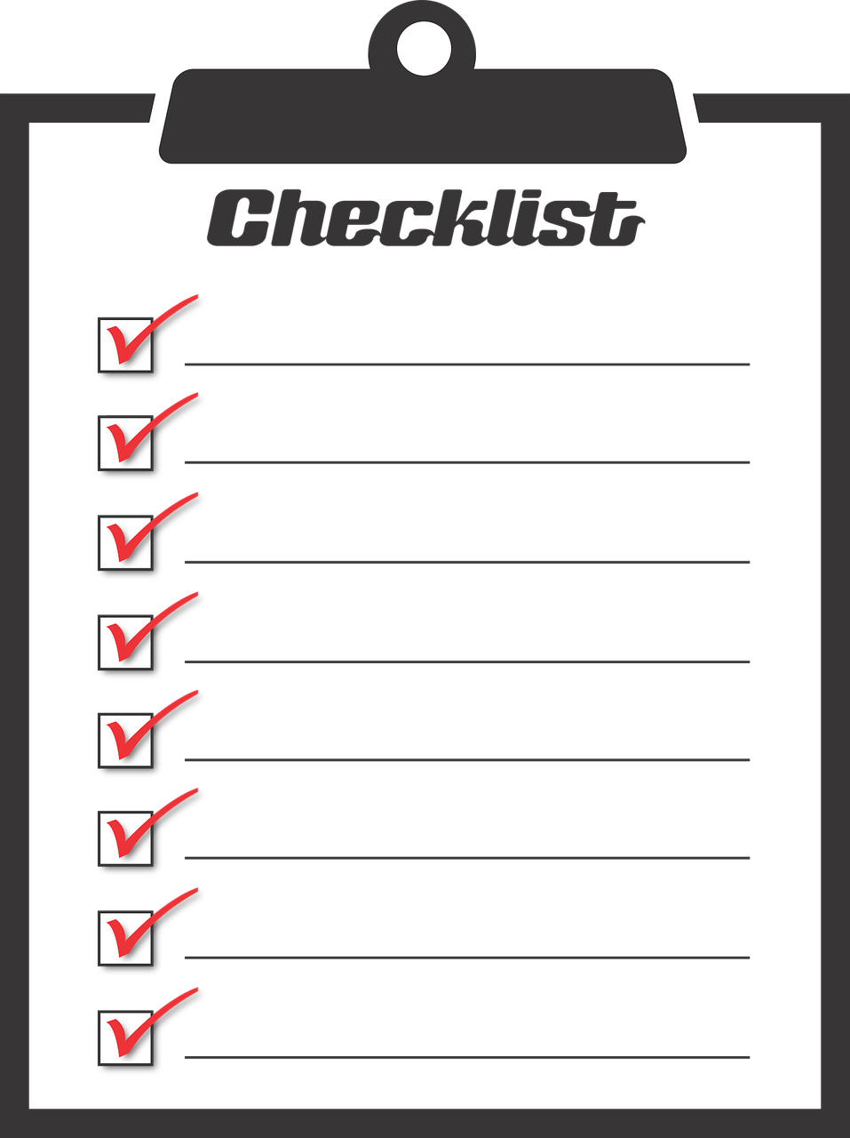
Checklist to Complete Before Meeting:
Review all slides in this power point
Make a list of questions for your counselor
Review list of Senior Courses & Course Descriptions
Complete Course Registration Sheet
Take time to review the counseling web page so you know the information that is available to you

Slide 4
West Mec and DVUSD CTE Updates
West Mec is an option Juniors should consider for their senior year, they offer many 1 year programs. For a complete list of West Mec Programs CLICK HERE.
You can also apply for a DVUSD CTE Programs HERE.
Applications opened on October 17th. You can find the application HERE.
Reach out to your counselor with any questions.

Slide 5

College Testing Timeline
ACT-April 4, 2023. This will be given during school hours. All juniors are registered to take the test.
More details about testing will be shared closer to testing dates.
You can always check our website for updates on all testing.

Slide 6


SAT & ACT
Fall Dates and Information
SAT Register online at: Collegeboard | ACT Register online at: ACT
Cost: $60.00 | Cost: $63.00 without writing $88.00 with writing
Test Date: 8/27/2022 10/01/2022 11/05/2022 12/03/2022 3/11/2023 5/06/2023 6/03/2023 | Test Date: 9/10/2022 10/22/2022 12/10/2022 2/11/2023 4/4/2023 (free at BCHS) 4/15/2023 6/10/2023 7/15/2023
 | students are encouraged to check with the colleges they are applying to, to see if they require the writing for ACT or essay for SAT.

Slide 7



Important Links for Post Secondary Planning!
MILITARY
TRADES/TECH SCHOOL
CAREER RESEARCH
COMMUNITY COLLEGE

Slide 8

You need 22 credits to graduate
High School Requirements
COLLEGE/UNIVERSITY REQUIREMENTS
  4 credits of English Language Arts
  4 credits of Math
  3 credits of Lab Science (1 must be Biology)
  .5 credit of Health & .5 credit of P.E.
  3 credits of Social Studies
  1 credit of CTE OR Fine Arts
  6 credits of Elective
  4 credits of English Language Arts
  4 credits of Math
  3 credits of Lab Science
  2 credits of Social Studies
  1 credit of CTE OR Fine Arts
  2 credits of the SAME World Language
  *Be sure to check University admission requirements! They may require a 3rd year of World Language or a fine art.
Notes:
Students, your counselors want to take one more opportunity to remind you of the credit requirements for graduation. Remember that 22 credits are needed to graduate from BCHS, but you must also have met all of the course requirements as well. Your counselor will review your credits with you during your individual ECAP meeting; however, if at any point you have a question about taking classes online or outside of BCHS, please make sure to check with your counselor prior to enrolling to ensure you will receive credit. We cannot accept credits from schools that are not accredited.

Slide 9

Senior Schedule Reminders:
“I want a half day!”
Only those students who are on track with credits are eligible for a half day their senior year.
Half day does not necessarily mean that you will have a morning-only schedule (morning senior classes fill up).
Yes, you have to be in four classes as a senior even if you are ahead with your credits.

Slide 10

Not sure if you are on track to graduate?
Request your unofficial transcript on Parchment. You will also request your official transcript (colleges require this) through Parchment.
Complete a credit check sheet found on our web page to know where you stand.

Slide 11
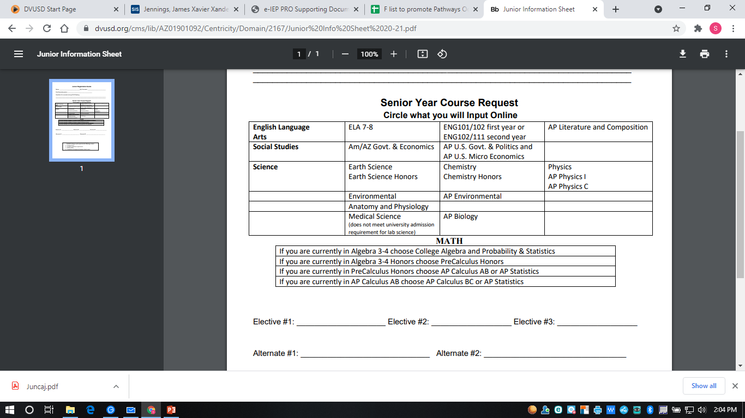
Circle your courses and be sure to choose back up elective courses.
Use the course request sheet located on our web page as a guide as you decide on classes.
Please bring this with you to your counseling appointment.

Slide 12
Individual ECAP Meeting
Your counselor will send a pass for you when it is time for your individual ECAP meeting.
There will be a time on your pass when to come to counseling. Be sure to come at that
time to limit how long you may wait.
You will go over post secondary plans
and courses to be taken your senior year.
Junior ECAP Meeting
Name: Jane Smith
Class Period: 4 Room: 300
Time: 9:15 am
Counselor: Mrs. Sherrod

Slide 13

Take time to learn what information is on the counseling web page.
Visit the Counseling Webpage to know what colleges are visiting our campus and for college fair opportunities.
Prepare for your counselor meeting so all your questions are addressed.
Fill out your courses request sheet.
You can always request your unofficial transcript on Parchment and check to be sure you are on track to graduate!

