Slide 1

Community Meeting, July 18, 2016
School Size Report Overview
Notes:
Need other company logos involved to place on cover.

Slide 2

01
02
03
04
05
Purpose
Enrollment chart
Elementary schools in other districts
Relationship to student learning
Other/miscellaneous information
Notes:
NOTE: THE NUMBERS IN THE RIGHTHAND CORNER ARE DONE IN PPT. FEEL FREE TO CHANGE AS NEEDED.

Slide 3

Purpose for Report
What did the most recent master plans state about elementary school size? What actions have the Board taken in relationship to school size?
What is the capacity of each State College Area School District elementary school?
What is the current enrollment of each State College Area School District elementary school?
What are the most recent projections for each attendance area through 2022? (2013 Stewman Study)
What are the elementary school enrollments of our cohort school districts?
What does the research say about elementary school size and student learning?

Slide 4
State College Area School District Elementary School Enrollment Information
SCHOOL | Current Capacity (SCASD Policy estimates) | 2012-2013 | 2013-2014 | 2014-2015 | 2015-2016 | Projected 2022
Corl Street | 276 | 244 | 243 | 254 | 235 | 345
Easterly Parkway | 414 | 336 | 340 | 345 | 346 | 361
Ferguson Township | 414 | 355 | 352 | 373 | 371 | 369
Gray’s Woods | 483 | 371 | 383 | 389 | 408 | 363
Houserville/Lemont | 414 | 357 | 343 | 337 | 357 | 351
Mount Nittany | 391 | 355 | 351 | 325 | 335 | 351
Park Forest Elem | 529 | 488 | 475 | 476 | 490 | 466
Radio Park | 414 | 378 | 350 | 375 | 359 | 334
Total Elementary | 3,335 | 2,884 | 2,837 | 2,730 | 2,901 | 2,938

Slide 5
Comparing Elementary School Enrollments
Abington School District (Montgomery County, PA)
Cumberland Valley School District (Cumberland County, PA)
Lower Merion School District (Montgomery County, PA)
North Allegheny School District (Allegheny County, PA)
Parkland School District (Lehigh County, PA)
State College Area School District (Centre County, PA)
Tredyffrin/Easttown School District (Chester County, PA)
Upper Saint Clair School District (Allegheny County, PA)
Charlottesville City Schools (Charlottesville, VA)
Cambridge Public Schools (Cambridge, MA)
Penn-Harris-Madison School Corporation (Mishawaka, IN)

Slide 6
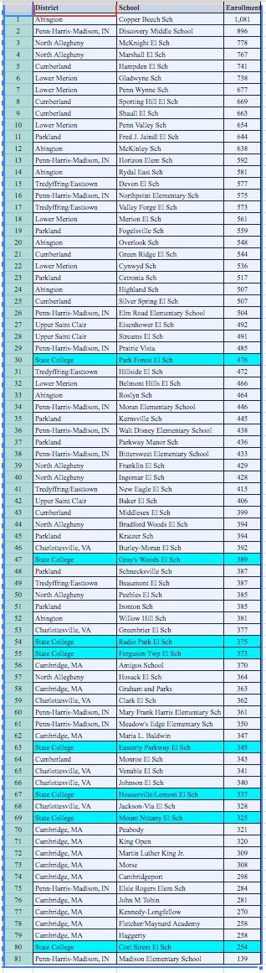
Elementary School Size:
Comparison to 10 other School Districts (including recent SCASD Cohort + 3 University Communities)
Please view on separate report document. This image is for a visual comparison to rank in school size.

Slide 7
Elementary School Size & Student Learning
Leithwood, K. & Jantzi, D. (March 2009). A Review of Empirical Evidence About School Size Effects: A Policy Perspective. Review of Educational Research (vol. 79 no. 1464-490).
Stevenson, K. (April 2006). School Size and Its Relationship to Student Outcomes and School Climate: A Review and Analysis of Eight South Carolina Statewide Studies. National Clearinghouse for Educational Facilities, 1090 Vermont Avenue, N.W., Suite 700, Washington, D.C. 20005-4905. http://www.ncef.org/pubs/size_outcomes.pdf

Slide 8
Miscellaneous Information & Questions/Discussion

