Slide 1

Community Meeting, July 18, 2016
Update Designs and Phasing
Notes:
Need other company logos involved to place on cover.

Slide 2

01
02
03
04
05
06
07
08
DESIGN OPTIONS
SITE INVESTIGATION
OPTION DEVELOPMENT
PUBLIC VS PRIVATE ZONES OF SCHOOL
GRADE HOUSES
PUBLIC SPACE (CORE PROGRAM)
SUSTAINABILITY
PHASING
Notes:
NOTE: THE NUMBERS IN THE RIGHTHAND CORNER ARE DONE IN PPT. FEEL FREE TO CHANGE AS NEEDED.

Slide 3
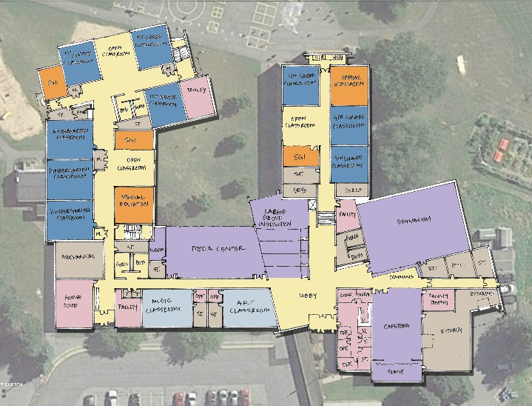
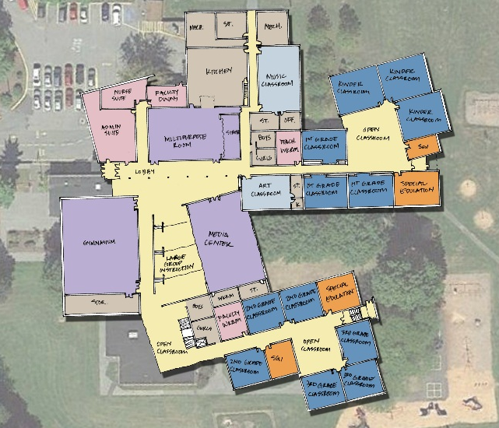
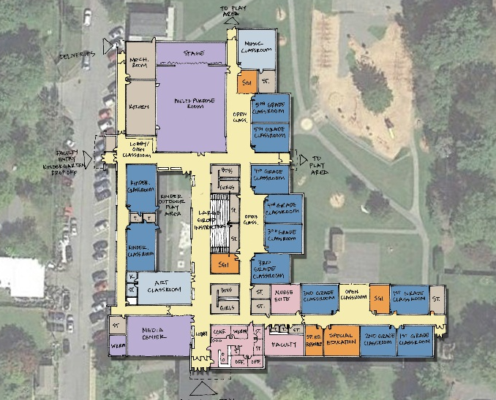
Updated Preliminary Design Options – Ground Rules
Current building size.
Current student enrollment.
Incorporate community, zoning, land development, administration and board committee comments.
Radio Park ES
Houserville ES
Corl ES
The design team continues to explore additional building size, configuration options and attendance area analysis pending
results of demographic study and municipal planning efforts.
DESIGN OPTIONS

Slide 4
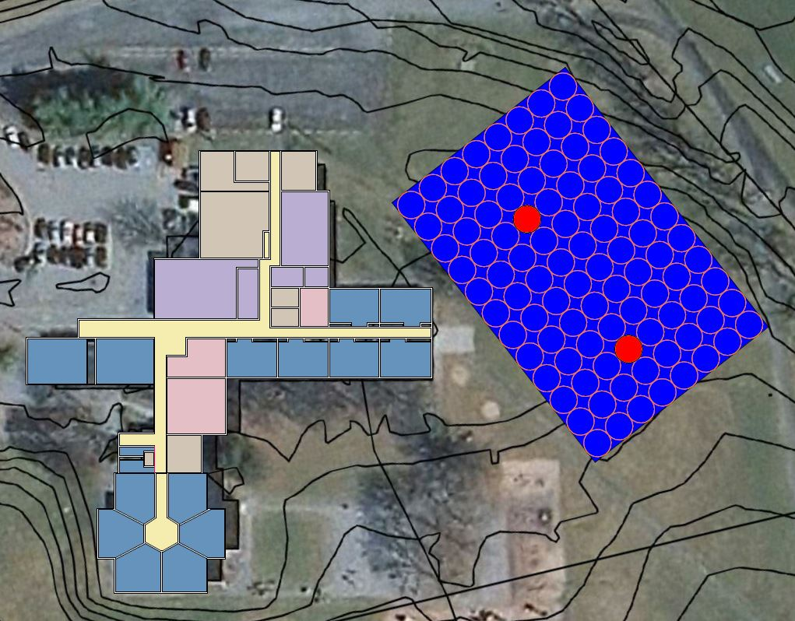
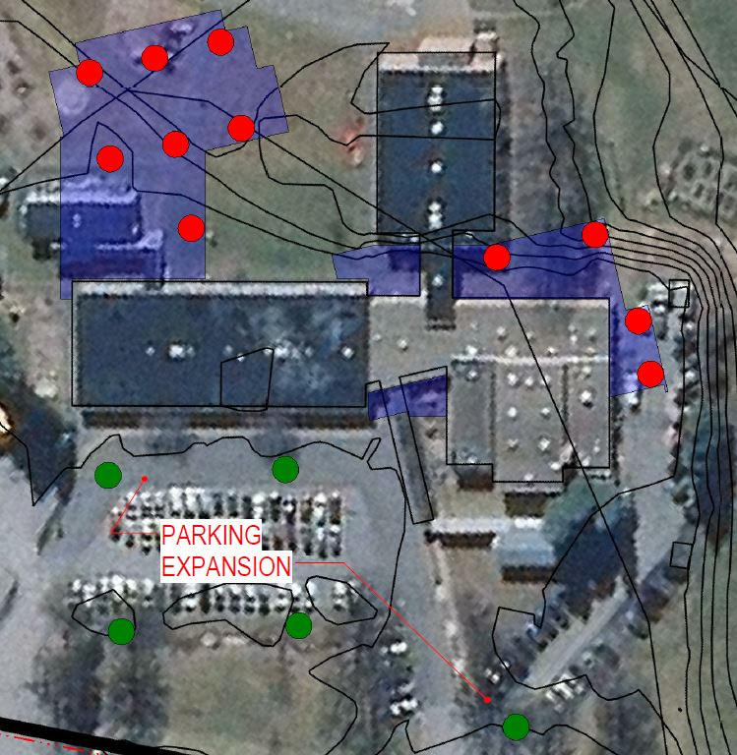
Investigation of Site Conditions is occurring at Radio Park, Houserville and Corl Street Schools
Site Surveys
Zoning & Municipality Requirements
Geotechnical Bore Investigation (Is there rock or substandard soil at locations of Building Designs?)
Geothermal Conductivity ( Is ground conducive to geothermal HVAC systems.
Geothermal Conductivity Testing
Geotech Bore Locations
Site Investigation

Slide 5
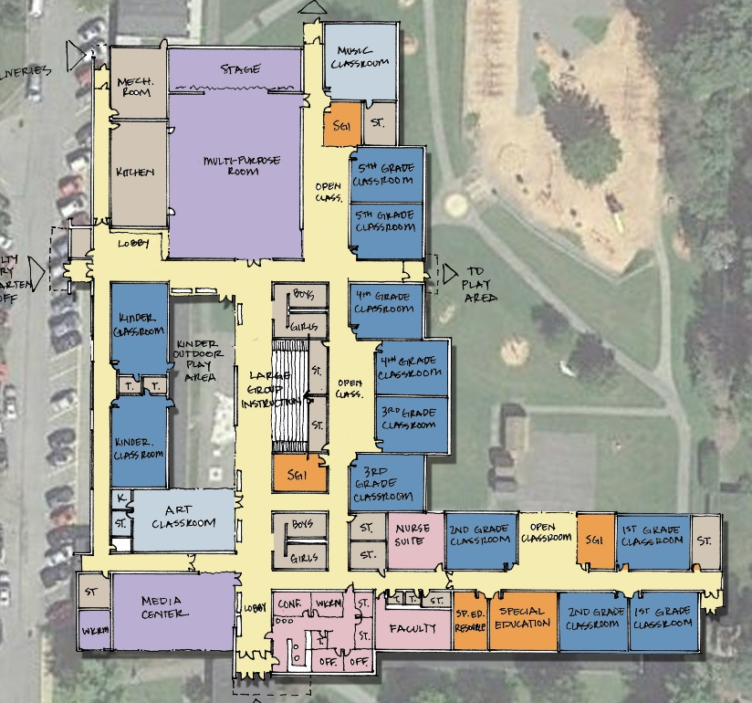
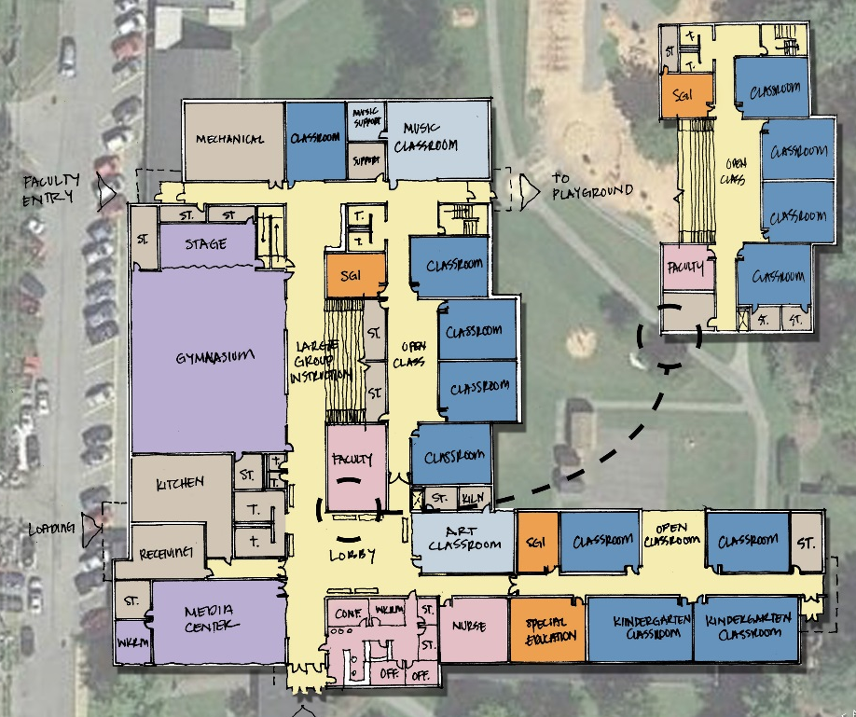
Design team is investigating preliminary plans and developing educational program of spaces for elementary schools at this time with school district.
This includes one and two story building plans (No plans have been finalized at this time).
Discussions of classroom program, security, STEM (Science, Technology, Engineering and Math) and core program (Media Center, Gym, Large Group Instruction, Art & Music and additional shared program.)
Anticipate this will evolve over the following 3 months.
Corl St. ES- One Story Option
Corl St. ES- Two Story Option
Option Development

Slide 6
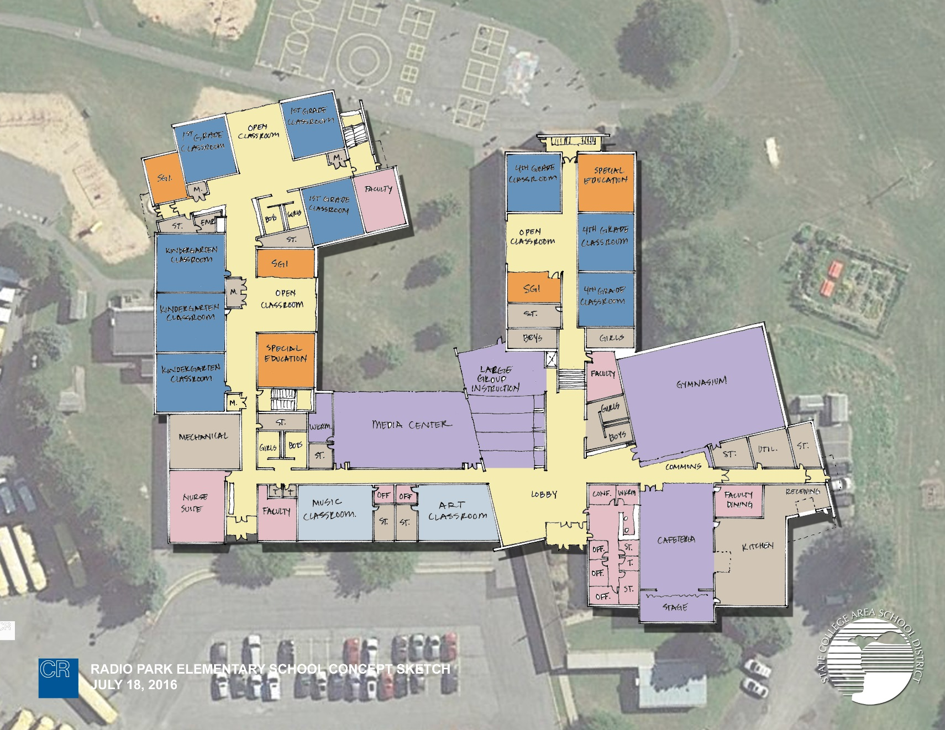
Radio Park ES
All school designs are being developed to create clear public/community and student zones.
Grade Houses
Shared Public/ Community Space
Public versus Private Zones of Schools

Slide 7
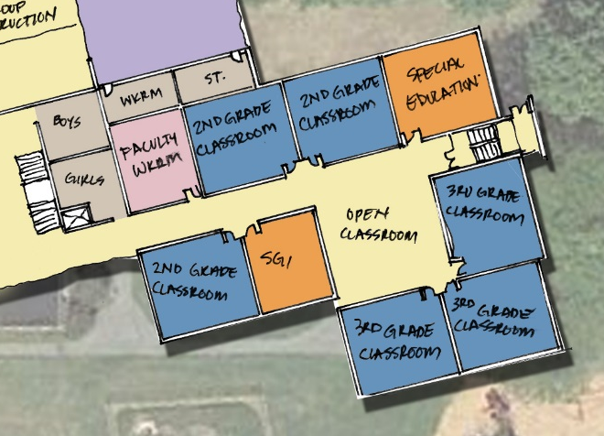

Early Discussion of Classroom Pods/ Grade Houses
Dedicated Zones for K-1, 2/3 & 4/5 Grade Structures
Each Grade House typically includes 2 Grades
Locations of Grade Houses are designed to create identity and are entered from main public spaces.
Grade Houses include
  2 Grades Structures
  Open Classroom for Informal
  Breakout Instruction
  Special Education
  Small Group Instruction (SGI)
  Close Proximity of Support Space
    Faculty Rm, Storage, Toilets
  Ability to quickly move between formal classroom and breakout work whether in a SGI, open classroom or support. (Maximize Educational Time)
Corl ES
Radio Park ES
Houserville ES
Grade Houses (School within a School)

Slide 8

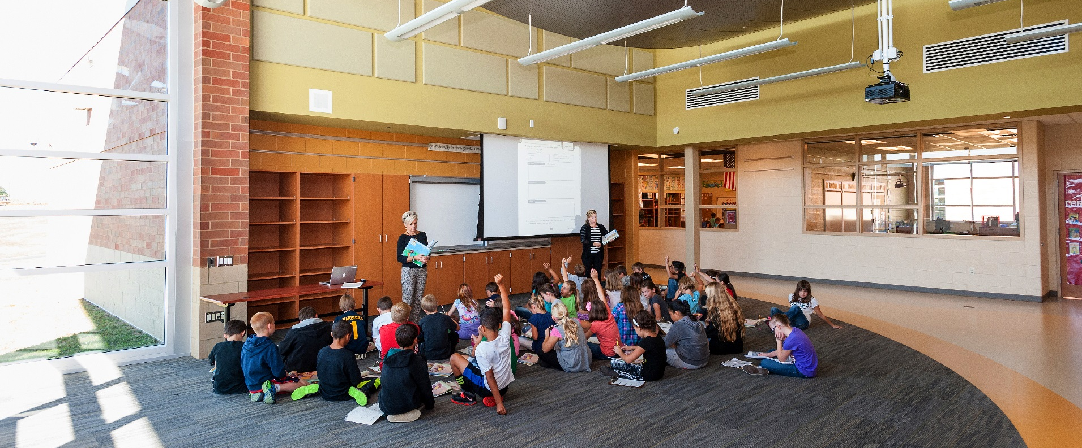
Open Classrooms
Direct Adjacency to Classroom Instruction
Opportunity for Formal & Informal Instruction
Visual Connection to Classrooms (Acoustically Separated)
Multiple Classroom Instruction, Small Group Instruction, Individual
Each Grade House typically includes 2 Grades
Locations of Grade Houses are designed to create identity and are entered from main public spaces.
Open Classroom (Center of Grade House)

Slide 9

Shared Building Program
Each Grade House Shares Core Building Program that includes
  Administration/ Nurse
  Kitchen/ Cafeteria
  Gymnasium
  Media Center
  Large Group Instruction
  Art Classroom
  Music Classroom
Shared Program is also designed to be used as community space after school hours.
  Ability to limit access to entire building.
Houserville ES
Public Space (Core Program)

Slide 10
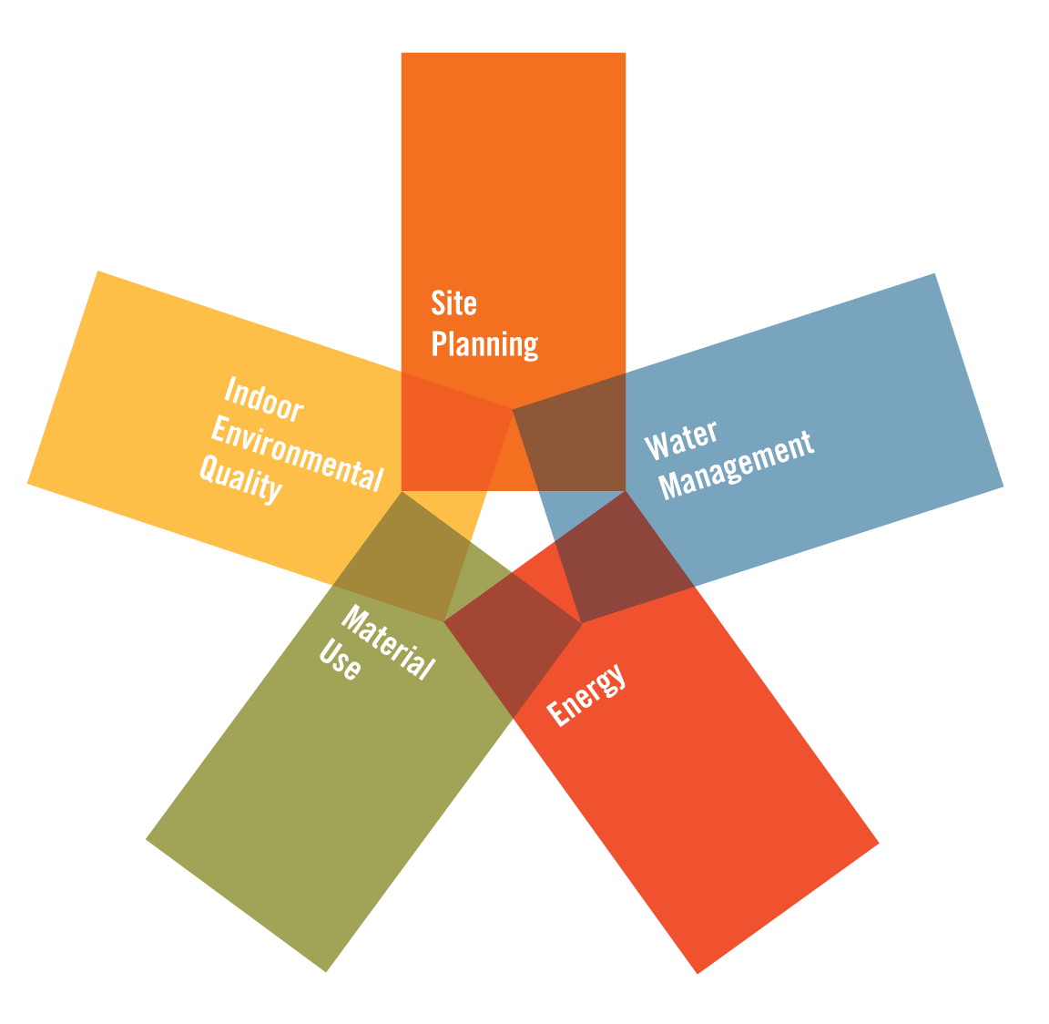
Early Discussions
Energy Efficiency
  Heating/Air Conditioning System Selection
  High R-Value Thermal Exterior Envelope
  LED Lighting
  Building Commissioning
  Daylight Sensoring
  Investigation of Potential Use of Solar
Water Use Reduction
Low-Emitting VOC Materials
Indoor Air Quality Monitoring
  During & After Construction
Thermal Comfort
Acoustics
Daylighting and Exterior Views
Stormwater Run-off Reduction
School as a Teaching Tool Opportunity
Sustainability

Slide 11
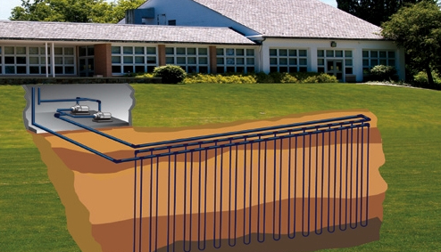
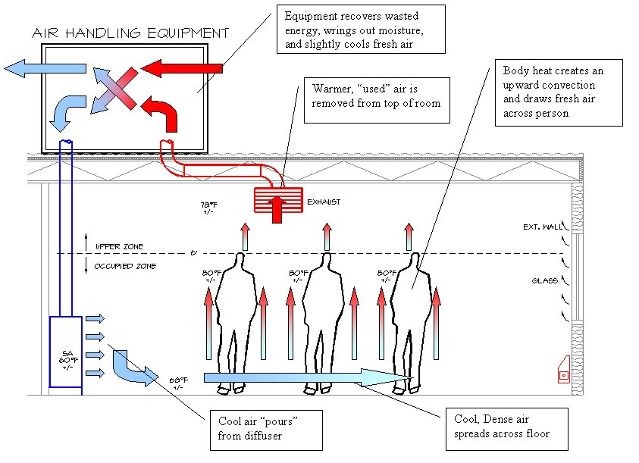
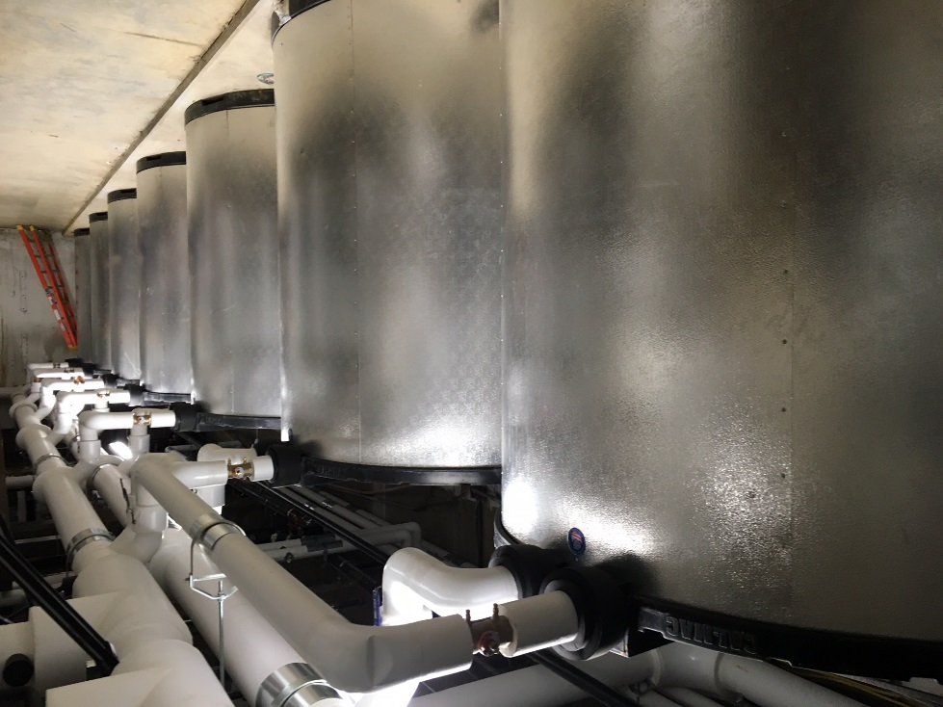
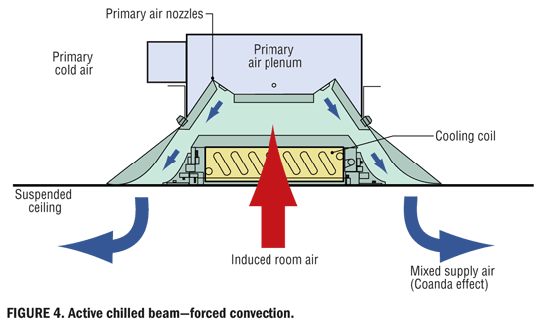
Geothermal
Displacement Ventilation
Thermal Storage- Minimize daytime use of electricity
Chilled Beam
Preliminary Discussion of efficient mechanical systems are being investigated. Site & Building Design may create advantages for certain mechanical systems.
Heating & Air Conditioning System Selection

Slide 12
Key Elements of Phasing
Seperation of Students and Construction
Phase 1 (Red Highlighted Areas)
  Construction of new classrooms to allow existing building to be renovated.
18 months of construction (Anticipate 3 phases of construction)
Radio Park ES
Houserville ES
Corl ES
At this time it appears 3 buildings can effectively phase additions and renovation to the existing buildings. It is anticipated this will
evolve with school district, design and construction team input.
Construction Phasing

