Slide 1

Community Meeting, July 18, 2016
Notes:
Need other company logos involved to place on cover.

Slide 2

01
02
03
04
WELCOME AND OVERVIEW
PROJECT GOALS and UPDATE
PREVIOUS MASTER PLAN SYNOPSIS
BREAKOUT SESSIONS
ENROLLMENT SCHOOL SIZE
COST ANALYSES
UPDATED DESIGNS AND PHASING
QUESTION AND ANSWER
NEXT STEPS
Notes:
NOTE: THE NUMBERS IN THE RIGHTHAND CORNER ARE DONE IN PPT. FEEL FREE TO CHANGE AS NEEDED.

Slide 3
01
02
03
04
WELCOME AND OVERVIEW
PROJECT GOALS and UPDATE
PREVIOUS MASTER PLAN SYNOPSIS
BREAKOUT SESSIONS
ENROLLMENT SCHOOL SIZE
COST ANALYSES
UPDATED DESIGNS AND PHASING
QUESTION AND ANSWER
NEXT STEPS
Notes:
NOTE: THE NUMBERS IN THE RIGHTHAND CORNER ARE DONE IN PPT. FEEL FREE TO CHANGE AS NEEDED.

Slide 4
01
02
03
04
WELCOME AND OVERVIEW
PROJECT GOALS and UPDATE
PREVIOUS MASTER PLAN SYNOPSIS
BREAKOUT SESSIONS
ENROLLMENT SCHOOL SIZE
COST ANALYSES
UPDATED DESIGNS AND PHASING
QUESTION AND ANSWER
NEXT STEPS
Notes:
NOTE: THE NUMBERS IN THE RIGHTHAND CORNER ARE DONE IN PPT. FEEL FREE TO CHANGE AS NEEDED.

Slide 5
Elementary School Study
Option Development Phase – through September
Option Selection – Fall 2016 (October)
Non-local Funding
    PA Department of Economic Development Grants (1)
      July 1, 2016 Grant Approved - $3.8 Million
    PA Department of Education Project Justification
      Approved - $2-$3 Million
Completion date under grant agreement changed to June 30, 2019.
Allows for greater flexibility for construction and LEED certification periods.
PROGRESS REPORT

Slide 6
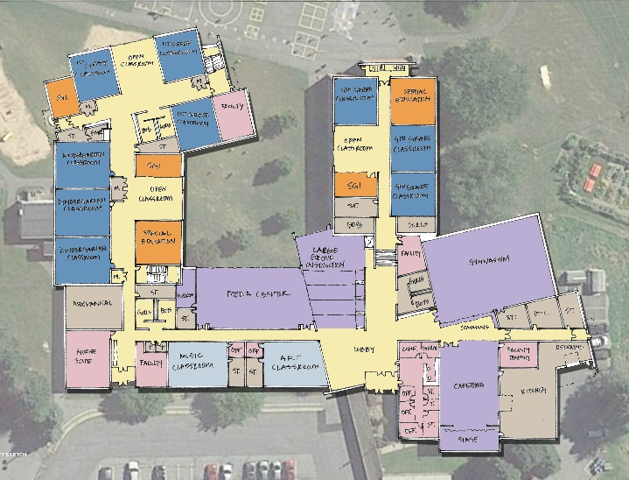
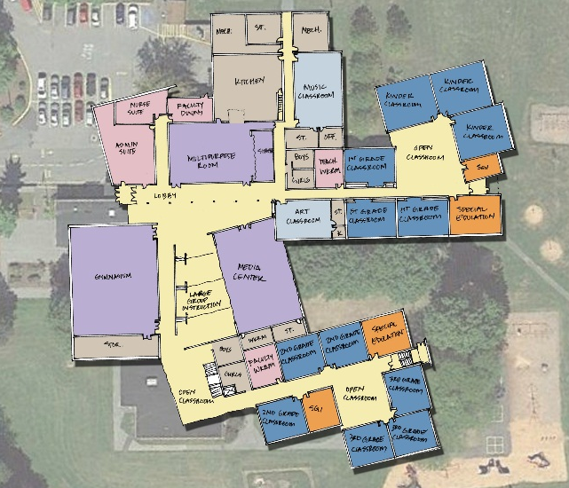
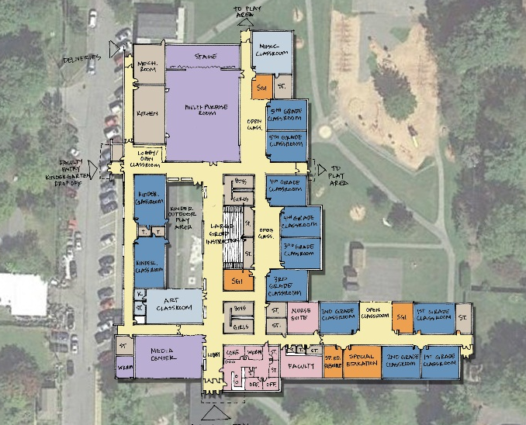
Updated Preliminary Design Options – Ground Rules
Current building size.
Current student enrollment.
Incorporate community, zoning, land development, administration and board committee comments.
Radio Park ES
Houserville ES
Corl ES
The design team continues to explore additional building size, configuration options and attendance area analysis pending
results of demographic study and municipal planning efforts.
DESIGN OPTIONS

Slide 7
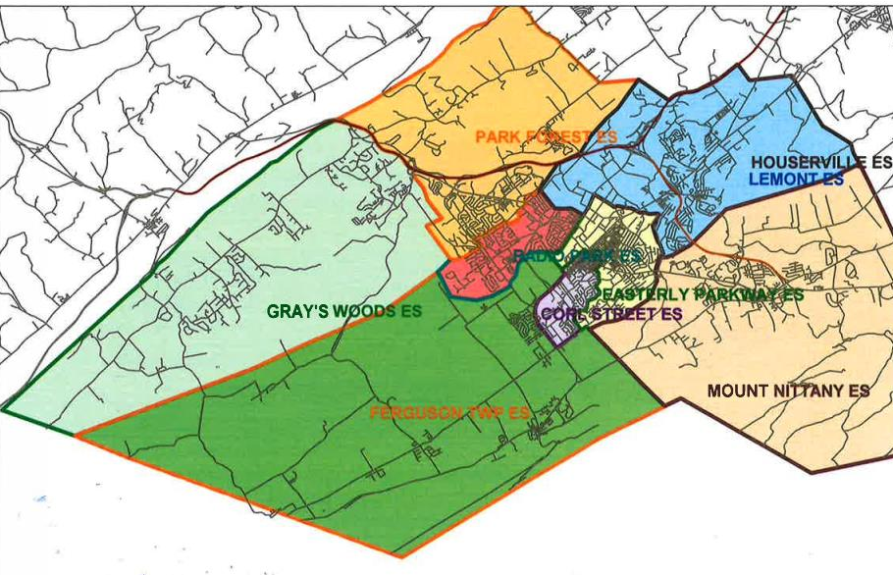
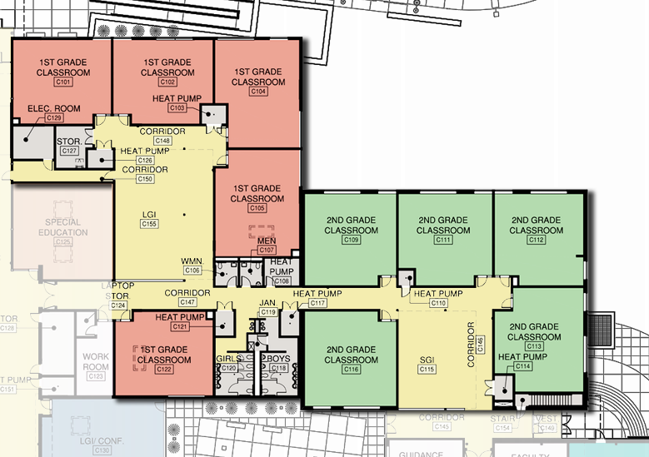
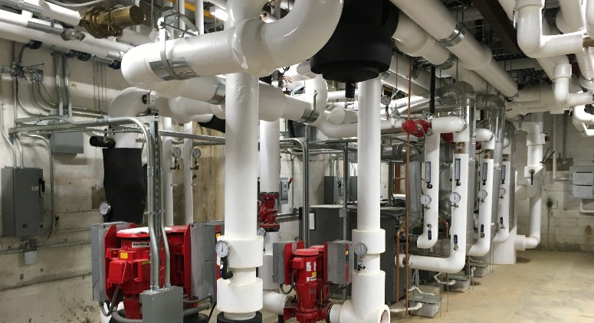
Comparable Buildings and Programs in Elementary Schools
Sustainability and energy efficiency
Program Flexibility
Long term attendance boundary stability
PROJECT GOALS
Notes:
Jeff

Slide 8
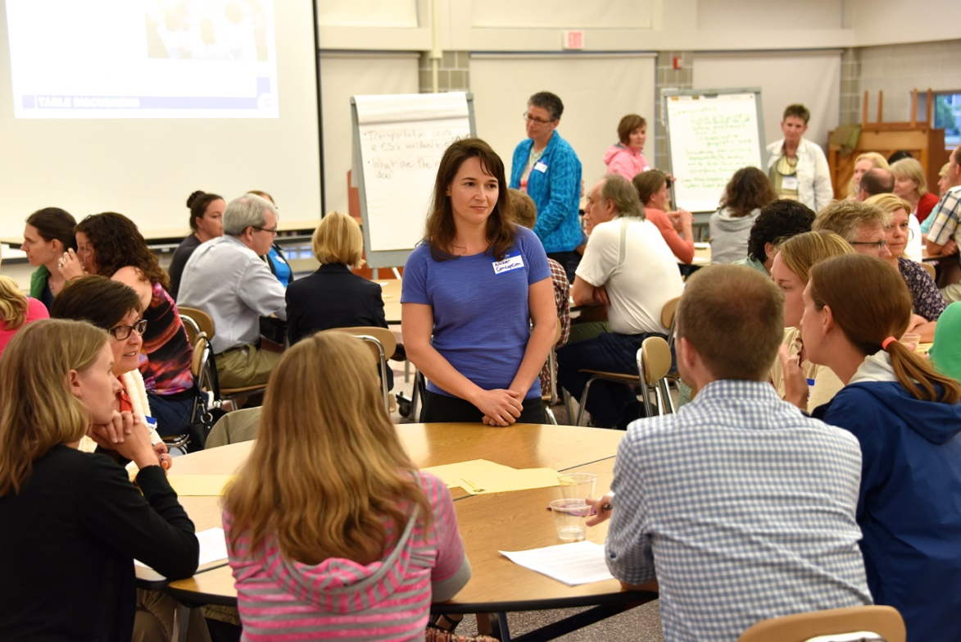
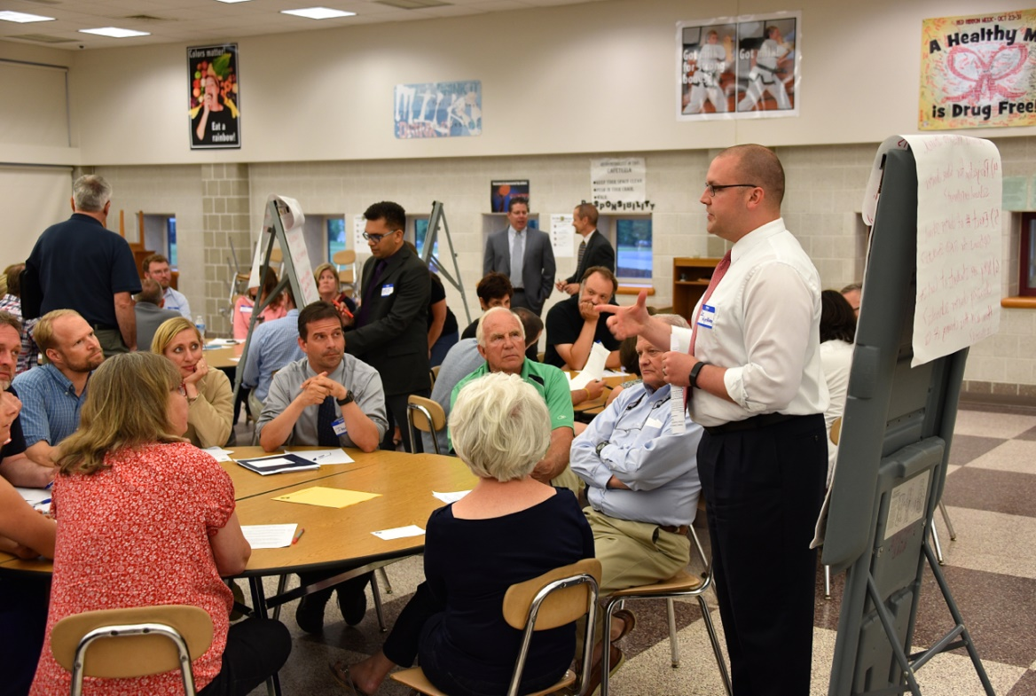
COMMUNITY INPUT
Forums held in May and June.
Tonight review:
  Review progress to date
  Previous Master Plan Synopsis
  Student Enrollment Discussion
  Cost Analysis
  Proposed Design and Phasing Update
MEETING GOALS
Notes:
Jeff

Slide 9
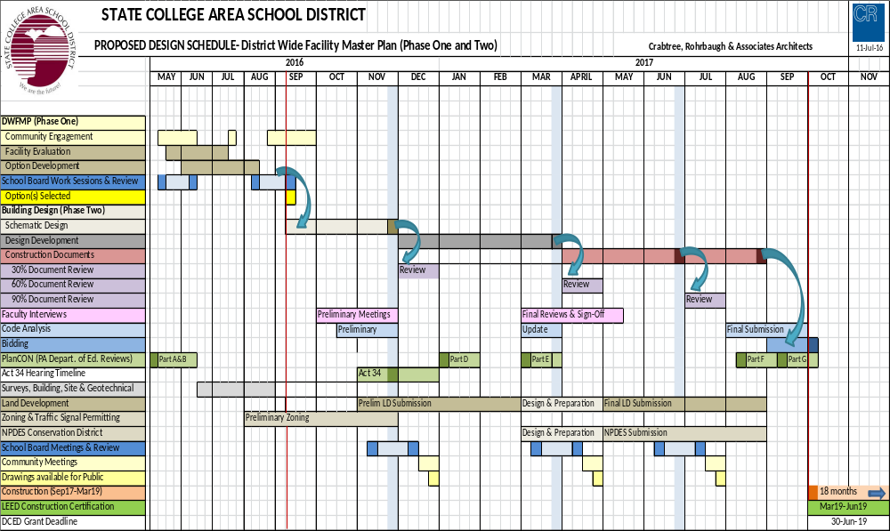
*Preliminary DWFMP Schedule to identify general approach, it is anticipated this schedule will evolve with the integration of the School Board, Administration, and Design Team..
PROPOSED DESIGN SCHEDULE
Notes:
Jeff

Slide 10
BOARD DECISION INFORMED BY:
Guiding Principles From the Strategic Plan
  Culture of Trust, Relationships, and Collaboration
  Responsive Teaching and Learning
  High Expectations for All
  Welcoming and Safe Climate for Learning and Work
Community Involvement
Demographic Analysis
  Population Growth, Enrollment Boundaries, Elementary Capacity
Capital Cost of the Projects
Long Term Operation and Maintenance Costs
DECISION MAKING
Notes:
Rob

Slide 11

Community Input

Slide 12
01
02
03
04
WELCOME AND OVERVIEW
PROJECT GOALS and UPDATE
PREVIOUS MASTER PLAN SYNOPSIS
BREAKOUT SESSIONS
ENROLLMENT SCHOOL SIZE
COST ANALYSES
UPDATED DESIGNS AND PHASING
QUESTION AND ANSWER
NEXT STEPS
Notes:
NOTE: THE NUMBERS IN THE RIGHTHAND CORNER ARE DONE IN PPT. FEEL FREE TO CHANGE AS NEEDED.

Slide 13
1999 Elementary School Master Plan
 | 1999
 | Option A | Option B
Radio Park | Renovations and Additions | Renovations and Additions
Park Forest | Renovations and Additions | Renovations and Additions
Matternville* | Close | Close
Gray's Woods* | Build New | Build New
Easterly Parkway* | Renovations and Additions | Renovations and Additions
Fairmount* | Repurpose | Repurpose
Houserville | Combine with Lemont; Reno/Adds | Renovations and Additions
Lemont | Close | Renovations and Additions
Corl Street | Close | Renovations and Additions
Ferguson Twp. | Close | Renovations and Additions
New School | Build a new school to combine FT and CS | NA
Panorama Village | Combine with Boalsburg; Reno/Adds | Renovations and Additions
Boalsburg | Close | Renovations and Additions
*Completed as part of the plan adoption

Slide 14
2001 District Wide Master Plan (Elementary portion)
 | 2001
 | Primary Option | Option B
Radio Park | Renovations and Additions
Park Forest* | Renovations and Additions | Build New; same site*
Matternville | Sell
Gray's Woods | Complete
Easterly Parkway | Complete
Fairmount | Complete
Houserville | Combine with Lemont; Reno/Add
Lemont | Sell
Corl Street | Renovations and Additions
Ferguson Twp. | Renovations and Additions
Panorama Village | Combine with Boalsburg; Reno/Add
Boalsburg | Sell
*Completed as part of the plan adoption

Slide 15
2009 District Wide Facilities Master Plan (Elementary portion)
 | 2009
 |  | Alternate
Radio Park | Renovations and Additions
Park Forest | Complete
Matternville | Complete
Gray's Woods* | Addition*
Easterly Parkway | Complete
Fairmount | Complete
Houserville | Combine with Lemont; Reno/Add | Combine with Lemont; New costruction
Lemont | Repurpose
Corl Street | Renovations and Additions | New Construction
Ferguson Twp.* | Renovations and Additions* | New Construction
Panorama Village* | Combine with Boalsburg; Reno/Add | Combine with Boalsburg; New Construction*
Boalsburg | Repurpose
*Completed as part of the plan adoption

Slide 16
2014 District Wide Facilities Master Plan Update (Elementary portion)
 | 2014
 | Option A Option B
Radio Park | Renovations and Additions | Renovations and Additions
Park Forest | Complete | Complete
Matternville | Complete | Complete
Gray's Woods | Complete | Complete
Easterly Parkway | Complete | Complete
Fairmount | Administration | Administration
Houserville | Renovations and Additions | Combine with Lemont; Reno Add or New
Lemont | Renovations and Additions | Administration
Corl Street | Renovations and Additions | Administration
Ferguson Twp. | Complete | Complete
Panorama Village | Administration | Administration
Boalsburg | Complete | Complete
2014 suggested that either FA, LE, CS, or PV could be administration (but not all)

Slide 17
01
02
03
04
WELCOME AND OVERVIEW
PROJECT GOALS and UPDATE
PREVIOUS MASTER PLAN SYNOPSIS
BREAKOUT SESSIONS
ENROLLMENT SCHOOL SIZE
COST ANALYSES
UPDATED DESIGNS AND PHASING
QUESTION AND ANSWER
NEXT STEPS
Notes:
NOTE: THE NUMBERS IN THE RIGHTHAND CORNER ARE DONE IN PPT. FEEL FREE TO CHANGE AS NEEDED.

Slide 18
01
02
03
04
WELCOME AND OVERVIEW
PROJECT GOALS and UPDATE
PREVIOUS MASTER PLAN SYNOPSIS
BREAKOUT SESSIONS
ENROLLMENT SCHOOL SIZE
COST ANALYSES
UPDATED DESIGNS AND PHASING
QUESTION AND ANSWER
(Return to Multipurpose Room)
NEXT STEPS
Notes:
NOTE: THE NUMBERS IN THE RIGHTHAND CORNER ARE DONE IN PPT. FEEL FREE TO CHANGE AS NEEDED.

Slide 19
FUTURE FORUM MEETINGS
August 15 7:00p.m. Mt. Nittany Elementary
September 19 7:00p.m. Mt. Nittany Middle
FUTURE BOARD MEETINGS
September 12 and 26
  7:00p.m. Panorama Village Administration Building
Updates can be found at www.scasd.org/elementaryplan
MEETING SCHEDULE

