Slide 1


Arizona
Civics Exam Review

Slide 2

U.S. GOVERNMENT OFFICIAL EDITION NOTICE
Please note that the Arizona Civics Test Review was adapted from the U.S. Naturalization Test.
Use of ISBN
This is the Official U.S. Government edition of this publication and is herein identified to certify its authenticity. Use of the ISBN 978-0-16-090460-8 is
for U.S. Government Printing Office Official Editions only. The Superintendent of Documents of the U.S. Government Printing Office requests that any reprinted edition clearly be labeled as a copy of the authentic work with a new ISBN.
The information presented in Civics Flash Cards for the Naturalization Test is considered public information and may be distributed or copied without alteration unless otherwise specified. The citation should be:
U.S. Department of Homeland Security, U.S. Citizenship and Immigration Services, Office of Citizenship, Civics Flash Cards for the Naturalization Test, Washington, D.C., 2012.
U.S. Citizenship and Immigration Services (USCIS) has purchased the right to use many of the images in Civics Flash Cards for the Naturalization Test. USCIS is licensed to use these images on a non-exclusive and non-transferable basis. All other rights to the images, including without limitation and copyright, are retained by the owner of the images. These images are not in the public domain and may not be used except as they appear as part of this publication.
For sale by the Superintendent of Documents, U.S. Government Printing Office Internet: bookstore.gpo.gov Phone: toll free (866) 512-1800; DC area (202) 512-1800
Fax: (202) 512-2250 Mail: Stop IDCC, Washington, DC 20402-0001
ISBN 978-0-16-090460-8

Slide 3
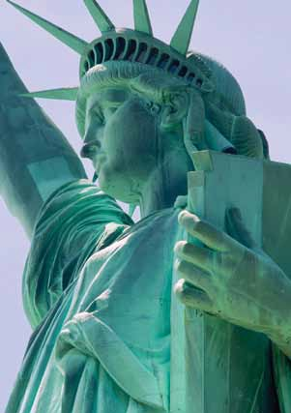
Arizona Civics Exam Review
This Civics Exam Review will help Arizona high school students prepare for the mandated Civics Exam about U.S. history , U.S. government, Civics. This review can also be used in the classroom as an instructional tool for exam preparation.
IMPORTANT NOTE: On the civics test, some answers may change because of elections or appointments. Students must be aware of the most current answers to these questions.

Slide 4
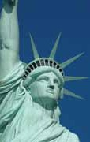


Question
1
What is the supreme law of the land?
Civics Exam Review

Slide 5
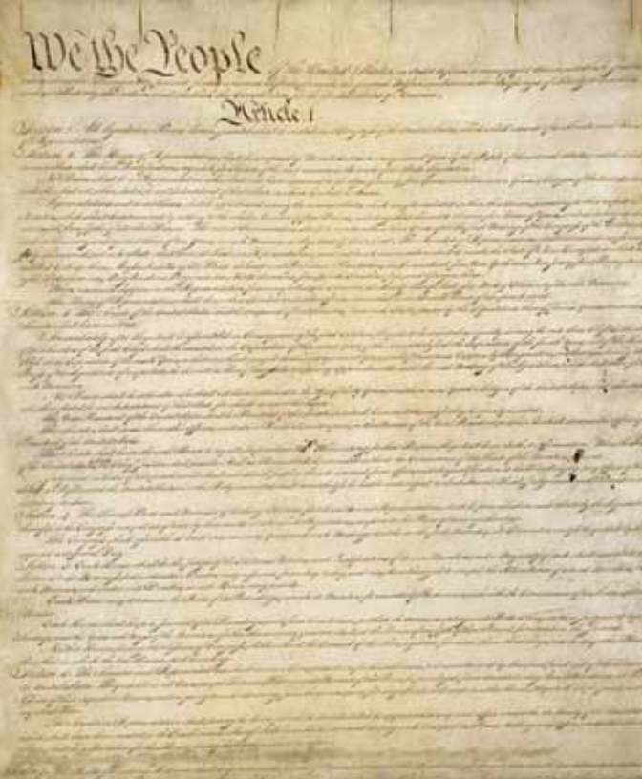
the Constitution
The Constitution of the United States.
Courtesy of the National Archives.

Slide 6
Question
2
What does the Constitution do?
Civics Exam Review

Slide 7
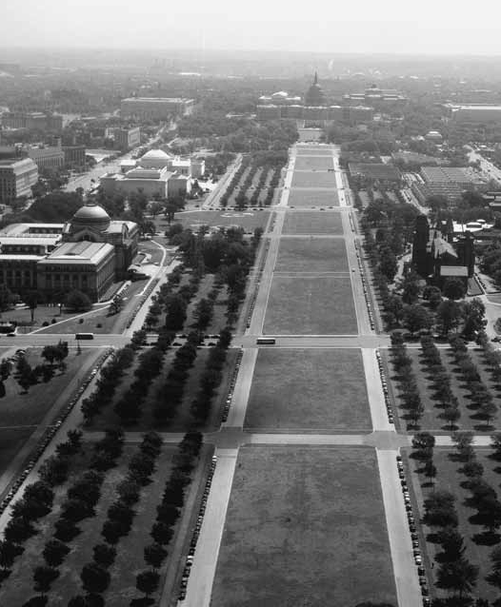
C sets up the government C defines the government C protects basic rights of
Americans
The National Mall in Washington, D.C., seen from the observation area of the Washington Monument, circa 1945.
Courtesy of the Library of Congress, LC-USW31-058713-C.

Slide 8
Question
3
The idea of self-government is in the first three words of the Constitution. What are these words?
Civics Exam Review

Slide 9
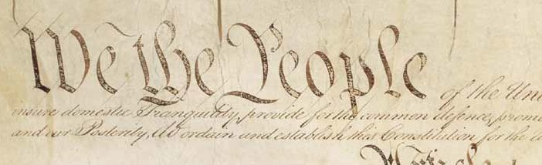
We the People
“We the People,” the first three words of the preamble to the Constitution
of the United States.
Courtesy of the National Archives.

Slide 10
Question
4
What is an amendment?
Civics Exam Review

Slide 11
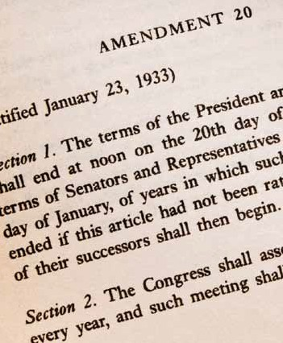
C a change (to the Constitution)
C an addition (to the Constitution)
The 20th Amendment to
the Constitution.

Slide 12
Question
5
What do we call the first ten amendments to the Constitution?
Civics Exam Review

Slide 13
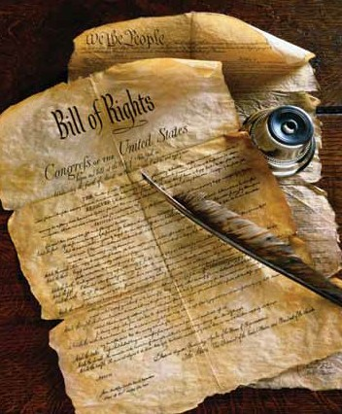
the Bill of Rights

Slide 14
Question
6
What is one right or freedom from the First Amendment?*
Civics Exam Review

Slide 15
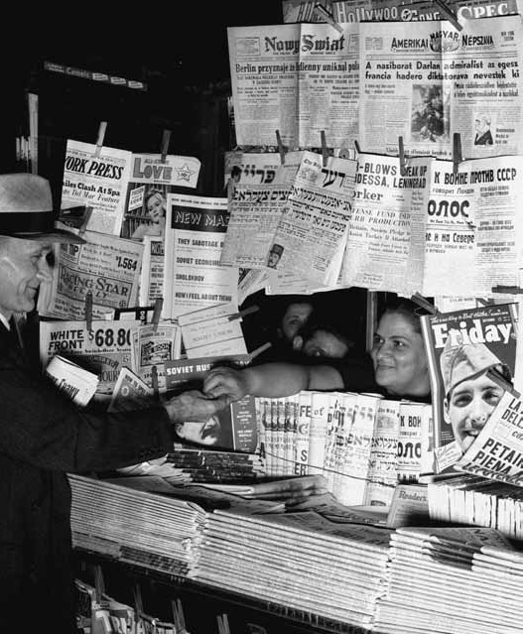
C speech
C religion C assembly C press
C petition the government
A newspaper stand in 1941.
Courtesy of the Library of Congress, LC-USF346-BN-001359-Q-C.

Slide 16
Question
7
How many amendments does the Constitution have?
Civics Exam Review

Slide 17
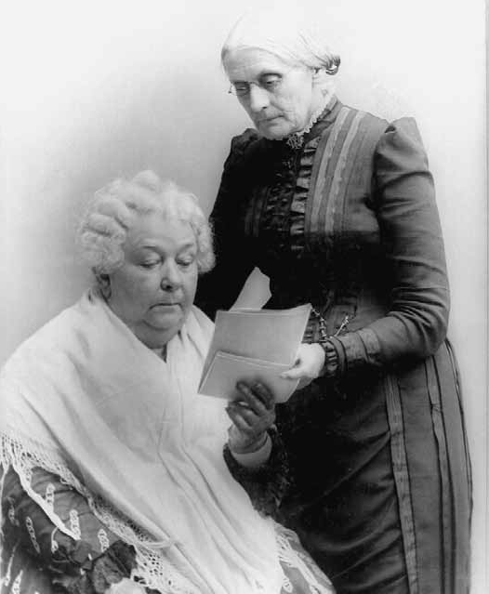
twenty-seven (27)
Portrait of Elizabeth Cady Stanton, seated, and Susan B. Anthony, standing, advocates for the rights
of women to vote.
Courtesy of the Library of Congress, LC-USZ61-791.

Slide 18
Question
8
What did the Declaration of Independence do?
Civics Exam Review

Slide 19
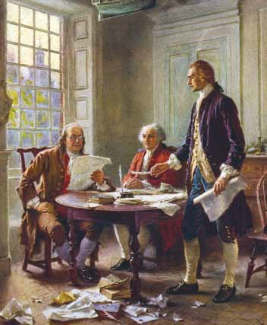
C announced our independence (from Great Britain)
C declared our independence (from Great Britain)
C said that the United States is free
(from Great Britain)
Benjamin Franklin, John Adams, and Thomas Jefferson in “Writing the Declaration of Independence, 1776,” by Jean Leon Gerome Ferris.
Courtesy of the Library of Congress, LC-USZC4-9904.

Slide 20
Question
9
What are two rights in the Declaration of Independence?
Civics Exam Review

Slide 21
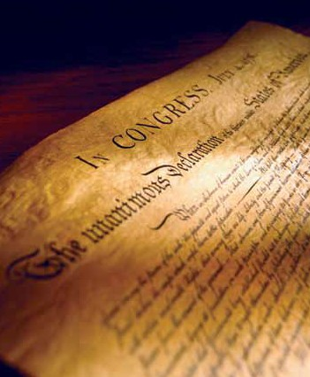
C life
C liberty
C pursuit of happiness

Slide 22
Question
10
What is freedom of religion?
Civics Exam Review

Slide 23
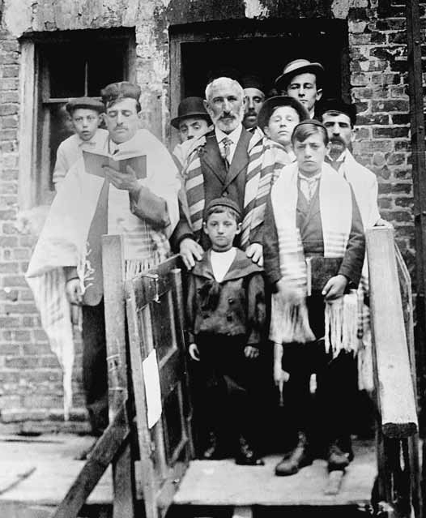
You can practice any religion, or not practice a religion.
A synagogue on Yom Kippur, circa 1900.
Courtesy of the Library of Congress,
LC-DIG-ggbain-02316.

Slide 24
Question
11
What is the economic system in the United States?*
Civics Exam Review

Slide 25

C capitalist economy
C market economy

Slide 26
Question
12
What is the “rule of law”?
Civics Exam Review

Slide 27
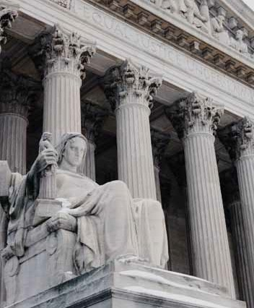
C Everyone must follow the law.
C Leaders must obey the law.
C Government must obey the law.
C No one is above the law.
The Contemplation of Justice statue outside the U.S. Supreme Court building in Washington, D.C.
Courtesy of the Collection of the Supreme Court of the United States.

Slide 28
Question
13
Name one branch or part of the government.*
Civics Exam Review

Slide 29
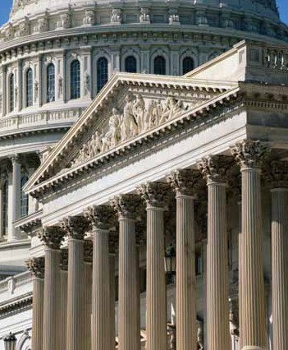
C Congress C legislative C President C executive C the courts C judicial
The U.S. Capitol (legislative branch) and the U.S. Supreme Court (judicial branch) buildings in Washington, D.C.

Slide 30
Question
14
What stops one branch of government from becoming too powerful?
Civics Exam Review

Slide 31
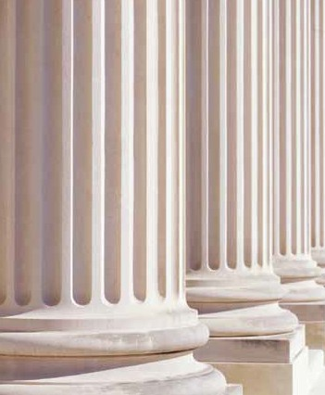
C checks and balances
C separation of powers

Slide 32
Question
15
Who is in charge of the executive branch?
Civics Exam Review

Slide 33
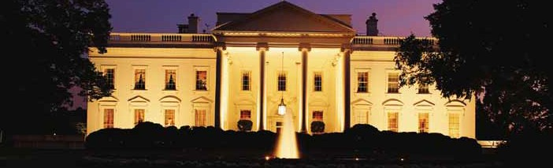
the President
The White House in Washington, D.C.

Slide 34
Question
16
Who makes federal laws?
Civics Exam Review

Slide 35
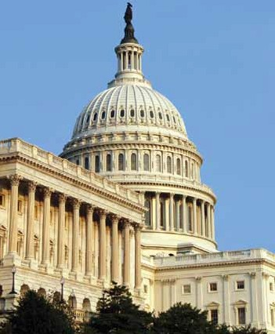
C Congress
C Senate and House (of Representatives)
C (U.S. or national) legislature
The U.S. Capitol in Washington, D.C.

Slide 36
Question
17
What are the two parts of the
U.S. Congress?*
Civics Exam Review

Slide 37
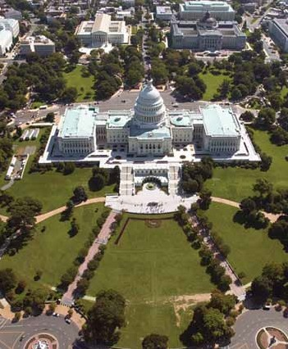
the Senate and House (of
Representatives)
Aerial view of the west front of the
U.S. Capitol in Washington, D.C.
Courtesy of the Architect of the Capitol.

Slide 38
Question
18
How many U.S. Senators are there?
Civics Exam Review

Slide 39
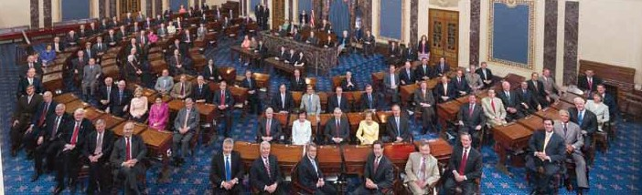
one hundred (100)
The Senators of the 109th Congress.
Courtesy of the U.S. Senate Photo Studio.

Slide 40
Question
19
We elect a U.S. Senator for how many years?
Civics Exam Review

Slide 41
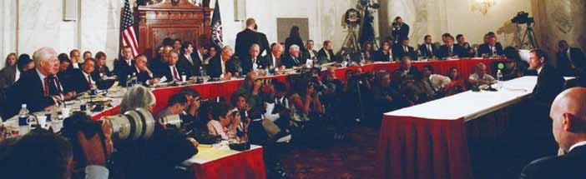
six (6)
Senate hearing on the confirmation of John G. Roberts, Jr. in 2005.
Courtesy of the U.S. Senate Historical Office.

Slide 42
Question
20
Who is one of your state’s
U.S. Senators now?*
Civics Exam Review

Slide 43
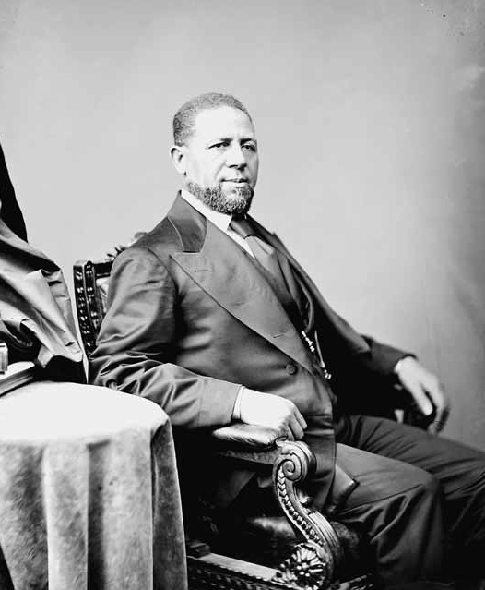
Answers will vary.
[District of Columbia residents and residents of U.S. territories should answer that D.C. (or the territory where the applicant lives) has no U.S. Senators.]
Hiram Revels of Mississippi became the first African American Senator in 1870.
Courtesy of the Library of Congress, LC-DIG-cwpbh-00554.

Slide 44
Question
21
The House of Representatives has how many voting members?
Civics Exam Review

Slide 45
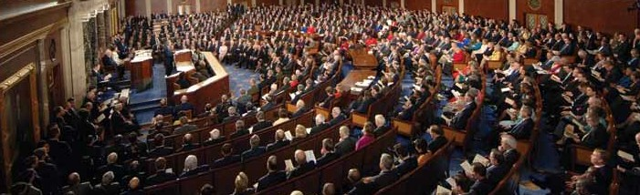
four hundred thirty-five (435)
President George W. Bush delivering the State of the Union Address before a joint session of Congress, January 23, 2007.
Courtesy of the U.S. House of Representatives,
Office of Photography.

Slide 46
Question
22
We elect a U.S. Representative for how many years?
Civics Exam Review

Slide 47
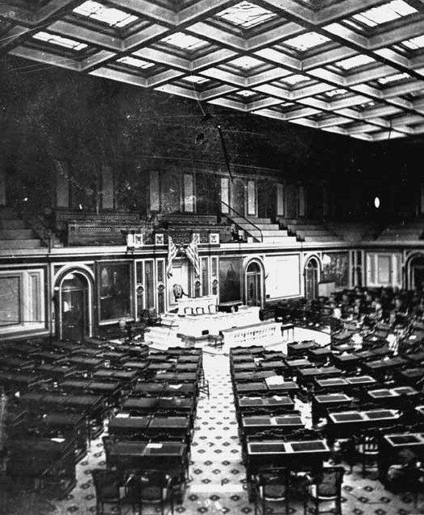
two (2)
Interior view of the Chamber of the
U.S. House of Representatives, circa 1861.
Courtesy of the U.S. House of Representatives, Office of Photography.

Slide 48
Question
23
Name your
U.S. Representative.
Civics Exam Review

Slide 49
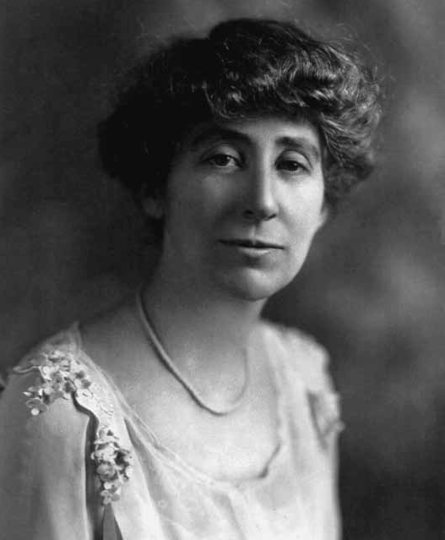
Answers will vary.
[Residents of territories with nonvoting Delegates or Resident Commissioners may provide
the name of that Delegate or Commissioner. Also acceptable is any statement that the territory has no (voting) Representatives in Congress.]
Jeannette Rankin, the first woman to be elected to the
U.S. House of Representatives.
Courtesy of the Library of Congress, LC-USZ62-66358.

Slide 50
Question
24
Who does a U.S. Senator represent?
Civics Exam Review

Slide 51
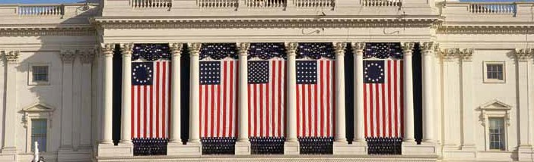
all people of the state

Slide 52
Question
25
Why do some states have more Representatives than other states?
Civics Exam Review

Slide 53
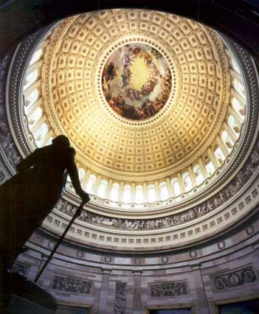
C (because of) the state’s population
C (because) they have more people
C (because) some states have more people
The Rotunda of the U.S. Capitol.
Courtesy of the Architect of the Capitol.

Slide 54
Question
26
We elect a President for how many years?
Civics Exam Review

Slide 55
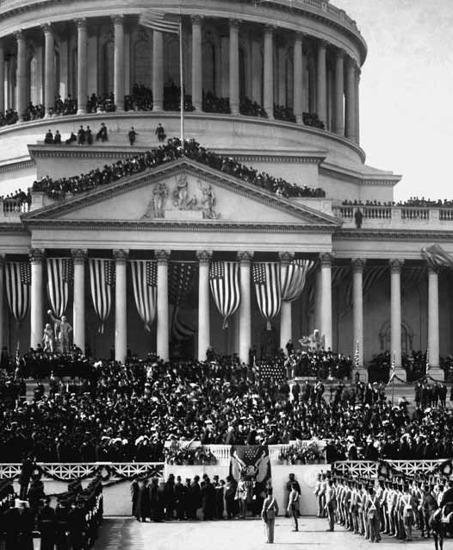
four (4)
The inauguration of President Theodore Roosevelt on March 4, 1905.
Courtesy of the Library of Congress, LC-USZ62-231.

Slide 56
Question
27
In what month do we vote for President?*
Civics Exam Review

Slide 57
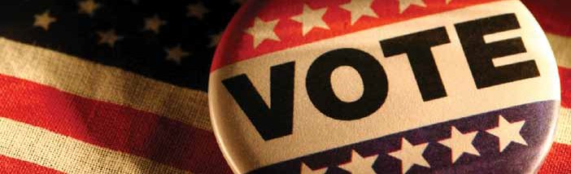
November

Slide 58
Question
28
What is the name of the President of the
United States now?*
Civics Exam Review

Slide 59
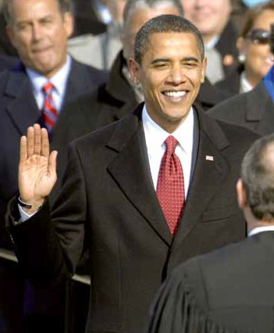

Barack Obama is sworn in as the 44th president of the United States by Chief Justice of the United States
John G. Roberts, Jr. in Washington, D.C., January 20, 2009.
U.S. Department of Defense photo by
U.S. Air Force Master Sgt. Cecilio Ricardo.

Slide 60
Question
29
What is the name of the Vice President of the United States now?
Civics Exam Review

Slide 61
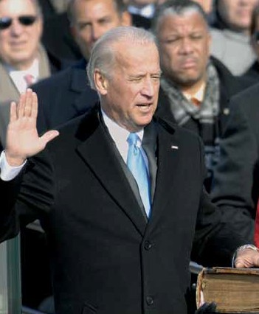


Slide 62
Question
30
If the President can no longer serve, who becomes President?
Civics Exam Review

Slide 63
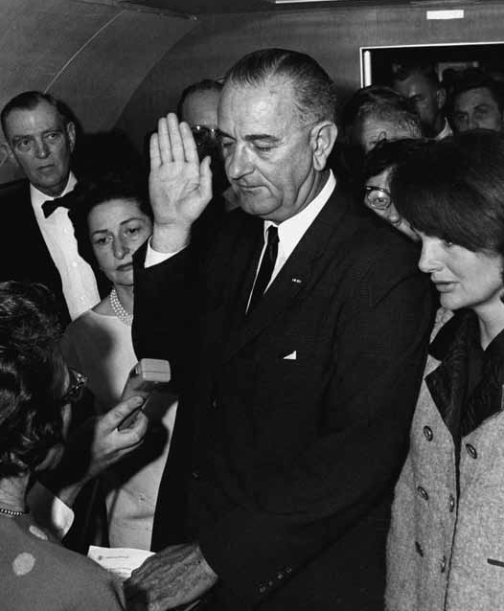
the Vice President
Swearing in of Vice President Lyndon B. Johnson as president aboard Air Force One following the death of President John F. Kennedy on
November 22, 1963.
Courtesy of the Lyndon Baines Johnson Library and Museum, photo by Cecil Stoughton.

Slide 64
Question
31
If both the President and the Vice President can no longer serve, who becomes President?
Civics Exam Review

Slide 65
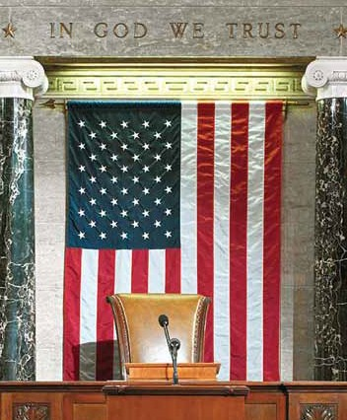
the Speaker of the House
The Rostrum, a place for public speaking, is the location from which the Speaker of the House presides.
Courtesy of the Architect of the Capitol.

Slide 66
Question
32
Who is the Commander in Chief of the military?
Civics Exam Review

Slide 67
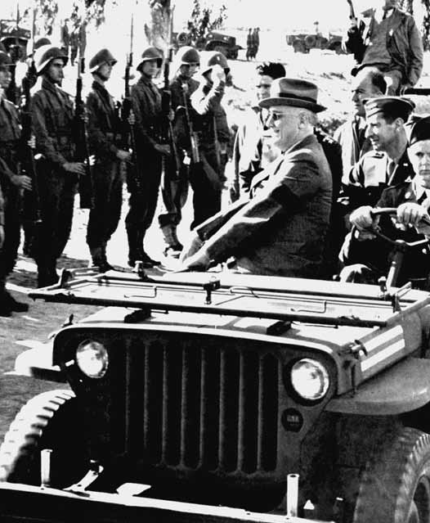
the President
President Franklin D. Roosevelt reviewing American troops
in Casablanca, Morocco during
World War II.
Courtesy of the Library of Congress,
LC-USW33-027834-ZC.

Slide 68
Question
33
Who signs bills to become laws?
Civics Exam Review

Slide 69
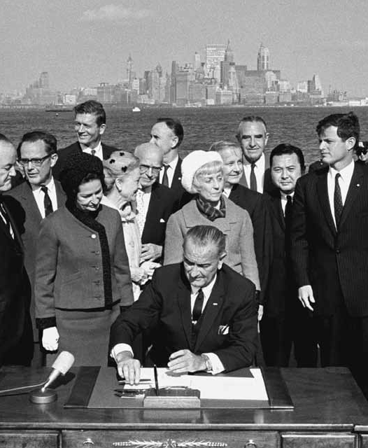
the President
President Lyndon B. Johnson signing the Immigration Act of 1965 on October 3rd of that same year, Liberty Island, NY.
Courtesy of the Lyndon Baines Johnson Library and Museum.

Slide 70
Question
34
Who vetoes bills?
Civics Exam Review

Slide 71
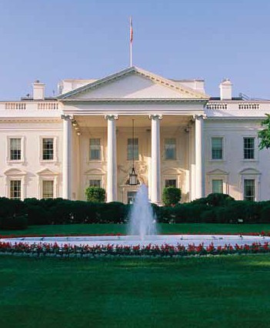
the President
The White House in Washington, D.C.

Slide 72
Question
35
What does the President’s Cabinet do?
Civics Exam Review

Slide 73
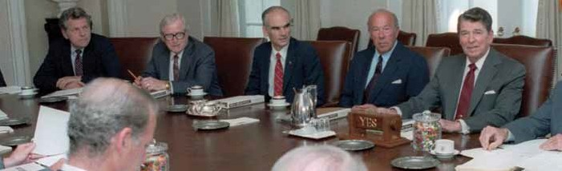
advises the President
President Ronald Reagan leads a Cabinet meeting at the White House
in September 1986.
Courtesy of the Ronald Reagan Presidential Library, C36864-19.

Slide 74
Question
36
What are two Cabinet-level positions?
Civics Exam Review

Slide 75
C | Secretary of Agriculture | C | Secretary of the Interior
C | Secretary of Commerce | C | Secretary of Labor
C | Secretary of Defense | C | Secretary of State
C | Secretary of Education | C | Secretary of Transportation
C | Secretary of Energy | C | Secretary of the Treasury
C | Secretary of Health and Human Services | C | Secretary of Veterans Affairs
C | Secretary of Homeland | C | Attorney General
C | Security Secretary of Housing and | C | Vice President
 | Urban Development

Slide 76
Question
37
What does the judicial branch do?
Civics Exam Review

Slide 77
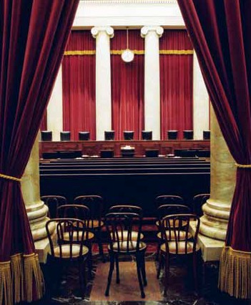
C reviews laws
C explains laws
C resolves disputes (disagreements)
C decides if a law goes against the Constitution
The Courtroom of the U.S. Supreme Court building, where the Court has sat since 1935.
Courtesy of the Collection of the Supreme Court of the United States.

Slide 78
Question
38
What is the highest court in the United States?
Civics Exam Review

Slide 79
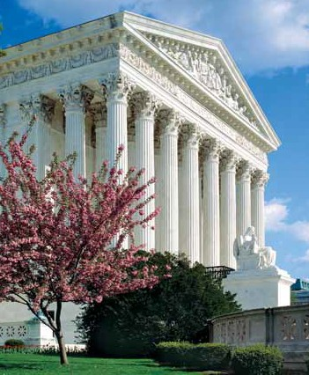
the Supreme Court
West facade of the U.S. Supreme Court building in Washington, D.C.
Courtesy of the Collection of the Supreme Court of the United States.

Slide 80
Question
39
How many justices are on the Supreme Court?
Civics Exam Review

Slide 81
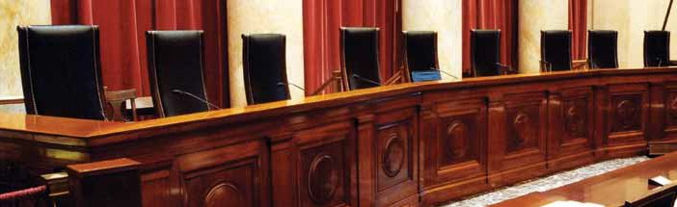
nine (9)
There are nine justices on the Supreme Court: eight associate justices and one
chief justice.
Courtesy of the Collection of the Supreme Court of the United States.

Slide 82
Question
40
Who is the Chief Justice of the United States now?
Civics Exam Review

Slide 83
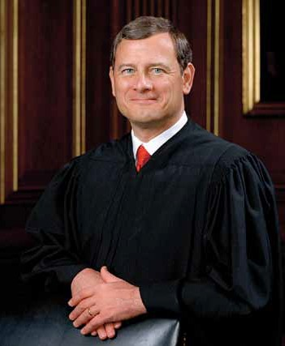
John Roberts (John G. Roberts, Jr.)
Chief Justice John G. Roberts, Jr.
Courtesy of the Collection of the Supreme Court
of the United States.

Slide 84
Question
41
Under our Constitution, some powers belong to the federal government. What is one power of the federal government?
Civics Exam Review

Slide 85
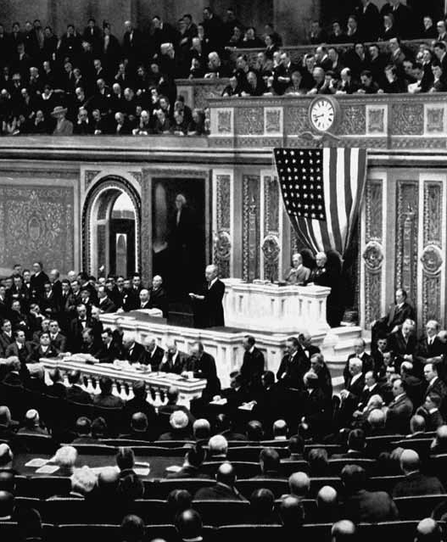
C to print money
C to declare war
C to create an army
C to make treaties
President Woodrow Wilson asking Congress to declare war on Germany,
April 2, 1917.
Courtesy of the Library of Congress, LC-USZC4-10297.

Slide 86
Question
42
Under our Constitution, some powers belong to the states. What is one power of the states?
Civics Exam Review

Slide 87

C provide schooling and education
C provide protection (police)
C provide safety (fire departments)
C give a driver’s license
C approve zoning and land use

Slide 88
Question
43
Who is the Governor of your state now?
Civics Exam Review

Slide 89
Answers will vary.
[District of Columbia residents should answer that D.C. does not have a Governor.]

Slide 90
Question
44
What is the capital of your state?*
Civics Exam Review

Slide 91
Answers will vary.
[District of Columbia residents should answer that D.C. is not a state and does not have a capital. Residents of U.S. territories should name the capital of the territory.]

Slide 92
Question
45
What are the two major political parties in the United States?*
Civics Exam Review

Slide 93
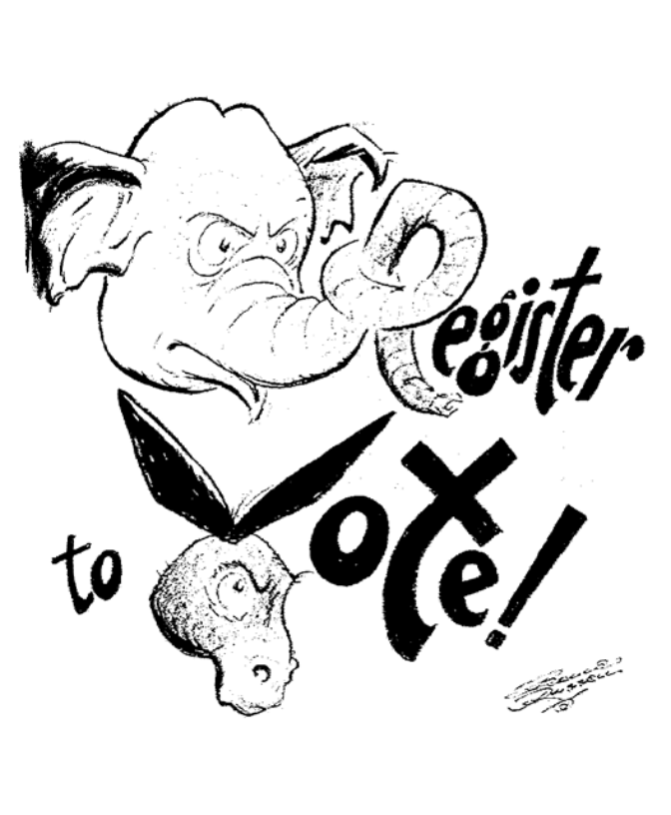
Democratic and Republican
Democratic (donkey) and Republican (elephant) Party icons from a 1962 political cartoon urging citizens to vote.
Courtesy of the Library of Congress, LC-USZ62-116449.

Slide 94
Question
46
What is the political party of the President now?
Civics Exam Review

Slide 95
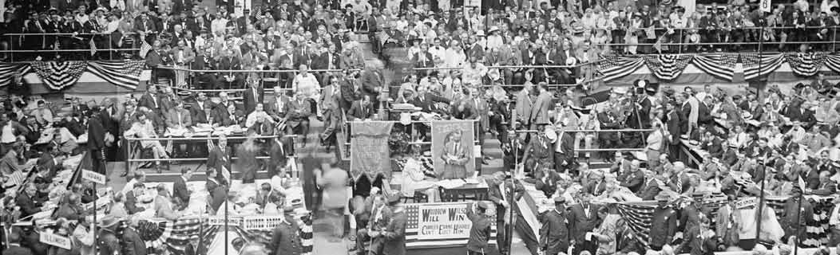

Democratic (Party)

Slide 96
Question
47
What is the name of the Speaker of the House of Representatives now?
Civics Exam Review

Slide 97
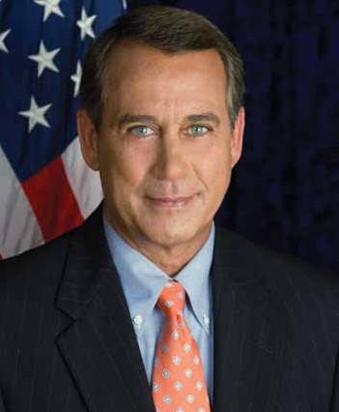
(John) Boehner
John Boehner, Speaker of the
U.S. House of Representatives.
Courtesy of the Office of U.S. Representative John Boehner.

Slide 98
Question
48
There are four amendments to the Constitution about who can vote. Describe one of them.
Civics Exam Review

Slide 99
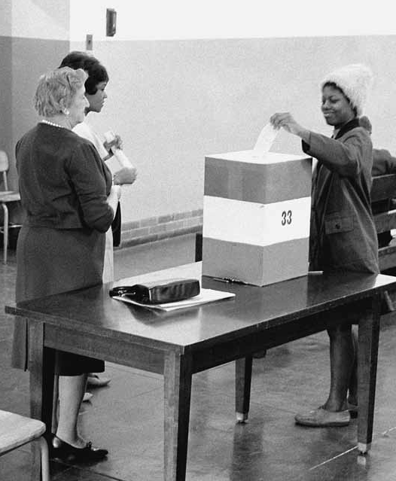
C Citizens eighteen (18) and older (can vote).
C You don’t have to pay (a poll tax) to vote.
C Any citizen can vote. (Women and men can vote.)
C A male citizen of any race (can vote).
A young woman casting her ballot in the 1964 presidential election.
Courtesy of the Library of Congress,
LC-DIG-ppmsca-04300.

Slide 100
Question
49
What is one responsibility that is only for United States citizens?*
Civics Exam Review

Slide 101
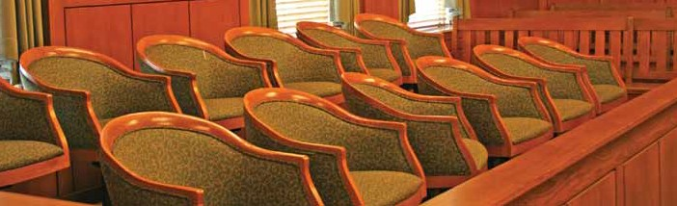
C serve on a jury
C vote in a federal election

Slide 102
Question
50
Name one right only for United States citizens.
Civics Exam Review

Slide 103
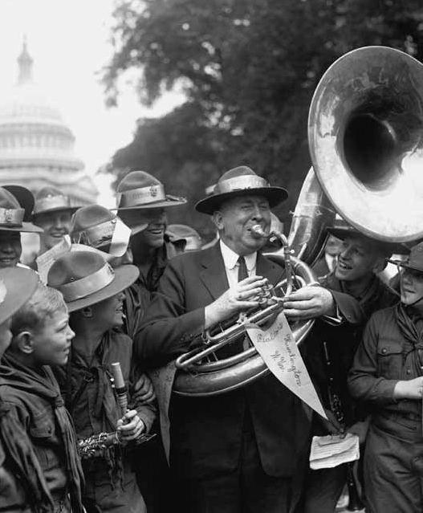
C vote in a federal election
C run for federal office
Congressman George W. Johnson of West Virginia with a Boy Scout band from his state, June 4, 1924.
Courtesy of the Library of Congress, LC-USZ62-29200.

Slide 104
Question
51
What are two rights of everyone living in the United States?
Civics Exam Review

Slide 105
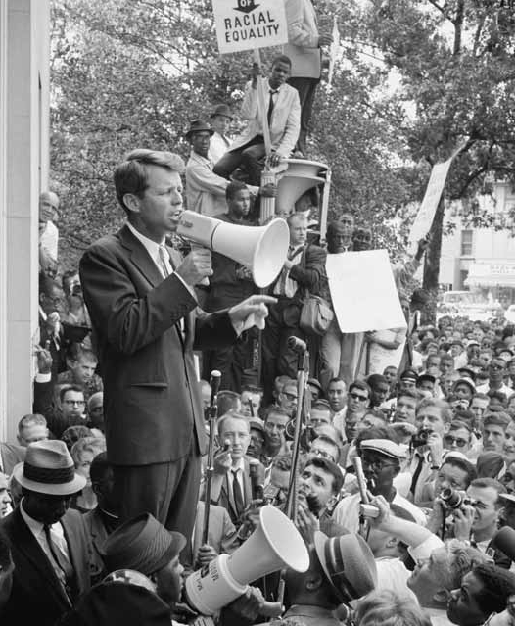
C freedom of expression
C freedom of speech
C freedom of assembly
C freedom to petition the government
C freedom of worship
C the right to bear arms
Attorney General Robert F. Kennedy speaking at a racial equality demonstration outside the Justice Department on
June 14, 1963.
Courtesy of the Library of Congress, LC-DIG-ppmsca-04295.

Slide 106
Question
52
What do we show loyalty to when we say the Pledge of Allegiance?
Civics Exam Review

Slide 107
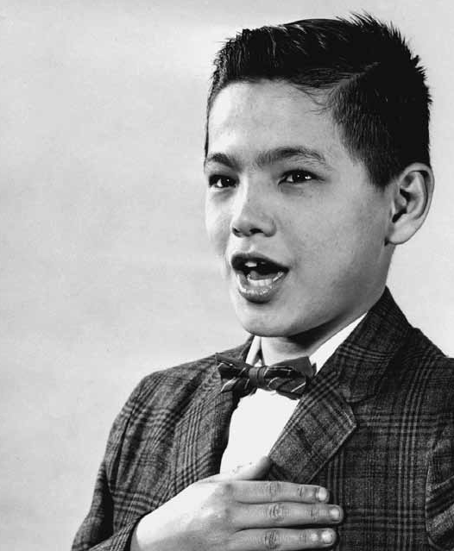
C the United States
C the flag
A young boy pledging allegiance at a naturalization ceremony in 1962.
Courtesy of the USCIS Historical Library,
BK9.4, Item 112.

Slide 108
Question
53
What is one promise you make when you become a United States citizen?
Civics Exam Review

Slide 109
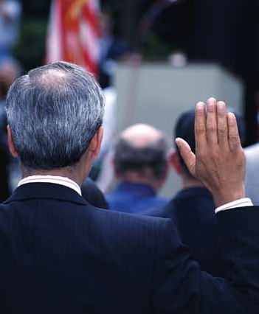
C give up loyalty to other countries
C defend the Constitution and laws of the United States
C obey the laws of the United States
C serve in the U.S. military (if needed)
C serve (do important work for) the nation (if needed)
C be loyal to the United States

Slide 110
Question
54
How old do citizens have to be to vote for President?*
Civics Exam Review

Slide 111

eighteen (18) and older

Slide 112
Question
55
What are two ways that Americans can participate in their democracy?
Civics Exam Review

Slide 113
C vote
C join a political party C help with a campaign C join a civic group
C join a community group
C give an elected official your opinion on an issue
C call Senators and Representatives
C publicly support or oppose an issue or policy
C run for office
C write to a newspaper

Slide 114
Question
56
When is the last day you can send in federal income tax forms?*
Civics Exam Review

Slide 115

April 15

Slide 116
Question
57
When must all men register for the Selective Service?
Civics Exam Review

Slide 117

C at age eighteen (18)
C between eighteen
(18) and twenty-six (26)
World War I draft registration card of Irving Berlin, an American composer who became a naturalized citizen in 1918.
Courtesy of the National Archives.

Slide 118
Question
58
What is one reason colonists came to America?
Civics Exam Review

Slide 119

C freedom
C political liberty
C religious freedom
C economic opportunity C practice their religion C escape persecution
“Mayflower Approaching Land,” an engraving of the ship that carried the Pilgrims to Plymouth, MA in 1620.
Courtesy of the Library of Congress, LC-USZ62-3046.

Slide 120
Question
59
Who lived in America before the Europeans arrived?
Civics Exam Review

Slide 121

C American Indians
C Native Americans
American Indian woman and her baby in 1899.
Courtesy of the Library of Congress, LC-USZ62-94927.

Slide 122
Question
60
What group of people was taken to America and sold as slaves?
Civics Exam Review

Slide 123

C Africans
C people from Africa
Slaves on a Southern plantation in May 1862.
Courtesy of the Library of Congress, LC-DIG-ppmsca-04324.

Slide 124
Question
61
Why did the colonists fight the British?
Civics Exam Review

Slide 125

C because of high taxes (taxation
without representation)
C because the British army stayed in their houses (boarding, quartering)
C because they didn’t have self-government
Molly Pitcher firing a cannon at the Battle of Monmouth in 1778 during the American Revolutionary War by Percy Moran.
Courtesy of the Library of Congress, LC-USZC4-4969.

Slide 126
Question
62
Who wrote the Declaration of Independence?
Civics Exam Review

Slide 127

(Thomas) Jefferson
Thomas Jefferson. Copy of painting by Rembrandt Peale.
Courtesy of the National Archives, NARA File # 208-PU-104HH-4.

Slide 128
Question
63
When was the Declaration of Independence adopted?
Civics Exam Review

Slide 129

July 4, 1776
In “Declaration of Independence,” a painting by John Trumbull, Thomas Jefferson and his committee present the formal statement of independence from Great Britain.
Courtesy of the National Archives, NARA File # 148-GW-662.

Slide 130
Question
64
There were 13 original states. Name three.
Civics Exam Review

Slide 131

C New Hampshire C Massachusetts C Rhode Island
New Hampshire
C Connecticut
C New York
C New Jersey C Pennsylvania C Delaware
C Maryland
C Virginia
C North Carolina C South Carolina C Georgia
New York
Massachusetts
Rhode Island Connecticut
Pennsylvania
New Jersey
Delaware Maryland
Virginia
North Carolina
South Carolina
Georgia

Slide 132
Question
65
What happened at the Constitutional Convention?
Civics Exam Review

Slide 133

C The Constitution was written.
C The Founding Fathers wrote the Constitution.
“Scene at the Signing of the Constitution of the United States,” by Howard Chandler Christy. Courtesy of the Library of Congress, LC-USA7-34630.

Slide 134
Question
66
When was the Constitution written?
Civics Exam Review

Slide 135

1787
Independence Hall in Philadelphia, PA, where the Constitution was signed in 1787.

Slide 136
Question
67
The Federalist Papers supported the passage of the U.S. Constitution.
Name one of the writers.
Civics Exam Review

Slide 137

C (James) Madison
C (Alexander) Hamilton
C (John) Jay
C Publius
Title page of The Federalist, vol. 1, 1799.
Courtesy of the Library of Congress, LC-USZ62-70508.

Slide 138
Question
68
What is one thing Benjamin Franklin is famous for?
Civics Exam Review

Slide 139

C U.S. diplomat
C oldest member of the Constitutional Convention
C first Postmaster General of the United States
C writer of “Poor Richard’s Almanac”
C started the first free libraries
“Franklin’s Return to Philadelphia, 1785,”
by Jean Leon Gerome Ferris.
Courtesy of the Library of Congress, LC-USZC4-9906.

Slide 140
Question
69
Who is the “Father of Our Country”?
Civics Exam Review

Slide 141

(George) Washington
“George Washington at Princeton,” by Charles Willson Peale.
Courtesy of the U.S. Senate, Catalog # 31.00002.000.

Slide 142
Question
70
Who was the first President?*
Civics Exam Review

Slide 143

(George) Washington
“Washington Crossing the Delaware,”
by Emanuel Leutze.
Courtesy of the National Archives, NARA File # 066-G-15D-25.

Slide 144
Question
71
What territory did the United States buy from France in 1803?
Civics Exam Review

Slide 145

C the Louisiana Territory
C
Louisiana
Map of the Louisiana Purchase Territory.
Courtesy of the National Archives.

Slide 146
Question
72
Name one war fought by the United States in the 1800s.
Civics Exam Review

Slide 147

C War of 1812
C Mexican-American War
C Civil War
C Spanish-American War
“Battle of Lake Erie,” by Percy Moran, depicts a battle from the War of 1812.
Courtesy of the Library of Congress, LC-USZC4-6893.

Slide 148
Question
73
Name the U.S. war between the North and the South.
Civics Exam Review

Slide 149

C the Civil War
Civil War soldiers with cannon and caisson, Fort C.F. Smith, Co. L, 2d New York Artillery.
Courtesy of the Library of Congress, LC-USZ62-115177.
C the War between the States

Slide 150
Question
74
Name one problem that led to the Civil War.
Civics Exam Review

Slide 151

C slavery
C economic reasons
C states’ rights
Civil War Confederate General Robert E. Lee.
Courtesy of the Library of Congress, LC-B8172-0001.

Slide 152
Question
75
What was one important thing that Abraham Lincoln did?*
Civics Exam Review

Slide 153

C freed the slaves (Emancipation Proclamation)
C saved (or preserved) the Union
C led the United States during the Civil War
Abraham Lincoln.
Courtesy of the Library of Congress, LC-USZ62-13016.

Slide 154
Question
76
What did the Emancipation Proclamation do?
Civics Exam Review

Slide 155

C freed the slaves
C freed slaves in the Confederacy
C freed slaves in the Confederate states
C freed slaves in most Southern states
“The First Reading of the Emancipation Proclamation Before the Cabinet,” painted by Francis Bicknell Carpenter and engraved by A.H. Ritchie.
Courtesy of the Library of Congress, LC-DIG-pga-02502.

Slide 156
Question
77
What did Susan B. Anthony do?
Civics Exam Review

Slide 157

C fought for women’s rights
C fought for civil rights
Susan B. Anthony.
Courtesy of the Library of Congress, LC-DIG-ggbain-30125.

Slide 158
Question
78
Name one war fought by the United States in the 1900s.*
Civics Exam Review

Slide 159

C World War I C World War II C Korean War C Vietnam War
C (Persian) Gulf War
“Raising the Flag on Iwo Jima,” photographed by Joe Rosenthal, Associated Press, 1945.
Courtesy of the National Archives, 80-G-413988.

Slide 160
Question
79
Who was President during World War I?
Civics Exam Review

Slide 161

(Woodrow) Wilson
President Woodrow Wilson.
Courtesy of the Library of Congress, LC-USZ62-107577.

Slide 162
Question
80
Who was President during the Great Depression and World War II?
Civics Exam Review

Slide 163

(Franklin) Roosevelt
President Franklin D. Roosevelt signing the Declaration of War against Japan on December 8, 1941.
Courtesy of the National Archives.

Slide 164
Question
81
Who did the United States fight in World War II?
Civics Exam Review

Slide 165

Japan, Germany, and Italy
Surrender of Japan, September 2, 1945. General Douglas MacArthur signs as Supreme Allied Commander during formal surrender ceremonies
aboard the USS Missouri in Tokyo Bay.
Courtesy of the National Archives.

Slide 166
Question
82
Before he was President, Eisenhower was a general. What war was he in?
Civics Exam Review

Slide 167

World War II
General Dwight D. Eisenhower, 1945.
Courtesy of the National Archives.

Slide 168
Question
83
During the Cold War, what was the main concern of the United States?
Civics Exam Review

Slide 169

Communism
Germans from East and West stand on the Berlin Wall in front of the Brandenburg Gate in this November 10, 1989 photo, one day after the wall opened. The Berlin Wall was a symbol of the tyranny that restrained freedom throughout the Communist bloc of Eastern Europe during the Cold War.
AP Images/STF.

Slide 170
Question
84
What movement tried to end racial discrimination?
Civics Exam Review

Slide 171

civil rights (movement)
Demonstrators at the March on Washington for Jobs and Freedom in Washington, D.C., August 28, 1963.
Courtesy of the Library of Congress, LC-DIG-ppmsca-03128.

Slide 172
Question
85
What did Martin Luther King, Jr. do?*
Civics Exam Review

Slide 173

C fought for civil rights
C worked for equality for all Americans
Martin Luther King, Jr.

Slide 174
Question
86
What major event happened on September 11, 2001, in the United States?
Civics Exam Review

Slide 175

Terrorists attacked the United States.
Firefighters unfurl a large American flag over the scarred stone of the Pentagon on September 12, 2001.
White House photo by Paul Morse.

Slide 176
Question
87
Name one American Indian tribe in the United States.
Civics Exam Review

Slide 177

C | Cherokee | C | Apache | C | Arawak | C | Crow
C | Navajo | C | Iroquois | C | Shawnee | C | Teton
C | Sioux | C | Creek | C | Mohegan | C | Hopi
C | Chippewa | C | Blackfeet | C | Huron | C | Inuit
C Choctaw
C Pueblo
C Seminole
C Cheyenne
C Oneida
C Lakota
Four Pueblo women.
Courtesy of the Library of Congress, LC-USZ62-54421.

Slide 178
Question
88
Name one of the two longest rivers in the United States.
Civics Exam Review

Slide 179

C Missouri (River)
C Mississippi (River)
The Mississippi River near
Minneapolis, MN.

Slide 180
Question
89
What ocean is on the West Coast of the United States?
Civics Exam Review

Slide 181

Pacific (Ocean)
View of the Pacific Ocean from Big Sur, CA, near Bixby Creek Bridge.

Slide 182
Question
90
What ocean is on the East Coast of the United States?
Civics Exam Review

Slide 183

Atlantic (Ocean)
Portland Head Light in Cape Elizabeth, ME.

Slide 184
Question
91
Name one U.S. territory.
Civics Exam Review

Slide 185

C Puerto Rico
C U.S. Virgin Islands C American Samoa C Northern Mariana
Islands
C Guam
Old Spanish Bridge in Umatac, Guam.
Courtesy of the Office of U.S. Representative
Madeleine Z. Bordallo.

Slide 186
Question
92
Name one state that borders Canada.
Civics Exam Review

Slide 187

C Maine C C New Hampshire C C
C C
Ohio Michigan
C Minnesota
C North Dakota
C Montana
C Idaho
C Washington
C Alaska
Vermont New York Pennsylvania

Slide 188
Question
93
Name one state that borders Mexico.
Civics Exam Review

Slide 189

C California
C Arizona
C New Mexico
C Texas

Slide 190
Question
94
What is the capital of the United States?*
Civics Exam Review

Slide 191

Washington, D.C.
A view of Washington, D.C., from Virginia, across the Potomac River. The view shows the Lincoln Memorial, the Washington Monument, and
the U.S. Capitol.

Slide 192
Question
95
Where is the Statue of Liberty?*
Civics Exam Review

Slide 193

C New York (Harbor)
C Liberty Island
[Also acceptable are New Jersey, near New York City, and on the Hudson (River).]

Slide 194
Question
96
Why does the flag have 13 stripes?
Civics Exam Review

Slide 195

C because there were 13 original colonies
C because the stripes represent the original colonies

Slide 196
Question
97
Why does the flag have 50 stars?*
Civics Exam Review

Slide 197

C because there is one star for each state
C because each star represents a state
C because there are 50 states

Slide 198
Question
98
What is the name of the national anthem?
Civics Exam Review

Slide 199

The Star- Spangled Banner
In “The Star-Spangled Banner,” by Percy Moran, Francis Scott Key reaches toward the flag flying over
Fort McHenry.
Courtesy of the Library of Congress, LC-USZC4-6200.

Slide 200
Question
99
When do we celebrate Independence Day?*
Civics Exam Review

Slide 201

July 4
Patriotic celebration at the
U.S. Capitol in Washington, D.C.

Slide 202
Question
100
Name two national U.S. holidays.
Civics Exam Review

Slide 203

C New Year’s Day
C Martin Luther King, Jr. Day
C Presidents’ Day
C Memorial Day
C Independence Day
C Labor Day
C Columbus Day C Veterans Day C Thanksgiving C Christmas
Atlantic Pavilion at the World War II Memorial in Washington, D.C.
© Richard Latoff.

