Slide 1
The Late Middle Ages:
Crisis and Disintegration in the Fourteenth Century
Chapter 11

Slide 2
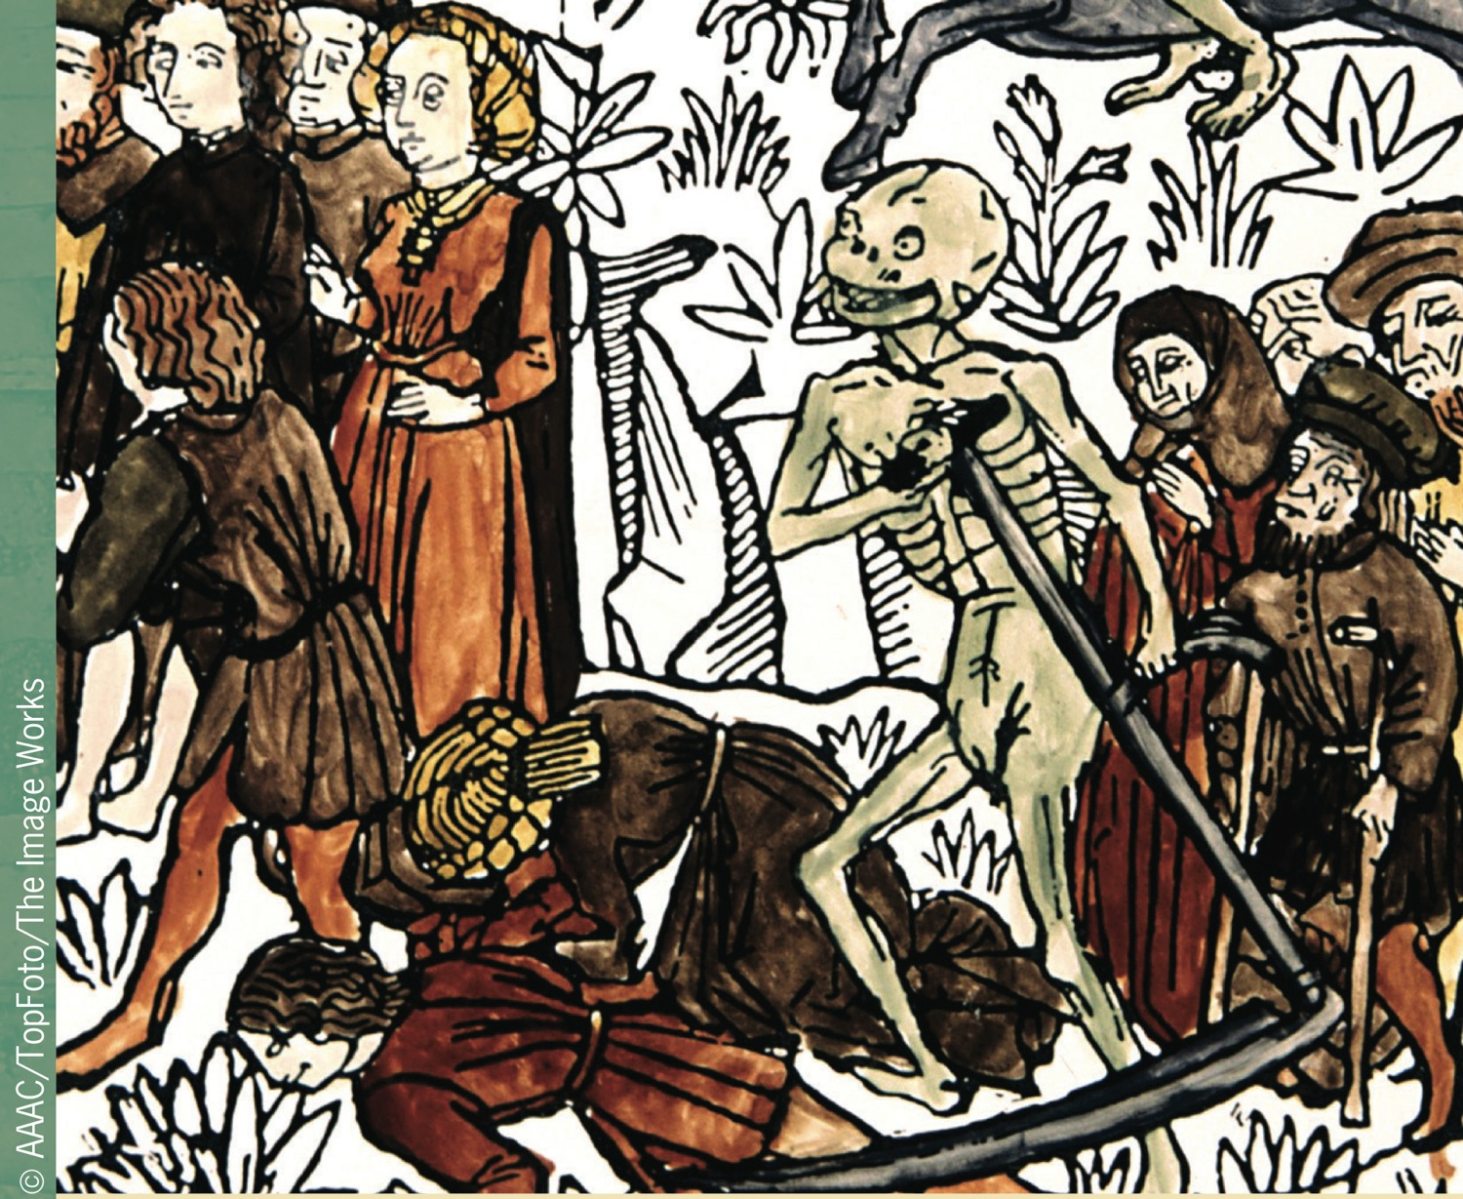
A medieval illustration of Death as a reaper during the Black Death
p299
Notes:
A medieval illustration of Death as a reaper during the Black Death

Slide 3
A Time of Troubles: Black Death and Social Crisis
Famine and Population
  “Little Ice Age”
  The Great Famine (1315 – 1317)
    Population outstripping resources by 1300
The Black Death: From Asia to Europe
  Role of the Mongols
    Eurasian landmass under single rule
    Spread of plague along trade routes

Slide 4
The Black Death in Europe
Impact, Symptoms, and Spread of Plague
  Most devastating natural disaster in European history
    Bubonic
      Rats and fleas
    Pneumonic
  Arrived in Europe in 1347
    Mortality reached 50 – 60 percent in some areas
  Wiped out between 25 – 50 percent of European population (19 – 38 million dead in four years)
  Plague returns in 1361 – 1362 and 1369

Slide 5
Life and Death: Reactions to the Plague
Attempts at Explanation
  Plague as a punishment from God
  The flagellants
Attacks against Jews
Violence and Preoccupation with Death
Art and the Black Death
  Ars moriendi, the art of dying

Slide 6
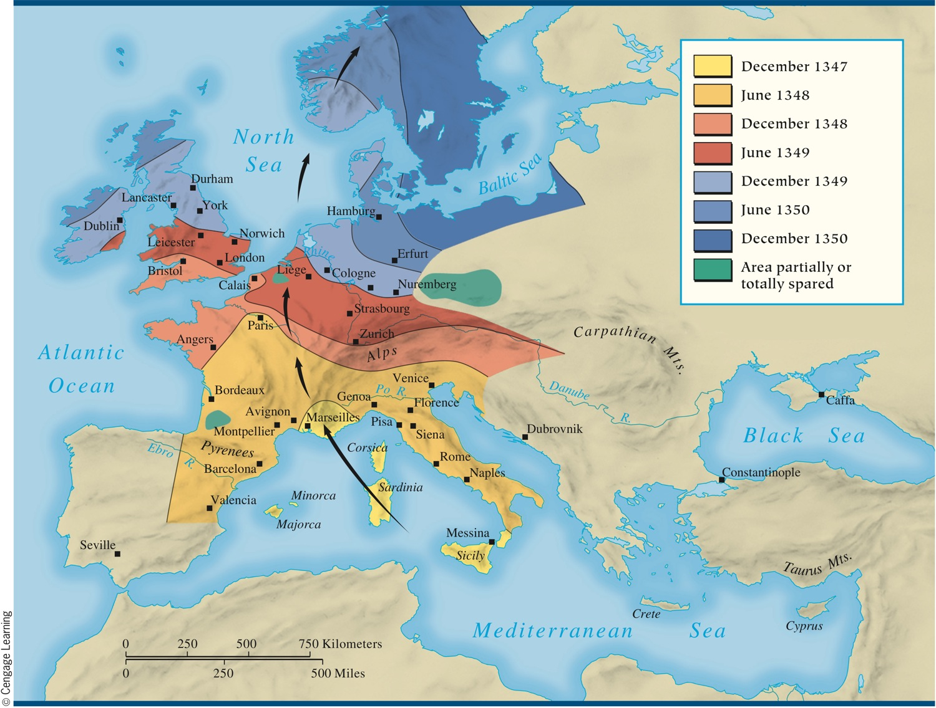
MAP 11.1 Spread of the Black Death
Map 11.1 p303
Notes:
MAP 11.1 Spread of the Black Death. The plague entered Europe by way of Sicily in 1347 and
within three years had killed between one-quarter and one-half of the population. Outbreaks
continued into the early eighteenth century, and the European population took two hundred years
to return to the level it had reached before the Black Death.

Slide 7
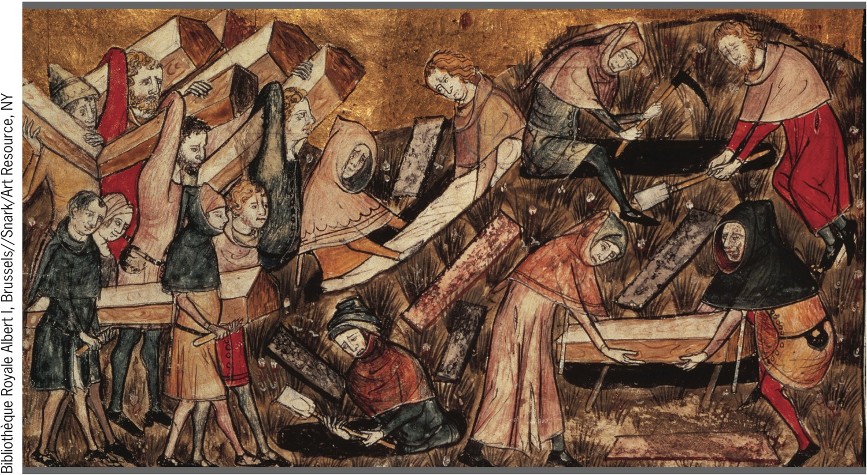
Mass Burial of Plague Victims
p303
Notes:
Mass Burial of Plague Victims.
The Black Death had spread to northern
Europe by the end of 1348. Shown here
is a mass burial of victims of the plague
in Tournai, located in modern Belgium.
As is evident in the illustration, at this
stage of the plague, there was still time
to make coffins for the victims’ burial.
Later, as the plague intensified, the dead
were thrown into open pits.

Slide 8
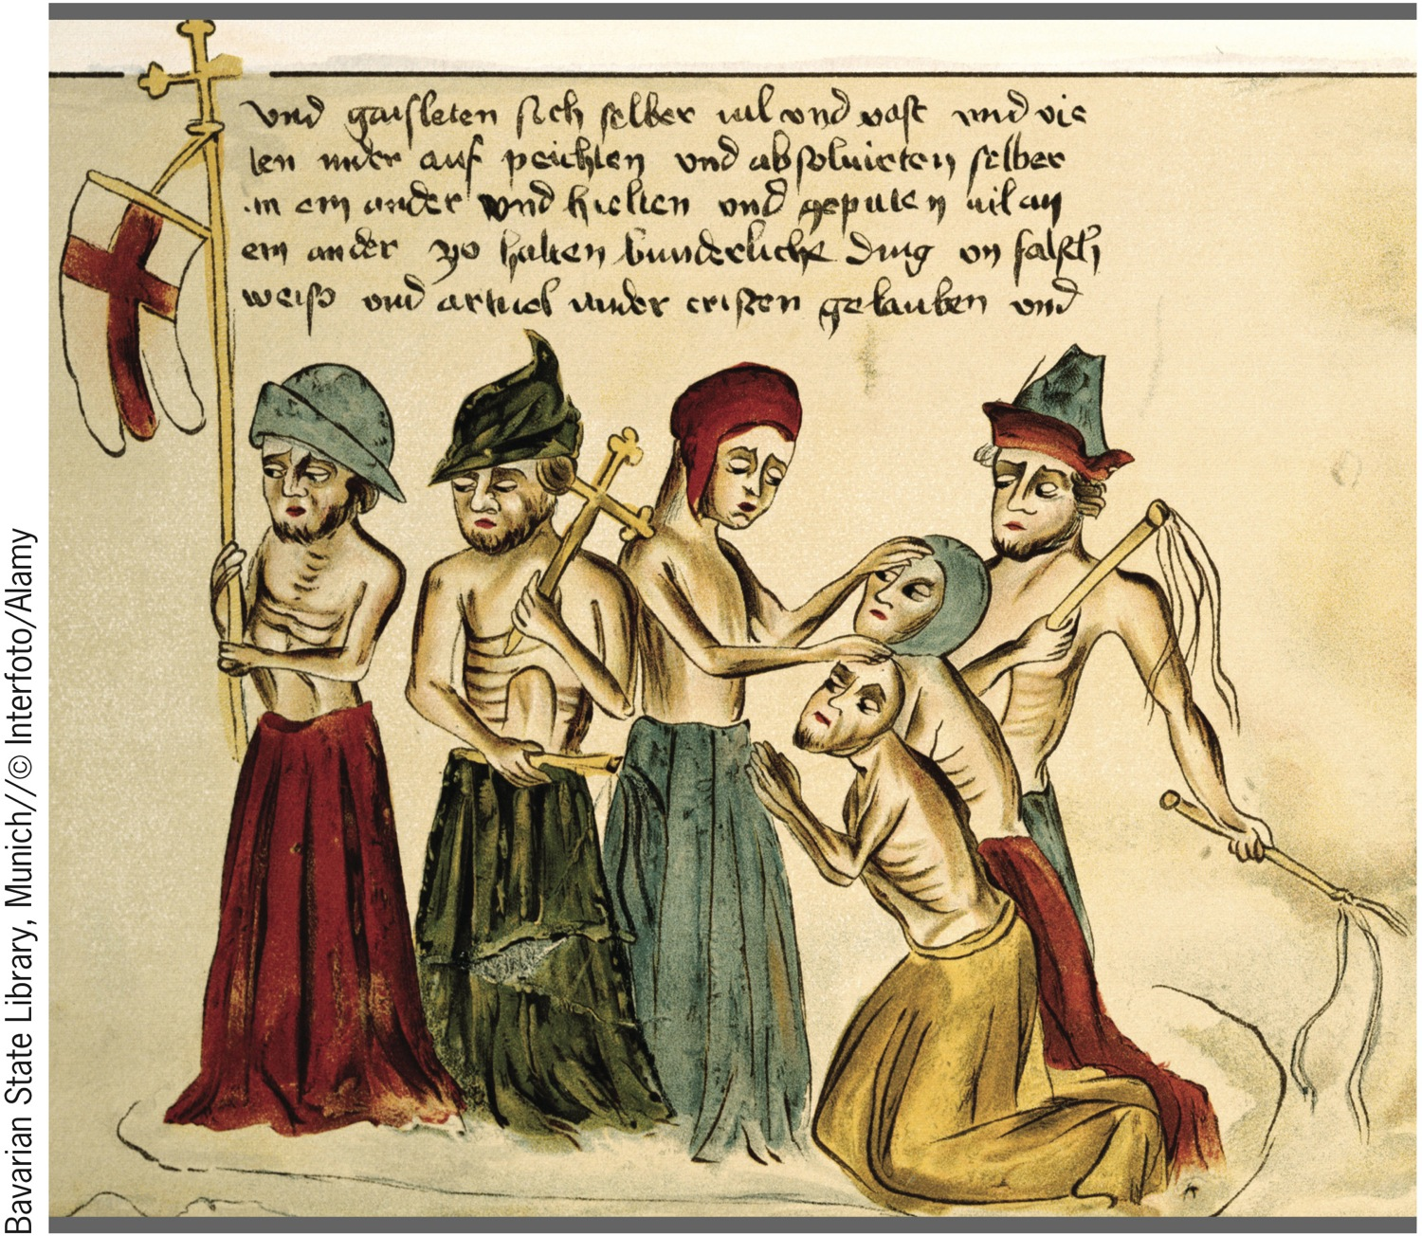
The Flagellants
p304
Notes:
The Flagellants. Reactions to the plague were extreme at times.
Believing that asceticism could atone for humanity’s sins and win God’s
forgiveness, flagellants wandered from town to town flogging
themselves and each other with whips as in this illustration from a
fifteenth-century German manuscript.

Slide 9
Economic Dislocation and Social Upheaval
Noble Landlords and Peasants
  Labor shortage + falling prices for agricultural products = drop in aristocratic incomes
  Statute of Laborers (1351) : limit wages
  Social mobility
Peasant Revolt in France
  Jacquerie (1358)
An English Peasant Revolt (1381)
Revolts in the Cities
  Ciompi revolt in Florence (1378)

Slide 10
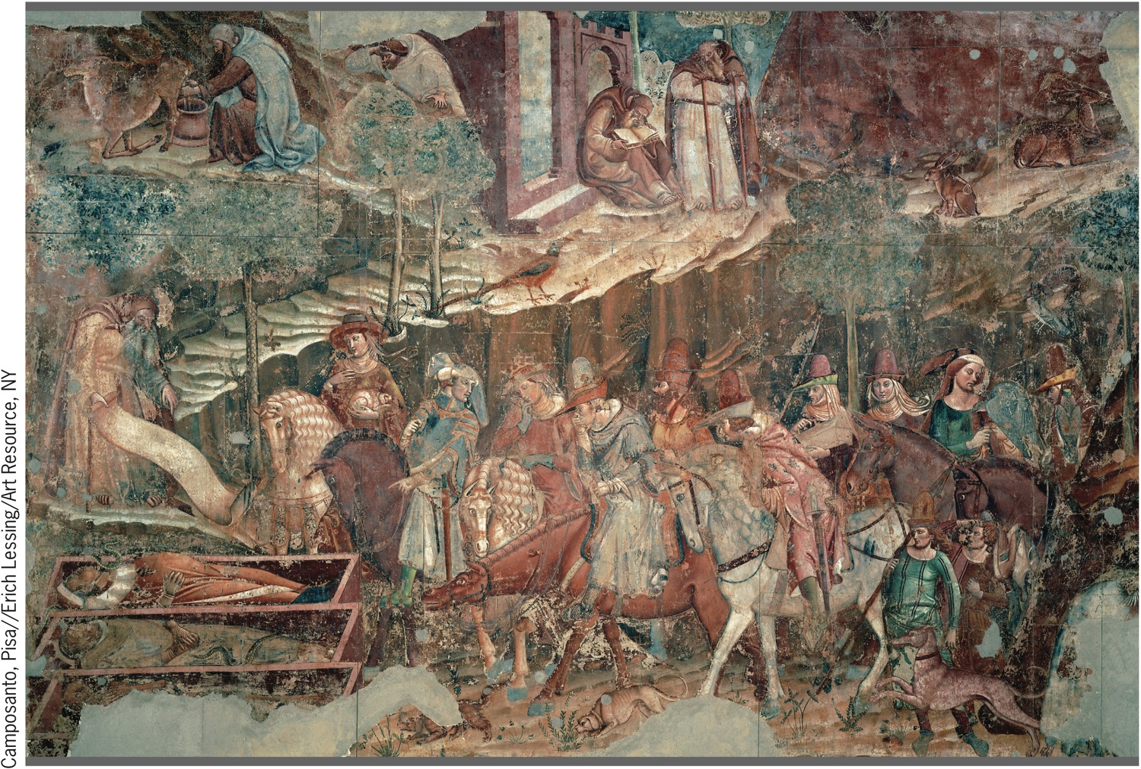
Francesco Traini, The Triumph of Death
p305
Notes:
Francesco Traini, The Triumph
of Death. The plague led to a
morbid fascination with death that is
visible in the art of the period. Shown
here is the left side of Francesco
Traini’s fresco, which depicts a group
of young aristocrats on a hunt
encountering three decaying corpses
in coffins. One of the nobles is shown
gagging at the smell of the
decomposing bodies.

Slide 11
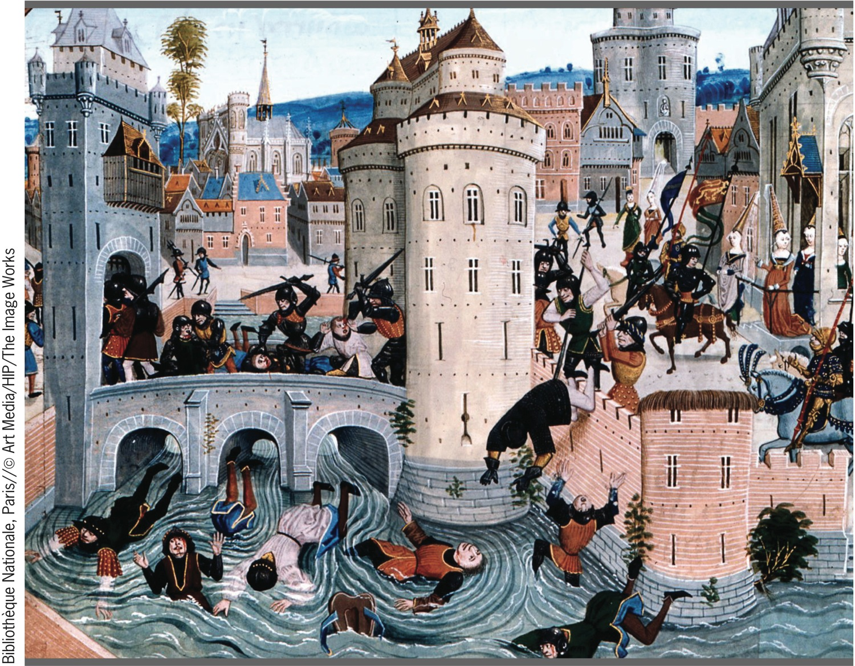
Peasant Rebellion
p306
Notes:
Peasant Rebellion. The fourteenth century
witnessed a number of revolts of the peasantry
against noble landowners. Although the revolts
often met with initial success, they were soon
crushed. This fifteenth-century illustration shows
nobles during the French Jacquerie of 1358
massacring the rebels in the town of Meaux, in
northern France.

Slide 12
The Hundred Years’ War
Causes of the Hundred Years’ War
  The English king as vassal to the French king
  Disputed succession to the French crown
    The claims of Edward III of England
  Immediate cause: French attack on English Gascony (1337)

Slide 13
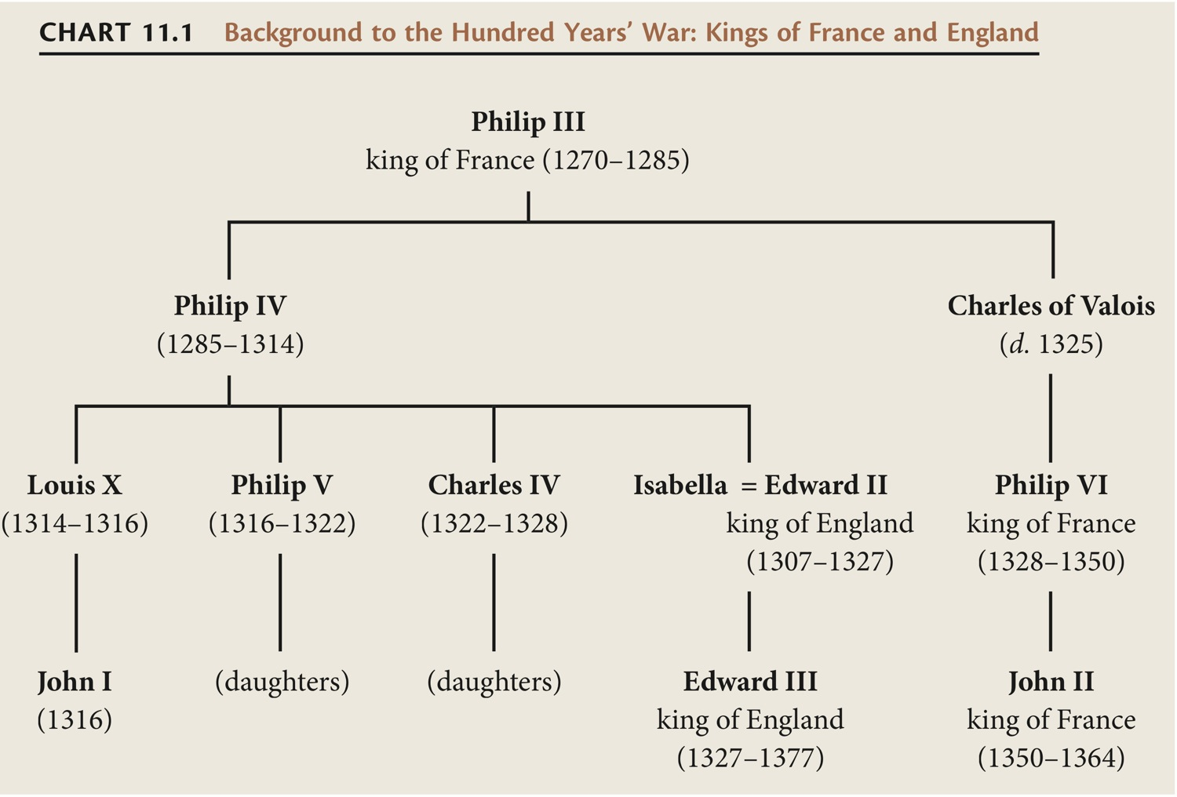
CHART 11.1 Background to the Hundred Years’ War: Kings of France and England
Chart 11.1 p308
Notes:
CHART 11.1 Background to the Hundred Years’ War: Kings of France and England

Slide 14
The Hundred Years’ War
Conduct and Course of the War
  Early phases of the war
    The Battles of Crécy (1346) and Poitiers (1356)
    Intermittent war and truce
  Renewal of the war
    Henry V (1413 – 1422)
      The Battle of Agincourt (1415)
    Charles the dauphin (heir to the French throne)
  Joan of Arc (1412 – 1431)
    Siege of Orléans
    Captured by allies of the English in 1430
    Burned at the stake (1431)
  The end of the war: French victory (1453)

Slide 15
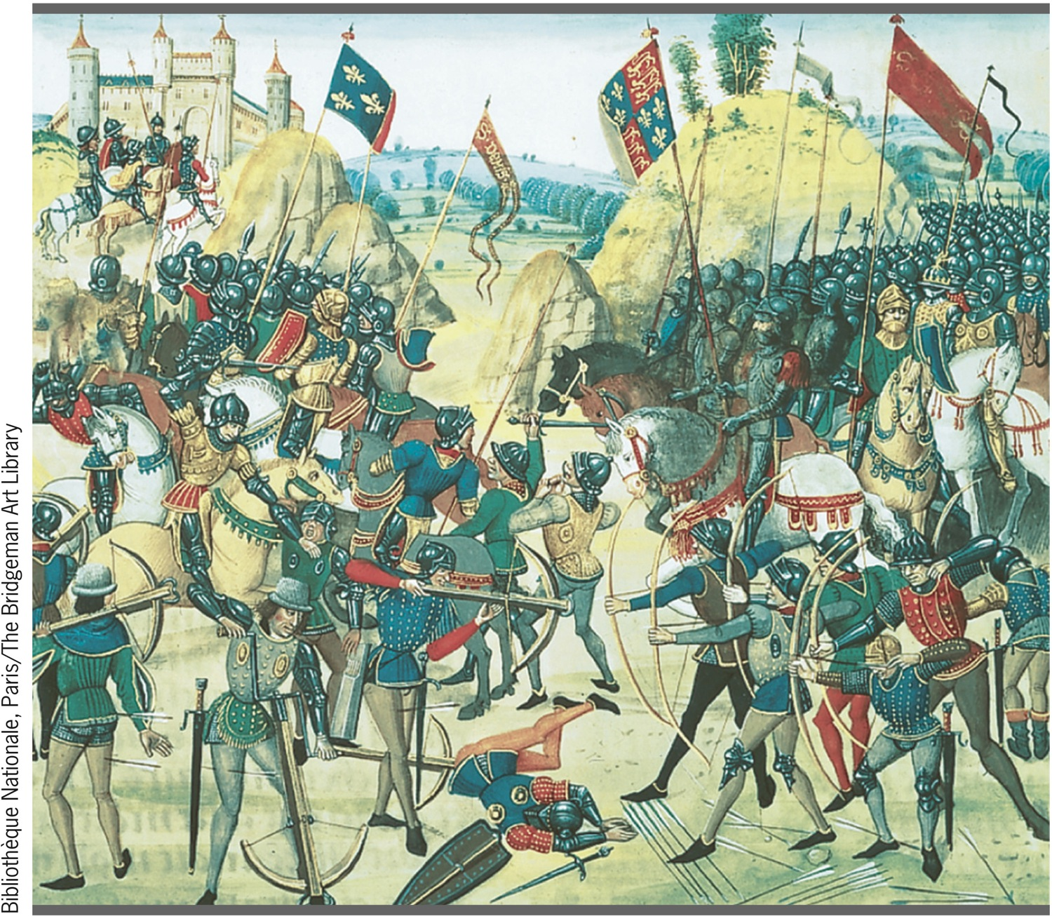
Battle of Crecy
p309
Notes:
Battle of Cre´cy. This fifteenth-century manuscript
illustration depicts the Battle of Cre´cy, the first of several
military disasters suffered by the French in the Hundred
Years’ War, and shows why the English preferred the
longbow to the crossbow. At the left, the French
crossbowmen have to stop shooting and prime their
weapons by cranking the handle, while the English archers
continue to shoot their longbows (a skilled archer could
launch ten arrows a minute).

Slide 16
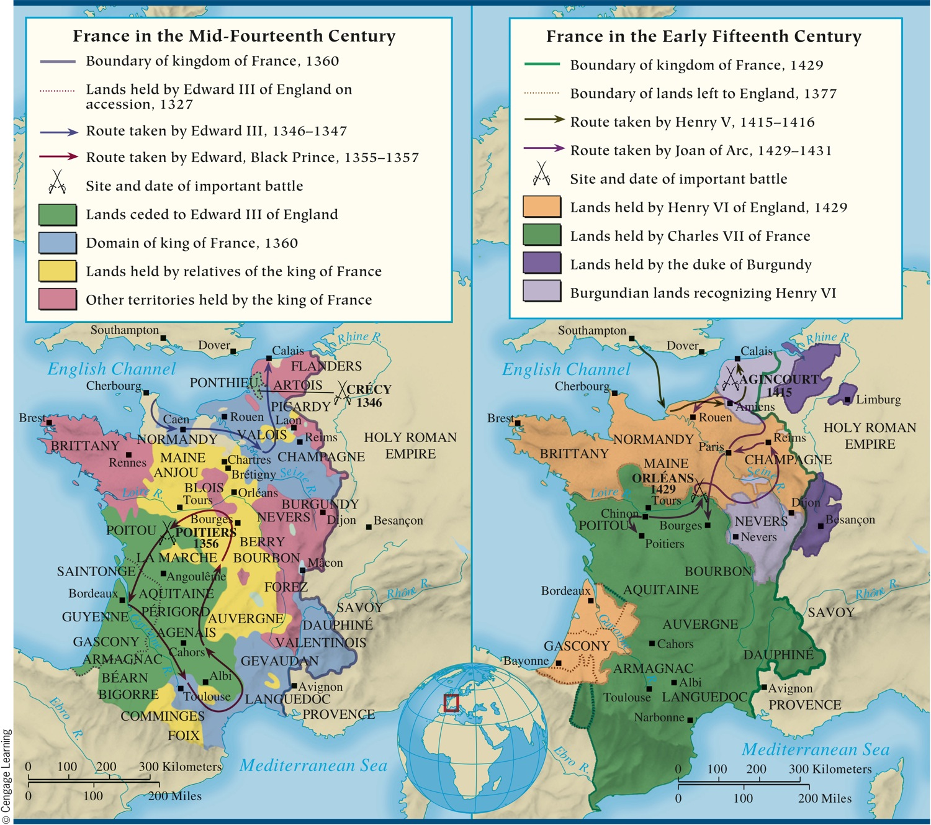
MAP 11.2 The Hundred Years’ War
Map 11.2 p311
Notes:
MAP 11.2 The Hundred Years’ War. This long, exhausting struggle began in 1337 and dragged on
until 1453. The English initially gained substantial French territory, but in the later phases of the war,
France turned the tide, eventually expelling the English from all Continental lands except the port of
Calais.

Slide 17
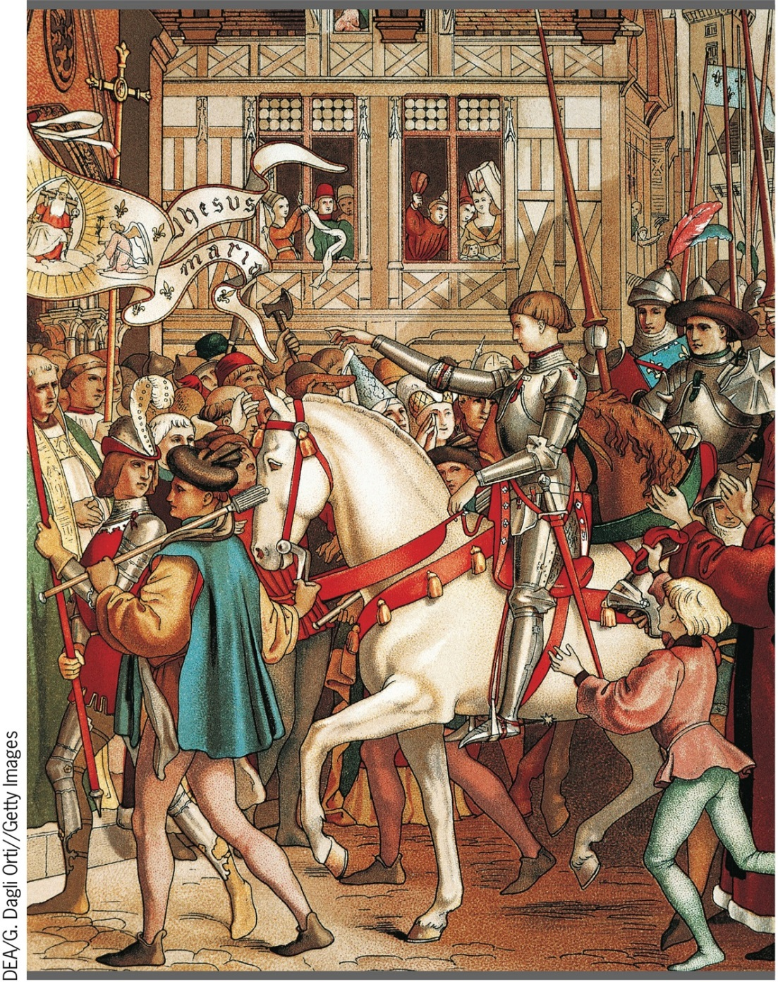
Joan of Arc
p312
Notes:
Joan of Arc. Pictured here in a fifteenth-century design for a window
for the cathedral of Orleans, Joan of Arc is seen in a suit of armor
entering the city. There are no known portraits of Joan made from life.

Slide 18
Political Instability
The Breakdown of Feudal Institutions
  Scutage
New Royal Dynasties
Financial Problems
  Parliaments gain power

Slide 19
Western Europe: England and France
The Growth of England’s Political Institutions
  Edward III (1327 – 1377)
  Parliament
    House of Lords
    House of Commons
  Aristocratic factionalism
The Problems of the French Kings
  Basic lack of unity and financial troubles
  Civil war
    Burgundy and Orléans

Slide 20
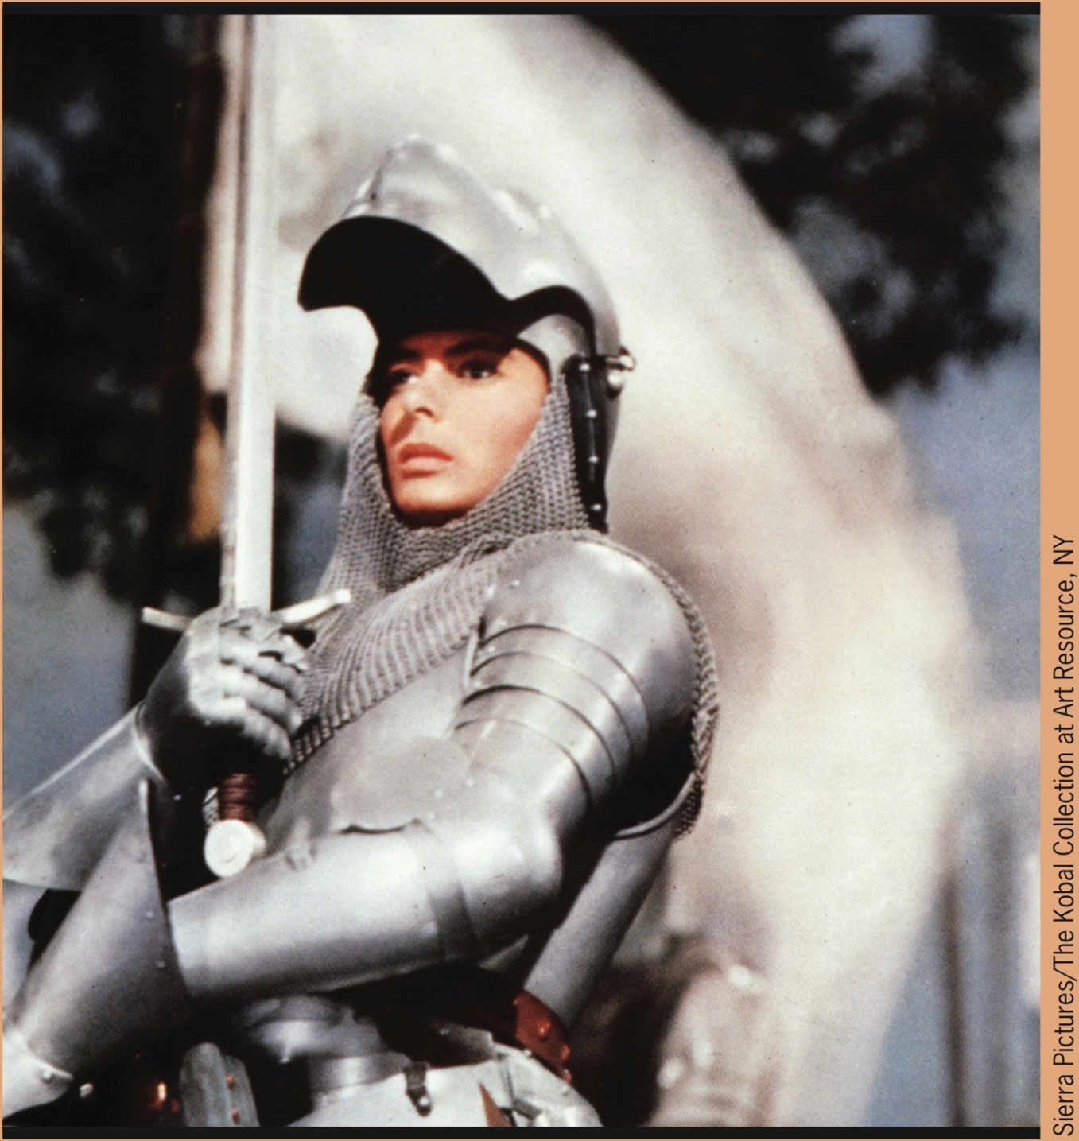
Joan (Ingrid Bergman) prepares for battle
p313
Notes:
Joan (Ingrid Bergman) prepares for battle.

Slide 21
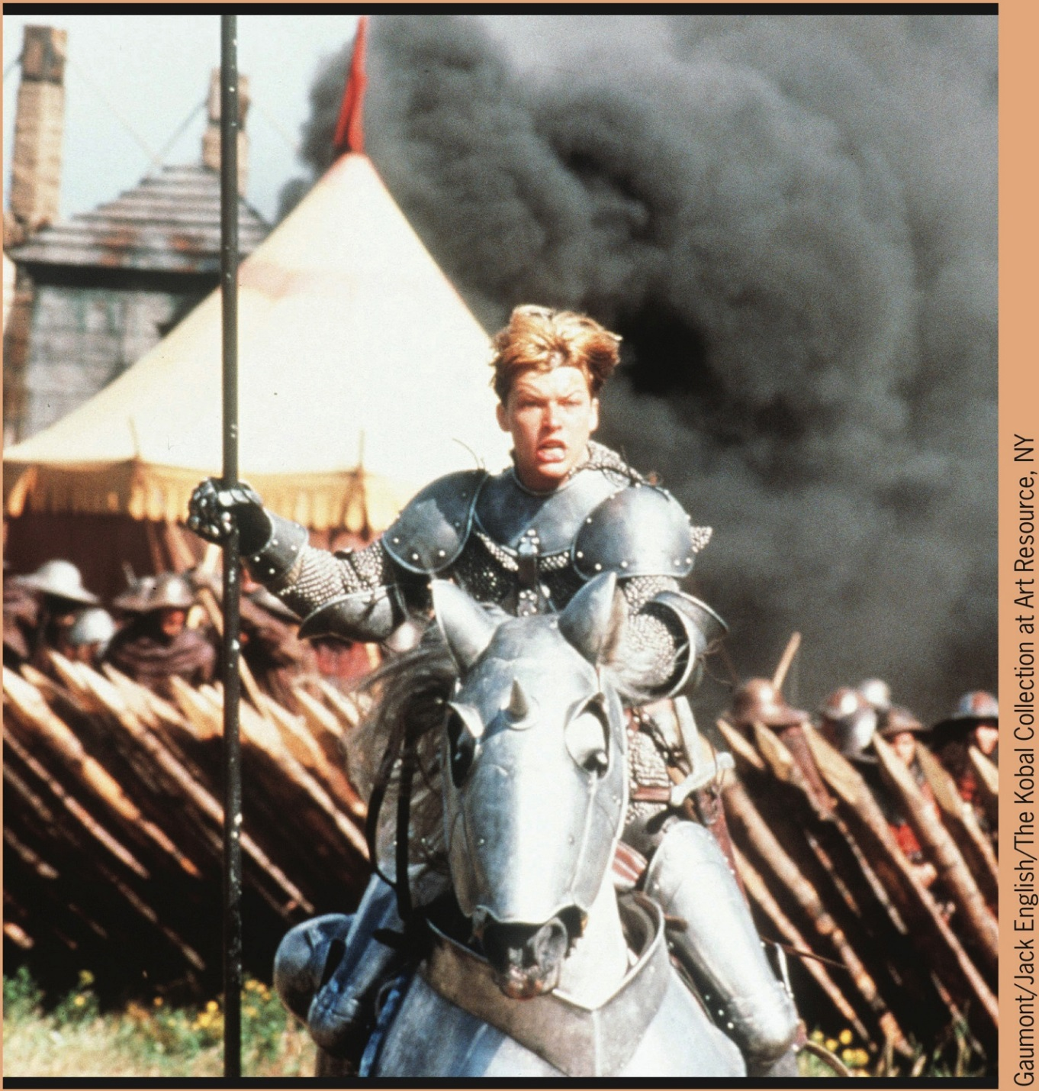
Joan (Milia Jovovich) rides into battle
p313
Notes:
Joan (Milia Jovovich) rides into battle.

Slide 22
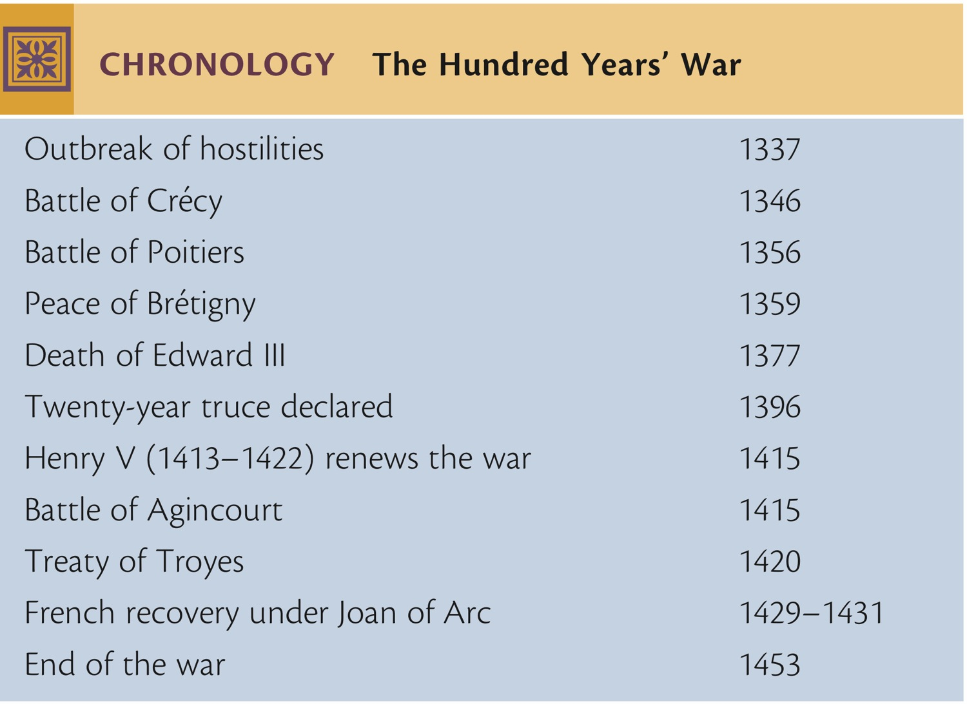
CHRONOLOGY The Hundred Years' War
p316
Notes:
CHRONOLOGY The Hundred Years' War

Slide 23
Germany & Italy
The German Monarchy
  Breakup of the Holy Roman Empire
    Hundreds of states
  Electoral nature of the German monarchy
    The Golden Bull (1356)
    Weak kings
The States of Italy
  Lack of centralized authority
    Republicanism to tyranny
    Duchy of Milan
    Republic of Florence
    Republic of Venice

Slide 24
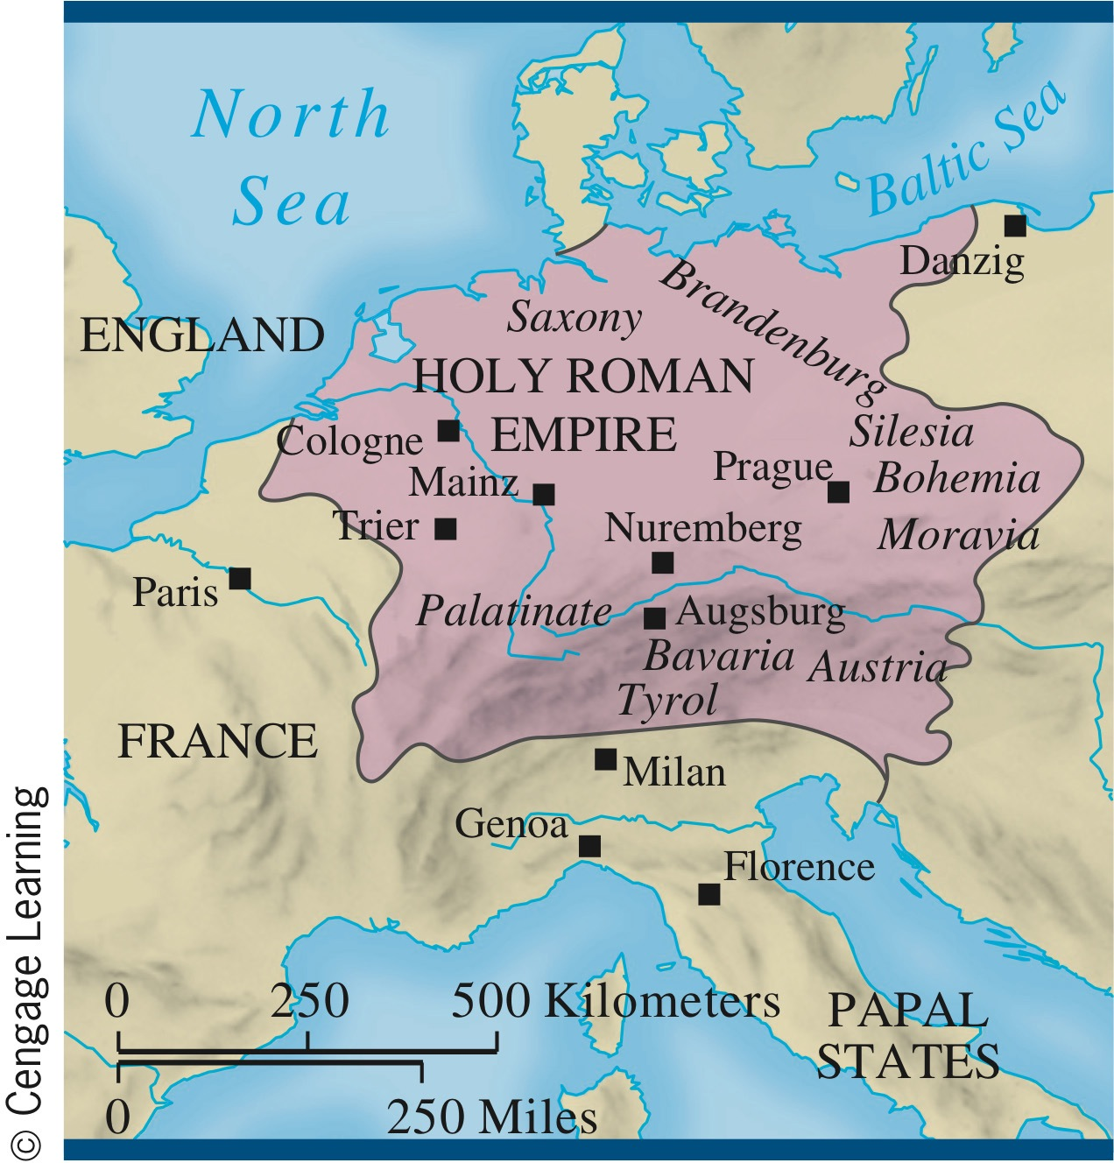
The Holy Roman Empire in the Fourteenth Century
p316
Notes:
The Holy Roman Empire in the
Fourteenth Century

Slide 25
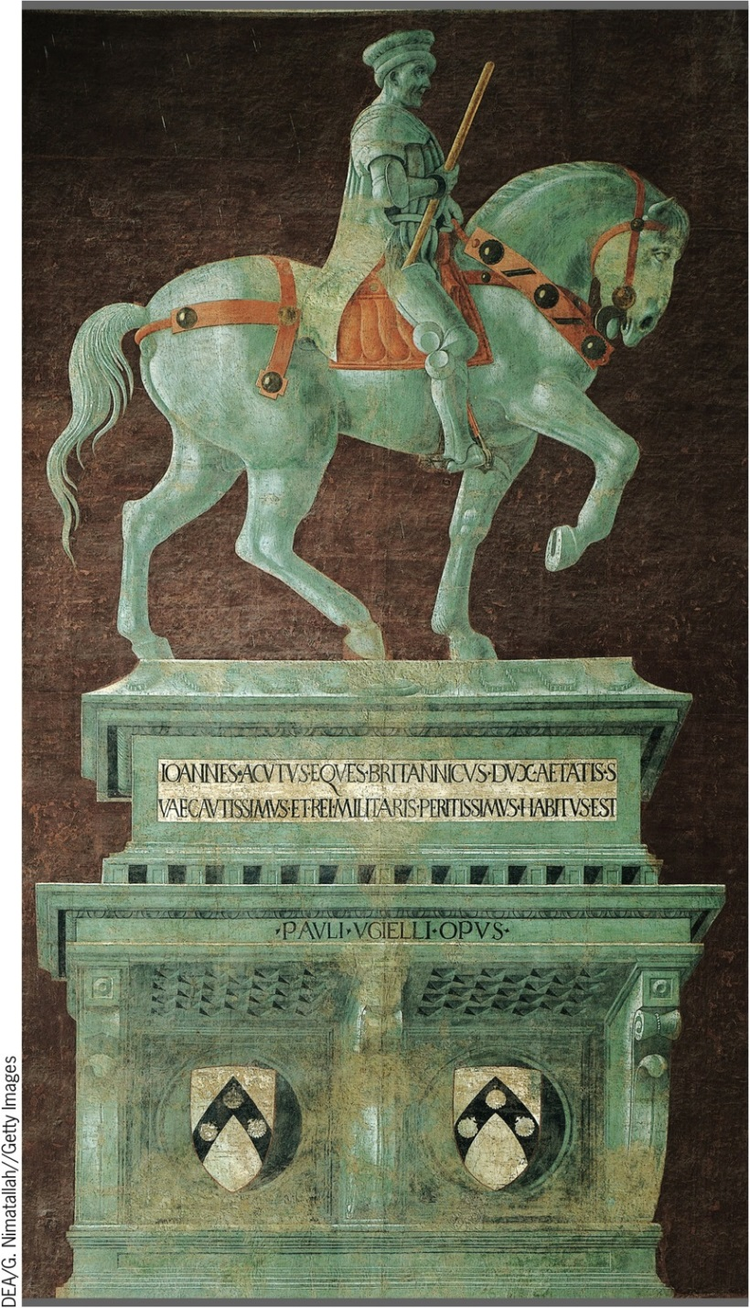
A Famous Condottiere
p317
Notes:
A Famous Condottiere. Many of the condottieri who fought in Italy
were foreigners. One of the most prominent was Sir John Hawkwood,
who went to Italy after fighting on the English side in the Hundred
Years’ War. There he led a band of mercenary soldiers in many battles.
Hawkwood, known to the Italians as Giovanni Acuto, ended his career
in the early 1390s fighting for the city of Florence. To honor him, the
city commissioned this fresco by Paolo Uccello (PAH-oh-loh oo-
CHELL-oh), which can still be seen today in the cathedral of Florence.

Slide 26
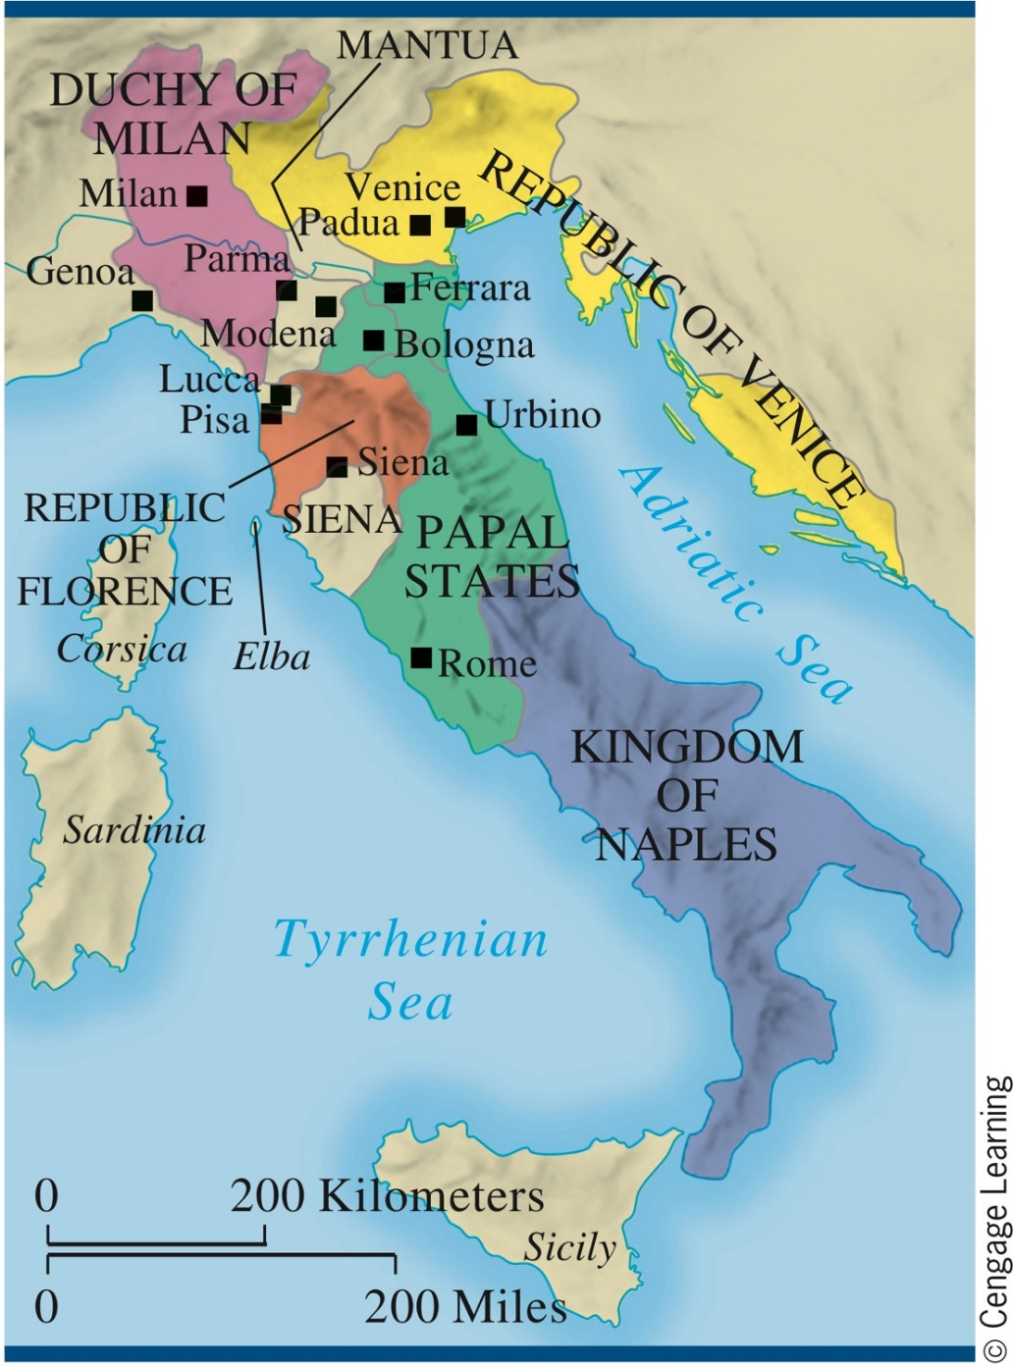
The States of Italy in the Fourteenth Century
p317
Notes:
The States of Italy in the Fourteenth Century

Slide 27
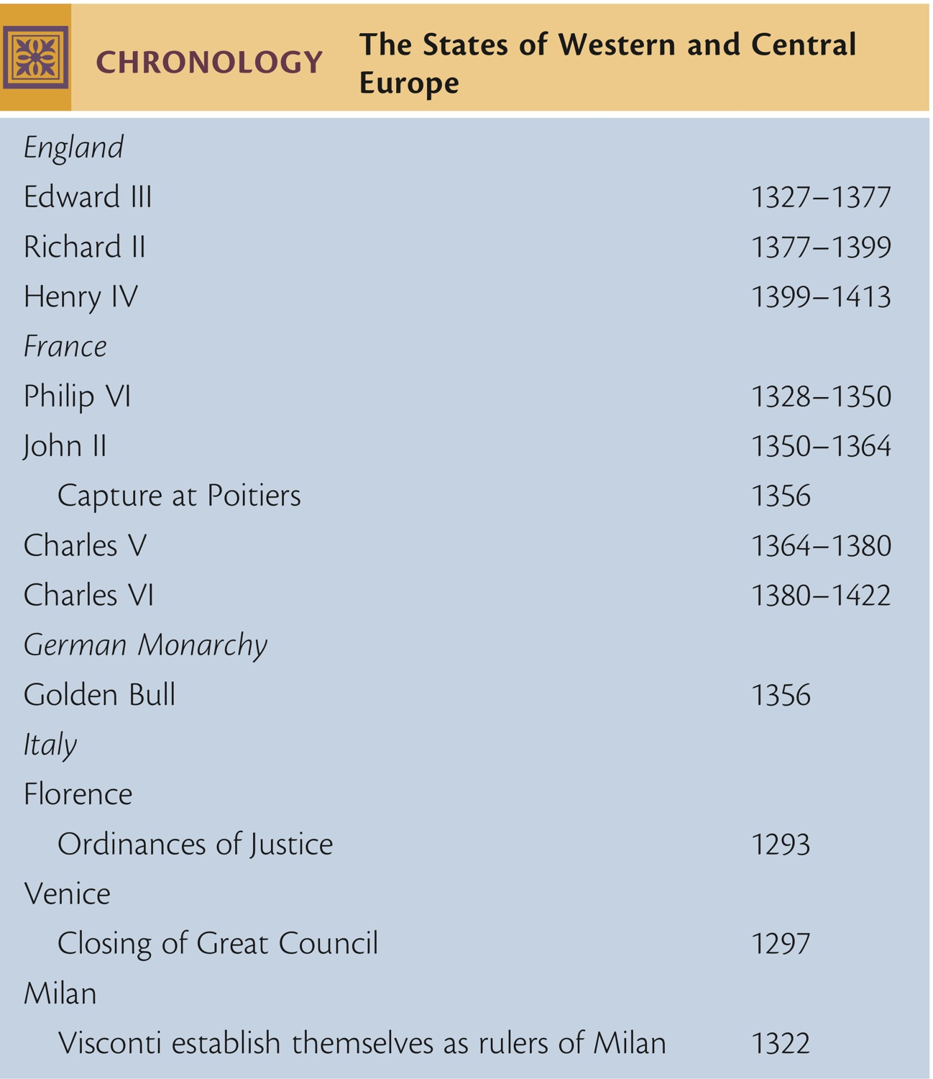
CHRONOLOGY The States of Western and Central Europe
p318
Notes:
CHRONOLOGY The States of Western and Central
Europe

Slide 28
The Decline of the Church
  Boniface VIII (1294 – 1303) and the Conflict with the State
  Conflict with Philip IV of France
    Unam Sanctam (1302)
    Captured by French at Anagni
  Clement V (1305 – 1314)
The Papacy at Avignon (1305 – 1377)
  Decline in papal prestige
    Captives of the French monarchy
  New sources of revenue
  Catherine of Siena (c. 1347 – 1380)

Slide 29
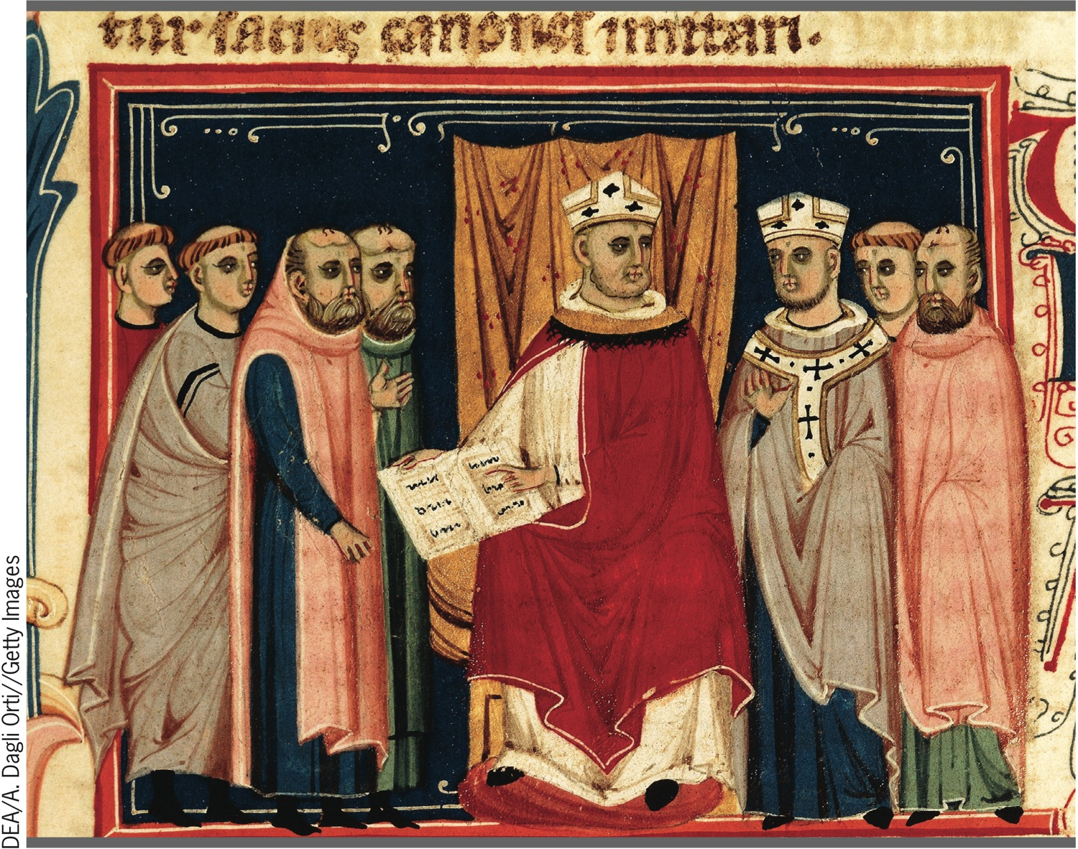
Pope Boniface VIII
p319
Notes:
Pope Boniface VIII. The conflict between church and state in the Middle Ages
reached its height in the struggle between Pope Boniface VIII and Philip IV of France.
This fourteenth-century manuscript miniature depicts Boniface VIII promulgating his
decrees.

Slide 30
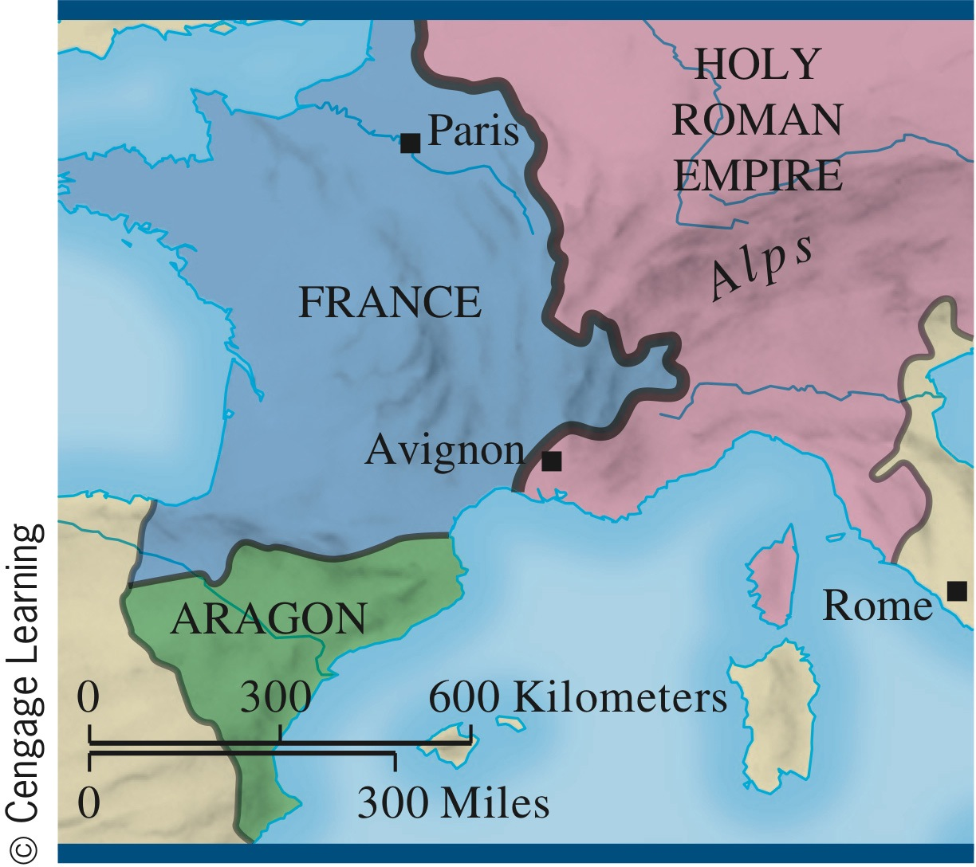
Avignon
p320
Notes:
Avignon

Slide 31
The Great Schism
The Papacy’s Return to Rome (1378)
  Rival popes elected
    Pope Urban VI and Pope Clement VII
The Great Schism Divides Europe
Impact
  Heightened financial abuses
  Damage to the faith of believers

Slide 32
New Thoughts on Church and State
Marsiglio of Padua (c. 1270 – 1342)
  Defender of the Peace
  Questions of authority
The Conciliar Movement
  Council of Pisa (1409)
    Deposed both popes and elected a new pope
    Popes refuse to step down
    Results in three popes
  Council of Constance (1414 – 1418)
    End of the Schism
    Pope Martin V (1417 – 1431)

Slide 33
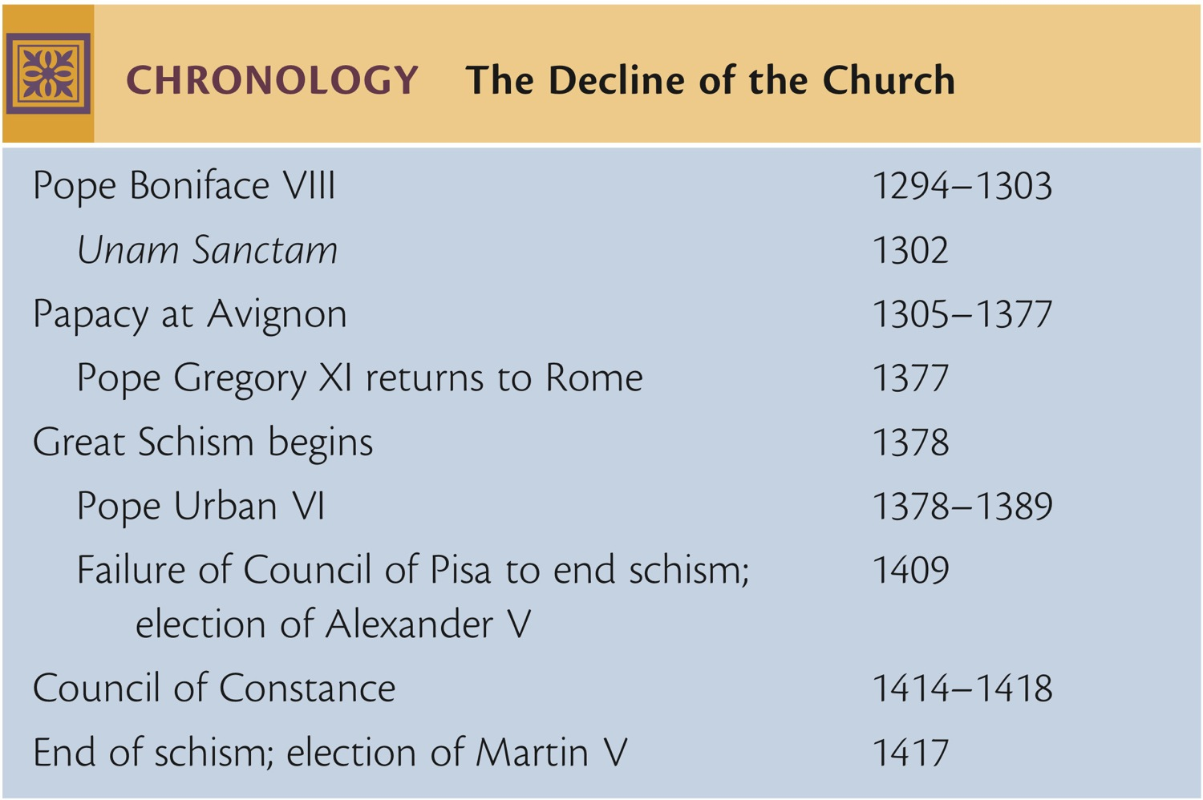
CHRONOLOGY The Decline of the Church
p321
Notes:
CHRONOLOGY The Decline of the Church

Slide 34
Religion in an Age of Adversity
The Variety of Responses to Crisis
  New trends concerning salvation
    Good works and charitable bequests
    Purgatory
Popular Religion
  Mysticism and lay piety
    Meister Eckhart (1260 – 1327)
    Modern Devotion
      Founder, Gerard Groote (1340 – 1384)
  Unique female mystical experiences
Changes in Theology
  William of Occam (1285 – 1329)

Slide 35
The Cultural World of the Fourteenth Century
The Development of Vernacular Literature
  Dante Alighieri (1265 – 1321)
    The Divine Comedy (1313 – 1321)
  Francesco Petarca (Petrarch, 1304 – 1374)
    Sonnets
  Giovanni Boccaccio (1313 – 1375)
    Decameron
  Geoffrey Chaucer (c. 1340 – 1400)
    The Canterbury Tales
  Christine de Pizan (c. 1364 – 1400)
    The Book of the City of Ladies (1404)
A New Art: Giotto (1266 – 1337)

Slide 36
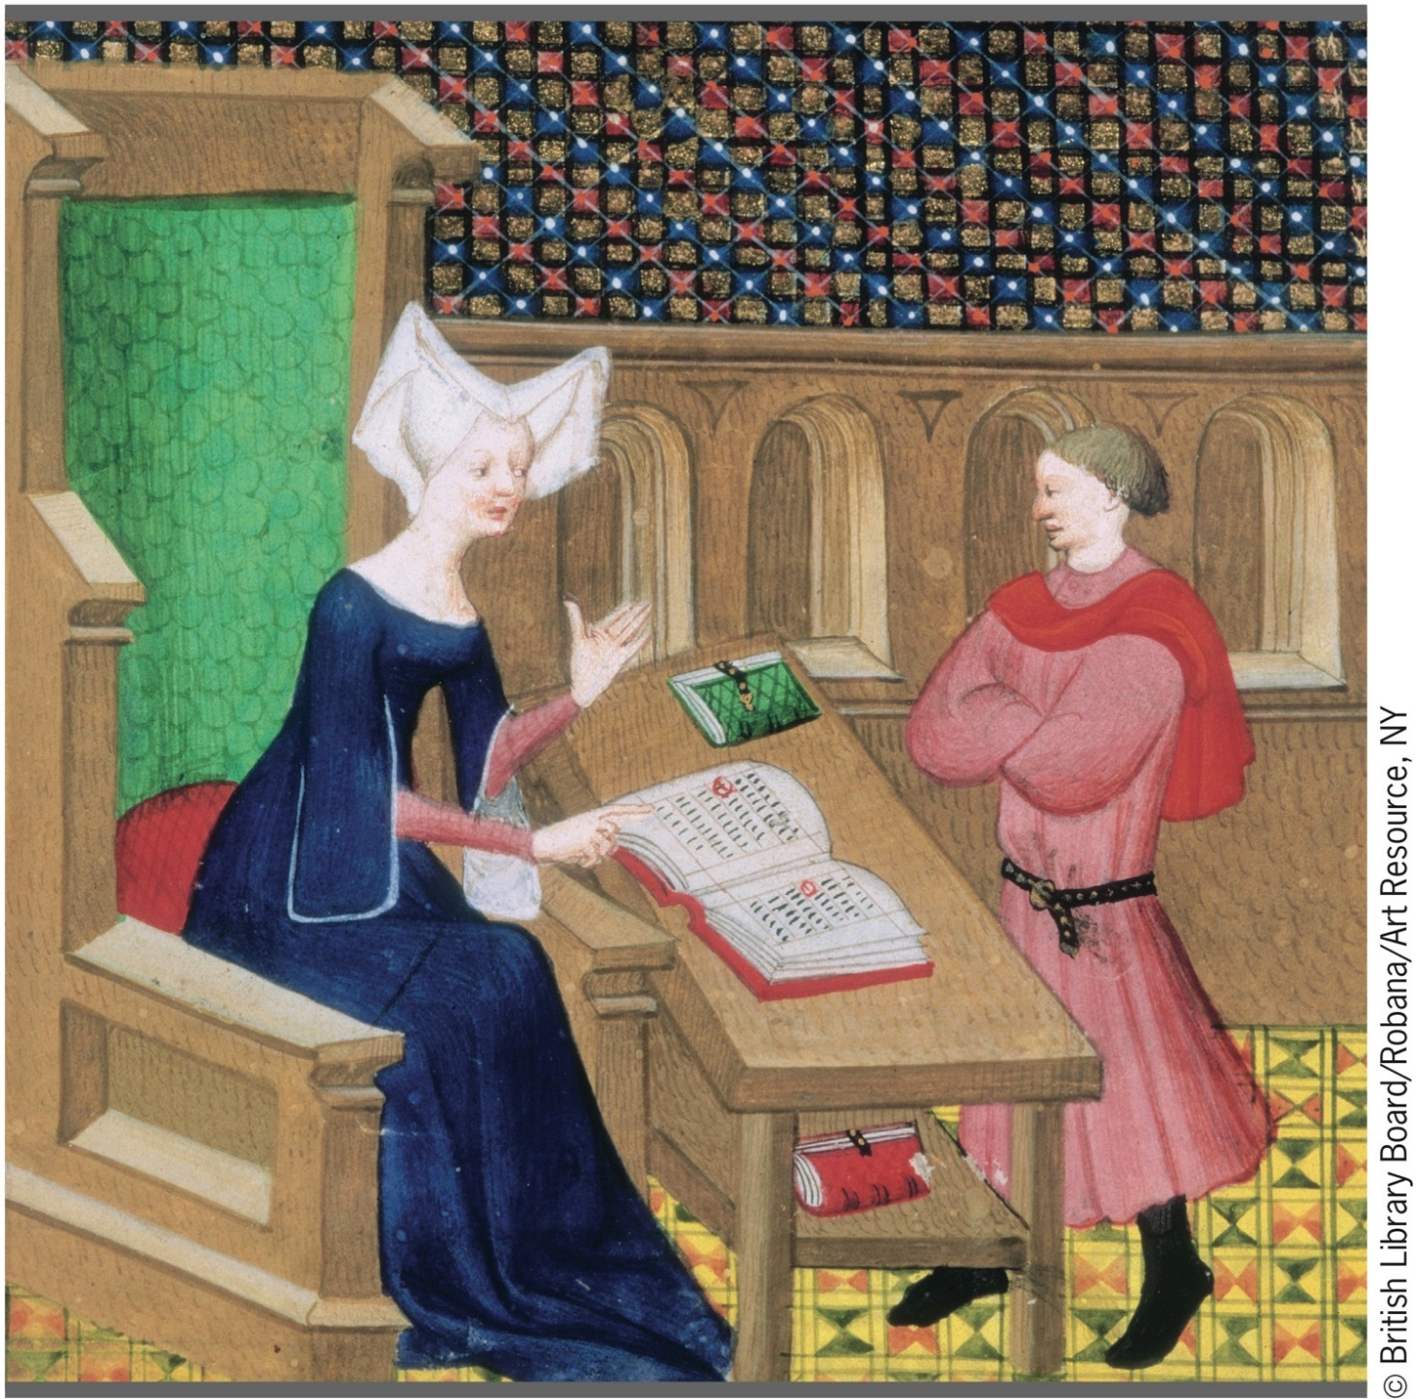
Christine de Pizan
p324
Notes:
Christine de Pizan. Christine de Pizan was one of the extraordinary
vernacular writers of the late fourteenth and early fifteenth centuries. In
this fifteenth-century French illustration from the Works of Christine de
Pizan, she is shown giving instructions to an assistant.

Slide 37
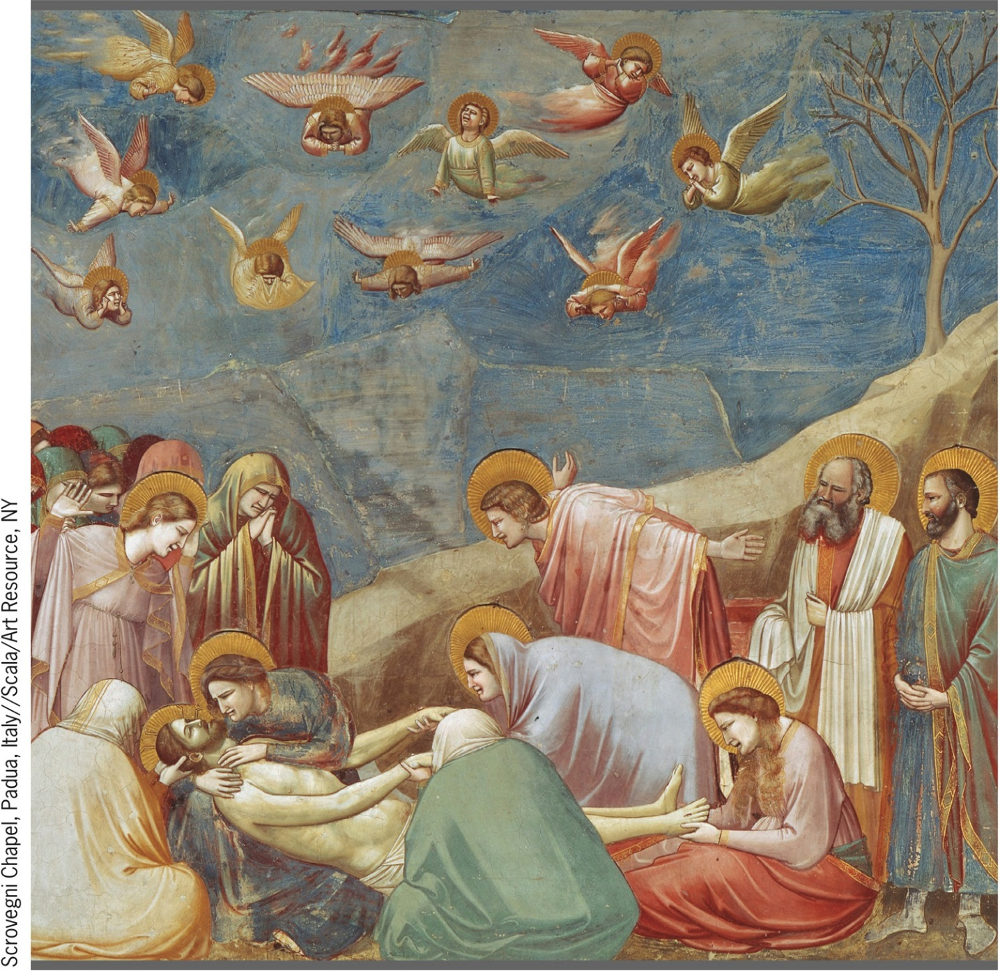
Giotto, Lamentation
p325
Notes:
Giotto, Lamentation. The work of Giotto marked the
first clear innovation in fourteenth-century painting, making
him a forerunner of the early Renaissance. This fresco was
part of a series done on the walls of the Arena Chapel in
Padua begun in 1305. Giotto painted thirty-eight scenes on
three levels: the lives of Mary, the mother of Jesus, and her
parents (top panel); the life and work of Jesus (middle
panel); and his passion, crucifixion, and resurrection (bottom
panel). Shown here from the bottom panel is the
Lamentation. A group of Jesus’s followers, including his
mother and Mary Magdalene, mourn over the body of Jesus
before it is placed in its tomb. The solidity of Giotto’s
human figures gives them a three-dimensional sense. He
also captured the grief and despair felt by the mourners.

Slide 38
Society in an Age of Adversity
Changes in Urban Life
  Family life and gender roles in late medieval cities
  Medieval children
New Directions in Medicine
  Practitioners: medical schools, midwives, barber-surgeons
  Public health and sanitation
Inventions and New Patterns
  The clock: new conception of time
  Eyeglasses and paper
  Gunpowder and cannon

Slide 39
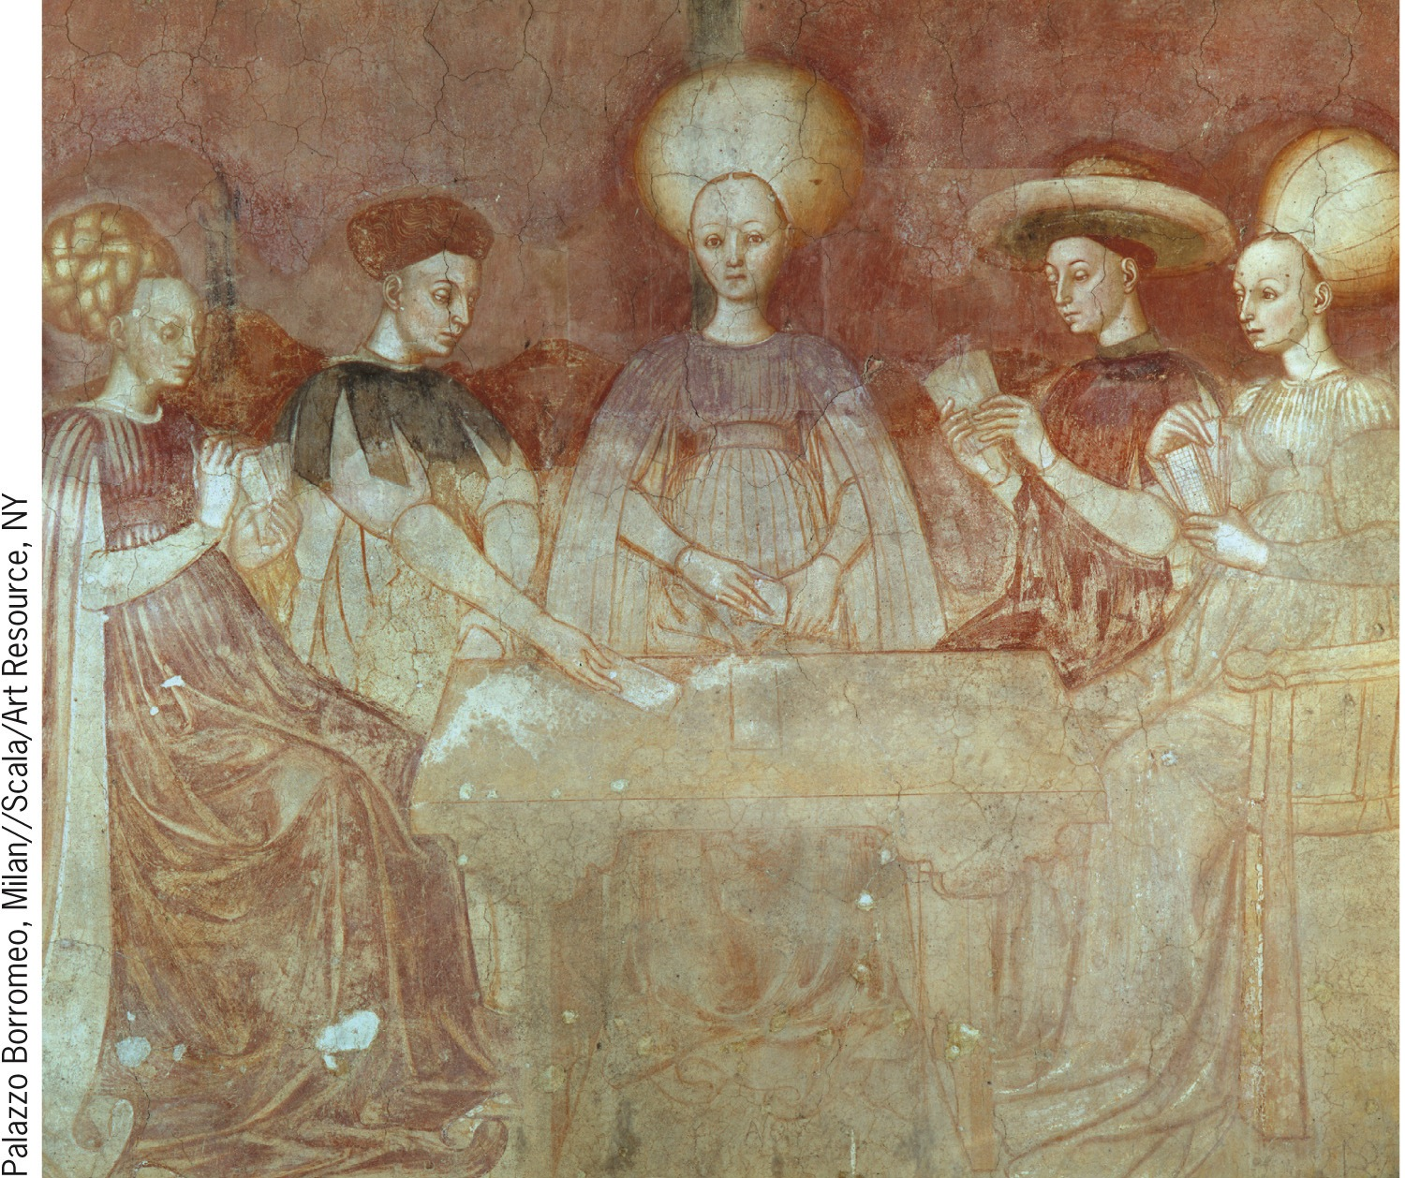
Entertainment in the Middle Ages
p327
Notes:
Entertainment in the Middle Ages

Slide 40
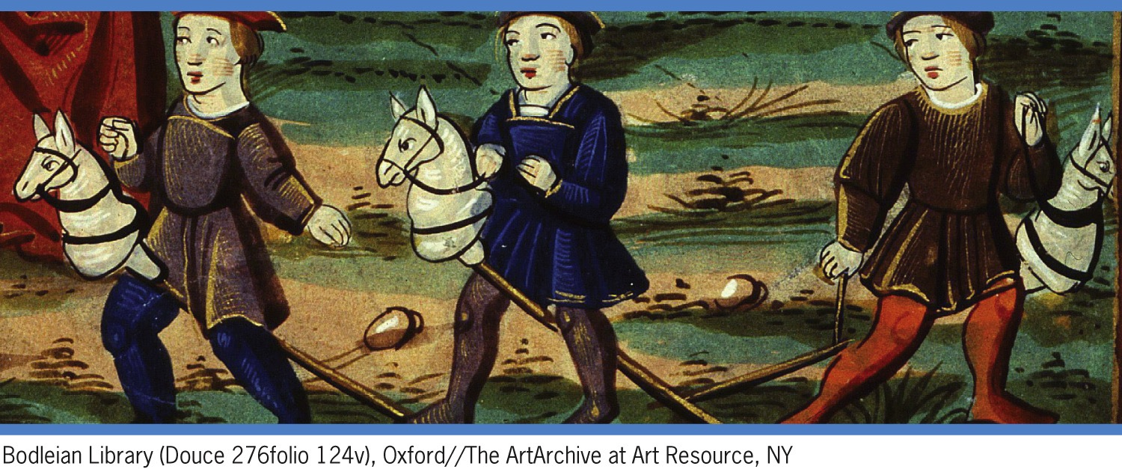
Entertainment in the Middle Ages
p327
Notes:
Entertainment in the Middle Ages

Slide 41
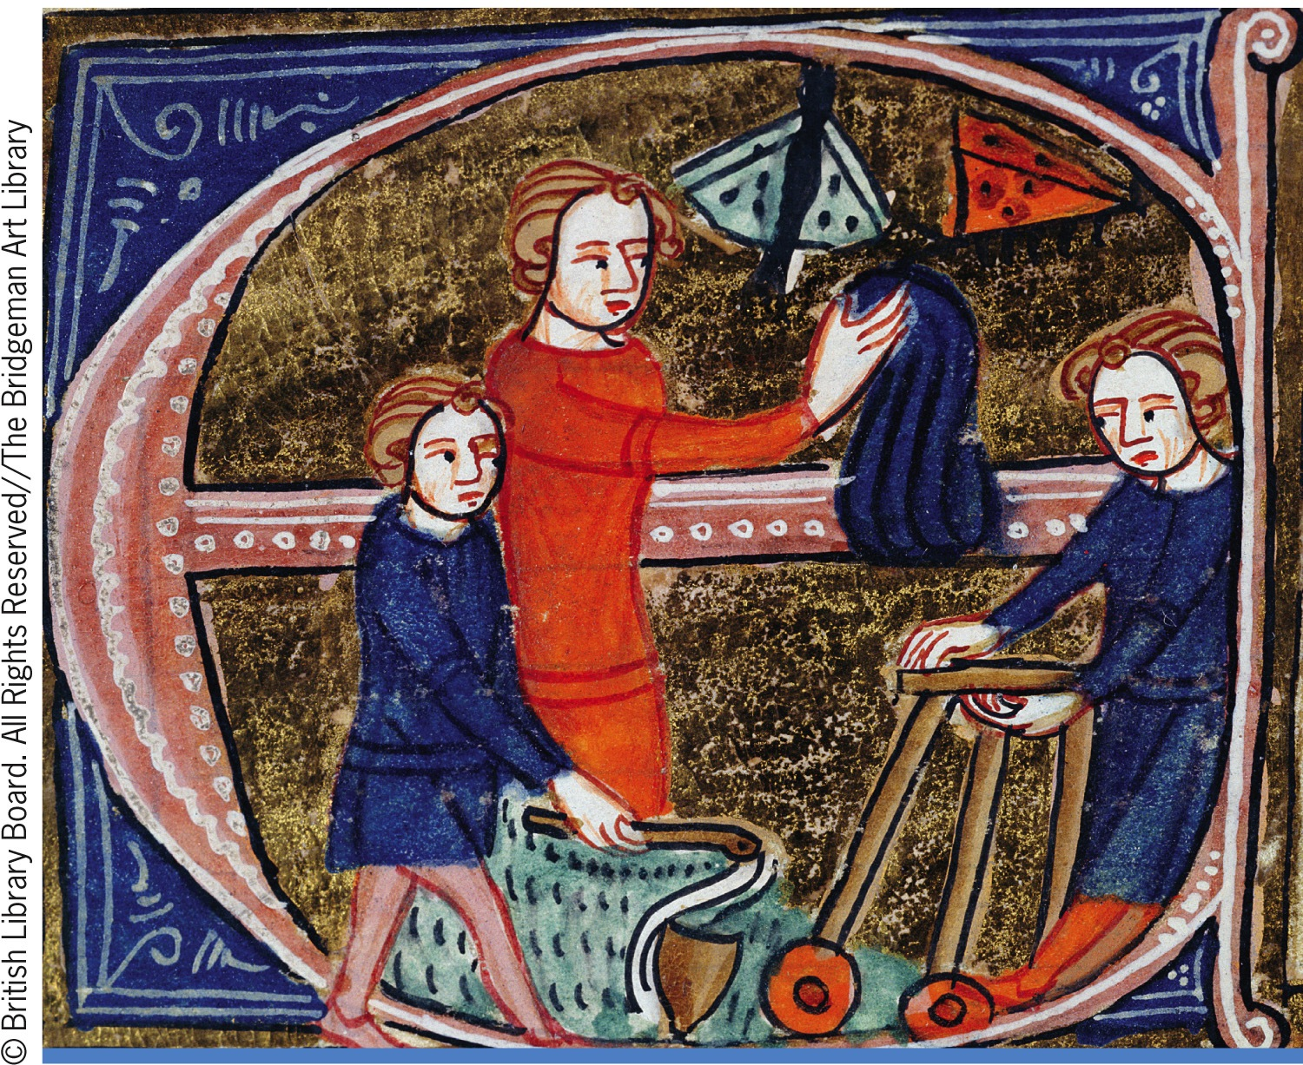
Entertainment in the Middle Ages
p327
Notes:
Entertainment in the Middle Ages

Slide 42
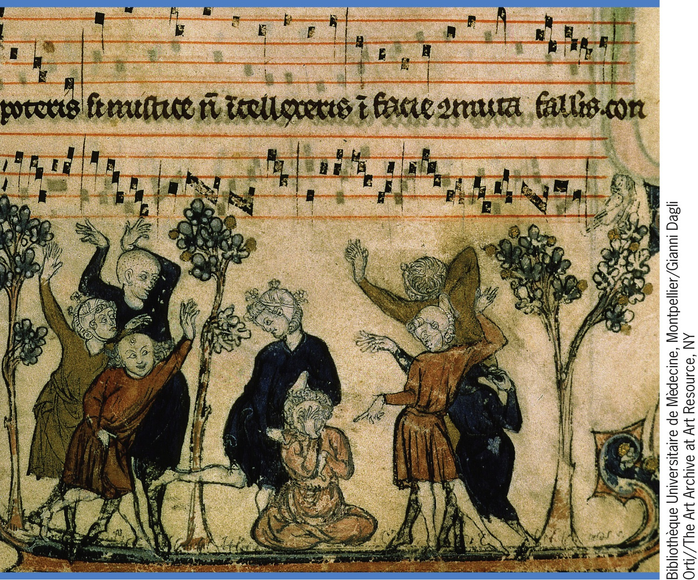
Entertainment in the Middle Ages
p327
Notes:
Entertainment in the Middle Ages

Slide 43
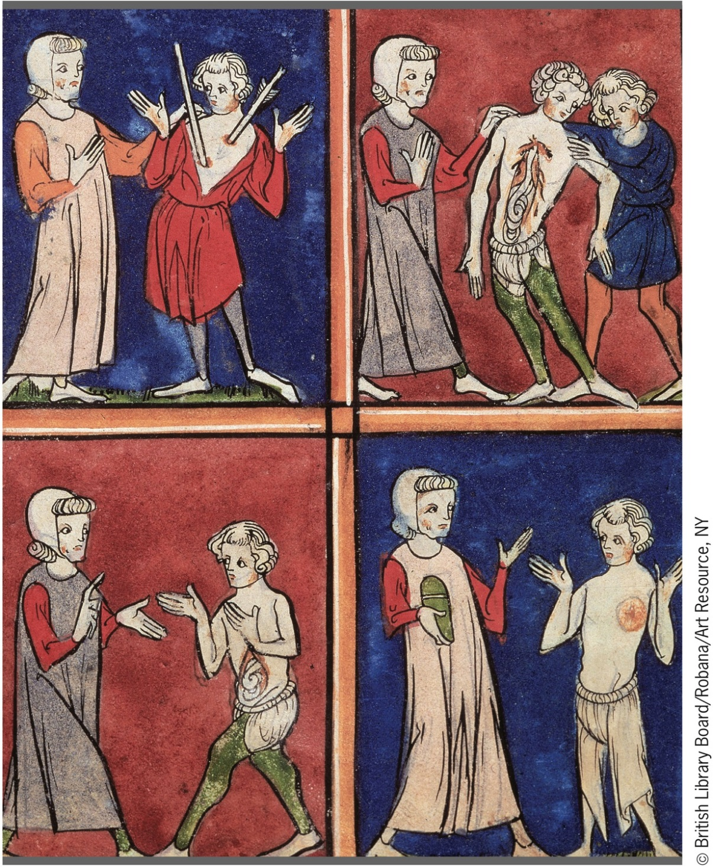
A Medical Textbook
p328
Notes:
A Medical Textbook. This illustration is taken from a fourteenthcentury
surgical textbook that stressed a how-to approach to surgical
problems. Top left, a surgeon shows how to remove an arrow from a
patient; top right, how to open a patient’s chest; bottom left, how to deal
with an injury to the intestines; bottom right, how to diagnose an abscess.

Slide 44
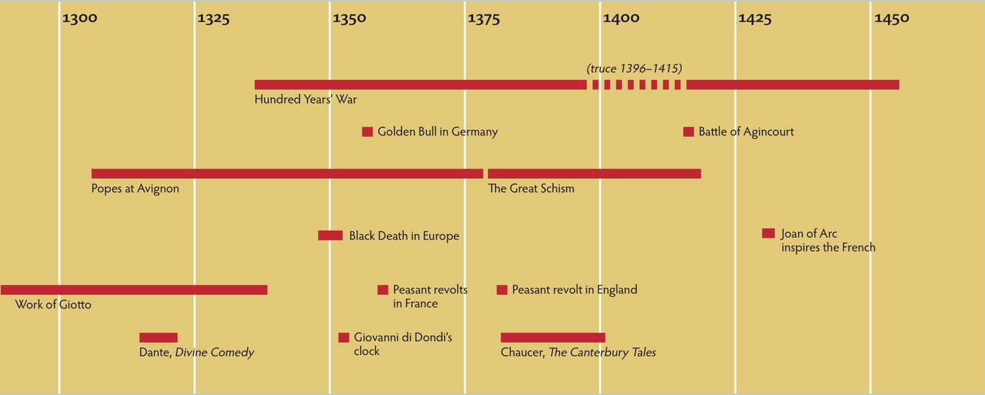
Chapter Timeline
p330

