Slide 1
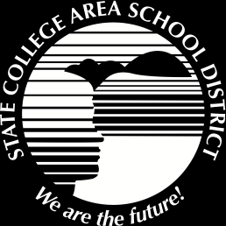
SCASD Pennsylvania Youth Survey Report 2019
Developed By
Jeanne Knouse
Director of Student Service

Slide 2
PAYS Purpose
Provides benchmark for alcohol, tobacco, and other drugs (ATOD)
Helps indicate whether prevention and treatment programs are achieving their intended results
Assesses risk and protective factors

Slide 3
PAYS FAQs
How do we know we can trust the results?
  Developed, studied and validated in numerous research studies. www.sdrg.org
  Validity questions 1,666 valid out of 1,654 (21 invalid surveys)
Is the survey reliable and valid?
  Yes. Each risk and protective factor scale has been statistically validated in multiple samples across gender, race and ethnicity and predicts adolescent problem behaviors.
Don’t kids lie on surveys?
  Yes, but rarely. Research indicates students tend to be honest about behavior and experiences on anonymous, confidential surveys.
  Strategies built into the analysis of the survey to screen for dishonest, inconsistent and exaggerated responses.
Are these data representative of our student population?
  When 80% or greater participate there is confidence that the information reflects the student population (SCASD had a 71.8% participation rate).

Slide 4
PAYS Data Point Reminders
 | Grades | Students
1999-2013 every two years | 1999: 6-12 (pilot year) 2000-2013 : 6, 8, 10, 12 | 1,600-2,200
2015 | 6 ,8, 10, 12 | 1,850 83% participation rate
2017 | 6, 8, 10 ,12 | 1,772 75.6% participation rate
2019 | 6, 8, 10 ,12 | 1,645 71.8% participation rate
Risk and Protective Factors are scale scores
The percentage represents the population of youth that are either at greater risk or with lower protection than the national cut-point level.
All other scores are percentage use
12th grade = 2.5 students per % point
10th grade = 2.6 students per % point
8th grade = 3.2 students per % point
6th grade = 3.6 students per % point

Slide 5
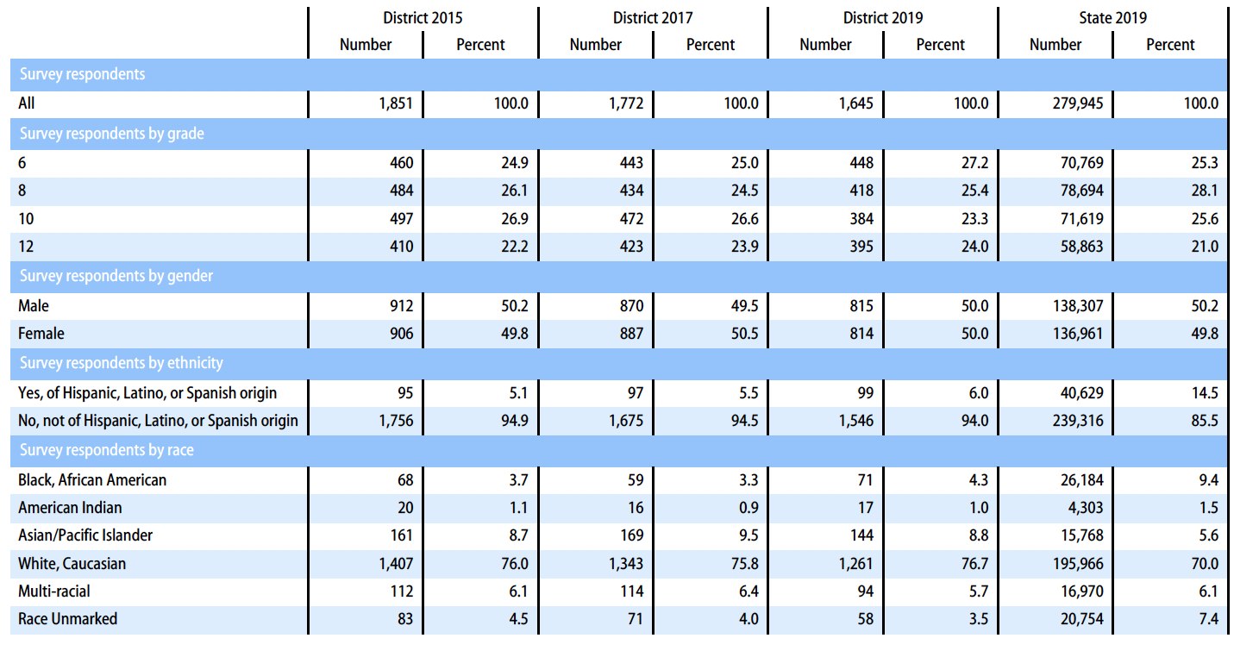
PAYS Demographics

Slide 6
PA Youth Survey Protective and Risk Factors 2019
Risk is associated with negative behavioral outcomes. It is better to have lower risk factor scale scores but we look at highest scores for areas of risk.
Protective factors are associated with better behavioral outcomes. It is better to have higher protective factor scale scores.
Notes:
2007 protective: Community opp for prosocial involvement, belief in a moral order and school opportunities for prosocial involvement
2007 risk: early initiation of drug use, community disorganization (31) and family history of antisocial behavior (42).

Slide 7
Protective Factors
Family Opportunities for Prosocial Involvement (77% with protection)
  Young people who are exposed to more opportunities to participate meaningfully in the responsibilities and activities of the family are less likely to engage in drug use and other problem behavior.
Family Attachment (76% with protection)
    Young people who feel that they are a valued part of their family are less likely to engage in substance use and other problem behaviors.
Family Rewards for Prosocial Involvement (74% with protection)
  When parents, siblings, and other family members praise, encourage, and attend to things done well by their child, children are less likely to engage in substance use and problem behaviors.

Slide 8
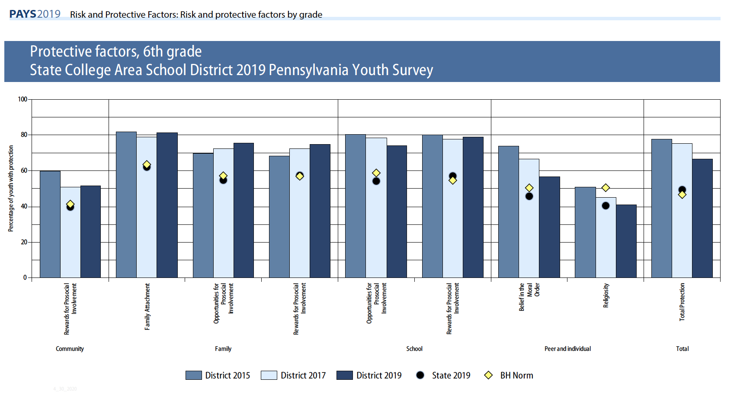

Slide 9
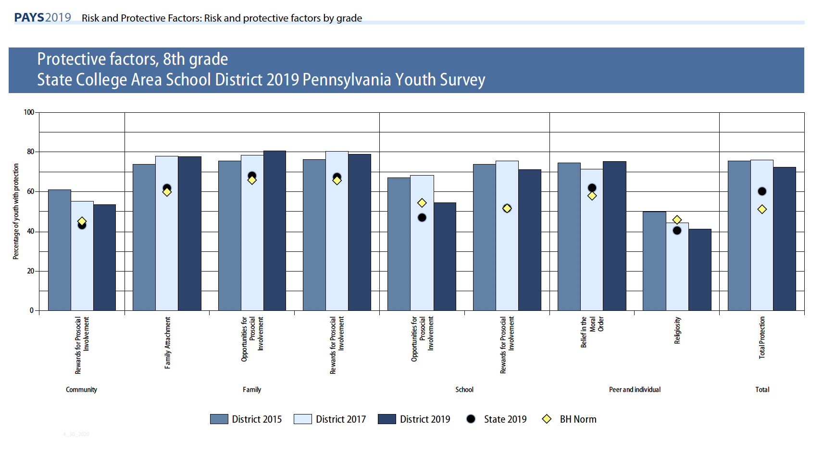

Slide 10
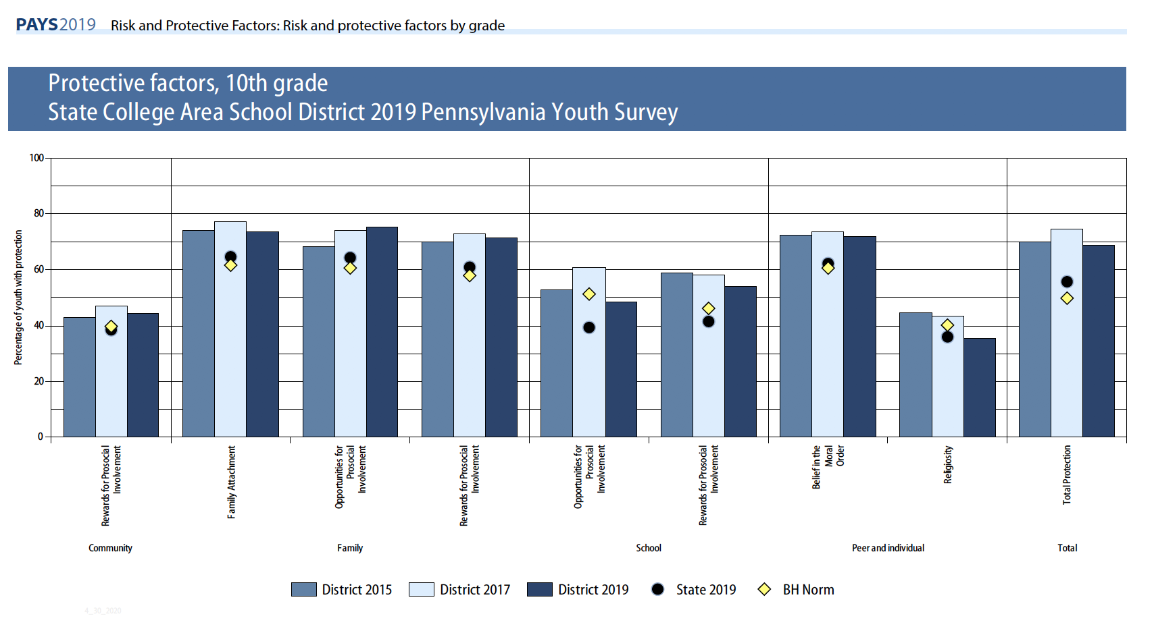

Slide 11
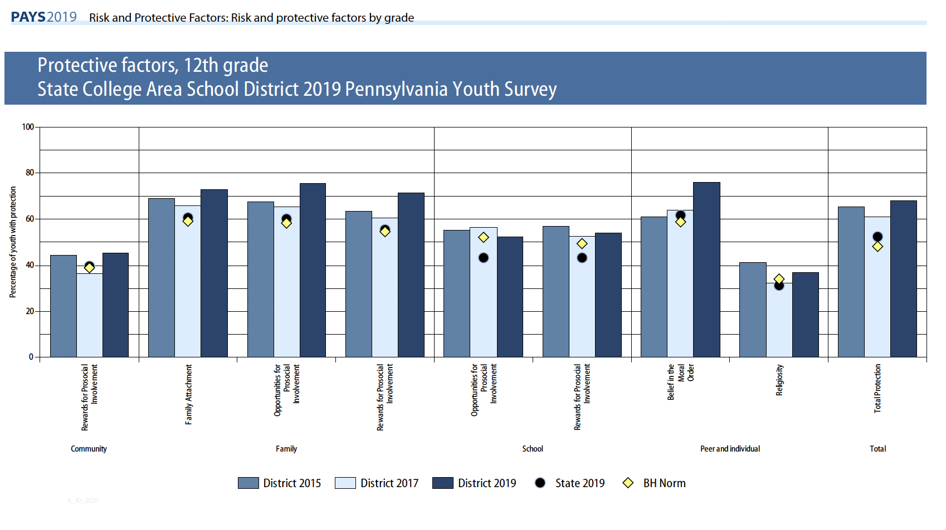

Slide 12
Risk Factors
Perceived Risk of Drug Use (40% at risk)
  Young people who do not perceive drug use to be risky are far more likely to engage in drug use.
Parental Attitude Favorable Toward Antisocial Behavior (35% at risk)
  In families where parents use illegal drugs, are heavy users of alcohol, or are tolerant of children’s use, children are more likely to become drug abusers during adolescence. The risk is further increased if parents involve children in their own drug (or alcohol) using behavior — for example, asking a child to light the parent’s cigarette or get the parent a beer from the refrigerator.
Low Commitment Toward School (34% at risk)
  Surveys of high school seniors have shown that the use of drugs is significantly lower among students who expect to attend college than among those who do not. Factors such as liking school, spending time on homework, and perceiving coursework as relevant also contribute to lower drug use.

Slide 13
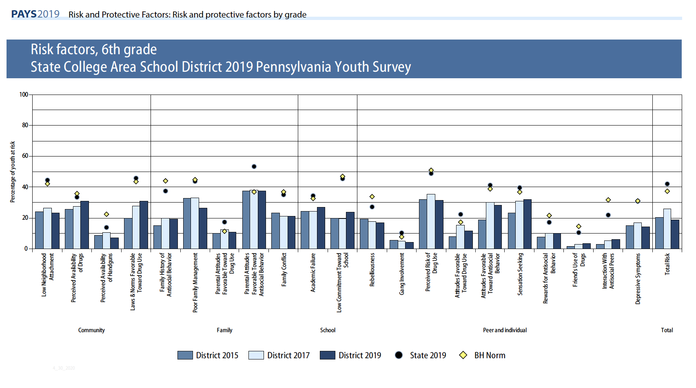

Slide 14
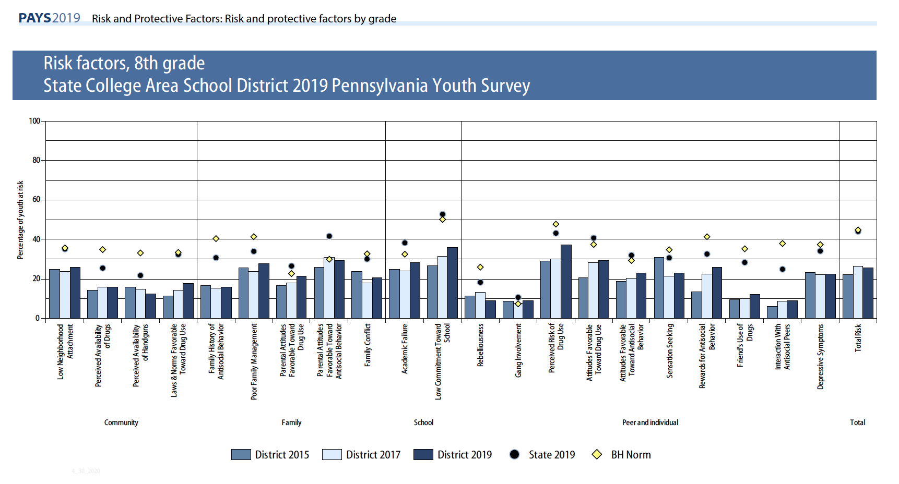

Slide 15
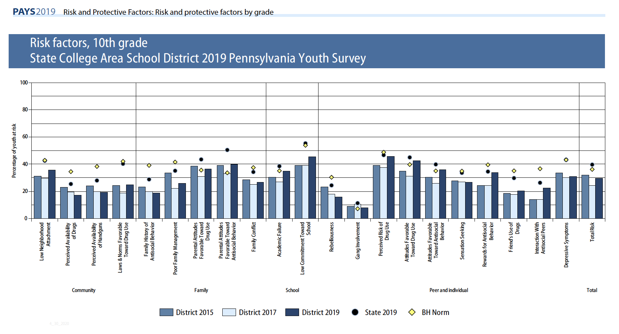

Slide 16
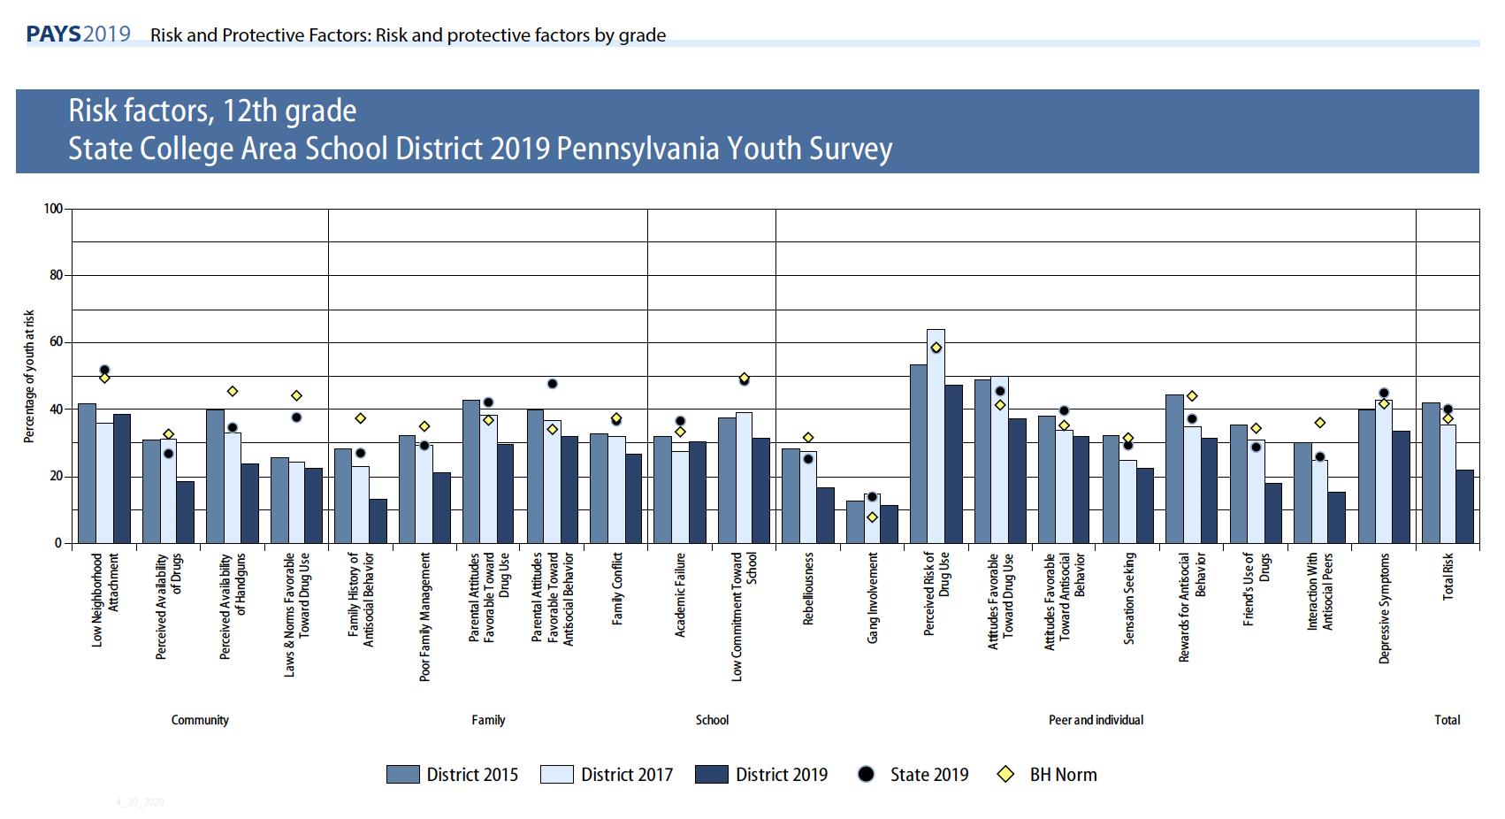

Slide 17
SCASD Programs and Services Aimed to Improve Risk and Protective Factors
9th Grade Learning Communities Big Brother Big Sister Child Abuse Training Counseling Services Family Outreach Services LGBTA Alliance Health Courses Home School Visitor Services My Mental Health Matters Group Parenting Classes Professional Learning Communities Restorative Practices/Conferences Safety Care Training School Resource officer School Wide Positive Behavior Supports/ROAR | Shorts and Sports Programs Straight Talk Task Force Strengthening Families Suicide Prevention Training Summer Library Transition Services Universal Screening For Behavior and Emotional Needs Youth Mental Health First Aid Training After School Activities & Clubs Community Partnerships with: Communities That Care PSU Jana Marie Foundation Youth Service Bureau Equity and Inclusivity Training

Slide 18
High Prevalence/Early Initiation Drugs
First drugs most commonly abused by youth
Social acceptability
  Normalize idea that drug use is acceptable
  “Prime” the brain for addiction to other substances
  Most common early initiation for State College
    Alcohol 30.3% vs. 41% State
    Marijuana 8.2% vs. 17.3% State
    E-cigarettes and vape products 9.5% vs 19% State

Slide 19
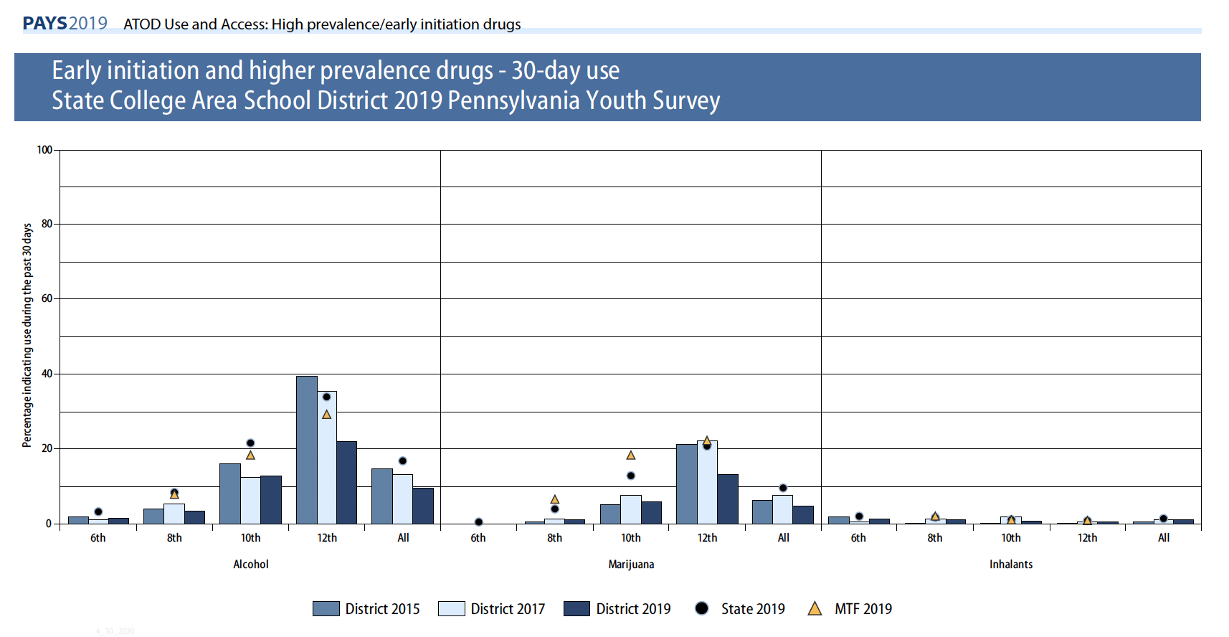

Slide 20
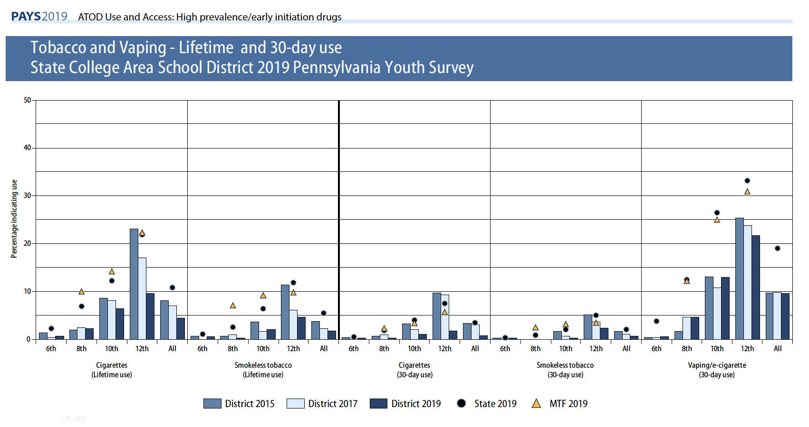

Slide 21
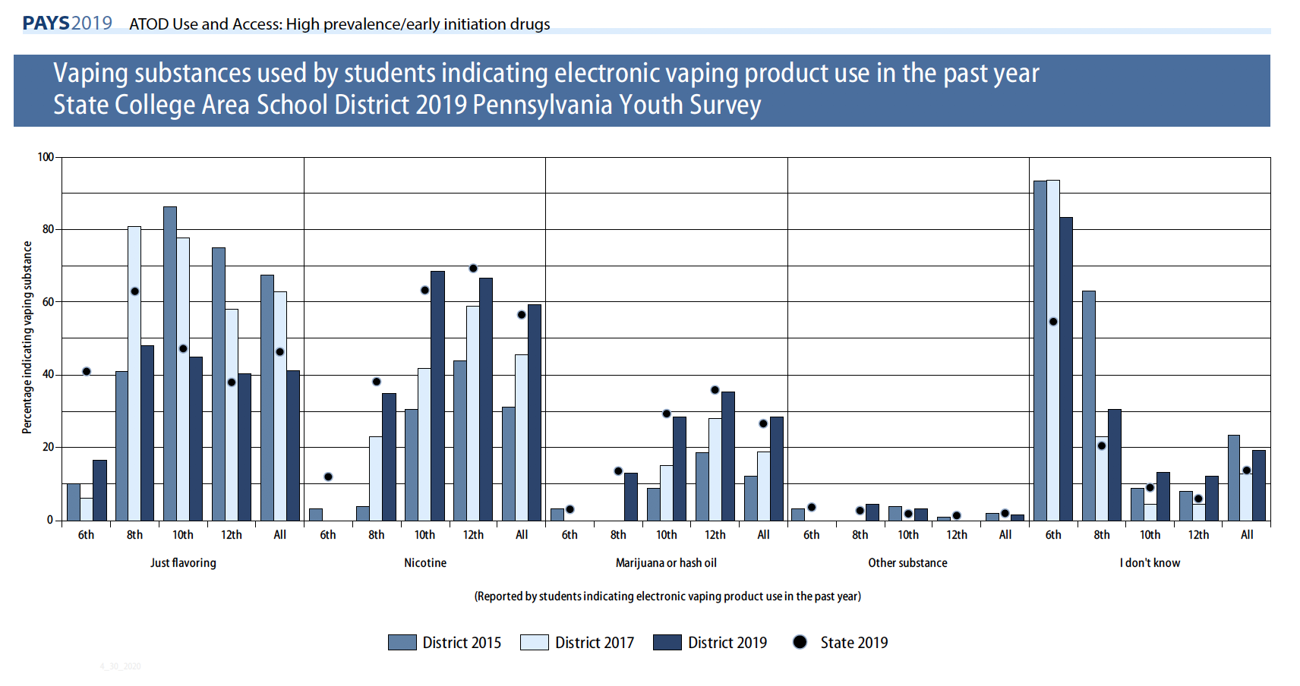

Slide 22
Prescription and Over-the-Counter Drugs
and Medications
Prescription drugs are the most abused category of drugs after alcohol, tobacco and marijuana.
  Prescription is safer than illicit drugs because prescribed by a doctor.
Prescription drug most frequently used by SCASD students:
  Over-the-counter drugs – 3.1% vs. 3.9% State
  Prescription pain relievers – 2.5% vs. 4.1% State

Slide 23
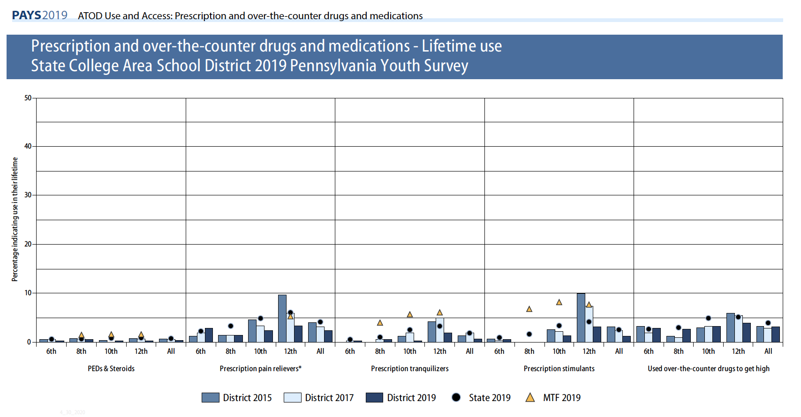

Slide 24
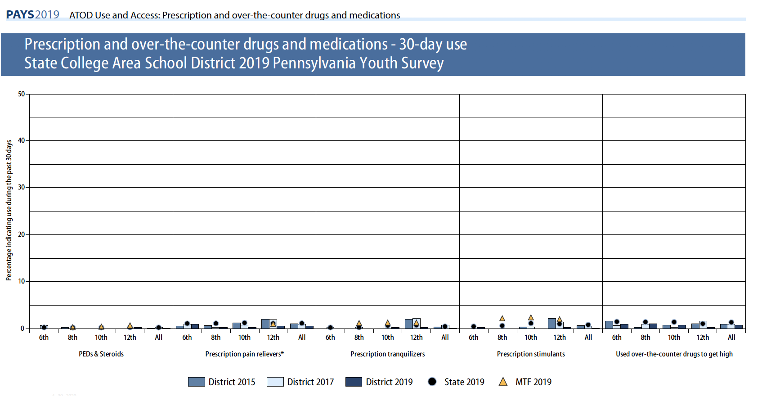

Slide 25
SCASD Programs and Services Aimed to Decrease ATOD Use
Act 211 Programming Casings Conference Attendance/Professional Development Counseling Curriculum Counseling Services LGBTA Alliance Health Courses Instructional Support Team Integrated Mental Health Services Little Lion Ambassadors My Mental Health Matters (MMHM) Psychological Services School Resource Officer School Wide Positive Behavior Support Programs/ROAR Straight Talk Programs Student Assistance Program Restorative Practices

Slide 26
Bullying and
Internet Safety
Bullying behavior contributes to:
  Lower attendance rates
  Lower student achievement
  Low self-esteem
  Depression
  Higher rates of juvenile and adult crime
  Bullying in the past 12 months in SCASD 22.1% vs. 25.1% State
    Reasons: 37.7% = “Some other reason”; 37.7% =“I don’t know why”; 29.1% = “The way I look”

Slide 27
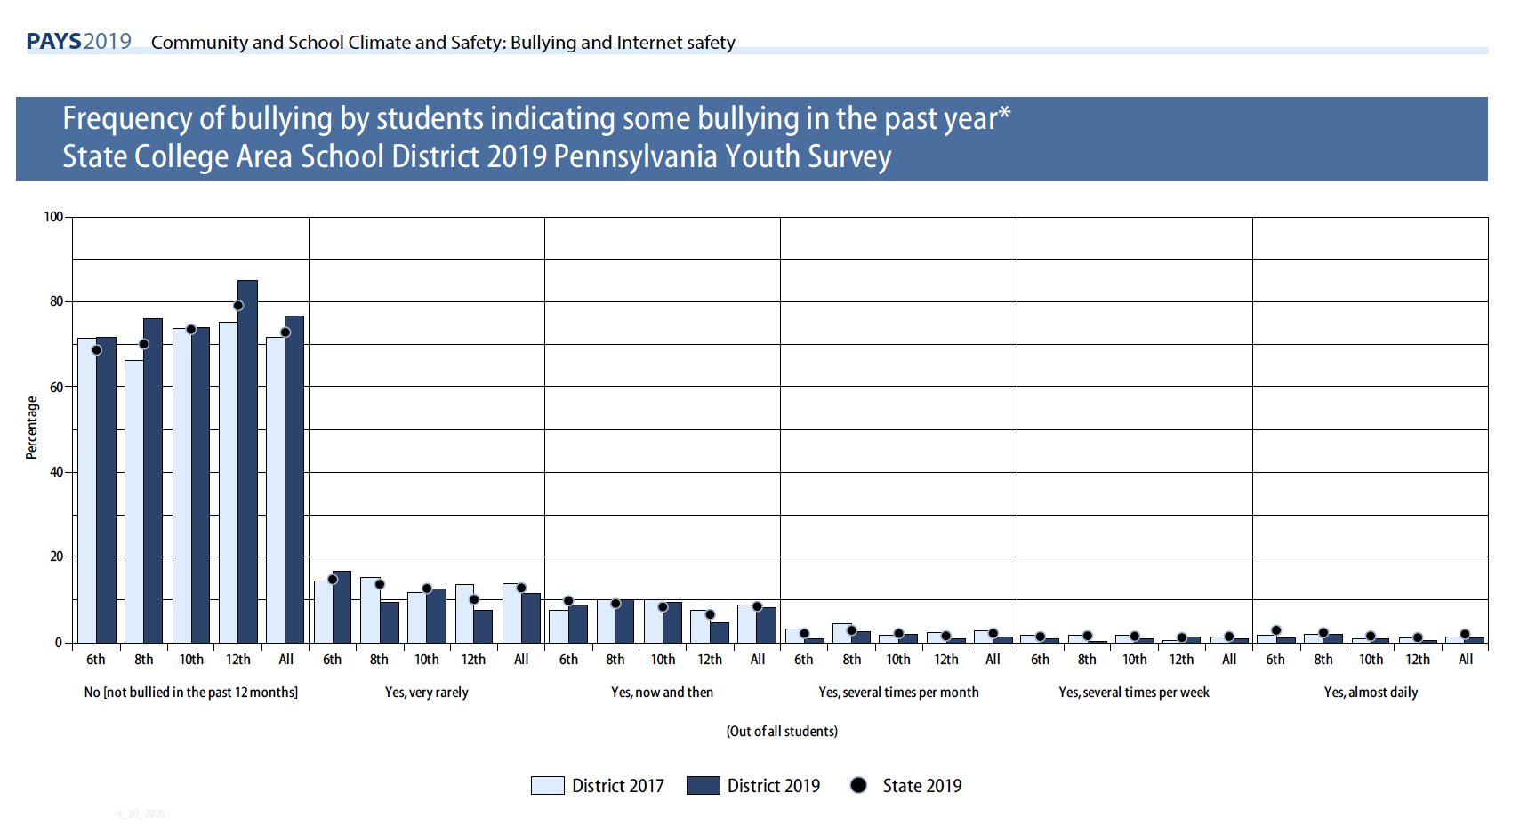

Slide 28
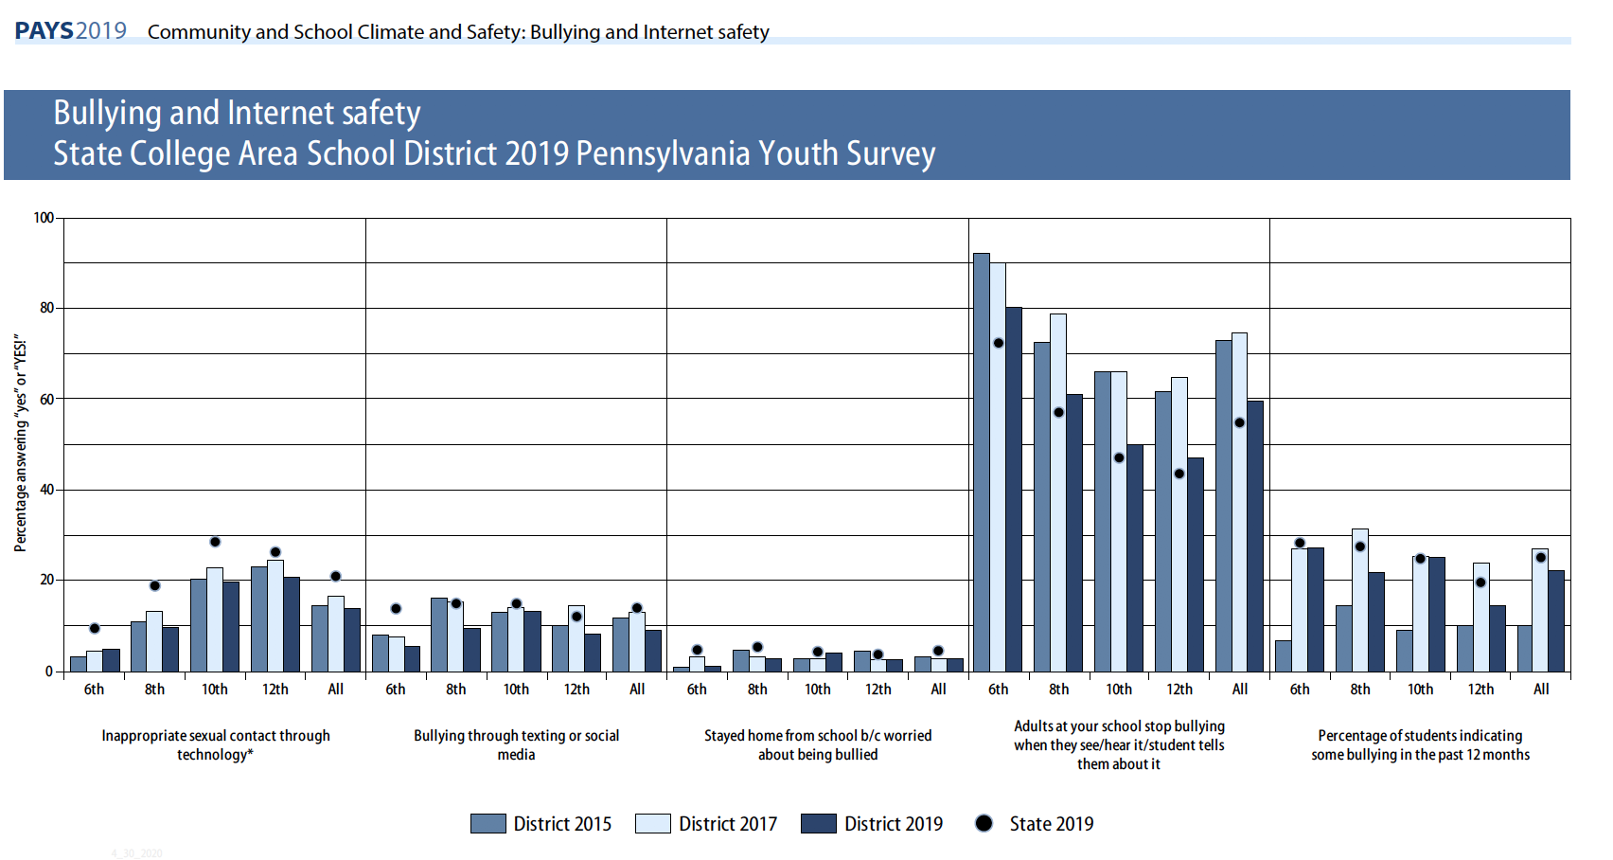

Slide 29
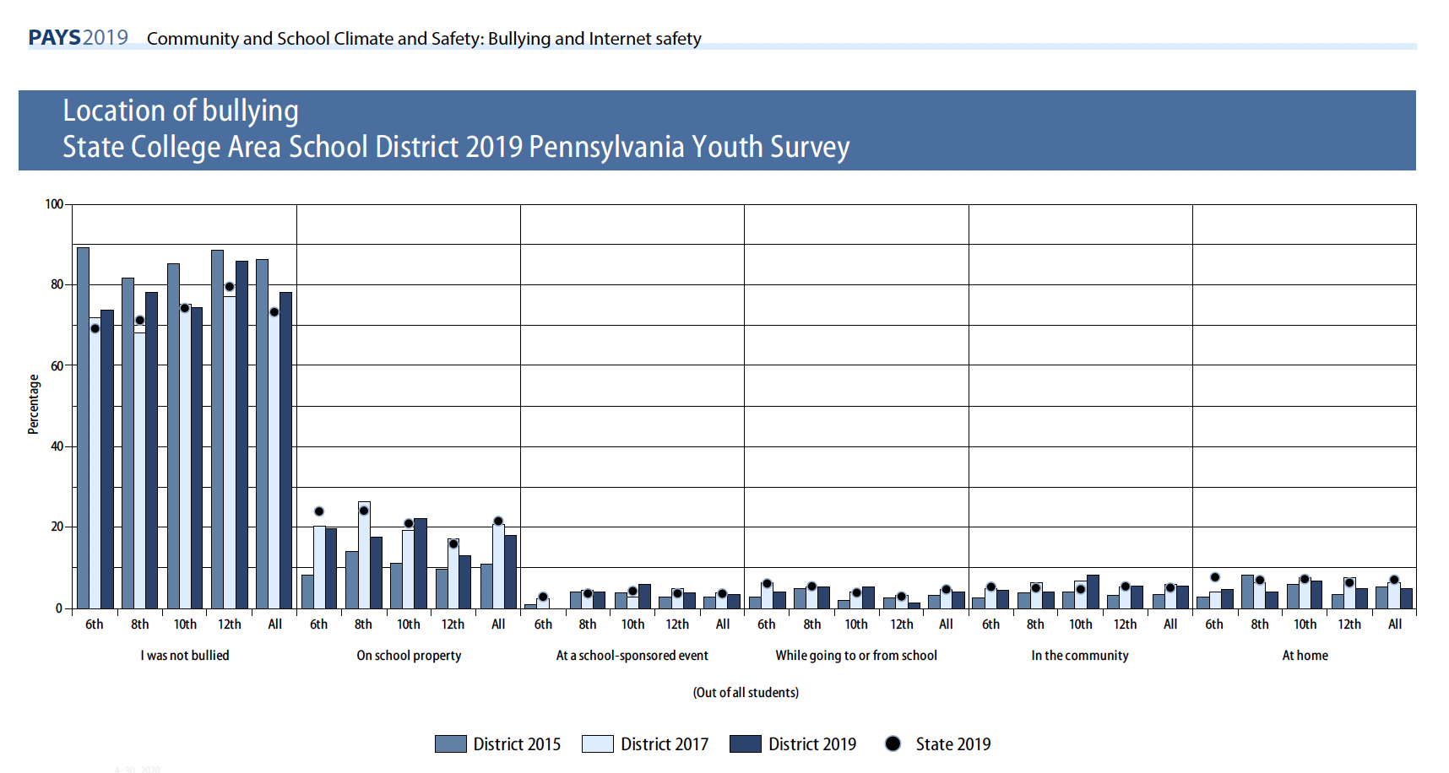

Slide 30
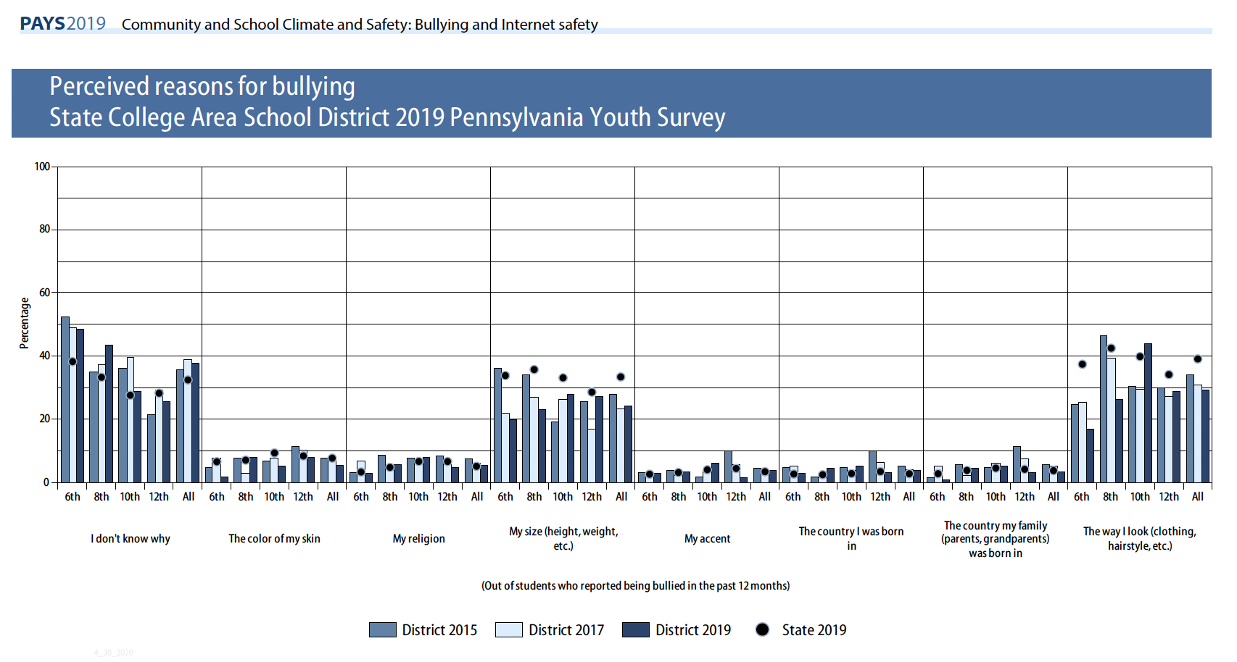

Slide 31
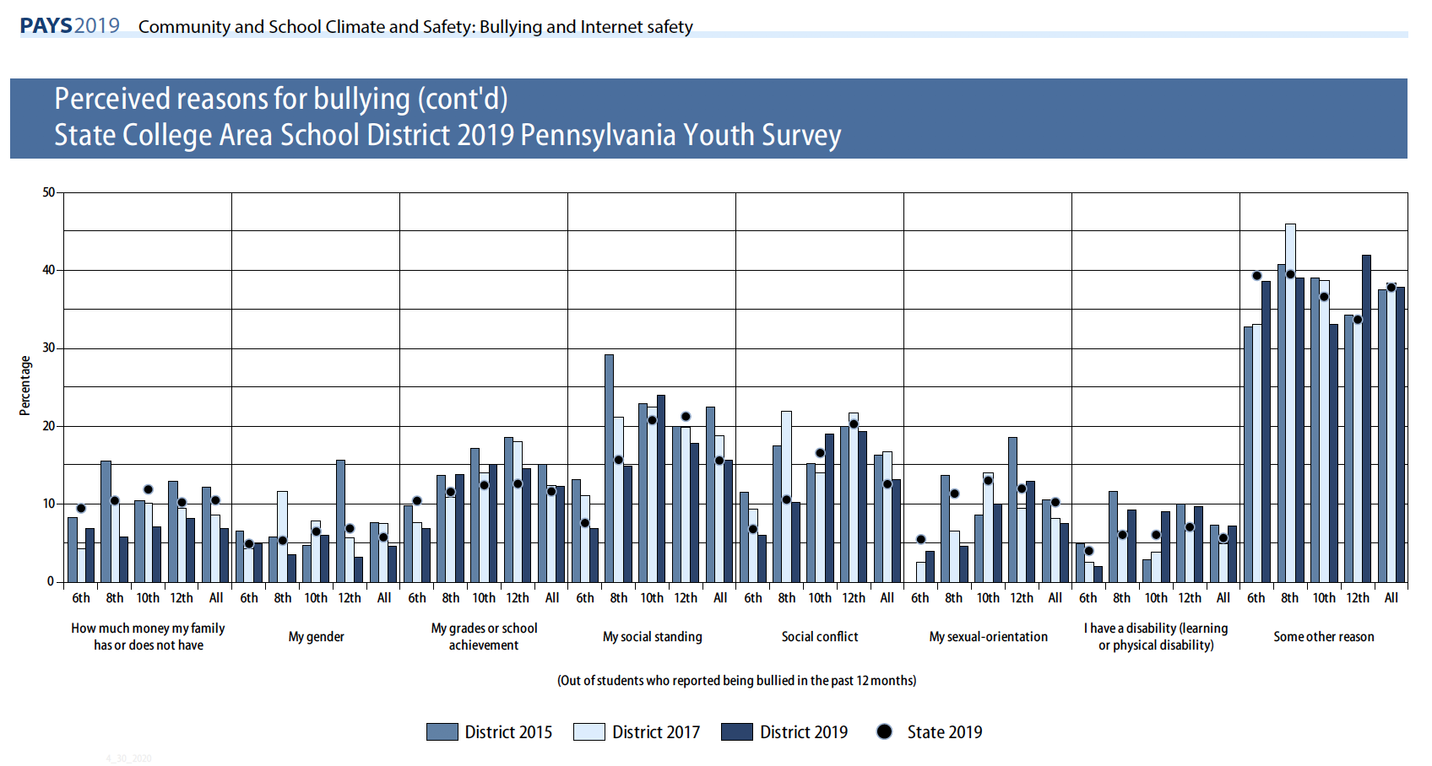

Slide 32
Breakdown of Perceived Bullying Data
Survey Respondents By Grade | Total By Number | Number Reported Being Bullied Because Color of Skin | Number Reported Being Bullied Because “I have a disability” (learning or physical disability)
6th | 448 | 2.0% = 9 Students | 2.0% = 9 Students
8th | 418 | 8.0% = 33 Students | 9.2% = 38 Students
10th | 384 | 5.0% = 19 Students | 9.0% = 35 Students
12th | 395 | 8.1% = 32 Students | 9.7% = 38 students
Total | 1645 | 5.7% = 93 Students 28.5% (93 of 326 ) of non-white students (if skin color is different, so this could be a higher percentage) (34% in 2017) (39% in 2015) | 7.3% = 120 Students Estimated 49% (10% of 1,645 = 165 so 120/165=73%) of Special Education Identified students (49% in 2017) (76% in 2015)

Slide 33
Social and
Emotional Health
Stress, anxiety, loneliness, and frustration are all emotions that can negatively impact student health.
SCASD most common depressed thoughts:
  23.4% “at times I think I am no good at all”
  23.6% felt sad or depressed MOST days in past 12 months
  Overall, 10.4% (16.2% State) seriously considered attempting suicide.

Slide 34
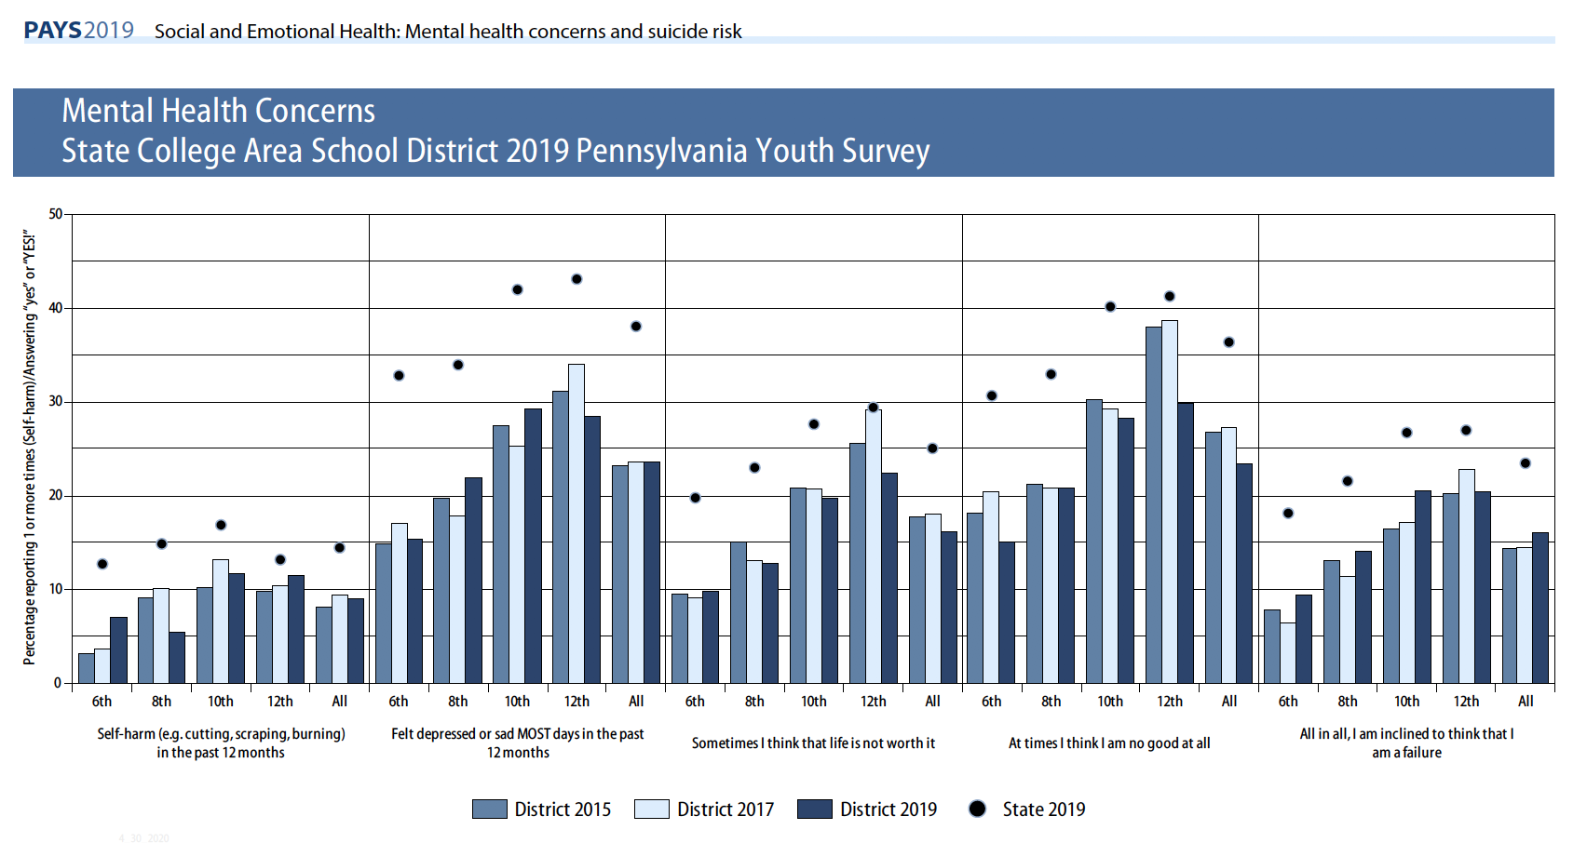

Slide 35
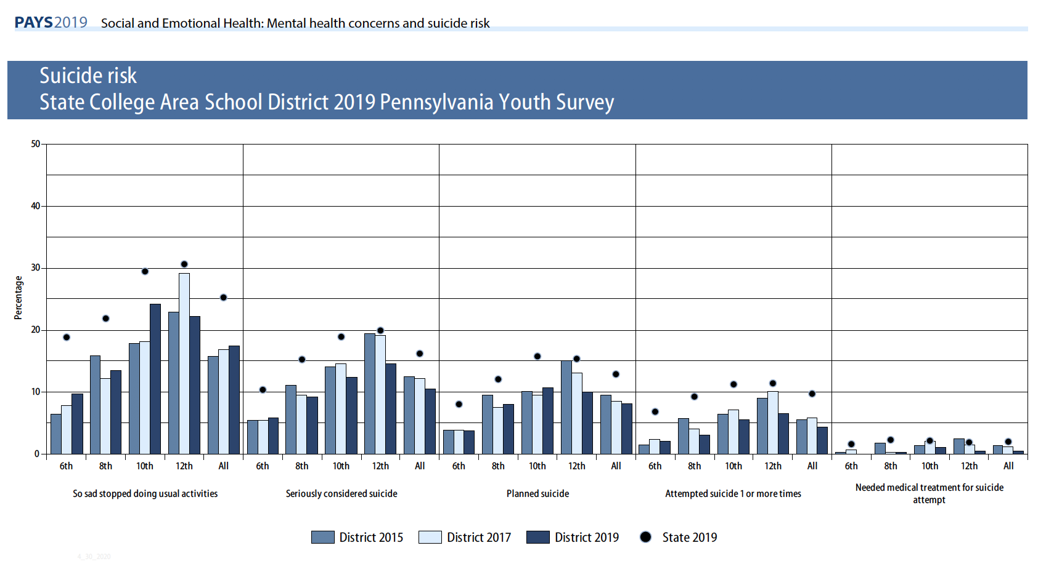

Slide 36
PAYS By Grade Level
Grade Level | Self- harming (cutting scraping burning ) | Felt depressed or sad most days | Sometimes I think that life is not worth it | At times I think I am no good at all | All and all I am inclined to think that I am a failure
6-2015 | 3.2 | 14.8 | 9.5 | 18.1 | 7.8
6-2017 | 3.6 | 17 | 9.1 | 20.4 | 6.4
6-2019 | 7.0 | 15.3 | 9.8 | 15 | 9.3
8-2015 | 9.2 | 19.7 | 15.0 | 21.2 | 13.0
8-2017 | 10.1 | 17.8 | 13.1 | 20.8 | 11.4
8-2019 | 5.5 | 21.9 | 12.8 | 20.9 | 14.1
10-2015 | 10.3 | 27.4 | 20.8 | 30.3 | 16.4
10-2017 | 13.2 | 25.4 | 20.6 | 29.2 | 17.1
10-2019 | 11.5 | 29.3 | 19.6 | 28.3 | 20.5
12-2015 | 9.8 | 31.1 | 25.6 | 37.9 | 20.3
12-2017 | 10.3 | 34 | 29.1 | 38.6 | 22.8
12-2019 | 8.9 | 28.4 | 22.3 | 29.8 | 20.4
Blue shows trend Red shows improvement for 2019

Slide 37
SCASD Programs and Services Aimed to Support
Positive Mental Health
BESS Review 360 Survey 6-12 9th Grade Learning Communities Act 211 Programming Casings Conference Attendance/Professional Development Counseling Services Family & Community Engagement Services LGBTA Alliance Health Courses HEARTS/RIT Programs Home School Visitor Instructional Support Team Integrated Mental Health Services Little Lion Ambassadors My Mental Health Matters Club Professional Learning Communities Psychological Services | Restorative Practices/Conferencing Safety Care School Resource Officer School Wide Positive Behavior/ ROAR Straight Talk Programs Stompers Project By Jana Marie Foundation Student Assistance Program Suicide Prevention Training Support Programs TIDES Transition Services Universal Screening For Behavior and Emotional Needs Youth Mental Health First Aid Training After School Activities and Clubs Equity Summer Institute

Slide 38
Programs/Initiatives 2019-2021
Implementing School Wide Positive Behavior Supports District wide
Restorative Practices District Wide Implementation and training
Straight Talk Task Force
Integrated Mental Health Providers on School Teams
Universal Screening for Behavior grades k-12
Restorative Practices Student Handbook Revisions
Equity Audit

