Slide 1

SCASD Pennsylvania Youth Survey Report 2017
Presented By
Jeanne Knouse Director SS

Slide 2
PAYS Purpose
Provide benchmark for alcohol, tobacco, and other drug (ATOD)
Help indicate whether prevention and treatment programs are achieving their intended results
Assesses risk and protective factors

Slide 3
PAYS FAQs
How do we know we can trust the results?
  Developed, studied and validated in numerous research studies. www.sdrg.org
Is the survey reliable and valid?
  Yes. Each risk and protective factor scale has been statistically validated in multiple samples across gender, race and ethnicity and predicts adolescent problem behaviors.
Don’t kids lie on surveys?
  Yes but rarely. Research indicates students tend to be honest about behavior and experiences on anonymous, confidential surveys.
  Strategies built into the analysis of the survey to screen for dishonest, inconsistent and exaggerated responses.
Are these data representative of our student population?
  When 80% or greater participate there is confidence that the data reflects the student population.

Slide 4
PAYS Data Point Reminders
 | Grades | Students
1999-2013 every two years | 1999: 6-12 (pilot year) 2000-20013 : 6, 8, 10, 12 | 1,600-2,200
2015 | 6 ,8, 10, 12 | 1,850 83% participation rate
2017 | 6, 8, 10 ,12 | 1,772 78.3% participation rate
Risk and Protective Factors are scale scores
The percentage represents the population of youth that are either at greater risk or lower protection than the national cut-point level.
All other scores are percentage use
12th grade = 4.2 students per % point
10th grade = 3.8 students per % point
8th grade = 4.1 students per % point
6th grade = 4 students per % point

Slide 5
PA Youth Survey Protective and Risk Factors 2017
Risk is associated with negative behavioral outcomes. It is better to have lower risk factor scale scores but we look at highest scores for areas of risk
Protective factors are associated with better behavioral outcomes. It is better to have higher protective factor scale scores
Notes:
2007 protective: Community opp for prosocial involvement, belief in a moral order and school opportunities for prosocial involvement
2007 risk: early initiation of drug use, community disorganization (31) and family history of antisocial behavior (42).

Slide 6
Protective Factors
Family Attachment (75% with protection)
  Young people who feel that they are a valued part of their family are less likely to engage in substance use and other problem behaviors.
Family Opportunities for Prosocial Involvement (73% with protection)
  Young people who are exposed to more opportunities to participate meaningfully in the responsibilities an activities of the family are less likely to engage in drug use and other problem behavior
Family Rewards for Prosocial Involvement (72% with protection)
  When parents, siblings, and other family members praise, encourage, and attend to things done well by their child, children are less likely to engage in substance use and problem behaviors.

Slide 7
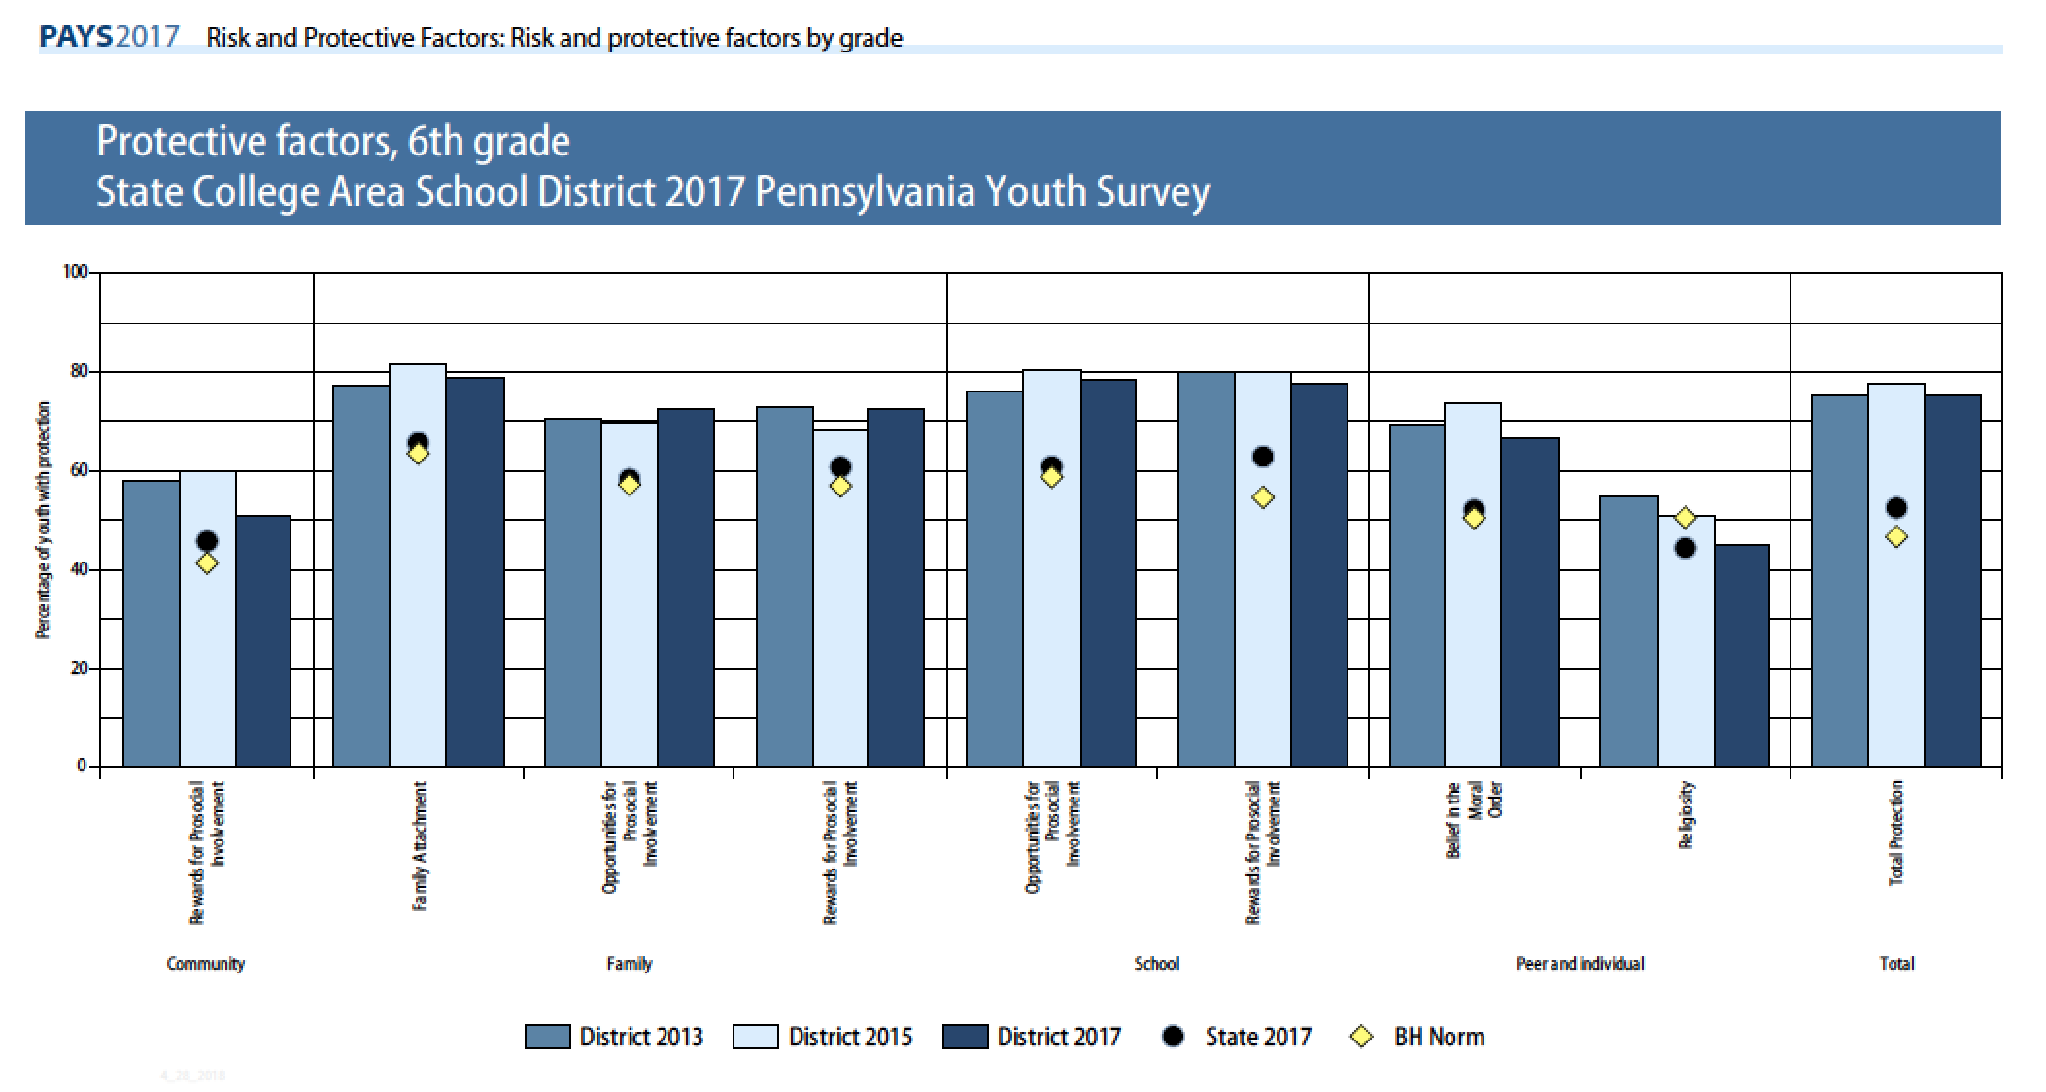

Slide 8
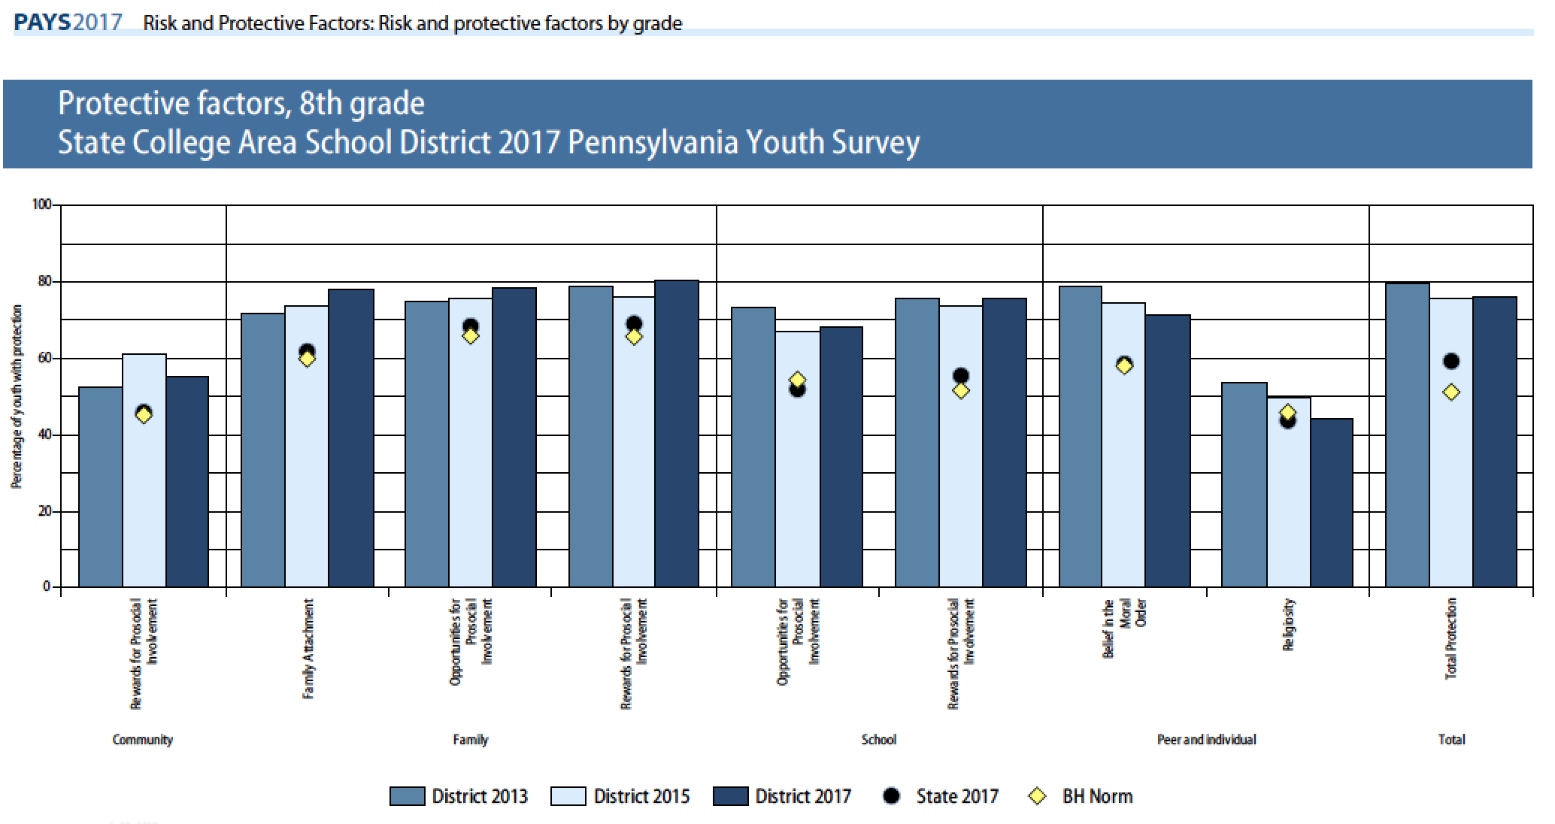

Slide 9
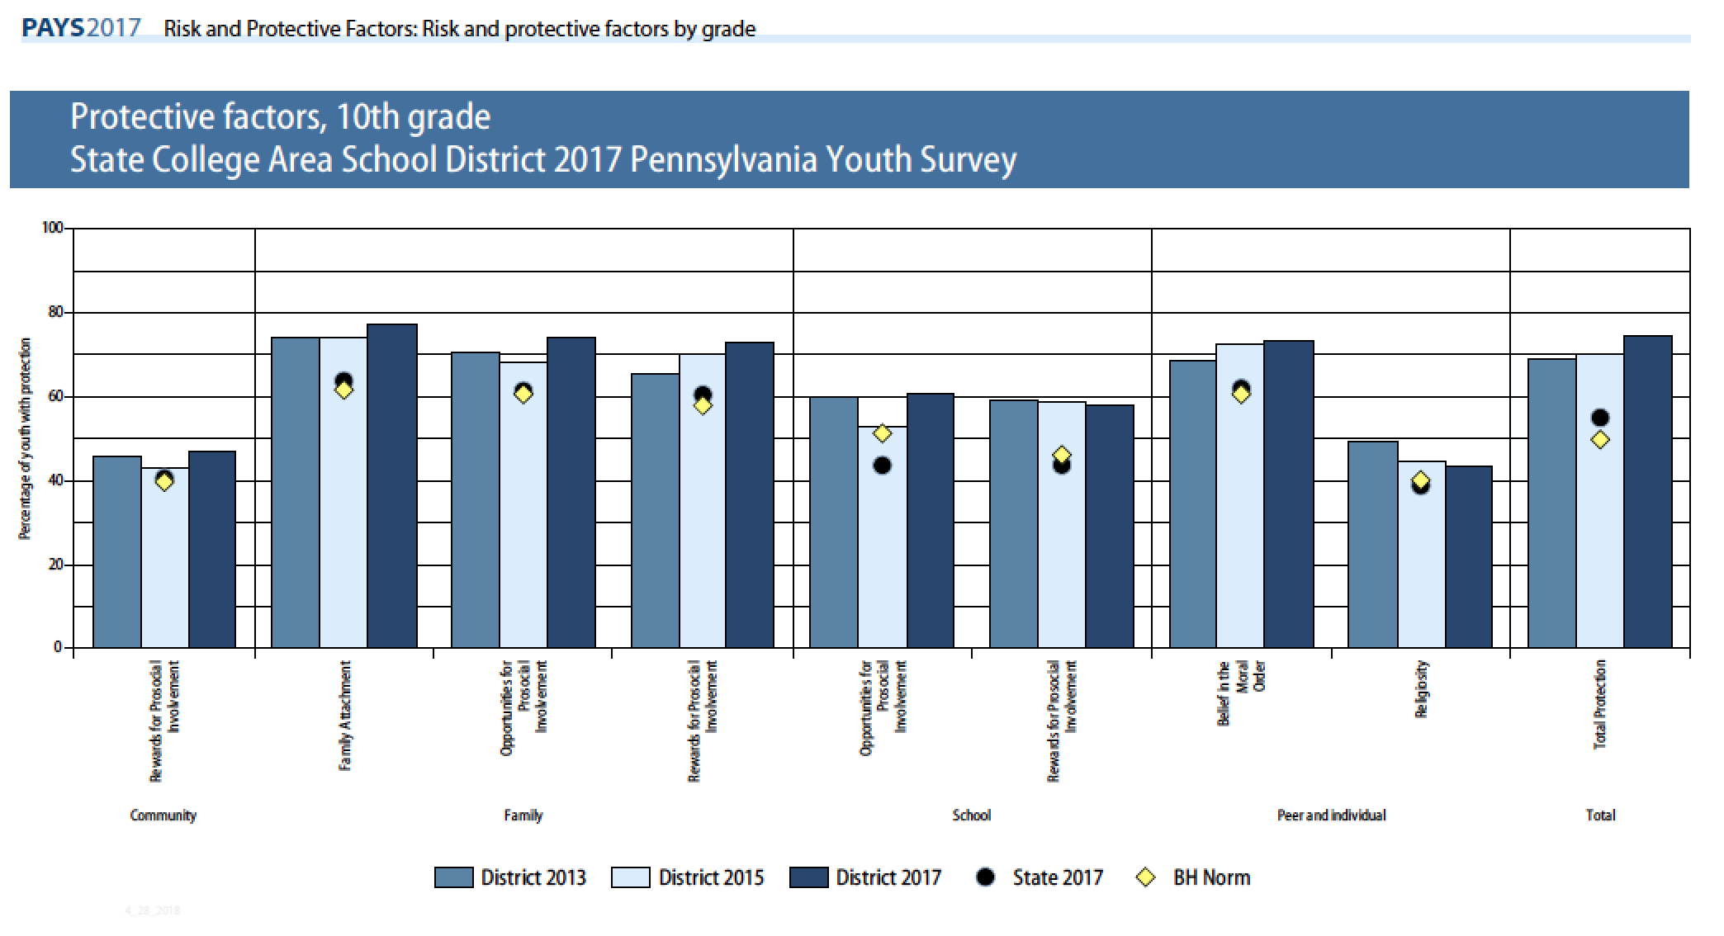

Slide 10
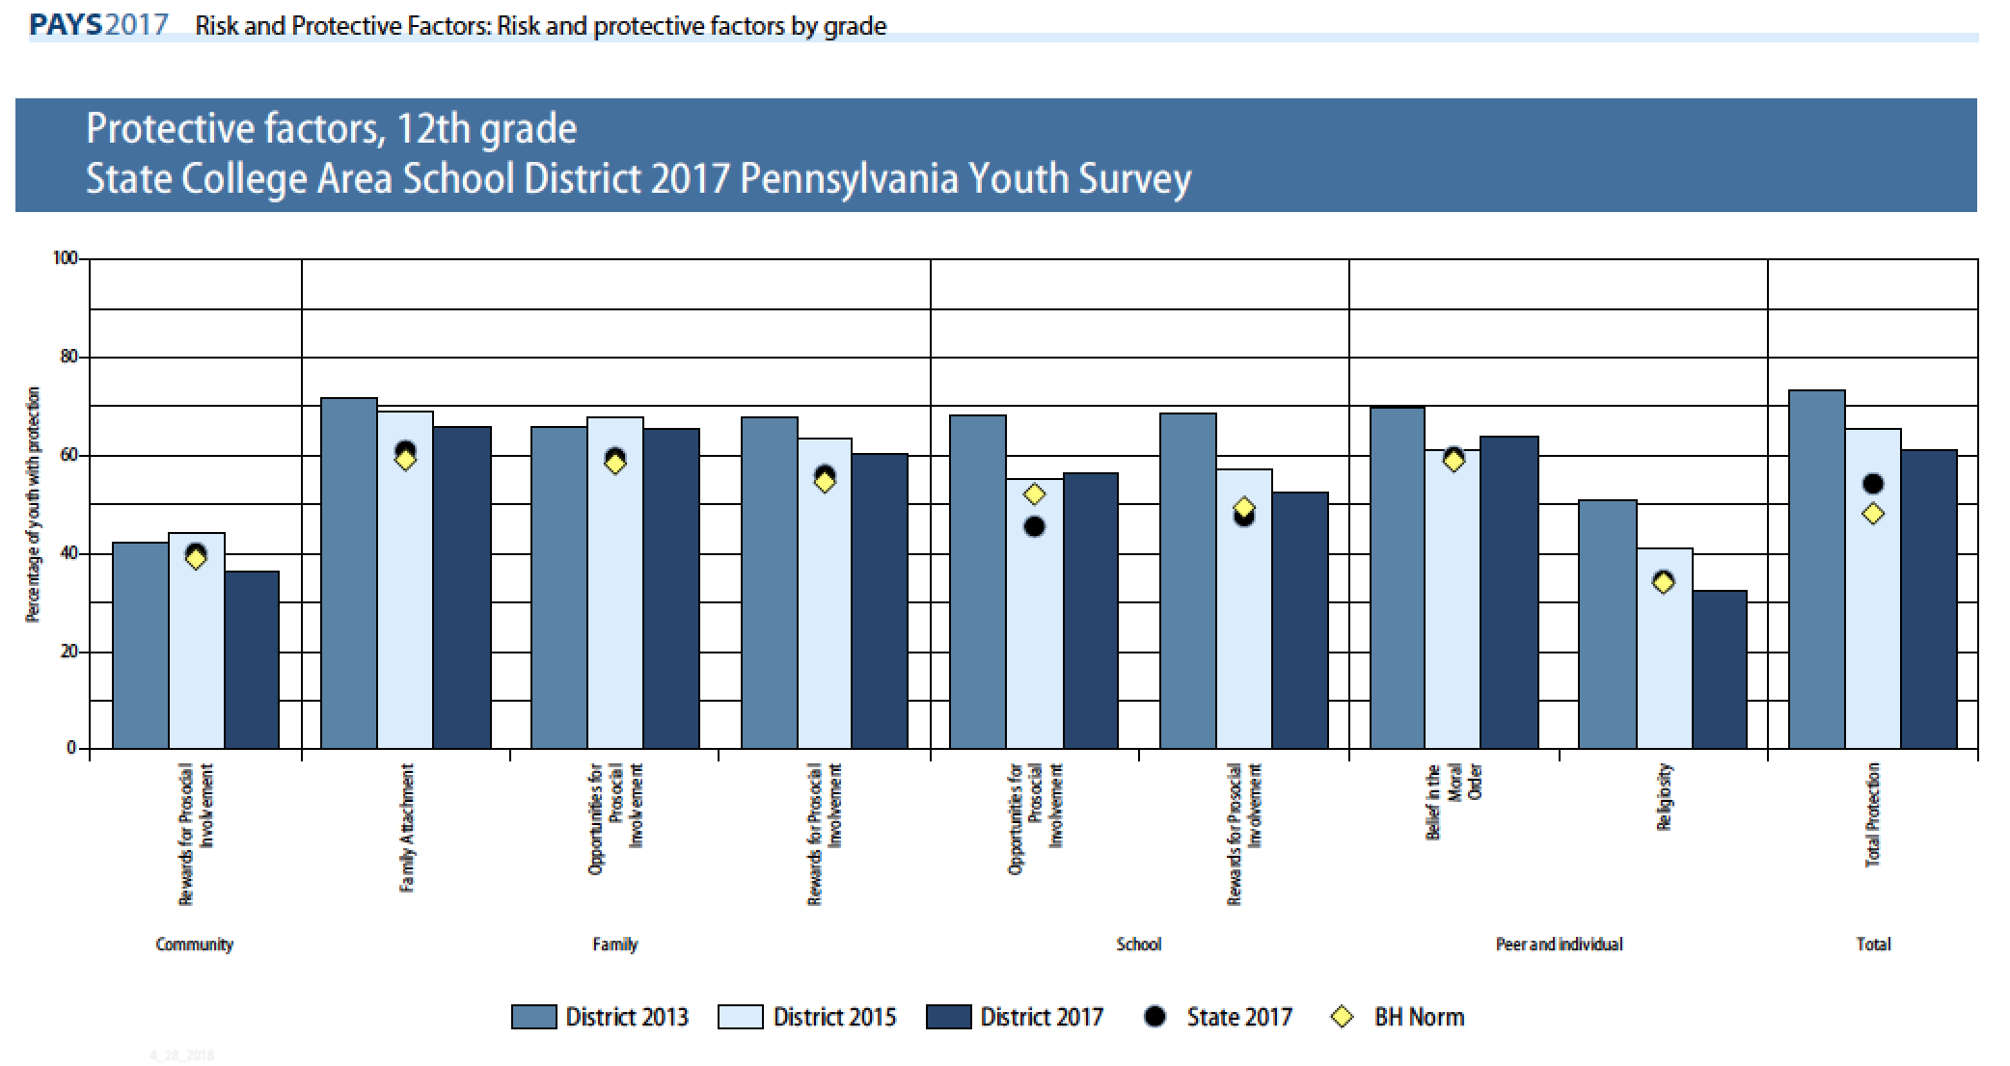

Slide 11
Risk Factors
Perceived Risk of Drug Use (42% at risk)
  Young people who do not perceive drug use to be risky are far more likely to engage in drug use.
Parental Attitude Favorable Toward Antisocial Behavior (35% at risk)
  In Families where parents use illegal drugs, are heavy users of alcohol, or are tolerant of children’s use, children are more likely to become drug abusers during adolescence. The risk is further increased if parents involve children in their own drug (or alcohol) using behavior for example, asking a child to light the parent’s cigarette or get the parent a beer from the refrigerator.
Low Commitment Toward School (32% at risk)
  Surveys of high school seniors have shown that the use of drugs is significantly lower among students who expect to attend college than among those who do not. Factors such as likings school, spending time on homework, and perceiving coursework as relevant are also negatively related to drug use.

Slide 12
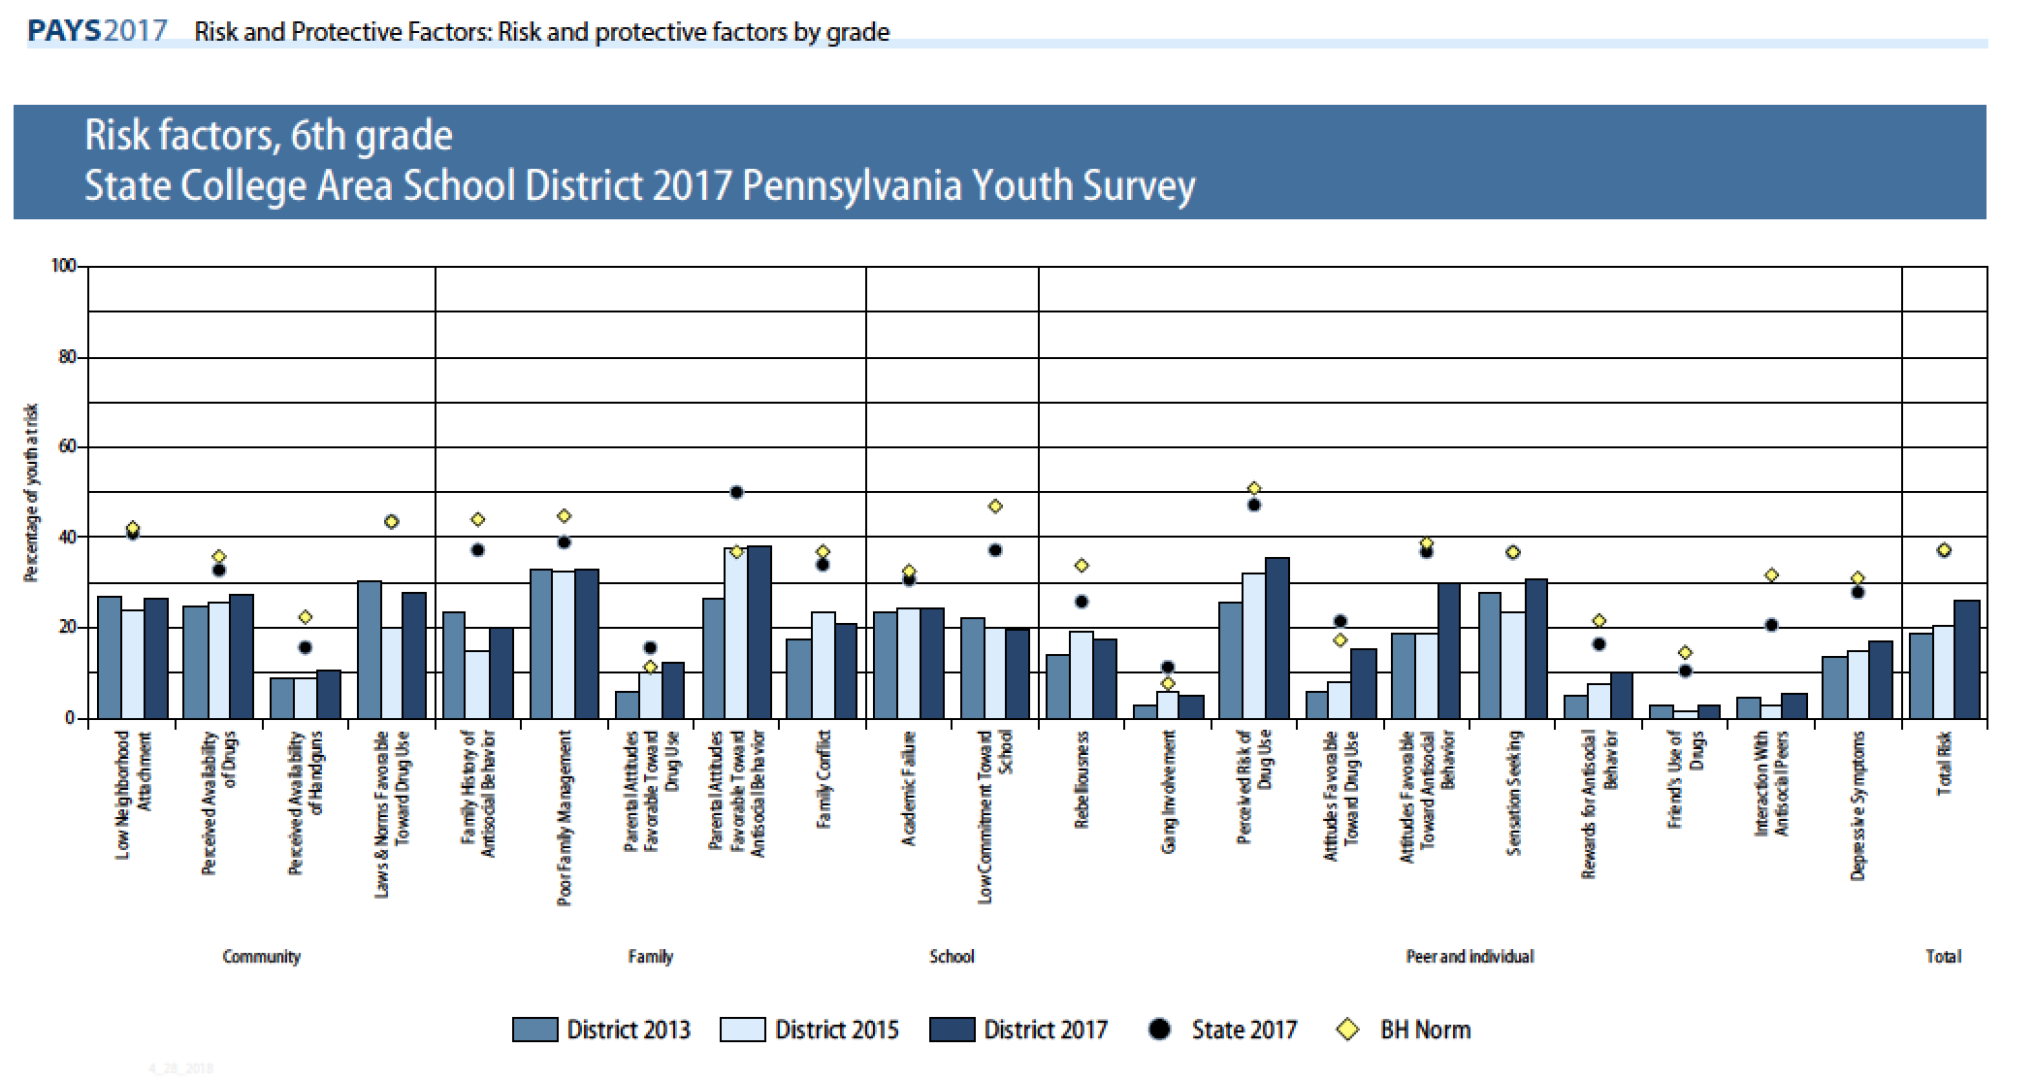

Slide 13
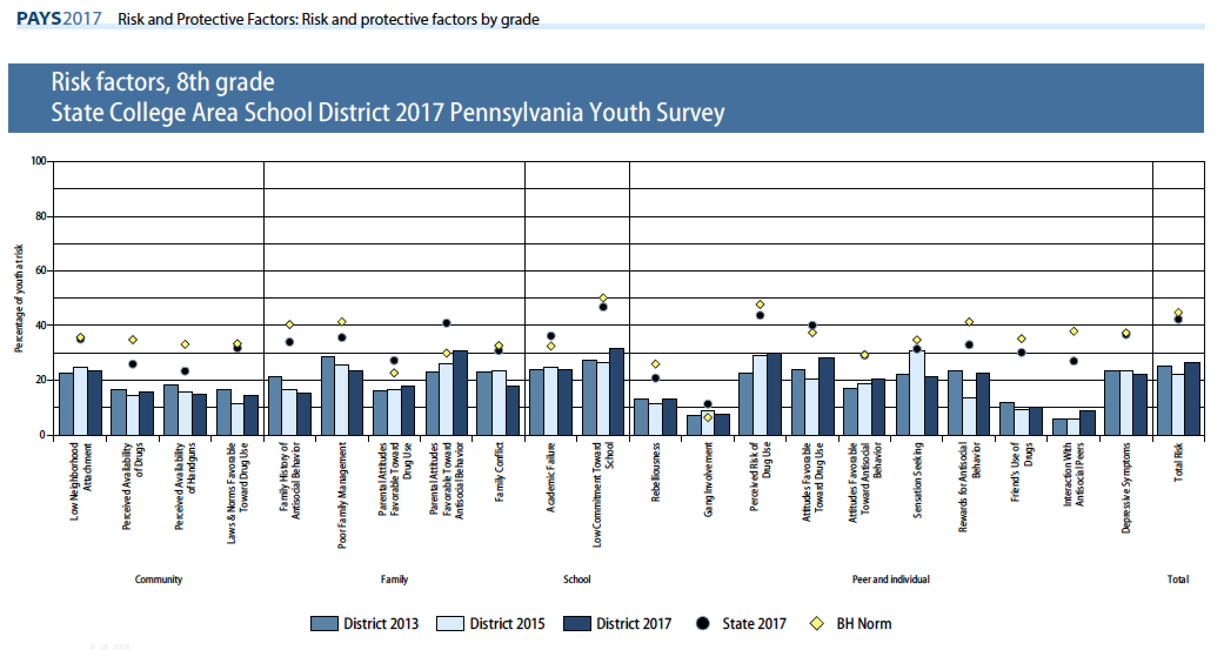

Slide 14
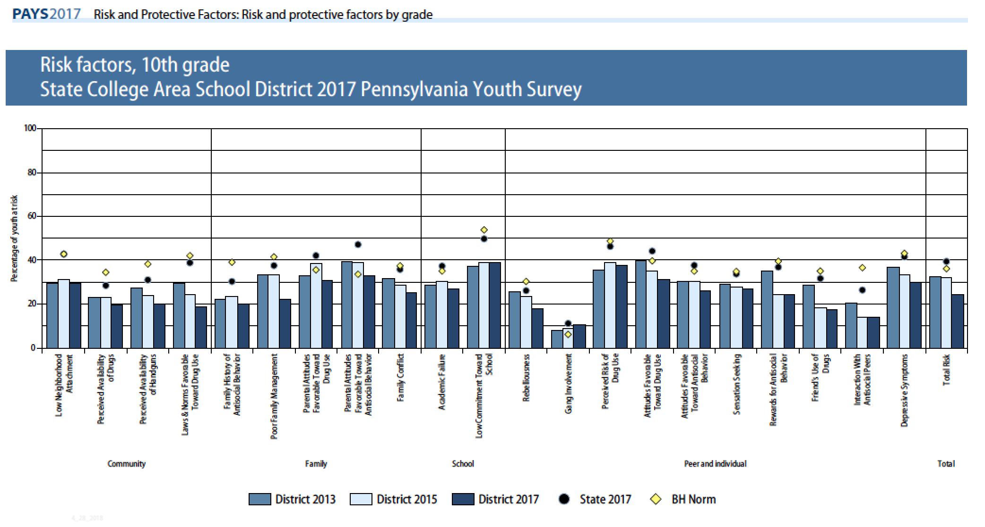

Slide 15
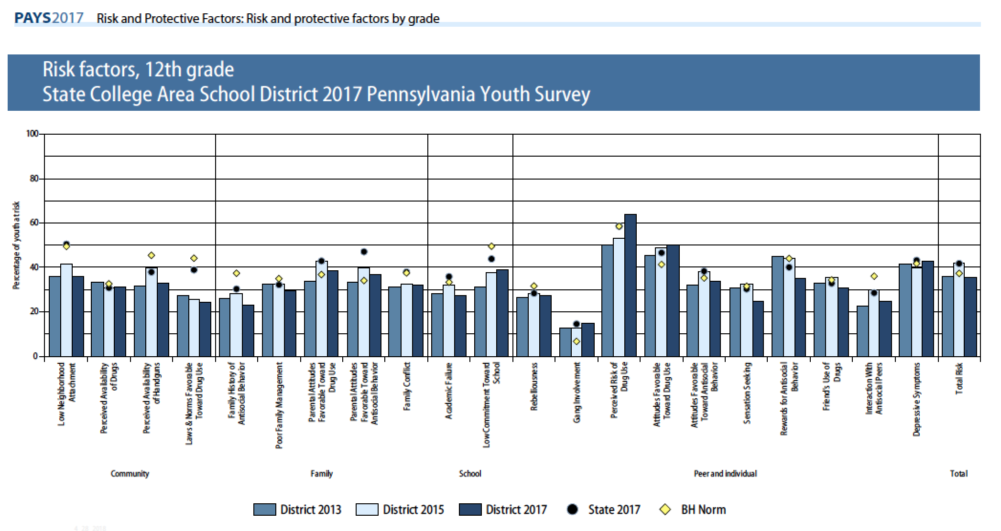

Slide 16
SCASD Programs and Services Aimed to Improve Risk and Protective Factors
9th Grade Learning Communities Big Brother Big Sister Child Abuse Training Counseling services Family Outreach Services LGBTA Alliance Health Courses Home School Visitor Services My Mental Health Matters Group Parenting Classes Professional Learning Communities Restorative Practices/Conferences Safety Care Training School resource officer School Wide Positive Behavior Supports/ROAR | Shorts and Sports Programs Straight Talk Task Force Strengthening Families Suicide Prevention Training Summer Library Transition Services Universal Screening For Behavior and Emotional Needs Youth Mental Health First Aide Training After School Activities & Clubs Community Partnerships with: Communities That Care PSU Jana Marie Foundation Youth Service Borough

Slide 17
High Prevalence/Early Initiation Drugs
First drugs most commonly abused by youth
Social acceptability
  normalize idea that drug use is acceptable
  “prime” the brain for addiction to other substances
  Most common early initiation for State College
    Alcohol 35.3% vs. 43.3 State
    Marijuana 12.5% vs. 17.7 State

Slide 18
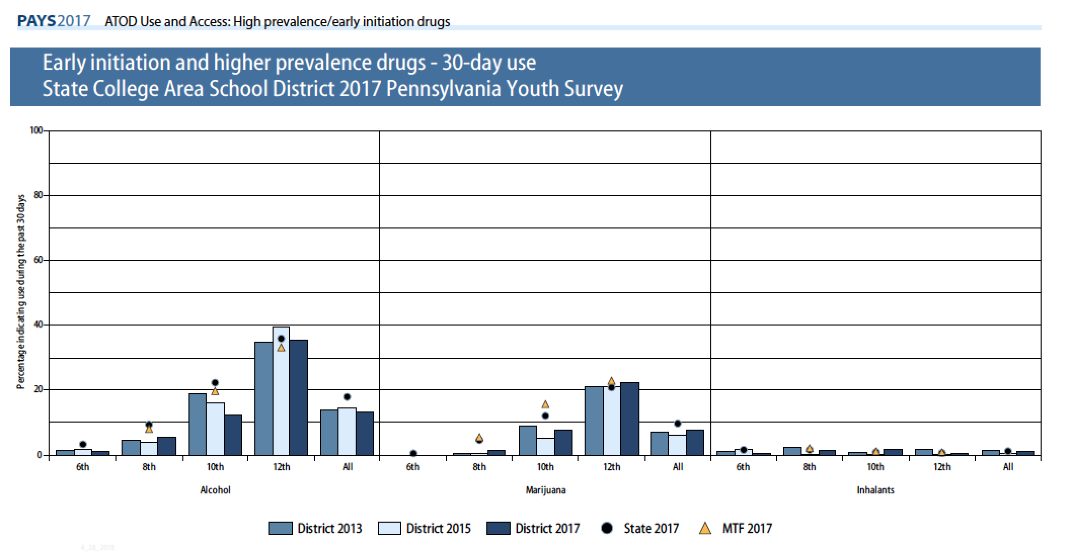

Slide 19
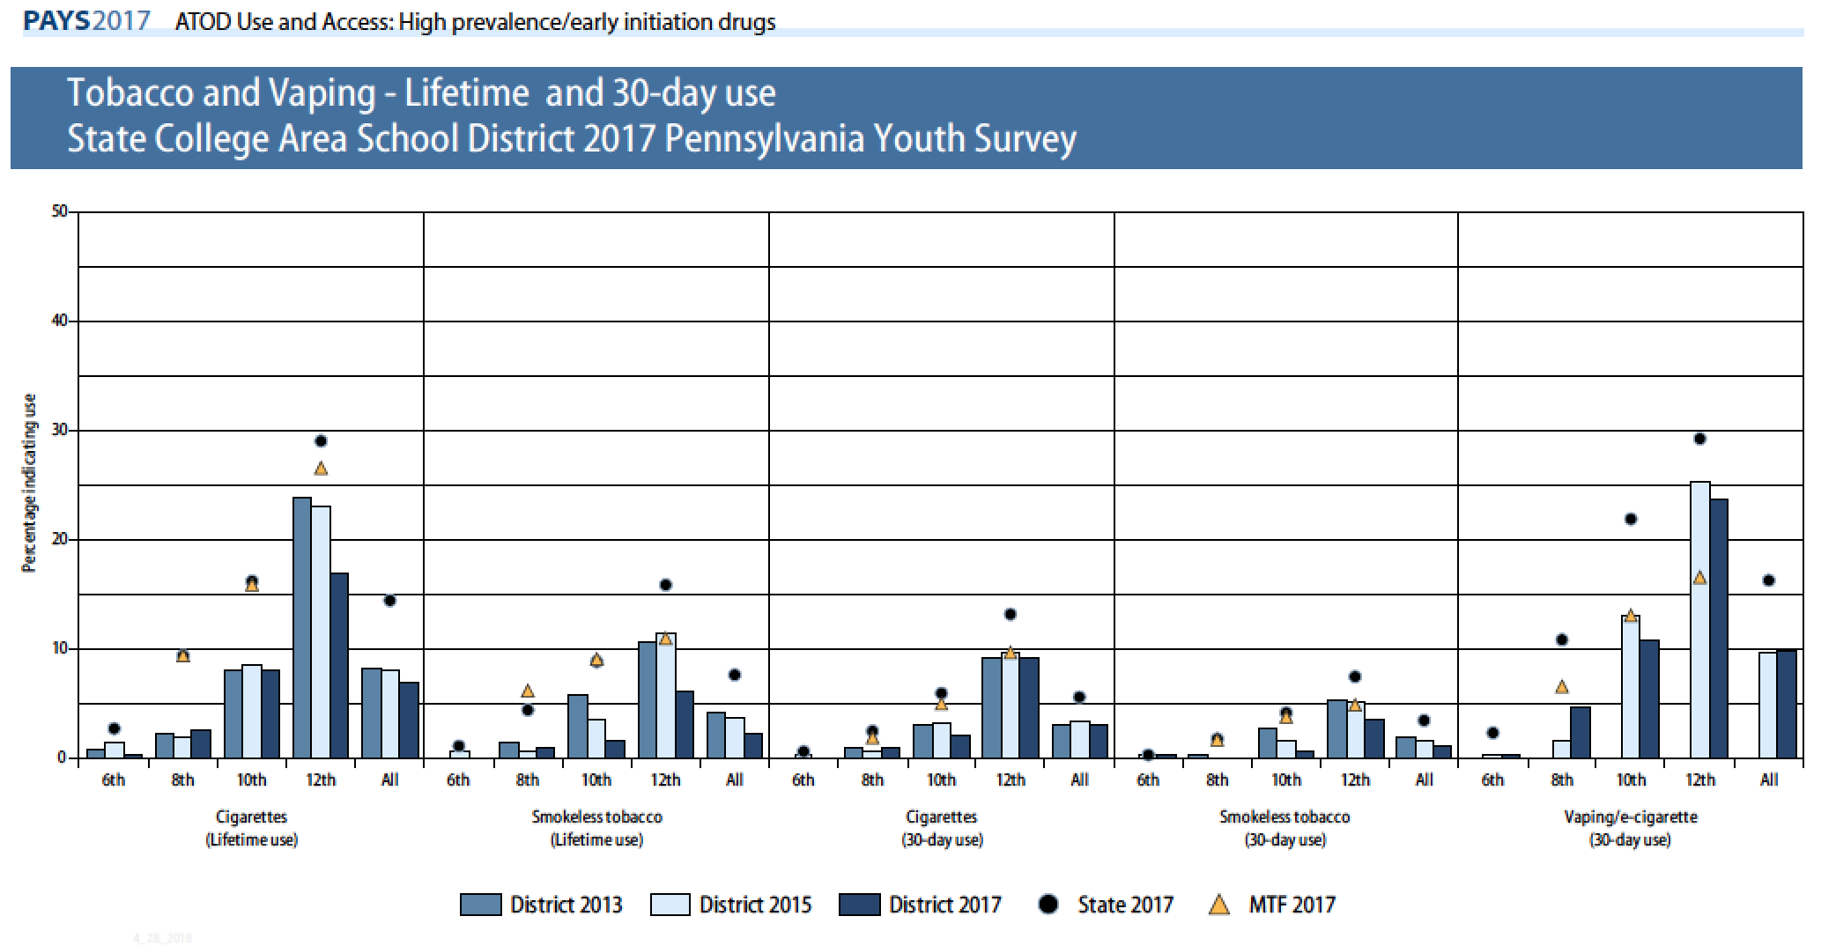

Slide 20
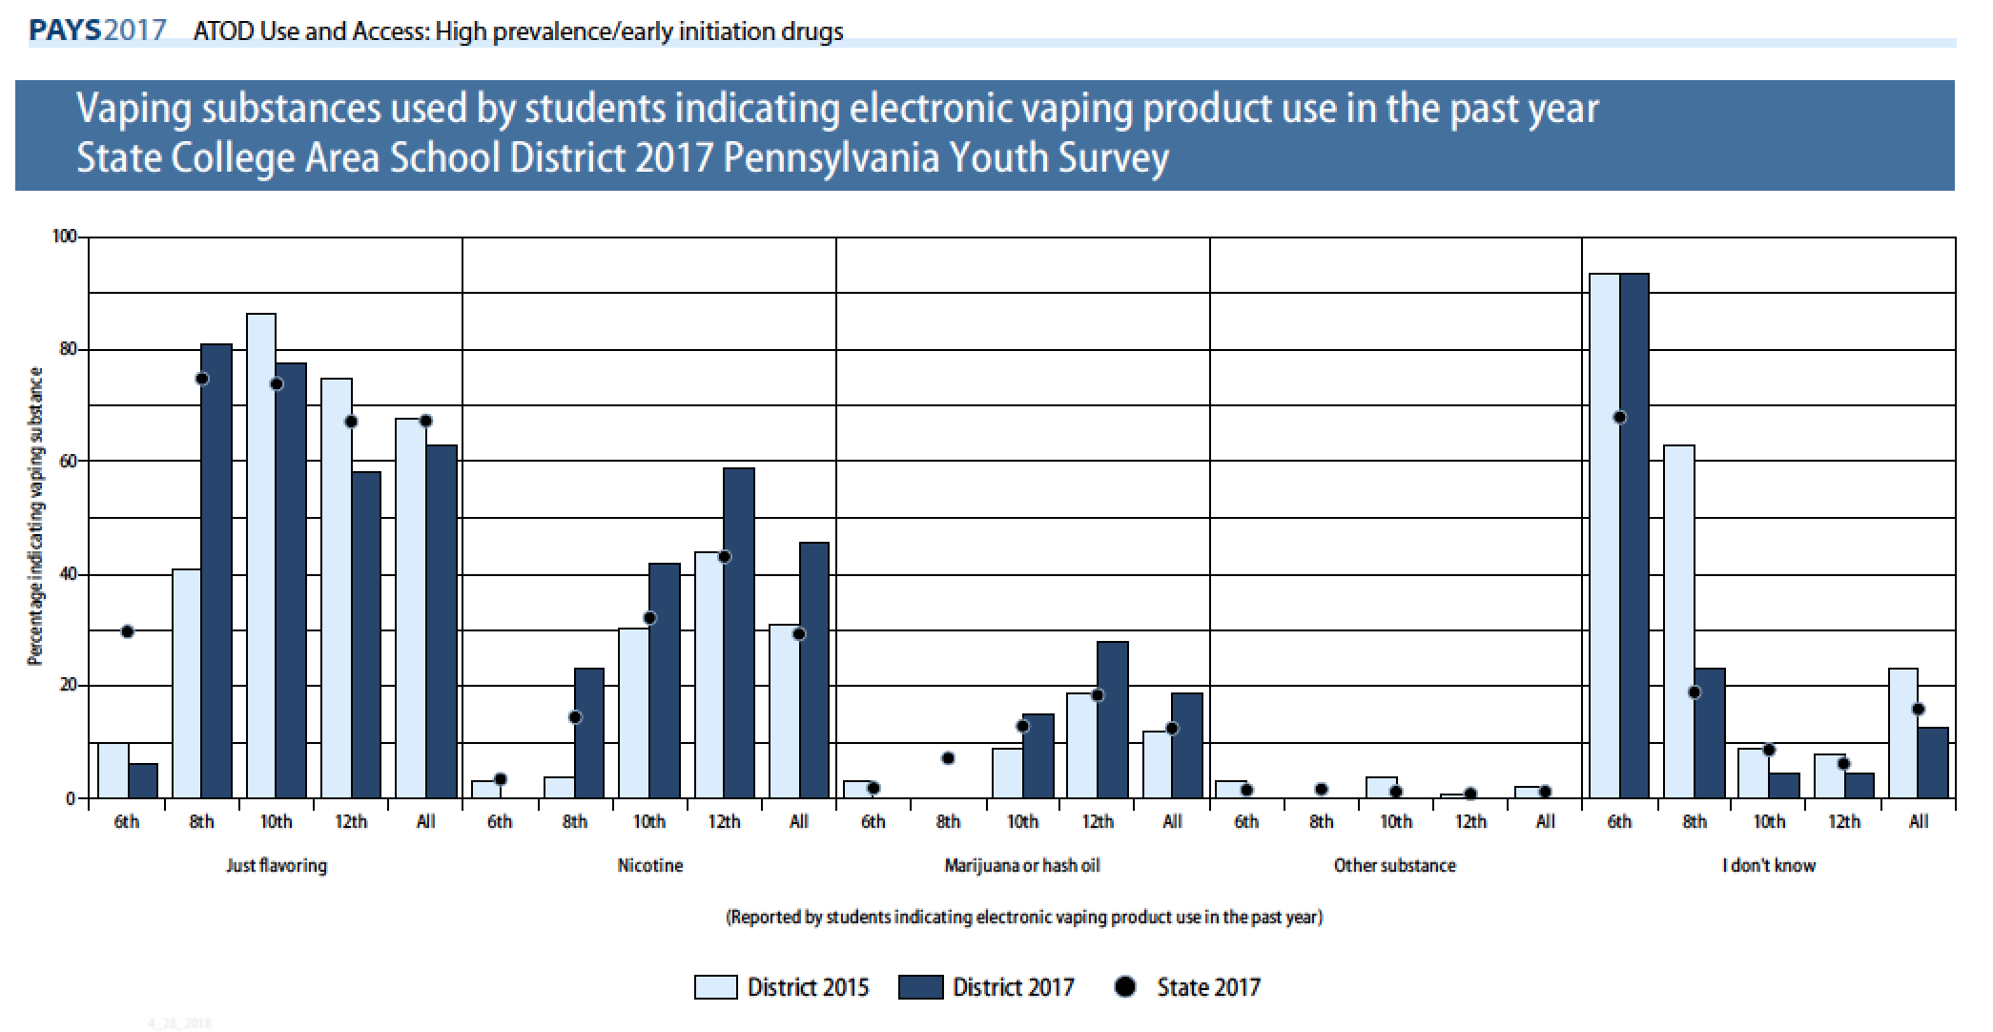

Slide 21
Prescription and Over-the-Counter Drugs and Medications
Prescription drugs are the most abused category of drugs after alcohol, tobacco and marijuana
  Prescription is safer than illicit drugs because prescribed by a doctor
Prescription drug most frequently used by SCASD students
  Narcotic prescription drugs – 3.1% vs. 5.1% State
  Over the counter drugs – 2.9% vs. 3.8% State

Slide 22
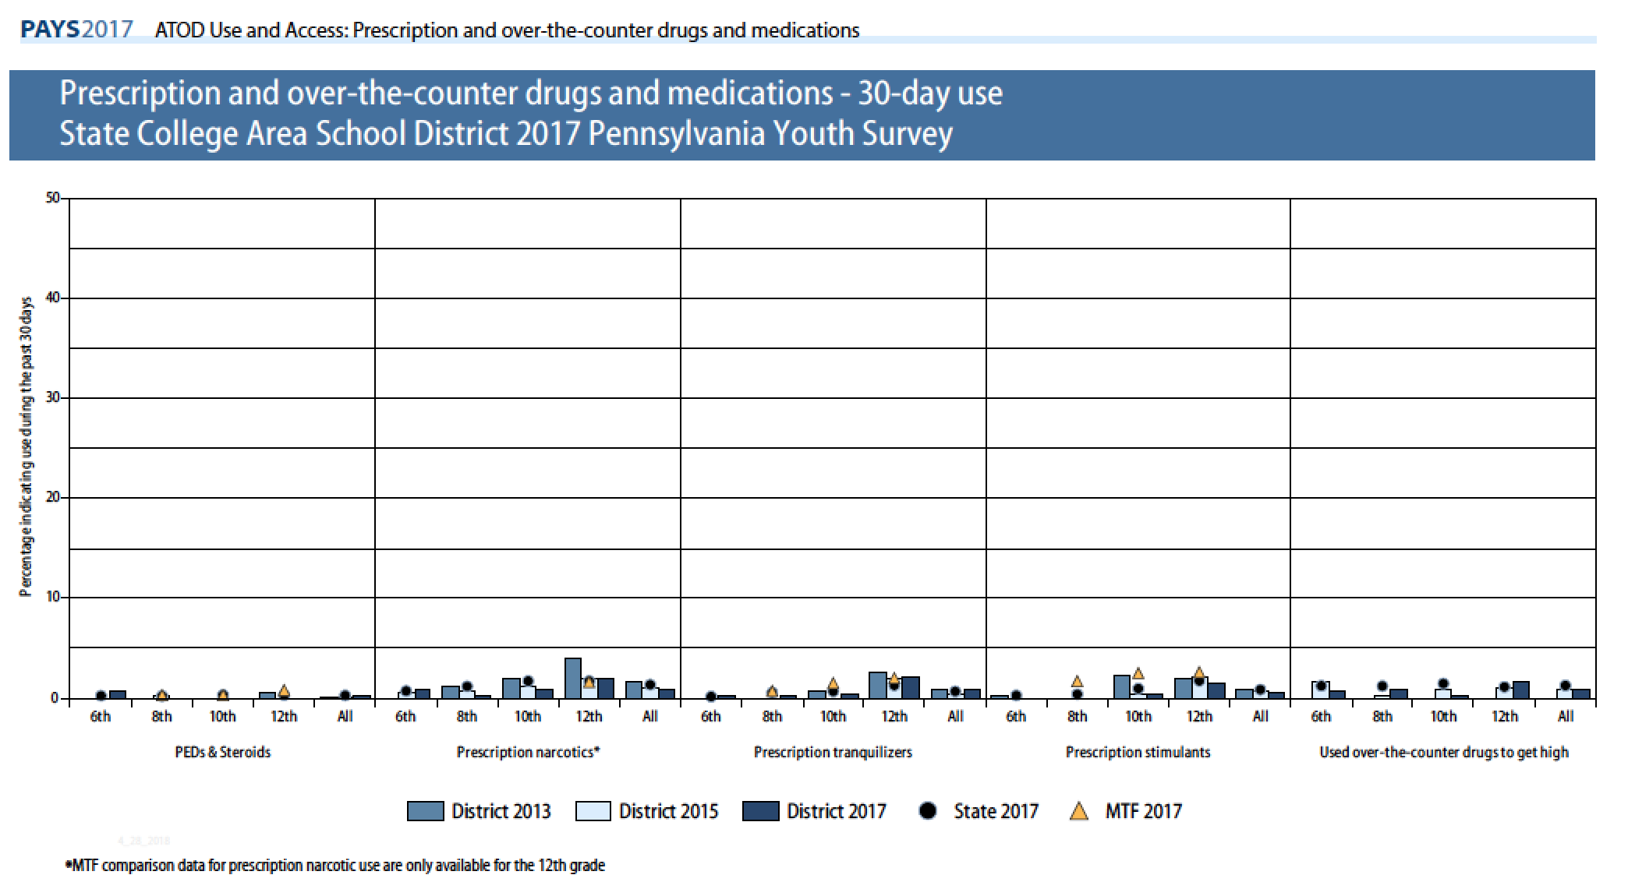

Slide 23
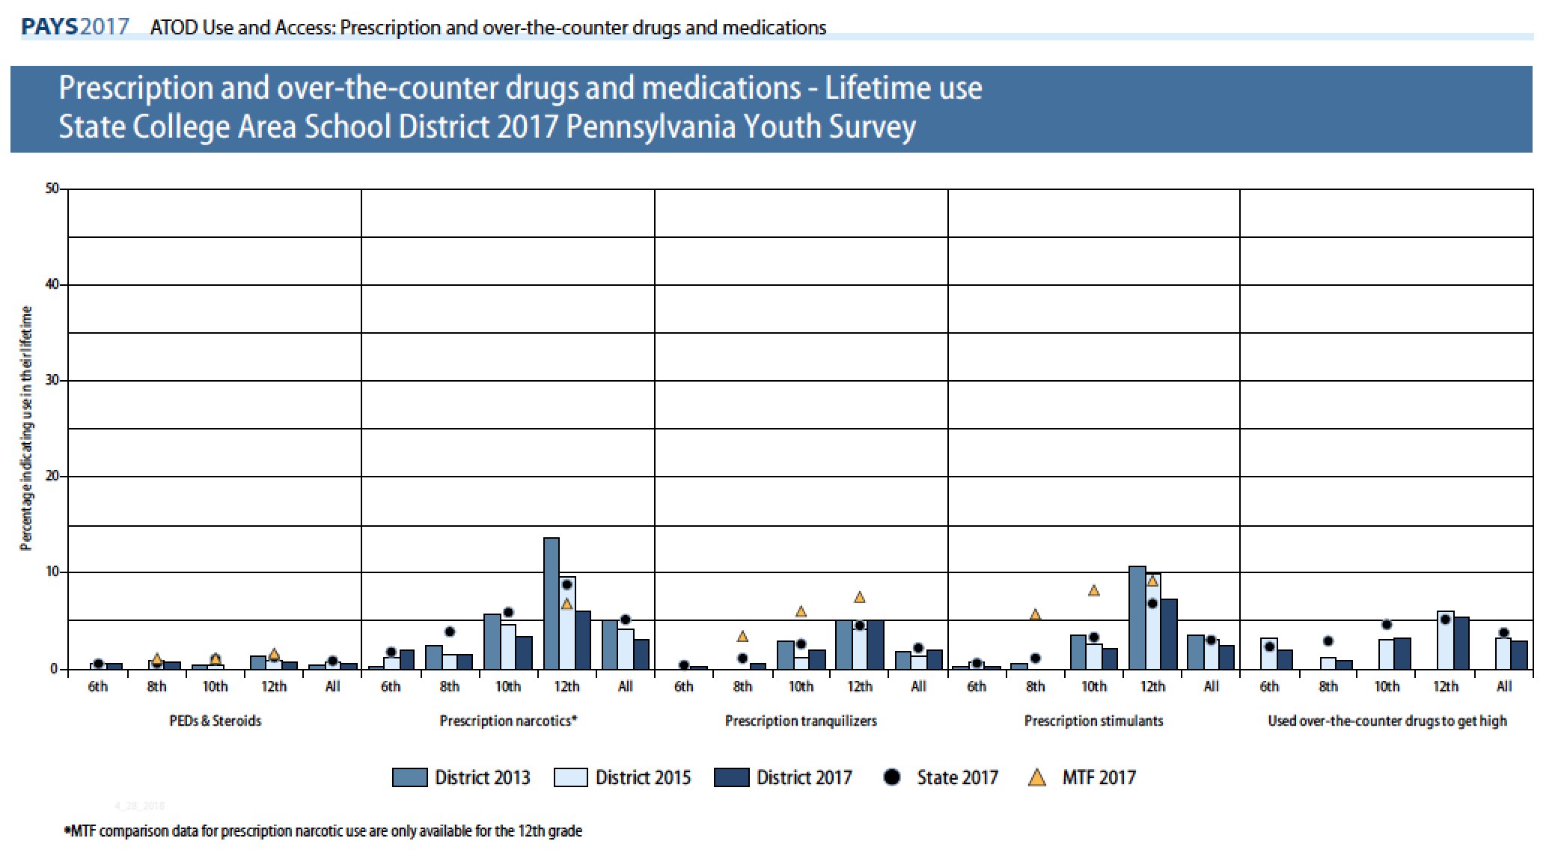

Slide 24
SCASD Programs and Services Aimed to Decrease ATOD Use
Act 211 Programming Casings Conference Attendance/Professional Development Counseling Curriculum Counseling Services LGBTA Alliance Health Courses Instructional Support Team Integrated Mental Health Services Little Lion Ambassadors My Mental Health Matters (MMHM) Psychological Services School Resource Officer School Wide Positive Behavior Support Programs/ROAR Straight Talk Programs Student Assistance Program

Slide 25
Bullying and Internet Safety
Bullying behavior contributes to
  Lower attendance rates
  Lower student achievement
  Low self-esteem
  Depression
  Higher rates of juvenile and adult crime
  Bullying in the past 12 months in SCASD 26.9% vs. 28.2% State
    Reason: 38.4% = “some other reason”, 39% “I don’t know why”, 30.8% “the way I look”

Slide 26
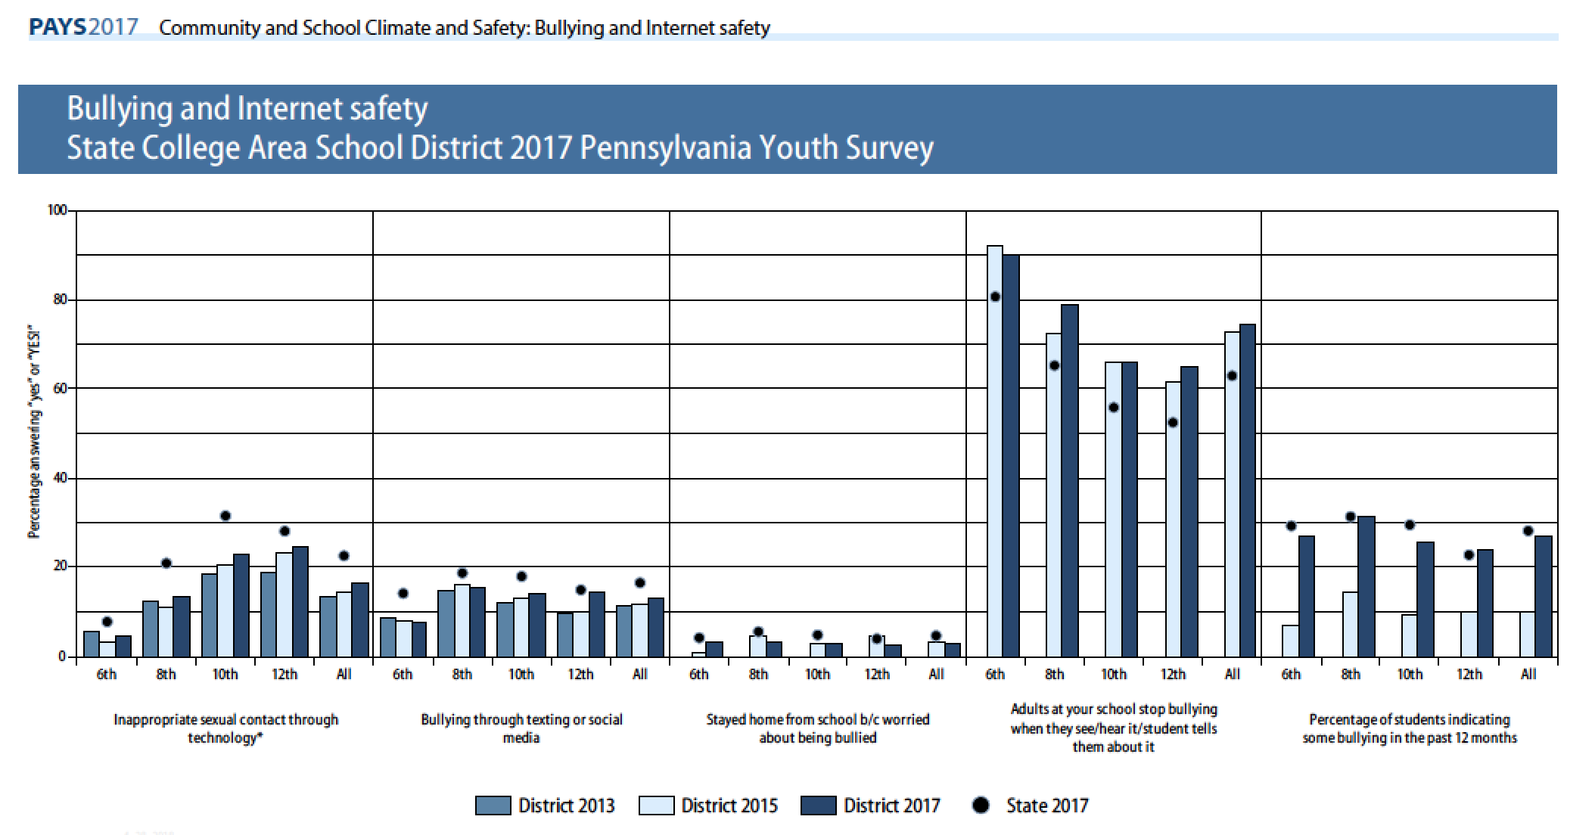

Slide 27
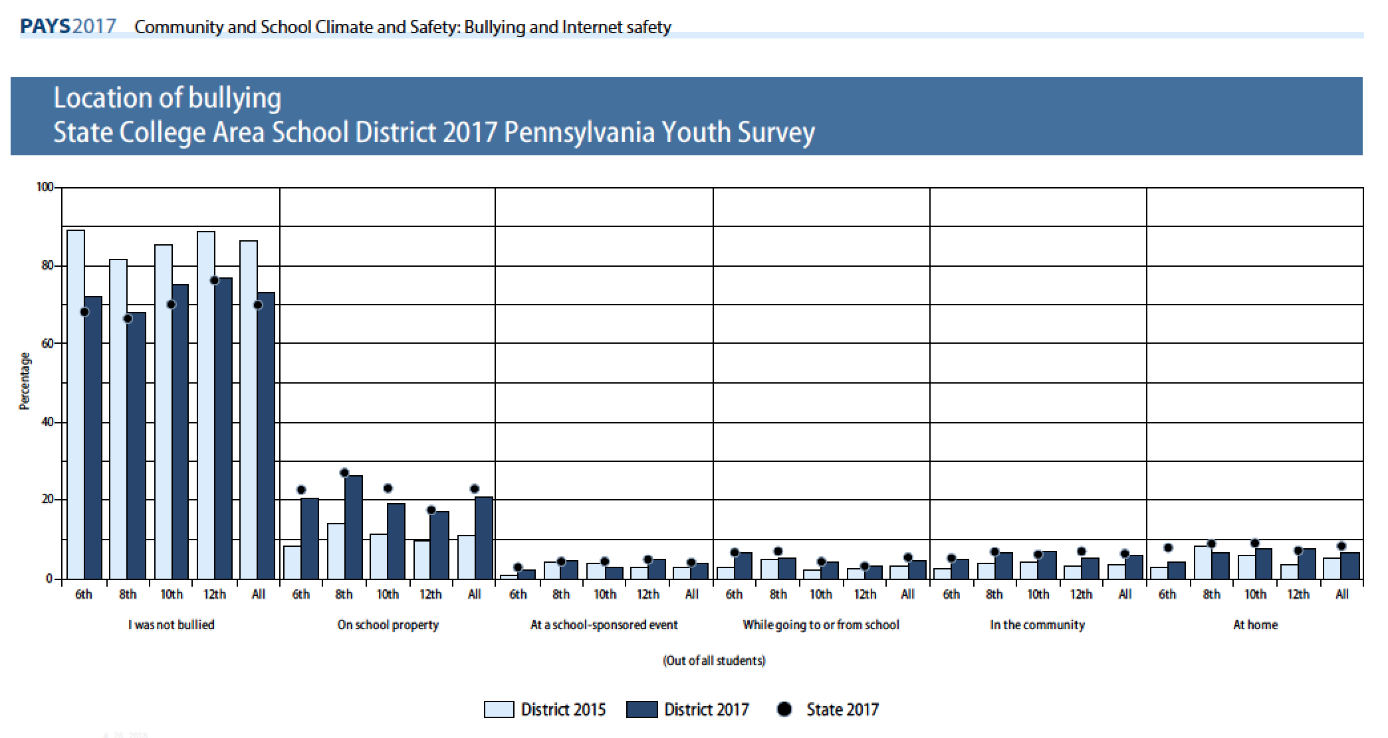

Slide 28
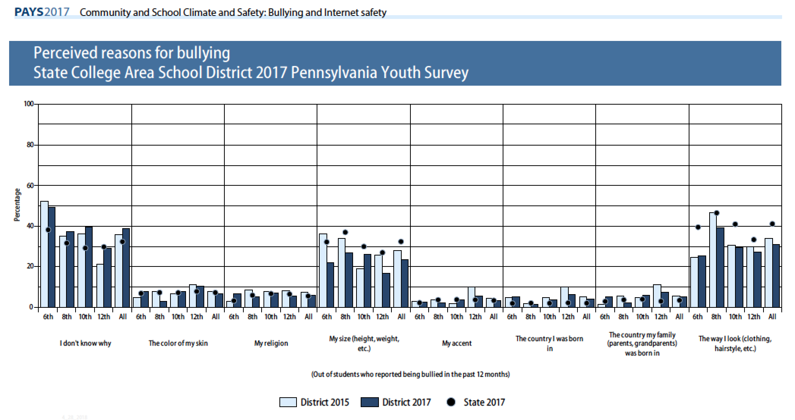

Slide 29
Social and Emotional Health
Stress, anxiety, loneliness, and frustration are all emotions that can negatively impact student health
SCASD most common depressed thoughts
  26.7% “at times I think I am no good at all”
  23.2% felt sad or depressed MOST days in past 12 months
  Overall, 12.4% (16% State) seriously considered attempting suicide

Slide 30
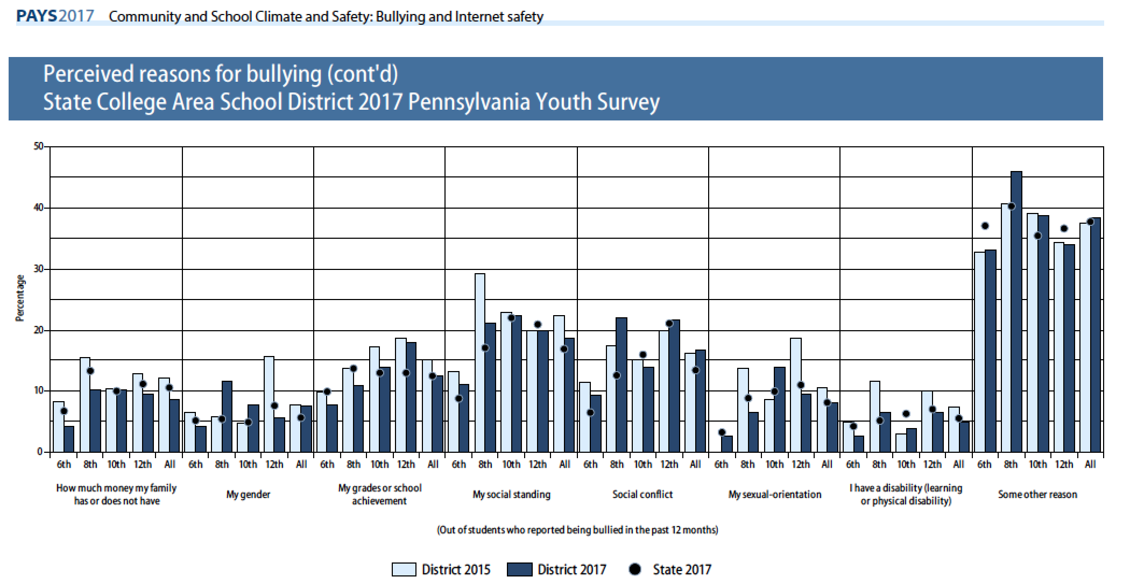

Slide 31
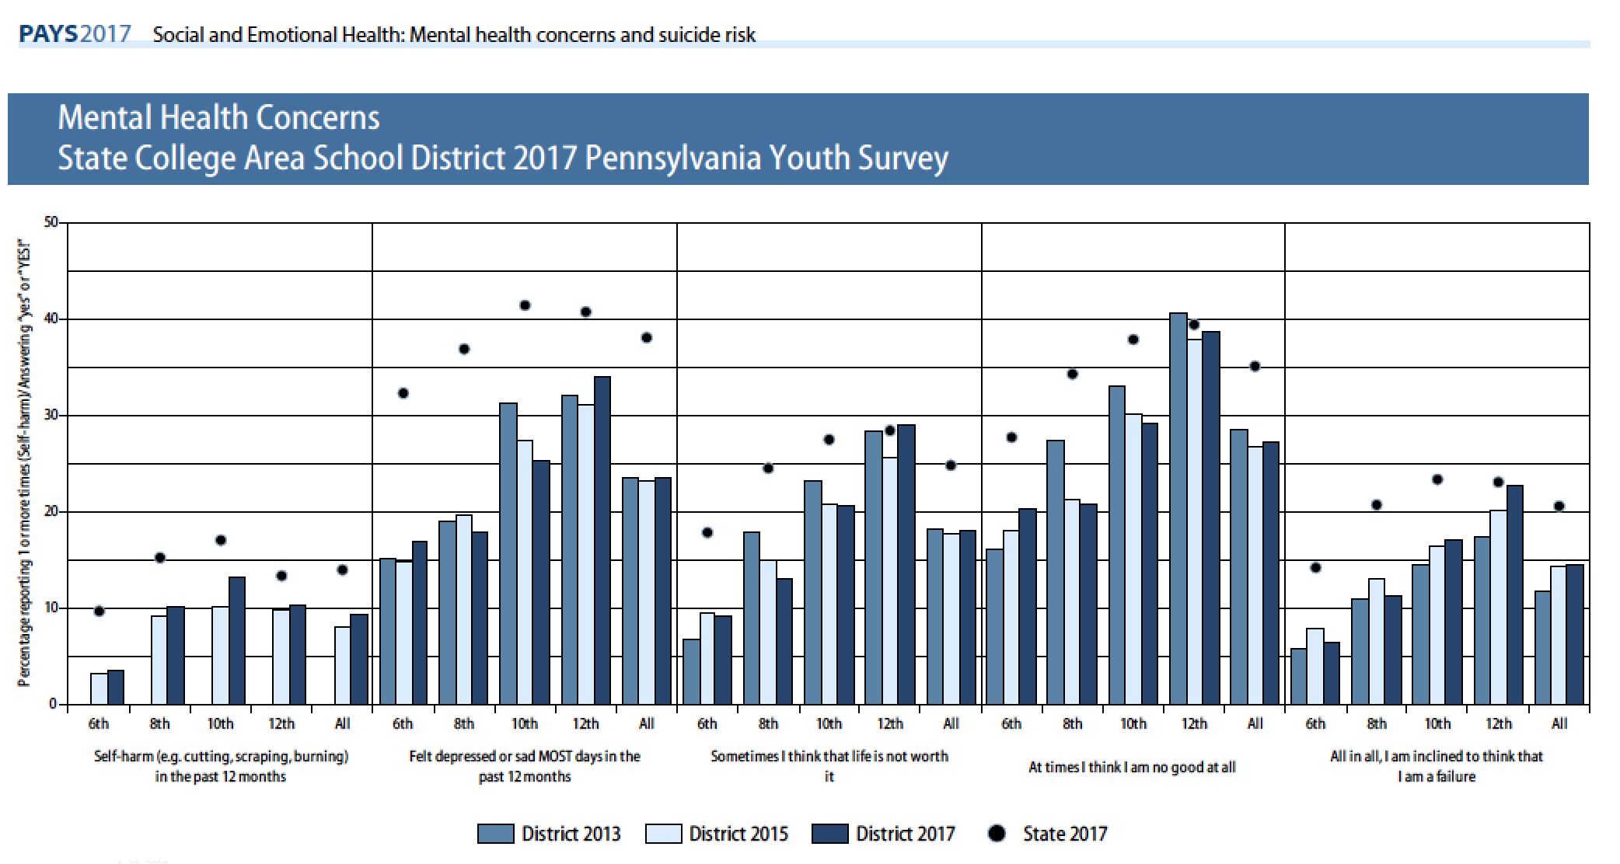

Slide 32
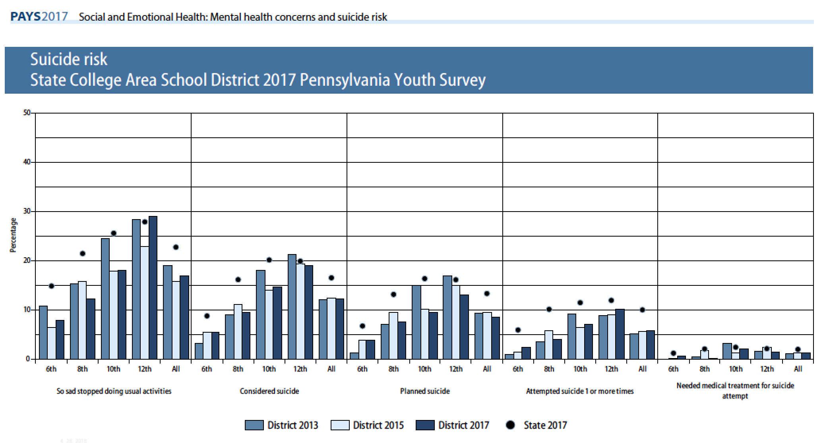

Slide 33
SCASD Programs and Services Aimed to Support Positive Mental Health
9th Grade Learning Communities Act 211 Programming Casings Conference Attendance/Professional Development Counseling Services Family & Community Engagement Services LGBTA Alliance Health Courses HEARTS/RIT Programs Home School Visitor Instructional Support Team Integrated Mental Health Services Little Lion Ambassadors My Mental Health Matters Club Professional Learning Communities Psychological Services | Restorative Practices/Conferencing Safety Care School Resource Officer School Wide Positive Behavior/ ROAR Straight Talk Programs Stompers Project – Jana Marie Foundation Student Assistance Program Suicide Prevention Training Support Programs TIDES Transition Services Universal Screening For Behavior and Emotional Needs Youth Mental Health First Aide Training After School Activities and Clubs

Slide 34
Protective Factors
(higher is better)

Slide 35
Community and Family Risk Factors (lower is better)

Slide 36
School and Individual Risk Factors

Slide 37
School and Individual Risk Factors

Slide 38
Past 30 Day Use

Slide 39
Past 30 Day Use of Gateway Drugs

Slide 40
Alcohol – Past 30 Day Use

Slide 41
Prescription Drug Use Lifetime
Notes:
12th 3 students per %
10th 4 students per %
8th 4.5 student per %
6th 4 students per %

Slide 42
Marijuana – Past 30 Day Use

Slide 43
Cigarettes – Past 30 Day Use

Slide 44
Frequency of Bullying by Student Indicating some Bullying in Past Year

Slide 45
Perceived Reasons For Bullying

Slide 46
Perceived Reasons For Bullying

Slide 47
Social & Emotional Concerns

Slide 48
Programs/Initiatives 2017-2019
Implementing School Wide Positive Behavior Supports District wide
Restorative Practices Train the Trainer
Straight Talk Task Force
Implementation of Mindfulness Staff Trainings
Implementation of elementary counseling curriculum resource and increase 2 counselors at elementary level
Universal Screening for Behavior grades 6-12

