Slide 1

Education for Children and Youth Experiencing Homelessness
Region #6

Slide 2
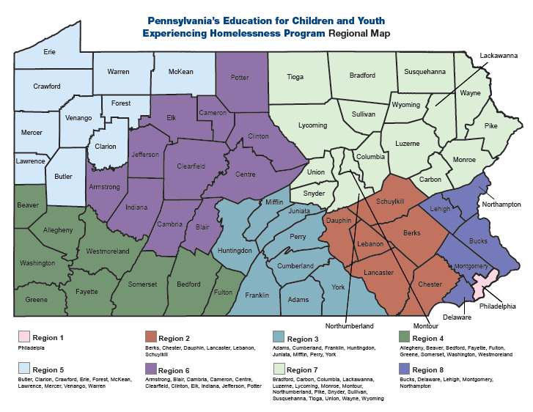

Slide 3

What is the
Pennsylvania’s Education for the Children and Youth Experiencing Homelessness Program:
Assures the implementation of the federal legislation, McKinney-Vento Homeless Assistance Act established in 1987
Supports children Birth through graduation of high school
  Early Intervention, Pre-School Programs, School-Age
Divided into 8 regions across the state of Pennsylvania

Slide 4

McKinney-Vento Homeless Assistance Act
Homeless children and youth have equal access to the same, free, appropriate, public education; including preschool education, as provided to other children and youth.

Slide 5

Definition of a Homeless Student:
A child or youth who lack a fixed, regular, and adequate night-time residence.
  Public or private shelters
  Places not designed for/or ordinarily used as regular sleeping accommodations: hotels, motels, vehicles, parks, campgrounds, etc.
  Doubled up with friends or relatives due to a lack of housing
  Children of migrant families who lack adequate housing

Slide 6


Continued, Definition of a homeless student:
School-age, single mothers or expectant teens living in homes for unwed mothers when they have no other available accommodations
Runaways, who have been abandoned or forced out of the home

Slide 7

How Do Schools Determine Homelessness?
Was there an event?
  Death
  Divorce
  Domestic Violence
  Flood
  Fire
  Illness
  Incarceration
  Runaway
  Separated from family
  Thrown Out/ Kicked Out

Slide 8

McKinney-Vento Homeless Assistance Act
Educational rights include:
  Choice to attend school of origin or school of current residence
  Immediate enrollment
  Assistance from school district in obtaining required documentation; ie: immunization records
  Prompt access to appropriate education services
  Transportation
  Free breakfast and lunch

Slide 9
Who is your districts Homeless Liaison?
Jeanne Knouse – Director of Student Services
  240 Villa Crest Drive
  State College PA 16801
  (814)231-1054

Slide 10

F
For additional support or information,
Please contact:
Andrea Sheesley
Regional Coordinator
  ARIN IU 28
  724-463-5300
  ext. 1235
asheesley@iu28.org

