Slide 1

Board of Education
FY 2024-2025
Budget
Reconvening of the Annual Town Meeting June 3, 2024
Board of Education Members
Susan Lannon, Chairperson
Danny Rovero, Vice Chairperson
Laura Dombkowski
Meredith Giambattista
Laura Lawrence
Kevin Marcoux
Kelly Martin
Misty Murdock
Kyle Napierata
Student Board Members: Phillip Purcell, Anya Oliverson, Sherry Simoneau, Melody Kettle

Slide 2
FY 2024-25 Budget Development
Department Level Budget Development:
October-November
District Level Budget Development: November-December
Preliminary Budget: February 14
Budget Workshops: February-March
Board Approval: March 13
BOE Presentation to Town Council: April 2
Public Hearing: April 11
Annual Town Meeting: May 6
Budget Referendum: May 14 (Fail)
Town Council Deliberation: May 21
Reconvened Town Meeting: June 3
2nd Referendum: June 11
Notes:
On may 14th the town and boe budget failed - unfortunately. I know we along with the town council are disappointed with this result bc a lot of effort and time go into crafting the budgets and presenting them- but as it is a re-eval year townspeople were understandably concerned about their taxes. The BOE budget received 298 yes votes and 375 no votes. 351 of those voters throught the budget was too high and 27 thought it was too low. So when a budget fails the town council convenes and deliberates on an amount to reduce. The TC can reduce particular line items on their budgets but only an overall amount for the BOE budget. After much deliberation there was a motion made that included a 125K reduction to the BOE budget.
Today I will explain briefly the history of this year’s budget process - and how we will reduce the additional 125K.

Slide 3
Introduce 0-based budgeting to administrative team
Administrators reduced their budgets by 15%. Moved some summer school expenses into a grant. Total reduction: -$438,056 (.93%)
$48,699,886 4.05%
Town council reduction to the BOE budget:
- $703,722 $47,508,839 1.5%
MR .38mil
Propose $125,000 reductions to bring BOE budget to:
$47,383,839 1.24%
MR .32mil
Fall 2023
February 2024
April 2024
June 2024
January 2024
March 2024
May 2024
Preliminary Budget
$49,137,943 4.98%
District & BOE made further reductions and unanimously adopted
$48,212,561 3.01% MR .78mil
Referendum fails &
Town Council reduces BOE budget by an additional
-$125,000
Notes:
So let's dive in - in the fall I introduced a 0 based budgeting approach to the administrative team. It was a new strategy for the team- 0- based budgeting requires each purchase to be itemized and justified. In other words you build your budget one justified line by one justified line. We made this decision because sometimes you just have to clear all the lines out and start from scratch to make sure everything we have in our budget is supporting our educational goal and we do not have any overlap or redundancy in purchases across departments. It was a long and tedious process but in the end we were able to reduce our nearly all of our budget lines, with the exception of salaries.- so that strategy was well worth it.
So after building up our budgets line by line - and taking into consideration our contracted salaries we had a preliminary budget of 49 million 0r 4.98% increase over last year… clearly too high- so back to the drawing boards,
In feb I asked the administors to reduce their budgets by 15% we moves some of our summer school costs into existing grants and we reduced 483K which brought the budget down to 4.05% increase…. Still too high.
So in March prior to presenting budget options to the BOE we analyzed all of our current budget lines. In the spring there is sometimes savings to be found in salary and benefits lines. You may wonder why that is… well if a position isn't filled for the entire year or a new hire does not take benefits there is a saving there. Also we found some savings in utilities, we have moved to natural gas and have installed many solar panels and we are beginning to see potential savings there. So at the end of the March BOE meeting, the members unanimously voted on a budget that is 48 212 561- or 3.01% this wouldhave a .78 effect on the mill rate
After our BOE adots a budget the budget is sent to the town council for deliberation. This year, after that deliberation, the town council requested a reduction of 703,722 to the boe’s budget- this would bring our budget down to 47 million which would be a 1.5% increase from last year and a .38 effect on the mill rate
After the failed referendum the town council deliberated and reduced the BOE budget by an additional 125K our budget now stands at 47,383.839 which is a 1,24% increase - this would Have a .32 effect on the mil rate
Effect on the mil rate

Slide 4
Town Council Reductions
BOE Adopted Budget
$48,212,561 3.01%
Town Council Reduction
$703,722.22
$47,508,839 1.50%
Further Town Council Reductions
$125,000
$47,383,839 1.24%
Notes:
Here we have a quick synopsis of how the numbers have trended since March- i want to linger on the first town council reduction of 703, 722 for just a moment to explain what those reductions looked like.
First there were natural savings that occurred through hiring next year’s vacant positions at a lower step- sometimes a new hire might not take benefits- this will continue to happen as we fill antici[alte vacancies for next year. To be clear there are not always savings when you fill a vacancy- it can work in the opposite as well if you hire an educator on a higher student than the one who help the position previously.
Then we reduced the IT budget again and reduced the KIS library aide to half time. Another reduction was made when we decided not to fill the vacant teacher of the deaf positions. Wer had two teachers of the deaf and when one resigned we reviewed how many students required services from this specialized educator and were confidence we would be able to provide those services with one teacher of the deaf- we also found some other funding sources. For us, other funding sources are mainly grants - and by moving these positions into grants we were able to save 97K.
Additionally we made a couple maneuvers that held some risk. The first reduced agency place tuition to 0 - this is a tuition to place a studnet in an out of district setting where the placement is determined by an agency- most often DCF. we had 190K budgeted for this tuition. If i s important to know aht there are years we do not have any students agency placed and there are some years we have several. If we do have students that require tuition we will take the tuition from our non lapsing account.
Lastly- we increased excess cost reimbursement estimate - this is the funding that the state provides to districts to assist in their special education costs. The unfortunate things about the excess cost grant is that districts never know at what percent they will be reimbursed until the spring. So these are always best guesses. WWe had initially budgeted more conservatively but increasing the reimentumnet estimate up to 70% recognizes a savings of - 205K
And that is a quick summary of how we reduced the town council’s irst reduction of 703K. As I mentioned earlier, after the failed referendum, the TC reduced the BOE budget by an additional 125. I would liek to spend the next few slides explaining how we can make those reductions. But before I do- I wanted to read this slide to the audience. This has been our philosophy throughout our budget process this year.

Slide 5
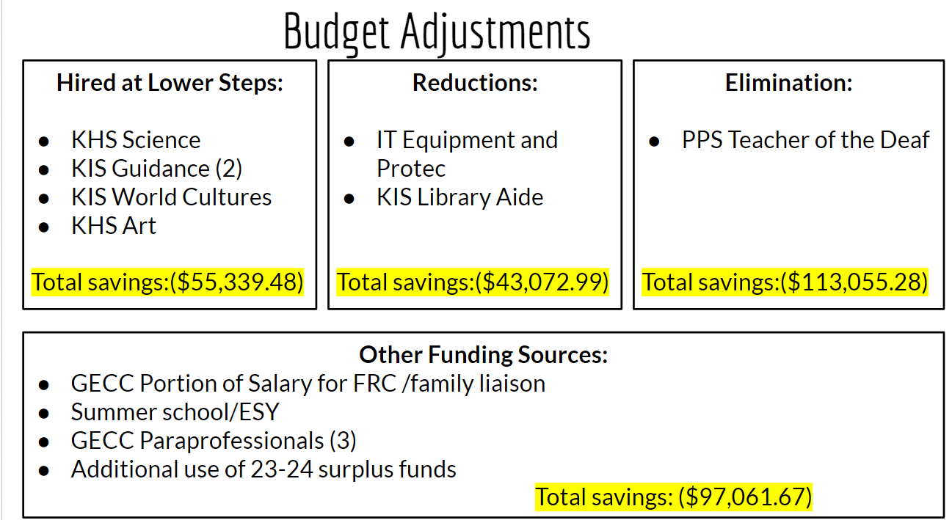

Slide 6
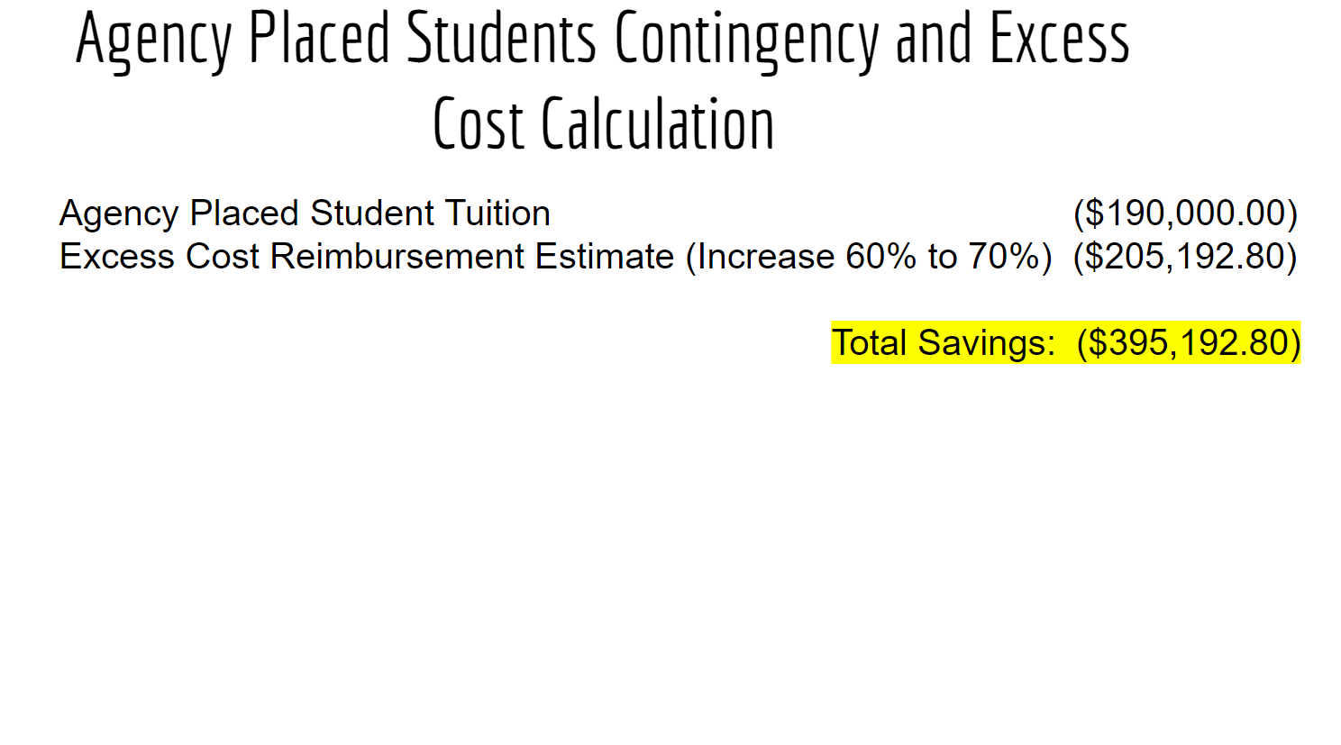

Slide 7
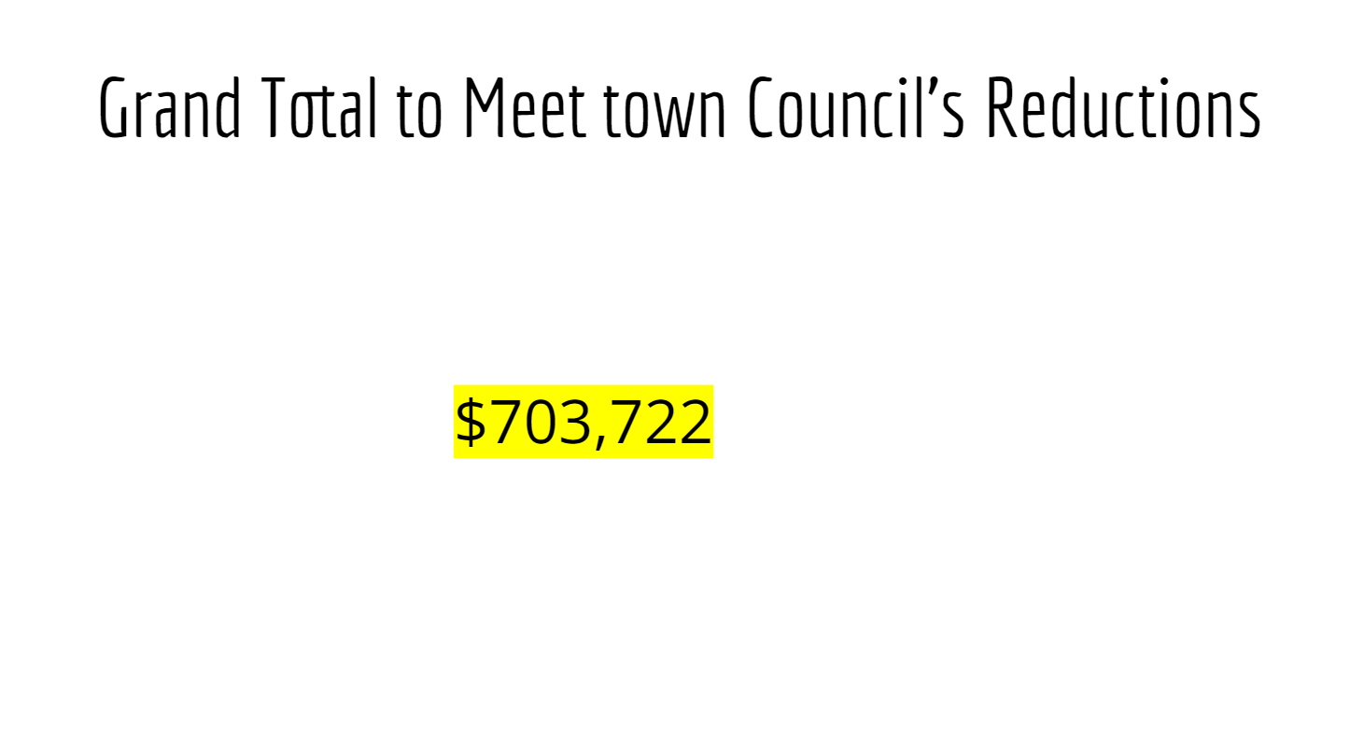

Slide 8
Town Council Reductions
BOE Adopted Budget
$48,212,561 3.01%
Town Council Reduction
$703,722.22
$47,508,839 1.50%
Further Town Council Reductions
$125,000
$47,383,839 1.24%
Notes:
Here we have a quick synopsis of how the numbers have trended since March- i want to linger on the first town council reduction of 703, 722 for just a moment to explain what those reductions looked like.
First there were natural savings that occurred through hiring next year’s vacant positions at a lower step- sometimes a new hire might not take benefits- this will continue to happen as we fill antici[alte vacancies for next year. To be clear there are not always savings when you fill a vacancy- it can work in the opposite as well if you hire an educator on a higher student than the one who help the position previously.
Then we reduced the IT budget again and reduced the KIS library aide to half time. Another reduction was made when we decided not to fill the vacant teacher of the deaf positions. Wer had two teachers of the deaf and when one resigned we reviewed how many students required services from this specialized educator and were confidence we would be able to provide those services with one teacher of the deaf- we also found some other funding sources. For us, other funding sources are mainly grants - and by moving these positions into grants we were able to save 97K.
Additionally we made a couple maneuvers that held some risk. The first reduced agency place tuition to 0 - this is a tuition to place a studnet in an out of district setting where the placement is determined by an agency- most often DCF. we had 190K budgeted for this tuition. If i s important to know aht there are years we do not have any students agency placed and there are some years we have several. If we do have students that require tuition we will take the tuition from our non lapsing account.
Lastly- we increased excess cost reimbursement estimate - this is the funding that the state provides to districts to assist in their special education costs. The unfortunate things about the excess cost grant is that districts never know at what percent they will be reimbursed until the spring. So these are always best guesses. WWe had initially budgeted more conservatively but increasing the reimentumnet estimate up to 70% recognizes a savings of - 205K
And that is a quick summary of how we reduced the town council’s irst reduction of 703K. As I mentioned earlier, after the failed referendum, the TC reduced the BOE budget by an additional 125. I would liek to spend the next few slides explaining how we can make those reductions. But before I do- I wanted to read this slide to the audience. This has been our philosophy throughout our budget process this year.

Slide 9
We are proud of the experiences our students receive in Killingly Public Schools. Those experiences are made possible by our dedicated staff- ALL staff play a role in this experience.
We will not impact our students’ superior experiences ….
Notes:
And to that end I will presnet two ideas to reduce additional 125K that do not impact positions or programs

Slide 10
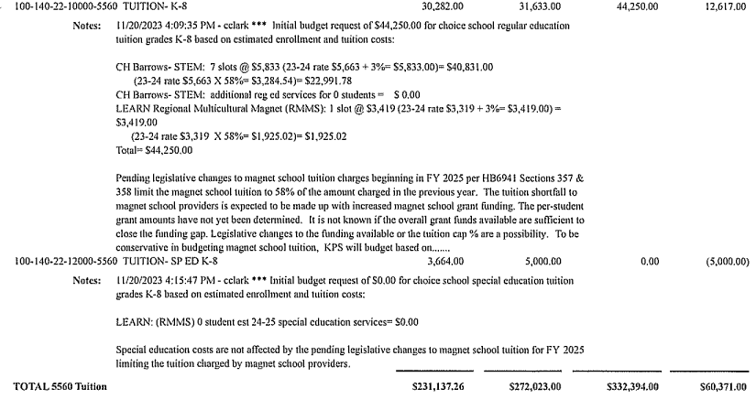
New
Legislation
The house bill# 5523 was passed on May 7th. It confirms that for the next school year the amount of tuition that towns can collect is reduced to 58% of what has been previously collected. Based on the number of magnet school slots KPS budgets for, we will save: $111,061
Notes:
When we initially presented our budget back in the january and february workshops there was a note in our budget book that spoke od pending legislation. If the legislation passed it would reduce what sending districts would pay a for tuition for students attending magnet schools. We like most districts have some students that attend magnet schools. The legislation passed last month and was just signed by the governor last week. As a result, based on the 44 slots we have budgeted for students attending Magaet schools next year will find a savings of 11, 061.

Slide 11
Possible Reduction Plan
Increase Excess Cost Reimbursement to 71% - $13,939
Savings in Magnet School Tuition - $111,061
Total - $125,000
Notes:
So in this first ideas for reducing 125K is to use the savings on magnet school tuition and increase the excess cost reimbursement estimate up from 70 to 71 and this would be a savings of 125

Slide 12
Another Plan
Increase Excess Cost Reimbursement to 75% - $73,282
Reduce Special Education Tuition - $51,718
Total - $125,000
Notes:
Another ideas to reduce 125K would be to increase the excess cost reimbursement to 75% and to reduce special education tuition, knowing that if needed we would use non lapsing to cover special education tuition overages.
Ultimately the BOE will decide what path to take here - but the impoartnat part is that at this current time we are still able to hold true to not cutting any filled positions or programs that would impact our students experiences in KPS

Slide 13
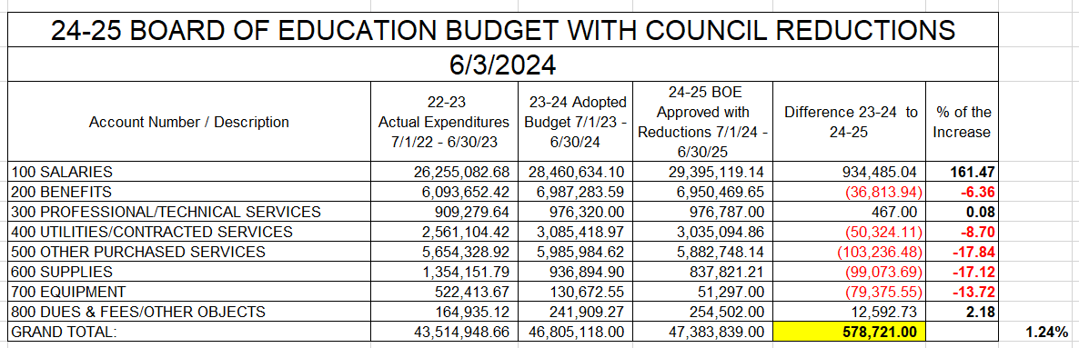
% of the Increase
Notes:
Here is how the budget lines look when compared to last year- as expected salaries are the biggest increase - it should be known that most of our salaries are negotiated contracts- and thus cannot be adjusted outside of negotiations. Our personnel committee as well as our full BOE has recognized the need to be competitive so as to fill out positions and has done tremendous work to increase contracted salaries to make killingly a more attractive place to work. This is why there is such a large increase to that line. To offset that larger increase we had to be very diligent with the other lines we have more control over. Benefits actually came in a bit lower this year- we budgeted a bit less for utilities based on some of the current patterns we are seeing, supplies were significantly reduced. And to be 100% transparents we did use roughly 700K in surplus from this year to pre purchase supplies and equipment from next year's’ budget and thus we were able to significantly reduce those lines
If all the negative lines are flat - and the teacher and para contract requirements are 2.09 — minimum increase of 2.87

Slide 14
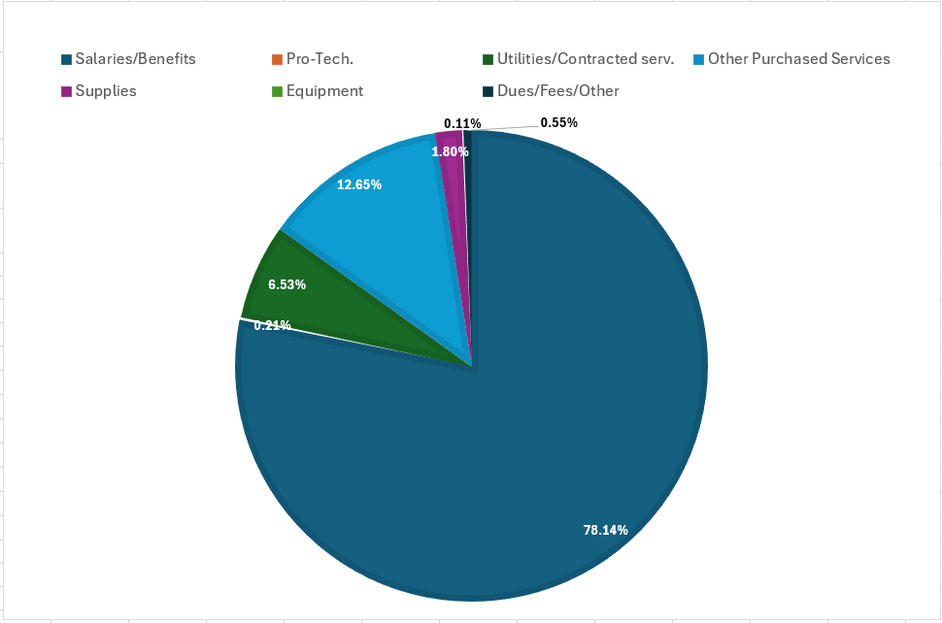
% of the Budget
Notes:
Another way to look at this is to see the budget as a whole and the percentage each part makes up of the budget - again there is no surprise here that salaries and benefits make up the majority of the budget

Slide 15
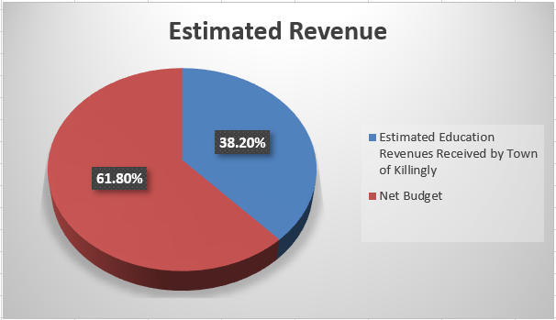
2024-2025 BOE Budget(with Town Council Reductions) | $47,383,839
Estimated Education Revenues Received by Town of Killingly | ($18,099,923)
Net Budget | $29,283,916
Notes:
Another aspect of the budget to consider is that we do take in revenue. We have many tuition paying students that attend out high school. We receive an agriculture operating grant for our ag program at the high school as well as an education cost sharing funds form the state- and so we generate roughly 18 million dollars in revenue to offset the education budget.

Slide 16
% of the Increase
Notes:
Here is how the budget lines look when compared to last year- as expected salaries are the biggest increase - it should be known that most of our salaries are negotiated contracts- and thus cannot be adjusted outside of negotiations. Our personnel committee as well as our full BOE has recognized the need to be competitive so as to fill out positions and has done tremendous work to increase contracted salaries to make killingly a more attractive place to work. This is why there is such a large increase to that line. To offset that larger increase we had to be very diligent with the other lines we have more control over. Benefits actually came in a bit lower this year- we budgeted a bit less for utilities based on some of the current patterns we are seeing, supplies were significantly reduced. And to be 100% transparents we did use roughly 700K in surplus from this year to pre purchase supplies and equipment from next year's’ budget and thus we were able to significantly reduce those lines
If all the negative lines are flat - and the teacher and para contract requirements are 2.09 — minimum increase of 2.87

Slide 17
Minimum Budget Requirement
What is minimum budget requirement (MBR)?
● Connecticut’s MBR prohibits a municipality from budgeting less for education than it did the previous year,
Why does Connecticut have a minimum budget requirement to towns?
● Was implemented to prevent towns from reducing their local spending on education and using state aid for education as a replacement for local funds.
What happens if a town fails to meet its Minimum Budget Requirement?
● If a town fails to meet its MBR, the State can withhold the town’s Education Cost
Sharing (ECS) funds
Notes:
Why does Connecticut have a minimum budget requirement for towns? In 1975, the Connecticut General Assembly created the minimum expenditure requirement, which required towns to spend a minimum amount per pupil on education based on statewide expenditures.2 This requirement, now slightly altered and known as the MBR, was implemented to prevent towns from reducing their local spending on education and using state aid for education as a replacement for local funds, as well as to prevent towns from using state funds targeted for education for other purposes

Slide 18
2024-2025 School Year Scenario
July 1, 2024
Budget: $47,383,839 (1.24%)
Non-Lapsing Total: $2,000,000
Budget: $46,805,118.00 (0% inc)
Non-Lapsing Total: $2,000,000.00
September-December 2024
2 DCF Outplacements= $150,000
October 1, 2024
KIS Heat Repair = $100,000
$950,000
April 1, 2024
Completion of KHS access road = $750,000
$1,050,000
June 14, 2024
In need of $50,000 to cover special Education Tuition

Slide 19
2025-2026 School Year Scenario
Budget: $46,805,118.00 (0% inc)
Non-Lapsing Total: $2,000,000.00
October 2025
Roof Repair KIS
$400,000
July 1, 2025
Budget: $48,373,400 (2.09% inc)
Non-Lapsing Total: $950,000
September-December 2025
1 DCF Outplacement= $75,000
$335,000
June 14, 2026
In need of $140,000 to cover Special Education Tuition
$615,000

Slide 20
$ 703,721 0%

Slide 21
Reductions Scenarios
Teachers - $70,848
Administrators - $71,264
Non-Certified- $11,015
$250,000
*
$550,000
$700,000
3.5 teachers
or
3.5 administrators
or
22.5 non-certified
8 teachers
or
8 administrator
or
50 non-certified
10 teachers
or
10 administrators
or
64 non-certified

Slide 22
2024-2025 School Year Scenario
Budget: $46,805,118 0%
Non-Lapsing: $2,000,000

