Slide 1


2016 EDUCATOR & EVALUATION SYSTEM AND OASYS UPDATES

Slide 2
Presentation Outline
  Beginning of the Year Conference Updates
  Evidence Collection Tool
  Walk-Through Forms
  Evaluation Waiver
  Summative Form Updates
  Learning Loop Overview
  How to view past evaluation portfolios
  Student Learning Objectives (SLOs)
Notes:
Any item that is in bold, blue font is linked directly to the form.

Slide 3
BEGINNING OF THE YEAR CONFERENCE

Slide 4
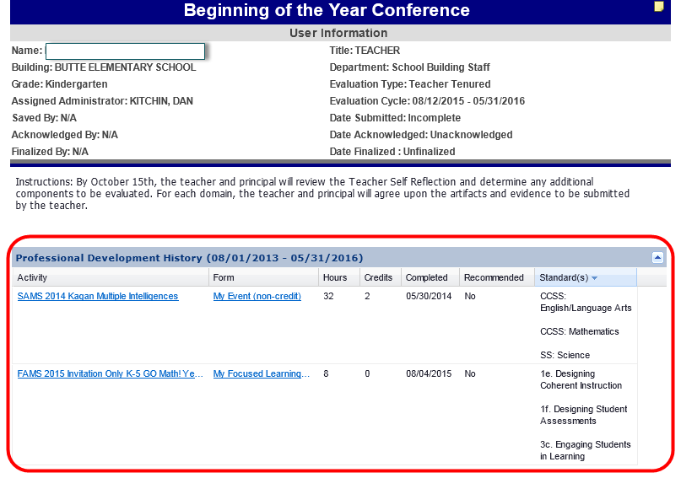
Beginning of the Year Conference
Includes PD Summary for user

Slide 5
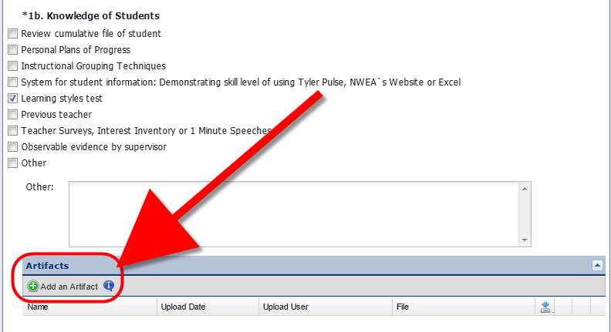
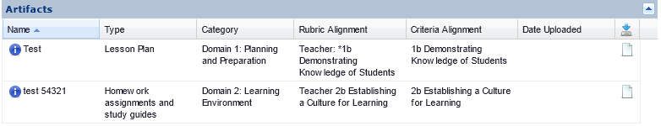
Beginning of the Year Conference
Artifact upload toolbar under each required component
Artifact Summary report at bottom of form for
Administrator convenience

Slide 6
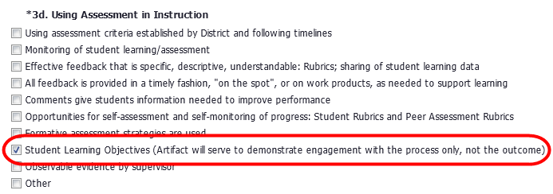
Beginning of the Year Conference
3d. Using Assessment in Instruction
  Student Learning Objectives (Artifact will serve to demonstrate engagement with the process only, not the outcome)
  Automatically checked for Teachers, Instructional Specialists, Librarians and Principals

Slide 7
EVIDENCE COLLECTION TOOL

Slide 8
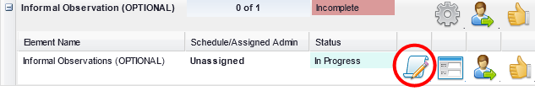
Evidence Collection
The Evidence Collection feature of OASYS allows for quick and convenient note taking during observations with automatic date and timestamping
To use the Evidence Collection tool, simply open the necessary form by using the “Paper Scroll” icon

Slide 9
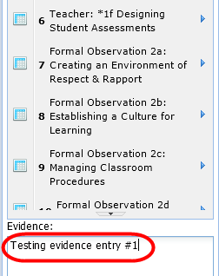
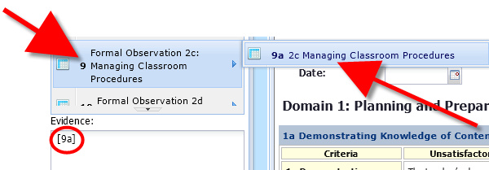
Evidence Collection
The form will open with a notes sidebar
Simply type in the Evidence box and press enter and any notes you take will be saved
You can also align any evidence by clicking on the rubric and criteria, the selected rubric will appear in the evidence box, and you simply type your evidence and press enter

Slide 10
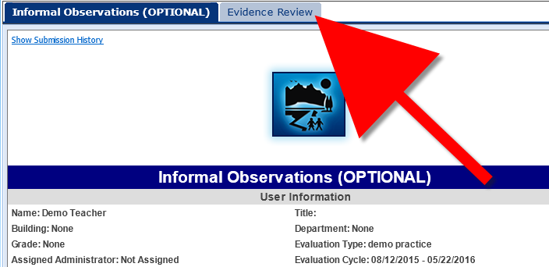
Evidence Collection
After you have completed your collection you can review it by clicking on the Evidence Review tab
Aligned Evidence will show under the Aligned tab
Unaligned Evidence will show under the Unaligned tab

Slide 11
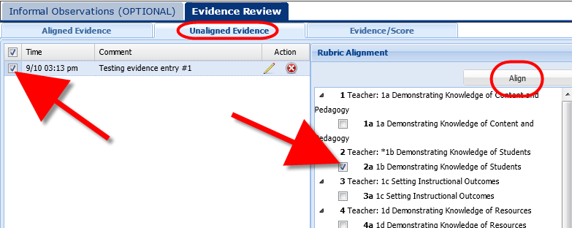
Evidence Collection
Please Note: Any evidence that you want to show on a user’s form will need to be aligned AND synched
  Under the Unaligned Evidence Tab, select the evidence you want to align
  Then on the right select the necessary rubric alignment and click: Align

Slide 12
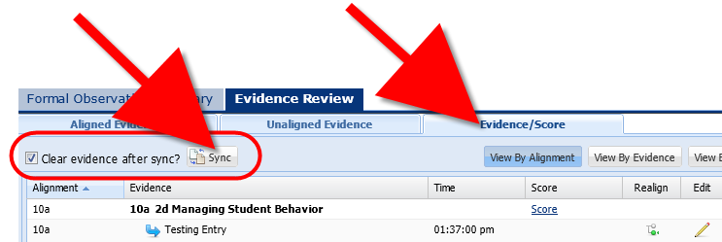
Evidence Collection
To SYNCH your evidence so that it appears on your users form:
  Go to the Evidence/Score tab
  Click SYNCH
  Note: If you select: Clear Evidence After Synch evidence will only be removed from the Evidence Review tab

Slide 13
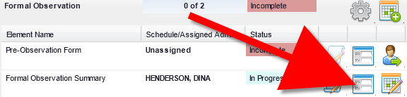
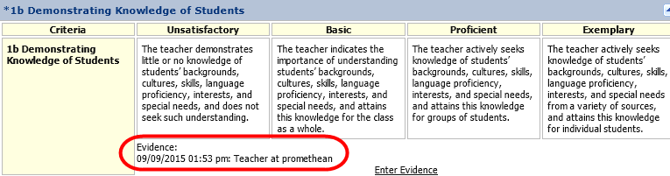
Evidence Collection
After synching the form will close, reopen the form (without the evidence tool) and you will see your evidence under each component with the date and time it was entered

Slide 14
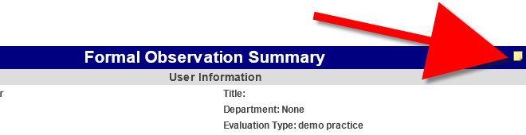
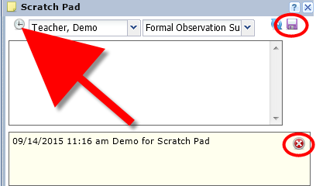
Evidence Collection
There is also a Scratch Pad icon at the top of each form in the header bar
Enter in notes as needed and click the floppy disk to save
Use the clock icon in the left corner for a timestamp
Use the red X to delete

Slide 15
WALK-THROUGH FORMS

Slide 16
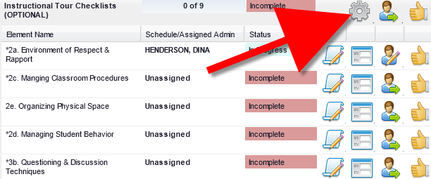
Walk-Through Forms
Instructional Tour Checklists (OPTIONAL)
  Each component a separate form for Domains 2 and 3
  Optional use: If you want to remove them from users use the Gear Icon and set the instances to zero
  Users cannot see these forms until submitted by administrator

Slide 17
EVALUATION WAIVER

Slide 18
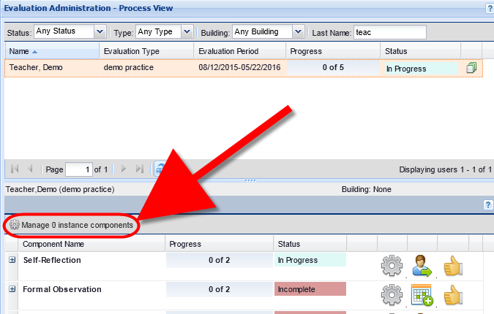
Evaluation Waiver
To assign a user the Evaluation Waiver in OASYS go to the Process View
Click on: “Manage 0 Component Instances”

Slide 19

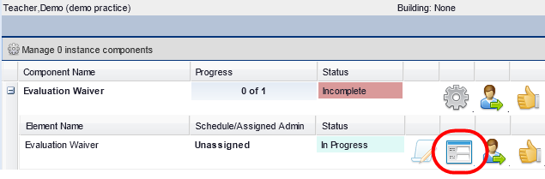
Evaluation Waiver
In the “Manage Components” box that opens, for the Evaluation Waiver form, type in the number “1” and press enter
The Waiver form appears in the Employee’s list of forms and can be viewed and filled out by clicking on the “View Form” button

Slide 20
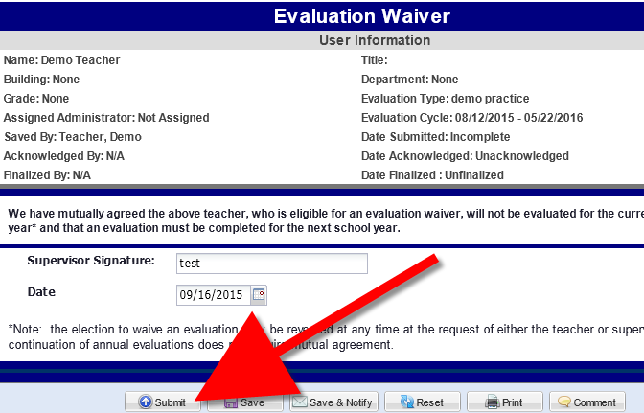
Evaluation Waiver
Put in the date and type in your digital signature
SUBMIT the form
The user will receive the form and Acknowledge it
You can finalize the form after user acknowledgement

Slide 21


Evaluation Waiver
To remove forms that users will not be using, use the Gear Icon in the Process View
At the folder level of the forms that you want to remove, click on the Gear Icon
In the “Manage Instances” box, type in the number “0” and submit

Slide 22
Evaluation Waiver
The forms disappear from your view, as well as the users
If your user has filled out some of the forms and you would like to leave them in their MLP, then do not change the instances to “0”.

Slide 23
SUMMATIVE FORM

Slide 24
Summative Form
Plan of Improvement/Professional Growth added
Administrator digital signature required
Employee signature NOT required
  Employees Acknowledge the form in OASYS and acknowledgment serves as consent
  If there is a disagreement, employee will submit comments on the form
No paper forms submitted to HR

Slide 25
LEARNING LOOP

Slide 26
Learning Loop
Basic or Unsatisfactory rating in any component on Summative form will trigger the Learning Loop (Potential recommended areas for PD)
Currently only built for standard teacher evaluation

Slide 27
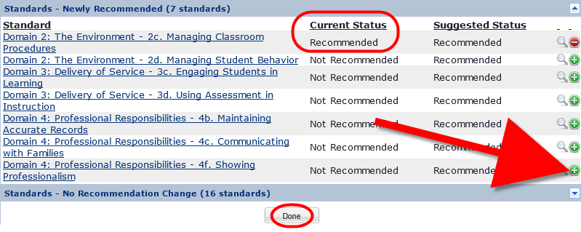
Learning Loop
After submitting the Summative Form the system will generate recommended areas of PD based on the ratings selected
Select the green plus sign next to the standard you would like to recommend PD for
The status will change to ‘Recommended”

Slide 28
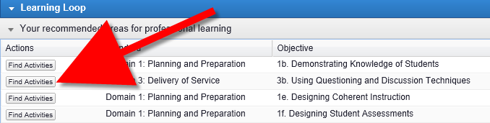
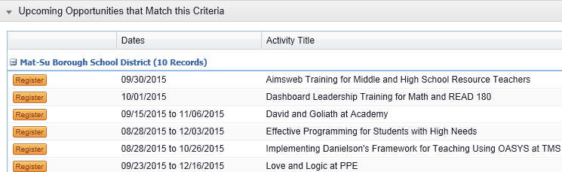
Learning Loop
The user will see the recommended areas when they login to MLP:

Slide 29
ARCHIVE EVALUATION PORTFLIOS

Slide 30
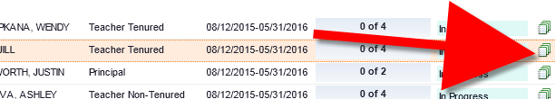

Archived Evaluations
All evaluations completed in OASYS are archived in the Process View
Locate the staff members name
On the far right, click on the Paper Stack Icon
All archived evaluations and artifacts will be listed
Click the Plus sign to expand the folder to view the files

Slide 31
STUDENT LEARNING OBJECTIVES (SLO)

Slide 32
SLOs
All type A, B, and M are required to do the SLO process this year
Documents are available on the HR website
  Will be completed electronically
  Template is being built
Monica Goyette & Dina Henderson will offer multiple webinars on October 16th and November 11th
  Staff only need to attend one section.

Slide 33

Questions?

