Slide 1


Lorain City School District
November 2023 Forecast Submission
Fiscal Year 2024

Slide 2

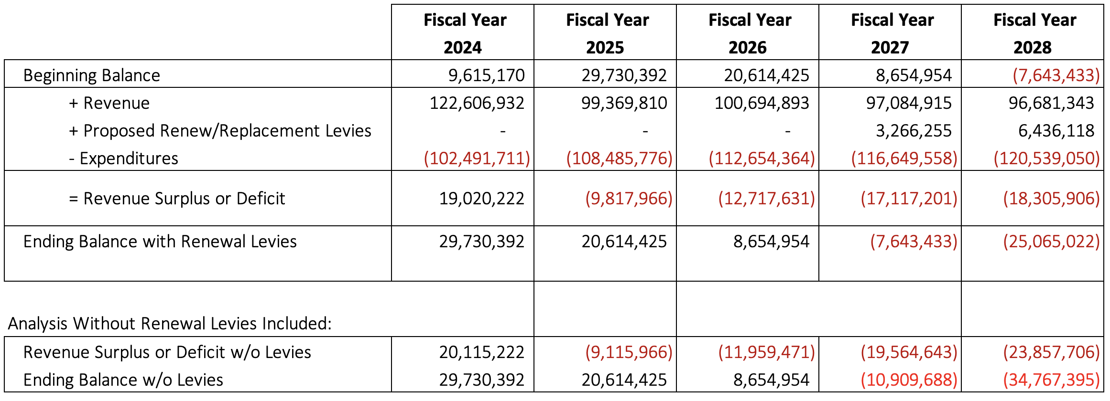
Simplified Five Year Forecast

Slide 3

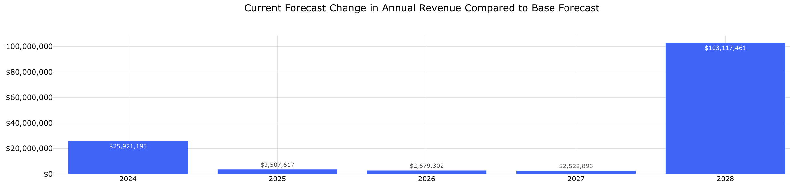
What Has Changed in Revenue Since May?
Increases:
  Unrestricted Grants-In-Aid: $3.25M
  Continuity of Services Transfer from ESSER: $17M
  Advances-In

Slide 4
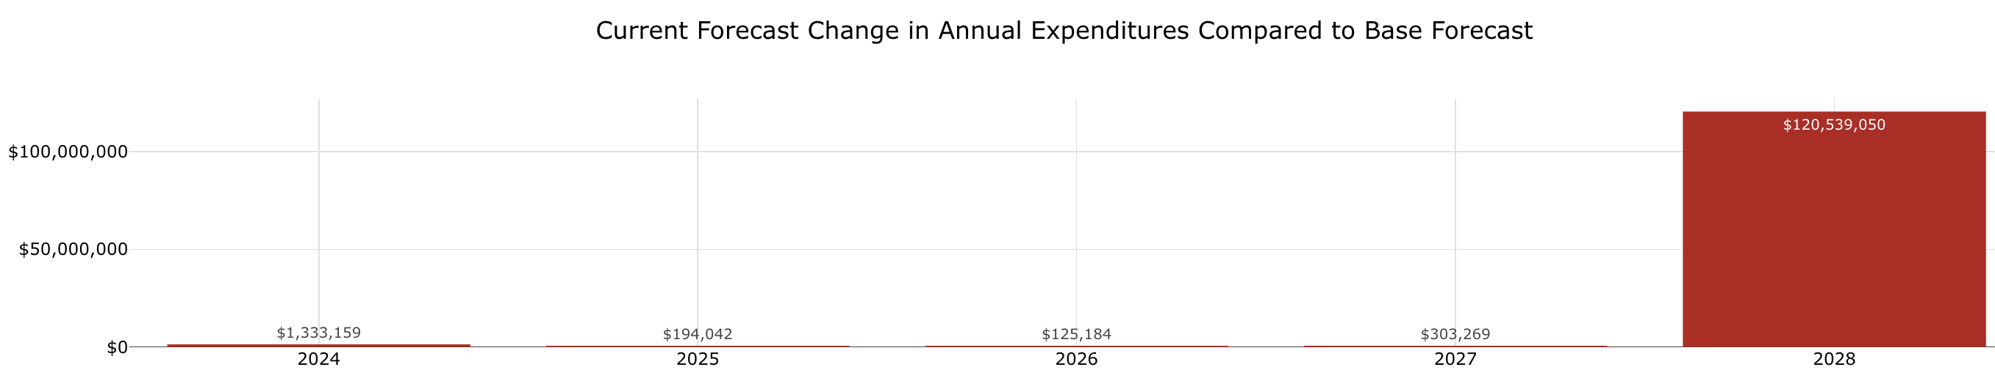
What Has Changed with Expenditures Since May?
  Increases
  Purchased Services Currently Funded by ESSER: $607K
  Supplies Currently Funded by ESSER: $763K

Slide 5
ESSER Spending Review

Slide 6
ESSER Allocations
Round 1: | $ 3,937,192.99
Round 2: | $16,647,146.55
Round 3: | $37,413,681.66
Total: | $57,998,021.20

Slide 7
ESSER Restrictions
Authorized ESSER Activities
  Safely reopen schools
  Measure and effectively address significant learning loss
  Other actions to mitigate the impact of COVID-19 on the students and families who depend on our K-12 schools
Maintenance of Equity & Maintenance of Effort
  Requirement to spend at least the same amount of state and local general funds from year to year
  PENALTY for non-compliance
    A portion of Title, IDEA, and ESSER funds would have to be returned to the state
    Forced to use more general fund dollars due to loss of federal & state funding

Slide 8
ESSER Spending
ESSER I
  Initial losses in revenue
  Initial costs due to the pandemic
  Must be used by September 2023
ESSER II
  Bridge gap between initial pandemic expenses & continuity plan for academic and non-academic services
  Must be used by September 2023
ESSER III
  Continuity plan
  Must be used by September 2024

Slide 9
ESSER II & ESSER III Spending
$54M in ESSER II and ESSER III allocated to be spent by FY2024
  Approximately $12M: Staff
    Includes: Elementary School Counselors, Wellness Coaches, Behavior Specialists, Additional Fine Arts Teachers, Class Coverage, and additional substitute costs
  Approximately $17M: Programs, Services, and Supplies
    Includes: Recovery Learning Programing, Arts Expansion, After School Programing, Computers, Medical Buses, Cleaning Supplies, and PPE
  Approximately $8M: District-Wide Roofing Project
  Approximately $17M: Reimbursement to General Fund for FY21 Salaries
    ESSER Category: “other activities that are necessary to maintain the operation of, and continuity of services, in the local education agency, and continuing to employ existing staff of the local education agency.”

Slide 10
Funding Sources for Construction Projects
Permanent Improvement Fund (PI)
  Campagna Park Project - $1.8M
  Transportation and Technology Facility - $1.9M
  Safety Mass Communication System - $3M
  Flexible Seating at LHS - $345K
Locally Funded Initiatives Fund (LFI)
  George Daniel Stadium Improvement Project - $2.5M

Slide 11
Planning for May’s Forecast
Potential Future Construction Projects
  Resource Facility
  Expansions at LHS
  Alternative School Updates,
  Relocation of the Current Administration Building
ESSER Spending
Evaluation of Programs, Services, and Initiatives
Current Levies and/or New Levy

