Slide 1

Lorain City School District
November 2021 Five Year Forecast

Slide 2

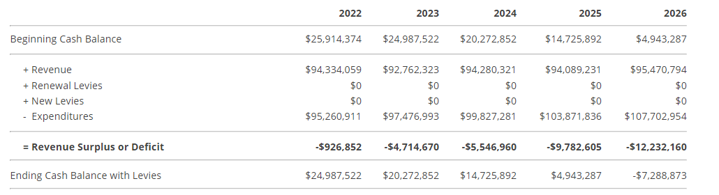
Simplified Five Year Forecast

Slide 3

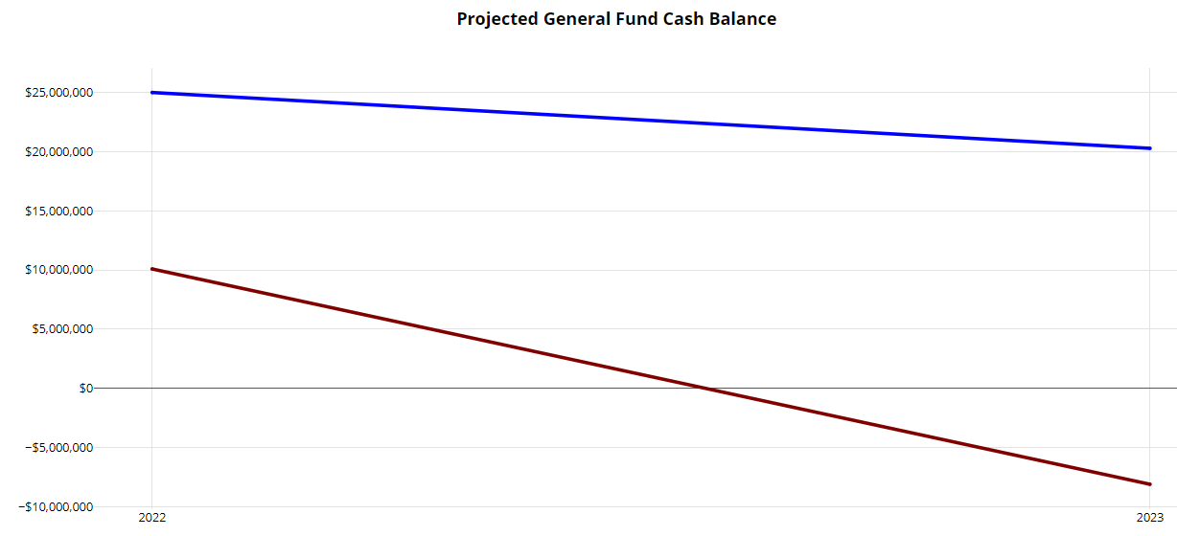
How Does This Forecast compare to the May Forecast?

Slide 4
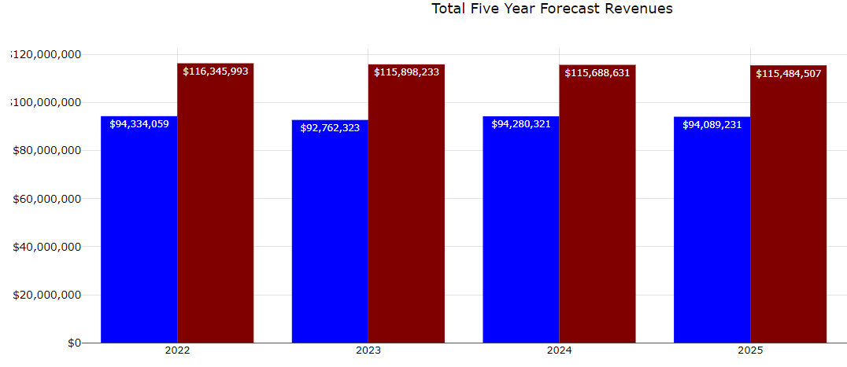

What Has Changed in Revenue Since May?
Increases in property tax revenue due to changes in property values and increases in collection rates
The State of Ohio adopted a new state funding formula that dramatically changes:
  State Revenue projections
  How tuition related students are funded and accounted for by school districts
    - This dramatically effects Other Revenue line and Purchases Services
  How Student Wellness Funds are accounted for
Fiscal Year 2021 Year-End Actual Revenues came in 1.7% or $2.062 Million more than the May Forecast Projections

Slide 5
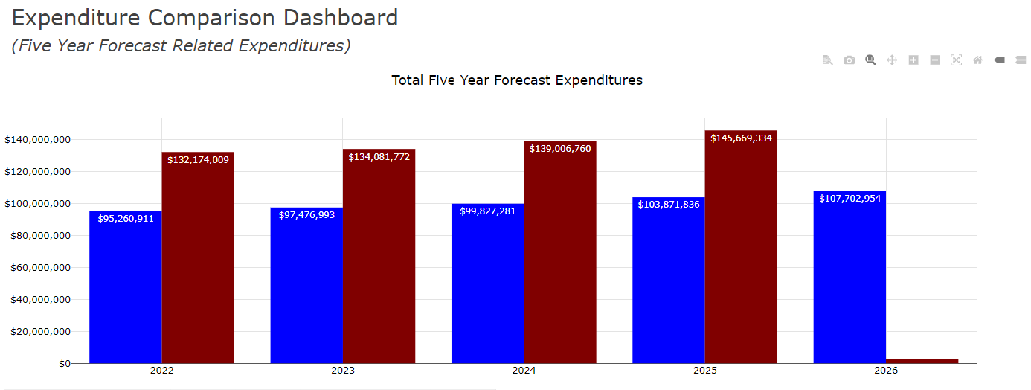

What Has Changed with Expenditures Since May?
The district had numerous staff leave at the end of fiscal year 2021/beginning of fiscal year 2022
  This resulted in cost savings due to higher costing staff being replaced with staff lower on the salary schedule
  There are still a number of vacated positions that have not been filled for the current fiscal year
Health Insurance premiums increases came in under May projections
Fiscal Year End 2021 Actual Expenditures came in 1% or $1.2 Millions less than the May Forecast

Slide 6
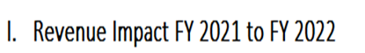
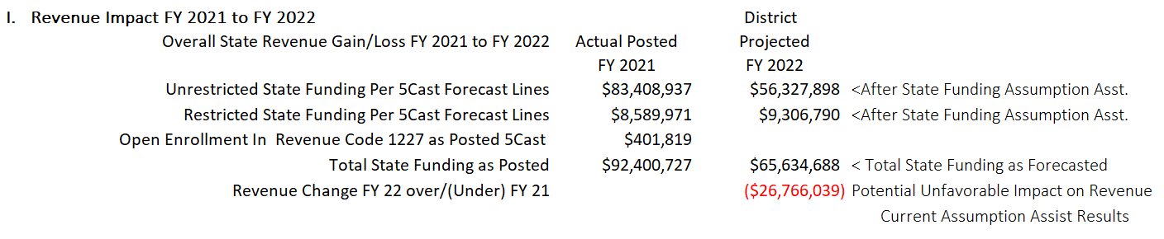
How has the new State Funding Formula Impacted the District’s forecast?

Slide 7
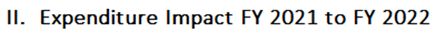
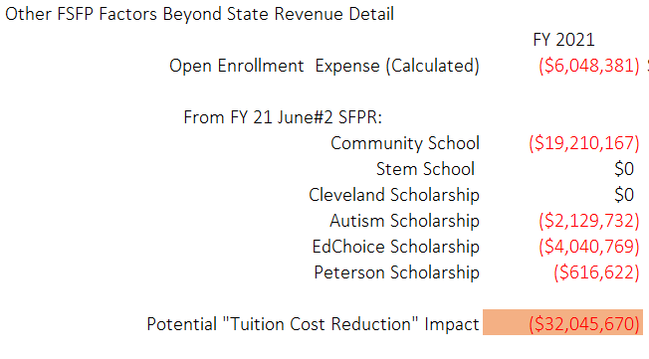
How has the new State Funding Formula Impacted the District’s forecast?

Slide 8
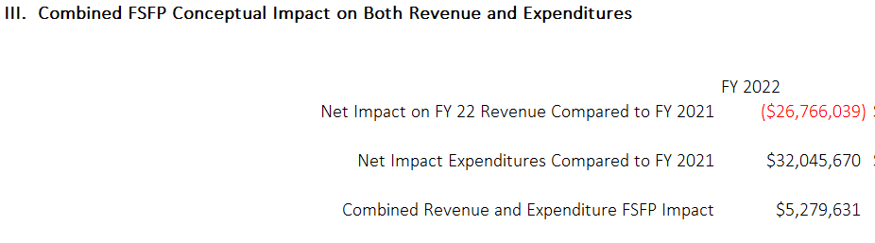
How has the new State Funding Formula Impacted the District’s Forecast?

Slide 9
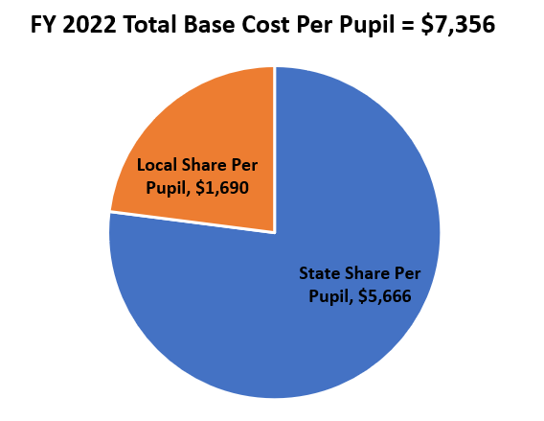
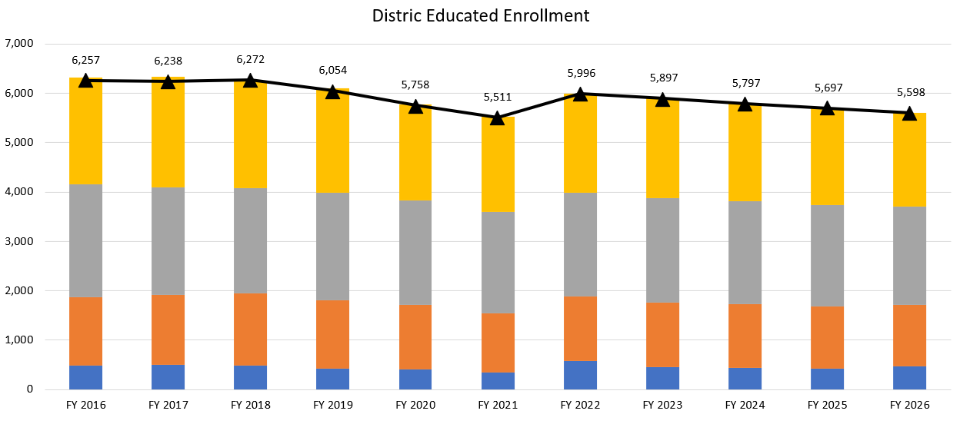
How has does current enrollment impact Forecast?

Slide 10
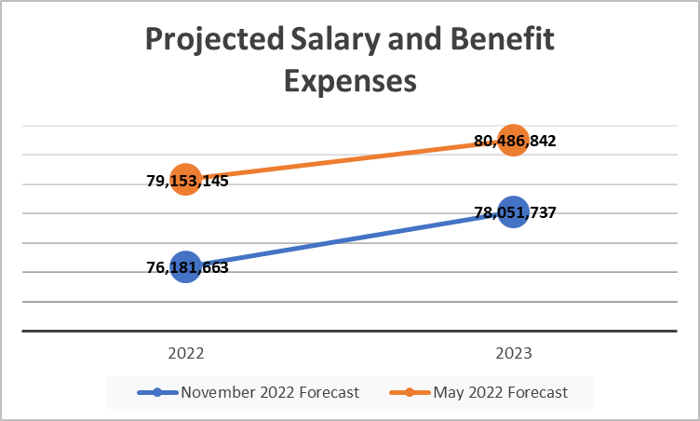
What changed in Salary and Benefit projections?
$827,201 in FY 2022 and additional $410,365 in salary costs savings due to retirees/resignations being replaced with lower costs staff in FY 2022
$325,000 reductions in costs due to unfilled positions that won’t be filled until FY 2023
Lower than anticipated health insurance premium increases combined with savings in salary driven fringe benefits from costs savings noted above = $1,338,403 in FY 2022 and $1,803,976 in FY 2023

Slide 11
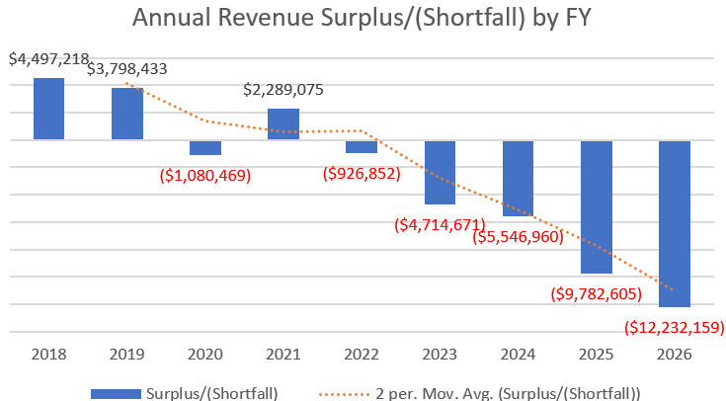
How does this impact the District’s financial stability

Slide 12
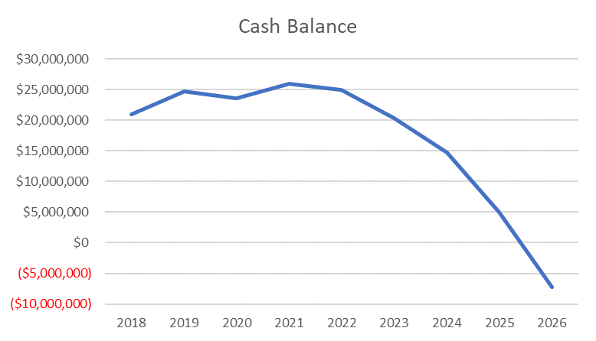
How Does this impact the District’s financial stability

Slide 13
