Slide 1

Lorain City School District
May 2022 Forecast Submission
Fiscal Year 2022 Update

Slide 2
Lorain City School District
Fiscal Year 2022 Update

Slide 3

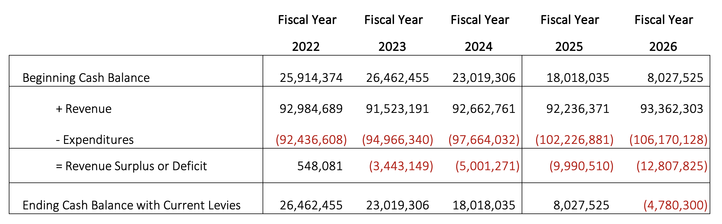
Simplified Five Year Forecast

Slide 4

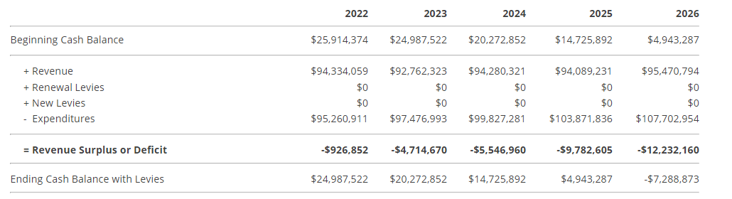
How Does
This Forecast Compare to the November Forecast?
November 2021
May 2022

Slide 5
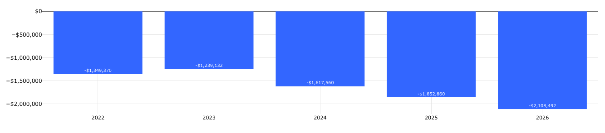
What Has Changed in Revenue Since November?
Total revenue for FY 2022 was $1.35M or 1.43% lower than projected in November
  Property Tax: $330K increase
  All Other Revenue: $236K increase
  State Aide: $2M decrease
    Enrollment numbers updated to reflect 5,617 students
Changes are compounded through the life of the forecast

Slide 6
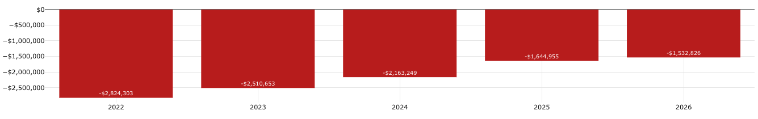
What Has Changed with Expenditures Since November?
Total Expenses were $2.8M or 2.96% less than projected in November.
  Salaries and Benefits: $2M decrease
    Vacant positions and use of ESSER funds
  Purchased Services & Supplies & Materials: $975K decrease
    ESSER funds
  Capital Outlay: $315K increase
    Replacement Vehicles for Operations
These changes are compounded through the life of the current forecast.

Slide 7
ESSER Spending Update

Slide 8
ESSER Allocations
Round 1: | $ 3,937,192.99
Round 2: | $16,647,146.55
Round 3: | $37,413,681.66
Total: | $57,998,021.20

Slide 9
ESSER Restrictions
Authorized ESSER Activities
  Safely reopen schools
  Measure and effectively address significant learning loss
  Other actions to mitigate the impact of COVID-19 on the students and families who depend on our K-12 schools
Maintenance of Equity & Maintenance of Effort
  Requirement to spend at least the same amount of state and local general funds from year to year
  PENALTY for non-compliance
    A portion of Title, IDEA, and ESSER funds would have to be returned to the state
    Forced to use more general fund dollars due to loss of federal & state funding

Slide 10
ESSER Spending
ESSER I
  Initial losses in revenue
  Initial costs due to the pandemic
  Must be used by September 2023
ESSER II
  Bridge gap between initial pandemic expenses & continuity plan for academic and non-academic services
  Must be used by September 2023
ESSER III
  Continuity plan
  Must be used by September 2024

Slide 11
ESSER Spending for FY2023 and FY2024
$40M in ESSER II and ESSER III allocated to be spent in FY2023 and FY2024
  Approximately $8.5M: Programs and Services
    Includes: Recovery Learning Programing, Arts Expansion, After School Programing, Computers, Mercy Clinic Medical Vans, Cleaning Supplies, and PPE
  Approximately $11.5M: Staff
    Includes: Elementary School Counselors, Wellness Coaches, Behavior Specialists, Additional Fine Arts Teachers, Class Coverage, and additional substitute costs
  Approximately $20M: Construction Projects
    Includes: roofing projects, stadium upgrades, and the potential partnership to provide free city-wide internet, helping to resolve accessibility inequities that have plagued our community for decades.

