Slide 1

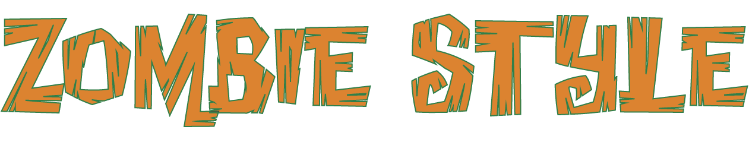

Slide 2
spoken: Uh-oh!
Zombie style!
Zombie style!

Slide 3
Watch out
for walkers
comin’ at you
down the street.

Slide 4
They’re movin’ slowly ’cause they’re draggin’ all their feet.

Slide 5
sing/speak:
But don’t be fooled, they’re really not that cool.

Slide 6
spoken:
They only want to eat, eat, eat.

Slide 7
They want some brainy snacks.

Slide 8
They want some
ooey gooey
ummy nummy
brainy snacks.

Slide 9
They want some
icky wicky
smooshy wooshy brainy snacks.

Slide 10
They want some squishy wishy clammy wammy brainy snacks.

Slide 11
They want brainy snacks.

Slide 12
sing:
When they are movin’, they might be groovin’,

Slide 13
but they are zombies. (spoken solo: Oh!)

Slide 14
They’re really zombies. (spoken solo: Oh!)

Slide 15
They might be dancing while they’re advancing,

Slide 16
but you must run! (spoken solo: Run!)

Slide 17
Oh, you must run! (spoken solo: Run!)

Slide 18
Oh, you must run as fast as you can run
or they might get you!

Slide 19
(solo scream, optional)
(solo zombie: Brains...)
spoken (all): Uh-oh!
Zombie style!

Slide 20
(zombie sounds)
Zombie style!

Slide 21
(zombie: Braaains...)
Uh-oh! Zombie style!

Slide 22
(zombie sounds)
Zombie style!

Slide 23
(zombie: Eat brains...)
Uh-oh! Zombie style!

Slide 24
(zombie sounds)
sing:
Oh, hungry zombie.

Slide 25
(zombie: Hungry...)
spoken: Uh-oh!
Zombie style!

Slide 26
(zombie sounds)
sing:
Oh, hungry zombie.

Slide 27
(zombie: Want brains...)

Slide 28
spoken:
Watch out for walkers movin’ slowly to the beat.

Slide 29
These are the creatures that you just don’t want
to meet.

Slide 30
sing/speak:
So, watch your head, these things are walking dead.

Slide 31
spoken:
They only want to eat, eat, eat.

Slide 32
They want some brainy snacks.

Slide 33
They want some
ooey gooey
ummy nummy
brainy snacks.

Slide 34
They want some
icky wicky
smooshy wooshy brainy snacks.

Slide 35
They want some squishy wishy clammy wammy brainy snacks.

Slide 36
They want brainy snacks.

Slide 37
sing:
When they are movin’, they might be groovin’,

Slide 38
but they are zombies. (spoken solo: Oh!)

Slide 39
They’re really zombies. (spoken solo: Oh!)

Slide 40
They might be dancing while they’re advancing,

Slide 41
but you must run! (spoken solo: Run!)

Slide 42
Oh, you must run! (spoken solo: Run!)

Slide 43
Oh, you must run as fast as you can run
or they might get you!

Slide 44
(solo scream, optional)
(solo zombie: Brains...)

Slide 45
spoken (all):
Uh-oh!
Zombie style!

Slide 46
(zombie sounds)
Zombie style!

Slide 47
(zombie: Braaains...)
Uh-oh! Zombie style!

Slide 48
(zombie sounds)
Zombie style!

Slide 49
(zombie: Eat brains...)
Uh-oh! Zombie style!

Slide 50
(zombie sounds)
sing:
Oh, hungry zombie.

Slide 51
(zombie: Hungry...)
spoken: Uh-oh!
Zombie style!

Slide 52
(zombie sounds)
sing:
Oh, hungry zombie.

Slide 53
(zombie:
Yummy brains...)

Slide 54
(zombie sounds)
sing (divisi, opt.):
Oh, hungry zombie.

Slide 55
(zombie: Need brains!)
spoken: Uh-oh! Zombie style!

Slide 56
(zombie sounds)
sing: Oh,
hungry zombie.

Slide 57
(zombie: Huuungrryy!)
spoken: Uh-oh!
Zombie style!

