Slide 1



Slide 2
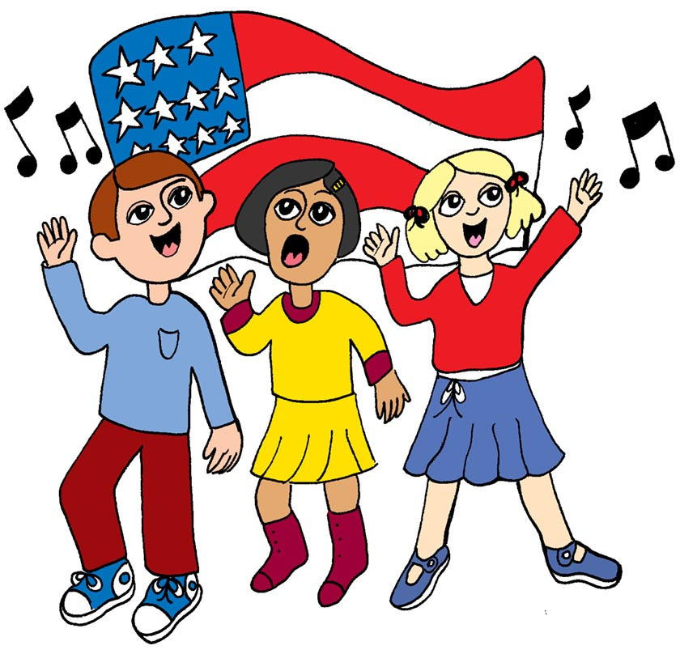
We’re marching for
our veterans to celebrate
their service.
We’re marching for
our veterans to
celebrate them all.

Slide 3
We’re marching for
our veterans to show
respect and honor.
To the veterans of America who heard our country’s call.

Slide 4
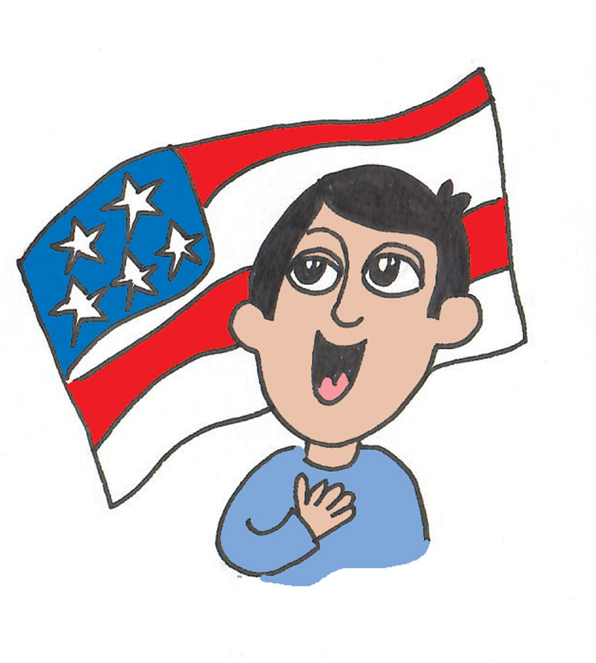
Thank you, thank you
to our veterans.
Thank you, thank you,
thank you
once again.

Slide 5
Thank you, thank you to our veterans.
Thank you from
our country and
its grateful citizens.

Slide 6
We’re marching for
our veterans to celebrate
their service.
We’re marching for
our veterans to
celebrate them all.

Slide 7
We’re marching for
our veterans to show
respect and honor.
To the veterans of America who heard our country’s call.

Slide 8
Thank you, thank you
to our veterans.
Thank you, thank you,
thank you
once again.

Slide 9
Thank you, thank you to our veterans.
Thank you from
our country and
its grateful citizens.

Slide 10
We’re marching for
our veterans to celebrate
their service.
We’re marching for
our veterans to
celebrate them all.

Slide 11
We’re marching for
our veterans to show
respect and honor.
To the veterans of America who heard our country’s call.

Slide 12
We’re marching
for our
(divisi, optional):
veterans!

