Slide 1

Employee Access Center
(EAC) Guide

Slide 2
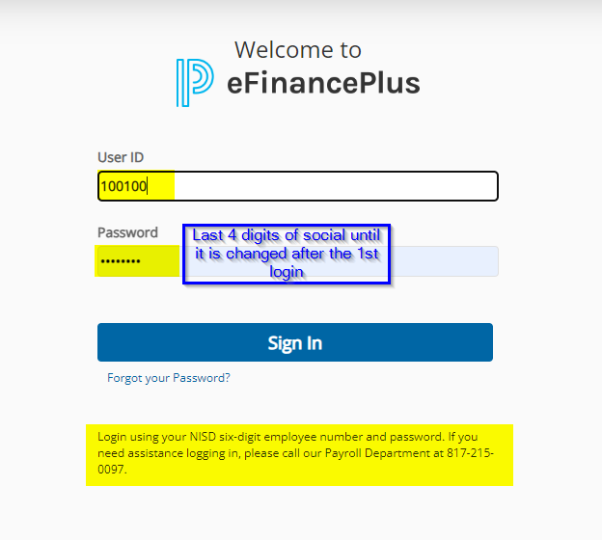
Logging into the EAC

Slide 3
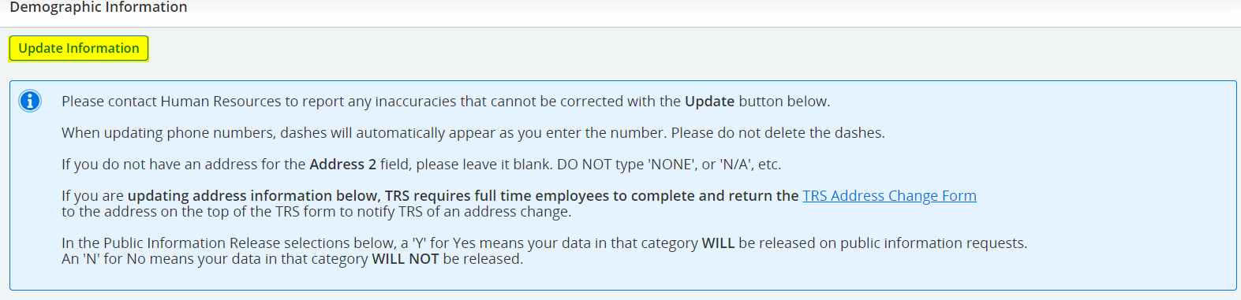
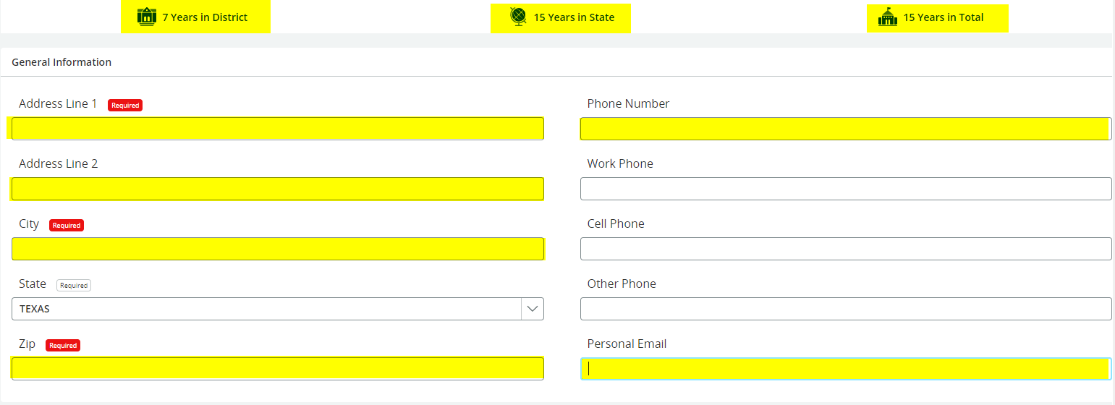
Updating Employee Address

Slide 4
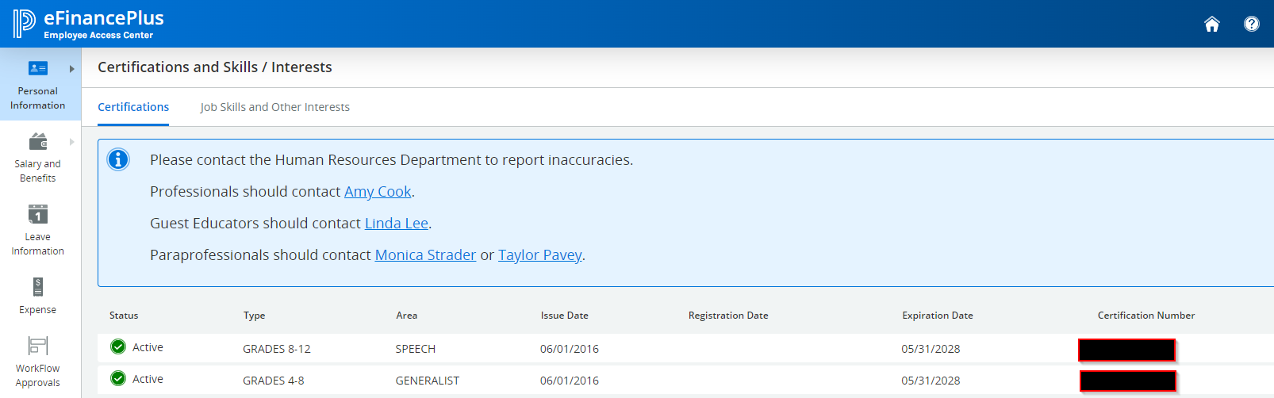

Certifications

Slide 5
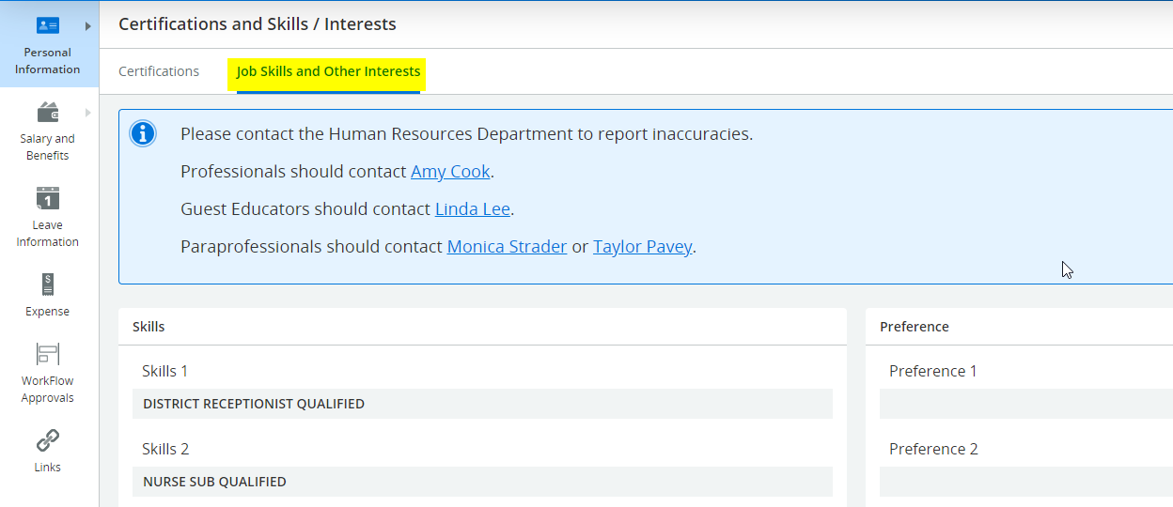
Job Skills

Slide 6
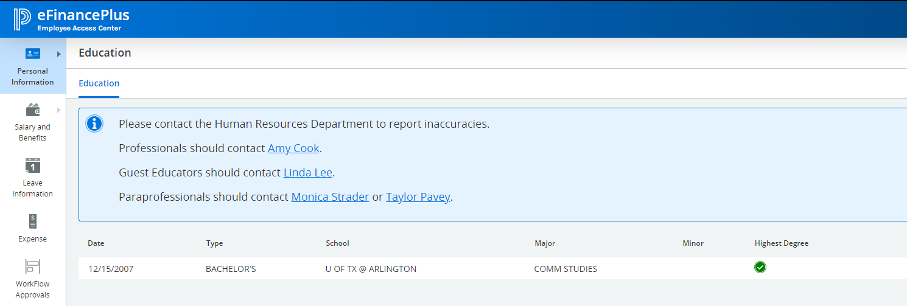
Education/Degrees

Slide 7
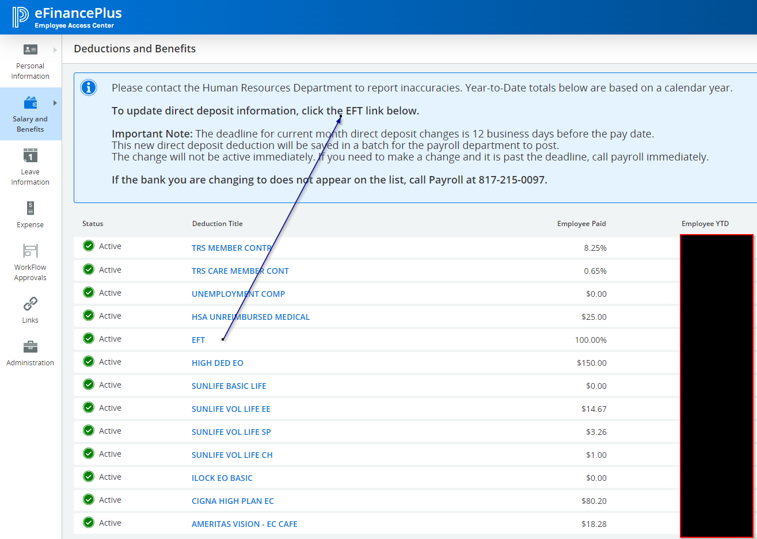
Updating Direct Deposit

Slide 8
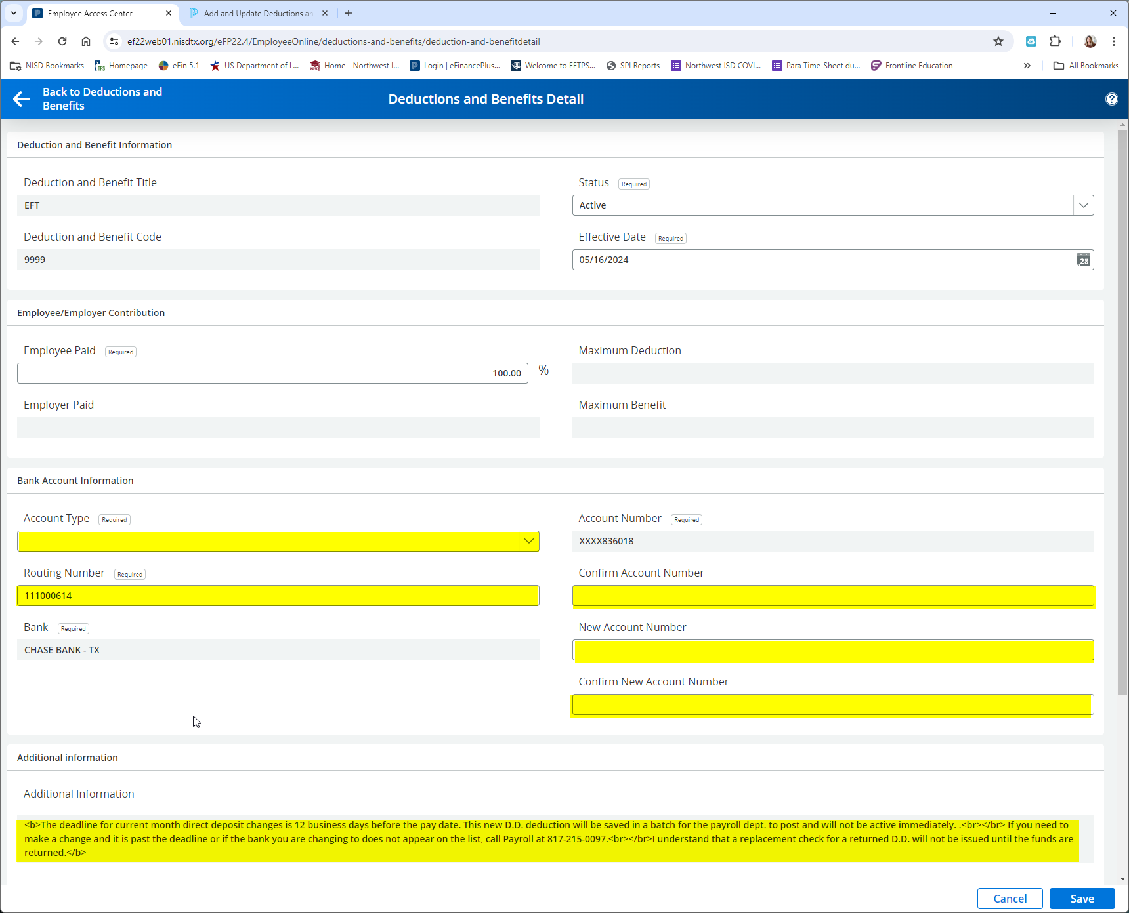

Slide 9
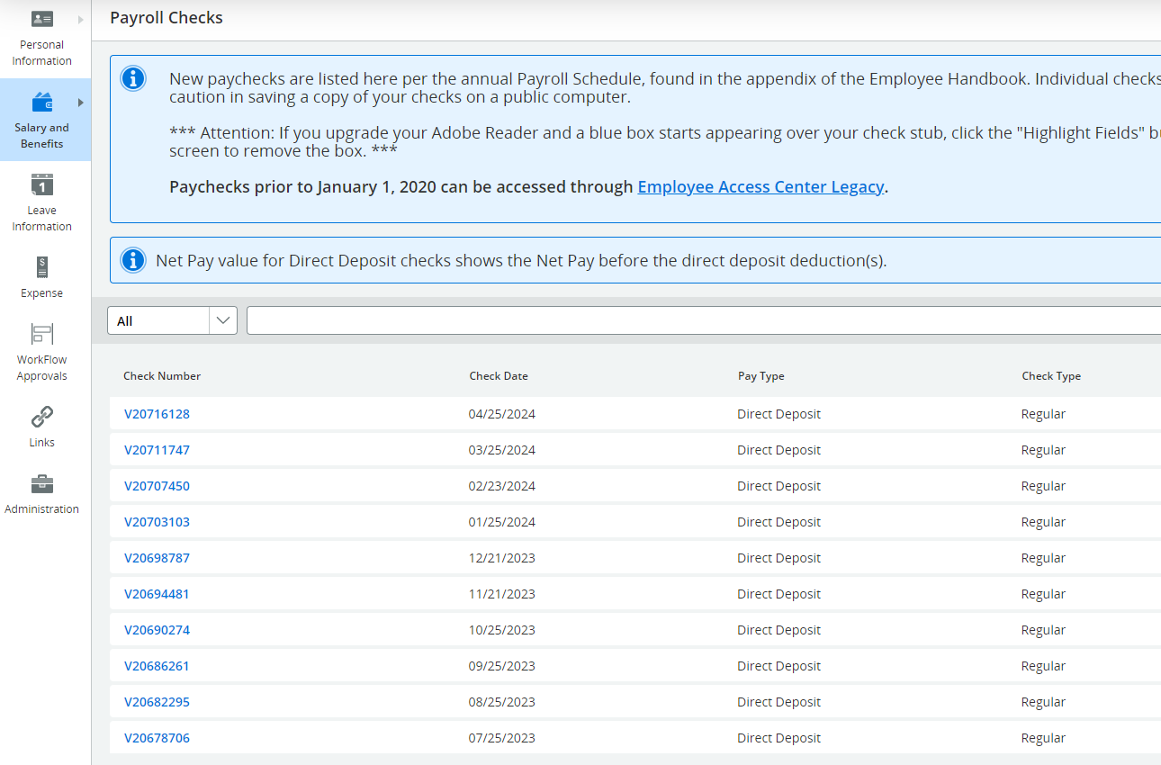
Checks Stubs

Slide 10
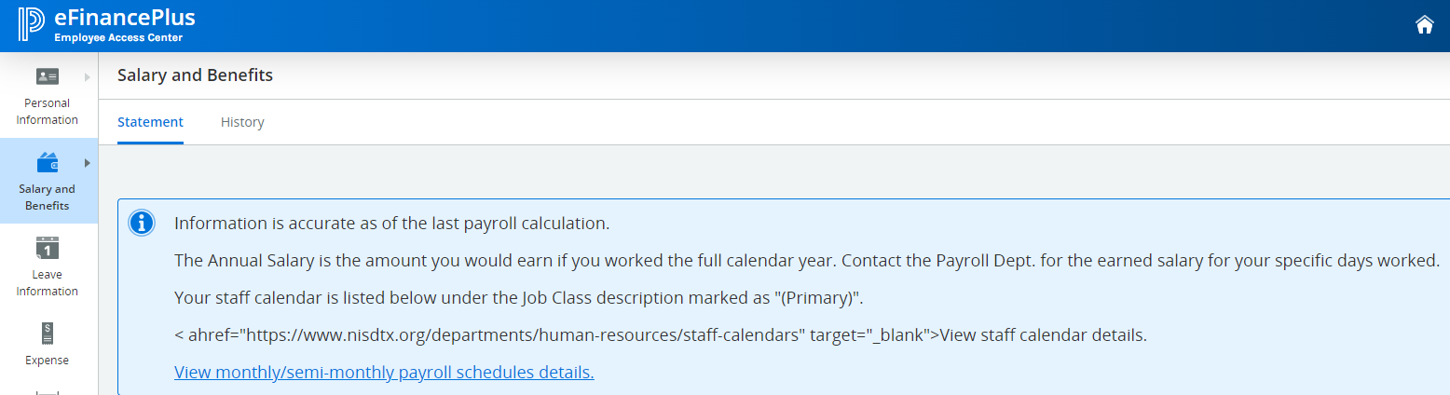
Salary Information
Employee’s location, calendar and Annual salary included in the area

Slide 11
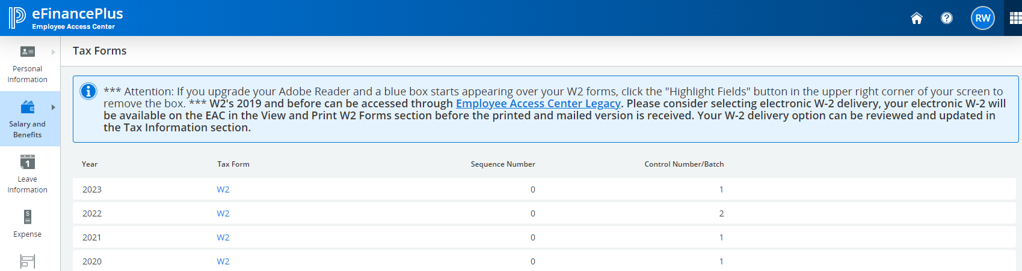
W2 Forms

Slide 12
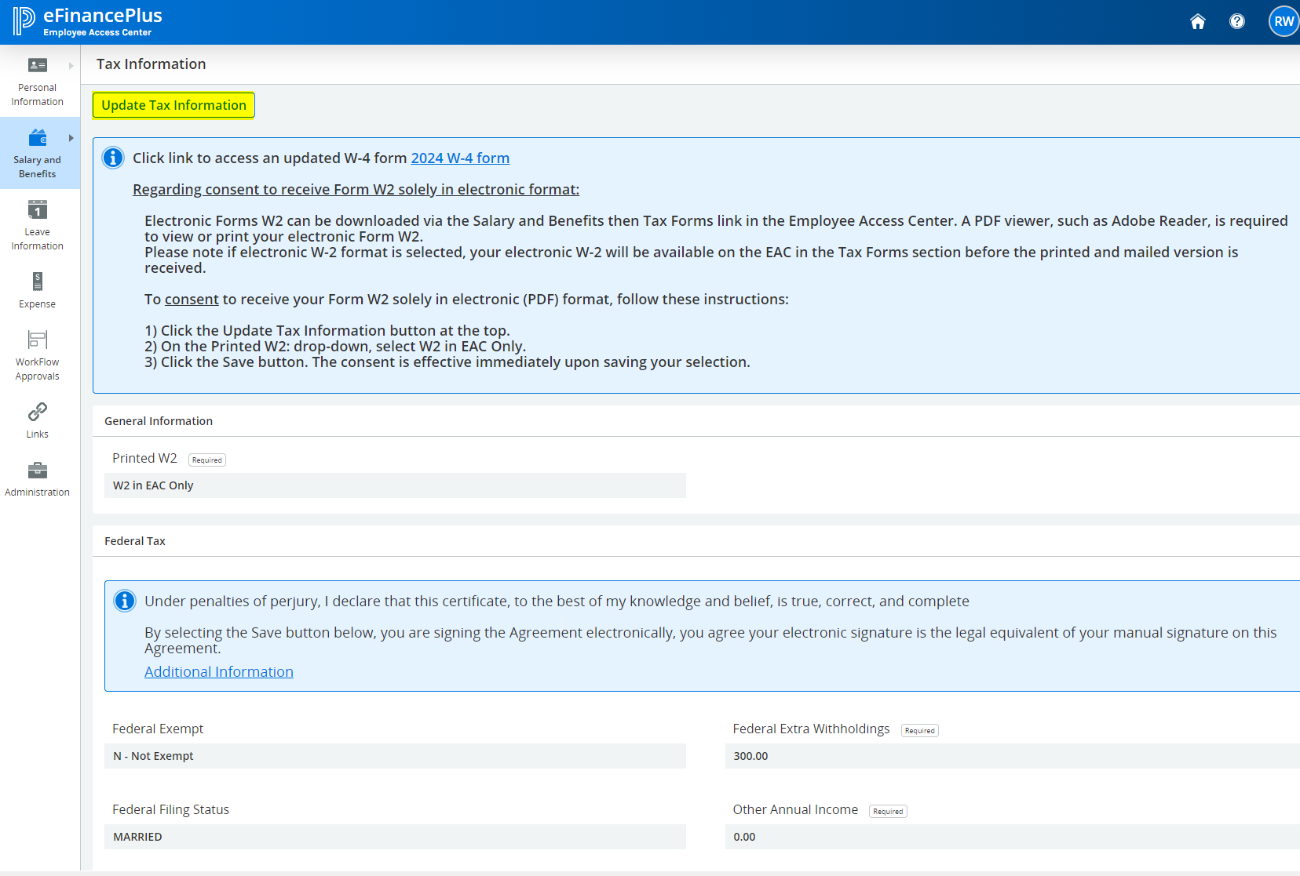
Updating Tax Information

Slide 13
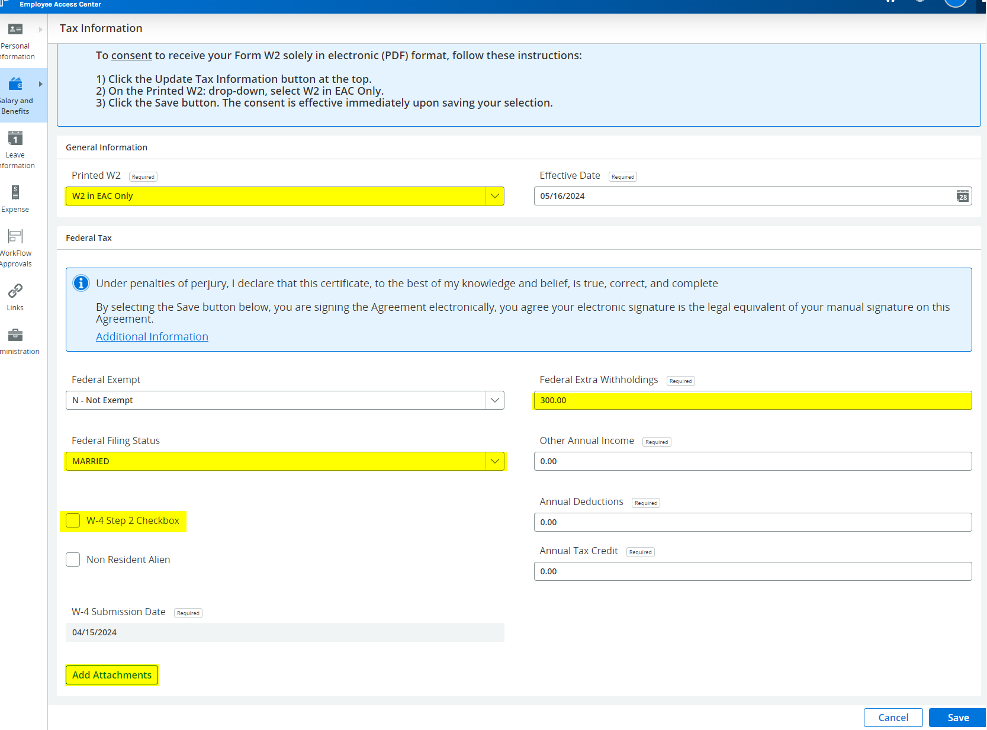

Slide 14
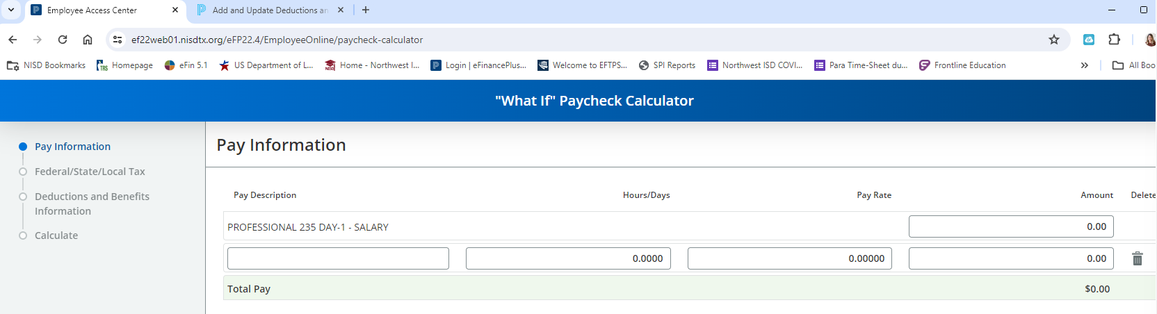
“What If” paycheck calculator

Slide 15
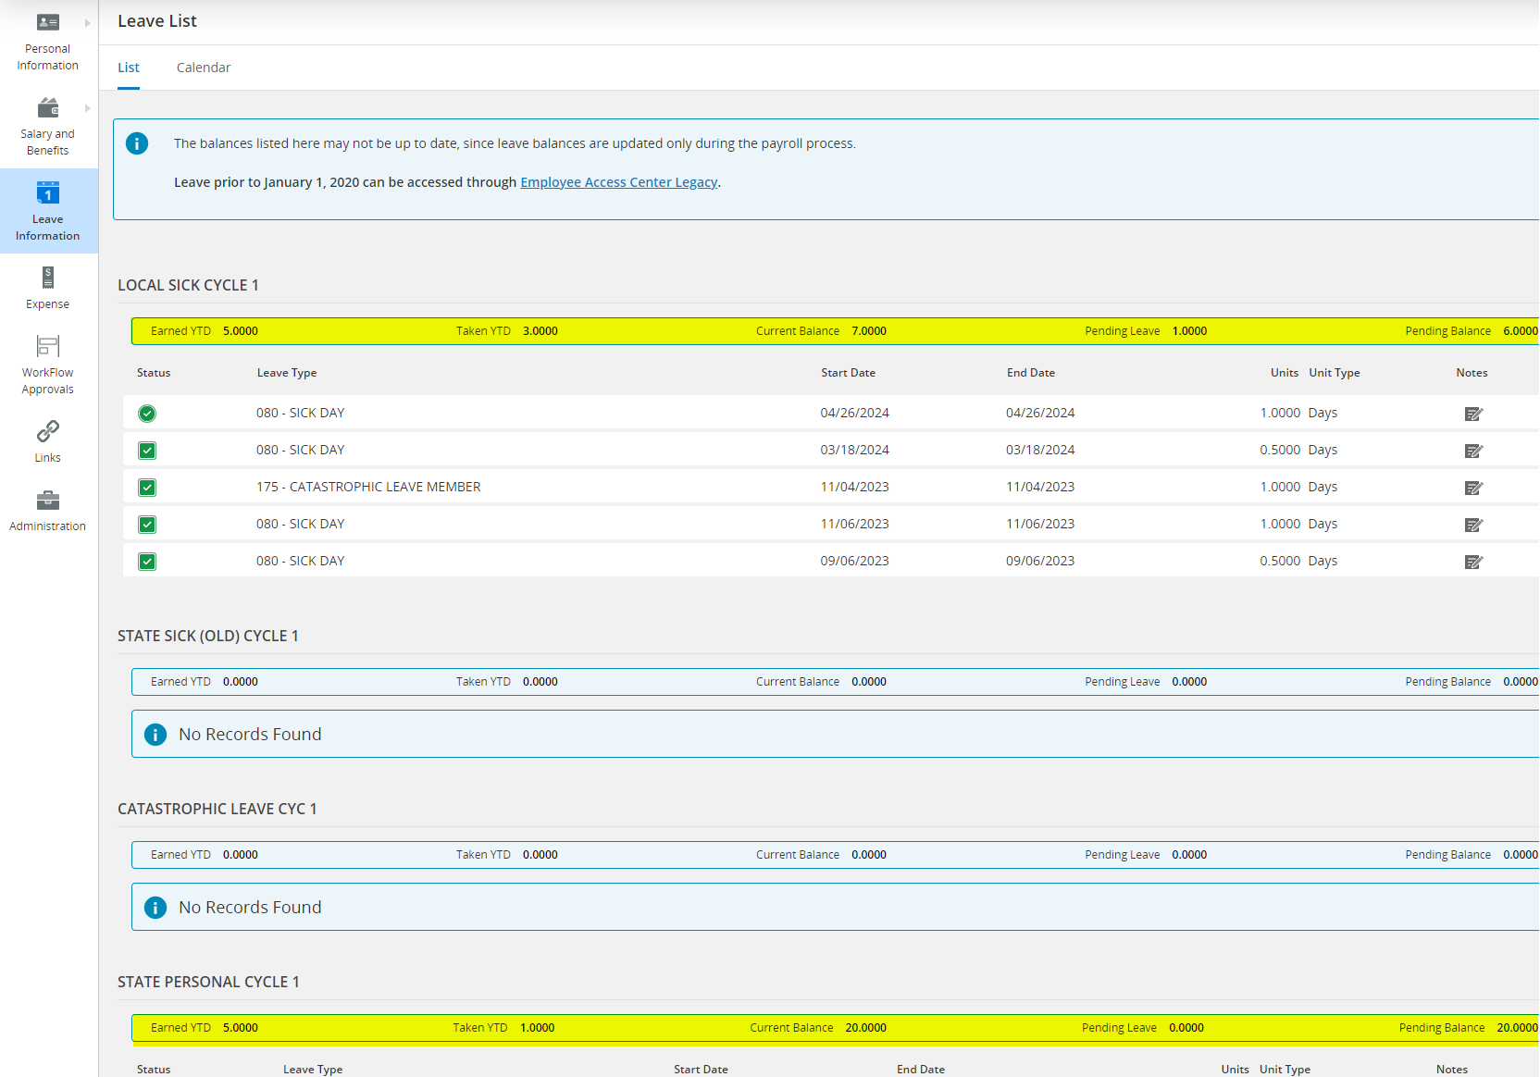
Leave Information
EAC is leave bank of record and is imported according to the Payroll Schedule

