Slide 1

Title IX Policy & Process
Employee Title IX Training

Slide 2

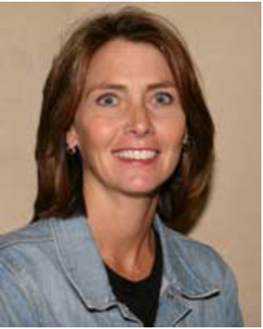
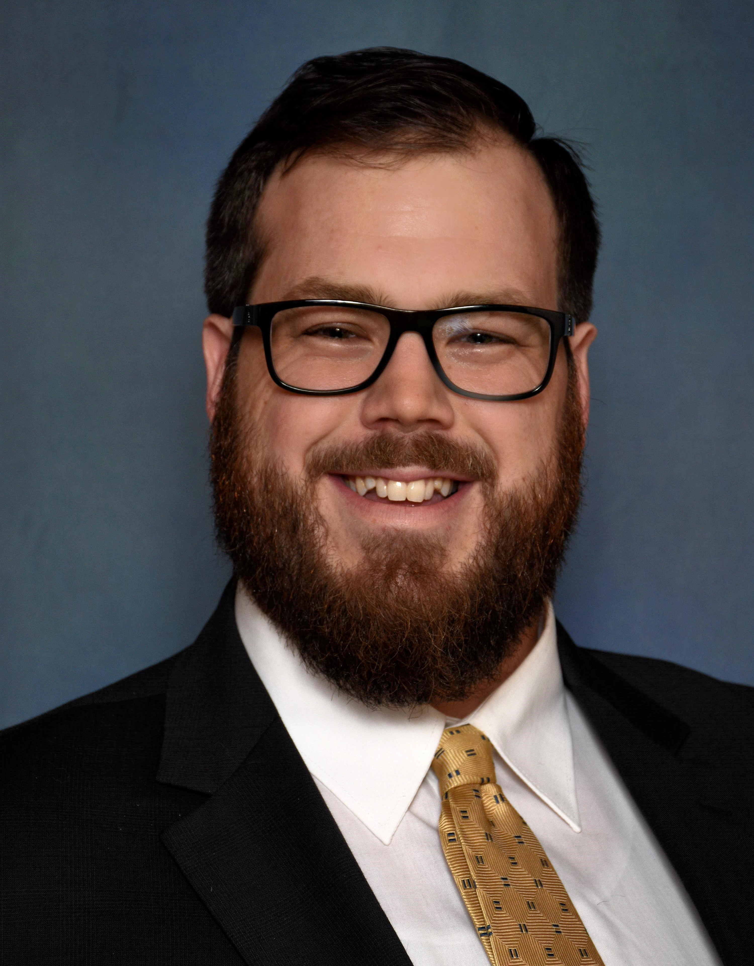
Title IX Office
Melanie Oelfke
Jake Sapp
Title IX Coordinator
Deputy Title IX Coordinator

Slide 3
Title IX
Federal Law prohibiting Sex Discrimination

Slide 4
Title IX Office at Austin College
Handle Reports & Complaints
Provide Support for all members
Enforce the Policy

Slide 5
Course Objectives
Overview of Title IX at AC
Employee Reporting Obligations
Handling Student Disclosures
Student Training Update

Slide 6


Title IX Policy & Process
Prohibited Conduct
Process Outline
Reporting Misconduct
Policy Definitions
Austin College Website Navigation

Slide 7
Prohibited Conduct

Slide 8
Sexual Assault
(A) “Rape” means the penetration, no matter how slight, of the vagina or anus with any body part or object, or oral penetration by a sex organ of another person, without the consent of the victim.
(B) “Fondling” means the touching of the private body parts of another person for the purpose of sexual gratification, without the consent of the victim, including instances where the victim is incapable of giving consent because of his/her age or because of his/her temporary or permanent mental incapacity.
(C) “Incest” means sexual intercourse between persons who are related to each other within the degrees wherein marriage is prohibited by law.
(D) “Statutory Rape” means sexual intercourse with a person who is under the statutory age of consent.

Slide 9
Sexual Harassment
– Title IX
Sexual Harassment means unwelcome conduct determined by a reasonable person to be so severe, pervasive, and objectively offensive that it effectively denies a person equal access to Austin College’s educational Program or activity.

Slide 10
Sexual Harassment - Texas
Sexual Harassment means unwelcome, sex based verbal or physical conduct that:
(a) in the employment context, unreasonably interferes with a person’s work performance or creates an intimidating, hostile, or offensive work environment; or
(b) in the education context, is sufficiently severe, persistent, or pervasive that the conduct interferes with a student’s ability to participate in or benefit from educational programs or activities of Austin College.

Slide 11
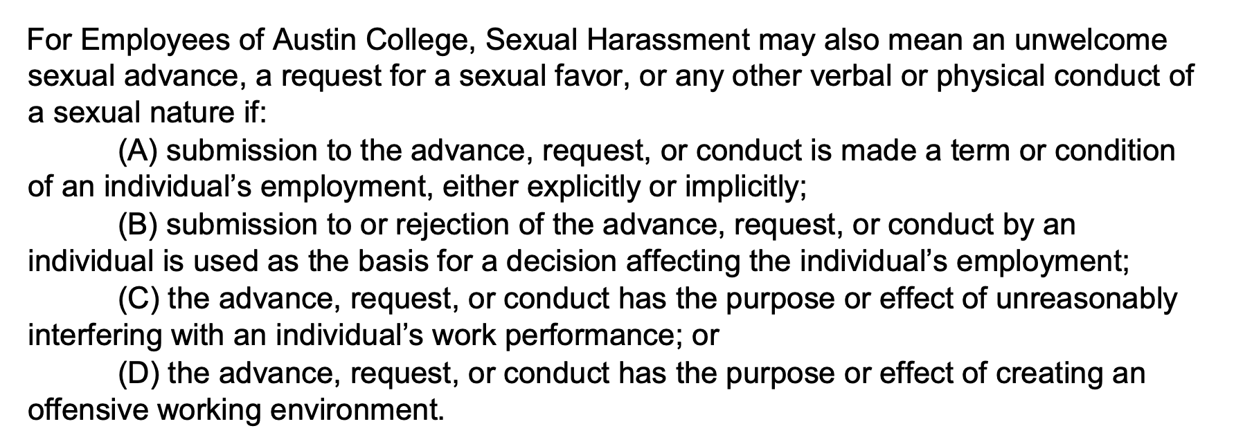
Texas Employee Sexual Harassment

Slide 12
Quid Pro Quo
Quid Pro Quo Harassment means an employee of the college conditioning the provision of an aid, benefit, or service of the college on an individual’s participation in unwelcome sexual conduct.

Slide 13
Stalking
(A) Course of conduct means two or more acts, including, but not limited to, acts in which the stalker directly, indirectly, or through third parties, by any action, method, device, or means, follows, monitors, observes, surveils, threatens, or communicates to or about a person, or interferes with a person's property.
(B) Reasonable person means a reasonable person under similar circumstances and with similar identities to the victim.
(C) Substantial emotional distress means significant mental suffering or anguish that may, but does not necessarily, require medical or other professional treatment or counseling.

Slide 14
Dating Violence
“Dating Violence” means violence committed by a person –
Who is or has been in a social relationship of a romantic or intimate nature with the victim.
The existence of such a relationship shall be determined based on the consideration of: 1) length of the relationship, 2) the type of relationship, and 3) the frequency of interaction between the persons involved in the relationship

Slide 15
Domestic Violence
Domestic Violence includes felony or misdemeanor crimes of violence committed by a current or former spouse or intimate partner of the victim, by a person with whom the victim shares a child in common, by a person cohabitating with or has cohabitated with the victim as a spouse or intimate partner, by a person similarly situated to a spouse of the victim under the domestic of family violence laws of the jurisdiction receiving grant monies, or by any other person against the an adult or youth victim who is protected form that person’s act under the domestic or family violence laws of Texas. (Citation: 34 U.S.C. 12291(a)(8))

Slide 16
Sexual Exploitation
Sexual exploitation occurs when a person takes non-consensual, unjust, or abusive sexual advantage of another for their own advantage or benefit, or for the benefit or advantage of anyone other than the one being exploited. This behavior may not fall within the definition of non-consensual sexual contact/activity, or sexual harassment, but it is still a violation of policy. There are many degrees and types of sexual exploitation.
HB 2789 -> Sexually Explicit

Slide 17
Retaliation
Retaliation occurs when an adverse action is taken against an individual for raising concerns about conduct which is prohibited by law or policy. All members of the Austin College community have the right to raise concerns or file a complaint without fear of retaliation. Additionally, it is a violation of college policy to retaliate against an individual for filing a report of sexual misconduct or gender-based discrimination. Retaliation is also prohibited against reporting participant, responding participant, and anyone who participates in an investigation of sexual misconduct or gender- based discrimination. Examples of retaliation include hostility, intimidation, threats, exclusion, or discrimination.

Slide 18
Sexual Orientation, Gender, Gender Identity
Harassment based on sexual orientation, gender, or gender identity is defined as derogatory comments, actions, or conduct that may include acts of verbal, nonverbal, cyber, or physical aggression, intimidation, or hostility, even if those acts do not involve conduct of a sexual nature. Such conduct is directed toward an individual by virtue of their actual or presumed sexual orientation, gender, or gender identity and humiliates or intimidates an individual, impedes academic or work performance, or interferes with college life.
Must meet the Sexual Harassment Standard.

Slide 19
Employee-Student Relationships
Sexual, romantic, or dating relationships between employees and students are inconsistent with the mission of the College and inappropriate because they carry a risk of damaging the student's educational experience and the faculty or staff member's career. The College thus prohibits sexual, romantic, or dating relationships, even of a consensual nature, between employees and currently enrolled students. Enrolled students who are employed by College are considered students for consensual relationships

Slide 20
Intentional Presentation of False Information
Participants in this resolution process must present, in good faith, truthful and accurate information to those involved in ensuring a fair process. Knowingly making false statements or presenting inaccurate information is unacceptable and will result in a separate disciplinary action regarding that conduct. Please note that filing a report or providing information which a participant or witness genuinely believes is accurate, but which is ultimately dismissed due to insufficient evidence or found to be untrue, does not constitute the intentional presentation of false information.

Slide 21
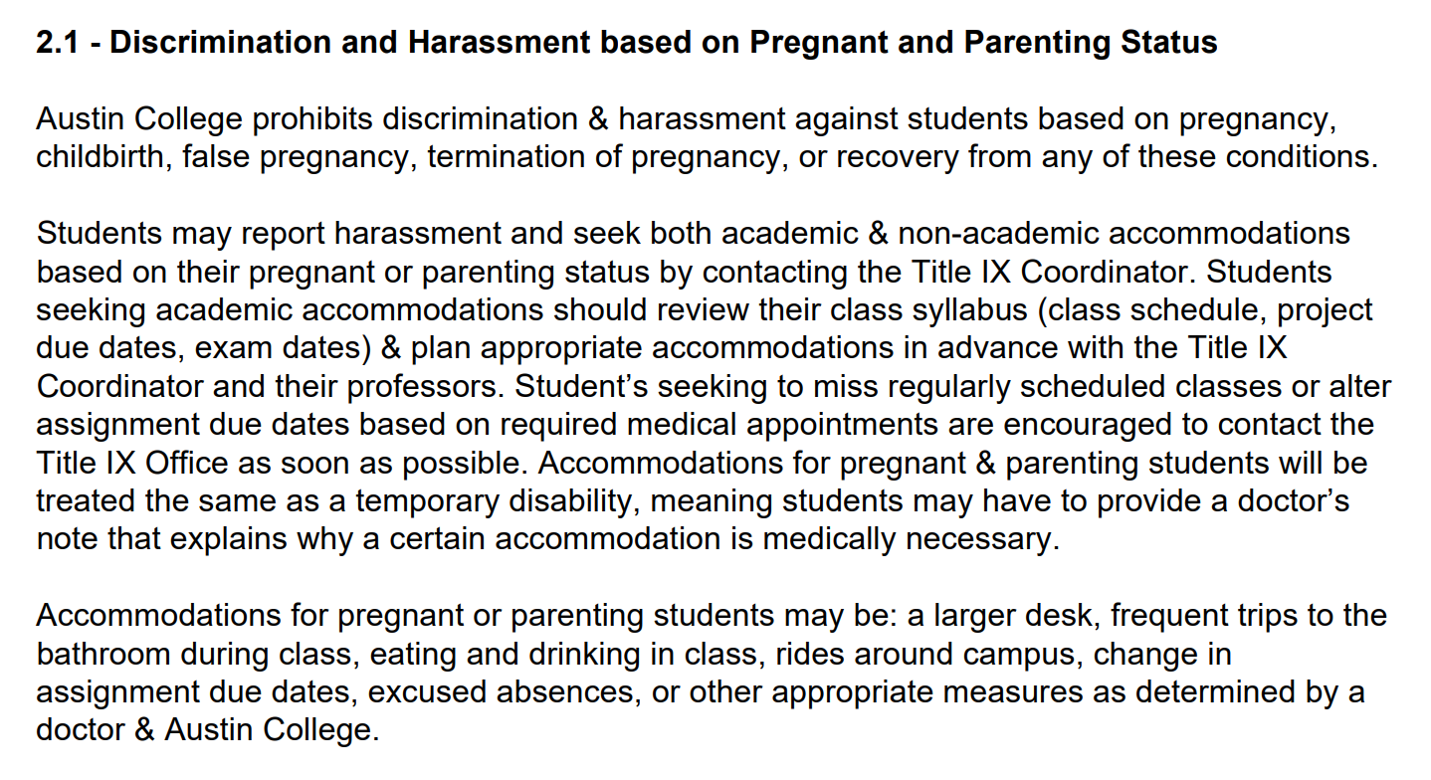

Slide 22
Policy Definitions

Slide 23
Scope of Policy
Title IX & Texas Requirements
Educational Program or Activity = Locations, events, or circumstances over which the college exercised substantial control over both the respondent and the context in which the sexual harassment occurs, & also includes any building owned or controlled by a student organization that is officially recognized by the College.
On & Off Campus
Never be nervous about Reporting

Slide 24
Consent
Consent is clear, active, and affirmative permission to act, either by words or actions.
The person who initiates sexual activity is responsible for obtaining the other person’s consent for that activity each and every time.
Once consent has been given, it can be withdrawn at any time.
Consent can never be assumed or implied. The absence of “no” or silence does not mean that consent has been given.
Additionally, consent to one form of sexual activity does not imply consent to other forms of sexual activity.

Slide 25
Incapacitated
An incapacitated individual is someone who cannot make rational, reasonable decisions because that person lacks the capacity to understand the “who, what, when, where, why, or how” of a sexual interaction. This includes a person whose incapacity results from a disability, sleep or lack thereof, involuntary physical restraint, unconsciousness, or use of alcohol or other drugs. Every individual may manifest signs of incapacitation differently; typical signs include slurred or incomprehensible speech, unsteady gait, combativeness, emotional distress, vomiting, or incontinence. The impact of alcohol and other drugs varies from person to person, and if there is any doubt as to the level or extent of the other person’s intoxication or impairment, the prudent course of action is to forgo or cease any sexual contact or activity.

Slide 26
Coercion
Coercion, meaning the use of an unreasonable amount of pressure to gain sexual access. Coercion is more than an effort to persuade, entice, or attract another person to have sex. When a person makes a clear decision not to participate in a particular form of sexual contact or sexual intercourse, a decision to stop, or a decision not to go beyond a certain interaction, continued pressure can be coercive.
In evaluating whether coercion was used, the College will consider: (a) the frequency of the application of the pressure, (b) the intensity of the pressure, (c) the degree of isolation of the person being pressured, and (d) the duration of the pressure. Coercion includes continued pressure after an individual has made it clear that they do not want to engage in the behavior.

Slide 27
Amnesty
In situations involving allegations of sexual misconduct, Austin College will seek to make the sexual misconduct allegation the primary focus of any investigation or disciplinary action.
The College will not pursue disciplinary action against reporting participants, witnesses or a third party for disclosure of their own personal consumption of alcohol or drugs at or near the time of the incident provided that any such violation did not harm or place the health and safety of any other person at risk

Slide 28
Reporting Misconduct

Slide 29

Report = Support
Report ≠ Automatic Resolution Process

Slide 30
Official Reporting Channels
In Person -> 900 N. Grand Ave., Caruth Admin., STE 6I
Mail -> 900 N. Grand Ave., STE 6I Sherman, TX 75090
Email -> moelfke@austincollege.edu // jsapp@austincollege.edu
Phone -> 903.813.2433 // 903.813.2432
Phone/Phone Anonymous -> 866.943.5787
Online/Online Anonymous -> https://hopper.austincollege.edu/hlive/webhopper?TOKENIDX=6472200303&SS=1&APP=ST&CONSTITUENCY=WBST

Slide 31
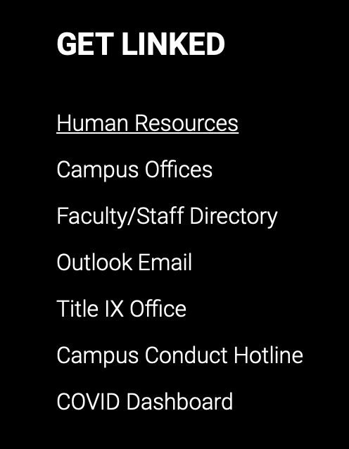
Sexual Misconduct Policy & Reporting Link
(Bottom of every Austin College webpage)

Slide 32
Supportive Measures
Supportive measures may include:
Counseling,
Extensions of deadlines or other course-related adjustments,
Modifications of work or class schedules,
Campus escort services,
Mutual restrictions on contact between the parties, (No Contact Order)
Changes in work or housing locations,
Leaves of absence,
Honoring an order of protection or a no-contact order entered by a State civil or criminal court. Increased security and monitoring of certain areas of the campus.

Slide 33
Employee Obligation to Report

Slide 34
Employees
All Employees of Austin College who, in the course and scope of employment, witnesses or receives information regarding the occurrence of an incident that the employee reasonably believes constitutes sexual harassment, sexual assault, dating violence, or stalking and is alleged to have been committed by or against a person who was a student enrolled at or an employee of the institution at the time of the incident must report that information to the Title IX Coordinator.

Slide 35
Reporting Requirements - 1
All employees* must promptly report to the institution’s Title IX coordinator or deputy coordinator:
Observations witnessed or information received while in the course and scope of their employment;
That the employee reasonably believes constitutes an incident of sexual harassment, sexual assault, dating violence, or stalking;
Committed by or against
A student who was enrolled at the institution at the time of the incident
An employee employed by the institution at the time of the incident
* Four categories of employees are excepted from mandatory reporting.

Slide 36
Reporting Requirements - 2
Example: An accountant in the business office is out to eat at a restaurant with friends on a Saturday evening. During dinner, the accountant overhears someone from the next table talking about working at your institution and being groped by their supervisor. Does the accountant have to report to the Title IX Coordinator?
The Texas law would not require the accountant to report, because the accountant was engaged in a personal activity at the time they heard the information and was not performing duties to further the institution’s interests. However, the institution’s policy may impose different requirements.

Slide 37
What must be reported by an employee? - 1
ALL INFORMATION, unless the report is made to an employee who is designated or licensed to maintain confidentiality.
An employee must report:
  All information relevant to the incident known to the employee
    Regardless of when or where the incident occurred
    For purposes of the institution’s investigation
    To redress the incident via interim measures or other forms of support
    To convey an alleged victim’s request for confidentiality

Slide 38
What must be reported by an employee? - 2
Example: A lecturer shares with their department chair that a tenured faculty member in the department made unwanted sexual advances toward the lecturer. The lecturer asks the department chair to keep the concern anonymous. Can the department chair withhold the lecturer’s name when making the report to the Title IX Coordinator?
No. The department chair must share all information known to them with the Title IX Coordinator. The department chair should indicate that the lecturer wishes to remain anonymous, and the Title IX Coordinator will take that into account in moving forward with the matter.

Slide 39
Circumstances in which Employees
Must Report - 1
Employees shall promptly report information regarding the occurrence of an incident the employee reasonably believes constitutes sexual harassment, sexual assault, dating violence, or stalking committed by or against a person who was or is a student or employee of the institution at the time of the alleged misconduct.
The employee shall report information that they witness, receive first hand, receive second hand or via “hearsay,” overhear, or are otherwise made aware of.

Slide 40
Circumstances in which Employees
Must Report - 2
The employee is required to report regardless of when or where the incident occurred.
  The exception is when incidents are disclosed at a sexual harassment, sexual assault, dating violence, or stalking public awareness event sponsored by the institution or by a student organization affiliated with the institution.
The employee is required to report all known details, including if and how the report was remedied and if the alleged victim has expressed a desire to keep the report confidential.

Slide 41
Circumstances in which Employees
Must Report - 3
Example: Professor Crane receives an email from a student explaining that they had missed class due to being attacked by an ex. The professor contacts the Title IX Coordinator asking if the professor needs to report, as there were very few details included in the student’s email. The professor explains they are not sure of when or where the attack happened, or if it involved a student from their institution.
Professor Crane should report regardless of when or where the incident occurred, as it involves a student who is enrolled at the institution. Even if there are very few details, Professor Crane should include them all.

Slide 42
Employees Excepted: Category 1
Employees Who are Students - 2
Example: The institution designates students who work in student housing as employees who are required to report sexual harassment, sexual assault, dating violence, and stalking. A student tells their resident advisor that the student has been sexually harassed by a staff member. Is the resident advisor required to report?
The resident advisor is required by the institution’s policy (but not by Texas law) to report. Sanctions for failure to report are determined solely by the institution’s policy. The Texas law requiring mandatory termination and criminal liability would not apply.

Slide 43
Employees Excepted: Category 2
Employees Who are Victims
Victims of sexual harassment, sexual assault, dating violence, or stalking are not mandatory reporters of/for their own incident.

Slide 44
Employees Excepted: Category 3
Employees Receiving Information at a Public Awareness Event - 1
Employees are not required to report information about an incident that is disclosed at a public awareness event on sexual harassment, sexual assault, dating violence, or stalking.

Slide 45
Employees Excepted: Category 3
Employees Receiving Information at a Public Awareness Event - 2
Example: The university’s Women and Gender Resource Center hosted an event during Sexual Assault Awareness Month where victims of sexual violence shared their stories publicly from the stage. During the event, a student shares a poem that details a sexual assault the student experienced during their freshman year. An English professor heard this disclosure during the event. Is the professor required to report this to the Title IX Coordinator?
No, required reporters are not required to report disclosures made during public awareness events such as Take Back the Night or events hosted during Sexual Assault Awareness Month.

Slide 46
Employee Failure to Report
It is a violation of Texas Law & Austin College policy for an employee who is required to make a report to not make a report to the Title IX Office. The State of Texas has determined that an employee commits an offense if: 1) they are required to make a report & knowingly fails to make a report; or 2) with the intent to harm or deceive, knowingly makes a report that is false. These offenses are classified as Class B Misdemeanors, which can be upgraded to a Class A Misdemeanor at trial.
As is required by Texas Law, Austin College shall terminate the employment of an employee whom the institution determines in accordance with the institution’s disciplinary procedure to have committed the offense of not making a report they knew of or making a false report.

Slide 47
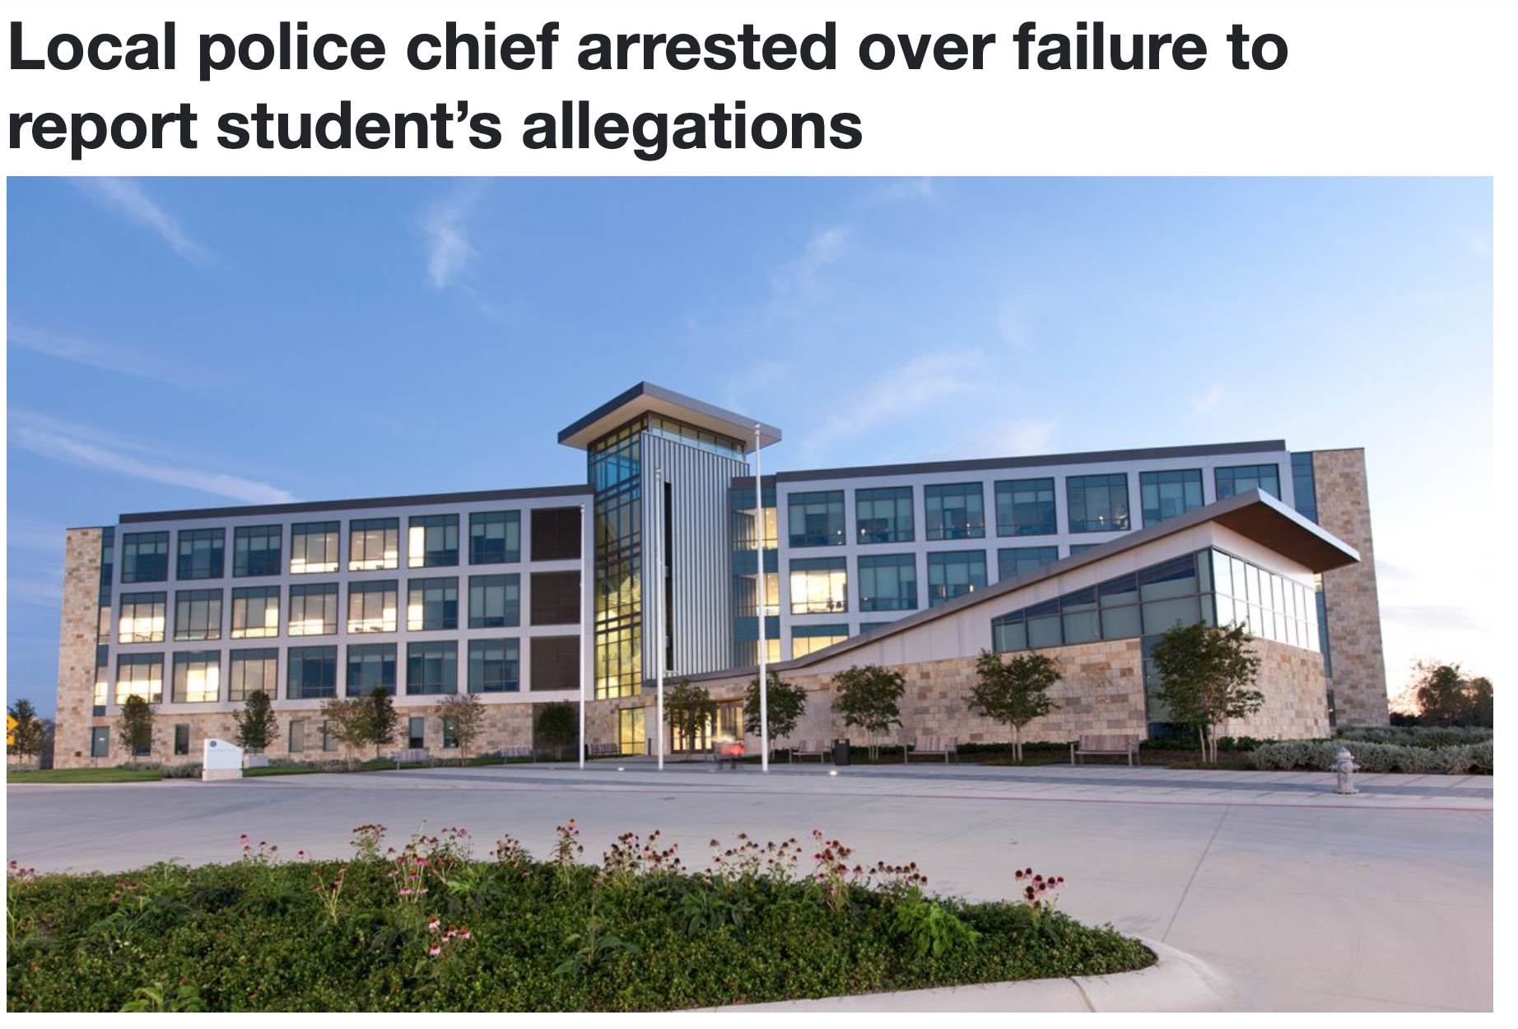

Slide 48
Confidential Employees
Confidential Resources: Medical professionals, professional, licensed counselors and the College chaplain are not required to report any information concerning an incident without the participant’s permission.
Counseling Services College Chaplain Medical Professional
Adams Center Wynne Chapel Adams Center
903.813.2247 903.813.2220 903.813.2247

Slide 49

Student Disclosure Litany

Slide 50
Recognize - potential disclosure
Inform - of obligation to report
Support – Resources Available: confidential or supportive measures // Listen

Slide 51

Austin College Website Navigation

Slide 52
Sexual Misconduct Policy & Reporting Link
(Bottom of every Austin College webpage)

Slide 53
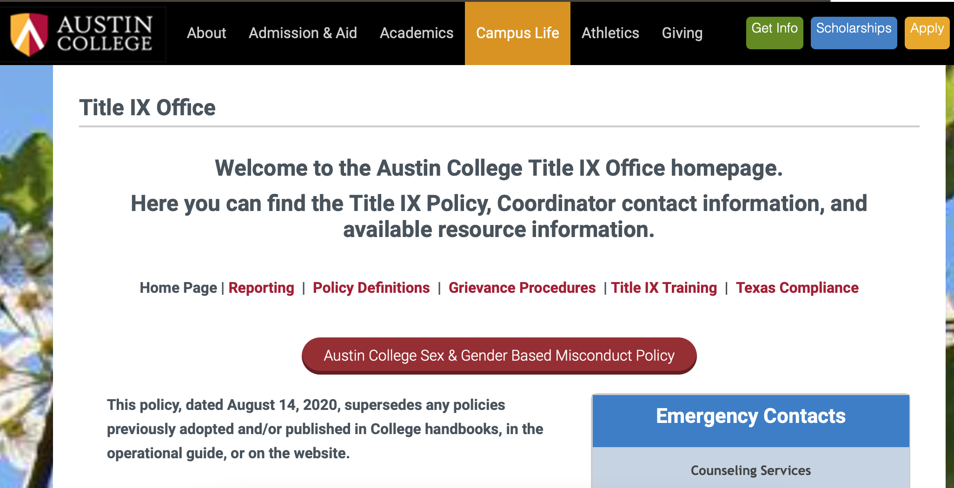

Slide 54
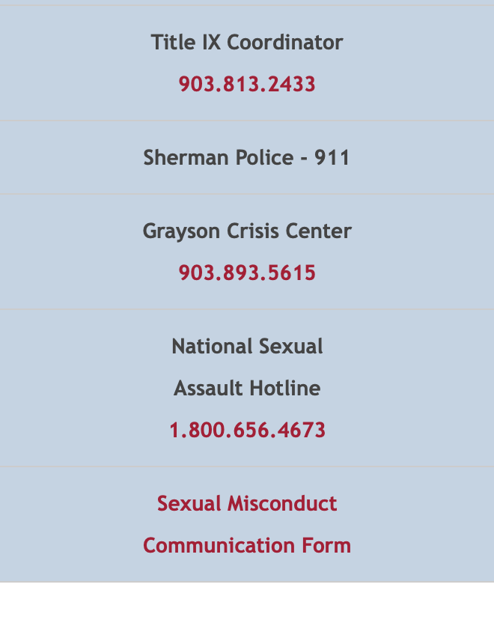
Title IX Page Additional Resources

Slide 55
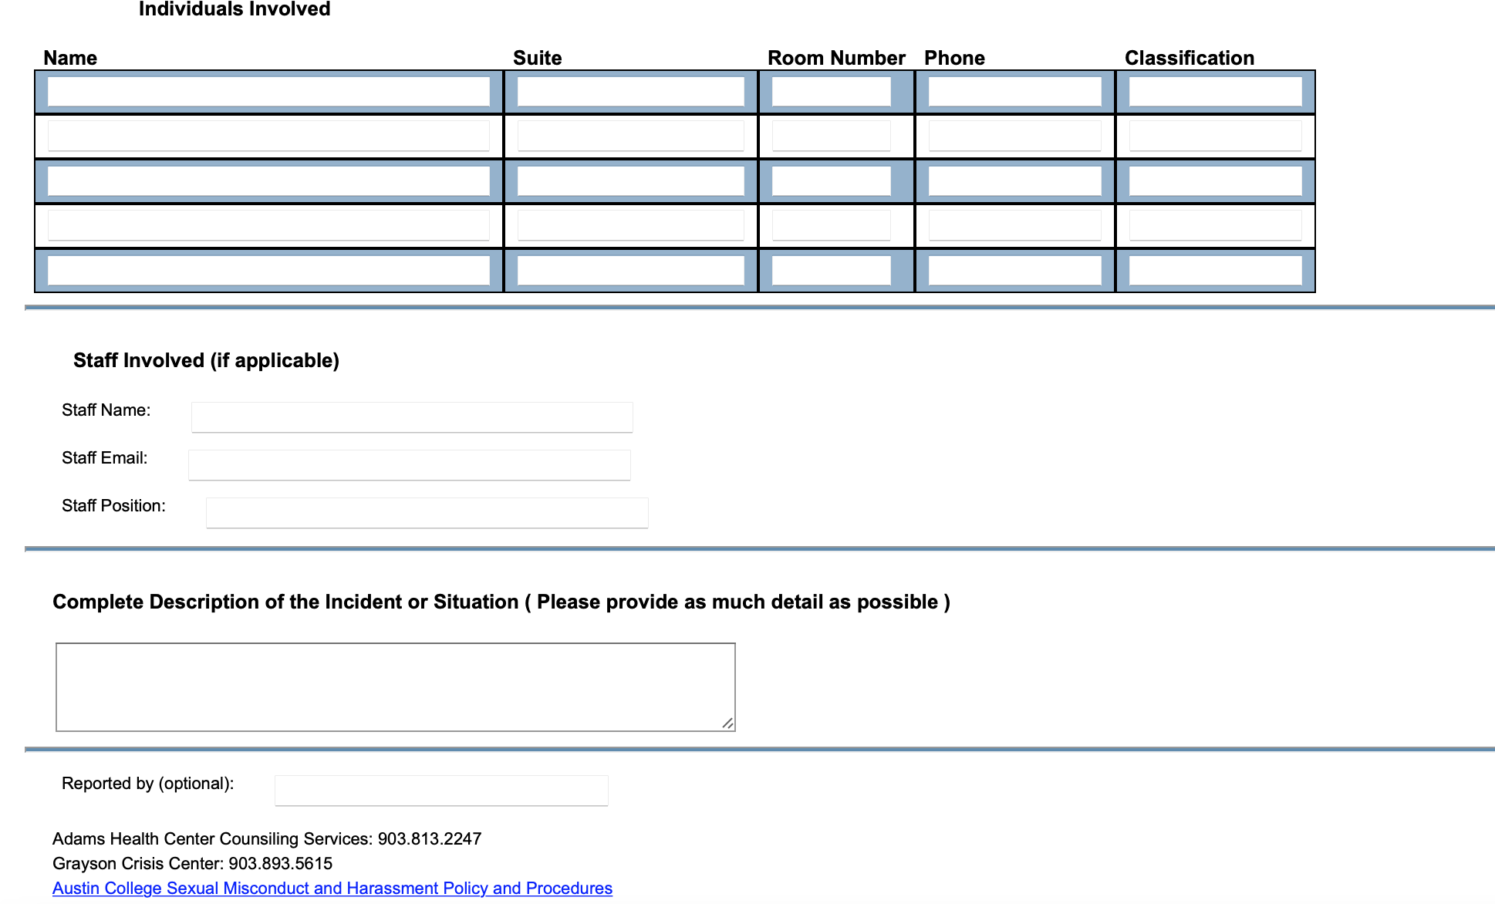

Slide 56
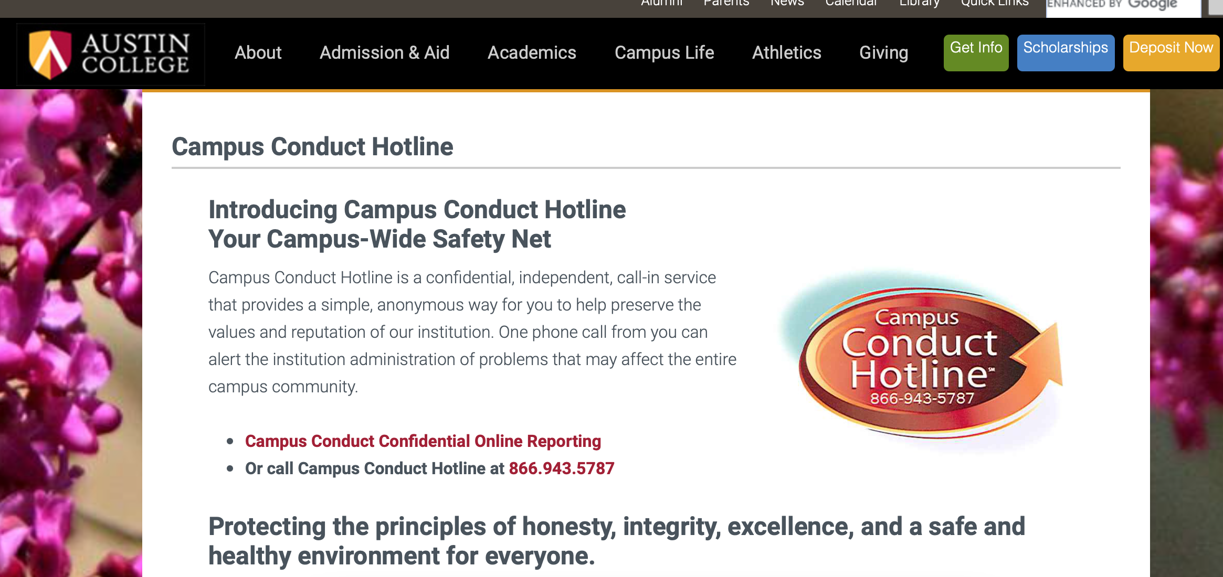

Slide 57
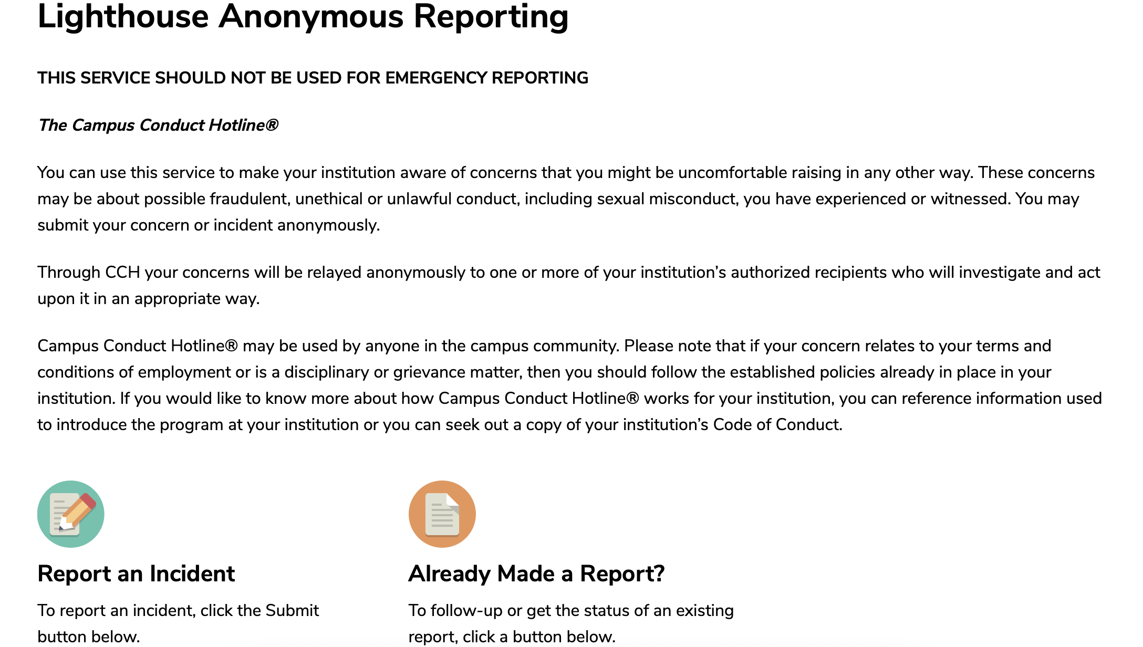

Slide 58
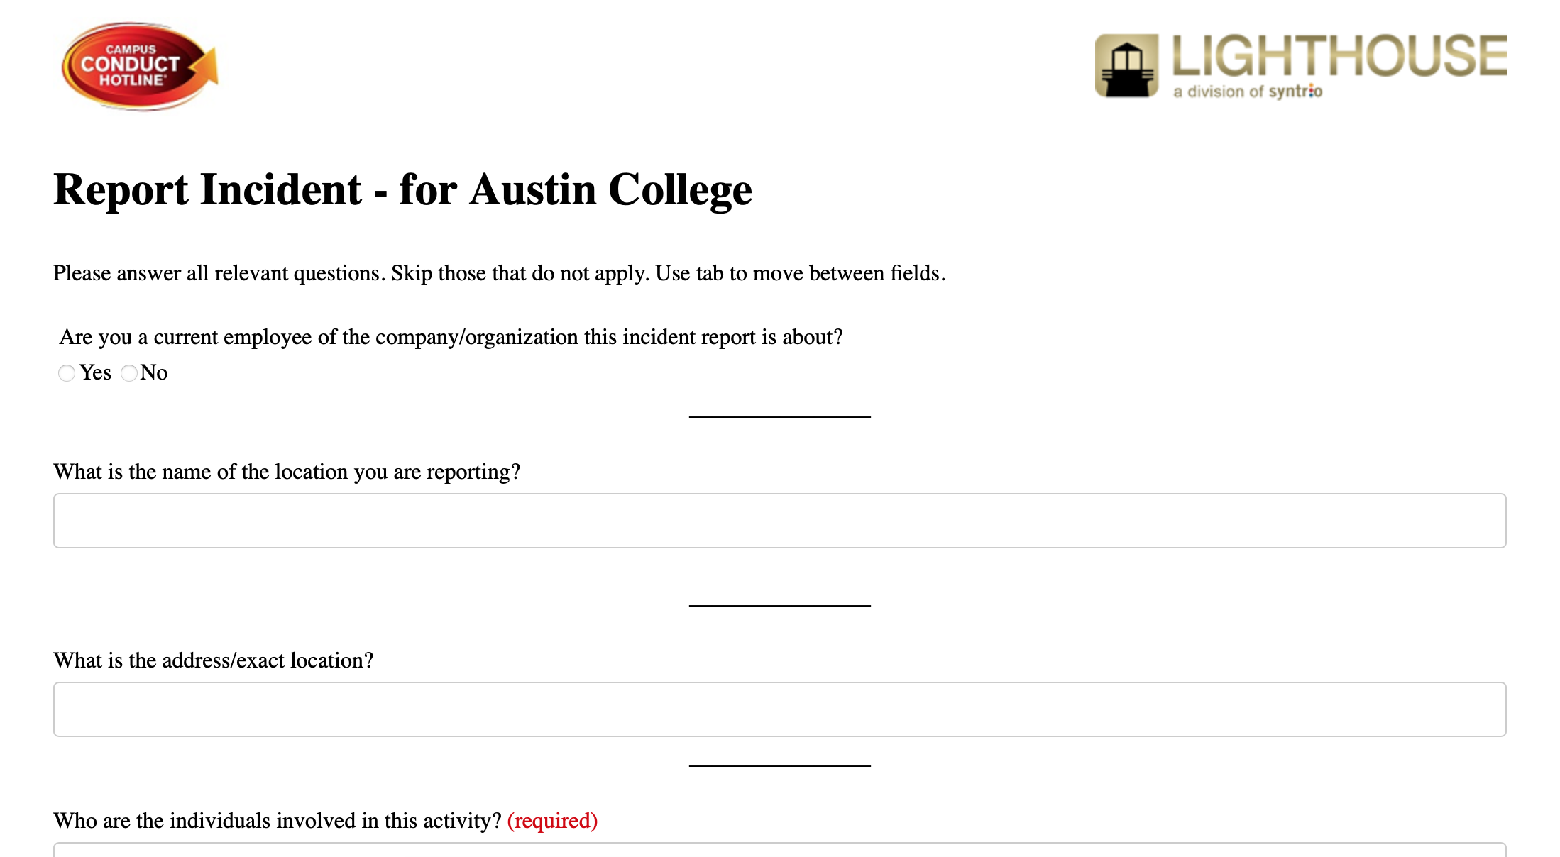
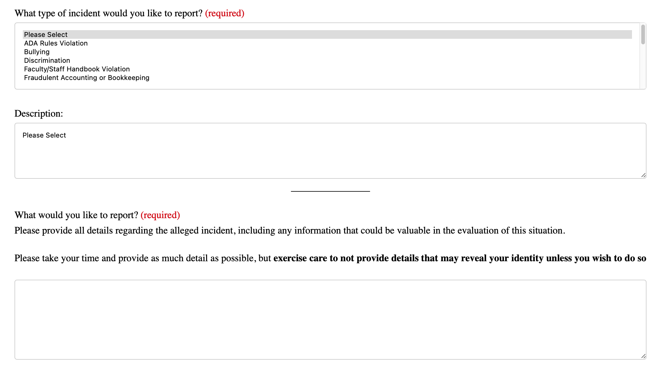

Slide 59

Process Outline

Slide 60
Formal Complaint
1) Signed & Submitted
3) Notice of Allegations
2) Mandatory Review
If Approved:
Formal or Informal (sometimes)

Slide 61
Informal Resolution
Remedies-based process which allows both participants to come to a mutual agreement regarding the resolution of the complaint.
Possible Mediation
Continued Supportive Measures

Slide 62
Formal Resolution
Investigation
Opportunity to review/respond to Evidence
Investigative Report review/respond
Live Hearing
1 Neutral Decision Maker
PA only -> Cross Examination on relevant evidence
May be performed Online if requested
Determination Report
Possible Sanction
Appeal Available

Slide 63
Sanctions
Possible sanctions include one or more of the following: Expulsion, Suspension, Probation, Educational sanctions
Revocation or withholding of admission or degree pending completion of other
No-contact orders
Time and place restrictions or bans
Housing restrictions
Extension of requirements used as interim measures;
Community service
Loss of privileges
Notation in permanent record
Sanctions withheld, such as additional sanctions if deadlines for sanctions are not met
Restorative justice requirement
Specific sanctions that must be met before resuming status at Austin College
Referrals for assessment, such as counseling or medical assessment
Written warning or reprimand
Oral warning or reprimand
Termination of employment
Other sanctions deemed appropriate by the Title IX Coordinator or designee

Slide 64
Appeals
(A) Procedural irregularity that affected the outcome of the matter;
(B) New evidence that was not reasonably available at the time the determination regarding responsibility or dismissal was made, that could affect the outcome of the matter; and
(C) The Title IX Coordinator, investigator(s), or decision-maker(s) had a conflict of interest or bias for or against complainants or respondents generally or the individual complainant or respondent that affected the outcome of the matter.

Slide 65

Updated Student Training Program
Different Training Modules each year
4 – year program covering topics:
Consent, Bystander Intervention
Hazing, Wellness

Slide 66

Austin College – Title IX
Questions?
https://www.austincollege.edu/campus-life/sexual-misconduct/

