Slide 1


Fort Miller Middle School
Student Rules & Responsibilities

Slide 2
Success at The Fort
Positivity
Be Positive and stay positive every day!
Respect
Respect you peers, your teachers, and yourself
Integrity
Always do the right thing, even if no one is watching
Determination
Work hard and come to school every day
Excellence
Regardless of circumstances, always strive to do your best

Slide 3
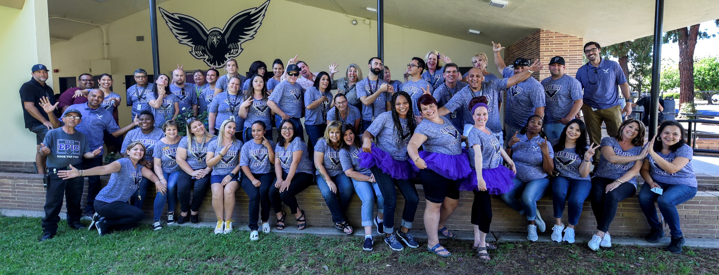
Support at The Fort
Administrators
Academic Counselors
Social Workers
Office Staff
Teachers
CAs

Slide 4
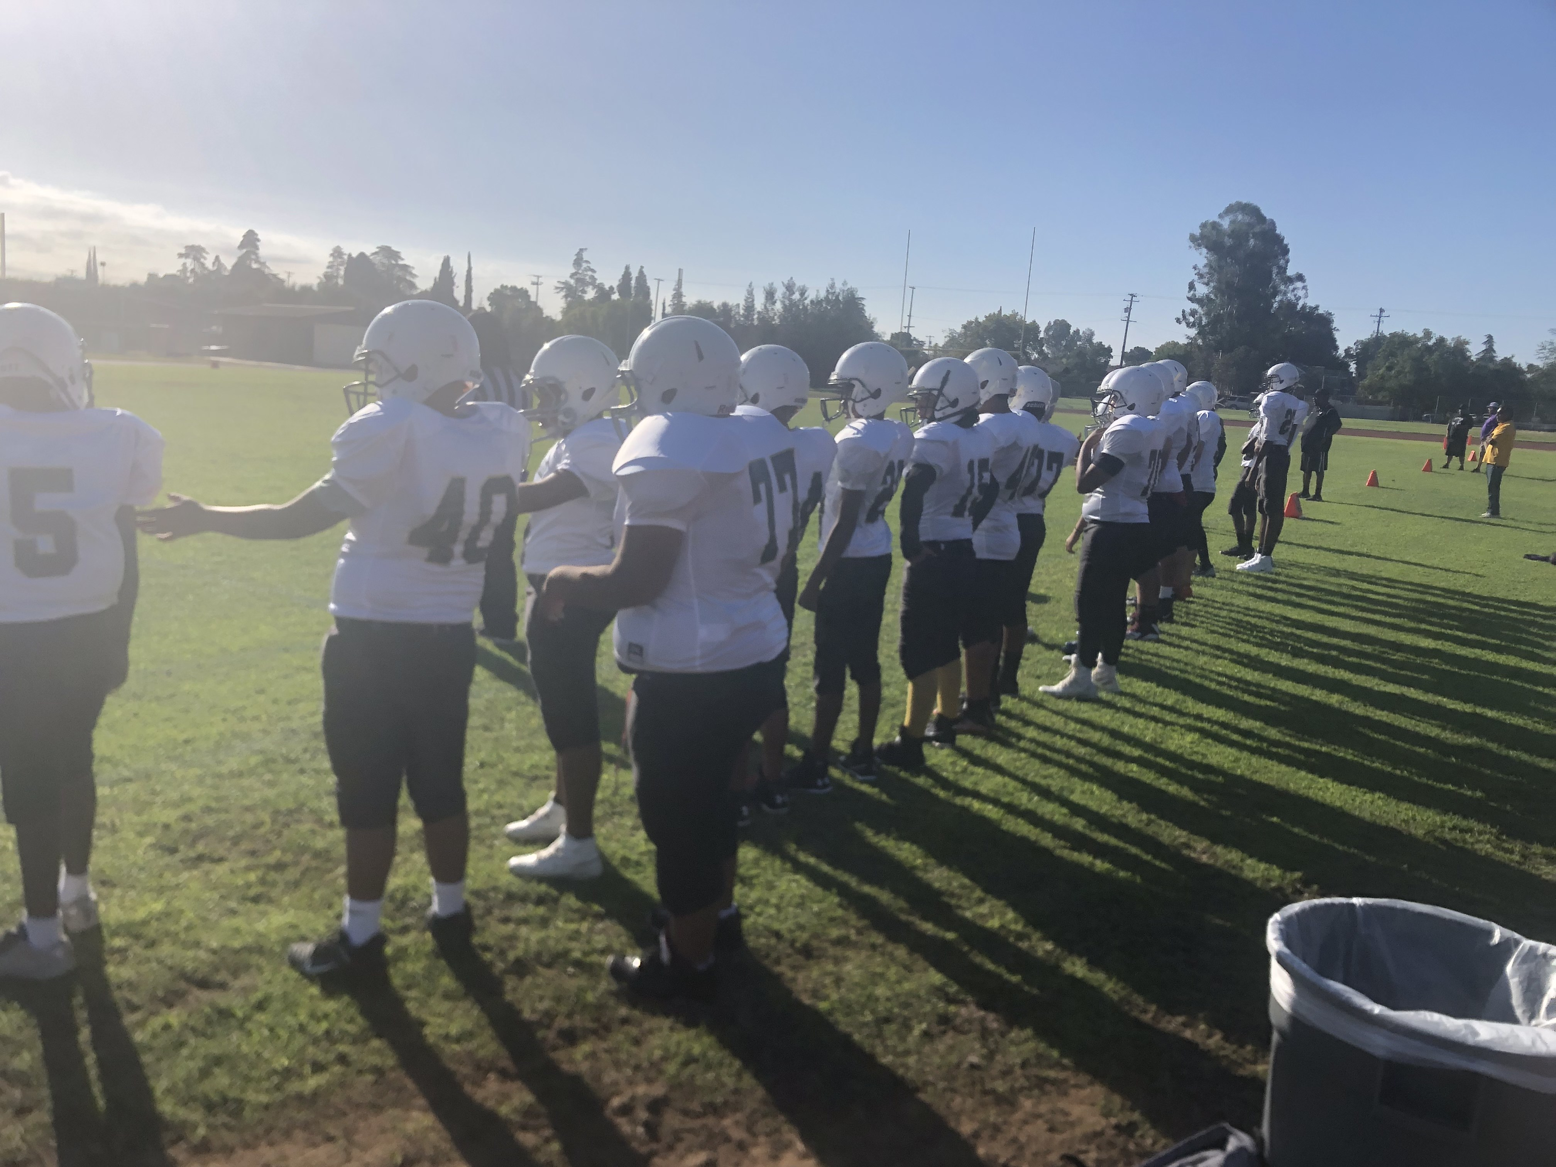
Get Involved @ The Fort
Athletics
Clubs
3rd Quarter Sports
  Girls Basketball
  Baseball
4th Quarter Sports
  Track & Field
  Boys Volleyball
  Tennis
  Softball
CLASA
Lunch Bunch
Board Games
GSA
Math O Rama
Boxing
Card Games
Photography
Yearbook
Computers
Coloring
Robotics
BSU

Slide 5
Student-Athlete Expectations
You are a Student, first and foremost
This means you must maintain good grades and attendance
On Gamedays – YOU WILL NOT PLAY IF…
You miss a single period
You are tardy to any of your classes
You are sent out of class

Slide 6
Clubs
There will be no club meetings the first week of school
All students must eat in the cafeteria. You will no longer take your food to your club meetings
Only exception is lunch bunch
Students in clubs will have designated lunch tables and your club advisor (the teacher for the club) will come and pick you up.
You must stay in the room with your club the entire lunch
Must have sticker to attend the club

Slide 7
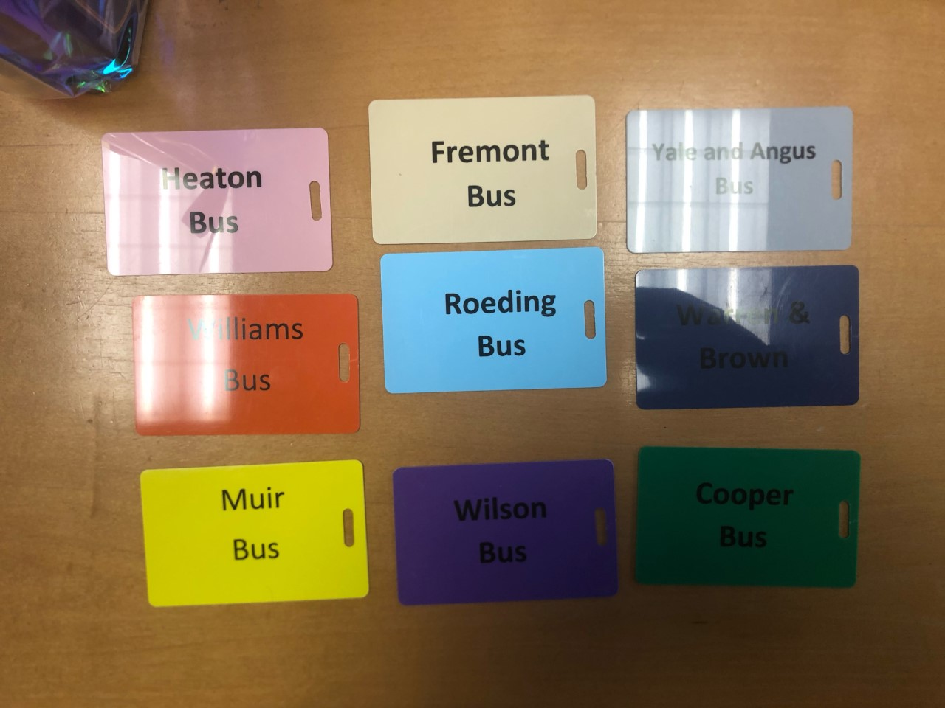
ID and Bus Pass
Wear your ID and bus pass daily
Each student was given an ID and lanyard. Wearing it is the best way to keep it safe
You must have your ID and bus pass to ride a bus, no exceptions
You must have your ID to get into the Cafeteria for lunch or you will be last and will stay in their for lunch
You cannot go to clubs without an ID

Slide 8

Bus Rider Expectations
The bus driver and all bus riders must have the opportunity to be safe to and from school.
If you violate this in any way, your bus pass will be revoked
Stay in your seat at all times the bus is in motion
If you are going to cross the street after you get off the bus, inform the bus driver as you exit
DO NOT argue with the bus driver
Leave others alone
Do not throw anything on the bus

Slide 9
Removal from the bus
Warning
10 day suspension from the bus (to and from school)
Removal remainder of the year
IMMEDIATE REMOVAL REST OF THE YEAR
Fight at or around bus stops
Drugs/Alcohol at or around bus stops

Slide 10

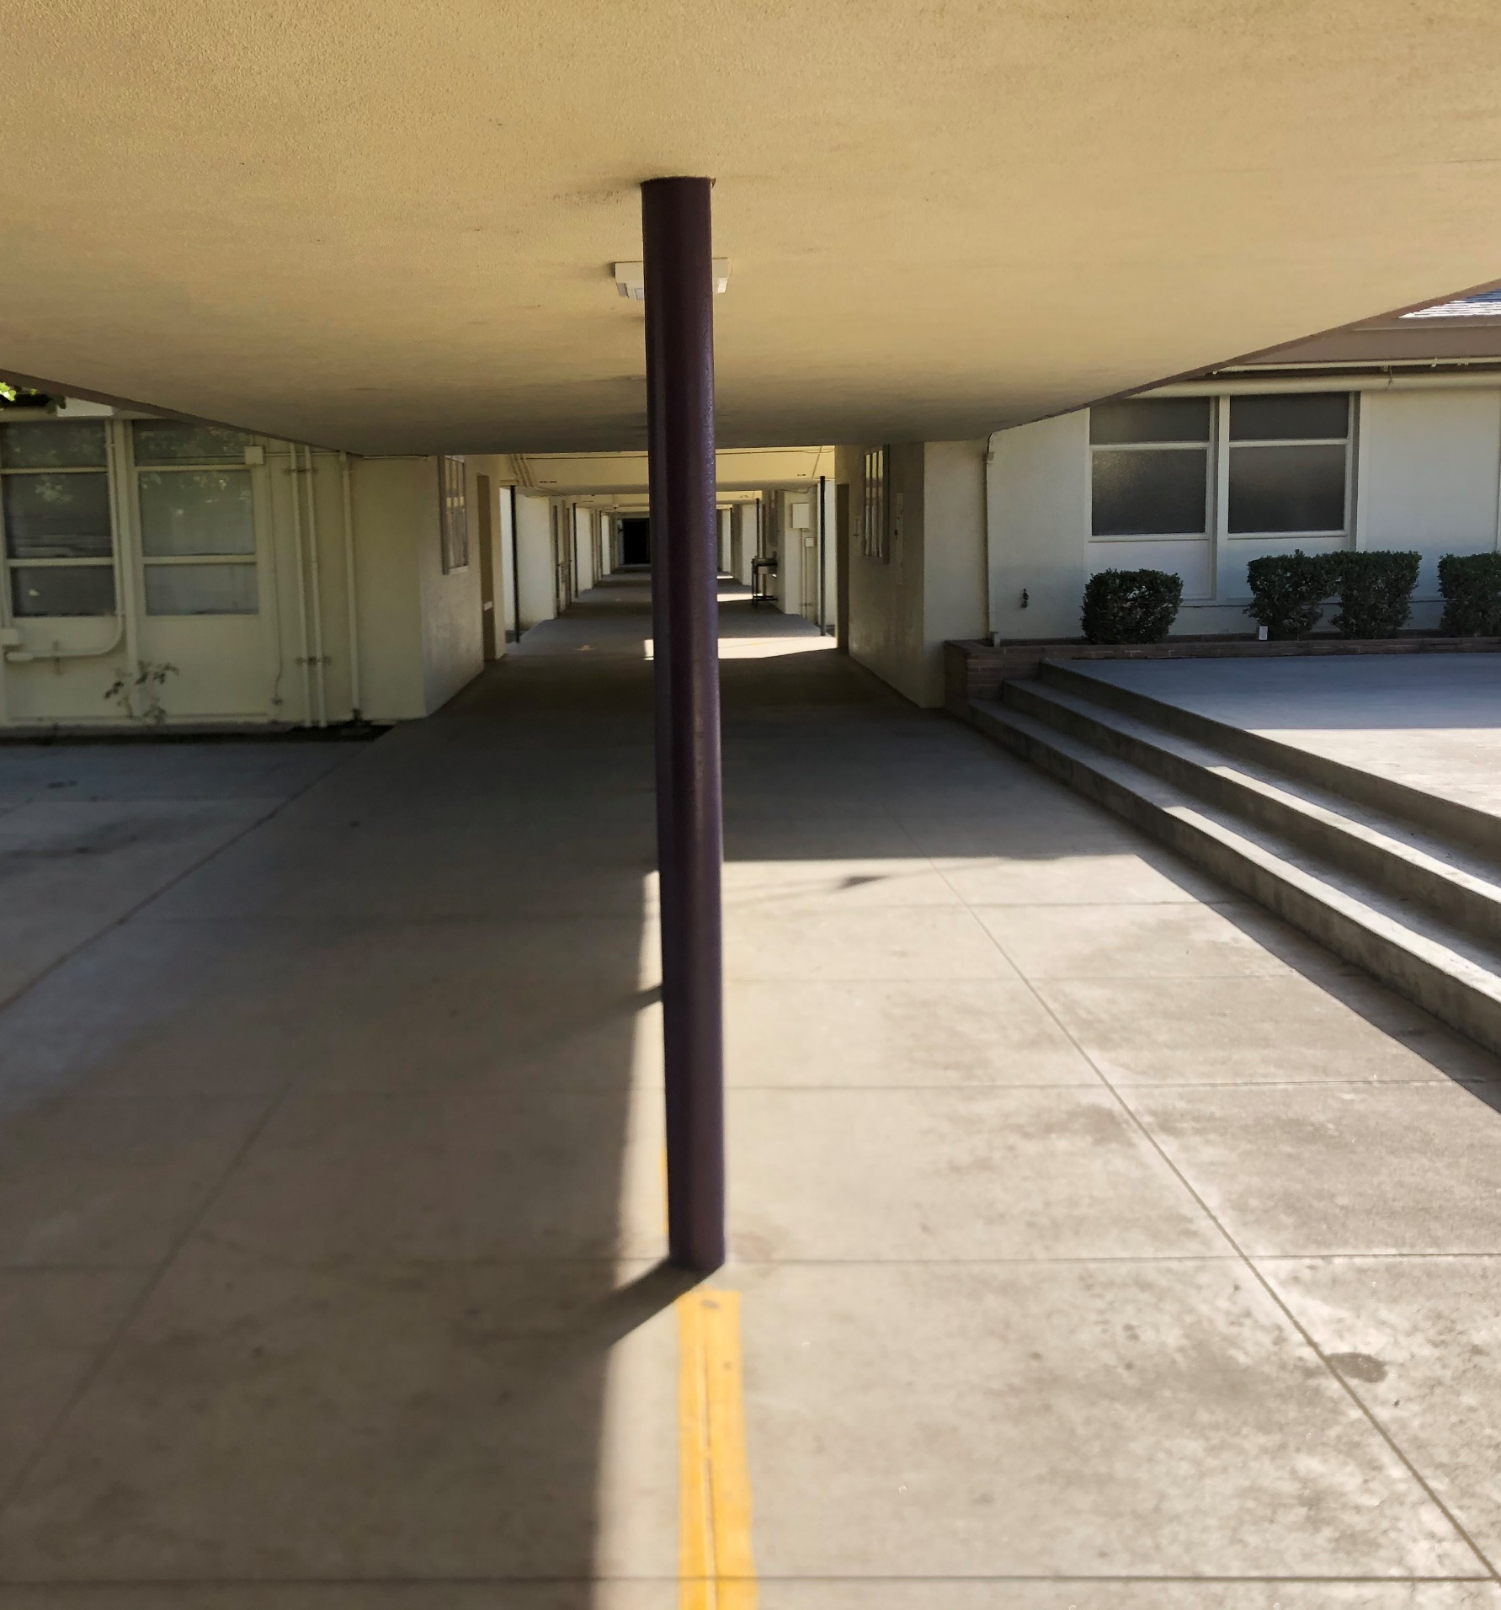
Lining Up
Students are not dismissed by the bell.
Students will line up and be walked to the main hallway to line up for lunch by their teacher
  3rd Period for 8th grade
  4th Period for 7th grade
The line will now be the main hallway.
We will have two lines for lunch to get you in and out quicker

Slide 11
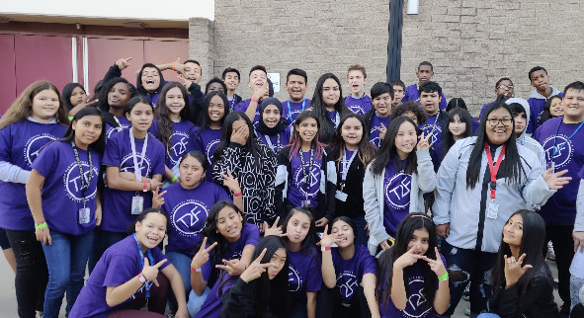
All Students Go Through the Lines
ALL students MUST go through the line. No exceptions

Slide 12
Lunch Areas
Library
Cafeteria
Patio
Classrooms with clubs on specified day.
Clear Hallways side and main hallways
First two restrooms are open
  Enter from the area between library/office

Slide 13
Recommendation for Expulsion
Possessing, selling, or furnishing a firearm/weapon
Brandishing a knife
Selling a controlled substance
Sexual Assault/Battery
Possession of an explosive
Serious physical Injury
Robbery or extorsion
Threatened bodily injury or Assault/battery on school official

Slide 14

Dress Code
Dress for Success
  No Slides
  No 2 articles of red
  No clothing that has a bulldog symbol (even if it is Fresno State)
  No clothing that shows any part of your stomach
  No see through clothing
  No undergarments can be shown
  clothing or accessories which show profanity, obscene words or pictures, sexually suggestive statements, or incites to violence
  Clothing with drug or alcohol products
  No short shorts (entire thigh exposed)
  No Hats (only Fort Miller Hats)

Slide 15

No Bullying Zone
Physical
  Hitting, pushing, shoving, slapping, tripping, spitting
Cyber/Social Media/Text
  sending, posting, or sharing negative, harmful, false, or mean content about someone else. It can include sharing personal or private information about someone else causing embarrassment or humiliation. Some cyberbullying crosses the line into unlawful or criminal behavior.
Harassment
  Aggressive behavior or intimidation
SPEAK UP!

Slide 16
Sexual Harassment
Unwanted sexual advances
Making sexual jokes, comments, or gestures to or about someone
Spreading sexual rumors (in person, by text, or online)
Writing sexual messages about people
Showing someone inappropriate sexual pictures or videos
Asking someone to send you naked pictures of herself or himself ("nudes")
Posting sexual comments, pictures, or videos on social networks like Facebook, or sending explicit text messages
Making sexual comments or offers while pretending to be someone else online
Touching, grabbing, or pinching someone in a deliberately sexual way
Pulling at someone's clothing and brushing up against them in a purposefully sexual way
Asking someone to go out over and over again, even after the person has said no

Slide 17

Hall Pass

Slide 18
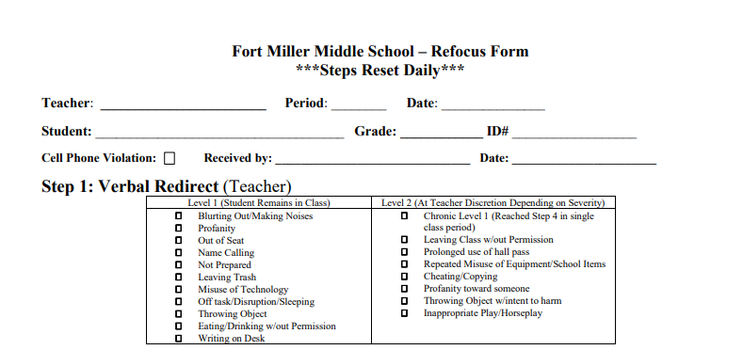
Refocus Form

Slide 19
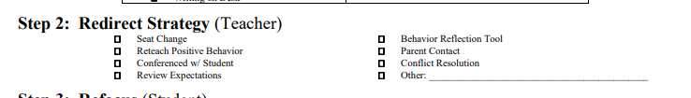
Refocus Form

Slide 20
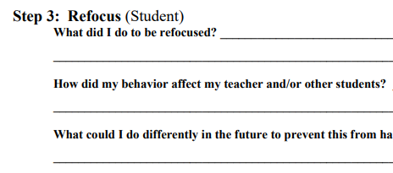
Refocus Form

Slide 21
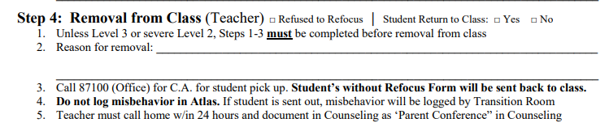
Refocus Form

Slide 22
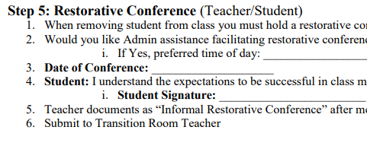
Refocus Form

Slide 23
PE Non-Suits
Fort Miler P.E. Clothes or any athletic style clothing. Clothing can be any color other than red.
Jeans, cargo shorts, or other non-athletic clothing will not be allowed.
Clothing must allow student to sit on blacktop outside and gym floor inside.
Students without their P.E. Clothes must wear school issued Loaner Clothes
Appropriate shoes for movement (ATHLECTIC SHOES) such as cross trainers, court or running shoes.
ABSOLUTELY NO SLIDES
For safety reasons only ¼” stud earrings are recommended. All jewelry should be removed but is worn at students own risk.
Locker rooms are a “no cell phone zone”. Phones will be confiscated and sent to the office. No pictures or videos are allowed.
1st Offense: Teacher Warning
2nd Offense: Parent Contact
3rd Offense: Transition Room / ASD
4th Offense: Referral to VP for Parent Meeting

Slide 24
Cell Phones
Cell Phones Zones in the Cafeteria and Library
Cell phones should not be out at any other time
Anyone who has there phone out to record a fight will have their phone confiscated and it will be a parent pick up

