Slide 1


Slide 2


Slide 3


Notes:
In Wylie ISD, Achievement Education is known simply as, “The Wylie Way.”
The Wylie Way is a school district movement to foster hope, well-being and engagement in students by establishing relationships between children and teachers to foster student achievement by discovering student strengths and passions to map their future. Students learn values to develop social savviness and develop positive adult mentors that increase their hope, well-being and engagement.

Slide 4



Notes:
The Wylie Way is a school district movement to foster hope, well-being and engagement in students by establishing relationships between children and teachers to foster student achievement by discovering student strengths and passions to map their future. Students learn values to develop social savviness and develop positive adult mentors that increase their hope, well-being and engagement.

Slide 5
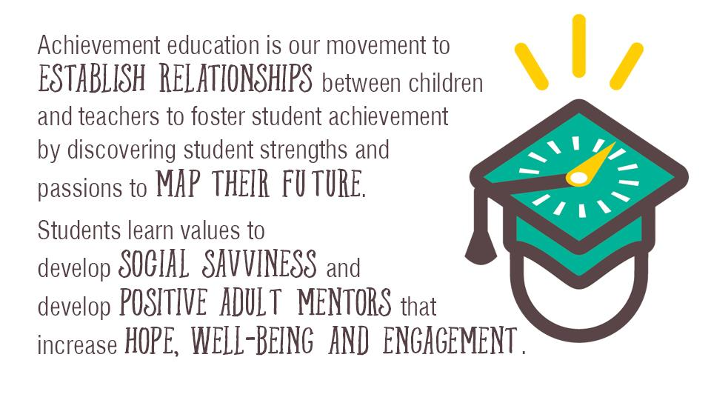
Notes:
Our answer is what we call “Achievement Education.” Achievement Education is…..(quote)
(This is just my suggestion, so feel free to change it! I brought over this quote because having the Achievement Education logo and the WW logo on the same slide wasn’t working very well, and I felt like I needed a transition from AE to WW. But please delete if you think it’s extraneous.)

Slide 6

Notes:
Hopeful kids believe tomorrow is better than today.
Hopeful people believe what they are doing is going to help them achieve a better tomorrow.
We want school to something kids value other than for socialization
As they grow older, school gets less relevant to them

Slide 7
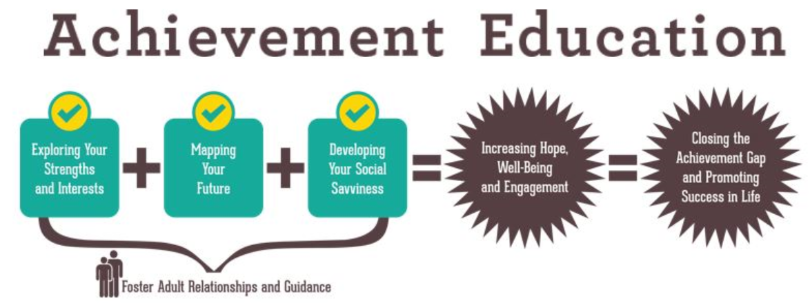

Slide 8
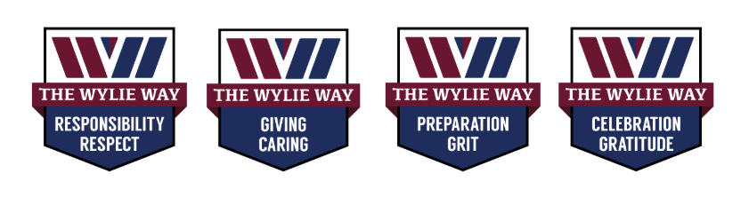

Slide 9




@wyliewaywisd
@wyliewaywisd
@TheWylieWay

Slide 10


