Slide 1
General Updates for the ELPAC
BCN Updates
Coordinator Emails

Slide 2
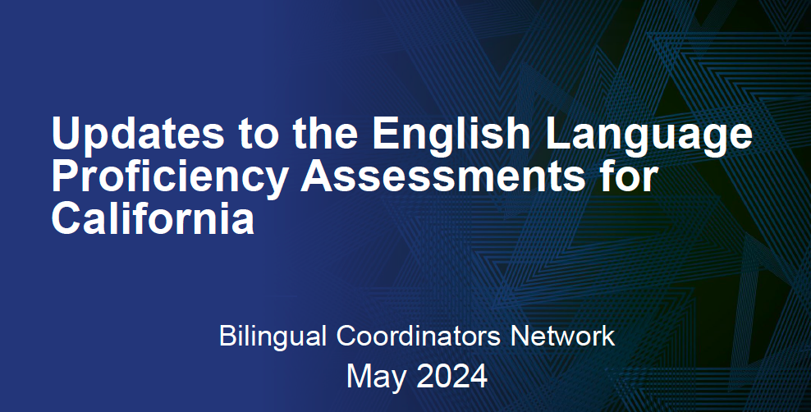

Slide 3
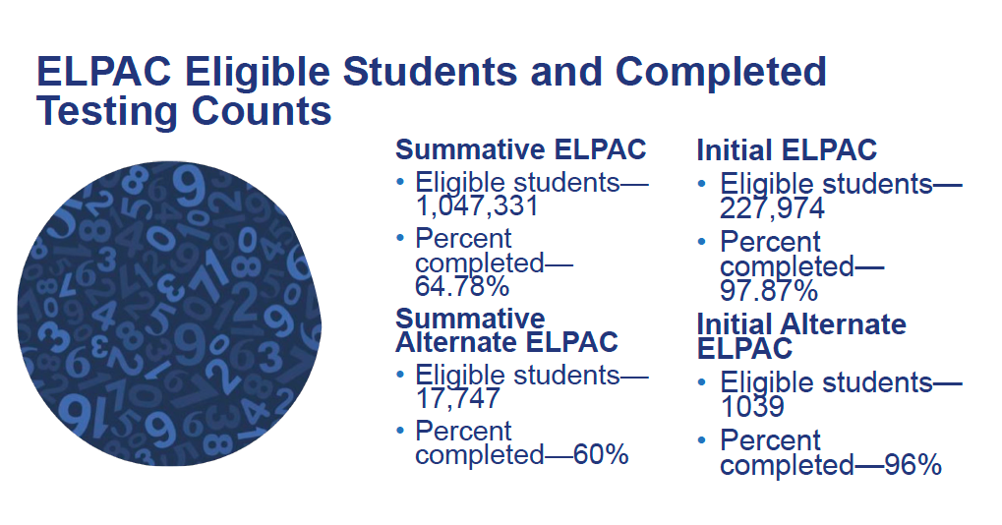
Results Available in Late May
Notes:
Summative ELPAC and the Summative Alternate ELPAC counts as of April 23, 2023
Summative ELPAC
Eligible students—1,047,331
Percent completed—64.78%
Summative Alternate ELPAC
Eligible students—17,747
Percent completed—60%
Initial ELPAC
Eligible students—227,974
Percent completed—97.87%
Initial Alternate ELPAC
Eligible students—1039
Percent completed— 96%.
As a reminder, test settings should be entered in the Test Operations Management System 48 hours before testing to ensure they will be available in the student test delivery system.
Summative ELPAC Grades Three Through Twelve Score Release Dates
LEA Coordinators received a communication on April 16, 2024, regarding the 2023–24 Summative ELPAC Grades Three Through Twelve Score Release Dates
Because of additional quality-control measures, the release of the 2023–24 Summative ELPAC Student Score Reports (SSRs) for grades three through twelve will be delayed slightly. The SSRs will be available in the Test Operations Management System and your student information system (SIS) in late May. (The original communications had stated early May for the release.)
Please note that, while this new schedule delays the release of scores for tested students in grades three through twelve, it will create a single release of the ELPAC scores for all grade levels, meaning that parents/guardians can receive scores for all students in kindergarten through grade twelve on the same day. Score release to the California Educator Reporting System (CERS) will occur around the same time as the release of SSRs to the SIS parent portals. ETS will update the ELPAC website and monthly communications to reflect the change.
Please contact your LEA Success Agent with any questions regarding the release of the SSRs.

Slide 4
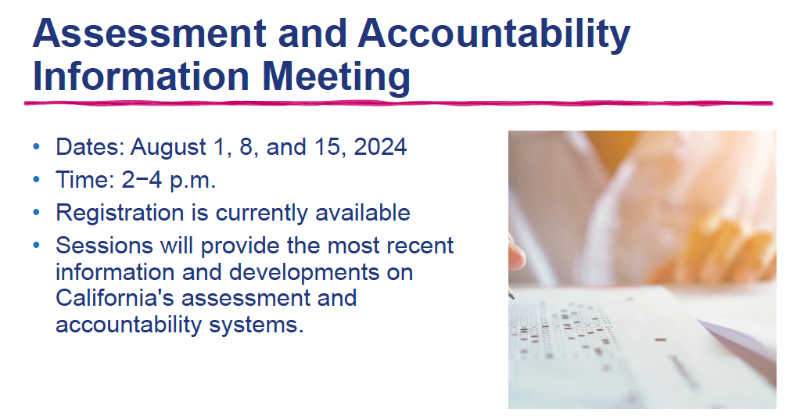
Notes:
Registration is currently available to all participants for the 2024 Assessment and Accountability Information Meeting (AAIM), hosted by the California Department of Education.
These two-hour virtual meeting sessions will provide coordinators, administrators and LEA staff with the most recent information and developments on California's assessment and accountability systems.
Dates: August 1, 8, and 15, 2024, from 2−4 p.m.
• August 1—General Assessment Updates, Interim and Formative Assessments, Physical Fitness Test, High School Equivalency and Proficiency Programs, National and International Tests
• August 8—English language arts/literacy and Mathematics Assessments, Science Assessments, English Language Proficiency Assessments for California, California Spanish Assessment
• August 15—Accountability Updates
To register, please use this link: 2024 Assessment & Accountability Information Meeting
If you are unable to attend and would like to receive materials or a notification when the recording is posted, complete the 2024 AAIM Materials and Recordings form.

Slide 5
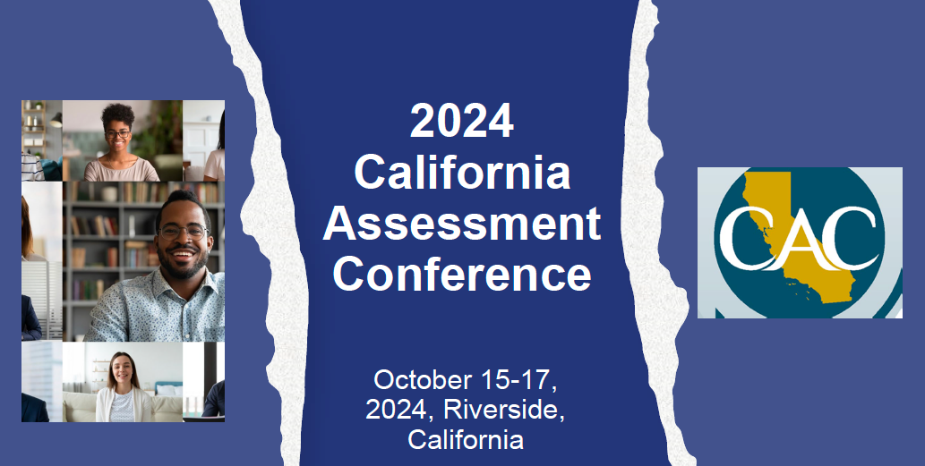
Notes:
n October 2024, the next California Assessment Conference (CAC) is happening! This conference is a unique opportunity for classroom educators to explore the connections between classroom instruction and assessment and learn how other California educators use assessment tools and strategies to improve teaching and learning.
For registration information and a link to presentation proposal submission, visit the CAC website at https://www.cdecac.org/.

Slide 6
General Updates for the ELPAC
BCN Updates
Coordinator Emails

Slide 7

NEW
Assessment Spotlight: Issue 257
ELPAC Question of the Week
Can my local educational agency mass assign the “pause and replay” accommodation to all students taking the ELPAC?
The “pause and replay” feature in the ELPAC is an embedded designated support for students to use and not a universal support. While universal tools are features available to all students, designated supports are only available for use by students for whom the need has been indicated by an educator (or team of educators working with the parent, guardian, or student).
  Read more on Link
Implications for use of Designated Support:
  You cannot turn on a designated support for all students
  Be strategic > Have a process > Who needs what, why?
  Consider EL Profiles and student needs
Notes:
New Requirement:
At least one person in the LEA must complete one of the two LEA Certification Courses in Moodle for the requirement to be met
Certification Vs. Calibration
Certification is only required to be completed by ONE person in the LEA. Typically certification is completed by the LEA Coordinator or the lead trainer, if it is a different person than the LEA Coordinator. In the past an experienced LEA Coordinator or lead trainer did not need to certify in Moodle every year based on past experience. Due to new 24-25 Field Test Questions, LEAs are required to certify this year.
Calibration is required for ALL Test Examiners, every year. Test Examiners do not need to complete the LEA Certification Course.
2b. LEA Certification Information (ELPAC)
For additional information contact:
Melissa Garcia, Coordinator of Language Education Services at mgarcia@sbceo.org

Slide 8
Coordinator Email: May 9th,2024
Eligible Students Remaining in TOMS Status Reports
ETS has received several contacts regarding students who:
exited an LEA before a testing window opened but are still listed in the Test Operations Management System (TOMS) as active
or have been reclassified for ELPAC but are still registered for the Summative ELPAC.
May Affect ELPAC Particiaption Rates
Notes:
Dear LEA CAASPP Coordinator or LEA ELPAC Coordinator:
ETS has received several contacts regarding students who:
exited an LEA before a testing window opened but are still listed in the Test Operations Management System (TOMS) as active
or have been reclassified for ELPAC but are still registered for the Summative ELPAC.
We understand the confusion and are taking steps to help ensure that your data is correct prior to the close of the testing windows.
ETS will conduct a thorough cleanup of files as we approach the end of the testing windows. LEA coordinators should work with their California Longitudinal Pupil Achievement Data System (CALPADS) administrator to ensure that all students who left the LEA prior to testing have been exited properly, and the exits have been posted to CALPADS.
To ensure transparency and clarity, we will be making the following specific corrections:
Students who were not enrolled and not tested within the LEA during the testing window will be removed if the correct exit date was entered and uploaded into CALPADS prior to the close of the testing window.
Students who were reclassified during the testing window and whose reclassification was posted to CALPADS by 5 p.m. on May 31, 2024, but did not complete the Summative ELPAC (3 or less domains) will have their registrations removed.
Students who were reclassified during the test window, completed the Summative ELPAC, but subsequently had a Security and Test Administration Incident Reporting System (STAIRS) case entered for a Reset Appeal for all four domains will have their registrations removed.
Please note that no changes will be made in the following scenarios:
If a student was enrolled at the LEA when the testing window was opened, they will not be removed.
If a student exited the school prior to the end of the testing window but the exit was not submitted until after the testing window closed, the student will remain in the LEA's TOMS files.
If a student was reclassified during the testing window and completed all domains for the Summative ELPAC with no STAIRS case entered, they will receive a score and a Student Score Report will be generated.
ETS and the CALPADS Office are collaborating to streamline this process for the 2024–25 test administration year. Testing coordinators and CALPADS administrators will receive detailed communications on how an LEA can ensure students are exited properly through both systems for future test administrations. This collaborative effort is aimed at making the process easier and more efficient for LEAs.
For further support, use the Get Answers lookup tool or contact your assigned LEA Success Agent.
Sincerely,
California Outreach Team
CAASPP website and ELPAC website
Contact Us: California Outreach web page

Slide 9
ETS Action 1
Coordinator Email: May 9th,2024
Eligible Students Remaining in TOMS Status Reports
ETS will make the following corrections:
Students who were not enrolled and not tested within the LEA during the testing window will be removed if the correct exit date was entered and uploaded into CALPADS prior to the close of the testing window.
Notes:
Dear LEA CAASPP Coordinator or LEA ELPAC Coordinator:
ETS has received several contacts regarding students who:
exited an LEA before a testing window opened but are still listed in the Test Operations Management System (TOMS) as active
or have been reclassified for ELPAC but are still registered for the Summative ELPAC.
We understand the confusion and are taking steps to help ensure that your data is correct prior to the close of the testing windows.
ETS will conduct a thorough cleanup of files as we approach the end of the testing windows. LEA coordinators should work with their California Longitudinal Pupil Achievement Data System (CALPADS) administrator to ensure that all students who left the LEA prior to testing have been exited properly, and the exits have been posted to CALPADS.
To ensure transparency and clarity, we will be making the following specific corrections:
Students who were not enrolled and not tested within the LEA during the testing window will be removed if the correct exit date was entered and uploaded into CALPADS prior to the close of the testing window.
Students who were reclassified during the testing window and whose reclassification was posted to CALPADS by 5 p.m. on May 31, 2024, but did not complete the Summative ELPAC (3 or less domains) will have their registrations removed.
Students who were reclassified during the test window, completed the Summative ELPAC, but subsequently had a Security and Test Administration Incident Reporting System (STAIRS) case entered for a Reset Appeal for all four domains will have their registrations removed.
Please note that no changes will be made in the following scenarios:
If a student was enrolled at the LEA when the testing window was opened, they will not be removed.
If a student exited the school prior to the end of the testing window but the exit was not submitted until after the testing window closed, the student will remain in the LEA's TOMS files.
If a student was reclassified during the testing window and completed all domains for the Summative ELPAC with no STAIRS case entered, they will receive a score and a Student Score Report will be generated.
ETS and the CALPADS Office are collaborating to streamline this process for the 2024–25 test administration year. Testing coordinators and CALPADS administrators will receive detailed communications on how an LEA can ensure students are exited properly through both systems for future test administrations. This collaborative effort is aimed at making the process easier and more efficient for LEAs.
For further support, use the Get Answers lookup tool or contact your assigned LEA Success Agent.
Sincerely,
California Outreach Team
CAASPP website and ELPAC website
Contact Us: California Outreach web page

Slide 10
ETS Action 2
Coordinator Email: May 9th,2024
Eligible Students Remaining in TOMS Status Reports
ETS will make the following corrections:
Students who were reclassified during the testing window and whose reclassification was posted to CALPADS by 5 p.m. on May 31, 2024, but did not complete the Summative ELPAC (3 or less domains) will have their registrations removed.
Notes:
Dear LEA CAASPP Coordinator or LEA ELPAC Coordinator:
ETS has received several contacts regarding students who:
exited an LEA before a testing window opened but are still listed in the Test Operations Management System (TOMS) as active
or have been reclassified for ELPAC but are still registered for the Summative ELPAC.
We understand the confusion and are taking steps to help ensure that your data is correct prior to the close of the testing windows.
ETS will conduct a thorough cleanup of files as we approach the end of the testing windows. LEA coordinators should work with their California Longitudinal Pupil Achievement Data System (CALPADS) administrator to ensure that all students who left the LEA prior to testing have been exited properly, and the exits have been posted to CALPADS.
To ensure transparency and clarity, we will be making the following specific corrections:
Students who were not enrolled and not tested within the LEA during the testing window will be removed if the correct exit date was entered and uploaded into CALPADS prior to the close of the testing window.
Students who were reclassified during the testing window and whose reclassification was posted to CALPADS by 5 p.m. on May 31, 2024, but did not complete the Summative ELPAC (3 or less domains) will have their registrations removed.
Students who were reclassified during the test window, completed the Summative ELPAC, but subsequently had a Security and Test Administration Incident Reporting System (STAIRS) case entered for a Reset Appeal for all four domains will have their registrations removed.
Please note that no changes will be made in the following scenarios:
If a student was enrolled at the LEA when the testing window was opened, they will not be removed.
If a student exited the school prior to the end of the testing window but the exit was not submitted until after the testing window closed, the student will remain in the LEA's TOMS files.
If a student was reclassified during the testing window and completed all domains for the Summative ELPAC with no STAIRS case entered, they will receive a score and a Student Score Report will be generated.
ETS and the CALPADS Office are collaborating to streamline this process for the 2024–25 test administration year. Testing coordinators and CALPADS administrators will receive detailed communications on how an LEA can ensure students are exited properly through both systems for future test administrations. This collaborative effort is aimed at making the process easier and more efficient for LEAs.
For further support, use the Get Answers lookup tool or contact your assigned LEA Success Agent.
Sincerely,
California Outreach Team
CAASPP website and ELPAC website
Contact Us: California Outreach web page

Slide 11
ETS Action 3
Coordinator Email: May 9th,2024
Eligible Students Remaining in TOMS Status Reports
ETS will make the following corrections:
Students who were reclassified during the test window, completed the Summative ELPAC, but subsequently had a Security and Test Administration Incident Reporting System (STAIRS) case entered for a Reset Appeal for all four domains will have their registrations removed.
Notes:
Dear LEA CAASPP Coordinator or LEA ELPAC Coordinator:
ETS has received several contacts regarding students who:
exited an LEA before a testing window opened but are still listed in the Test Operations Management System (TOMS) as active
or have been reclassified for ELPAC but are still registered for the Summative ELPAC.
We understand the confusion and are taking steps to help ensure that your data is correct prior to the close of the testing windows.
ETS will conduct a thorough cleanup of files as we approach the end of the testing windows. LEA coordinators should work with their California Longitudinal Pupil Achievement Data System (CALPADS) administrator to ensure that all students who left the LEA prior to testing have been exited properly, and the exits have been posted to CALPADS.
To ensure transparency and clarity, we will be making the following specific corrections:
Students who were not enrolled and not tested within the LEA during the testing window will be removed if the correct exit date was entered and uploaded into CALPADS prior to the close of the testing window.
Students who were reclassified during the testing window and whose reclassification was posted to CALPADS by 5 p.m. on May 31, 2024, but did not complete the Summative ELPAC (3 or less domains) will have their registrations removed.
Students who were reclassified during the test window, completed the Summative ELPAC, but subsequently had a Security and Test Administration Incident Reporting System (STAIRS) case entered for a Reset Appeal for all four domains will have their registrations removed.
Please note that no changes will be made in the following scenarios:
If a student was enrolled at the LEA when the testing window was opened, they will not be removed.
If a student exited the school prior to the end of the testing window but the exit was not submitted until after the testing window closed, the student will remain in the LEA's TOMS files.
If a student was reclassified during the testing window and completed all domains for the Summative ELPAC with no STAIRS case entered, they will receive a score and a Student Score Report will be generated.
ETS and the CALPADS Office are collaborating to streamline this process for the 2024–25 test administration year. Testing coordinators and CALPADS administrators will receive detailed communications on how an LEA can ensure students are exited properly through both systems for future test administrations. This collaborative effort is aimed at making the process easier and more efficient for LEAs.
For further support, use the Get Answers lookup tool or contact your assigned LEA Success Agent.
Sincerely,
California Outreach Team
CAASPP website and ELPAC website
Contact Us: California Outreach web page

Slide 12
LEA Actions
Coordinator Email: May 9th,2024
Eligible Students Remaining in TOMS Status Reports
Please note that no changes will be made in the following scenarios:
If a student was enrolled at the LEA when the testing window was opened, they will not be removed.
If a student exited the school prior to the end of the testing window but the exit was not submitted until after the testing window closed, the student will remain in the LEA's TOMS files.
If a student was reclassified during the testing window and completed all domains for the Summative ELPAC with no STAIRS case entered, they will receive a score and a Student Score Report will be generated.
May Affect ELPAC Particiaption Rates
Notes:
Dear LEA CAASPP Coordinator or LEA ELPAC Coordinator:
ETS has received several contacts regarding students who:
exited an LEA before a testing window opened but are still listed in the Test Operations Management System (TOMS) as active
or have been reclassified for ELPAC but are still registered for the Summative ELPAC.
We understand the confusion and are taking steps to help ensure that your data is correct prior to the close of the testing windows.
ETS will conduct a thorough cleanup of files as we approach the end of the testing windows. LEA coordinators should work with their California Longitudinal Pupil Achievement Data System (CALPADS) administrator to ensure that all students who left the LEA prior to testing have been exited properly, and the exits have been posted to CALPADS.
To ensure transparency and clarity, we will be making the following specific corrections:
Students who were not enrolled and not tested within the LEA during the testing window will be removed if the correct exit date was entered and uploaded into CALPADS prior to the close of the testing window.
Students who were reclassified during the testing window and whose reclassification was posted to CALPADS by 5 p.m. on May 31, 2024, but did not complete the Summative ELPAC (3 or less domains) will have their registrations removed.
Students who were reclassified during the test window, completed the Summative ELPAC, but subsequently had a Security and Test Administration Incident Reporting System (STAIRS) case entered for a Reset Appeal for all four domains will have their registrations removed.
Please note that no changes will be made in the following scenarios:
If a student was enrolled at the LEA when the testing window was opened, they will not be removed.
If a student exited the school prior to the end of the testing window but the exit was not submitted until after the testing window closed, the student will remain in the LEA's TOMS files.
If a student was reclassified during the testing window and completed all domains for the Summative ELPAC with no STAIRS case entered, they will receive a score and a Student Score Report will be generated.
ETS and the CALPADS Office are collaborating to streamline this process for the 2024–25 test administration year. Testing coordinators and CALPADS administrators will receive detailed communications on how an LEA can ensure students are exited properly through both systems for future test administrations. This collaborative effort is aimed at making the process easier and more efficient for LEAs.
For further support, use the Get Answers lookup tool or contact your assigned LEA Success Agent.
Sincerely,
California Outreach Team
CAASPP website and ELPAC website
Contact Us: California Outreach web page

Slide 13
2024-25 General Updates for the Initial ELPAC

Slide 14
Initial ELPAC LEA Certification
New 24-25 Field Test Questions for 25-26 ELPAC refresh
NEW 24-25 Requirement:
Every LEA needs to certify in Moodle for the Initial ELPAC
  At least one person must complete the 2024-25 Initial ELPAC LEA Certification
Notes:
New Requirement:
At least one person in the LEA must complete one of the two LEA Certification Courses in Moodle for the requirement to be met
Certification Vs. Calibration
Certification is only required to be completed by ONE person in the LEA. Typically certification is completed by the LEA Coordinator or the lead trainer, if it is a different person than the LEA Coordinator. In the past an experienced LEA Coordinator or lead trainer did not need to certify in Moodle every year based on past experience. Due to new 24-25 Field Test Questions, LEAs are required to certify this year.
Calibration is required for ALL Test Examiners, every year. Test Examiners do not need to complete the LEA Certification Course.
2b. LEA Certification Information (ELPAC)
For additional information contact:
Melissa Garcia, Coordinator of Language Education Services at mgarcia@sbceo.org

Slide 15
Coordinator Emails: April 15th, 2024
Administration of the computer based Initial ELPAC for 2024-25
Testing Window: July 3rd, 2024-June 30th, 2025
New test materials (Form 1 and Form 2) that include embedded field test items will be introduced for the 2024–25 Initial ELPAC
Notes:
New Requirement:
At least one person in the LEA must complete one of the two LEA Certification Courses in Moodle for the requirement to be met
Certification Vs. Calibration
Certification is only required to be completed by ONE person in the LEA. Typically certification is completed by the LEA Coordinator or the lead trainer, if it is a different person than the LEA Coordinator. In the past an experienced LEA Coordinator or lead trainer did not need to certify in Moodle every year based on past experience. Due to new 24-25 Field Test Questions, LEAs are required to certify this year.
Calibration is required for ALL Test Examiners, every year. Test Examiners do not need to complete the LEA Certification Course.
2b. LEA Certification Information (ELPAC)
For additional information contact:
Melissa Garcia, Coordinator of Language Education Services at mgarcia@sbceo.org

Slide 16
LEA Actions
Order new Writing domain Answer Books for kindergarten through grade two through TOMS.
Securely destroy previous year materials, which can no longer be used, by July 15, 2024.
Notes:
New Requirement:
At least one person in the LEA must complete one of the two LEA Certification Courses in Moodle for the requirement to be met
Certification Vs. Calibration
Certification is only required to be completed by ONE person in the LEA. Typically certification is completed by the LEA Coordinator or the lead trainer, if it is a different person than the LEA Coordinator. In the past an experienced LEA Coordinator or lead trainer did not need to certify in Moodle every year based on past experience. Due to new 24-25 Field Test Questions, LEAs are required to certify this year.
Calibration is required for ALL Test Examiners, every year. Test Examiners do not need to complete the LEA Certification Course.
2b. LEA Certification Information (ELPAC)
For additional information contact:
Melissa Garcia, Coordinator of Language Education Services at mgarcia@sbceo.org

Slide 17
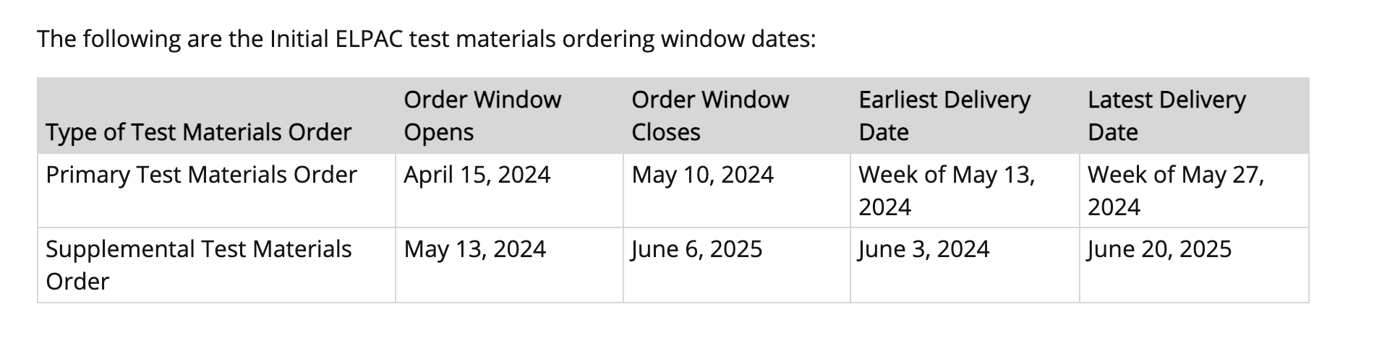
Order Windows
Notes:
New Requirement:
At least one person in the LEA must complete one of the two LEA Certification Courses in Moodle for the requirement to be met
Certification Vs. Calibration
Certification is only required to be completed by ONE person in the LEA. Typically certification is completed by the LEA Coordinator or the lead trainer, if it is a different person than the LEA Coordinator. In the past an experienced LEA Coordinator or lead trainer did not need to certify in Moodle every year based on past experience. Due to new 24-25 Field Test Questions, LEAs are required to certify this year.
Calibration is required for ALL Test Examiners, every year. Test Examiners do not need to complete the LEA Certification Course.
2b. LEA Certification Information (ELPAC)
For additional information contact:
Melissa Garcia, Coordinator of Language Education Services at mgarcia@sbceo.org

