Slide 1


Family Resource Navigators
101 Callan Ave., Ste. 200 San Leandro, CA 94577 Warmline: (510) 547-7322
Email: info@familyresourcenavigators.org
HUSD Special Education Townhall 5/13/24

Slide 2



Today’s Topics
Family Resource Navigators Overview
Meaningful Parent Participation & Informed Consent
FRN Resources

Slide 3

Family Resource Navigators Overview Who We Are
Family Driven and Family Centered
Multilingual & Multicultural Staff
Arabic, Cantonese, English, Dari, Persian (Farsi), German, Hindi, Mandarin, Spanish, Tamil, and Urdu
All FRN staff have experiential knowledge of systems as a parent or guardian, grandparent, sibling or as a person with a disability
Trained and Mentored Staff
Strengthening Families, Motivational Interviewing, IEP, 504, Early Start, Lanterman, RCEB, Basic Need Resources, IHSS, SSI, CCS, and Medi-Cal

Slide 4

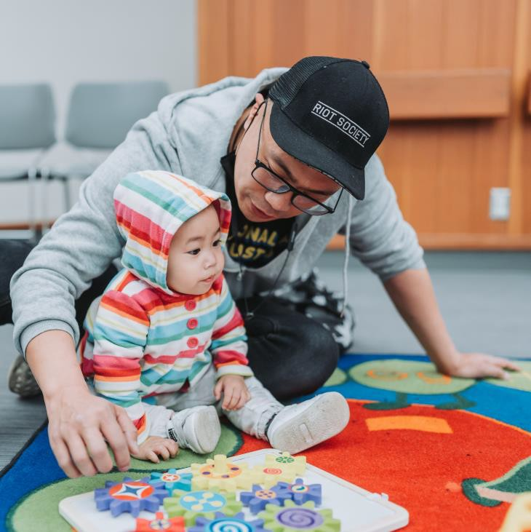
Family Resource Navigators Overview What We Do
Family Resource Navigators (FRN) is a peer-to- peer organization in Alameda County with 30+ years of experience serving families of children with developmental delays, disabilities and complex medical needs.
Through family navigation, training, and leadership opportunities, we help families secure the services they need and support them to become the best advocates for their children.

Slide 5





Family Resource Navigators Overview Information & Resource
Bilingual Warmline Support: (510) 547-7322
Monday thru Thursday 9:30AM – 12:30PM
Friday 9:30PM – 12:00PM
Information and Resources provided to families – some examples:
Childcare Resource and Referral Agencies
Regional Center of the East Bay
CAPTAIN – Evidence-based resources to support a child with autism.
*Click logos to view more information

Slide 6




Meaningful Parental Participation
& Informed Consent

Slide 7




Further Education Employment Independent Living
The Purpose of IDEA
34 CFR 300.1(a)

Slide 8

Core Entitlements Under IDEA
A Free Appropriate Public Education (FAPE)
In the Least Restrictive Environment (LRE)

Slide 9
Notice of Procedural Safeguards
(Parent Rights)
Includes information on:
Parent Participation
Parental Consent
Prior Written Notice
Independent Educational Evaluations
Access to Educational Records
Options for resolving disputes such as Alternative Dispute Resolution (ADR)
We will review these two

Slide 10

Notice of Procedural Safeguards (Parent Rights)
Parent Rights are available in these languages:
English
Spanish
Chinese (Simplified)
Chinese (Traditional)
Tagalog
Vietnamese
*Click to download PDF
Revised June 2022 – now lists all Family Empowerment Centers in California

Slide 11
Meaningful Parent Participation
Parents of a child with a disability must be afforded an opportunity to participate in meetings with respect to the identification, evaluation, and educational placement of the child; and the provision of a free and appropriate education (FAPE) to the child.

Slide 12

Informed Consent
This means parents are fully informed, understand and consent in writing, and know their consent is voluntary.

Slide 13
Meaningful Parent Participation & Informed Consent
Tips and Strategies to Support Diverse Families
De-stressing the Individualized Education Plan (IEP) by helping parents understand its contents:
What a child’s special educational needs are;
What special education services a child will receive;
How often and how much services;
How and where those services will be delivered.

Slide 14
Meaningful Parent Participation & Informed Consent
Tips and Strategies to Support Diverse Families
Helping parents get their items and concerns discussed
Parent topics are included in the meeting agenda.
Ensuring the required IEP team members are present.
Parents have enough information as a part of the IEP team
Parents are provided materials in advance to review. This includes translated documents.
Explaining special education words and acronyms in plain language.
Parent can request an interpreter. Allow enough time during the meeting for interpretation.

Slide 15
Meaningful Parent Participation & Informed Consent
Tips and Strategies to Support Diverse Families
Encourage and support participation by the family
IEP team members are respectful with each other.
Parents can ask questions.
IEP team explaining so parents can understand.
Help ensure everything is in the document so that the IEP the child receives is the one which was discussed. Some examples:
Documenting next steps (who, what, and where).
All services are detailed in the Offer of FAPE.

Slide 16

QUESTIONS?

Slide 17
Thank You!
April Key-Lee
FRN Program Manager
info@familyresourcenavigators.org 510-547-7322
www.familyresourcenavigators.org

Slide 18
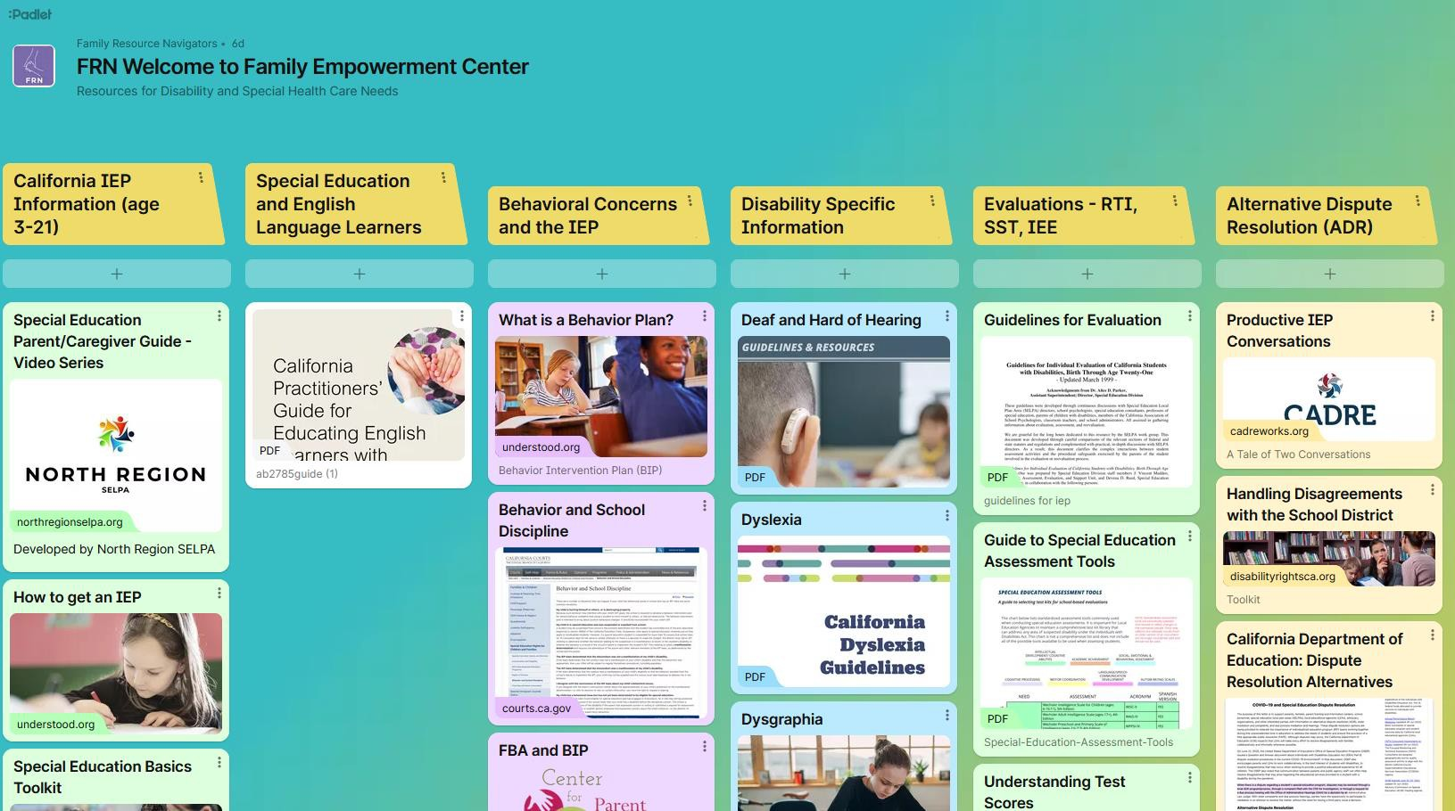
RESOURCE: Family Resource Navigators FEC Padlet
A digital resource created by FRN’s FEC to share vetted
information to families of children in special education.
What is Padlet?
An electronic version of a resource board.
Available Languages:
Arabic
English
Chinese (Simplified)
Chinese (Traditional)
Spanish

Slide 19

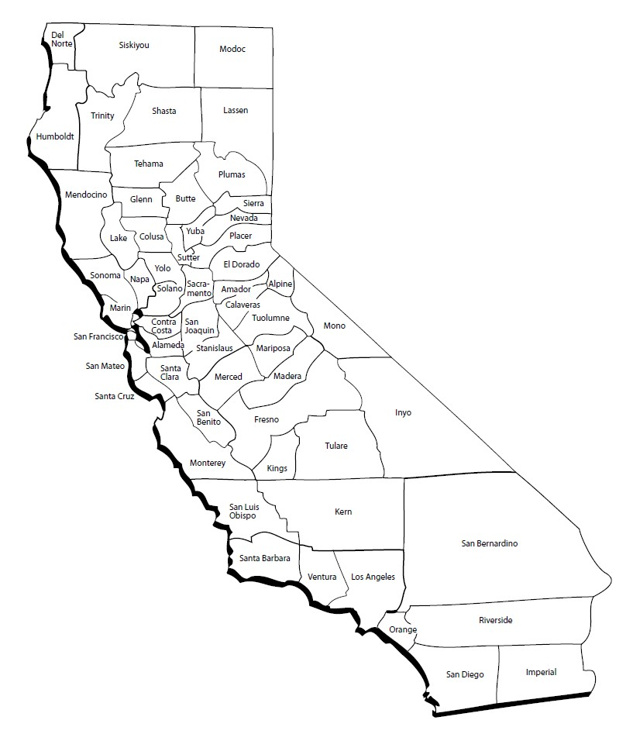

RESOURCE: Family Empowerment Centers in California
Find an FEC by County:
58 Counties in California
41 FEC Regions
31 FECs support one or more regions
FEC Contact Information
Counties & Regions Served
FECs listed alphabetically by center name
*Family Resource Navigators is the FEC for Alameda County
*Click logos to view more information

