Slide 1
Charleston County Schools
Financial Concerns and Response
Presented to the
Charleston County School District
Board of Trustees
December 14, 2015
Prepared by:
Dr. Gerrita Postlewait
Superintendent of Schools

Slide 2

Priorities
Address the Readiness Gap
  Literacy Improvement
  Career or College Entry Rates
Develop a Five-Year Strategic Plan
Stabilize the District’s Finances
2

Slide 3
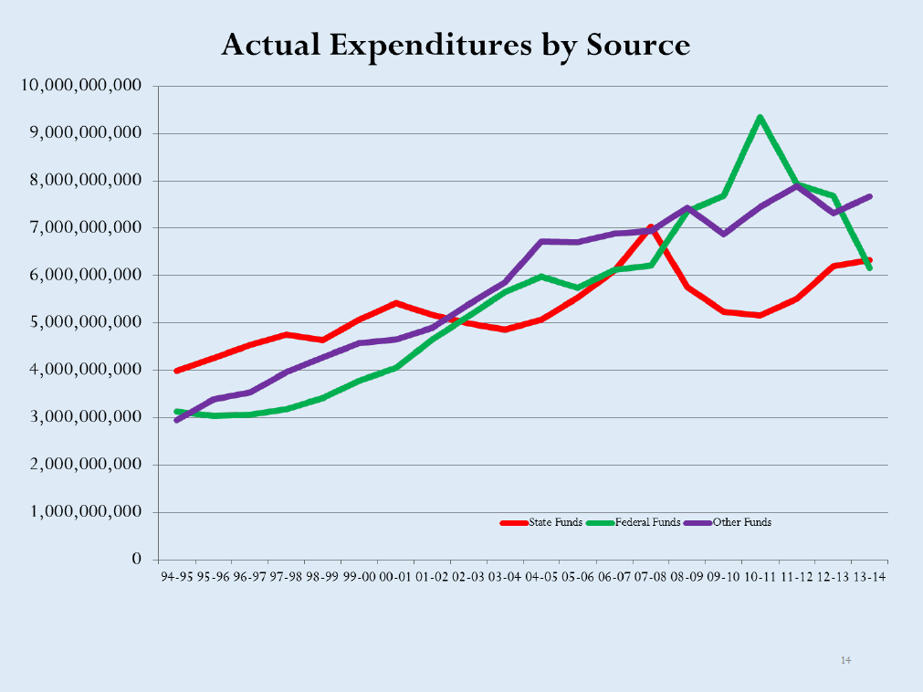
Actual Expenditures by Source – South Carolina
3

Slide 4
Fund Balance
$69.3
$55.4
$57.0
$31.1
Over 90% Reduction in Unassigned Fund Balance over 4 Years
4

Slide 5
2015-16 Budget Challenges
The Board of Trustees approved a General Operating Fund Budget of $426.7 million.
Unless we take measures to reduce it, the salary account is predicted to exceed budget by $7.6M.
With reductions we have implemented, our estimate of the salary and benefits budget shortfall is $4.1 million.
5

Slide 6
2015-16 Budget Challenges
Current estimate of the printing shortfall is $975,000.
Current estimate of the utilities budget shortfall is $1.3 million.
Left unchecked, our estimate of total expenditures over budget is $12.7M. We hope to be able to curtail spending by half that amount, ending the year with a total budget shortfall = $6.4 million.
6

Slide 7
Planned Use of Fund Balance*
Year | Fund Balance Budgeted | Actual ( Deficit) or Surplus
2011-12 | 5.7 Million | 21.0 Million
2012-13 | 5.5 Million | 13.9 Million
2013-14 | 10 Million | (12.2) Million
2014-15 | 7.4 Million | (25.9) Million
2015-16 | 7.2 Million | (6.4) Million
*Deficit budgeting
7

Slide 8
Fund Balance
$69.3
$55.4
$57.0
$31.1
$31.1
$12.7
Over 90% Reduction in Unassigned Fund Balance over 4 Years
8

Slide 9
Why is the Fund Balance Important?
Impact on the District Bond Rating could be negatively impacted if fund balance declines.
A lower bond rating would likely result in higher borrowing interest rates, costing taxpayers more money.
Fund balance decline will mean increased borrowing for short term tax anticipation notes and possibly at a higher interest rate.
Recovering a better bond rating after a downgrade is a multi-year process.
9

Slide 10
Ensuring Future Financial Stability
Changes in Practice
Changes in Policy
Budget Reductions
Systemic Issues
Longer-Term Considerations
10

Slide 11

Changes in Practice
Fiscal Responsibility
Improvements
System Utilization
Accountability
Budget Control
Defined Process
Required Training
Performance Monitoring
11

Slide 12
Changes in Practice
Reducing the degree of distributed authority, school-based autonomy (examples follow).
The financial staff has ceased an ongoing practice of schools and departments submitting point change forms (PCF). The PCF is the practice of adjusting the school allocations to “buy” more staff. For example, changing an allocation for a teacher to buy two teacher assistants, or saving a .5 teacher allocation until second semester to buy a 1.0 teacher. With all of the position movement the District was never able to stop and reconcile the payroll budget.
There will be a new process for point changes: July 1, 2016 to 7th day – no changes. After October 1, 2016 – no changes.
12

Slide 13
Changes in Practice
The Contract Recommendation Form (CRF) is a budgeting document used to identify all positions in accordance to the number of allocations. The finance staff has reconciled the CRF to ensure schools have not exceeded allocations.
The staff also reconciled the employees’ actual payroll to the payroll budget after visiting each school to make sure everyone at the school was accounted for.
13

Slide 14
Changes in Procedure
Once this reconciliation was completed the finance staff was able to create a comprehensive list of general operating fund vacancies. We are in the process of verifying the list with the Human Resources Department.
An email was sent out to every school and department that shows a deficit in the printing and overtime accounts instructing schools to cover the deficits.
The finance staff is reviewing all “lump sum” forms submitted for payment for availability of budget.
14

Slide 15
Changes in Procedure
We have implemented the payroll encumbering module in the MUNIS system. Benefit encumbering will be implemented in January. This process will help departments monitor the payroll budget.
Human Resources is reviewing the use of Kelly Services:
  Ensuring substitute work is charged to correct funding sources.
  Means of acquiring subs is inefficient. Moving toward a single point of contact in every school.
15

Slide 16
System Utilization
Fully utilize and integrate financial software (MUNIS) and legacy systems (KRONOS, AppliTrack, KASS, Harbor, etc.) to create an environment of accuracy, efficiency, and reduction of human error.
Continue district-wide implementation of KRONOS (electronic timekeeping system).
Ensure timely system upgrades and training.
16

Slide 17
Budget Control
Provide training and tools to allow principals/managers the ability to oversee, in real-time, their school/department Board approved budget and ongoing expenditures; thus creating shared fiscal responsibility.
Mandatory district-wide training focused on accessing and understanding year-to-date variances within each account associated with the school/department.
Implement monthly budget vs. actual reviews by school/ department.
Utilize MUNIS to generate accurate and up-to-date staffing reports.
17

Slide 18
Accountability
Consistently hold employees accountable for adhering to defined policies, procedures, and best practices.
Institute effective practices, procedures, and policies and adhere to them. “Exceptions” result in inconsistencies, inefficiencies, and low credibility. They also make the District susceptible to employee complaints, negative press, audit findings, and lawsuits.
Incorporate a budget management related line item within the established performance evaluation tool.
Enforce the already established progressive discipline policy (GBEBAA) for any employee who fails to observe defined policies and procedures.
18

Slide 19
Changes in Policy
We have reviewed 13 operational and finance policies and recommend changes to ensure consistency and coherence. We are also comparing our policies to those of other similar districts.
No major policy changes are recommended. We will develop administrative regulations and implement them with fidelity.
We will bring recommended policy “clean up” to Board in the coming months.
19

Slide 20
Short-Term Budget Adjustments
(Examples)
Hire only essential (mission critical) positions, both central and school based.
Eliminate all overtime (exceptions for identified positions such as first responders, facilities).
Eliminate all non-essential travel for the remainder of 2016.
Defer proposed Middle School Sports.
Analyze carefully all contingency funds for possible savings. Only fund mission critical items.
Point person at each school responsible for substitute teacher requests.
Limit the professional development during instructional days.
Work with vendor to decrease expenditures for printing and copying.
20

Slide 21
Longer-Term Budget Adjustments
Develop and adhere to Personnel Allocation Formulae
Identify and eliminate all Non-Required Personnel Positions
Evaluate the Costs of Operating all Sites in the District
Analyze Contractual Obligations in Non-Recurring Funds
Discontinue Programs and Approaches with Little or No Discernable ROI
Evaluate the amount CCSD spends for Charter Schools above that which is required.
21

Slide 22
FY17: Moving Toward Zero-Based Budget
Year | Fund Balance | Budget – GOF
Year 1 2015-16 | Low | Instructional Program ROI Allocation Formula/ Personnel 1/3
Year 2 2016-17 | Increasing | 1/3
Year 3 2017-18 | Greatly Improved | 1/3
Year 4 2018-19 | Stable | Full Zero-Based Budgeting System Implemented
This year: Focus on Allocation Formula and Program Impact
22

Slide 23
Efforts Underway
Forensic Audit (expect results by February 29)
Internal Investigations Continue
Special Education Audit
Transportation Route Efficiency Analysis
District Staffing Analysis
Examine Special Grants
Meetings regarding District’s Bond Rating
Discussions with County Treasurer, Auditor Staff
Five-Year Strategic Plan Effort
Mitigation Efforts: IRS Penalty and MOE Calculations
Council of the Great City Schools Financial Policies Review
23

Slide 24
Well-Managed Program
Building Program
  2005-09 Building Program
  2010-2016 Building Program
  Fixed Cost of Ownership (FCO) Program
  Zero Findings related to these Projects
  Three Separate Audits; No Significant Issues
Strong Controls at Multiple Levels; Adherence to Clear Procedures, Close and Continuous Monitoring.
24

Slide 25
Systemic Issues
FROM
TO
Decentralization without adequate controls, checks and balances
>100 currently active different revenue sources; lack of communication and coordinated effort across departments
Massive infusion of short-term funds (e.g. ARRA)
Use of non-recurring funds for recurring costs
Increase centralized management, monitoring
Align departments; coordinate effort and resources toward goals, outcomes
Selectively pursue grant funds; ensure sustainability
Increase accountability
Monitor frequently
Create short- and long-term financial projections
25

Slide 26
Our Intent
To put service to students first.
To effectively address the readiness gap.
To involve our communities in creating a five-year plan.
To achieve financial stability.
To earn the public trust.
26

