Slide 1


The California
Middle Class Scholarship
Presented by
Central Valley Cal-SOAP Program

Slide 2
The California
Middle Class Scholarship
Started in 2014-2015 for undergraduate students who are:
Attending a CSU or UC campus
From families with income up to $150,000
U.S. citizens, permanent residents or AB 540

Slide 3
The California
Middle Class Scholarship
Students must also:
Be California residents
Maintain a 2.0 GPA
Not have been incarcerated

Slide 4
The California
Middle Class Scholarship
How do students apply…?
Fill out & submit the FAFSA
Or Dream Act application
& Cal Grant GPA Verification is not required, but it is recommended.
**Note- There is no special part or section in the FAFSA that refers to MCS. All you have to do is submit a completed FAFSA application to hopefully qualify.

Slide 5
The California
Middle Class Scholarship
How much can students get?
Up to 40% of mandatory system-wide fees for students whose annual family income is up to $100,000 ...eventually.
No less than 10% of mandatory system-wide fees for students whose annual family income is between $100,001 and $150,000

Slide 6
MCS – The Next 4 years
Based on current CSU and UC system-wide fees, over the next 4 years, maximum awards will be…
Year | Up to | CSU Maximum Award (Fees = $5,472) | UC Maximum Award (Fees = $13,200)
2014-2015 | 14% | $ 766.08 | $ 1,848
2015-2016 | 20% | $ 1,094.40 | $ 2,640
2016-2017 | 30% | $ 1,641.60 | $ 3,960
2017-2018 | 40% | $ 2,188.80 | $ 5,280
Notes:
It was over the 10% that was assumed in 14/15. We’ll see how 15/16 goes.

Slide 7
This Past Year 14/15
There was 77,800 MCS Recipients
For 2014/2015 there was $107 million allotted towards MCS recipients.
For 2015/2016 there will be $152 million allotted towards MCS recipients.

Slide 8
Middle Class Scholarship
Total Budget Allocation
2014-15 - $107m
2015-16 - $152m
2016-17 - $228m
2017-18 - $305m
2018-19 -
2019-20 -
{
To be determined in the annual budget…
This year $53,685,498 has been awarded to MCS eligible students.

Slide 9
Looking towards 15/16
Students complete and submit their FAFSA by March 2nd, 2015.
The number of applicants will be reviewed and based on whatever is carried over of unused Cal Grant and State funds the number of awards and quantity will be determined.
MCS award notifications are slated for August and to be awarded in September.

Slide 10
Common Reasons why students did not apply to MCS
#1 Students who could apply think only Low-Income students get money.
Truth – While Low Income students may be awarded more money, Middle Income students will still qualify for some assistance, which has not been the case before.

Slide 11
Common Reasons Why Students Did Not Apply to MCS
#2 Students don’t apply because when they hear scholarship they think they have to write an essay or have to compete with students with higher GPA’s.
Truth – This is false, as long as the applicant submits their FAFSA and is Middle Income they may qualify. This is a scholarship for going to a CSU or UC.

Slide 12
Common Reasons why students did not apply to MCS
#3 Students think they will not be going to a CSU or UC and therefore not apply.
Truth – You should always have various options. It does not hurt to apply to the FAFSA and later decide if you’d rather go to a Community College or an Independent College that cannot qualify for the MCS scholarship.

Slide 13
Common Reasons why not to apply for MCS
#4 Completing the FAFSA will take too long. Parents don’t have time to complete the FAFSA.
Truth – Counselors at your schools are there to assist students in applying for the FAFSA. Students should go speak with them. Usually the FAFSA will not take more than 20 minutes to complete if you have the right information handy.

Slide 14
Common Reason why not to apply for MCS
#5 The amount of money given does not cover all tuition. It’s not worth getting.
Truth – With each year the percentage will increase. Every dollar given is helpful towards your education and is there to assist Middle Income students.

Slide 15
Common Reasons Why Students Did Not Apply for MCS
#6 Only graduating High School seniors qualify for MCS.
Truth – As long as you are a Middle Income undergraduate student, complete and submit your FAFSA and don’t fall under SAP, you can be a recipient of MCS.

Slide 16
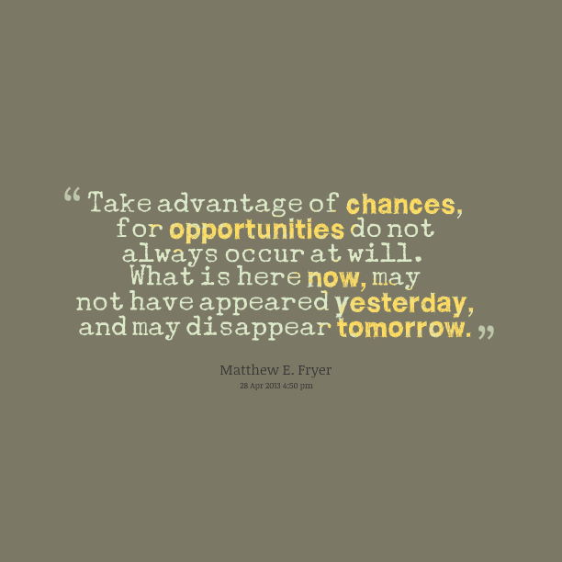


Slide 17

Questions
Contact us at:
CentralValleyMCS@gmail.com
or
call our office at (559) 278-5312

Slide 18




CSAC MCS Information
http://www.csac.ca.gov/mcs.asp
or call 1-888-224-7268

