Slide 1
Steps to create your personal account

Slide 2
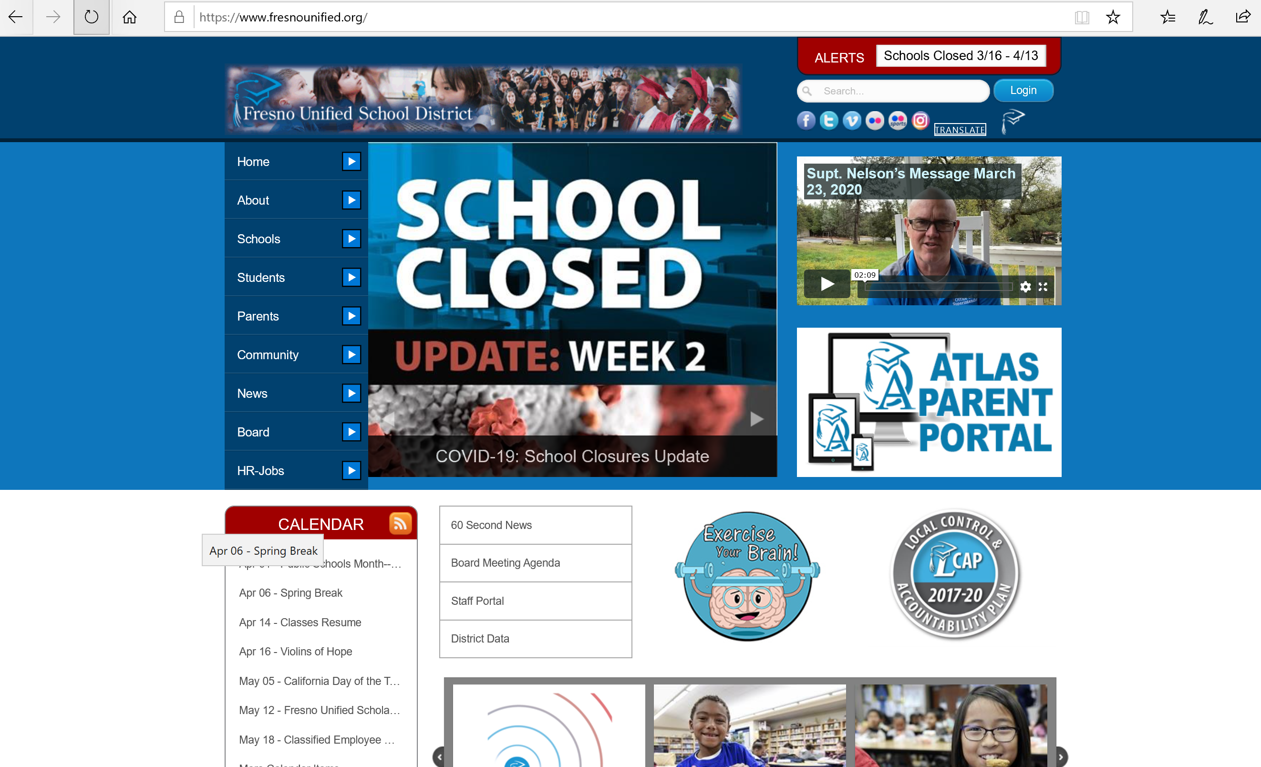
Create a personal account on the district's ATLAS Parent Portal.
Visit the district’s website at Fresnounified.org
Click on the Atlas Parent Portal icon

Slide 3
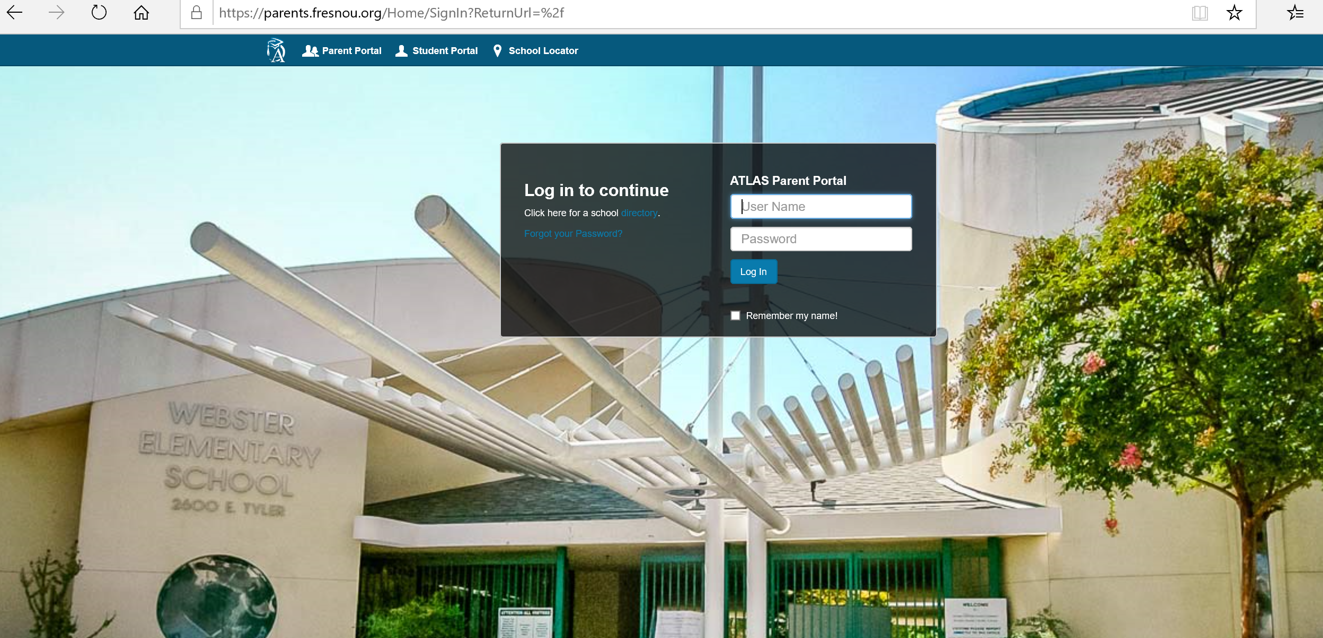
Log on to the Atlas Parent Portal; your login information will be located on your student’s report card

Slide 4
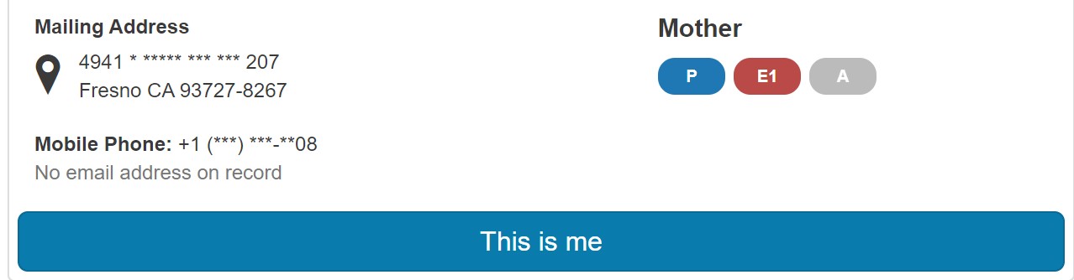
Click “This is me” button by your name (if you do not see your name, please contact your school site).

Slide 5
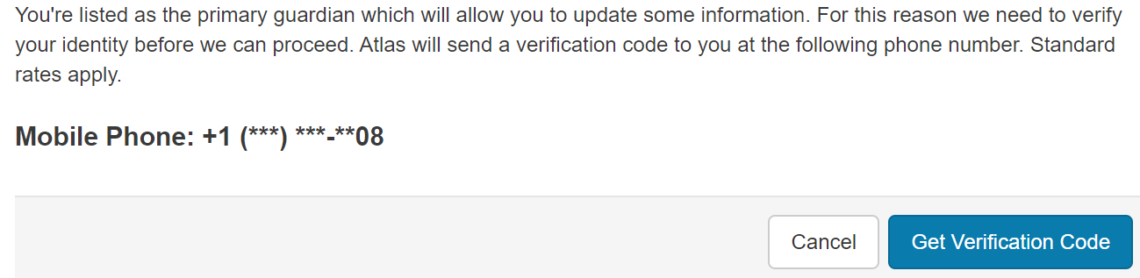
Choose your verification method and click “Get verification code”.

Slide 6
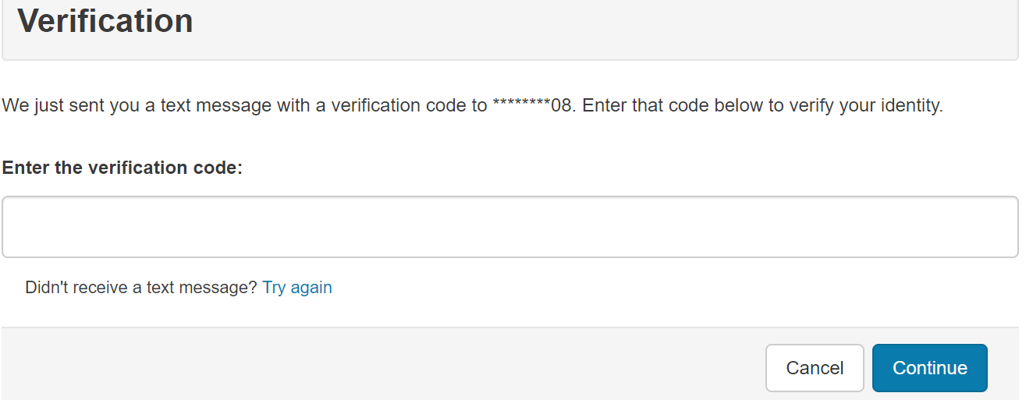
If you are the primary guardian type in the verification code and click continue.

Slide 7
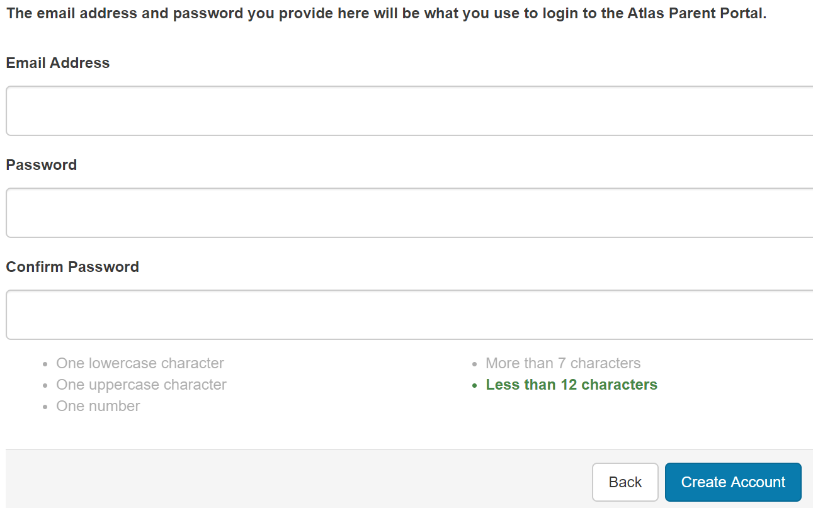
Enter your personal email address and choose an account password. Click “Create account”.

Slide 8
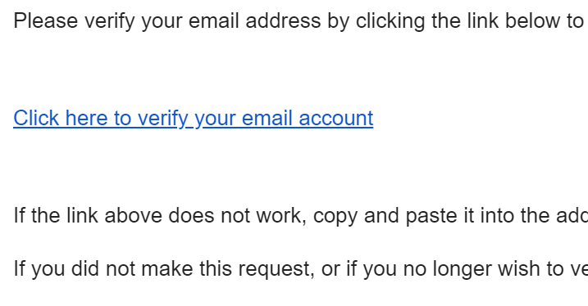
Check your email and click the link that was sent to you.

Slide 9
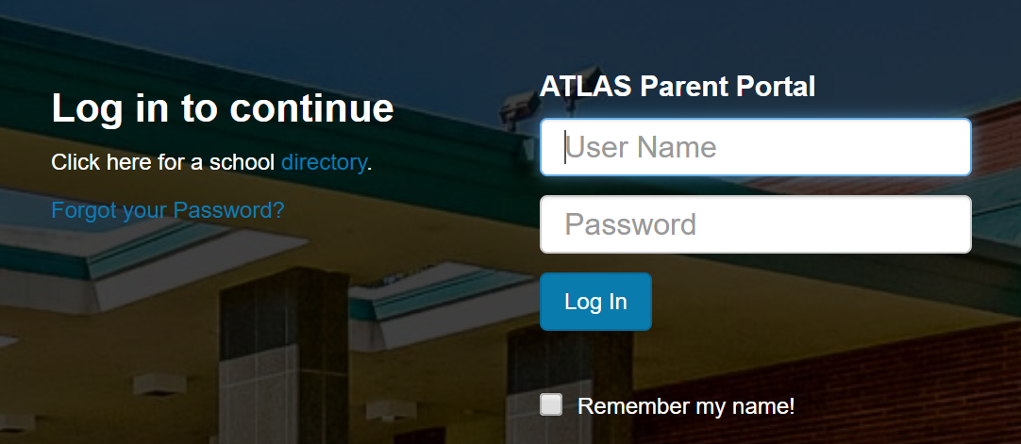
Login with the NEW LOGIN (email address and password you just created for your personal account.)

