Slide 1
Board of Education
2023-2024
Budget Hearing Presentation
May 3, 2023
Dr. Teresa Prendergast, Superintendent of Schools
John J. O’Keefe, Assistant Superintendent for Business
Brian C. Ernst, School Business Administrator

Slide 2
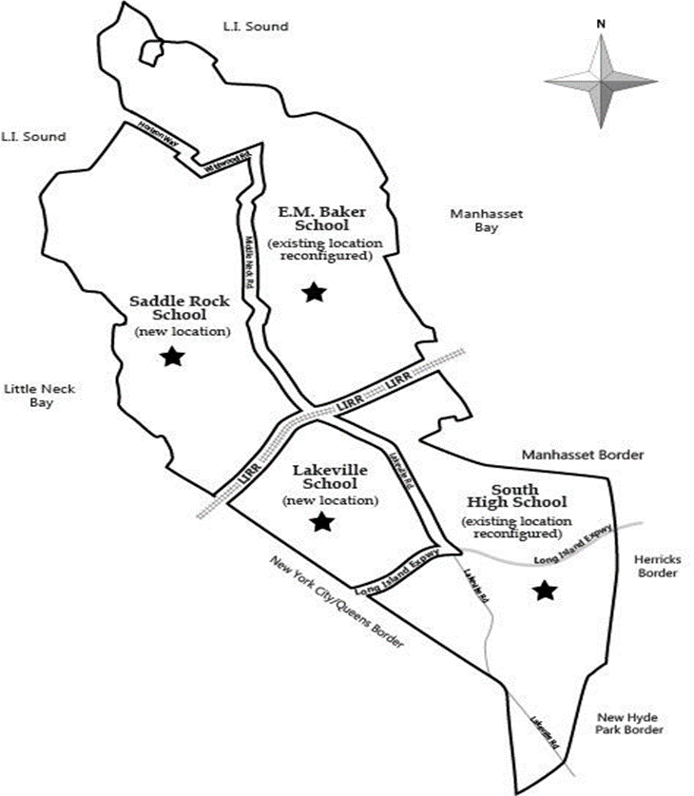
Budget Vote & Trustee Election
May 16, 2023 – Annual Election and Budget Vote
  7:00 AM – 10:00 PM at EM Baker, Lakeville, Saddle Rock, or
  South High School
In order to vote, you must be 18 years of age or older, a citizen of the U.S., and have lived in the District for at least 30 days
Register to vote at the Phipps Administration Building on school days from 9:00 am to 4:00 pm, or at the Nassau County Board of Elections
You must be registered to vote by May 11th to vote May 16th
Qualified voters can obtain applications for absentee ballots by contacting the District Clerk’s Office (516) 441-4007, or by emailing districtclerk@greatneck.k12.ny.us
Residents who are unsure of their polling location can use the online Poll Place Finder tool on the District website (www.greatneck.k12.ny.us/voting)
or call the
District Clerk on school days
from 9:00AM – 4:00 PM (516-441-4007)

Slide 3
2023-24 Budgetary Highlights
Fiscally Prudent Budgeting within the Tax Levy Cap limits
Maintains District Staffing to Support Student Needs
Provides Funding to Support Additional Positions Throughout District
    Addition of 1.0 FTE Elementary Social Worker
    Addition of 0.2 FTE Speech Pathologist
    Addition of 6.1 FTE of Elementary staff
    Addition of 4.1 FTE of Secondary staff
Continued investments in security upgrades throughout the District
    Additional: security cameras, security staff, and electronic door access controls
Continued Funding for New and Replacement Equipment Throughout District
  Classroom, Music, Instructional Technology, Security, Facilities, Athletics
Continued Funding for Capital Expenditures
    E.M. Baker - Renovate existing building foundation; J.F. Kennedy - Replace student cafeteria roof top HVAC unit, Renovation of teacher resource center (phase 2); Lakeville - Renovate masonry above art room windows, cafeteria and along rear classrooms, Replace exterior ramp/stair to lower classrooms and renovate retaining wall; Saddle Rock - Renovate loading dock/parking lot; North Middle - Replace student cafeteria roof top HVAC unit, Repave existing parking lot and drainage improvements (Arrandale Ave. entrance); North High - Repave parking lot and drainage improvements (Polo Rd. entrance), Replace floor, renovate wall and casework in classroom 28; South Middle - Renovate, recondition, grade, irrigate lacrosse and softball fields, Renovate student cafeteria bathrooms; South High - Replace corridor ceiling and lighting; Grace Avenue - Improve drainage, patch, and seal coat existing parking lot; Clover Drive - Repave front and rear parking lot, drainage improvements, Renovate east retaining wall;
    As well as, one new school bus; and final funding for the 2017 Bond Proposition
* FTE is a “Full Time Equivalent” … i.e. 1.0 FTE is one full time staff member

Slide 4
Proposed Budget Fast Facts
Proposed budget is balanced and fiscally prudent; developed within the challenges of 8.0% inflation
Proposed 2023-2024 Budget - $272,138,300
  This is a $10,705,610 Increase over Current Budget
    Represents a 4.09% Budget-to-Budget Increase
      Great Neck’s 12-year* average Budget increase is 2.90%
Proposed 2023-2024 Tax Levy - $229,498,923
  This Represents a 3.07% Increase
    This is Within the NYS Tax Cap limits and therefore only Requires a Simple Majority Vote
      Great Neck’s 12-year* average Tax Levy increase is 2.10%
* Since the Inception of the Tax Cap in the 2012-2013 School Year

Slide 5
Proposed 3-Part Expenditure Budget
* REMEMBER: There were shifts of various expenses between |  |  | 2022-2023 |  | 2023-2024
Functional Codes as we updated the Chart of Accounts |  |  | Budget |  | Proposed Budget
ADMINISTRATION
Board Operations |  |  | $ 195,108 |  | $ 199,964
Central Administration |  |  | $ 399,764 |  | $ 391,654
Business Administration/Finance |  |  | $ 2,073,324 |  | $ 2,134,647
Personnel/Communications/Legal |  |  | $ 1,599,812 |  | $ 1,724,534
Data Processing/Network Support |  |  | $ 1,423,558 |  | $ 1,375,495
District Insurance/BOCES Admin/Copiers |  |  | $ 2,777,342 |  | $ 2,149,926
Curriculum And Instruction |  |  | $ 8,125,773 |  | $ 8,668,036
Benefits |  |  | $ 1,598,131 |  | $ 2,382,442
 |  | Sub-Total Administration | $ 18,192,812 |  | $ 19,026,698
PROGRAM
Curriculum and Instruction |  |  | $ 74,604,234 |  | $ 77,336,720
Special Education * |  |  | $ 40,735,312 |  | $ 33,407,222
Curriculum and Professional Development * |  |  | $ - |  | $ 215,200
Occupational Education * |  |  | $ - |  | $ 608,000
Special Programs - Summer Ed / Adult Ed / Community Ed / Recreation |  |  | $ 2,335,023 |  | $ 2,421,895
Library Media / Television Studio Program |  |  | $ 1,949,309 |  | $ 2,064,854
Instructional Technology * |  |  | $ 502,300 |  | $ 2,815,910
Pupil Services - Nursing / Social Workers / Psychologists / Guidance / Registrar * |  |  | $ 6,262,846 |  | $ 9,941,008
Interscholastic Athletics and Co-Curricular Activities * |  |  | $ 2,070,465 |  | $ 3,240,156
District Transportation |  |  | $ 16,360,822 |  | $ 16,797,521
Benefits |  |  | $ 58,998,141 |  | $ 63,017,254
Interfund Transfers * |  |  | $ 1,733,752 |  | $ 2,824,173
 |  | Sub-Total Program | $ 205,552,204 |  | $ 214,689,913
CAPITAL
Facility Operations |  |  | $ 21,254,841 |  | $ 22,555,688
Purchase of Buses |  |  | $ - |  | $ 95,000
Benefits |  |  | $ 3,937,816 |  | $ 3,286,343
Debt - Principal & Interest |  |  | $ 5,529,017 |  | $ 5,655,325
Capital Projects |  |  | $ 6,966,000 |  | $ 6,829,333
 |  | Sub-Total Capital | $ 37,687,674 |  | $ 38,421,689
TOTAL BUDGET |  |  | $ 261,432,690 |  | $ 272,138,300

Slide 6
2023-24 State Aid (as of May 1, 2023)
 | 2022-23 |  | 2023-24
AID CATEGORY | ADOPTED |  | ADOPTED
 | STATE BUDGET |  | STATE BUDGET
FOUNDATION AID | $ 6,825,580 |  | $ 9,045,116
UNIVERSAL PRE-KINDERGARTEN * | $ 1,334,724 |  | $ 1,334,724
BOCES | $ 914,606 |  | $ 1,037,784
HIGH COST EXCESS COST | $ 427,979 |  | $ 347,349
PRIVATE EXCESS COST | $ 562,852 |  | $ 601,509
SOFTWARE, LIBRARY, TEXTBOOK | $ 670,198 |  | $ 682,092
TRANSPORTATION INCL SUMMER | $ 557,058 |  | $ 759,911
BUILDING AID | $ 377,714 |  | $ 574,007
HIGH TAX AID | $ 452,843 |  | $ 452,843
SUPPLEMENTAL PUBLIC EXCESS COST | $ 33,711 |  | $ 33,711
TOTAL AID | $ 12,157,265 |  | $ 14,869,046
Represents an approximate $2.7M increase over current year, and $25,382 more than the budget adopted by the District on April 18th
* REMEMBER: State Aid for the Universal Pre-Kindergarten (UPK) program is accounted for in the Special Aid Fund, and therefore NOT available as a funding source for the General Fund Budget

Slide 7
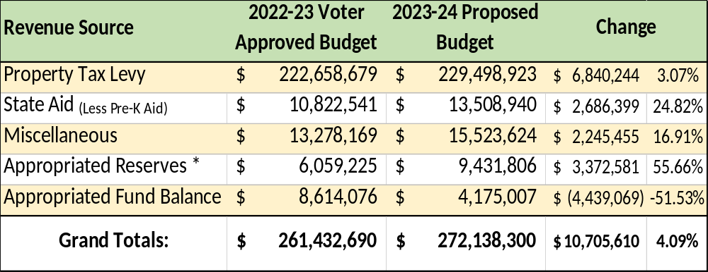
2023-24 Proposed Revenue Budget
* Recommended Reserve Utilization as Follows:
  Workers’ Compensation Reserve $1,350,000
  Employee Retirement System Reserve $3,041,056
  Teacher Retirement System Reserve $4,000,000
  Employee Benefit Accrued Liability Reserve $1,040,750
        $9,431,806

Slide 8
Budget Vote & Trustee Election
PROPOSITION NO. 1
2023-2024 SCHOOL DISTRICT BUDGET - RESOLVED, that the annual budget for the GREAT NECK PUBLIC SCHOOLS for the fiscal year 2023-2024 in the total amount of $272,138,300 as proposed by the Board of Education shall be approved, and the necessary tax be levied thereof upon the taxable property of the School District.
PROPOSITION NO. 2
2023-2024 PUBLIC LIBRARY BUDGET – SHALL, the annual budget for the GREAT NECK LIBRARY be approved for the fiscal year 2023-2024 in the total amount of ten million, thirteen thousand, six hundred and twenty-nine dollars ($10,013,629) and the necessary tax in the amount of nine million, seven hundred and seventy-six thousand, nine hundred and sixty-nine dollars ($9,776,969) be levied thereof upon the taxable property of the Library District.
Board of Education Trustee
Seat of Rebecca Sassouni
Vote for One (1)
Three (3) Year Term
7/1/23 to 6/30/26
Niloufar Tabari
Rebecca Sassouni
Board of Education Trustee
Seat of Jeff Shi
Vote for One (1)
Three (3) Year Term
7/1/23 to 6/30/26
Aili Zhang
Joanne Chan
CC BY-SA-NC

Slide 9
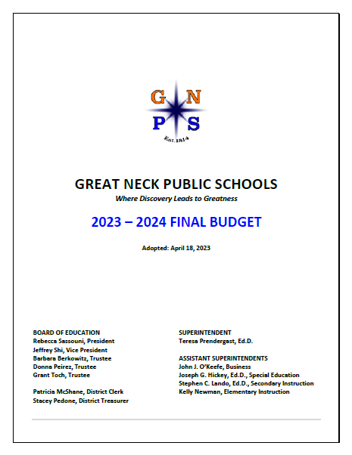
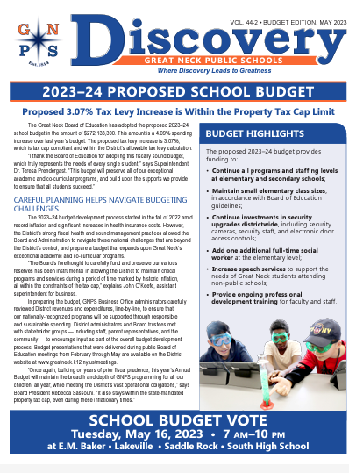
Additional Information & Details
Please visit the District’s website at: https://www.greatneck.k12.ny.us/
Click the ADMINISTRATION tab and follow the drop-down to BUSINESS AND FINANCE
On the left, please click on 2023-24 Budget Information
Here you will find:
All prior presentations
Budget Postcard
Budget Newsletter
Budget Book
Property Tax Report Card
NYSED School Report Card
Other Important Documents
Still have Questions?
Please call (516) 441-4020 or reach out via email: jokeefe@greatneck.k12.ny.us
CC BY-SA-NC

Slide 10

Budget Vote & Trustee Election
Tuesday, May 16, 2023
  7:00 AM – 10:00 PM
  EM Baker, Lakeville, Saddle Rock, or South High School
Residents who are unsure of their polling location can use the online Poll Place Finder tool on the District website ( www.greatneck.k12.ny.us/voting ) or call the
District Clerk on school days from 9:00AM – 4:00 PM (516-441-4007)
Please Remember to Vote
CC BY-SA-NC

