Slide 1

November 29, 2022
Orting School District No. 344
  CFAC Meeting
  Bond Issue Planning
Ryan Swanson
Trevor L. Carlson
Senior Vice President
Managing Director
Tel: +1 206-628-2852
Tel: +1 206-628-2890
Email: ryan.swanson@psc.com
Email: trevor.carlson@psc.com

Slide 2
Impacting the Vote
  Would you favor or oppose a bond measure for your school district if you knew:
% favor
Positive messages that highlight preparing students, solving problems and saving money will increase support for bond proposals
Messages work for all voters regardless of district size
Source: CFM Strategic Communications, 2019 Washington Education Study

Slide 3
Less Effective Messages
  Would you favor or oppose a bond measure for your school district if you knew the funds would be used to:
Source: CFM Strategic Communications, 2019 Washington Education Study

Slide 4
Key Education Problems
      Thinking about education in general, in your opinion what is the biggest problem facing schools in Washington State today?
Funding and overcrowding remain top problems
Top-of-mind problems vary by district and are based on what voters read and hear
Source: CFM Strategic Communications, 2019 Washington Education Study

Slide 5
Specific Sources of Information
  What is your main source of information about your local public school district?
Volunteered responses
No changes since 2017 except newspapers continue to decline
(‘07 40%, ‘09 33%, ‘11 26%,
‘13 24%, ‘17 20%)
Source
School District (sd) | 46%
Other (o) | 49%
Responses 1% or less excluded
Source: CFM Strategic Communications, 2019 Washington Education Study

Slide 6
Preferred Sources of Information
  How would you prefer to receive information about your local public school district?
Identical results found in 2017, except for newspapers (-8 points)
Source: CFM Strategic Communications, 2019 Washington Education Study

Slide 7
Preferred Information Source by Group
A printed newsletter from the district in the mail | Age 55 +, rural areas and small districts
Email from the district or schools | Age 35-54, parents, get info from district sources
In the newspaper | Preference increases with age, independent voters, urban areas, get info from other sources
A district or school website | Preference declines with age, independent voters
E-newsletter from the district | Parents, get info from district sources
Social media | Age 18-34
On radio or TV | 8% or less in all groups
Source: CFM Strategic Communications, 2019 Washington Education Study

Slide 8
Election Dates
2023 Election and Resolution Filing Dates, Under Current Law
Election Date | Approximate Ballot Mailing Date | Certification Date
February 14, 2023 | January 27, 2023 | February 24, 2023
April 25, 2023 | April 7, 2023 | May 5, 2023
August 1, 2023 | July 14, 2023 | August 15, 2023
November 7, 2023 | October 20, 2023 | November 28, 2023

Slide 9
Orting School District’s Election Results
Historical EP&O Levy Elections
Date | 1st Year | 2nd Year | 3rd Year | 4th Year | % Yes | Result
Feb-22 | $5,676,309 | $6,527,756 | $7,506,919 | $8,632,957 | 54.79% | PASSED
Apr-20 | $3,900,000 | $4,100,000 | -- | -- | 58.56% | PASSED
Feb-20 | $3,900,000 | $4,100,000 | -- | -- | 49.84% | FAILED
Feb-18 | $3,300,000 | $3,900,000 | -- | -- | 63.79% | PASSED
Feb-16 | $4,350,000 | $4,475,000 | -- | -- | 55.66% | PASSED
Feb-14 | $4,100,000 | $4,225,000 | -- | -- | 56.00% | PASSED
Feb-12 | $3,819,000 | $3,819,000 | -- | -- | 53.15% | PASSED
Feb-10 | $3,762,000 | $3,819,000 | -- | -- | 57.19% | PASSED
Mar-08 | $3,417,000 | $3,725,000 | -- | -- | 51.73% | PASSED
Feb-06 | $2,825,000 | $3,068,000 | -- | -- | 66.91% | PASSED
Feb-04 | $2,225,000 | $2,358,500 | -- | -- | 60.59% | PASSED
Apr-02 | $1,972,000 | $2,090,000 | -- | -- | 68.52% | PASSED
Feb-02 | $1,972,000 | $2,090,000 | -- | -- | 59.84% | FAILED
May-00 | $1,750,000 | $1,860,000 | -- | -- | 67.72% | PASSED
Mar-00 | $1,750,000 | $1,860,000 | -- | -- | 57.95% | FAILED
Feb-98 | $1,509,000 | $1,625,000 | -- | -- | 67.27% | PASSED
Feb-96 | $1,363,000 | $1,561,000 | --- | --- | 66.00% | PASSED
Feb-94 | $1,120,000 | $1,200,000 | -- | -- | 64.03% | PASSED
Feb-92 | $827,000 | $900,000 | -- | -- | 75.70% | PASSED
Feb-88 | $509,500 | $525,000 | -- | -- | 72.90% | PASSED
Historical Capital Projects Levy Elections
Date | 1st Year | 2nd Year | 3rd Year | 4th Year | 5th Year | 6th Year | % Yes | Result
Feb-94 | $100,000 | $100,000 | -- | -- | -- | -- | 64.05% | PASSED
Nov-92 | $80,000 | $80,000 | $80,000 | $80,000 | $80,000 | $80,000 | 55.96% | FAILED
Feb-92 | $150,000 | $150,000 | -- | -- | -- | -- | 75.00% | PASSED

Slide 10
Orting School District’s Election Results
Historical Bond Elections
Date | Par Amount | % Yes | Result
Nov-17 | $43,000,000 | 48.03% | FAILED
Feb-17 | $41,000,000 | 55.66% | FAILED
Feb-06 | $29,500,000 | 62.53% | PASSED
May-04 | $18,500,000 | 56.86% | FAILED
Feb-04 | $18,500,000 | 53.54% | FAILED
Feb-98 | $10,700,000 | 62.64% | PASSED
May-95 | $10,500,000 | 53.42% | FAILED
Feb-95 | $10,500,000 | 55.28% | FAILED

Slide 11
Tax Rate History
Historical Levy Rates
Year | Bond Levy |  | Capital Projects Levy |  | Technology Levy |  | Transportation Vehicle Levy |  | EP&O Levy |  | Total
2001 | $ | 1.77 | $ | -- | $ | -- | $ | -- | $ | 3.60 | $ | 5.37
2002 |  | 1.69 |  | -- |  | -- |  | -- |  | 3.40 |  | 5.09
2003 |  | 1.61 |  | -- |  | -- |  | -- |  | 3.49 |  | 5.10
2004 |  | 1.17 |  | -- |  | -- |  | -- |  | 3.48 |  | 4.64
2005 |  | 1.50 |  | -- |  | -- |  | -- |  | 3.29 |  | 4.79
2006 |  | 0.98 |  | -- |  | -- |  | -- |  | 2.77 |  | 3.74
2007 |  | 2.58 |  | -- |  | -- |  | -- |  | 2.60 |  | 5.19
2008 |  | 2.46 |  | -- |  | -- |  | -- |  | 2.38 |  | 4.85
2009 |  | 2.43 |  | -- |  | -- |  | -- |  | 2.65 |  | 5.08
2010 |  | 2.78 |  | -- |  | -- |  | -- |  | 3.14 |  | 5.91
2011 |  | 3.08 |  | -- |  | -- |  | -- |  | 3.59 |  | 6.67
2012 |  | 3.54 |  | -- |  | -- |  | -- |  | 3.93 |  | 7.47
2013 |  | 4.11 |  | -- |  | -- |  | -- |  | 4.43 |  | 8.54
2014 |  | 4.15 |  | -- |  | -- |  | -- |  | 4.36 |  | 8.51
2015 |  | 3.71 |  | -- |  | -- |  | -- |  | 3.99 |  | 7.70
2016 |  | 3.16 |  | -- |  | -- |  | -- |  | 3.85 |  | 7.01
2017 |  | 3.13 |  | -- |  | -- |  | -- |  | 3.52 |  | 6.65
2018 |  | 2.86 |  | -- |  | -- |  | -- |  | 3.26 |  | 6.13
2019 |  | 2.56 |  | -- |  | -- |  | -- |  | 1.50 |  | 4.06
2020 |  | 2.40 |  | -- |  | -- |  | -- |  | 2.18 |  | 4.58
2021 |  | 1.63 |  | -- |  | -- |  | -- |  | 1.86 |  | 3.49
2022 |  | 0.38 |  | -- |  | -- |  | -- |  | 1.56 |  | 1.95

Slide 12
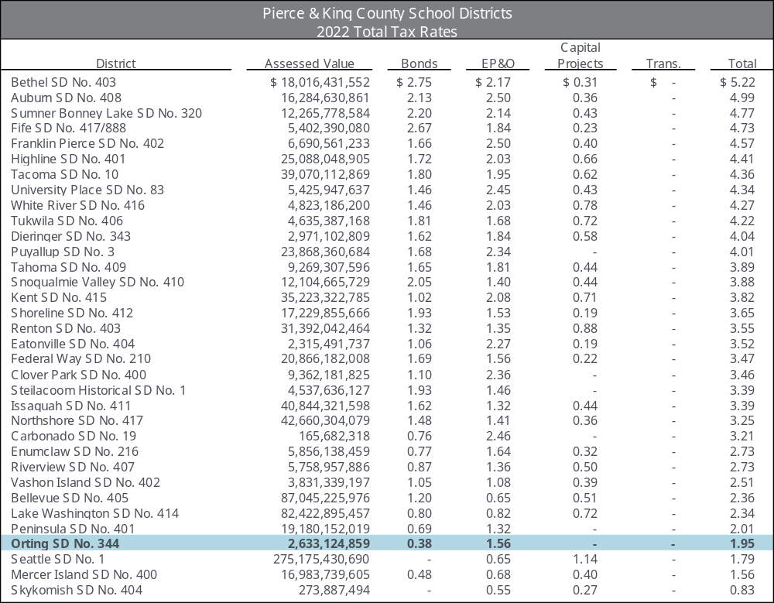
Comparable Tax Rates

Slide 13
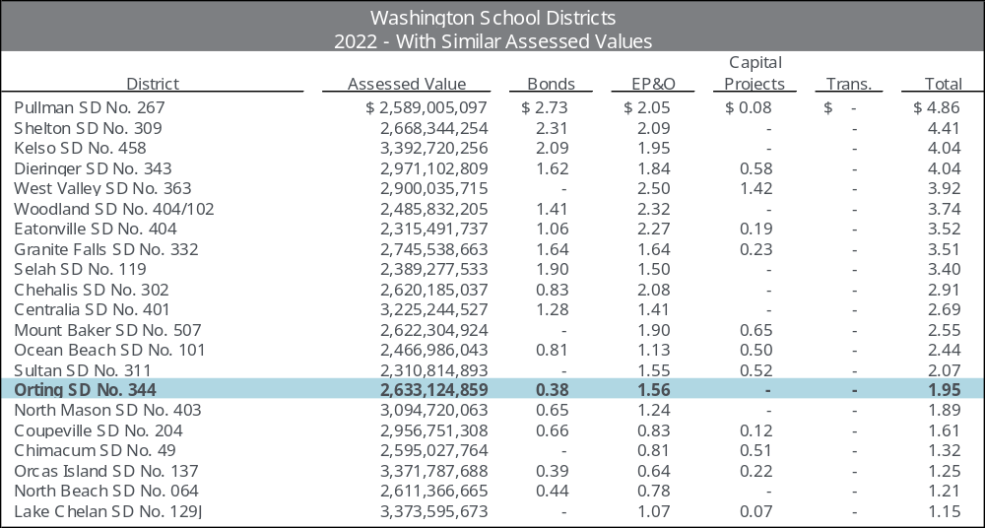
Comparable Tax Rates

Slide 14
Overview of Bonds and Capital Projects Levies
      Bonds are the primary method used by Washington school districts to finance the “local share” of major capital projects because:
        Cash is generated up front
        Payments can be spread over time
        Districts have some control over taxpayer impacts
Voter-Approved Unlimited Tax General Obligation (UTGO) Bonds
        New revenue created
        Repaid with property taxes
        Approved with a 60% yes vote, 40% validation
        5% debt capacity
        40-year maximum term (match useful life of asset)
        May only be submitted to voters twice in a calendar year
Preliminary 2023 Bond Assessed Value | $3,311,715,755
Statutory Capacity Rate | 5.000%
Total Statutory Capacity | $165,585,757
Less: Outstanding Voted Debt | $0
Less: Estimated Non-Voted Debt | ($6,588,750)
Remaining Capacity | $158,997,037
Capital Projects Levy
        One- to six-year collection cycle
        Pay costs to construct, modernize or remodel school facilities (includes technology improvements)
        Additional capital projects levy may be authorized for the same period (e.g. technology and new roof)
        No interest cost
        Possible life cycle mismatch
        Simple majority (50% + 1)
        If a capital projects levy fails, may be resubmitted to voters only once in the same 12-month period

Slide 15
Assessed Value
Orting School District’s Bond Assessed Value
        2023 preliminary
        $3,311,715,755
        2022 certified
        $2,633,124,859
        20-Year CAGR (2002-2022): 8.20%
        10-Year CAGR (2012-2022): 10.45%
        5-Year CAGR (2017-2022): 16.24%
Projection
 | Final 2020 | 10.3% | growth
 | Final 2021 | 16.5% | growth
 | Final 2022 | 25.2% | growth
 | Preliminary 2023 | 25.8% | growth
 | Assumed 2024-2027 | 15.0% | growth
 | Assumed 2028-2030 | 10.0% | annual growth
 | Assumed 2031 and on | 3.00% | annual growth
        Higher assessed values will lower the District’s tax rates
        (but not the overall payment)
        An individual’s taxes will be based on the assessed value of his or her own property
        Dissecting the components that make up the assessed value growth will be important. How much of the growth is related to new construction versus increased value of existing properties?

Slide 16
Assessed Value
Year | Assessed Value Total |  | % Change |  | New Construction Value |  | % of Value
2002 | $ | 544,272,673 | 14.22 | % | $ | 32,670,110 | 6.00 | %
2003 |  | 570,801,245 | 4.87 | % |  | 30,830,570 | 5.40 | %
2004 |  | 605,043,579 | 6.00 | % |  | 29,113,879 | 4.81 | %
2005 |  | 682,339,437 | 12.78 | % |  | 42,874,856 | 6.28 | %
2006 |  | 859,206,000 | 25.92 | % |  | 72,744,493 | 8.47 | %
2007 |  | 1,091,896,087 | 27.08 | % |  | 87,426,892 | 8.01 | %
2008 |  | 1,294,372,869 | 18.54 | % |  | 80,389,892 | 6.21 | %
2009 |  | 1,295,643,903 | 0.10 | % |  | 26,657,059 | 2.06 | %
2010 |  | 1,189,309,744 | (8.21 | % |  | 24,033,934 | 2.02 | %
2011 |  | 1,049,565,632 | (11.75 | %) |  | 5,788,665 | 0.55 | %
2012 |  | 974,335,271 | (7.17 | %) |  | 4,689,146 | 0.48 | %
2013 |  | 865,292,781 | (11.19 | %) |  | 6,931,058 | 0.80 | %
2014 |  | 881,147,951 | 1.83 | % |  | 13,538,734 | 1.54 | %
2015 |  | 1,030,651,079 | 16.97 | % |  | 22,810,455 | 2.21 | %
2016 |  | 1,106,312,045 | 7.34 | % |  | 16,598,960 | 1.50 | %
2017 |  | 1,240,614,482 | 12.14 | % |  | 26,489,379 | 2.14 | %
2018 |  | 1,381,064,563 | 11.32 | % |  | 45,241,499 | 3.28 | %
2019 |  | 1,636,507,414 | 18.50 | % |  | 64,661,980 | 3.95 | %
2020 |  | 1,804,746,296 | 10.28 | % |  | 54,234,848 | 3.01 | %
2021 |  | 2,103,184,344 | 16.54 | % |  | 126,416,372 | 6.01 | %
2022 |  | 2,633,124,859 | 25.20 | % |  | 174,451,760 | 6.63 | %
Preliminary 2023 |  | 3,311,715,755 | 25.77 | % |  | 206,733,000 | 6.24 | %

Slide 17
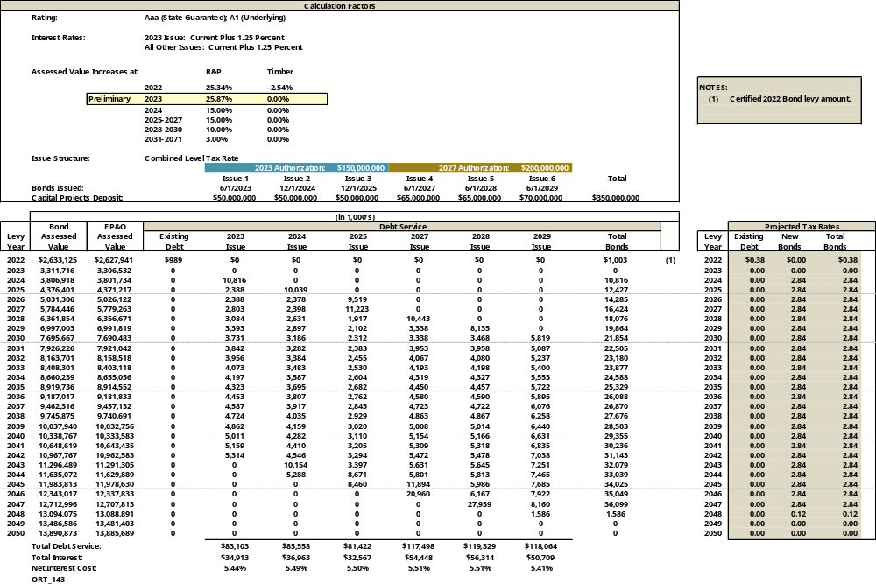
Projected Tax Rates

Slide 18
Historical & Projected Bond Tax Rate Graph

