Slide 1


Slide 2
Deephaven PTA Mission :
Engaging an inclusive environment, enhancing partnership amongst our parents and teachers/staff; to excel our Students’ experience at Deephaven Elementary
The Deephaven Elementary PTA - building our community:
Educational Enhancements to help our students reach their full academic potential
Cultural Enrichment to build a community of openness and inclusion
Social Connection to build camaraderie and common purpose across parent, students, and teachers
Volunteer opportunities – what can YOU do, how you can be involved

Slide 3
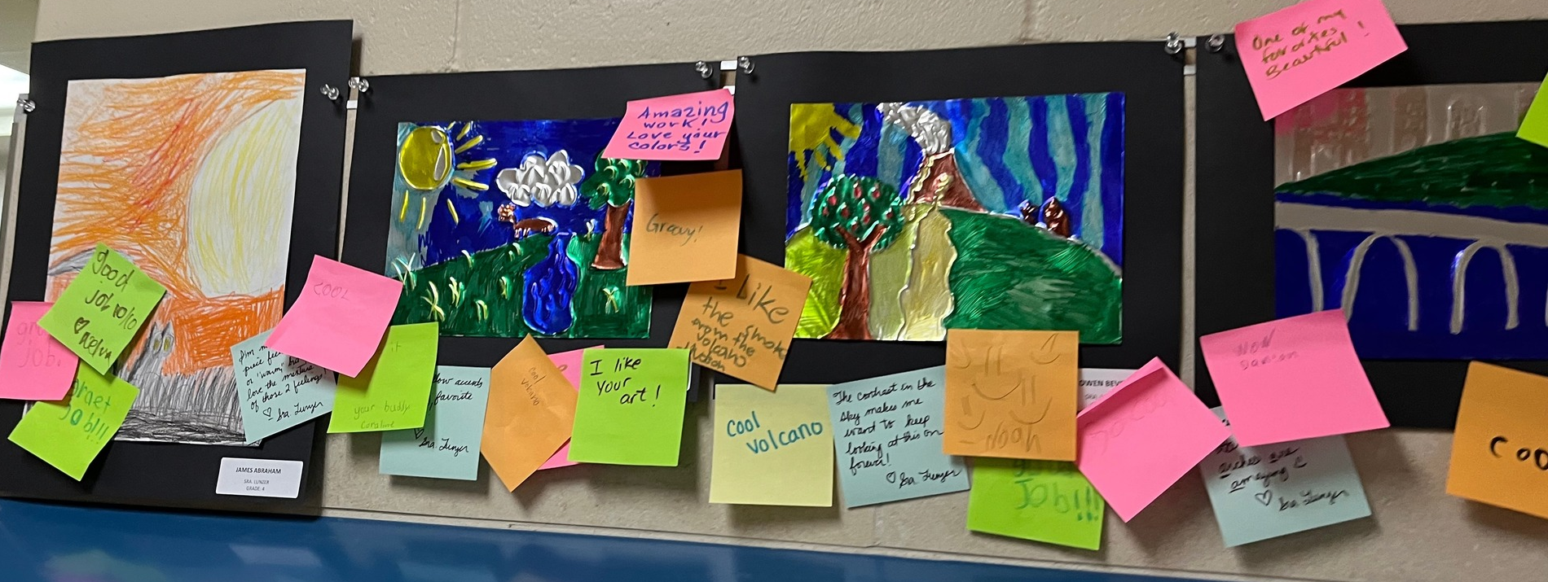
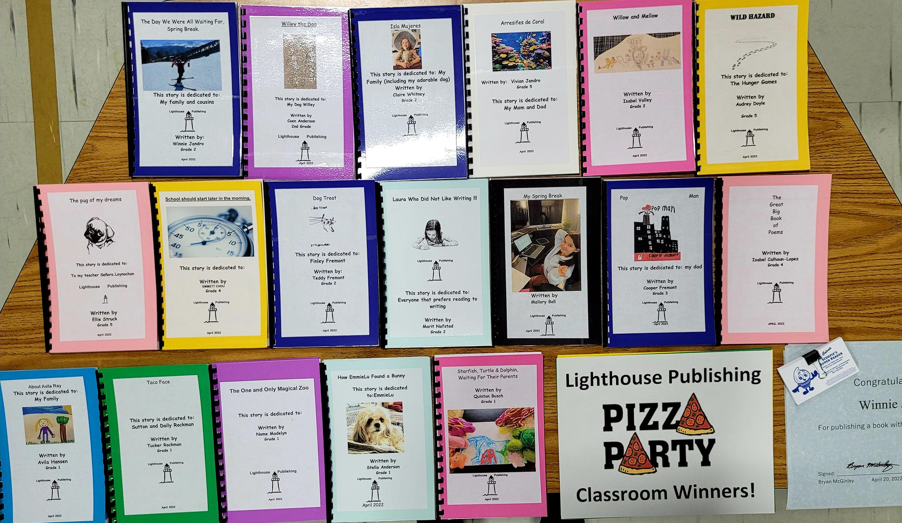
Academic Enhancements
Principal’s Challenge - had 132 participants!
  Encouraging & incentivizing summer reading, writing & Math
Read-A-Thon – had 88% participation, & raised $53k
  Month-long reading & fundraising event, incentivized with fun prizes and experiences.
Imagination Fair – had over 40+ variety of booths
  Weekend afternoon event encouraging varieties of student presentations (Art, STEM, Experiments, Games)
Lighthouse Publishing – Had 75+ authors
  An inhouse writing program; where kids write their stories and they are published, issued in an awards ceremony
Teacher Grant Process – PTA awarded $153k in teacher grant requests this schoolyear
  Additional flexible seating & curriculum storage throughout the school
  iPad keyboards for 4th and 5th graders
  New basketball hoops and climbing walls in the gym
  Advanced PA system
  IXL, Lexia, advanced Reading enhancement programs
  School wide math fluency programming
  Additional Arts and Music programs support and materials
  Updating, modernizing and maintaining our playground

Slide 4
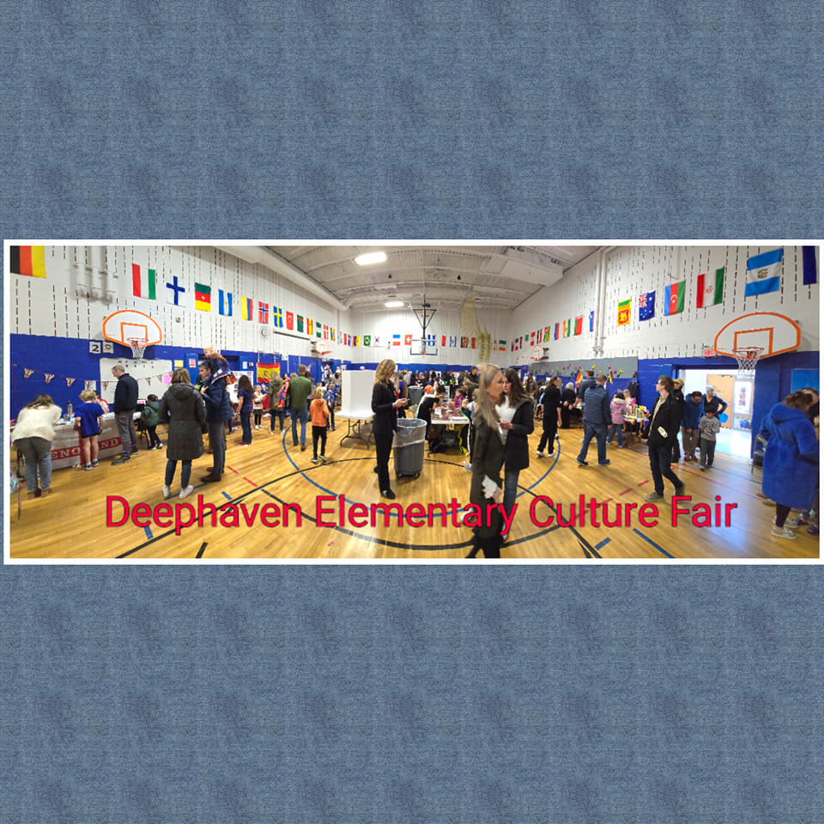
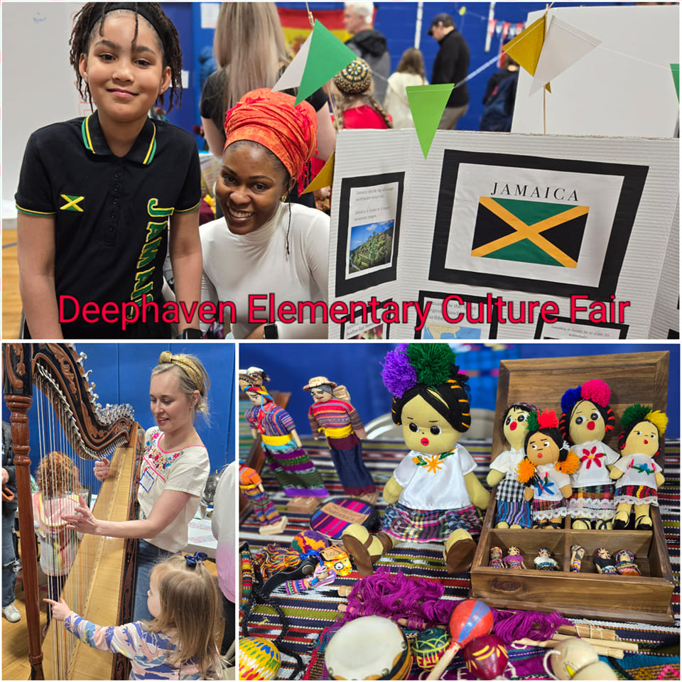
Cultural Enrichment
DEI / Belonging Committee
  Growing calendar of events, e.g. World Culture Week, Monthly Culture Celebrations, local apartment community events
  Strong committee engagement and teacher [Belonging Committee] support
  Executing ongoing DEI Survey to understand belonging at Deephaven and identify areas for improvement
Family Night & Culture Fair
  over 50 cultures represented in our school.
  Kids have passports to venture & learn, in-school & afterschool
Arts & Culture Community Events
  Cultural arts field trip funding
  Student Art Exhibition
  5th Grade Artist in Residence program

Slide 5
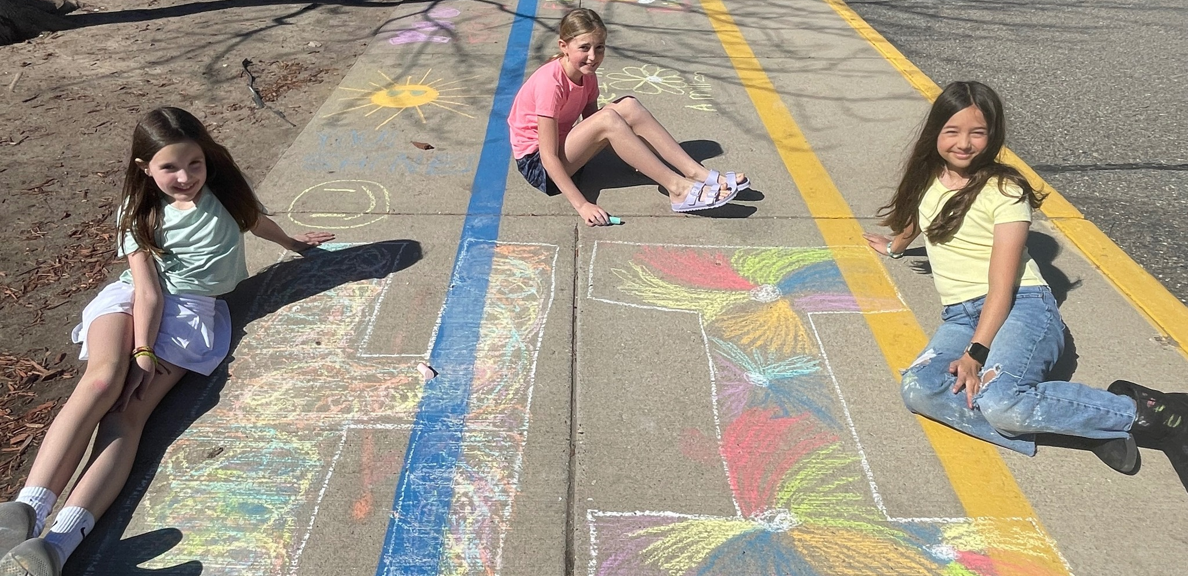
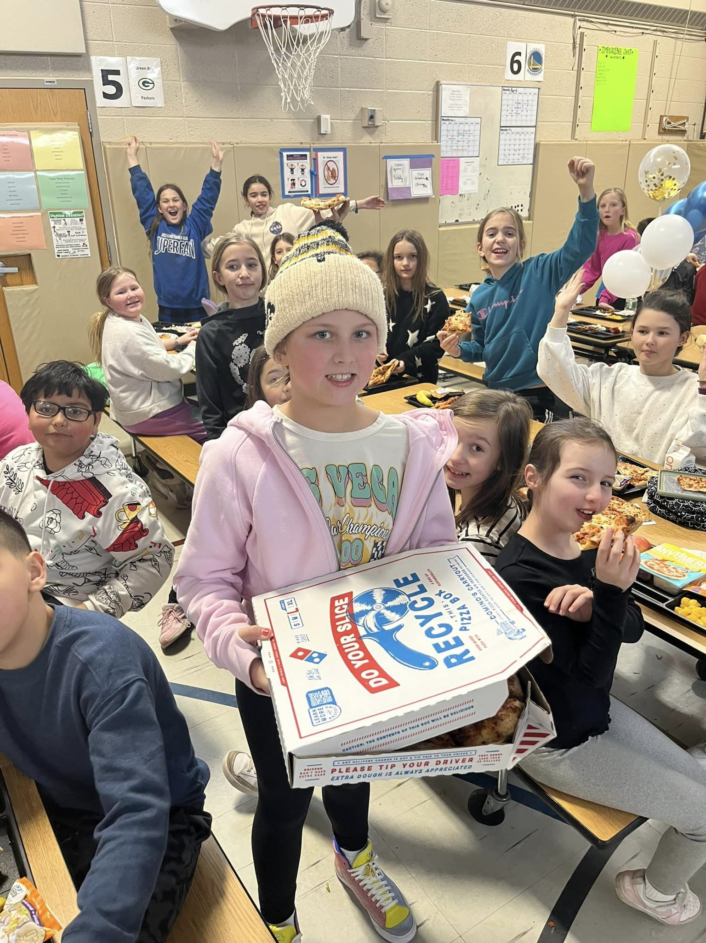
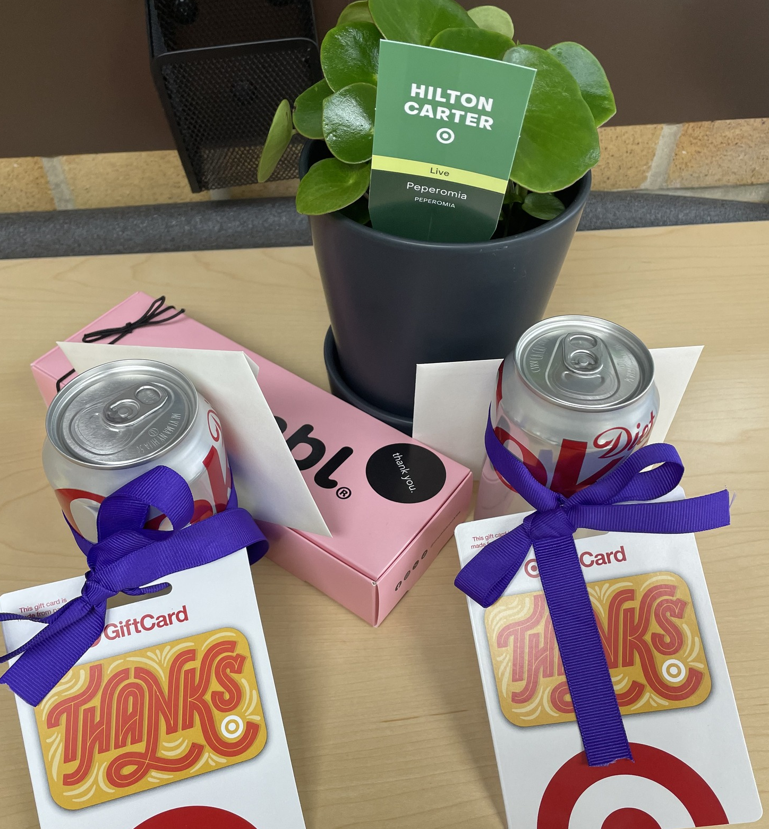
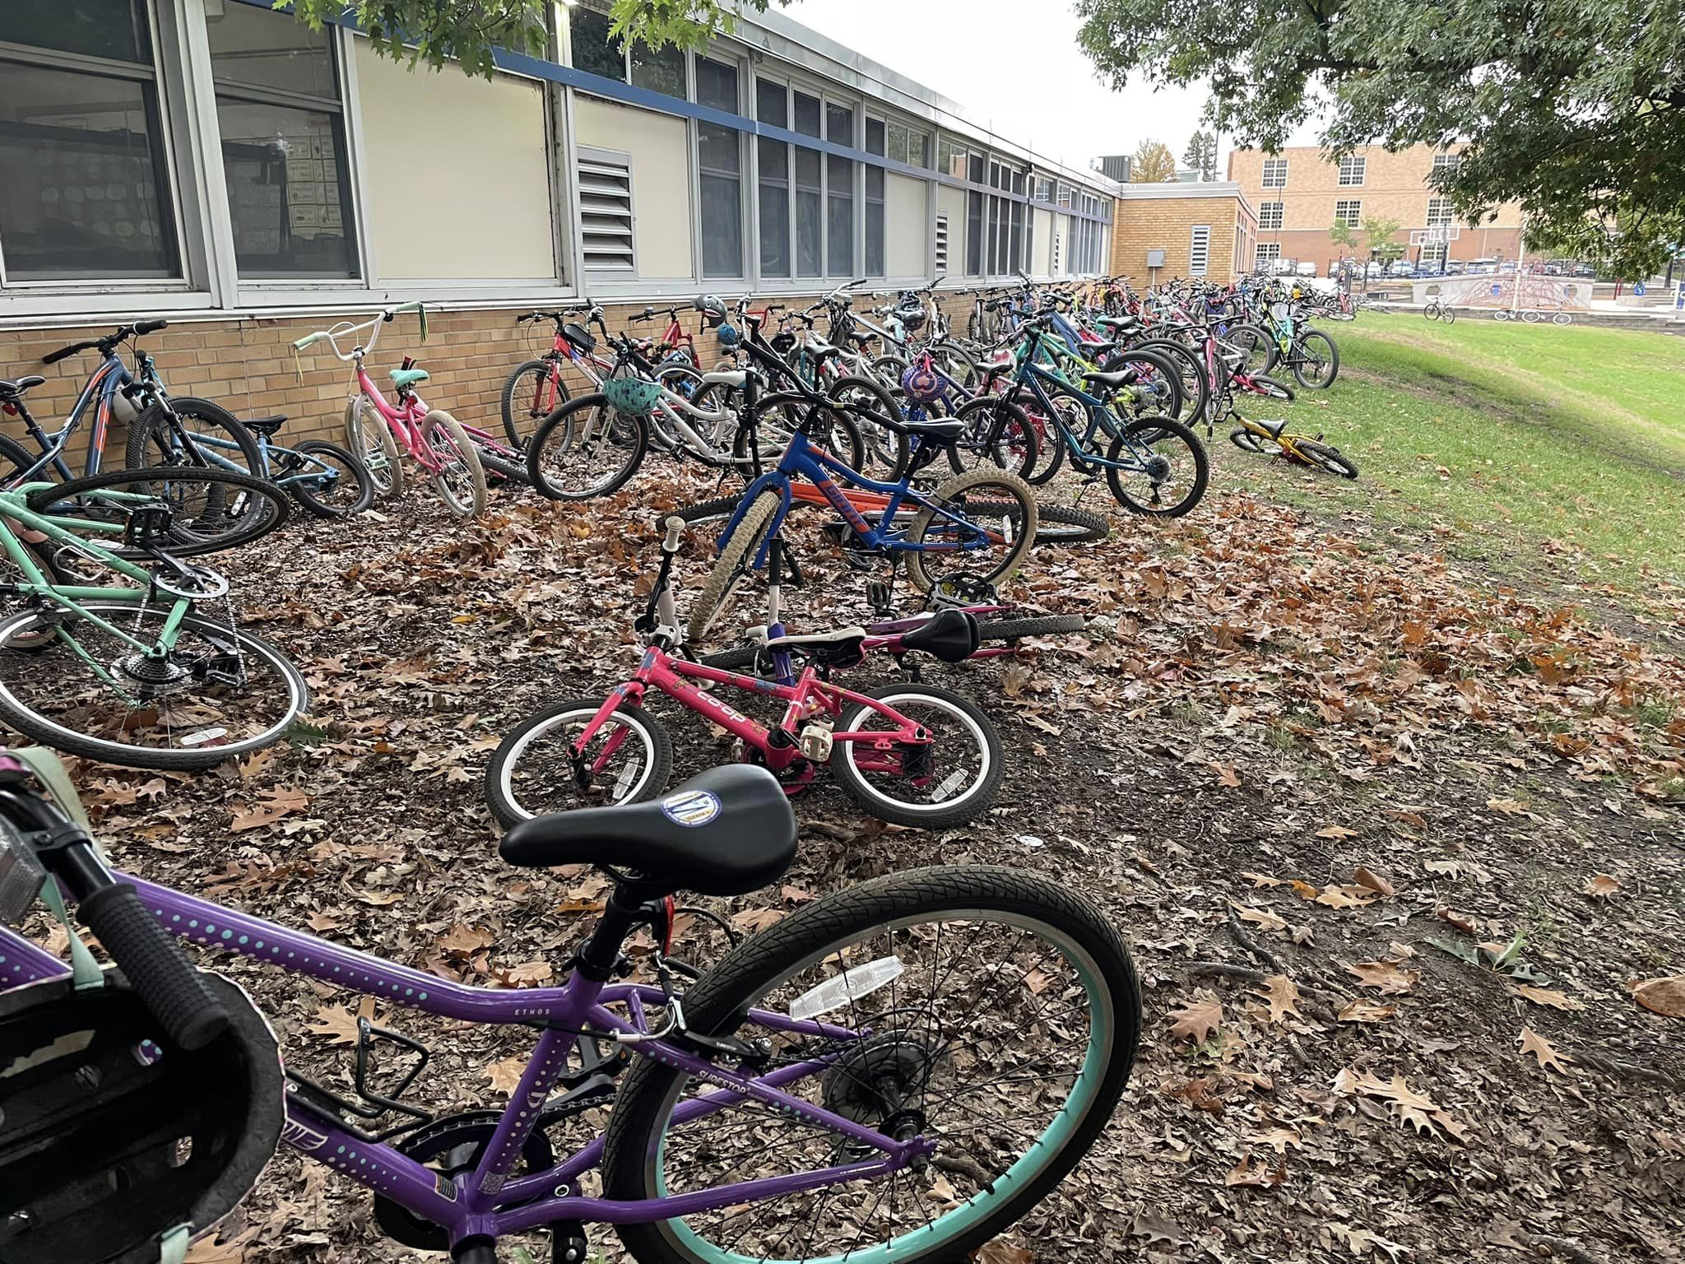
Social Connection
Connections Committee
  Providing social environments for parents and caregivers to connect
  Moms, and Dads, Night Out
    Reoccurring evening social events
      No agendas or itineraries, simply a social gathering to meet-greet, get re-acquainted
Teacher Appreciation
  Lunches, snacks, classroom support & conference dinners, throughout the year
Fall Pizza Party – Raised $4k in funds
  Fun BTS event, with pizza & door prizes, with the Ice Cream truck this year
Kindness Week
  Activities in & outside of school, promoting acts of kindness amongst kids and the community
Parent Party – Raised $24K in funds
  Annual evening out, for our parents! It’s a fundraiser, with ultimate fun!
PTA WAVES
  Monthly newsletter to strengthen communication of the PTA Mission
  Recaps opportunities for how to get involved

Slide 6
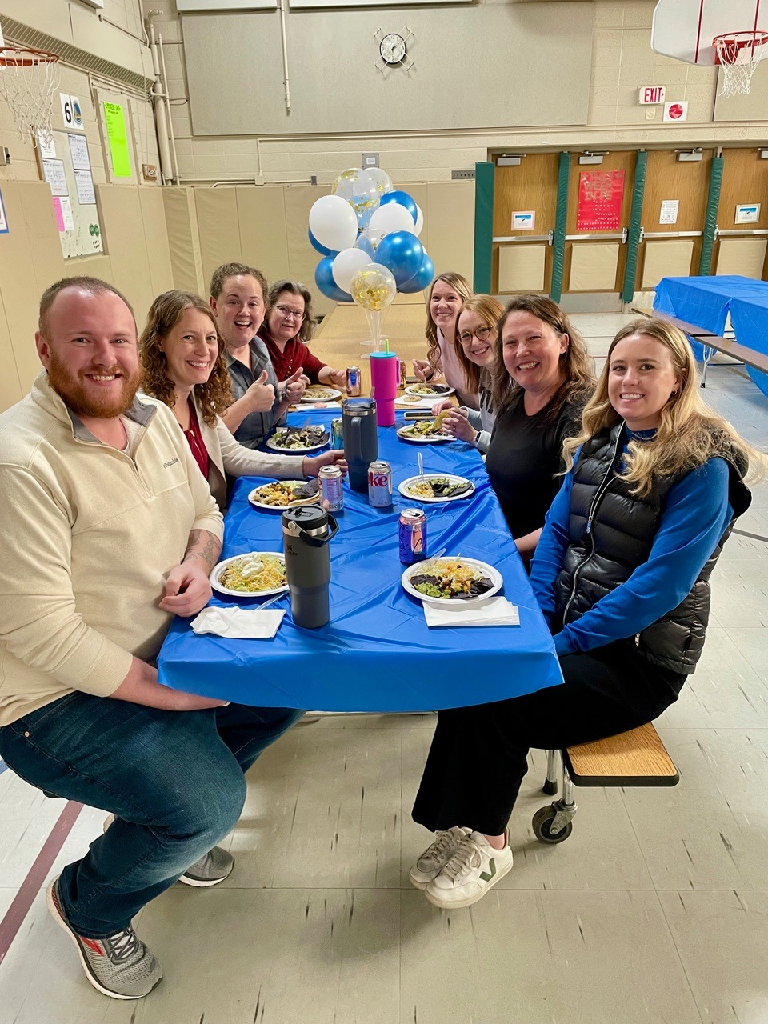
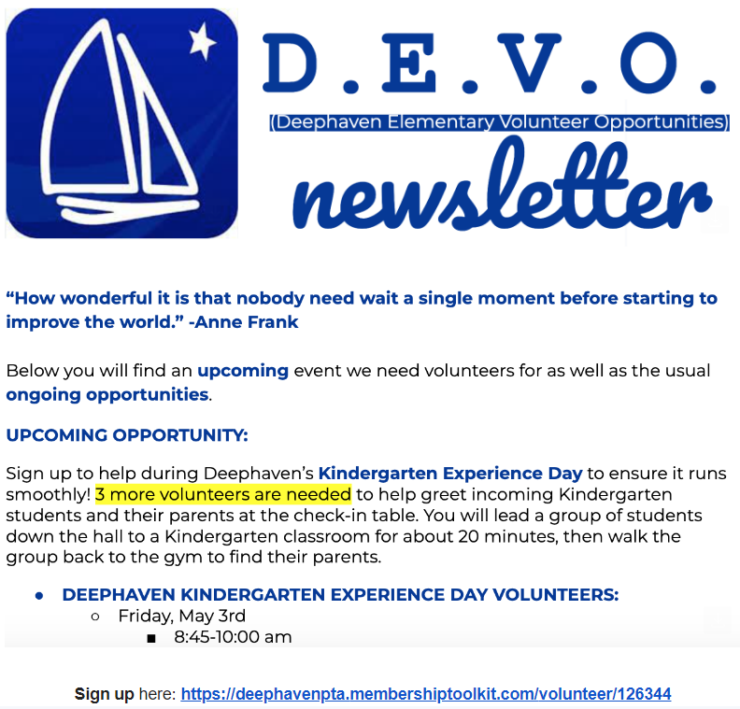
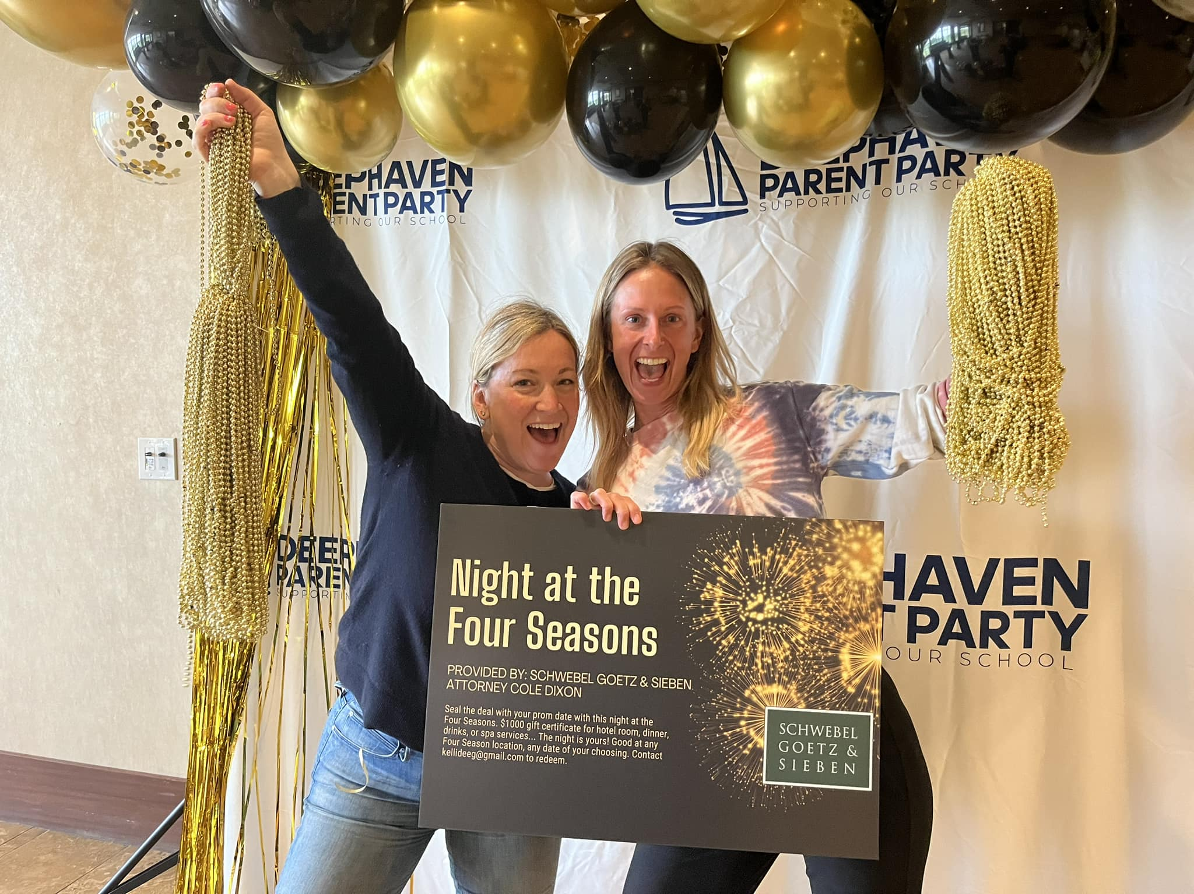
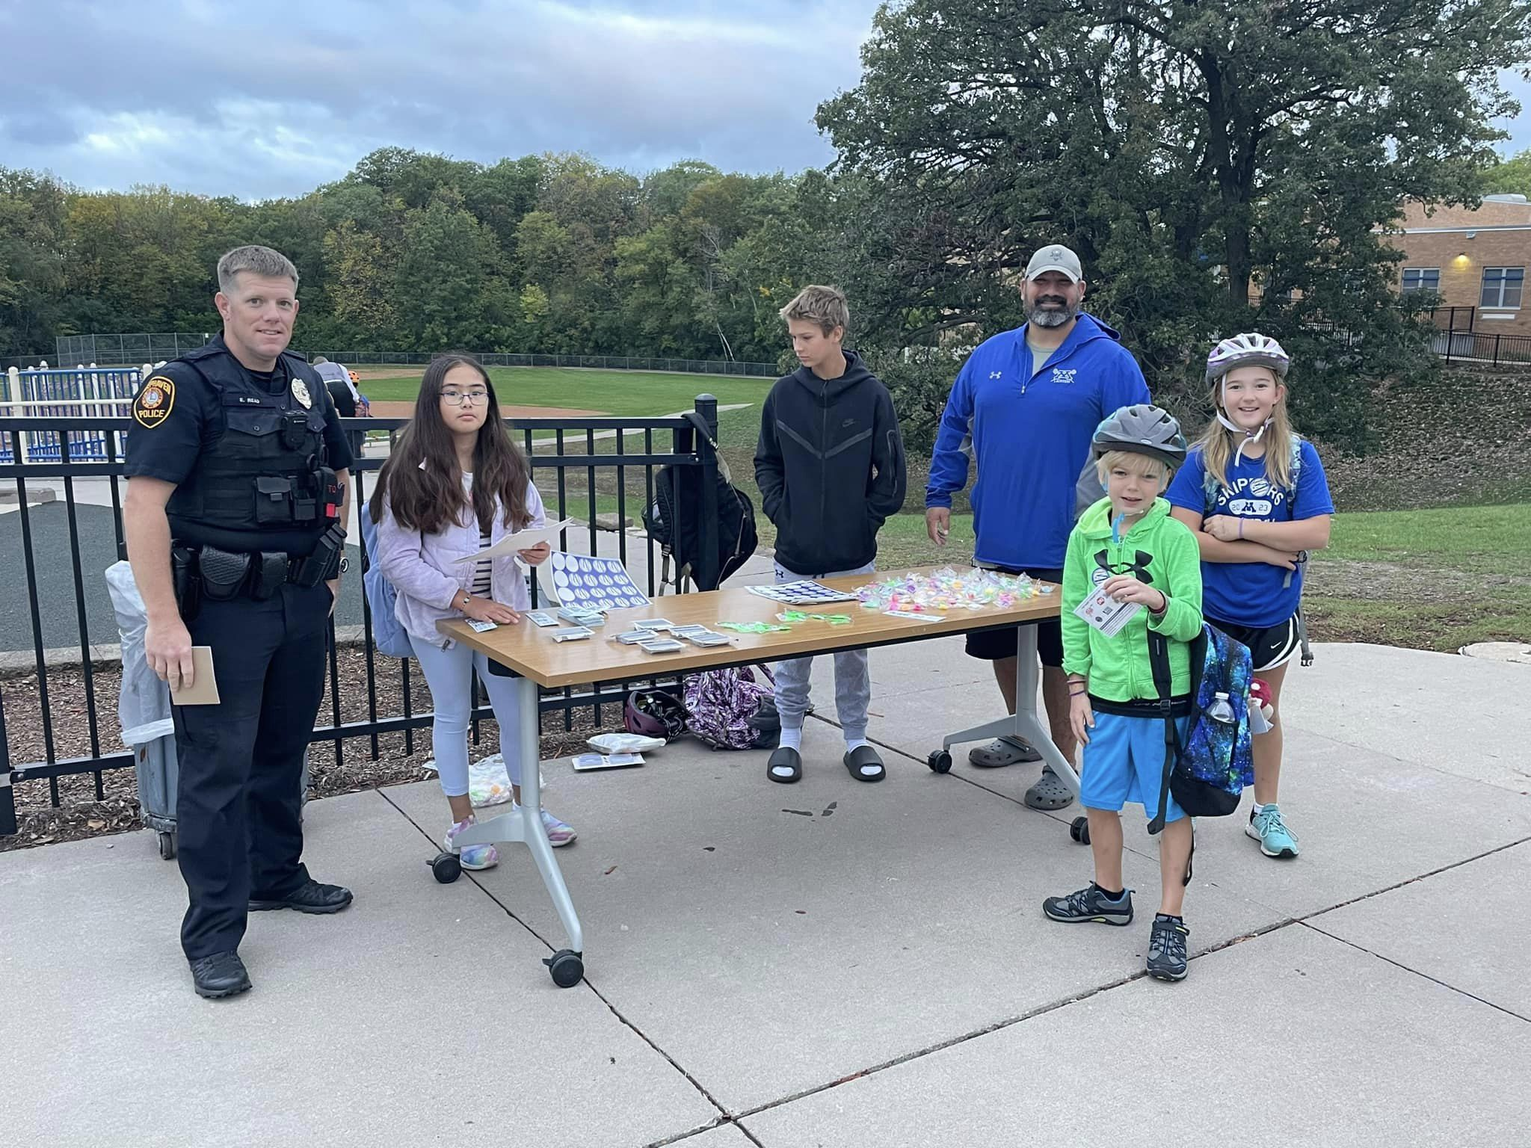
How YOU can be involved:
DEVO!
  Deephaven Elementary Volunteer Opportunities
Volunteer Opportunities throughout the year!
  Event driven: BookFair, Health Clinics, Imagination Fair, in-school events, Art shows, Culture event, Parent Party, etc…
  Daily lunchroom and playground volunteer opportunities
  Chairperson lead
    All events have a chairperson lead

Slide 7
2024-2025 Calendar of Events
2024-25 Highlights
Aug 28- PTA Welcome Back Celebration!
Sept 12- PTA Meeting
Oct 2- Bike to School Day
Oct 8- Fall Pizza Party
Nov 11- Veterans Day Assembly
Nov 12- PTA Meeting
Nov 18-21- Book Fair
Jan 14- PTA Meeting
Feb- Read-A-Thon
Mar 20- ‘We Are Deephaven’ Family Night & Culture Fair [Part of World Culture Week]
Apr 12- Imagination Fair
April 24- Art Exhibition
April 24- PTA Meeting
Apr 29- Kindness Week
TBD- Spring Talent Show
TBD- Parent Party
May 15- Thank You Volunteers Event at Spasso
May 16- Bike to School Day
*Full Calendar Available for Download at www.minnetonkaschools.org)

