Slide 1
Herricks
Union Free School District
2016 Capital Improvements
BOE Update – HS Courtyard
& Denton Avenue ES Loop
November 30, 2017

Slide 2
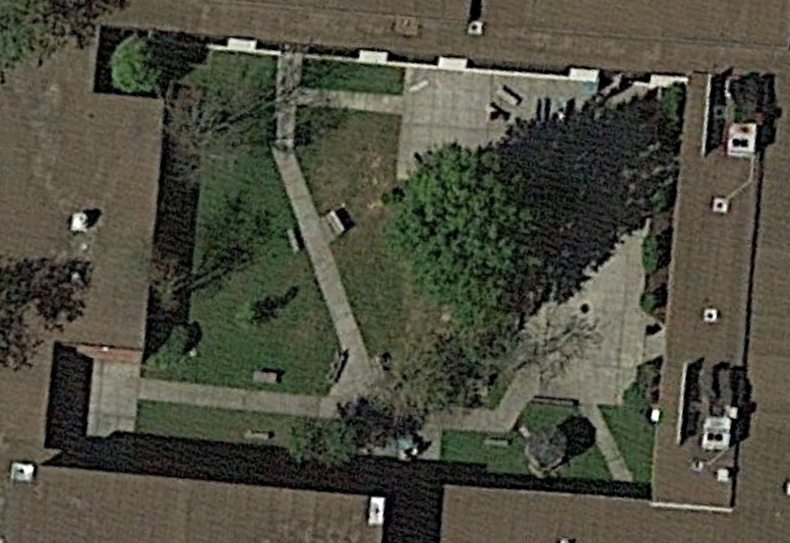
High School Courtyard – Existing Conditions

Slide 3
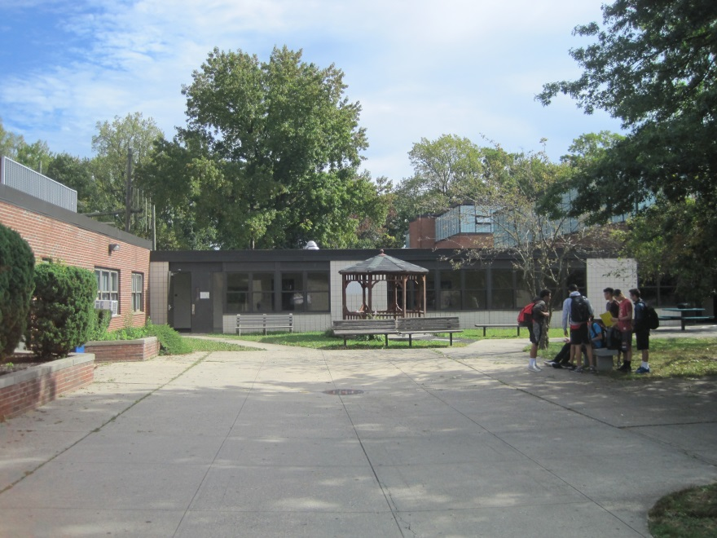
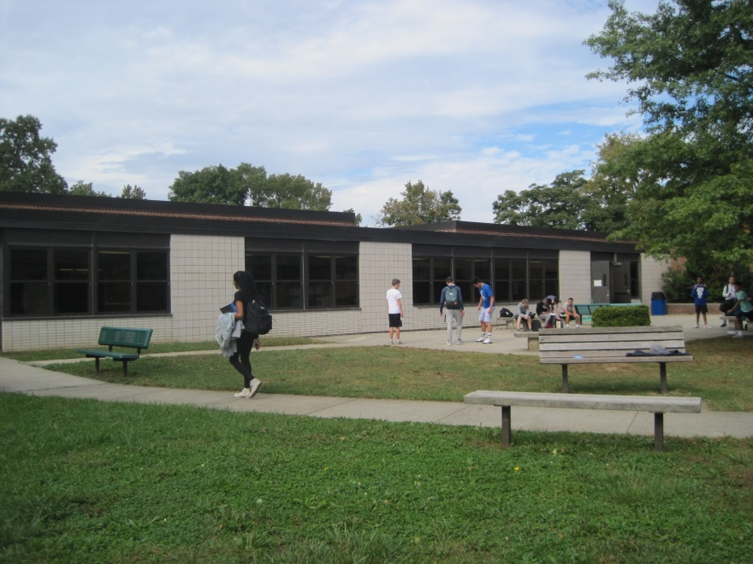
High School Courtyard – Existing Conditions

Slide 4
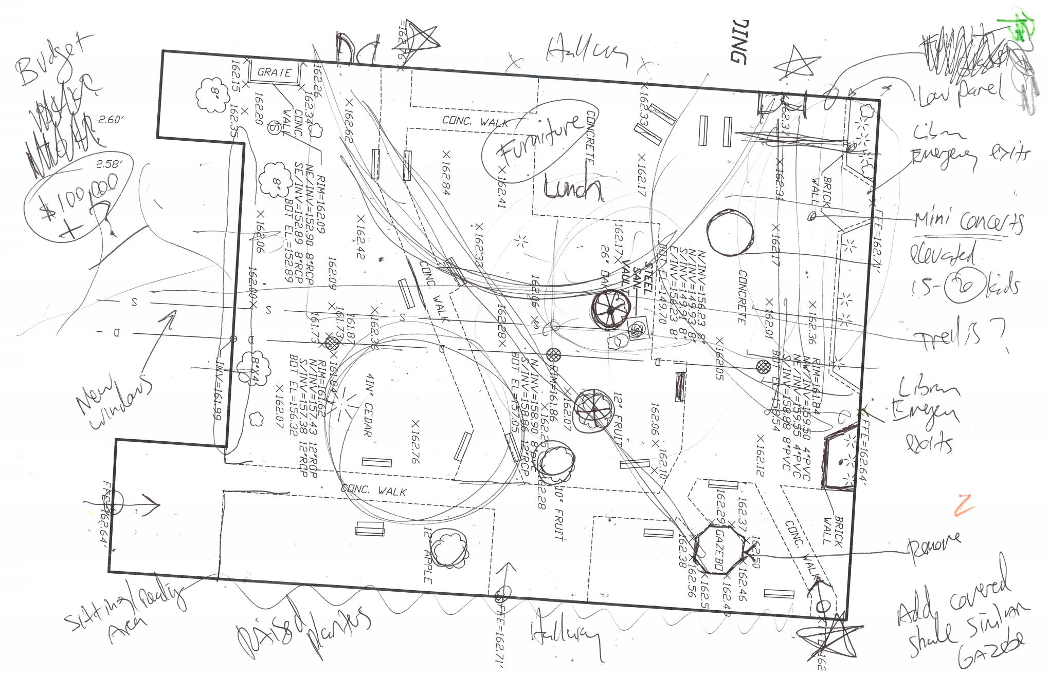
High School Courtyard – Initial Site Visit

Slide 5
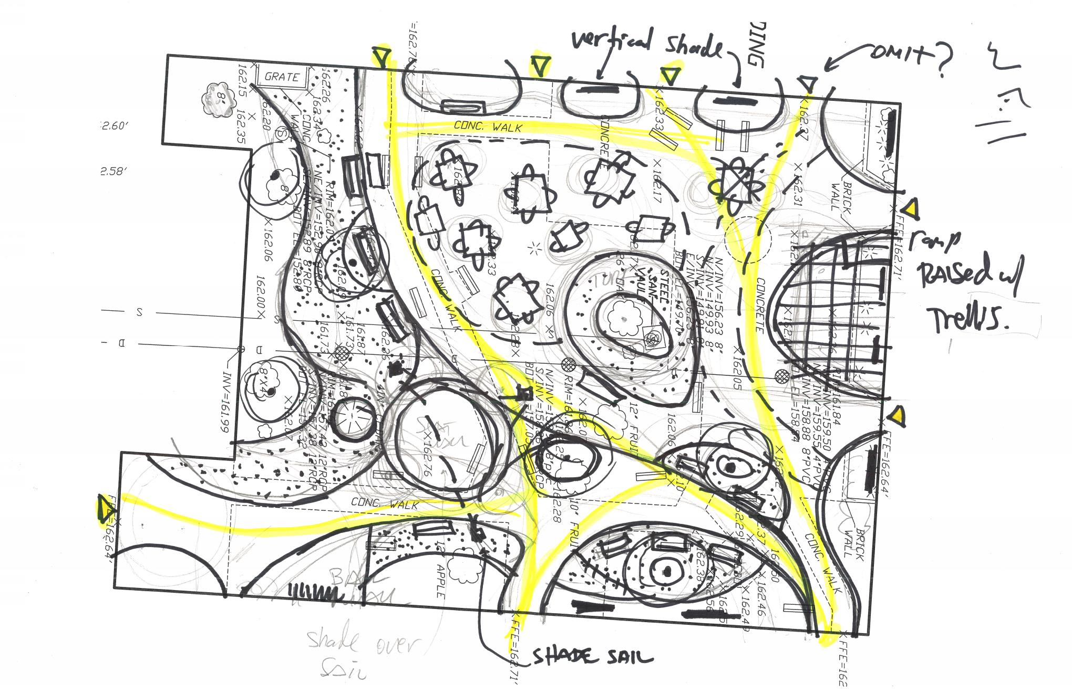
High School Courtyard – Preliminary Sketch

Slide 6
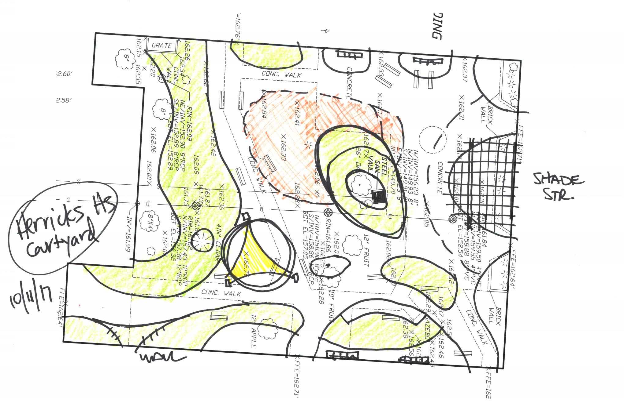
High School Courtyard – Refined Concept

Slide 7
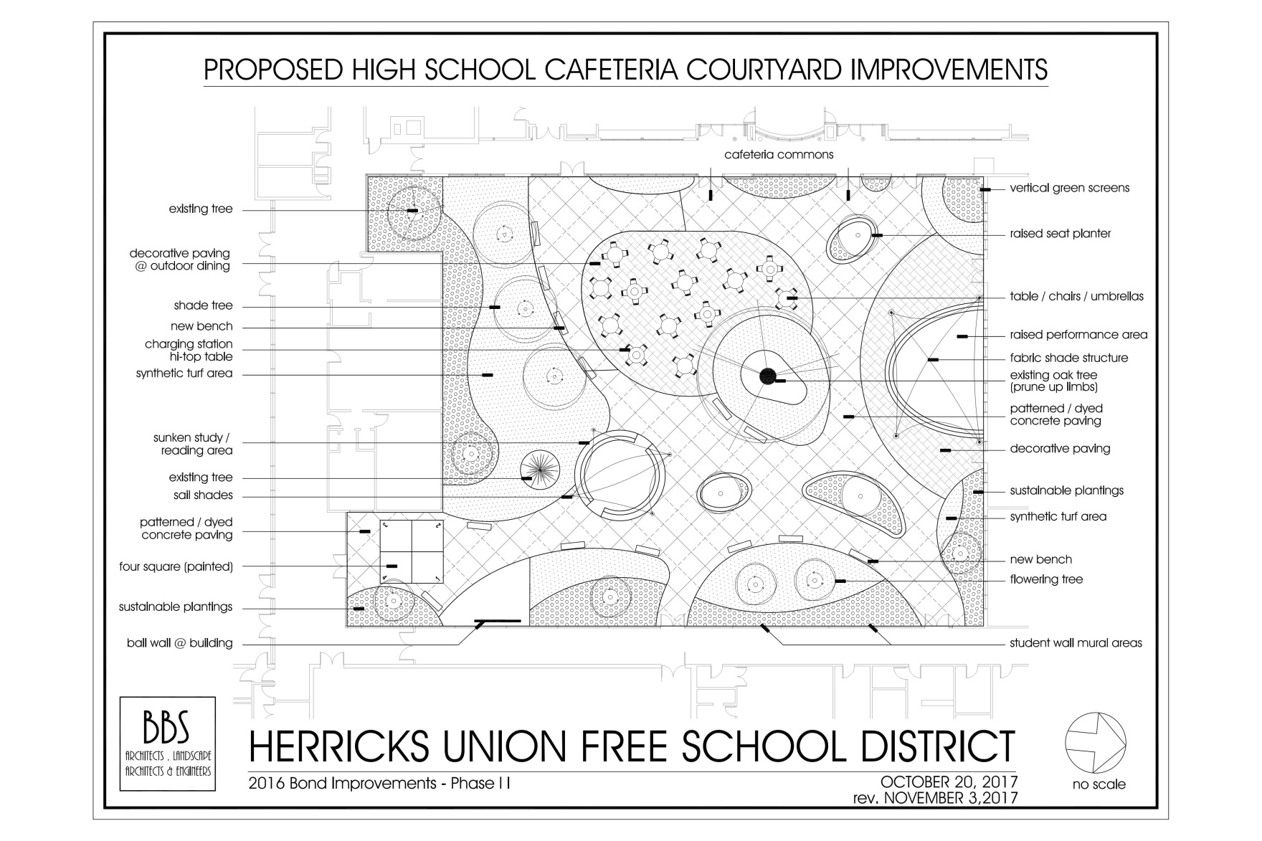
High School Courtyard – Master Plan

Slide 8
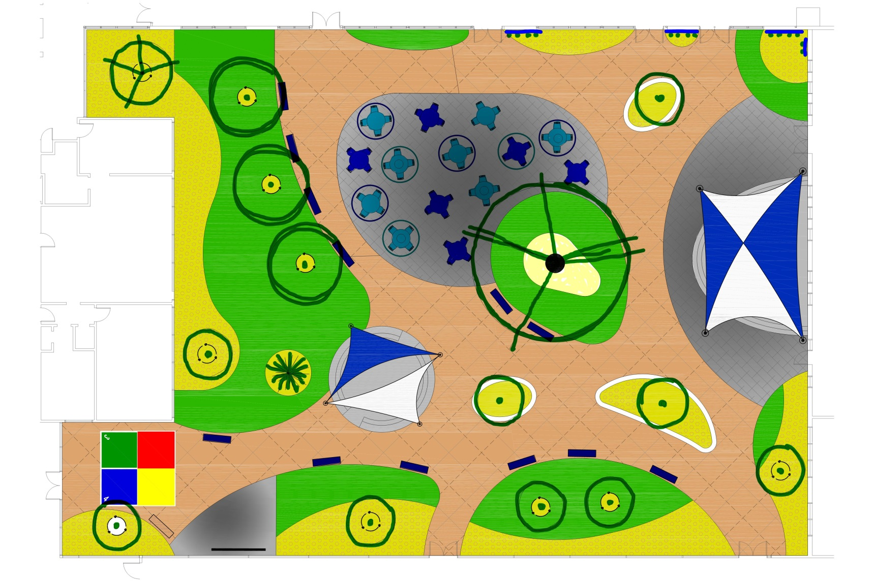
High School Courtyard – Enlargement

Slide 9
Herricks
Union Free School District
Questions ?

Slide 10
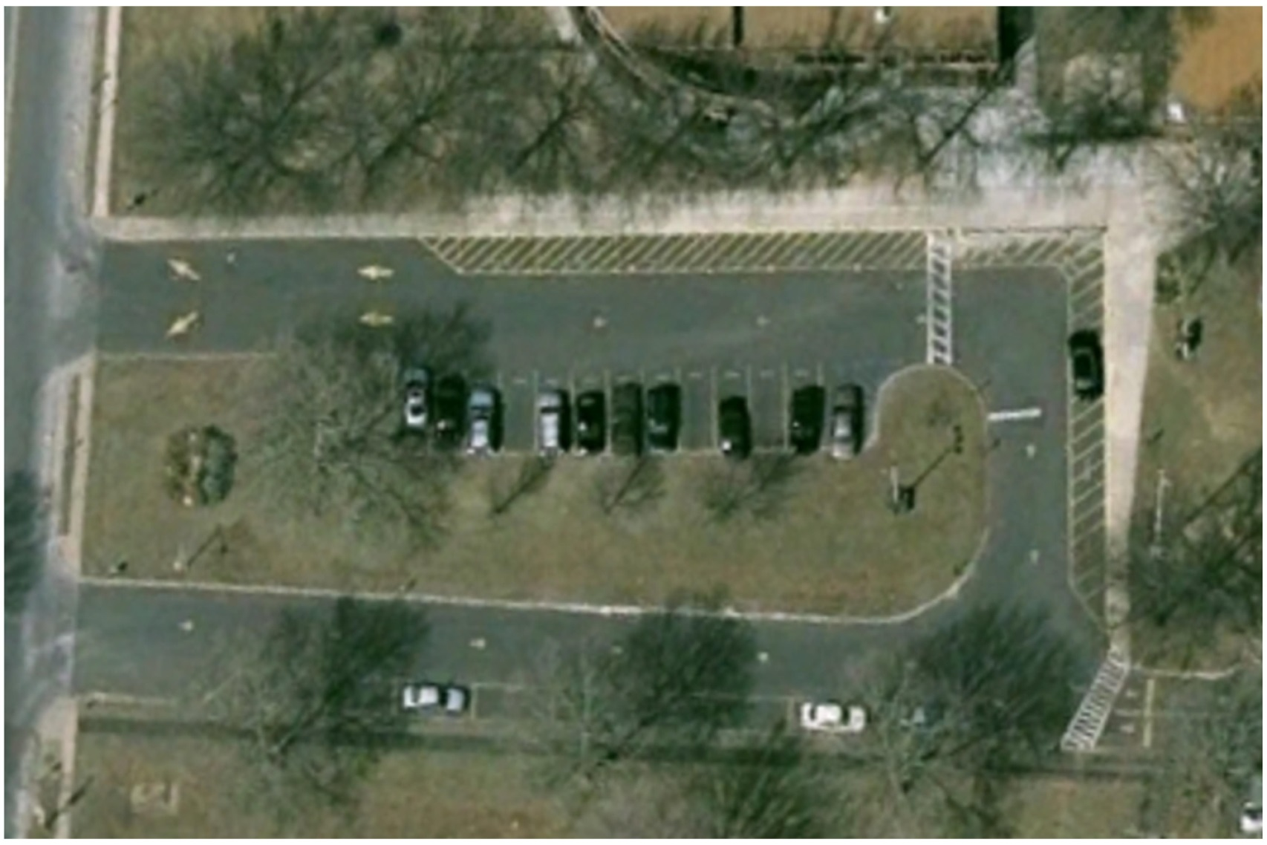
Denton Avenue E.S. – Existing Conditions

Slide 11
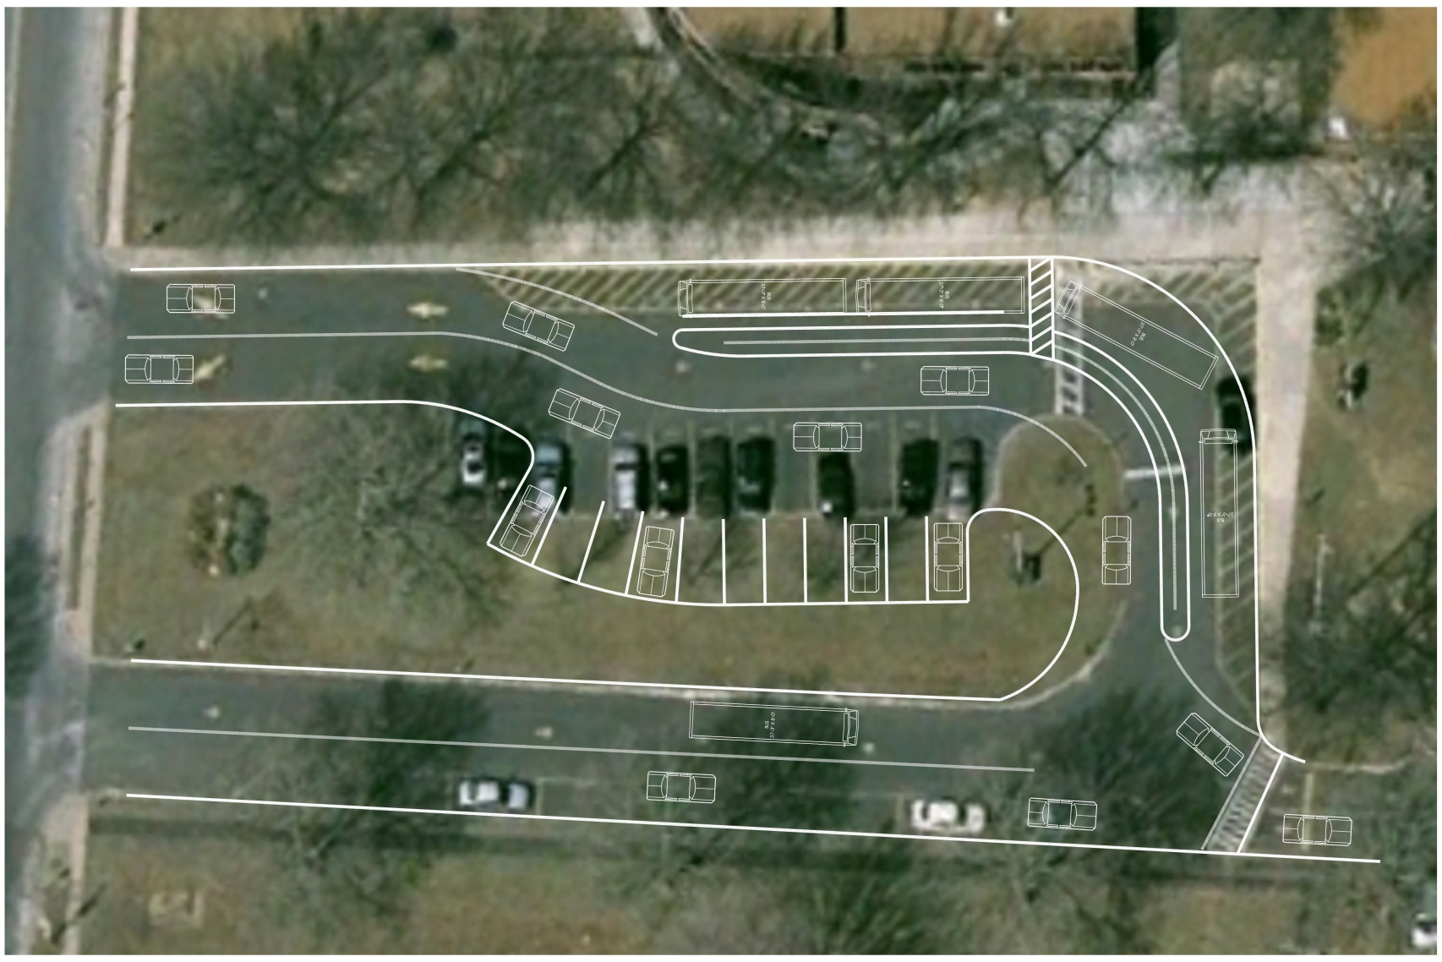
Denton Avenue E.S. – Bond Plan

Slide 12
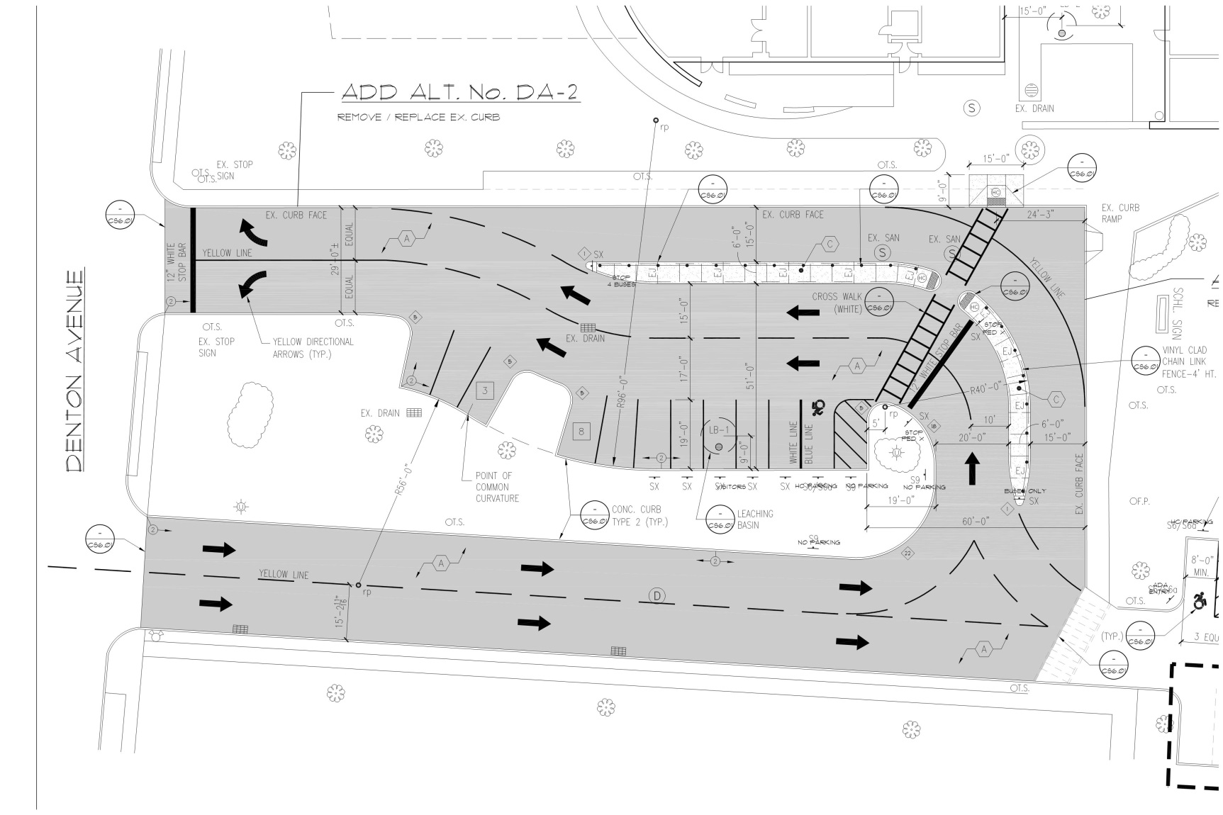
Denton Avenue E.S. – Construction Plan

Slide 13
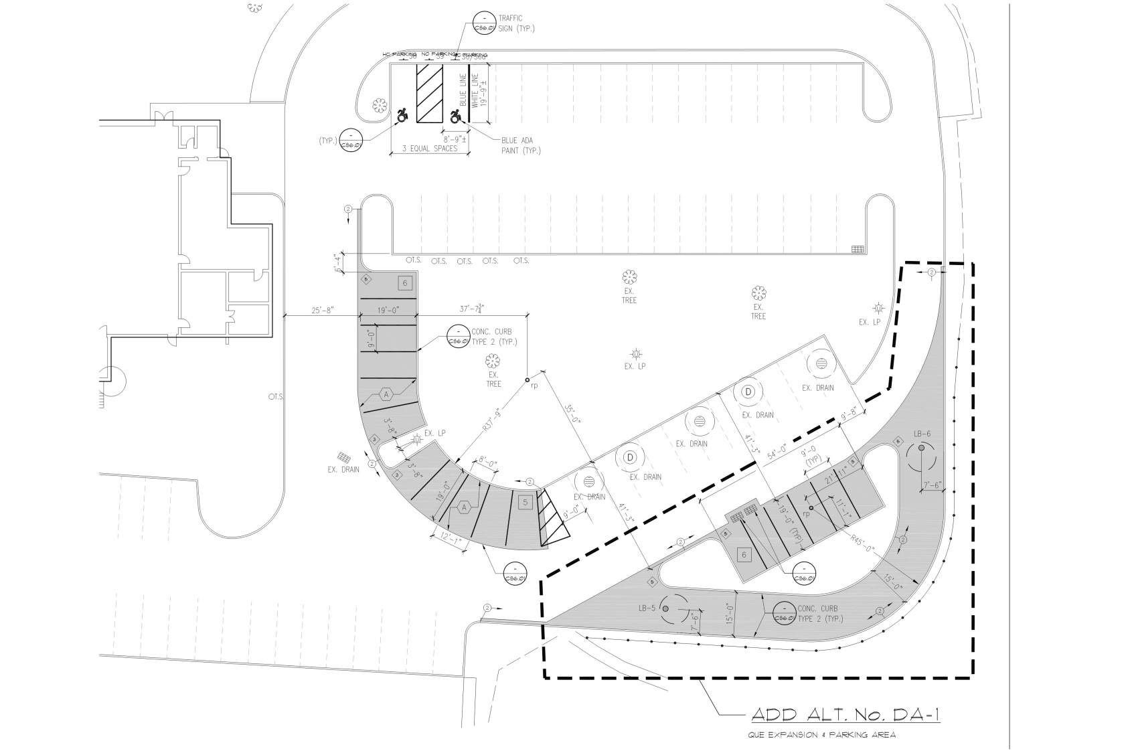
Denton Avenue E.S. – Construction Plan

Slide 14
Herricks
Union Free School District
Thank you

