Slide 1
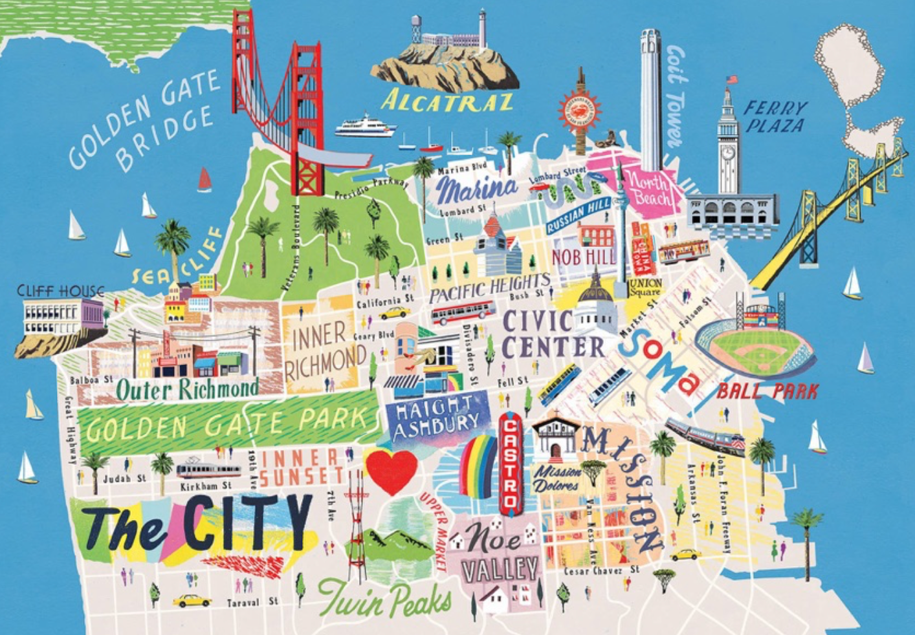
San Francisco
Housing
Investigation

Slide 2

Step 1: Housing Market
Go to Zillow.com
  Zillow is a website where you can see photos of houses and apartments to buy or rent and get an idea of how much they might cost
Search for “San Francisco”
Spend a few minutes clicking around to see houses and apartments that are currently for sale in San Francisco
What stands out to you?
  It could be something about a particular property you clicked on, something you notice about numbers, any observation!

Slide 3
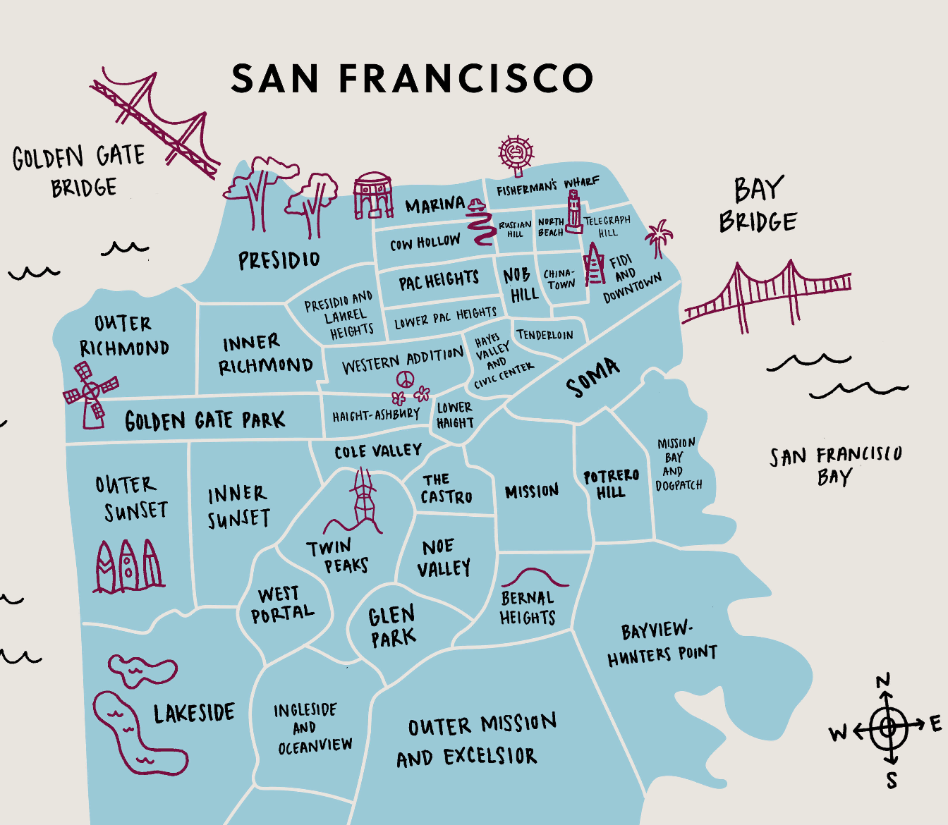
Step 2: Neighborhoods
Stay on Zillow, but next, you’re going to search by neighborhood…
Search “Pacific Heights, San Francisco”
  Take a look at some of the homes for sale in this neighborhood
  Complete the Step 2 Grid
Search “Outer Sunset, San Francisco”
  Take a look at some of the homes for sale in this neighborhood
  Complete the Step 2 Grid
Search “Mission, San Francisco”
  Take a look at some of the homes for sale in this neighborhood
  Complete the Step 2 Grid
Search “Hunters Point, San Francisco”
  Take a look at some of the homes for sale in this neighborhood
  Complete the Step 2 Grid

Slide 4

Step 3: Elementary Schools
These schools are ranked the top five elementary schools in San Francisco by US News & World Report.
Search the address of each school on Google Maps
Add a dot to your map of San Francisco to represent each school.
Tip: after typing in the address, zoom out so you can see where each school is located in the city as a whole. The school will appear as a red drop pin.
Chinese Immersion School at Deavila
  1250 Waller St., San Francisco, CA 94117
Peabody (George) Elementary
  251 Sixth Ave., San Francisco, CA 94118
Sunset Elementary
  1920 41St Ave., San Francisco, CA 94116
Chin (John Yehall) Elementary
  350 Broadway St., San Francisco, CA 94133
Ulloa Elementary
  2650 42Nd Ave., San Francisco, CA 94116
Click here if you’d like to learn more about how US News & World Report determines the ranking of elementary schools in San Francisco.

Slide 5
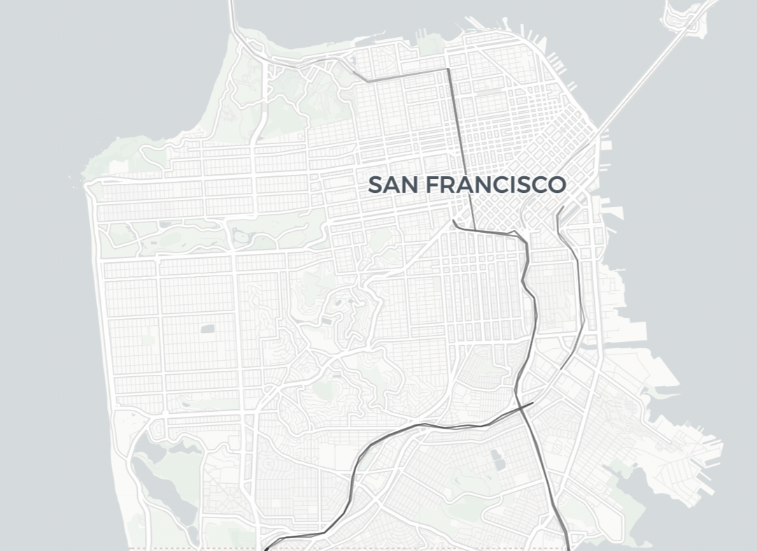
Step 4: Bridges, Roads & Freeways
Golden Gate
Bridge
Add the roads and freeways to your map of San Francisco
Van Ness Ave
Bay Bridge
Embarcadero
101
280
101

Slide 6
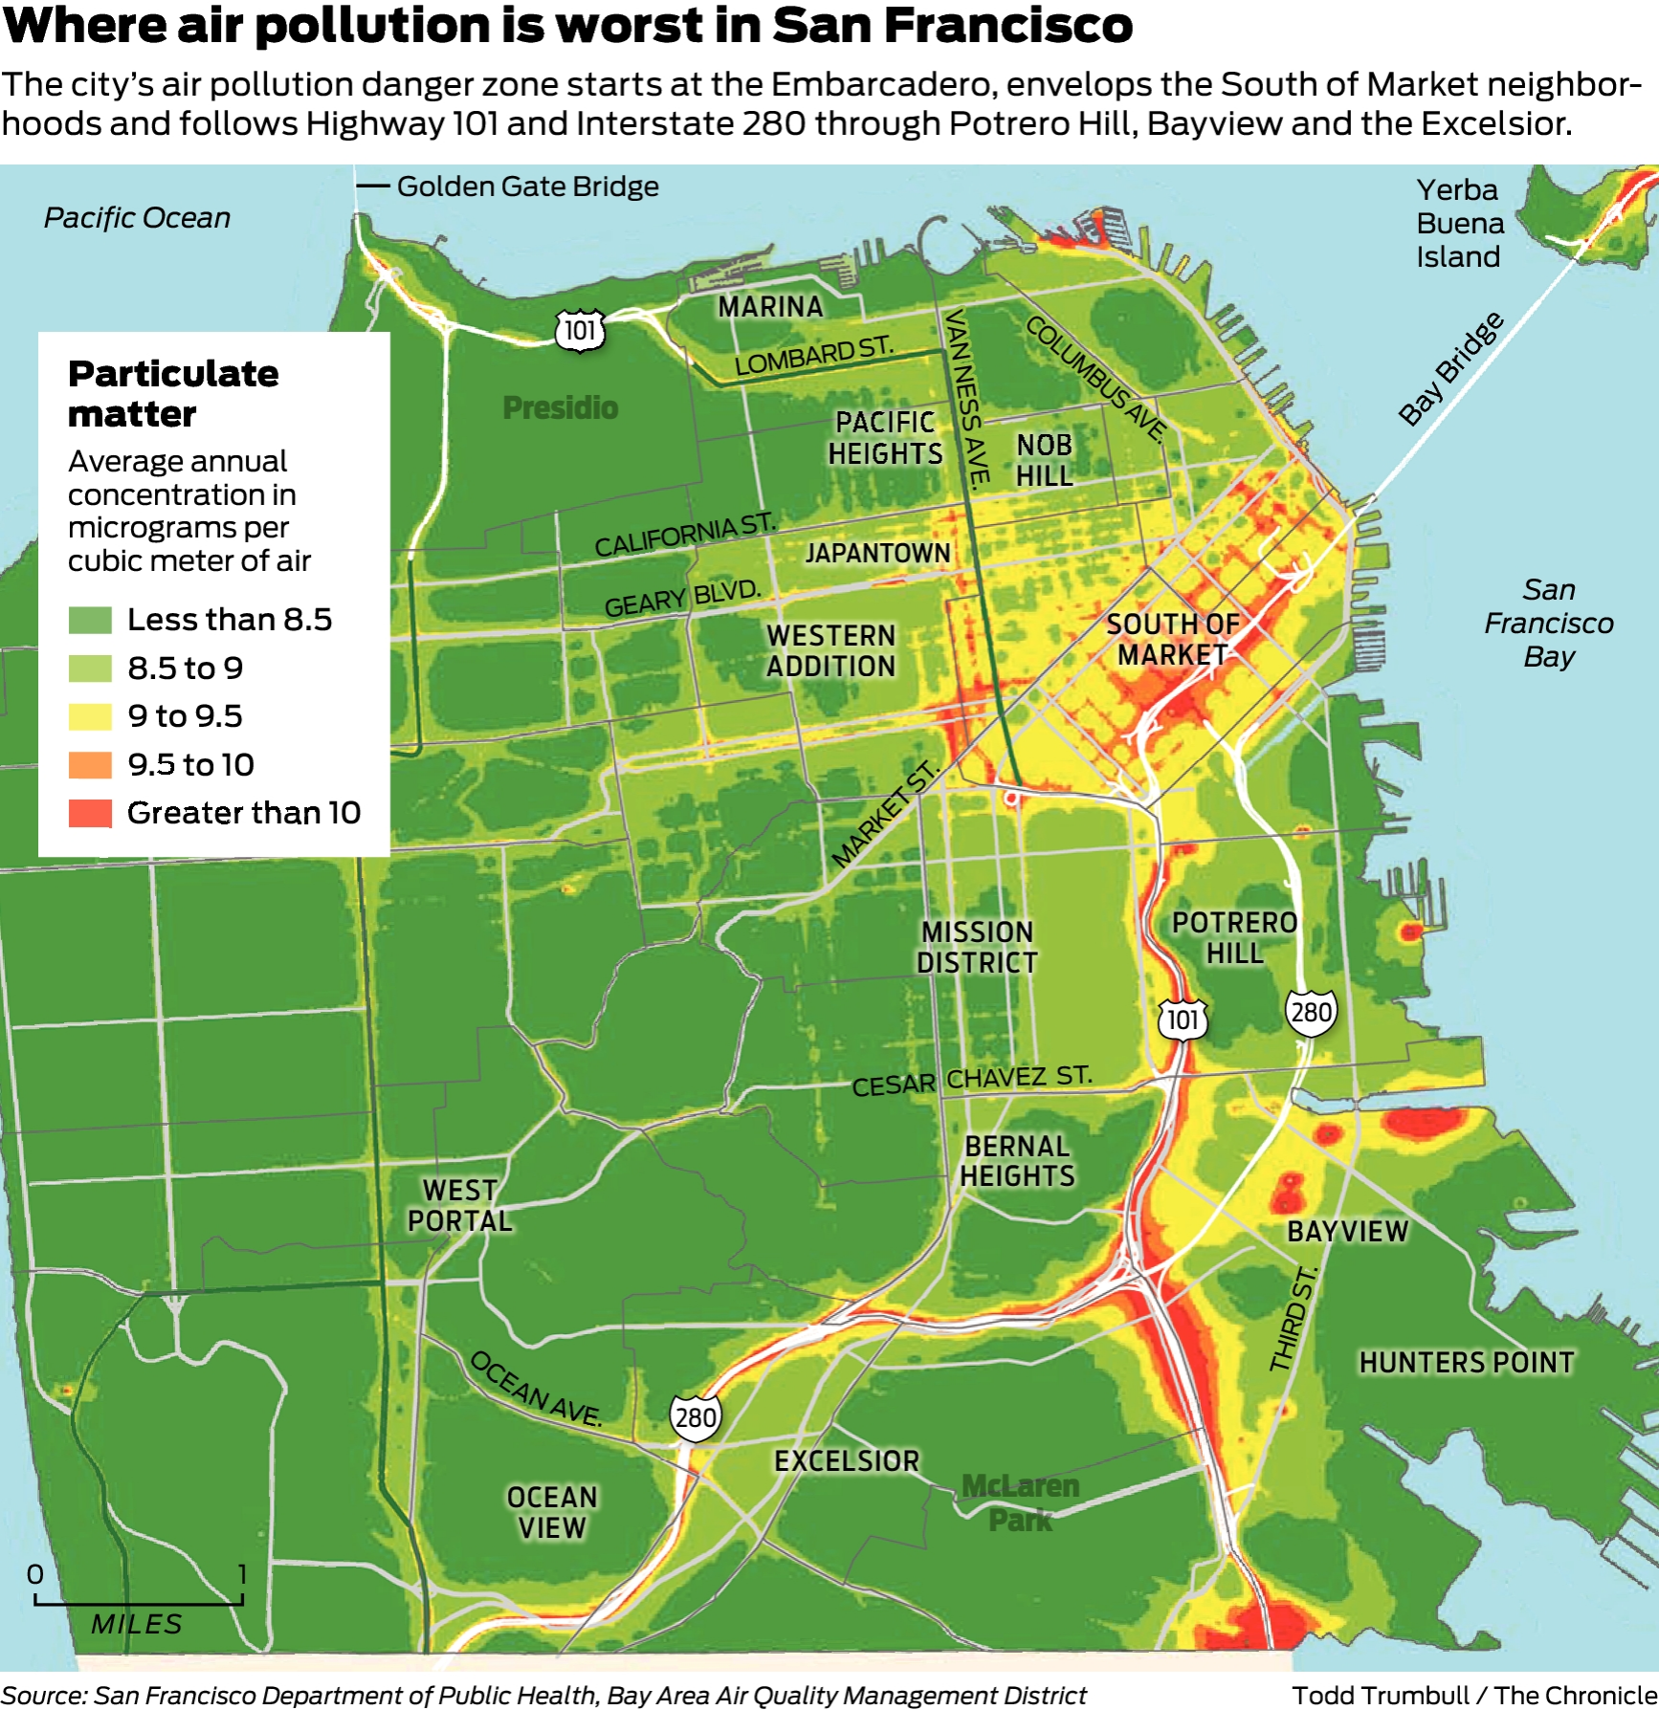
Step 5: Air Pollution
Shade in the air pollution levels throughout the city on your map of San Francisco

Slide 7
What is redlining?
Color-coded maps ranking the “loan worthiness” of neighborhoods in more than 200 cities and towns across the United States.
A- Green- Best
B- Blue- Good
C- Yellow- Declining
D- Red- Hazardous
The federal government deemed “D” areas as places where property values were most likely to go down and the areas were marked in red — a sign that these neighborhoods were not worthy of inclusion in homeownership and lending programs.
Not coincidentally, most of the “D” areas were neighborhoods where Black residents lived
MAKE A PREDICTION
Which neighborhoods of San Francisco do you predict were historically redlined?
What evidence from modern San Francisco supports your prediction?
I predict that _____ neighborhoods were redlined because…
I predict that ______ neighborhoods were not redlined because…

