Slide 1
Unit #2:
Systems and Solidarity
Lesson 4: How do systems perpetuate oppression?

Slide 2
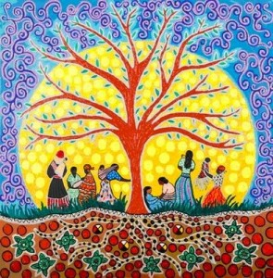
Ancestor Acknowledgement
We honor those that came before us, our ancestors. We carry our ancestors in our hearts and in our minds.
Share with students the ancestor you are honoring today and why?Ask students if they would like to share an ancestor they honor today and why?

Slide 3
Cultural
Energizer

Slide 4


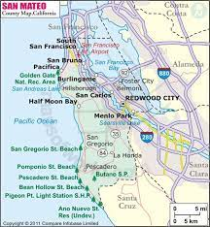

Looking at Neighboring Community
Directions: Read "The Black Lives Next Door". It is an editorial that appeared in the New York Times online on August 14 and as the lead editorial in the Sunday print edition on August 16. It focuses on Sophia Heath, a former Hillsdale senior who was inspired to become an activist by Hillsdale's South Africa Truth and Reconciliation activity (which you’ll be doing in the Spring!). The article also focuses on redlining (housing discrimination and segregation) in the Hillsdale neighborhood and potential solutions.
Write a personal response to the article. Some potential questions to address are:
Do you think the article is an accurate representation of the Hillsdale community?
What do you think about the proposed solutions to housing segregation in San Mateo neighborhoods?
What do you think it means to be inspired and act? What do you think of Sophia’s path to activism? Would you go about it in the same way? Why or why not?

Slide 5
Critical
Vocabulary

Slide 6

Systemic Racism: Definition
Systemic Racism: institutional racism that is embedded as normal practice within society or an organization.
It can lead to such issues as discrimination in criminal justice, employment, housing, health care, political power, and education, etc.

Slide 7

Systemic Racism
As you watch the video, respond to the questions:
Why do you think systemic racism might exist/continue in our society today? Explain
What is an example of systemic racism you've seen so far in THUG?
Source: “What are structural, institutional and systemic racism?” ABC7 News Bay Area (July 9, 2020)

Slide 8
Critical
Concepts

Slide 9
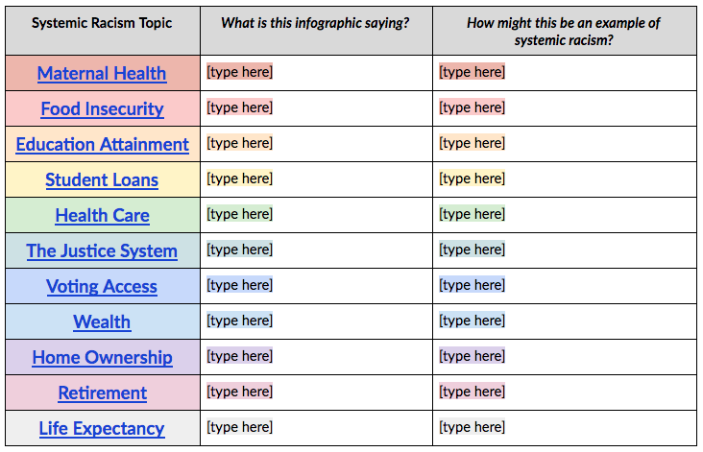


Reuters Infographic Article: The Race Gap
In order to understand how racism is systemic in America, you will read through this infographic article from Reuters looking at different topics complete the organizer.
You should read at least 12 infographics
However, you are encouraged to read them all
Notes:
https://www.reuters.com/graphics/GLOBAL-RACE/USA/nmopajawjva/index.html

Slide 10
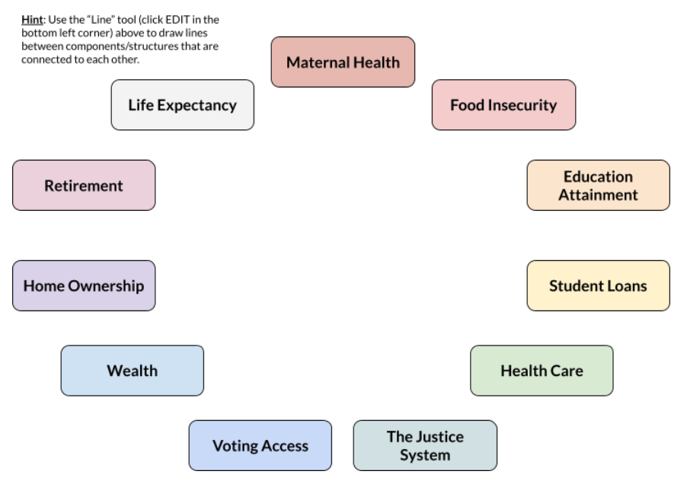
Reuters Infographic Article: The Race Gap
Directions: use the mind map to draw lines between topics/structures that you believe are connected to each other.
After you’ve completed drawing as many connections as you can think of, answer the following question:
How might these connections between different components/structures make it so that systemic racism is embedded (lasting and strong) in our society?

Slide 11
Conclusive Dialogue

Slide 12
Reuters Infographic Article: The Race Gap
Directions: After you’ve completed drawing as many connections as you can think of, answer the following reflection questions:
How might these connections between different components/structures make it so that systemic racism is embedded (lasting and strong) in our society?
Which topic of system racism do you think affects society the most? Why?

Slide 13
Cultural Production

Slide 14
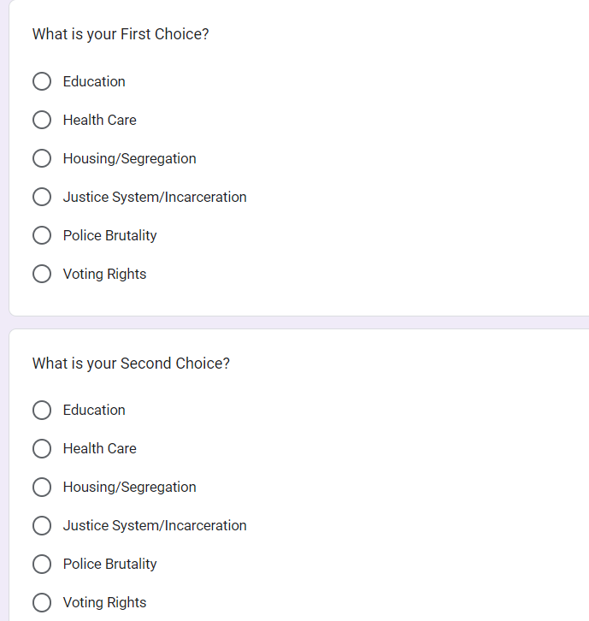
Group Exploration Preference Form
After browsing through the list of topics in the Reuters Systemic Racism Article, commit to your TOP 2 topics (Google Form LINK).
You will be researching and presenting on this topic in next week’s Roundtable Discussion.
Systemic Racism Exploration

Slide 15
Systemic Racism Exploration:
Gathering Evidence
Research your chosen topic. Start with the curated list (links on Canvas). Then, use your metacognitive skills to explore the resources.
Answer the following questions with your research:
How can an institution or system be racist? What are the historic origins of your selected topic of systemic racism?
What forces threaten, reinforce, or empower racial, social, sexual, or cultural identity?
How does your chosen topic of systemic racism impact people’s lives?
What are some ways people are acting to promote justice within this topic of system racism?

