Slide 1
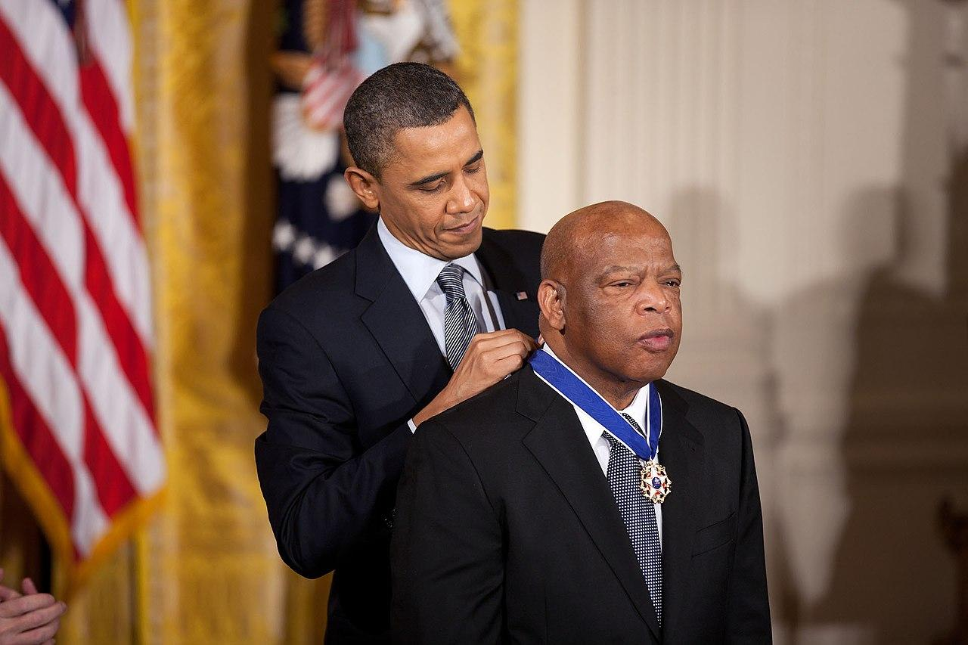
John Lewis & Hope for the Future

Slide 2
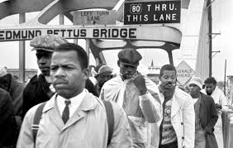
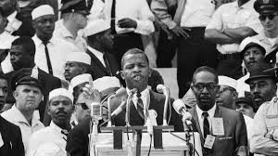
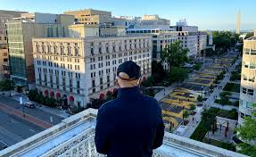
John Lewis & Hope for the Future
Who was John Lewis?
Famous civil rights activist who passed away over the summer
Leader of the Student Nonviolent Coordinating Committee from 1963 - 1966
One of six major speakers at the March on Washington
Part of a peaceful march that was disrupted by police in Selma, Alabama in 1965, where he was beaten to near death.
Congressperson from 1986 - 2020, representing a district from Atlanta, Georgia.
Joined protests against systemic racism in BLM Plaza in Washington DC, one month before his death
Known for inciting “good trouble”

Slide 3
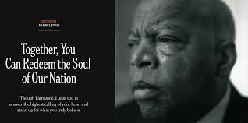
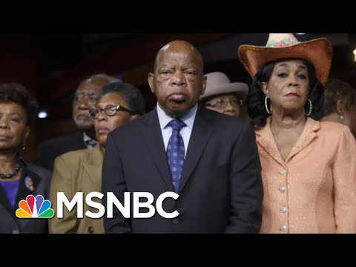
John Lewis & Hope for the Future
Listen to the recording of Lewis’ essay, “Together, You Can Redeem the Soul of Our Nation”, that was published in the New York Times after he died. While reading, consider the following question:
Kickoff: In spite of the presence of systemic racism in the world today, why is Lewis hopeful?

Slide 4


John Lewis & Hope for the Future
Write a letter to “the future” on the postcard on your desk, based off of your own personal experience, beliefs and what you learned in this unit. Answer one or all of these questions:
What should the story of the 21st century look like?
Are we responsible for writing and rewriting history?
Will you help write it and how will you do it?
Ideas: Brainstorm your answer on a piece of binder paper and then put your final draft on the postcard. Make it your postcard colorful. Include a picture or symbol on the “front” that connects to your answer
Note:
You’ll have time to finish this on Socratic Day!!!

Slide 5
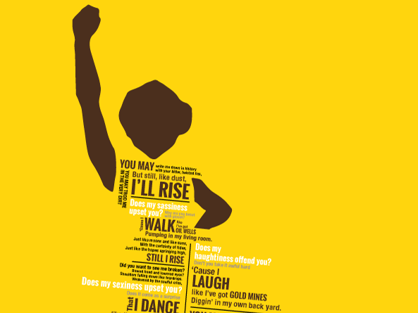
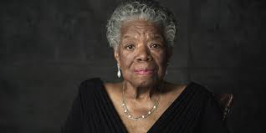
Learning Log
“You may write me down in history, with your bitter twisted lies. You may trod me in the very dirt. But still, like dust, I’ll rise.”
Is it possible to rise in the face of even the bitterest adversity? If so, where do you find the strength to do so?

