Slide 1
Colonial Economies
(1750 – 1914)
AP World History
Chapter 24
“Colonial Encounters (1750 – 1914)

Slide 2
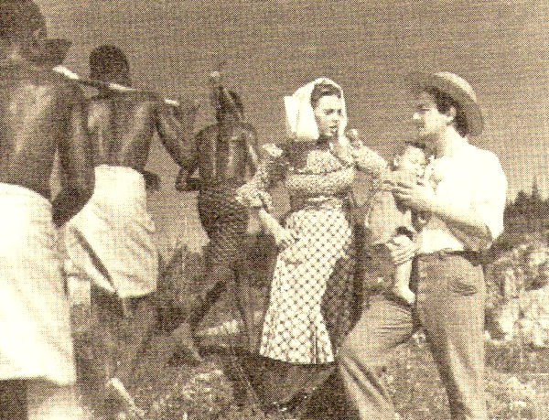
Economies of Coercion:
Forced Labor and the Power of the State
Forced labor was often used to meet the demands of the colonial state → Examples:
  Building railroads
  Constructing government buildings
  Transporting goods

Slide 3
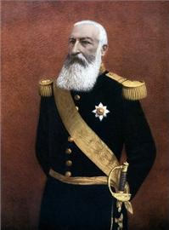
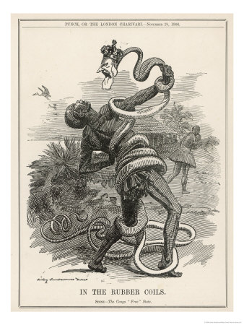
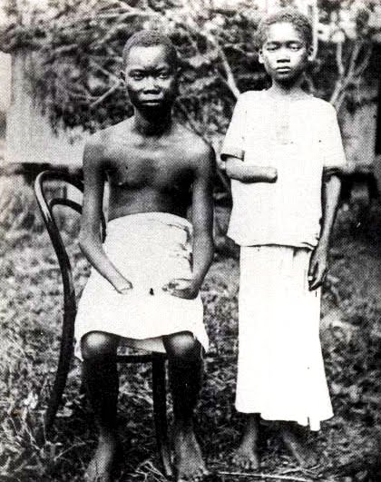
Economies of Coercion:
Forced Labor and the Power of the State
Most infamous cruelties of forced labor = in the Congo in the early 1900s
  Governed by King Leopold II of Belgium
  Forced villagers to collect rubber → they had daily rubber quotas
  If rubber quotas were not met, villagers were tortured and/or killed
    Shot, ears/limbs cut off, tied up with ropes around their necks and dragged away, etc.

Slide 4
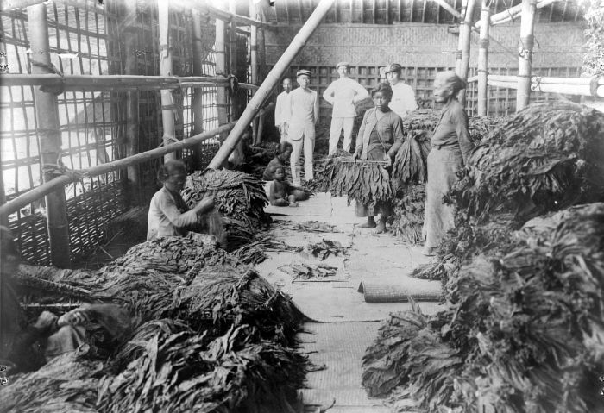
Economies of Coercion:
Forced Labor and the Power of the State
Several colonial states used “cultivation systems”
  Peasants required to cultivate 20% or more of their land in cash crops such as sugar or tobacco to meet their tax obligation
  Cash crops sold to government contractors at fixed, low prices
  Cash crops resold in the world market for a very high profit
Sorting Tobacco Leaves in Java, 1930s

Slide 5
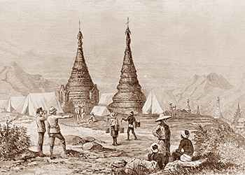
Economies of Cash-Crop Agriculture
In some places, colonial rule created conditions that facilitated and increased cash-crop production to the advantage of local farmers
Example: British authorities in Burma encouraged rice production among small farmers
  Ended the prohibition on rice exports
  Provided irrigation and transportation facilities
  Passed laws that encouraged private ownership of small farms
British Authorities Surveying Rice Production in Burma

Slide 6
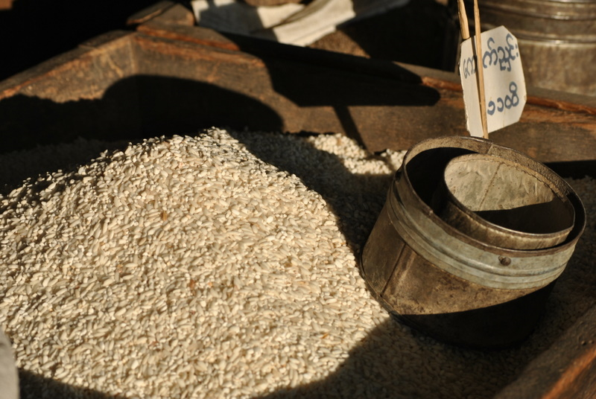
Economies of Cash-Crop Agriculture
Results of these policies in Burma:
  Population boomed → in Burma AND in other parts of Asia
  Rice exports soared
  Small farmers able to buy their own land, build nice homes, buy imported goods, etc.
  Standards of living improved sharply

Slide 7
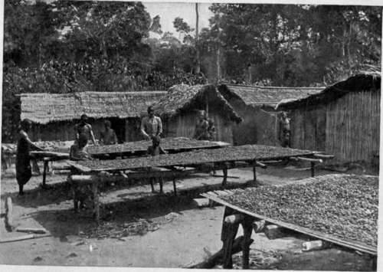
Economies of Cash-Crop Agriculture
Profitable cash-crop farming = in the southern Gold Coast
  British territory in West Africa
  Modern-day Ghana
  African farmers themselves developed this export agriculture
  Planted cacao trees in huge quantities and became the world’s leading supplier of cocoa by 1911
Drying Cocoa Beans in the Gold Coast

Slide 8
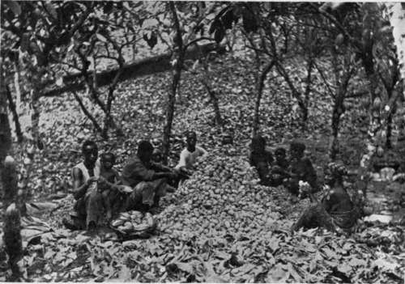
Economies of Cash-Crop Agriculture
Problems with this success:
  Labor shortage = led to employment of former slaves who were exploited
  Labor shortage = led to migration of workers from the interior of Africa to the Gold Coast → caused ethnic and class tensions
  Some men married women for their labor power, but didn’t take care of them
  Many colonies only specialized in one or two cash-crops → hurt them when world market prices dropped
Breaking Open (Cracking) the Pods

Slide 9
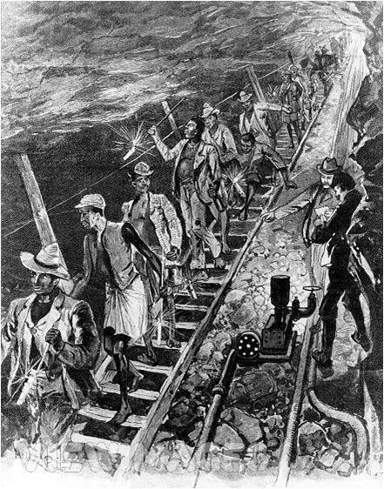
Economies of Wage Labor:
Working for Europeans
Millions of colonial subjects across Asia and Africa sought employment in European-owned plantations, mines, construction projects, and homes
  Needed money
  Lost land they needed to support their families
  Sometimes forced by colonial authorities
Workers in a South African Mine

Slide 10
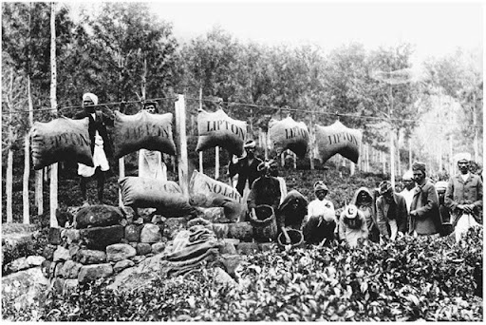
Economies of Wage Labor:
Working for Europeans
European-financed plantations in Southeast Asia that grew sugarcane, rubber, tea, tobacco, and so on employed hundreds of thousands of workers
  Workers = subject to very strict control
  Often housed in barracks
  Paid very little (and women made even less)
  Disease was common → high death rates
Tea Plantation in Ceylon

Slide 11
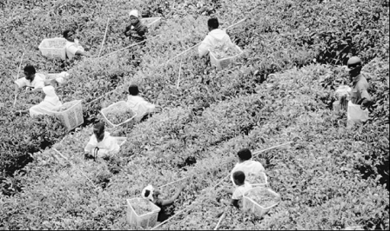
Economies of Wage Labor:
Working for Europeans
Even more land taken from local people in Africa than in Southeast Asia
  Ex: South Africa in 1913 → whites were 20% of the population, but controlled 88% of the land
“Squatters” = Africans who stayed and worked for the new landowners as the price of remaining on what had been their own land
Workers Harvesting Leaves on an African Tea Plantation

Slide 12
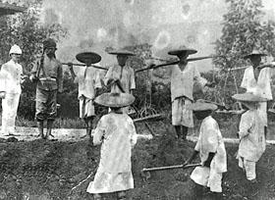
Economies of Wage Labor
Working for Europeans
Another source of wage labor for many = mines
Major tin mines in Malaysia
  Miners = mostly impoverished Chinese workers
  Worked on strictly-controlled 3-year contracts
  Horrible living conditions
  Rampant diseases
  Dangerous work = many accidents
  High death rates
Chinese Tin Miners

Slide 13
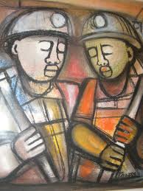
Economies of Wage Labor:
Working for Europeans
Major gold and diamond mines in South Africa
  Workers = mainly impoverished Africans
  Recruited on short-term contracts
  Lived in all-male prison-like barracks surrounded by barbed wire
  Forced to return home periodically so they didn’t establish a permanent family life near the mines
Painting of Two African Miners

Slide 14
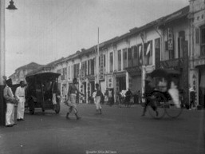
Large Colonial Cities
Examples: Nairobi, Cairo, Singapore, etc.
Racially segregated
Often unsanitary
Greatly overcrowded
Seen as meccas of opportunity for people all across the social spectrum
Western-educated people found opportunities as: teachers, doctors, professional specialists, clerks in European business offices, workers in European government bureaucracies, etc.
Singapore in the 1920s

Slide 15
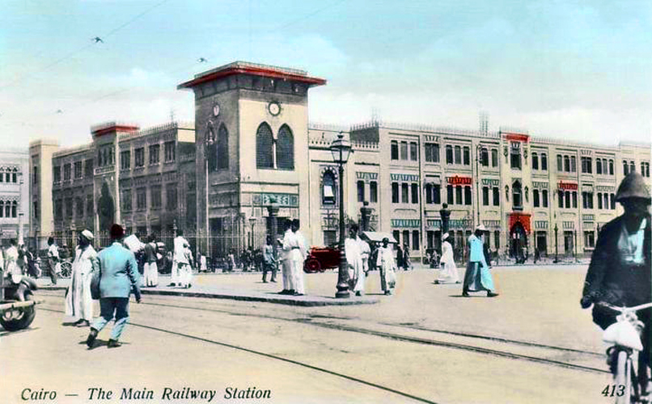
Large Colonial Cities
Working-class elite = skilled workers on railways or in ports
  Also included workers in factories that processed agricultural goods or manufactured products such as beer, cigarettes, furniture, etc.
Urban poor worked as: construction workers, rickshaw drivers, food sellers, domestic servants, prostitutes, etc.
Cairo in the 1920s
The Main Railway Station

Slide 16
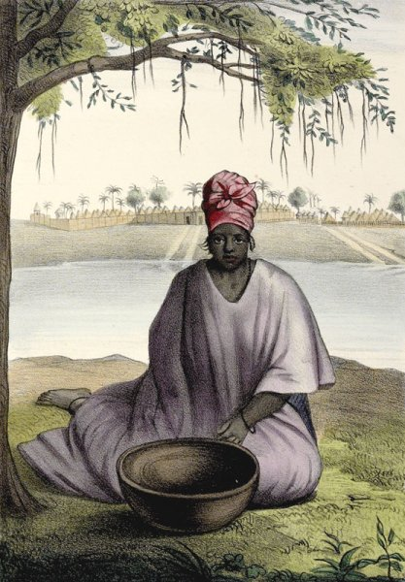
African Women and the Colonial Economy
In pre-colonial times African women:
  Were active farmers
  Were responsible for planting, weeding, and harvesting
  Prepared the food
  Cared for the children
  Were allocated their own fields with which they could feed their families
  Were involved in local trade activity
  Enjoyed some economic independence

Slide 17
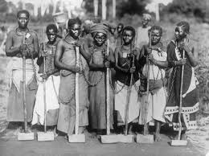
African Women and the Colonial Economy
Under colonial rule = men moved into wage labor or cash-crop agriculture
This put A LOT more responsibility on women:
  Total responsibility for domestic food production
  Had to also supply food to men in the cities
  Took over traditionally male tasks → breaking the ground for planting, milking cows, supervising the herds, etc.

Slide 18
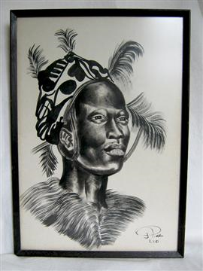
African Women and the Colonial Economy
Result = many men and women began to live separate lives and develop different cultures
  Men in the cities working for wages
  Women in the villages focusing on subsistence agriculture
Many married couples no longer lived together
  Women started to build closer relationships with their own family instead of their husband’s
Many women became the heads of their households
Portrait of a Luo Woman from Kenya

Slide 19
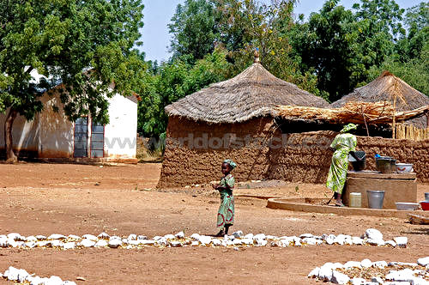
Assessing Colonial Development
Clear results of economic development within European colonies in the 19th-20th centuries:
(1) Colonial rule facilitated the integration of Asian and African economies into a global network of exchange
  More land and labor = devoted to production for the global market
(2) Nowhere did a breakthrough to modern industrial society occur
And, obviously, many of these ex-colonies have yet to develop a modern industrial society

Slide 20
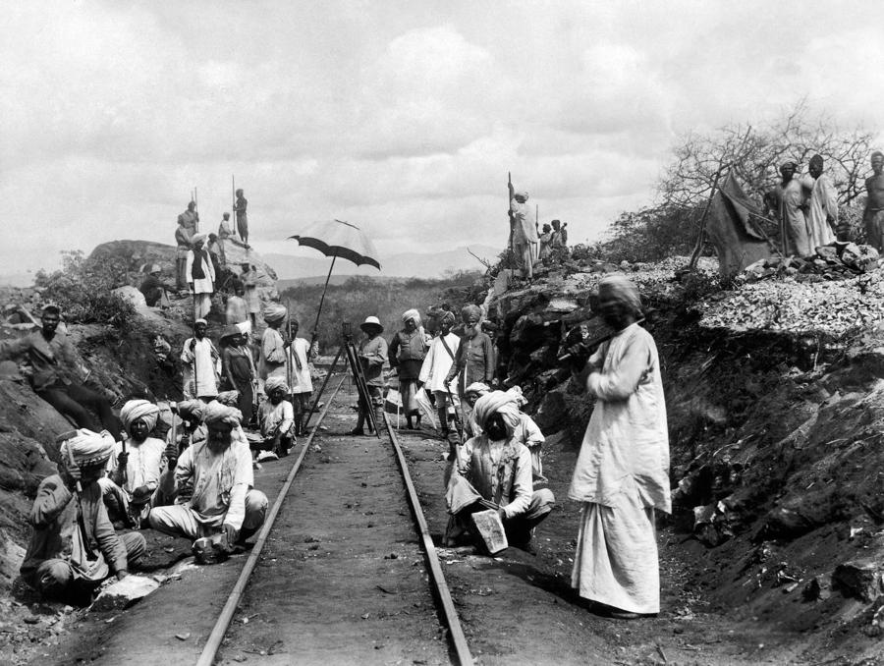
Assessing Colonial Development
(3) The appearance of some elements of modernization
  Modern administrative and bureaucratic structures
  Schools → used to train the intermediaries that were so crucial to colonial rule
  Communication and transportation → railroads, motorways, ports, telegraphs, postal services
  Modest health care provisions → part of the “civilizing mission”
The Building of an African Railway, 1905

