Slide 1



TOPIC 1.2
DEVELOPMENTS
IN DAR AL-ISLAM
CONTENT OBJECTIVES
“Everywhere
Islam is”
Explain how systems of beliefs and their practices affected society in the period from 1200 to 1450.
Explain the causes and effects of the rise of Islamic states over time.
Explain the effects of intellectual innovation in Dar al-Islam.
Notes:
Notesheet

Slide 2


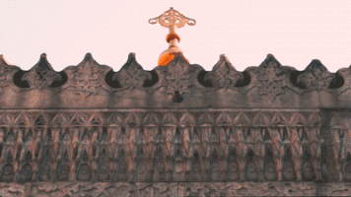

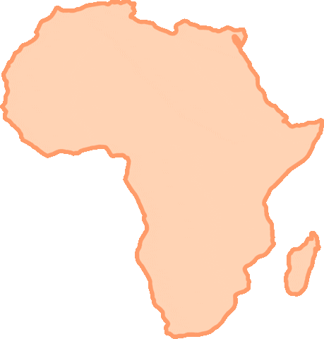
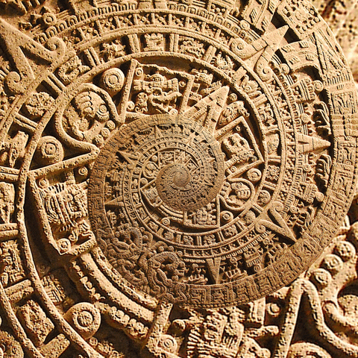
REVIEW
THE WORLD
IN 1200
By 1200, much of the world had recovered from the decline of the classical civilizations. In many regions, new states were emerging that were promoting trade and the transfer of ideas among regions.
Africa, Europe and Asia were connected through Indian Ocean Trade, the Silk Roads, and the trans-Saharan trade routes
The Byzantine Empire and various Islamic empires provided some stability in the region from Eastern Europe through the Middle East to South Asia
China and Dar al-Islam continued to be leading centers of learning and innovation
Africa largely remained stateless, except for some regions in West Africa and East Africa that were part of Dar al-Islam
Afro-Eurasia, America, and Oceania were developing in isolation from each other

Slide 3
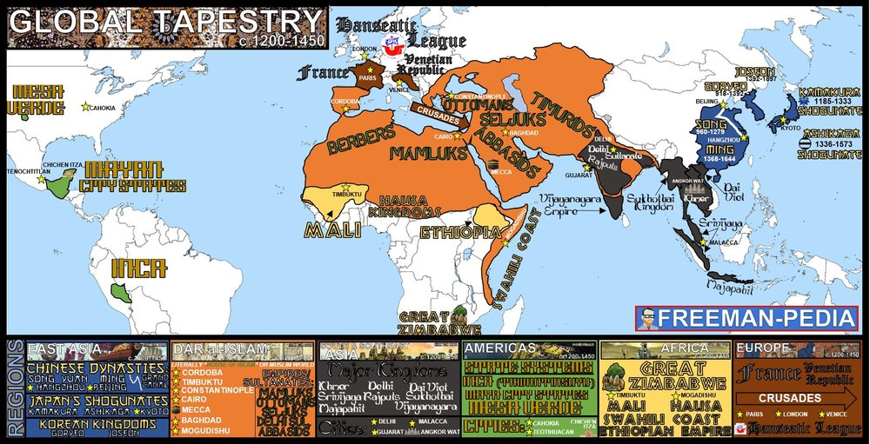
TOPIC 1.1
TOPIC 1.2
TOPIC 1.3
TOPIC 1.4
TOPIC 1.5
TOPIC 1.6

Slide 4


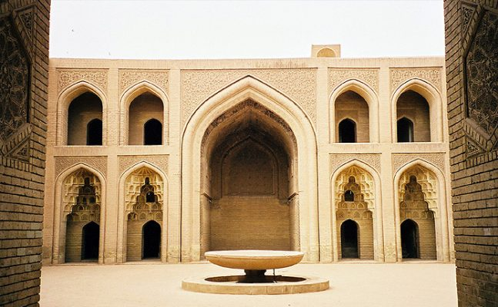
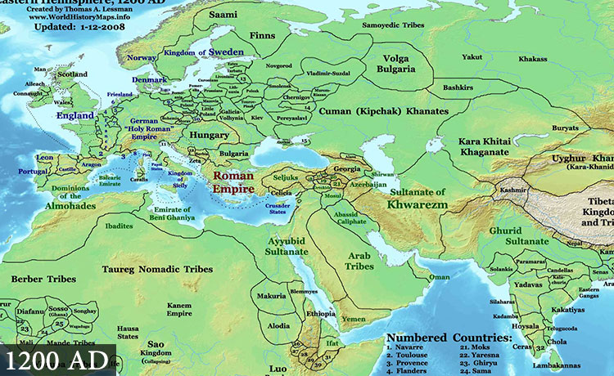

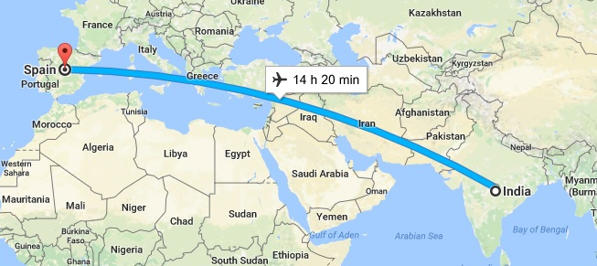
LET'S START WITH SOME CONTEXT
PREVIOUSLY
ON…
Death of Muhammad - founder of Islam (632)
  Islam spreads outward from Arabia
    Extended from India to Spain through military, merchants, & missionaries
  Islamic leaders showed tolerance to Christians, Jews, and others who believed in a single god and did good deeds.
Abbasid Empire: House of Wisdom
  Center of learning in Baghdad: library, translation
Institute and research center

Slide 5
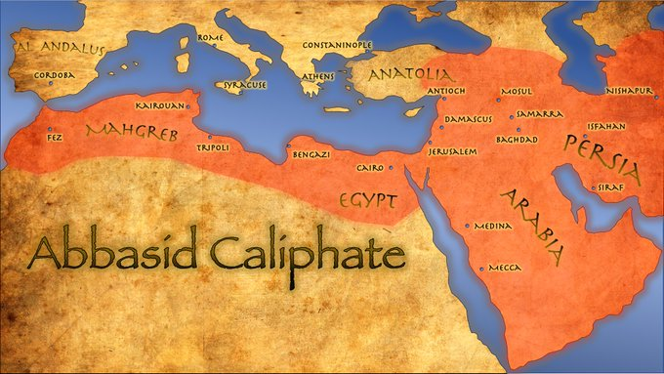
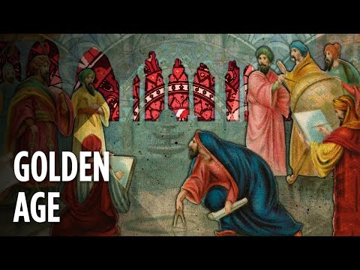

ABBASID CALIPHATE
ab-uh-sid
Came to power in Africa and the Middle East (8th - 13 century)
kal-uh-feyt
Major achievements: TRADE NETWORK
Because Islamic rule unified much of the Eastern world, thus abolishing many boundaries, trade was freer, safer
Muslim traders, consequently, established trading posts as far away as India, the Philippines, Malaya, the East Indies, and China
Imports: grain, metals, and wood. Exports: pearls from the Gulf, livestock from the Arabian Peninsula horses and camels), and one of the chief products – cloth. The Muslims also traded medicines, as well as paper and sugar.
Expansion of Commercial Activity = advanced system of banking, idea of credit, and business contracts

Slide 6
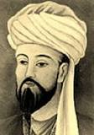
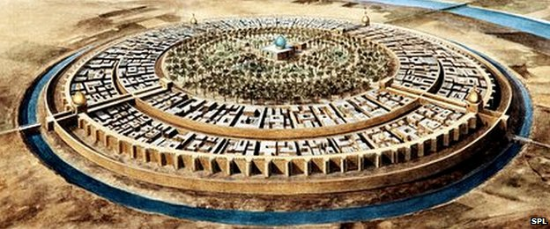

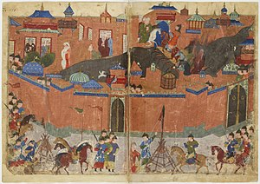

ABBASID CALIPHATE
ab-uh-sid
DECLINE OF THE CALIPHATE
Siege of Baghdad: Hulagu Khan conquered Baghdad in 1258
WHY BAGHDAD YOU ASK? It had been the capital of the Abbasid Caliphate for centuries. The Caliph refused Mongol demands for continued submission and payment of tribute (soldiers) for Mongol forces in Persia.
This Siege of Baghdad marks the end of
the Islamic Golden Age.
grandson
“ The Mongols looted and then destroyed mosques, palaces, libraries, and hospitals. Priceless books from Baghdad's thirty-six public libraries were torn apart, the looters using their leather covers as sandals. Grand buildings that had been the work of generations were burned to the ground. The House of Wisdom, containing countless precious historical documents and books on subjects ranging from medicine to astronomy, was destroyed. Survivors said that the waters of the Tigris ran black with ink from the enormous quantities of books flung into the river and red from the blood of the scientists and philosophers killed. “ Invaders Destroying Baghdad, 2005

Slide 7
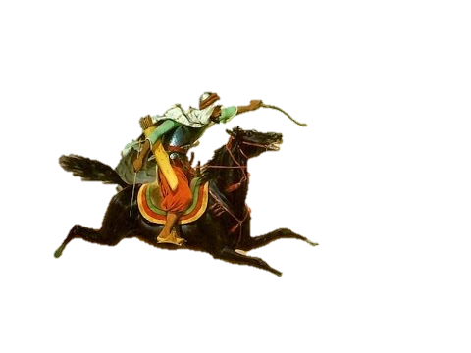
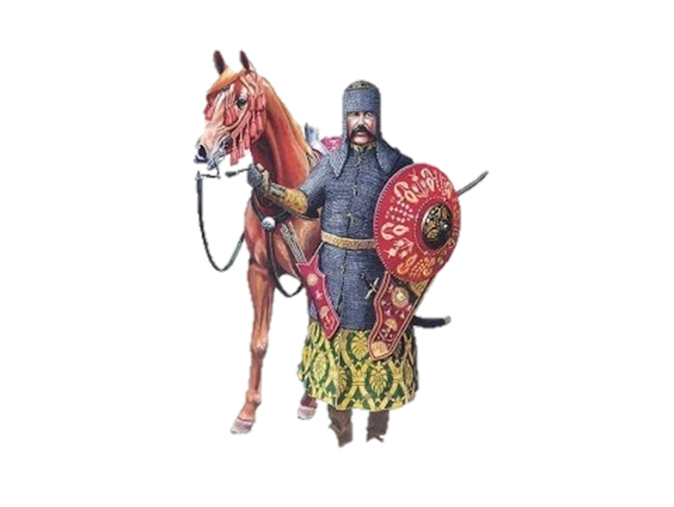
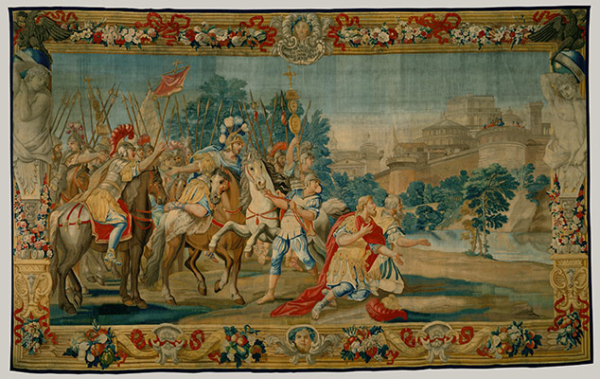

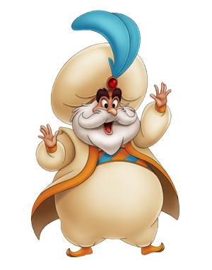
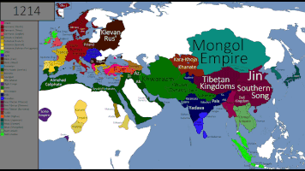
INVASIONS & SHIFTS IN TRADE ROUTES
Before those ruthless Mongols destroyed Baghdad you should know the Abbasid Empire had many invaders…..
Middle
East
Egyptian
Mamluks
sel-jook
North Africa
Crusaders
Seljuk
Turks
Abbasids, being tolerant of religion allowed Christians to travel to and from holy sites in and around Jerusalem.
mam-uh-look
Arabs purchased enslaved people (Mamluks) who were Turks from Central Asia to serve as soldiers and bureaucrats. Mamluks had more opportunities than most slaves.
In Egypt, Mamluks seized the government and established Mamluk Sultanates (1250-1517)
Traded cotton and sugar with Islamic World and Europe.
Declined when Portuguese and other Europeans developed new sea routes for trade.
Coming from Central Asia, the Seljuk Turks were also Muslim. The seljuk leader called himself a Sultan.
Calling himself Sultan reduced the role of the high ranking Abbasid from Caliph to Chief Sunni religious authority.
Empire expanded from areas in the Middle East to Western China.
Established Delhi
Sultanate
(SIDE LESSON)
Seljuk Turks limited this travel thus creating conflict.
To fight this, European Christians organized groups of soldiers called Crusaders to reopen and regain access.
We learn more about this in topic 1.6
Mongols
These were the invaders that ended the Abbasid Caliphate when they conquered Baghdad.
They also ended the Seljuk rule and pushed westward
BUT were stopped in Egypt by the Mamluks!
We learn more about them in topic 2.2

Slide 8

STOP & COMPARE YOUR NOTES WITH YOUR NEIGHBOR
TALK TO THEM ABOUT THE KEY POINTS YOU WROTE DOWN
ASK THEM TO HELP YOU IF THERE WAS SOMETHING YOU MISSED OR DID NOT UNDERSTAND
ADD TO YOUR NOTES ANY DETAILS THEY SHARED THAT YOU MISSED.

Slide 9
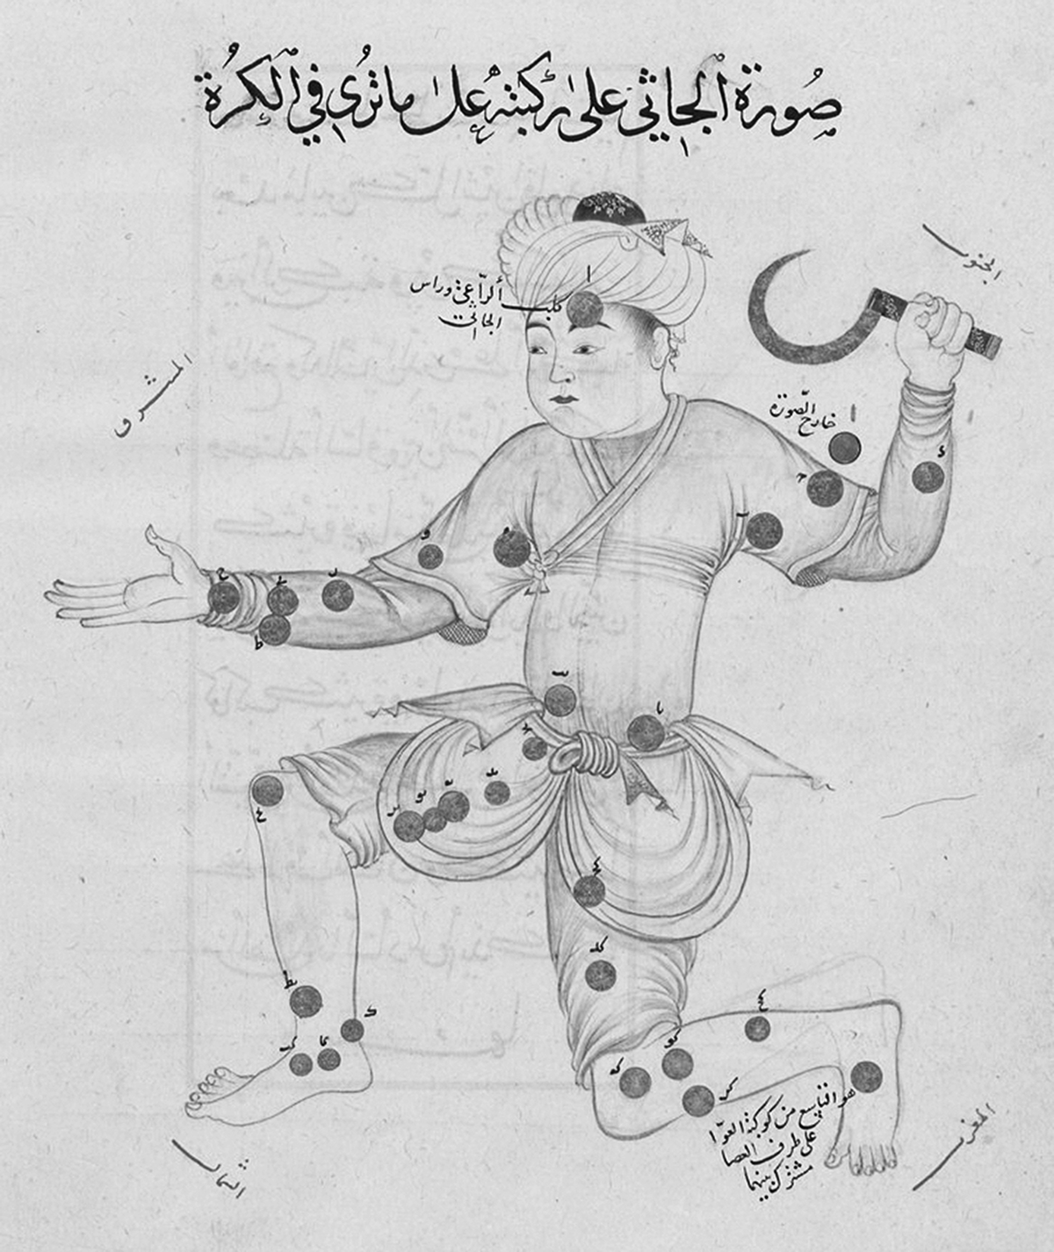
THE CONSTELLATION HERCULES, NAMED AFTER AN ANCIENT GREEK MYTHICAL HERO. PAGE FROM A 1430 COPY OF THE BOOK OF FIXED STARS, AN ASTRONOMY BOOK WRITTEN BY A TENTH-CENTURY MUSLIM SCIENTIST
CHECK IN
This copy of The Book of Fixed Stars was made for the ruler of the Timurid dynasty, a Turkic state that controlled much of Central Asia during the fifteenth century. The dots scattered across the figure indicate individual stars and the symbols next to the dots indicate the stars’ relative brightness, as observed by Muslim astronomers.
1. The sponsoring of scholarship by Turkic dynasties, such as the Timurids, best shows that, in the period circa 1200–1450, scholarly activities in the Muslim world continued despite the
conquest of Baghdad by the European Crusaders
expansion of the Song dynasty into Muslim Central Asia
Byzantine reconquest of Palestine and Lebanon
fragmentation of the Abbasid Caliphate

Slide 10
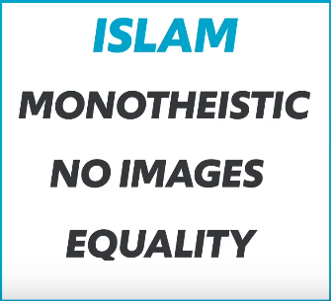
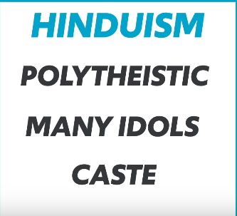
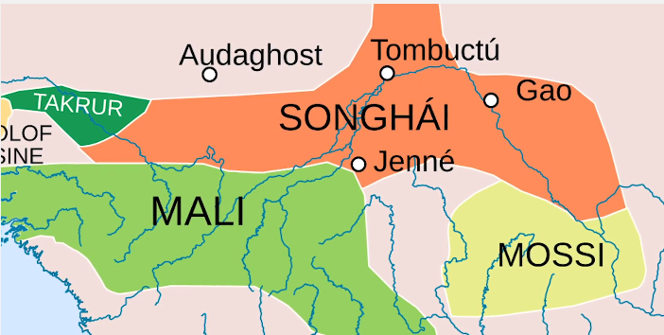
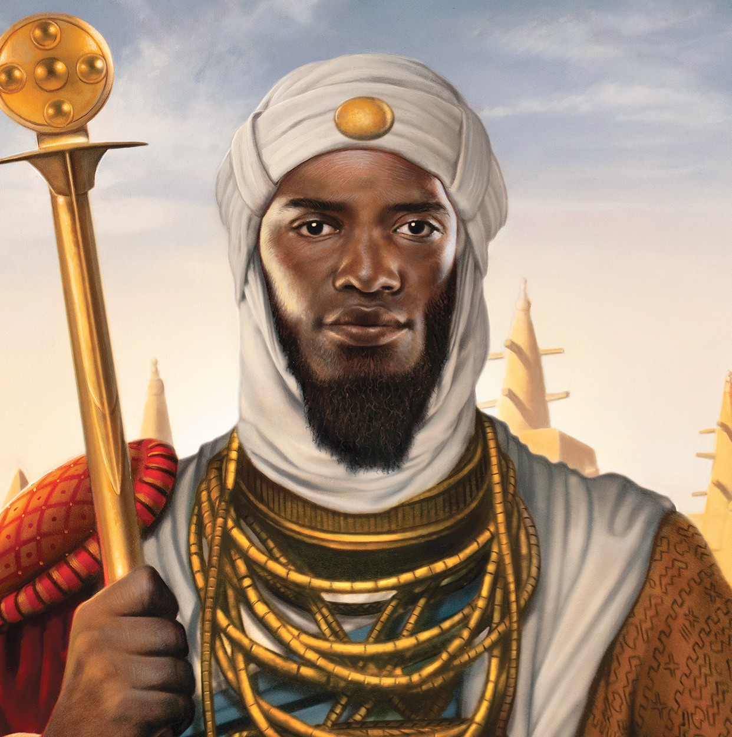
DELHI SULTANATE
South Asia
Located in India, this muslim political state in 1206.
The muslims in power found it very difficult to convert the Indian masses.
Different Responses to Islam
India
West Africa
Sufis - Group of Muslim Missionaries that were willing to accommodate Hindu gods and religious festivals. Lower class hindus were attracted to this since they had an opportunity for a better life. Sufi missionaries played an important role in the spread of Islam since they adapted to local cultures and traditions which won over may converts.
Islam also spread to West Africa, not by military conquest but by my traveling merchants. People converted voluntarily and usually were near urban centers where trade happened.
This region, Islam didn’t just spread to the lowest classes but to the highest levels of government. Ex: Mansa Musa ruler of Mali went on the Hajj (pilgrimage to Mecca)

Slide 11
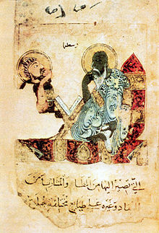
CULTURAL AND SOCIAL LIFE
Even though Islamic states adopted Abbasid practices, they were ethnically distant.
Abbasid Caliphate | Arabs and Persians
Mamluks | North Africa
Seljuks | Middle East
Delhi Sultanate | South Asia
These Islamic states formed a cultural region
Trade spread new goods and new ideas
Common use of Shariah law created similar legal systems
Great Universities created centers for sharing intellectual innovation
“Go in quest of knowledge even unto China.” - Muhammad
CULTURAL CONTINUITIES
Islamic scholars learned from different cultures and carried on the work from earlier thinkers
Translated Greek literary classics into Arabic, saving the works of Aristotle and other Greek thinkers from oblivion
Studied mathematics texts from India and transferred the knowledge to Europeans
Adopted techniques for paper making from China. Through them, Europeans learned to make paper

Slide 12
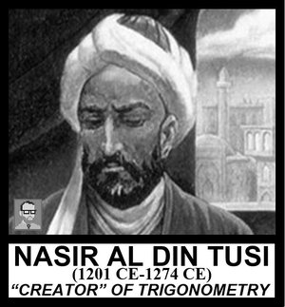
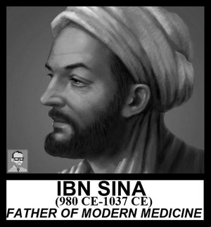
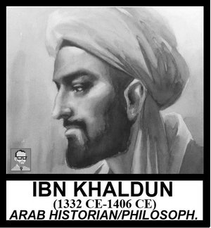
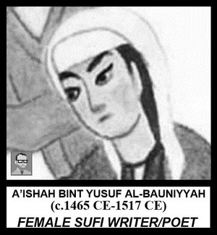
CULTURAL AND SOCIAL LIFE
CULTURAL INNOVATIONS
In addition to building on intellectual achievements of other cultures, scholars in the Golden Age made many of their own achievements
Contributed to astronomy, law, logic, ethics, mathematics, philosophy, and medicine. His observatory was the most advanced in the world and produced the most accurate astronomical charts. He studied the relationship between the lengths of the sides of a triangle and the angles.
Medical advances and hospital care improved. Doctors and pharmacists studied for exams for licenses that would allow them to practice medicine.
Founder of the fields of historiography (the study of the methods of historians) and sociology
Sufi poet, most prolific female muslim writer of her time.
“Clear Inspiration, on Praise of the Trusted One”

Slide 13
STOP & COMPARE YOUR NOTES WITH YOUR NEIGHBOR
TALK TO THEM ABOUT THE KEY POINTS YOU WROTE DOWN
ASK THEM TO HELP YOU IF THERE WAS SOMETHING YOU MISSED OR DID NOT UNDERSTAND
ADD TO YOUR NOTES ANY DETAILS THEY SHARED THAT YOU MISSED.

Slide 14
THE CONSTELLATION HERCULES, NAMED AFTER AN ANCIENT GREEK MYTHICAL HERO. PAGE FROM A 1430 COPY OF THE BOOK OF FIXED STARS, AN ASTRONOMY BOOK WRITTEN BY A TENTH-CENTURY MUSLIM SCIENTIST
CHECK IN
This copy of The Book of Fixed Stars was made for the ruler of the Timurid dynasty, a Turkic state that controlled much of Central Asia during the fifteenth century. The dots scattered across the figure indicate individual stars and the symbols next to the dots indicate the stars’ relative brightness, as observed by Muslim astronomers.
2. Muslim scientists in the period before 1450 c.e. generally participated in intellectual and scholarly exchanges with neighboring cultures by
being the recipients of funding from foreign rulers
serving strictly as copyists of earlier works that otherwise would have been lost
expanding upon the legacy of earlier scientific works by conducting their own research
learning from the superior scientific knowledge of medieval western European scientists

Slide 15
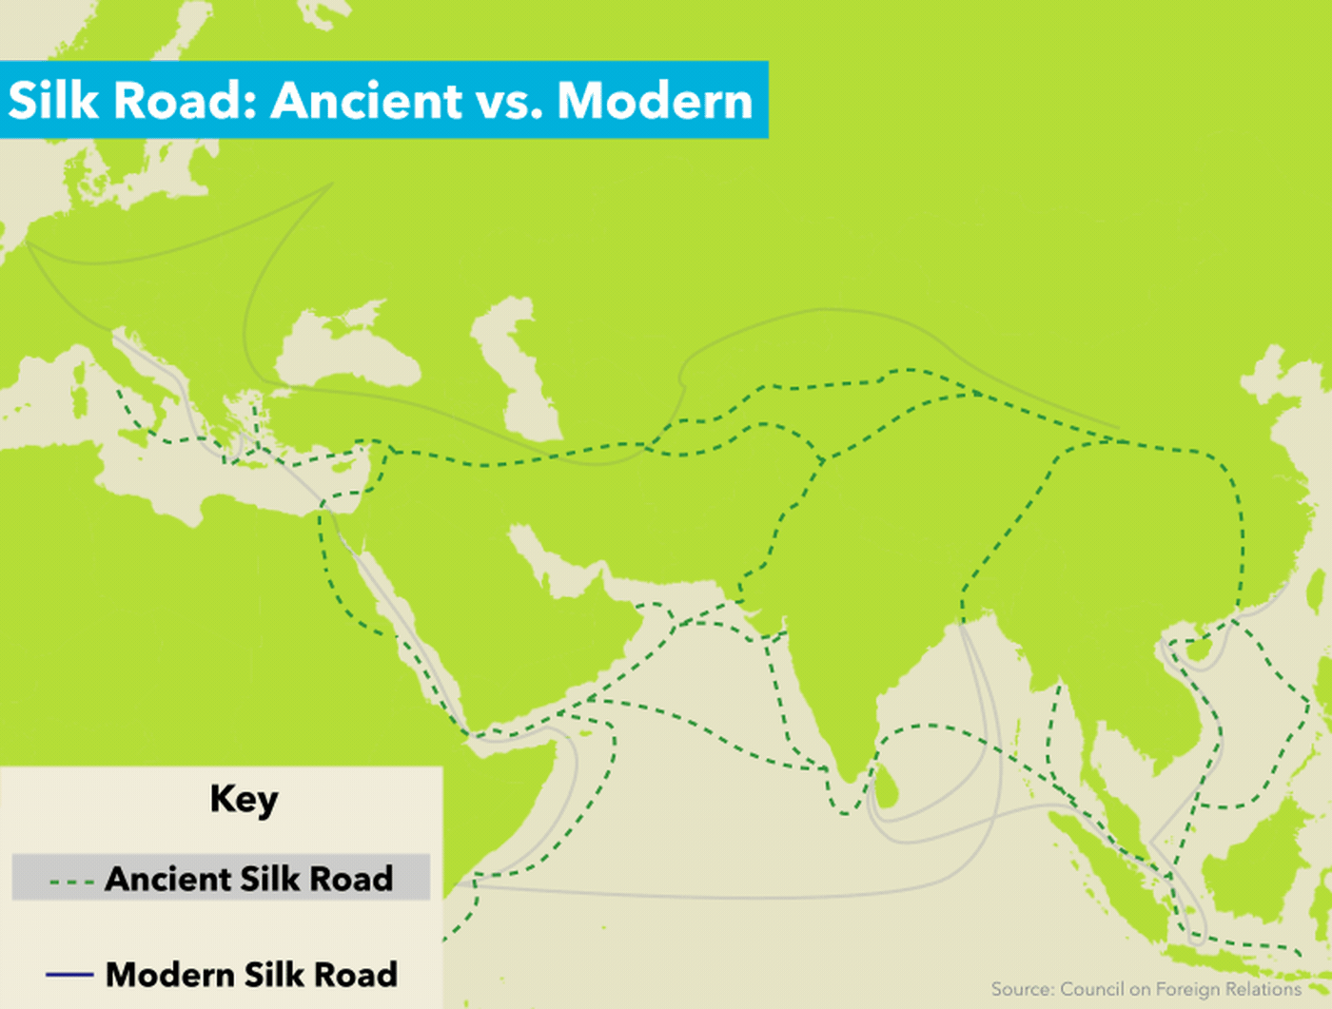
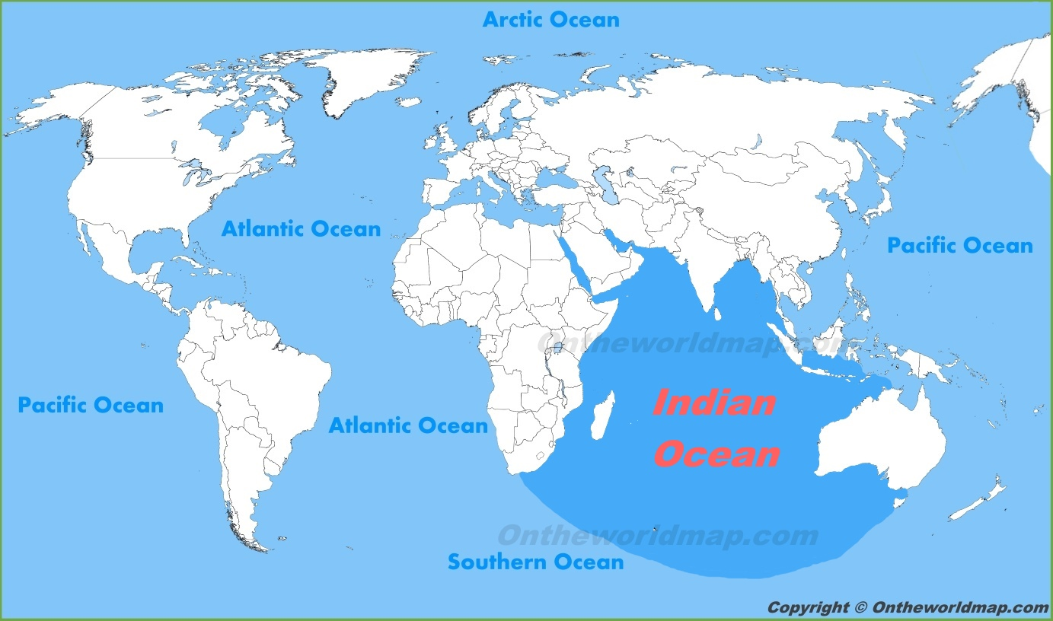
CULTURAL AND SOCIAL LIFE
COMMERCE, CLASS, & DIVERSITY
Islamic society viewed merchants as more prestigious than did other societies in Europe and Asia
Muhammad was a merchant as was his first wife
Arrival of the Silk Roads, merchants grew rich from trading across the Indian Ocean and Central Asia
Some merchants were sent out as missionaries
Central Asia

Slide 16
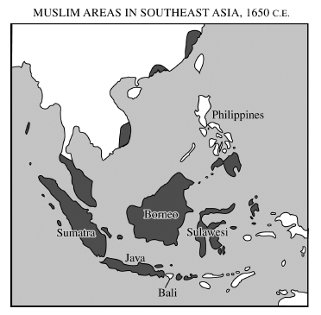
CHECK IN
3. Which of the following factors best explains the distribution of Muslim populations shown on the map above?
Religious pilgrimages
Merchant activity
Imperialism
Forced migration

Slide 17

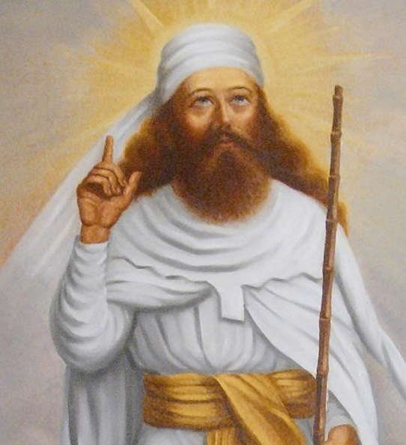

CULTURAL AND SOCIAL LIFE
SLAVERY
Zoroastrians
Although Islam allowed slavery, Muslims could not enslave other Muslims.
Exempt: Jews, Christians, and Zoroastrians
Slaves were imported from Africa, Kievan Rus (present day Russia
and Ukraine, and central Asia
The institution of hereditary slavery did not exist yet
Many slaves chose to convert to Islam, then their owner would free them
Women served as concubines to Islamic men who already had wed their allotment of four wives. This allowed slave women to actually have more independence than the legal wives. Ex: go to markets and run errands
  Slave women were permitted to dance or perform musically which allowed them to earn money and accumulate enough to buy their freedom in some cases
Pre-Islamic Iranian religion and one of the world’s oldest monotheistic religions
Notions of heaven and hell, judgment day, and the final revelation, humans as free moral agents, free choice, and angels and demons all originated in the teachings from Zarathustra, Zoroastrianism’s founder.
“There is an unequal battle between good and evil, light and dark, but eventually the truth will prevail”
Shaped Judaism, Christianity and Islam

Slide 18
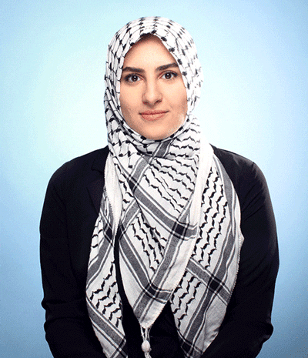
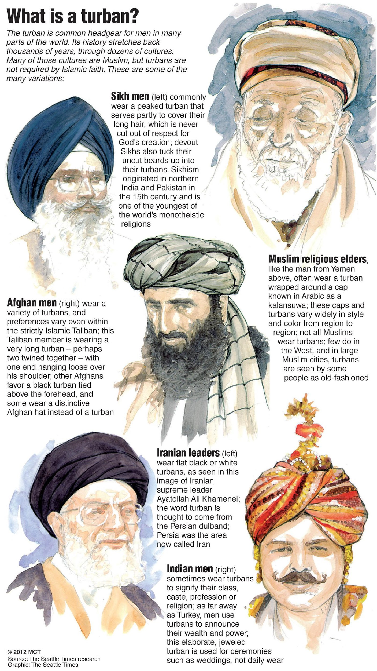
FREE WOMEN IN ISLAM
Men often wore head coverings, from turbans to skull caps.
- Muhammad raised the status of women
- Treated his wives with love, devotion, and respect
- his first wife was educated and owned her own
Business which set pattern for recognition of women
- Insisted that dowries (payments husbands made to secure
brides be paid to the future wide rather than her father
- Forbid female infanticide (killing of newborn girls)
- Status of Women
- Islamic women had higher social status than Christian or Jewish women
- Islamic women were allowed to inherit property and retain ownership after marriage. They could remarry if widowed and could received a cash settlement if divorced.
- Woman could practice birth control
- Rise of towns and cities in Islamic ruled areas resulted in new limitations
-Women could study and read but not around men they were not related to
- Woman who testified in court under shariah were to be protected from retaliation but their testimony was worth half of a man
Women often covered their heads and faces (hijab) a term that refers to either the practice of dressing modestly or to a specific type of covering.

Slide 19
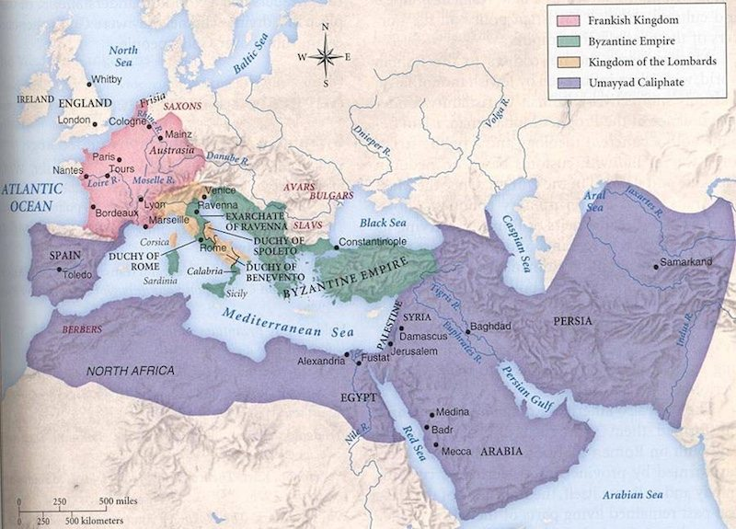
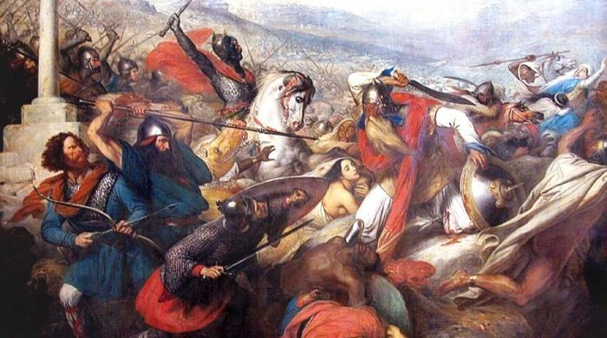
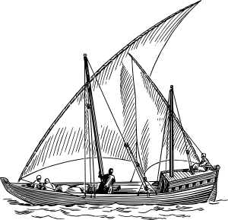
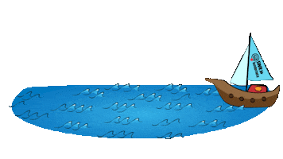
ISLAMIC RULE IN SPAIN
oo-mahy-ad
biz-uh n-teen
Umayyads Caliphate defeated the Byzantine Empire in North Africa and then conquered spain.
BATTLE OF TOURS - 732
A rare defeat for the Islamic military that limited rapid Islamic expansion into Western Europe
PROSPERITY UNDER ISLAM
Similar to the Abbasids in Baghdad, the Umayyad rules in Cordoba, Spain tolerated Christians and Jews, to coexist peacefully.
They also promoted trade and allowed Chinese and Southeast Asian products to enter into Spain to travel through Europe.
Dhows: Trade ships with long thin hulls that were more useful carrying products than conducting warfare.
CULTURAL & SCHOLARLY TRANSFERS
- Cordoba had the largest Library in the world at the time.
- The Muslims, Christians, and Jews living in al-Andalus, the Islamic State in Spain, all tolerated and influence each other. This laid the groundwork for the Renaissance and Scientific Revolution in Europe.
- Ex: PAPER, developed in China and taught to Europeans by Muslims

Slide 20
STOP & COMPARE YOUR NOTES WITH YOUR NEIGHBOR
TALK TO THEM ABOUT THE KEY POINTS YOU WROTE DOWN
ASK THEM TO HELP YOU IF THERE WAS SOMETHING YOU MISSED OR DID NOT UNDERSTAND
ADD TO YOUR NOTES ANY DETAILS THEY SHARED THAT YOU MISSED.

Slide 21
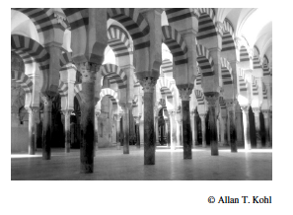
CHECK IN
4. The tenth-century structure in Córdoba, Spain, shown exemplifies the
adoption of gothic engineering techniques
Islamic architectural style
influence of Christian religious painting
influence of Chinese art
incorporation of art and architecture of the Aztecs

Slide 22
“If it were asked, why do we accept the theory of contagion, when already the divine law has refuted the notion of contagion, we will answer: The existence of contagion has been proved by experience, deduction, the senses, observation, and by unanimous reports. And it is not a secret to whoever has looked into this matter or has come to be aware of it that those who come into contact with plague patients mostly die, while those who do not come into contact survive. And amidst the horrible afflictions that the plague has imposed upon the people, God has afflicted the people with some learned religious scholars who issue fatwas* against fleeing the plague, so that the quills with which the scholars wrote these fatwas were like swords upon which the Muslims died. In conclusion, to ignore the proofs of plague contagion is an indecency and an affront to God and holds cheap the lives of Muslims.”
*rulings on Islamic law
Lisan al-Din Ibn al-Khatib, A Very Useful Inquiry into the Horrible Sickness, Granada, Spain, 1349–1352
CHECK IN
5. The passage by al-Khatib best illustrates which of the following?
The literary tradition of long-distance travelers in the Islamic world
The growth of scientific thought and innovation in Muslim Spain
The impact of Christian attempts to reconquer Spain from the Muslims
The efforts of Islamic missionaries to spread their faith along trade routes

Slide 23
“Between the eighth and tenth centuries Arabs brought back from India a variety of crops that they then began cultivating in the Middle East. These included staple crops such as hard wheat, rice, sugarcane, and new varieties of sorghum; fruits such as banana, sour orange, lemon, lime, mango, watermelon, and the coconut palm; vegetables such as spinach, artichoke, and eggplant; and the key industrial crop, cotton. From Iraq, many of these crops then spread westward all the way to Muslim Spain, which was transformed into a veritable garden under Muslim rule. Other crops passed by ship from southern Arabia to East Africa, while still others moved by caravan from northwest Africa across the Sahara to tropical West Africa. This was especially true for cotton, whose diffusion in Africa directly paralleled the spread of Islam itself.”
Richard Eaton, United States historian of South Asia, Islamic History as Global History, 1990.
CHECK IN
Which of the following political contexts most directly led to the developments in Afro-Eurasia described in the passage?
The collapse of the Gupta Empire
The expansion of the Islamic caliphates
The Crusades
The creation of the Mughal Empire

