Slide 1
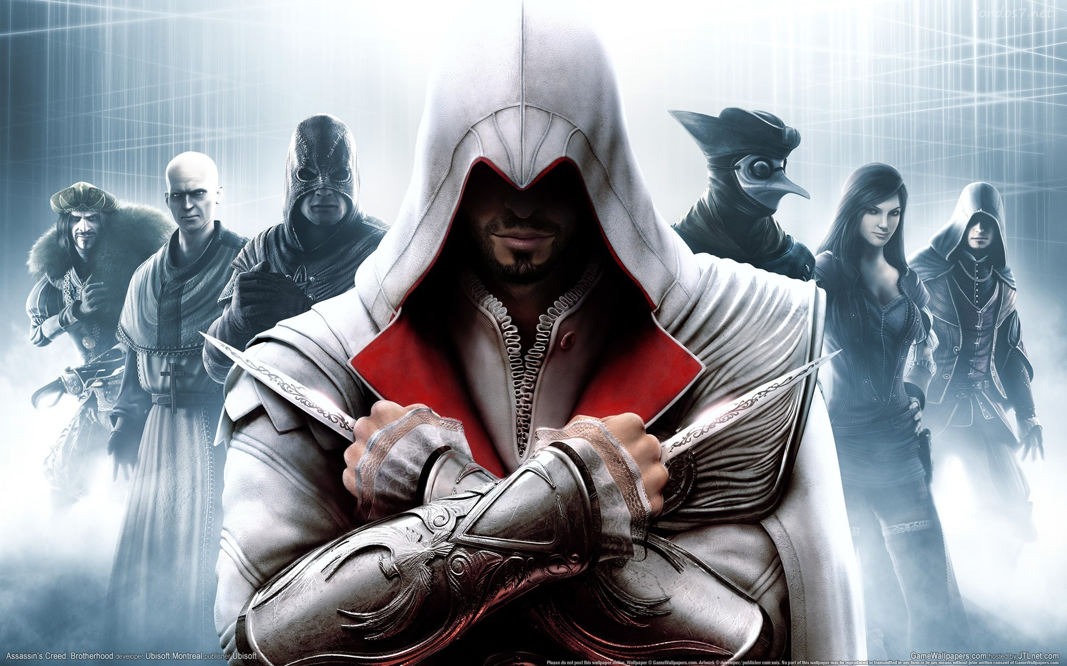

Assassin’s Creed Journey
Made by: Assassins Hayden and Mackenzie

Slide 2
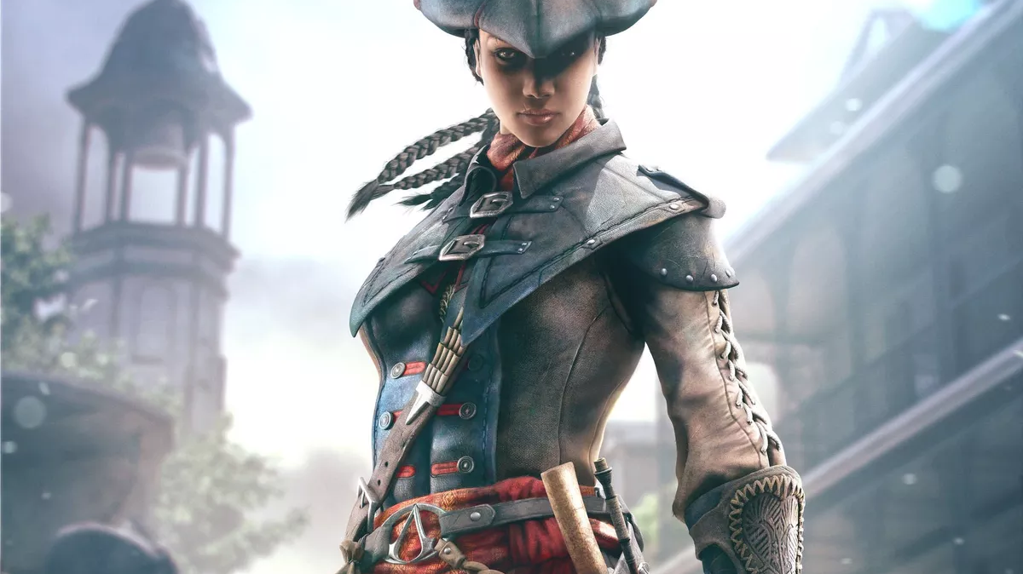
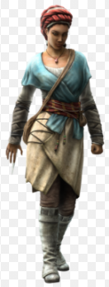
She may come across as your everyday lower-class merchant trading along the Indian Ocean basin, presenting herself in these clothes…
Meet the character
Colleen McCoy
Growing up in Malindi, a city that had gold, ivory and iron. Merchant by day, a mysterious murderer and raider by night. No one ever expected her to come out of the shadows. Her main source of income was trading her cattle, her side hustle was looting ships of their gold, killing the captains and enslaved crewmates.
But if you were to see Captain McCoy as shown on the left, you KNOW stuffs about to go down

Slide 3
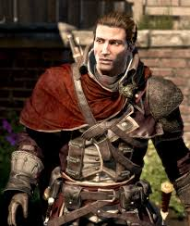

Shane Quincy
Her left-hand man in trading and manipulating. Their relationship kindled on a boat which caught fire due to her nemesis starting it on fire to capture her loot. His jobs pertain of being chief of McCoy’s secret service and planning out her trade deals. Being head of cannon control on the ship, he had to make sure everyone was in line.

Slide 4
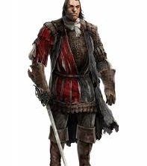
Douglas Waters
A long-time feud has been happening between Waters and McCoy. Constant battles over trade popularity have the two going as far as setting each other's ships on fire. This is a blessing and a curse because he was able to introduce Quincy and McCoy

Slide 5
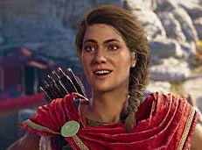
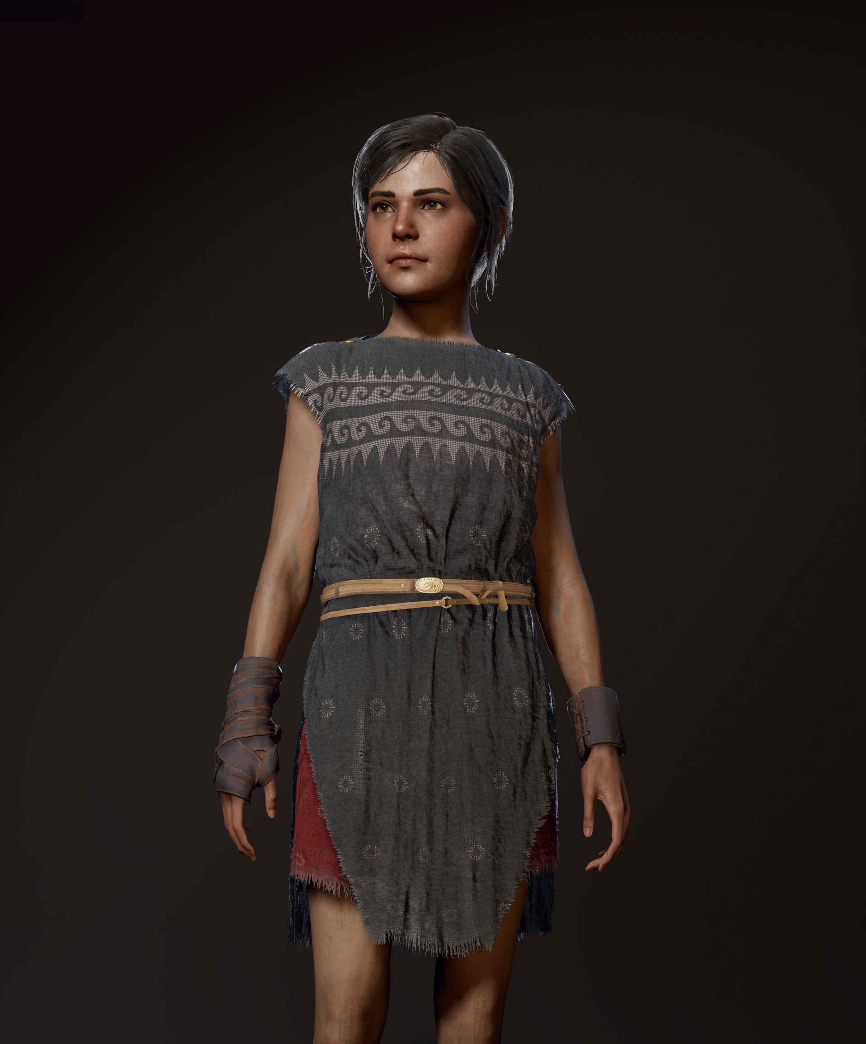
Isabel Quincy
Shane Quincy’s wife is a very vital behind the scenes character for McCoy’s expeditions. She lives in the town and gathers the information needed for McCoy to come out on top. While taking care of her daughter Elizabeth makes this all more of the challenge.

Slide 6
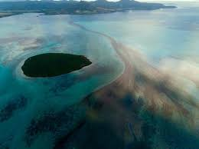
Story Line
One day while McCoy’s out trading a shipment of goods with Quincy at a far away port in Mecca, which takes 2 weeks to reach from Zimbabwe, while she’s away Douglas decides to get back at her for taking most of his clients by taking something that is important to McCoy, Isabel’s daughter. When McCoy comes back from her expedition, she decides to go and take Elizabeth back. Along the way there was many hardships that will affect the history of trade forever. She will look cruelty and death in the eye to recapture Elizabeth.

Slide 7
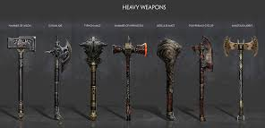
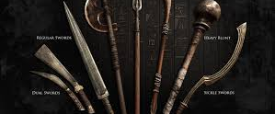
Weapons used
These would be the backups that they have on the ships for heavy duty cases
These were the weapons that would be their go to’s and easily accessible

Slide 8
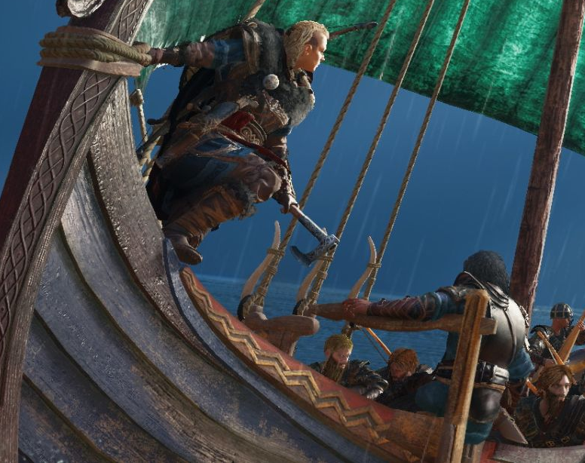
Game information
While traveling through the Indian Ocean, McCoy finds a whole other side of herself that she did not know before. She’s facing life or death situations in order to get Elizabeth back and chooses life by slaughtering dozens. On this trip she realizes her personality is not as it seems and her morals change. McCoy has the loss of her crewmates along the way which will scar her forever.
TO FOLLOW HER ON HER JOURNEY… CONTINUE IF YOU DARE

Slide 9
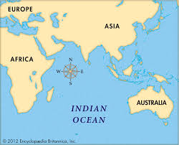
This will be the map that McCoy uses to gain wealth and become an infamous manipulator

Slide 10
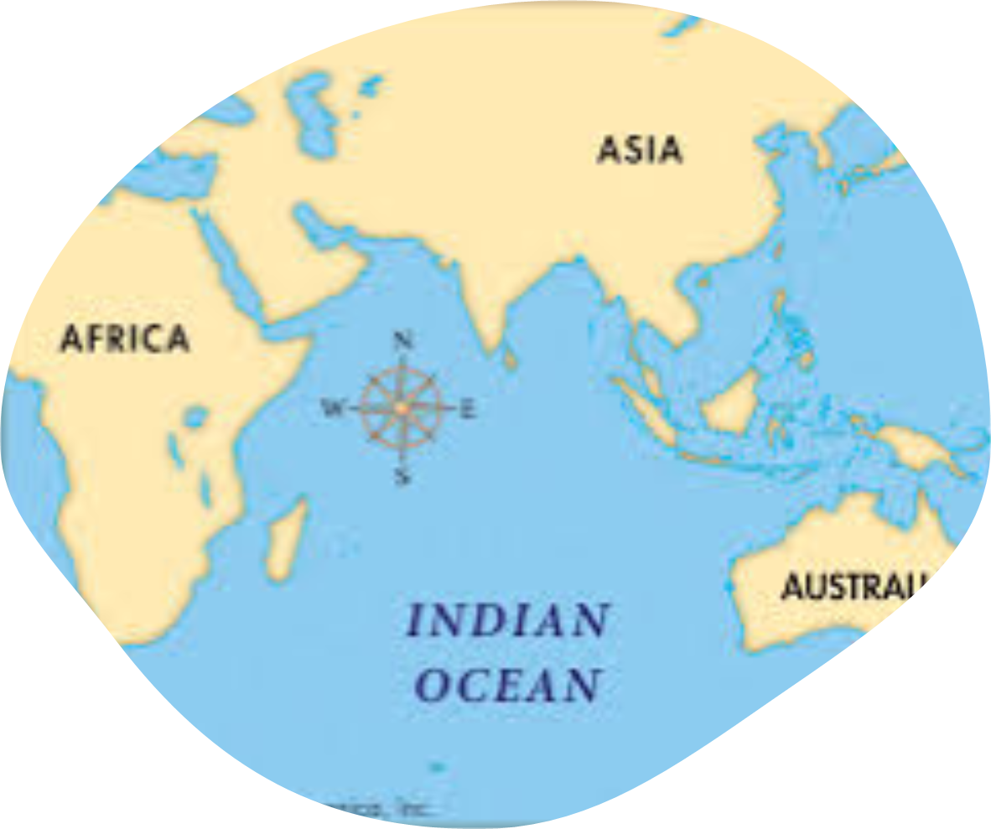
Date: August 5, 1374
When McCoy hears word of Elizabeth’s disappearance, she immediately packs up her ship and gets her crew together. She heads to Surat hoping that she will find Waters with Elizabeth there. When they reach the port, its bustling with activity and trade. While McCoy is hoping to find Elizabeth, she takes her chances of trading in a new city to spread her name and her goods in order to receive payment for her extensive journey.

Slide 11
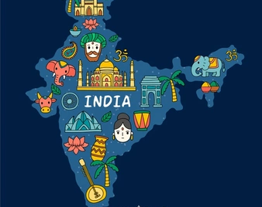
Leaving Surat with no signs of Elizabeth, she continues to head down the West Coast of India and goes to Calicut and then to Quilon, where the Indian culture grew on her. In Calicut, she finds a former customer of Waters and decides to ask this merchant if he has seen him. Giving no direct answers, she threatens to put his life on the line because there isn’t much more time to waste. Quilon wasn’t much better, while walking through the city she approaches Waters crewmate who didn’t recognize her. She follows him to the port to see if she can find any answers. Thinking that he is going to board Waters ship, she sneaks on saying that she is carrying some of their goods for the next stop the ship is going to.

Slide 12
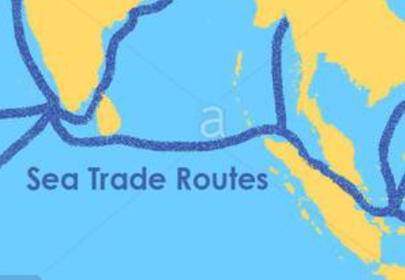
As McCoy is hiding in the storage space, she overhears the crewmates talking about how Waters has taken a separate ship, with Elizabeth onboard, to Palembang and that the ship that she’s on is also going there for trade opportunities. 4 nights later, they arrive in the port. She sneaks off once she hears no more movement on the ship and sets off into town. Luckily, some of her loyal customers are there and informs her on Waters movements around the city with who they figure is Elizabeth. They didn’t know where he was heading to, so McCoy took it into her own hands. By horseback she travels eastward and a day later, she arrives in a small town called Panai. Walking around she sees a suspicious old women trying to sell her glassware, but no signs of Waters. She goes up to the lady and asks her a few questions.

Slide 13
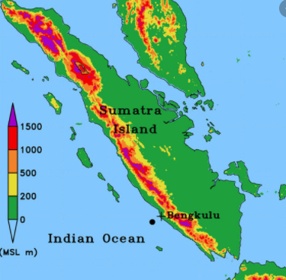
The lady turns her away. She waits until dusk to follow the old woman back to her house on the edge of town. After trying to set up a place to sleep, she feels something poke her in the back. Hidden under the straw she finds a latch. Pulling up, a door opens, and she finds herself looking into a tunnel. After deciding to step through it and walk for a few minutes in pitch black, she finds a room. Having a hunch that the room isn’t unoccupied, she calls out, “Is anyone in here?”, and her voice echoes. She hears a prominent scraping noise against the cement's walls and chains clatter. She jumps back from the noise and screams. Figuring it won’t be anything harmful, she approaches the figure on the ground. She hears a groan and reaching down to touch it, she feels long tangly hair. Running her hand over the object, she feels it breathing so it must be alive. Slowly spitting out the word, “H-Hello,” she recognizes the grasp of the soft, warm hand and inhales so fast it almost knocks her out. After searching and searching, she finally finds her. Having to slam the chains against the walls to break them off of her wrist and legs, Elizabeth was finally free.

Slide 14
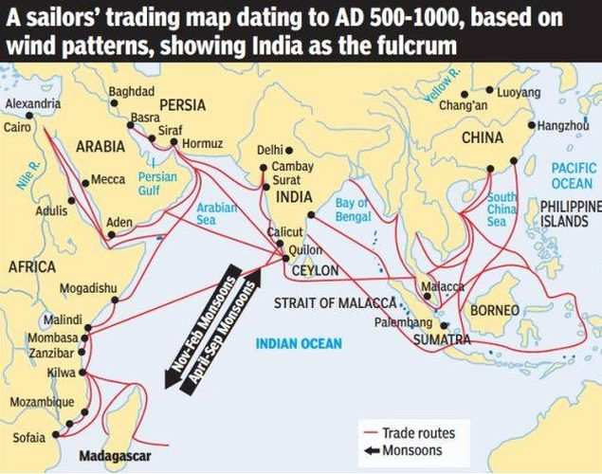
Taking Elizabeth by the hand, they escape from the barn and ride back to Palembang. With no food or water in their systems, when they arrive, they are completely weak. Staying undercover all night, they get their strength back and set out the next day. One of her close merchant friends hear she’s in desperate need of a ride back to India, and he helps her out. Another 4 days later, they arrive in Quilon with almost no complications. Getting her ship back and loading it with the materials needed, her crewmates rejoice that Elizabeth is safe. They are determined to not get caught by any of Water’s allies and speed off. Despite being monsoon season, they needed to get back to Africa. Going straight through the Indian Ocean, they face strong winds and heavy rain that takes 2 of their men overboard.

Slide 15
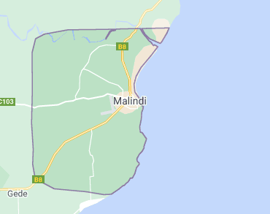
Once free of the monsoons, it was a straight shot back to Malindi. About an hour away from port, they see a unique ship approaching. The sails were all black and that’s how she knew that Waters had found her. Full of anger and rage, she holds her ground in hopes the Waters will approach her first. As the ship gets closer, she sees that she’s outnumbered, and he has come prepared. She orders her men to set up the cannons, showing Waters that she’s up for a duel. Cannons blowing from each side, there is yelling and blood coming out from everywhere. All of a sudden more ships approach the two. Once Water’s sees that these ships are obviously on McCoy’s side, he start to retreat. McCoy realizes that these ships are pirate ships and that she is in a danger zone. Hearing the piercing sound of the stern rudder move rapidly, the pirates are taken aback. McCoy’s men let the sails down and they ZOOM out of there. The pirates didn’t have the technology of the astrolabe or the newly incorporated stern rudder, so they were left in the dust. Back to the port they go, and once home the town rejoices that Elizabeth is safe and Quincy and his wife thank McCoy by bringing her into the family so that she no longer has to be alone on her ship.

Slide 16
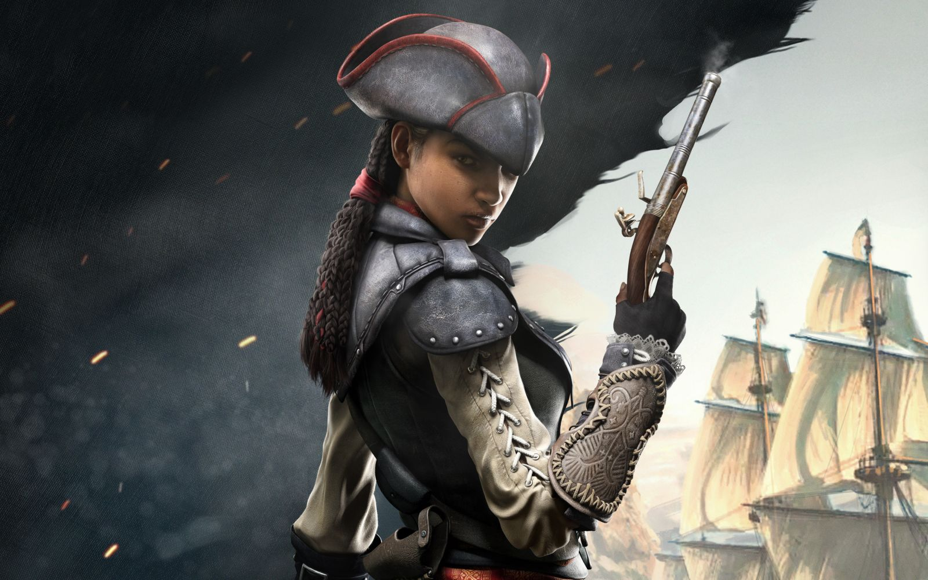
In the end, McCoy gained new knowledge from her adventures.
She realized she never had to be a lone wolf because there's people that cared about her. At the end of this she gained a new life and a new perspective. She spends time with Isabel, Quincy, and Elizabeth daily while keeping up with her trade and side hustles. Her and Waters continually battle and have their problems but neither of them do anything as extreme as kidnap. She faced many hardships along the way but in the end, it was all worth it to learn this new side of herself.

Slide 17
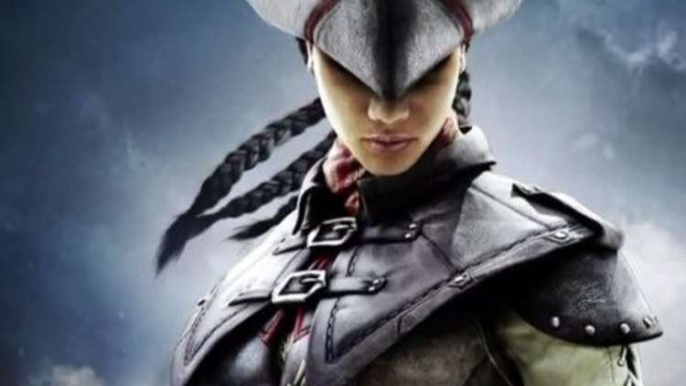
A look into the characters life many years later.....
3 years later, in 1330 McCoy meets a young man who is taken aback by her assertiveness and bravery. He instantly falls for her. This man was world renowned traveler Ibn Battuta. They spend many months together as he travels around East Africa and she shows him many parts of South Asia by taking him there on her boat. Soon enough she discovers Ibn Battuta had many loves of his life from various places he traveled. This angered her and he ended up leaving her to continue his travels. After many months McCoy has a child of her own...a child made from her and Ibn. Fast forward centuries later....As Colleen McCoy (AP world teacher to two very amazing students Kenzie Kelly and Hayden Herbold) gets a paper of her genetic ancestry test she feels nervous to read it. As she's skimming the pages she notices she has the same name as one of her great, great, great, great, great grandparents. She wonder to herself "huh interesting, I wonder if she has a good story of her own."

Slide 18


Slide 19


THE END

