Slide 1
Muscled Milton: the game
Connor Thompson and Max Miranda
Start the Game

Slide 2
Rules
Press the link to choose an option
Don’t cheat
Have fun
Read everything on the slides to get the full story
Next

Slide 3
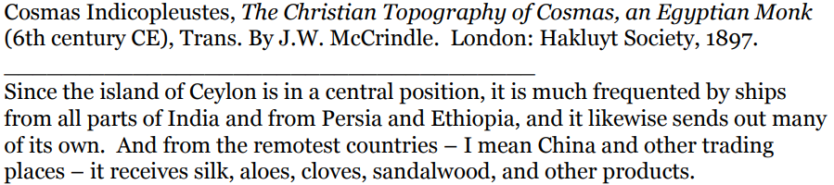
Source and HIPP
H: Created by an Egyptian Monk in the sixth century. This was the time that the Indian Ocean Trade first started to be used, and supplies were being transported everywhere.
I: This source was not specifically created for one singular person, it was made for anyone that wanted to learn about the Indian Ocean Trade.
P: This source was created to inform us about the Indian Ocean Trade, and how supplies were getting to places that they never had before.
P.O.V: This author did not seem to have any specific bias towards any one side or another for this subject.
Next

Slide 4
Setting
The game takes place in 1285. It takes place in cities all across the Indian Ocean Trade route such as Hangzhou, Malacca, Calicut, Gujarat, Baghdad, and also Constantinople.
Next

Slide 5
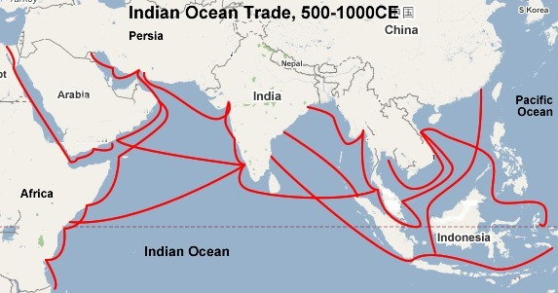
Map of the route
Next

Slide 6
Other Information
Items of Trade: Silk and porcelain.
Danger Zones: Between Calicut and Gujarat (bandits). Between Baghdad and Constantinople (Mongols).
Modes of Transportation: Boat and horse.
The hero will gain a new life by gaining 100 of the currency that is in the game, which can be obtained in various places.
The hero will face struggles such as the weather while traveling, and people such as bandits while on land.
The hero will use a sword.
Next

Slide 7
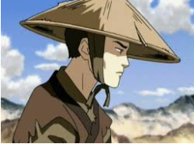
Muscled Milton Character Setup
Muscled Milton was a 5-year-old boy travelling on the silk when him and his parents were attacked by bandits. He was knocked out leaving a large scar on his face and when he woke up, he was in china.
Picture of Muscled Milton at the age of 20
Next

Slide 8
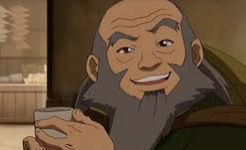
Goodwin Character Setup
Goodwin was a shopkeeper who found a young Muscled Milton. He sells silks and other textiles at his shop. He was Muscled Milton’s mentor in work, life and was a father figure to him.
Goodwin before sending Milton on his journey
Next

Slide 9
Game setup
15 years have passed since the tragic Bandit raid that killed Milton’s parents. He could still remember the face of the man that killed both of his parents. Muscled Milton is now 20. Goodwin realizes that Milton longs to return home and decides to send him on a quest back to Constantinople where he spent the first 5 years of his life. He gives Milton supplies and money so that he could start another life when he gets there. He gives him a boat to travel, and a magnetic compass to help navigate through the seas.
Next

Slide 10
Begin Story
The game starts in Hangzhou. At the beginning, Goodwin sends Muscled Milton on a journey to trade silk and go back to his home in Constantinople. Goodwin tasks Milton to get through to Constantinople by going through the Indian Ocean for most of the journey and going from Baghdad to Constantinople on a horse. He gives Milton a boat, and money to buy supplies for his journey. Then you set sail for Malacca.
Next

Slide 11
In Malacca
You get to Malacca quite smoothly, as there aren’t many weather disturbances on the way there. While you’re there, you decide it would be best to restock your supplies, as the journey from Malacca to Calicut is quite long. When buying supplies, a group of criminals comes by and attempts to rob a store. You decide to take care of them. The owner of the shop is so grateful that he gives you food as thanks. With everything cleared up, you set sail once again and head to Calicut.
Next

Slide 12
In Calicut
As you head to Calicut, the weather slowly gets worse along the journey, but you eventually make it in one piece. There isn’t as much action in Calicut as there is in Malacca, however you do hear in a local shop that a large band of bandits in Baghdad that will be making their way to Gujarat, and eventually, Calicut soon. You ponder whether it could be the ones that killed your parents. You decide it couldn’t hurt to check it out, but decide that it’s time to set sail for Gujarat.
Next

Slide 13
Setting sail for Gujarat
You set sail for Gujarat, and within a few hours you immediately realize that you made a mistake. The weather had been getting worse and worse for a while, and now is when it decided to become more devastating than ever. You attempt to turn back but the wind is far too strong, and you cannot control the boat. You then hold on for dear life, and will let the sea decide your fate.
Next

Slide 14
Shipwrecked
You wake up in a daze, it’s about midday as the sun is almost directly overhead. You see the remains of your boat crashed fairly close to you. You decide that you need to find out where it is that you shipwrecked. You see a large city in the distance. All that you can do is hope that it’s Gujarat, but for now, you salvage all that you can from the ship, and head to the city.
Next

Slide 15
Gujarat
You find that the city is indeed Gujarat. You gather up what little money that you still have left and buy food, water, and a horse to travel, as a boat would be far too expensive. You hear once again about how the bandits are traveling this way. You decide that it wouldn’t be a bad idea to pay them a visit.
Next

Slide 16
Bandits
You find the bandits on the way to Baghdad and decide to pay them a visit. You infiltrate the camp that they’ve set up for the night very sneakily and quietly. You find their leader and realize that he is the man who took away your parents fifteen years ago, and he is being guarded. You knockout the guards and think about what to do next. You finally decide that you will take revenge for what happened fifteen years ago.
Next

Slide 17
Baghdad
Just before arriving in Baghdad, which was conquered by the Mongols at the time, there is a checkpoint run by the Mongols that you must go through.
Assassinate the guards
Sneak Past Guards

Slide 18
Sneak past guards
You snuck past the guards. Narrowly making it by without getting seen. You continue your journey and make it to the city of Baghdad. You buy supplies with the rest of your money. You then continue and head to Constantinople.
Next

Slide 19
Assassinate the Guards
You, somehow, get through all of the guards standing at the checkpoint. It’s far enough away from the city that nobody there sees what happened, and you did it fast enough so that they couldn’t send word for help. You continue into Baghdad to buy supplies, and then head to Constantinople.
Next

Slide 20
Constantinople
You finally make your way into Constantinople. It’s been 15 long years since the last time that you were here. It looks very different, yet somewhat similar. Even throughout the past 15 years, you can still spot some places that you used to see as a child, and some of the buildings that were still the same. You now realize that your journey is over, and sit for the entire rest of the day, watching the sunset fall over the horizon.
Finish

Slide 21

Replay Game

