Slide 1


Slide 2
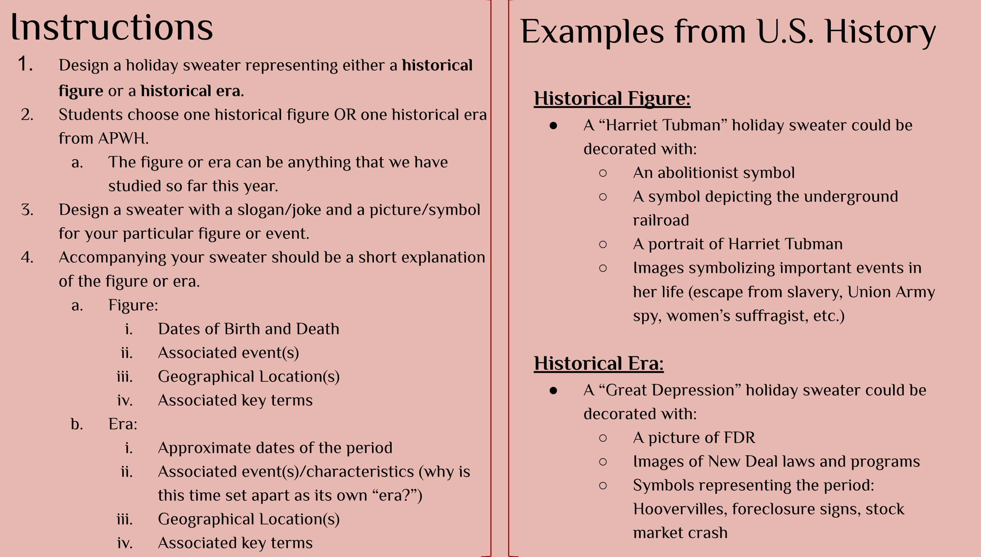

Slide 3
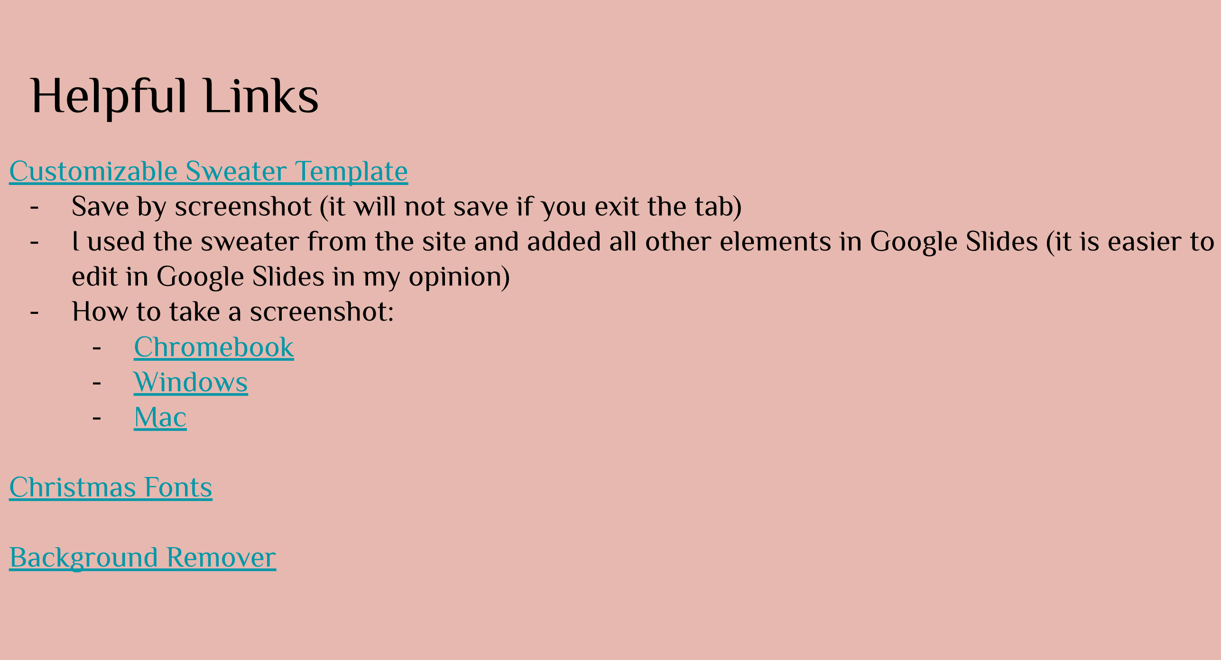
https://create.uglychristmassweater.com/custom-sublimated-sweater/
https://fontmeme.com/fonts/christmas-fonts-collection/
https://www.remove.bg/

Slide 4
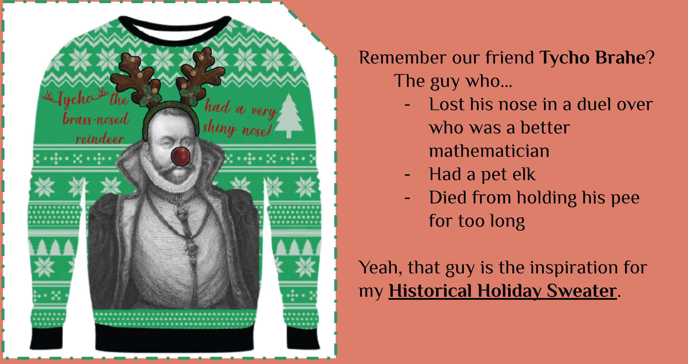

Slide 5
