Slide 1
Evolution

Slide 2
Theory of Evolution
https://www.youtube.com/watch?v=hqepQGOYKZ0

Slide 3
Fossils
C, D (4)
C (3)
A, B, C (2)
A (1)
Oldest Layer: 1
Newest Layer: 4
Ancestry: Species History

Slide 4
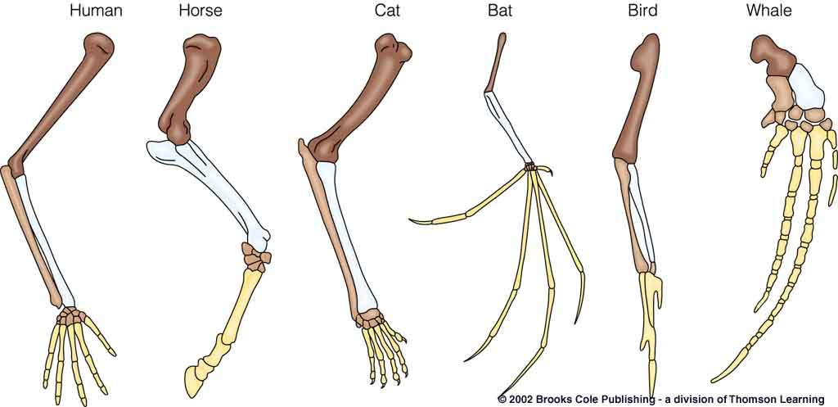
HOMOLOGOUS STRUCTURES
Similar Structure, Different Function
Example:
  Alligator Leg / Bird Wing/ Whale Flipper

Slide 5
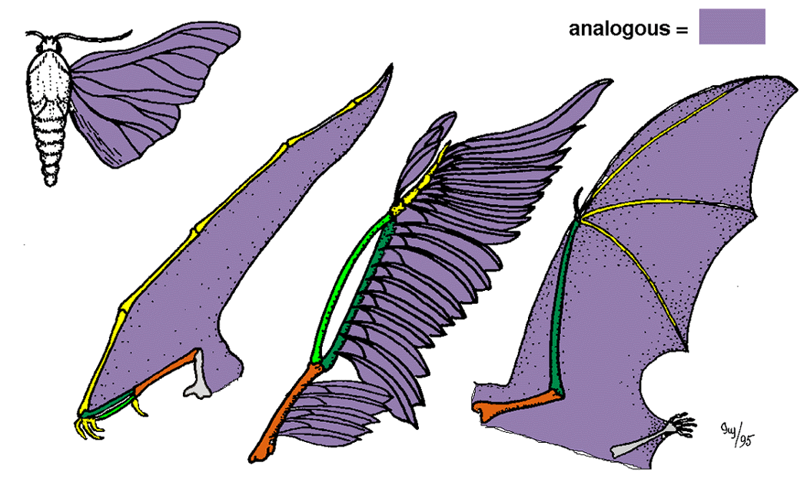
ANALOGOUS STRUCTURE
Similar Function / Different Structure
Example:
  Butterfly Wing / Hawk / Bat

Slide 6
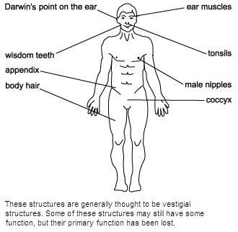
VESTIGIAL STRUCTURE
Structure with no function
Example:
  Tailbone, Wisdom Teeth, Appendix

Slide 7
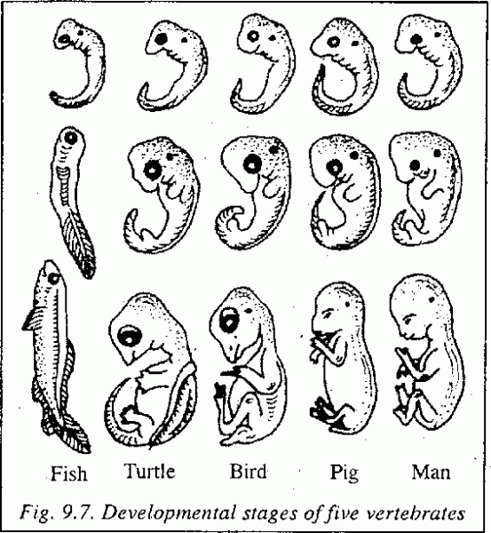
EMBYOLOGICAL SIMILARITIES
Early Development

Slide 8
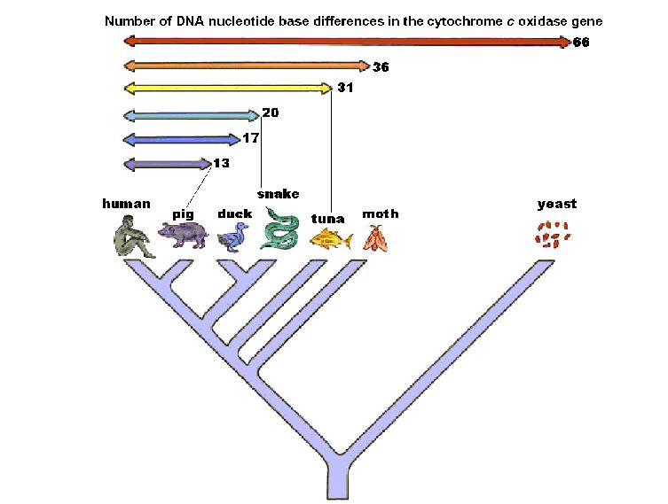
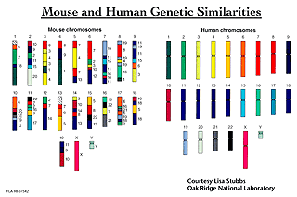
BIOCHEMICAL SIMILARITIES
Blood / Proteins / DNA / Insulin

Slide 9
Evidence of Evolution
https://www.youtube.com/watch?v=lIEoO5KdPvg

Slide 10
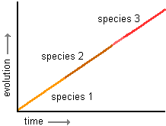
EVOLUTIONARY CHANGE
Gradualism
  Slow and steady change over a long period of time

Slide 11
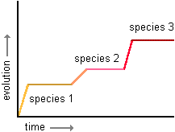
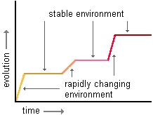
EVOLUTIONARY CHANGE
Punctuated Equalibrium
  No change and then sudden, extreme change

Slide 12
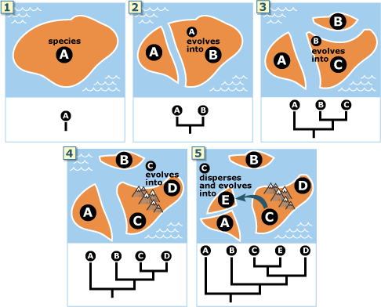
ISOLATIONISM
Little change, no variation

Slide 13
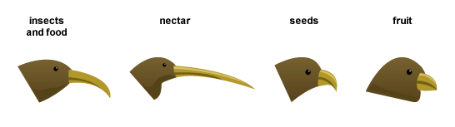
SPECIATION
Changes leading to a new species
The islands of Hawaii were colonized by a single species of finch-like birds. Eventually populations were isolated from each other on separate islands. The diagram shows how they evolved into the modern honeycreeper species with beak shapes, which adapt them for different feeding methods.

Slide 14
HETEROTROPH HYPOTHESIS
Anaerobic Heterotroph
Anaerobic Autotroph
Photosynthesis
Aerobic Autotroph / Heterotroph
https://vimeo.com/11188228

Slide 15
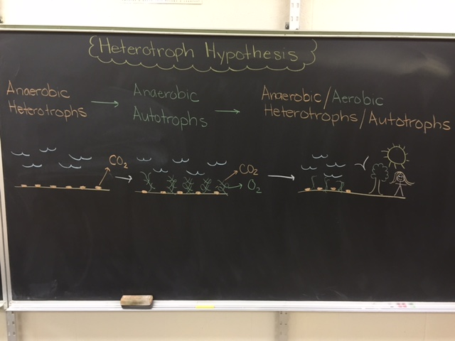

Slide 16
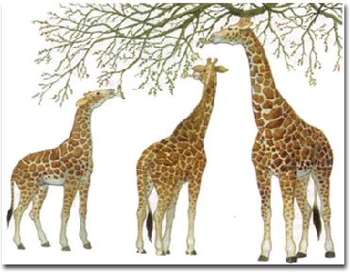
LAMARK
Use and Disuse
  If we use it we will keep it, if we don’t use it, we will lose it.

Slide 17
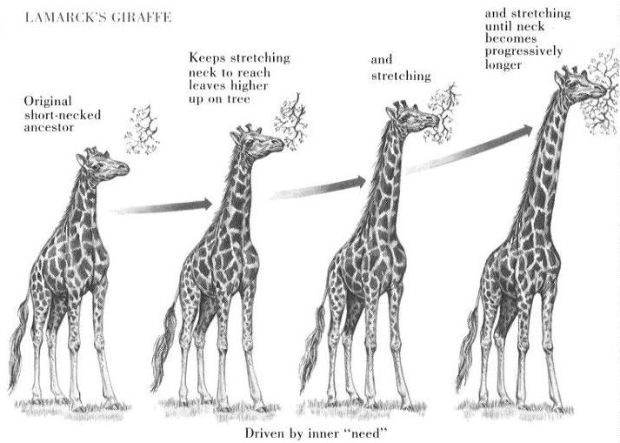
LAMARK
Acquired Characteristics
  Anything you acquire or obtain during your life will be passed on to your offspring. (FALSE)

Slide 18
Lamarck
https://www.youtube.com/watch?v=4HBdxDBqfHc

Slide 19
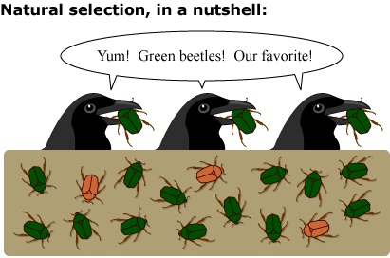
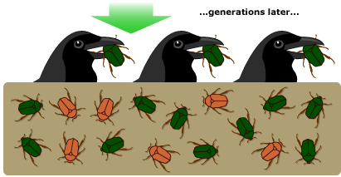
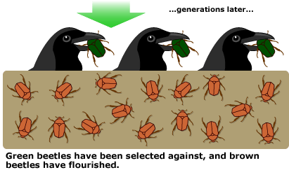
DARWIN
Natural Selection – Those animals best adapted survive.
“Best Adapted Survive”
“Survival of the Fittest”

Slide 20
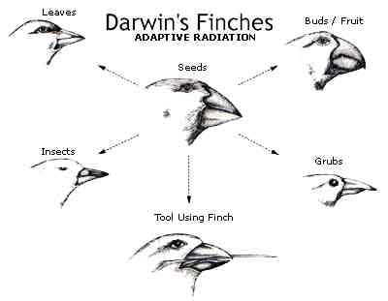
DARWIN
Does not explain VARIATION: Science was not advanced and DNA was not discovered.
Environment determines survival.

Slide 21
Natural Selection
https://www.youtube.com/watch?v=0SCjhI86grU

Slide 22
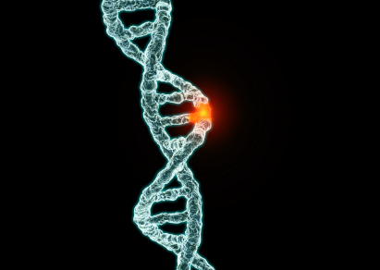
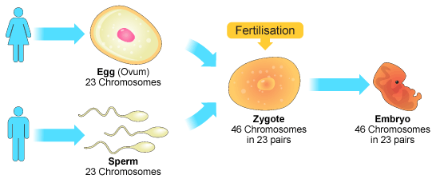
Variation
Causes: Mutations, Sexual Reproduction

Slide 23
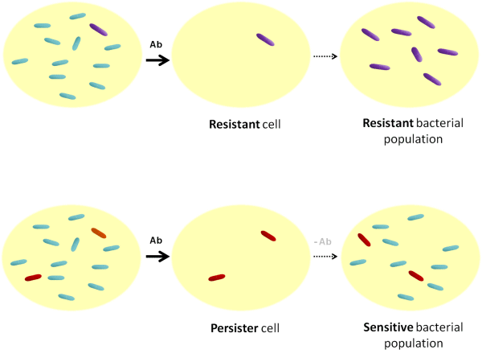
Resistance
Insecticide: Those not immune will die, those that are immune will survive and reproduce
Variations are responsible for immunity.

