Slide 1
Modern Genetics

Slide 2
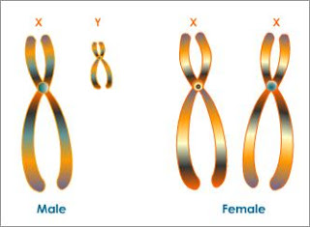
Sex Determination
Sex Chromosomes: Determine male or female
Male: XY
Female: XX
https://www.youtube.com/watch?v=YQyOgcGxn70

Slide 3
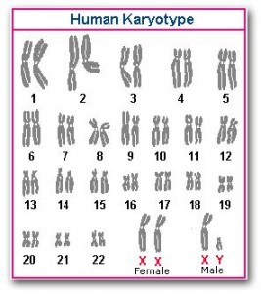
CHromosomes
Autosomes: Chromosomes that don’t determine sex.
(hair, eyes, etc.)
https://www.youtube.com/watch?v=-jz5znsygn0

Slide 4
Sex Chromosomes
Human Sex Chromosomes: 23rd pair of chromosomes (XX – Female, XY- Male)
https://www.youtube.com/watch?v=kMWxuF9YW38

Slide 5
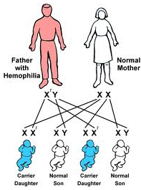
Sex Linked Traits
(Color Blindness)
Definition: trait carried on the sex chromosomes (x chromosome)

Slide 6
Sex linked traits
Expression: (Color blindness)
  XX: Female (not afflicted) (normal)
  X-Y: Male (afflicted)
  X-X: Female (not afflicted) (carrier)
  XY: Male (not afflicted) (normal)
  X-X-: female (afflicted)
https://www.youtube.com/watch?v=FKSOe5NK_qQ

Slide 7
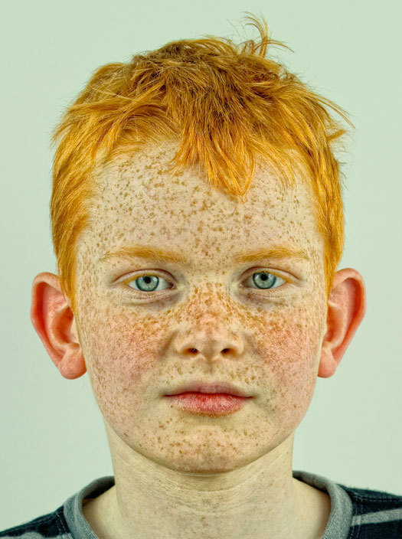
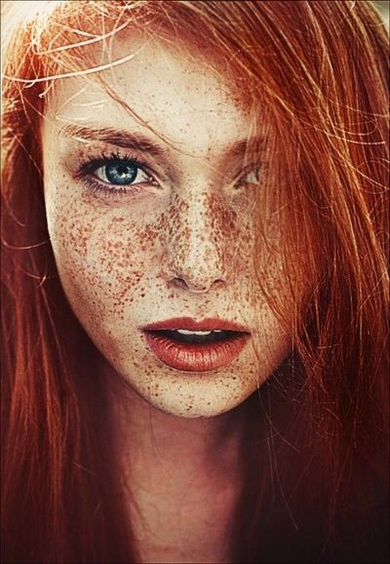
Gene linkage
2 traits / Same chromosome
Example: Red hair / Freckles

Slide 8
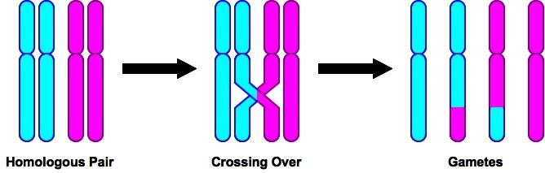
Crossing over
Combination and Variation

Slide 9
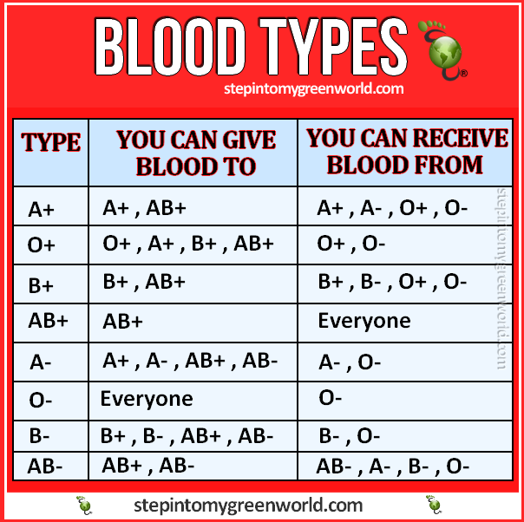
Multiple Alleles (Blood type)
A | B | AB | O
IAIA | IBIB | IAIB | ii
IAi | IBi
https://www.youtube.com/watch?v=ttjn1jVACk8

