Slide 1
Chemistry of Genes

Slide 2
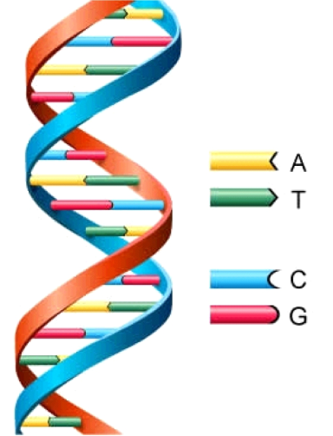
DNA
D: Deoxyribose (Sugar)
N: Nucleic (Base)
A: Acid (Phosphate Group)
Base Pairing:
  G-C
  A-T
https://www.youtube.com/watch?v=OiiFVSvLfGE

Slide 3
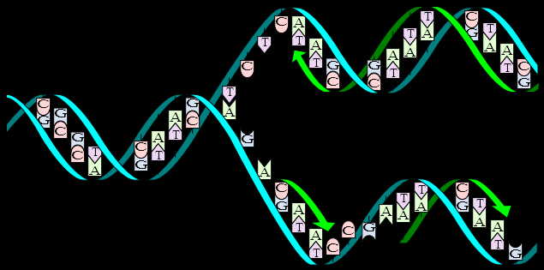
Protein Synthesis
DNA Replication - RNA
https://www.youtube.com/watch?v=5qSrmeiWsuc

Slide 4
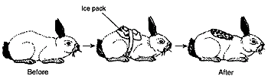
Gene Expression vs. Environment
Environment can switch genes “on” or “off”.
  Examples: Rabbit, Child

Slide 5
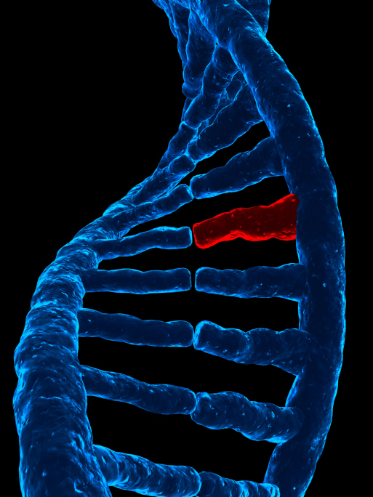
Mutations
Source of VARIATION (difference, change in DNA)

Slide 6
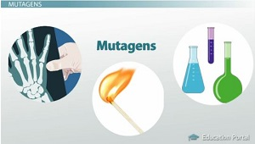
Mutations
Causes:
  Mutagens
    Radiation: X-rays, UV Rays
    Chemicals: Asbestos, Formaldehyde

Slide 7
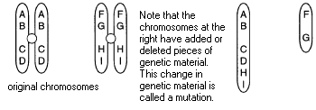
Mutations
Types
  Duplication: DNA segment REPEATED
  Deletion: DNA segment lost
  Inversion: DNA order reversed

Slide 8
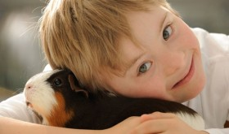
Mutations
Disorders
  Down Syndrome: Trisomy 21.
    Characteristics: short height, round face, enlarged or creased tongue.
https://www.youtube.com/watch?v=GieZ3pk9YVo

Slide 9
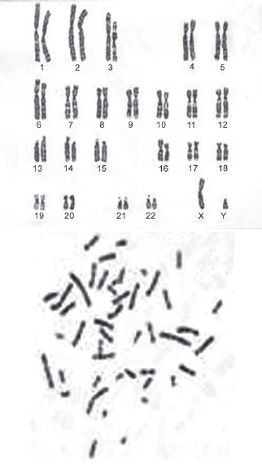
Karyotyping
Chromosome Arrangement
“Photo” of chromosomes

Slide 10
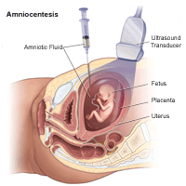
Amniocentisis
Removal of amniotic fluid to see the karyotype of the fetus.
https://www.youtube.com/watch?v=aAXABDawDiw

Slide 11
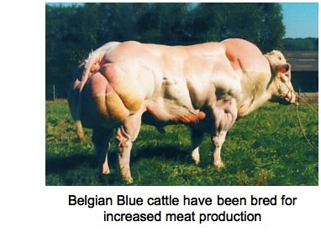
Selective Breeding
Crossing of animals or plants to achieve desired effects.
https://www.youtube.com/watch?v=rW54_vM9SF0

Slide 12
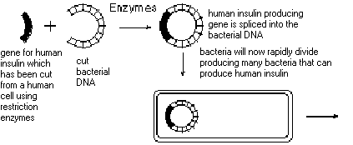
Gene Slicing
Produces recombinant DNA
  (desired outcome / characteristics)
https://www.youtube.com/watch?v=dKBfxoPnT7g

Slide 13
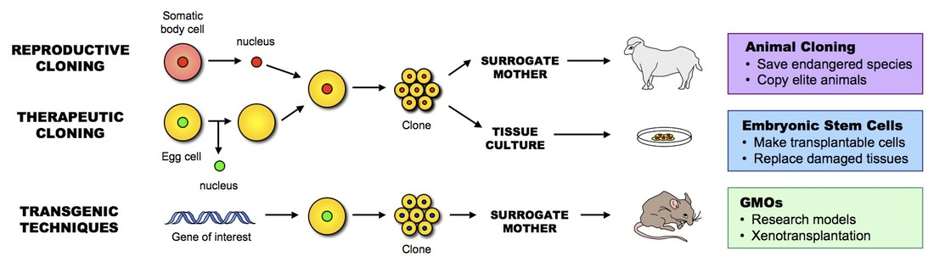
Clone
Genetic copy
https://www.youtube.com/watch?v=tELZEPcgKkE

