Slide 1
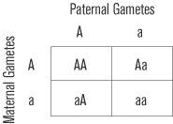


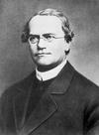
Genetics

Slide 2
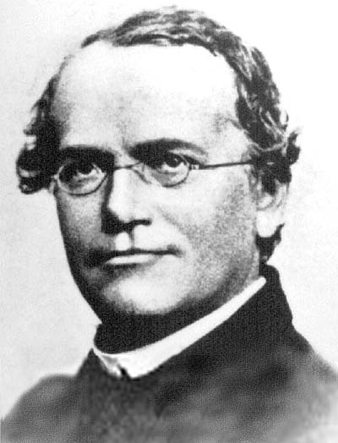
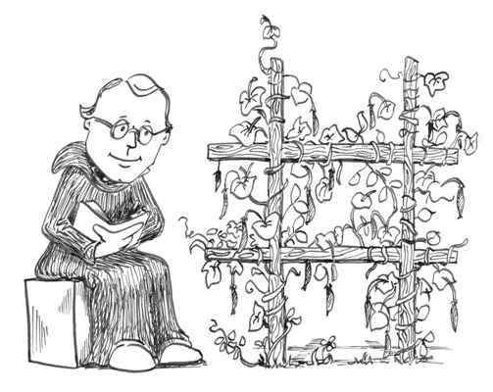
Genetics
Mendel
  Studied pea plants.
  Traits: something passed from parent to child

Slide 3
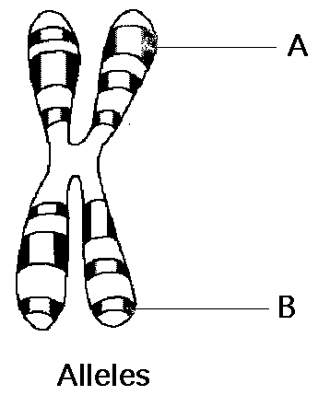
Gene – Chomosome Theory
Gene: DNA that codes for a specific trait
  Example: Hair Color / Eye Color
Allele: Different forms of the gene
  Example: Red air / Blue Eyes

Slide 4
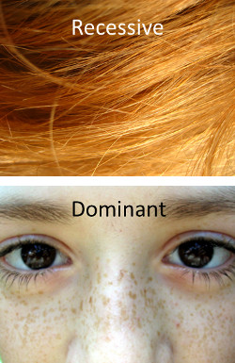
Law of Dominance
Dominant Gene: A gene that is ALWAYS expressed.
  Symbol: T (Tall)

Slide 5
Law of Dominance
Recessive Gene: A gene that is MASKED or HIDDEN.
  Symbol: t (short)

Slide 6
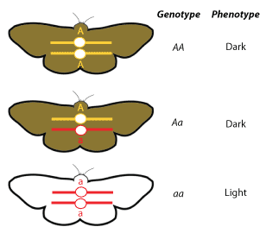
Law of Dominance
Genotype: Genetic make-up
  Homozygous (Pure): Both alleles are the same.
    Example: TT, tt
  Heterozygous (Hybrid): Alleles are different.
    Example: Tt

Slide 7
Law of Dominance
Phenotype: Physical Appearance
  Example: Tall, short

Slide 8
Law of Dominance
 | Genotype | Phenotype
Homozygous Dominant / Pure Dominance | TT | Tall
Heterozygous / Hybrid | Tt | Tall
Homozygous Recessive / Pure Recessive | tt | short

Slide 9
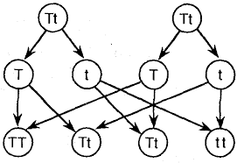
Segregation and Recombination

Slide 10
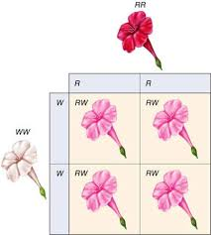
Incomplete Dominance
“In-between Dominance”
BLENDING of traits.

Slide 11
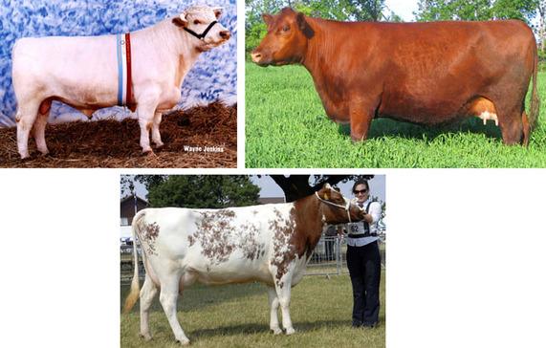
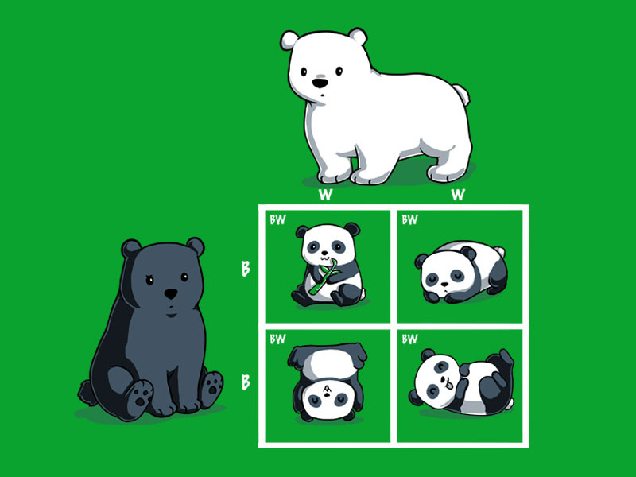
Co-Dominance
“Cow” Dominance
BOTH traits visible

Slide 12
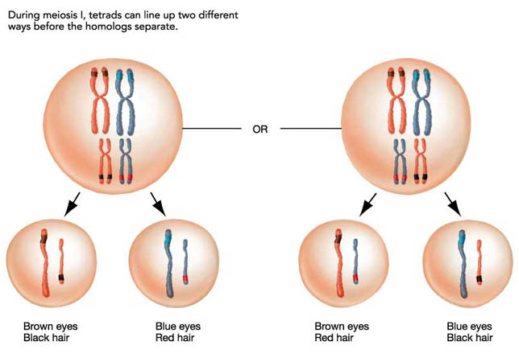
Independent Assortment
Traits are inherited separately of each other.
Traits are located on different chromosomes

Slide 13
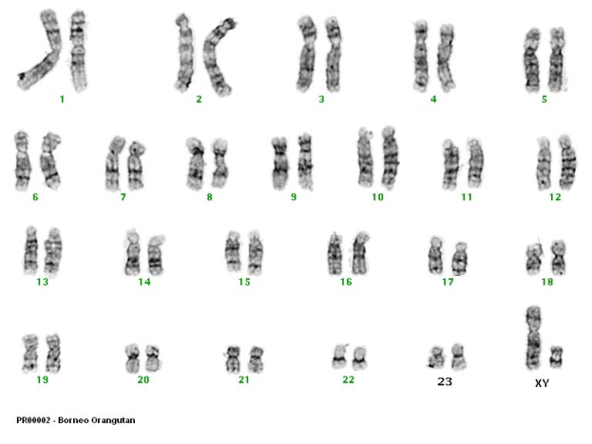
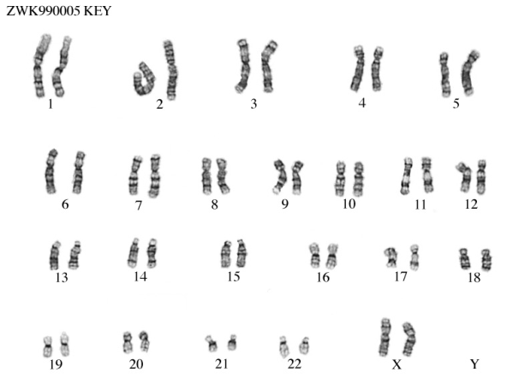
Chromosomes
Sex Chromosomes: Determine Gender
        XX = Female
        XY = Male
Autosomes: All chromosomes EXCEPT sex chromosomes
        All other traits

Slide 14
Sex Linked Traits
Traits determined by a gene located on the sex chromosomes.
Only expressed on X chromosomes
      Example: Color Blindness, Hemophilia
Genotype | Phenotype
XX | Normal Female
X⁻X | Carrier Female
X⁻X⁻ | Afflicted Female
XY | Normal Male
X⁻Y | Afflicted Male

Slide 15
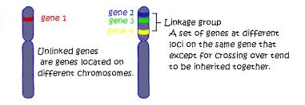
Gene Linkage
Traits located on the same chromosome often appear together.
  Example: Red hair and freckles

Slide 16
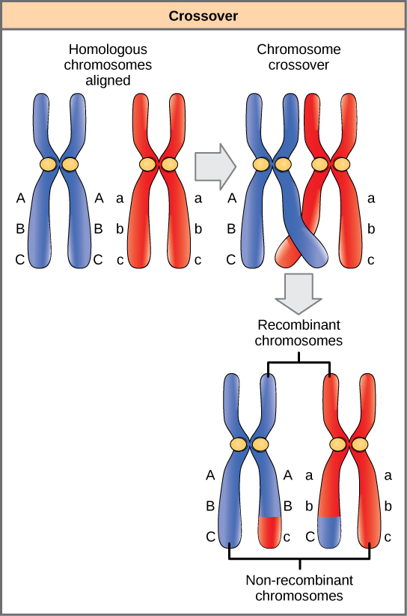
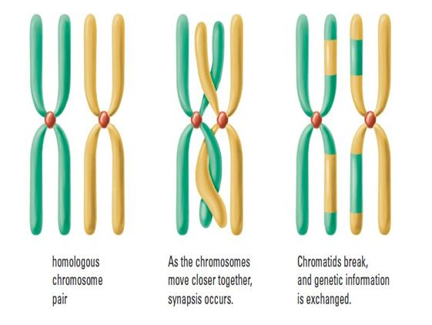
Crossing Over
One allele is replace with another as a result of “Crossing Over”

Slide 17
Multiple Alleles
When a trait has more than 2 alleles.
Blood Type | Possible Genotypes
Type A | I^{A}, I^{A} and I^{A}i
Type B | I^{B}I^{B}, and I^{B}i
Type AB | I^{A}I^{B}
Type O | ii
Blood Type Key:
AA = A
Ai = A
BB = B
Bi: B
AB = AB
ii = 0

