Slide 1
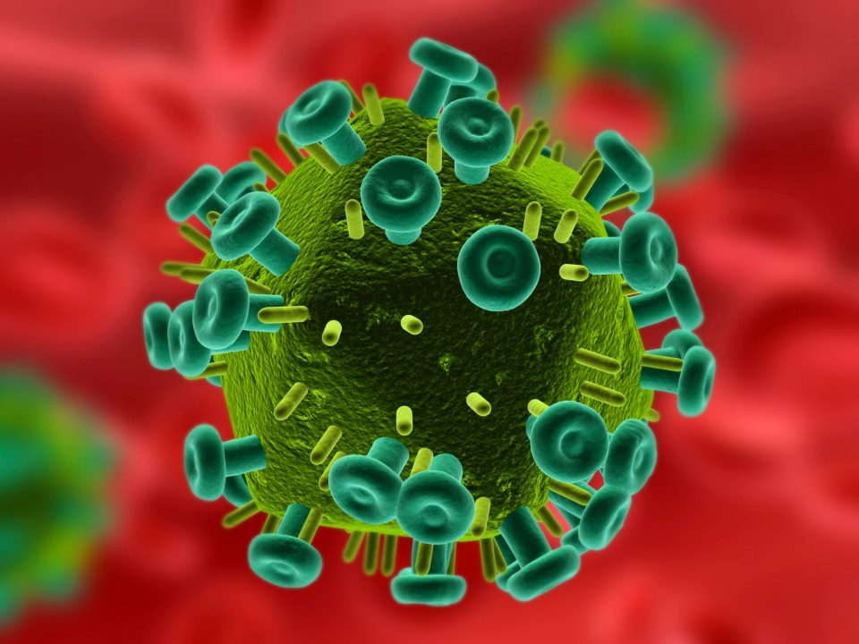
IMMUNOLOGY

Slide 2
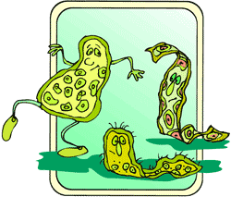
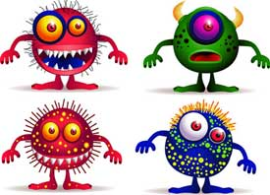
Pathogen
Causes Disease

Slide 3

Virus
EXAMPLE: Cold, Flu
MOT: Contact, Air
https://www.youtube.com/watch?v=Rpj0emEGShQ

Slide 4
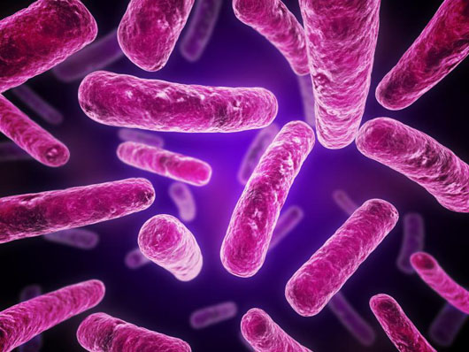
Bacteria
EXAMPLE: Meningitis
MOT: Contact, Liquids

Slide 5
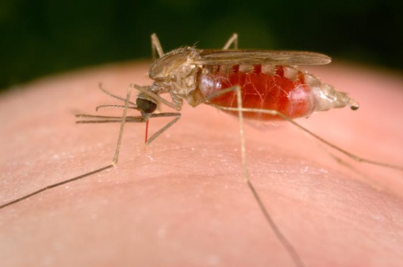
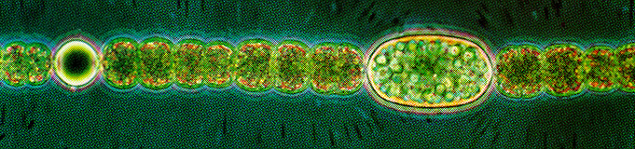
Protists
EXAMPLE: Malaria
MOT: Insects, Water
https://www.youtube.com/watch?v=gwYIyjwYluc

Slide 6
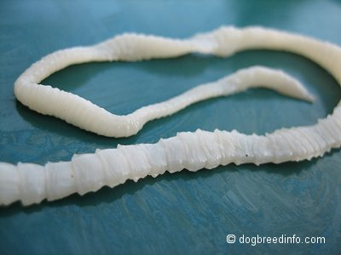
Worms
EXAMPLE: Tapeworms
MOT: Streams, Meat
https://www.youtube.com/watch?v=wZcsGe3FYF4

Slide 7
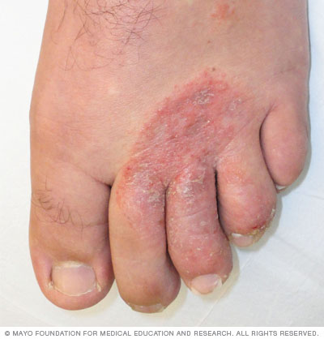
Fungus
EXAMPLE: Athletes Foot
MOT: Contact, shower

Slide 8
Sexually Transmitted Disease
Spread by sexual contact
Viral Examples: Hep B, HPV, HIV/AIDS
Bacterial Examples: Syphilis, Gonorrhea
https://www.youtube.com/watch?v=PKiPfX80pK4

Slide 9
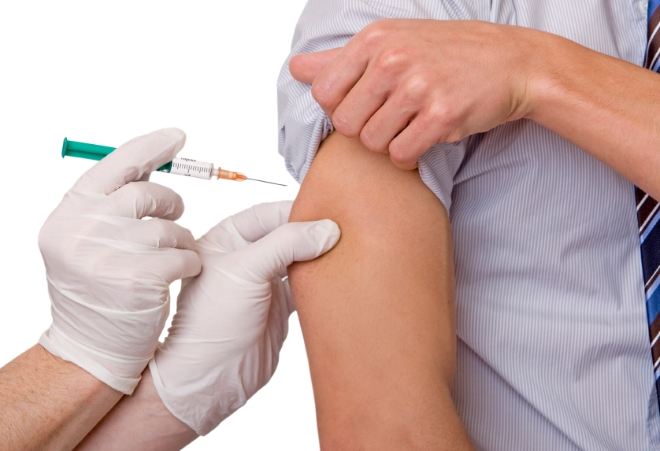
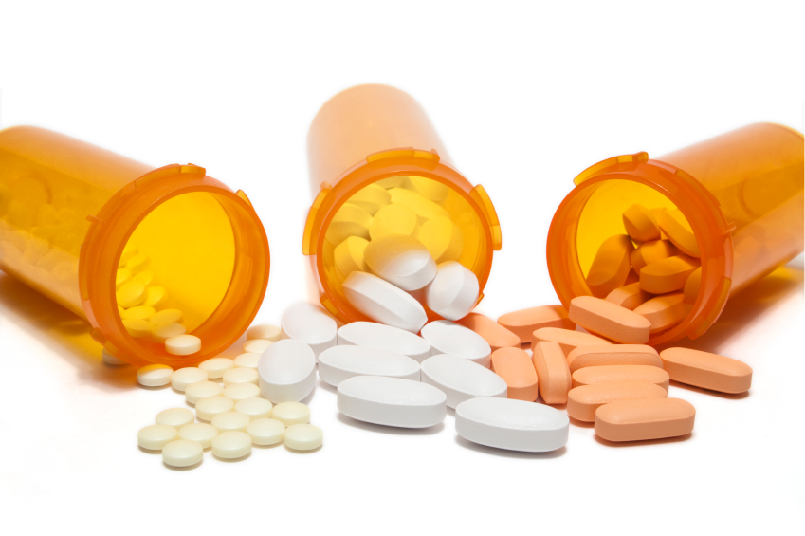
Fighting Disease
Antibiotics: Kill Bacteria
Vaccinations: Dead or weakened form of the virus

Slide 10
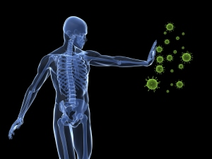
Immune System Defense
Skin
Fever
White Blood Cells
Antigens

Slide 11
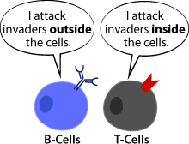
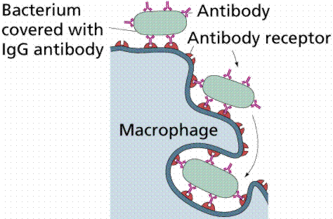
White Blood Cells
B-Cells: Make Antibodies
T-Cells: Attack
Microphages: Engulf

Slide 12
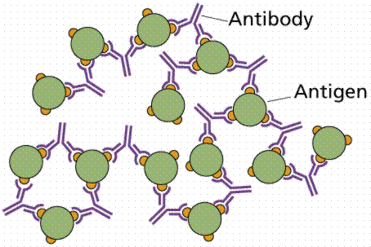
Antigen
Threat to Immune System
Antibodies Respond
https://www.youtube.com/watch?v=24IYt5Z3eC4

Slide 13
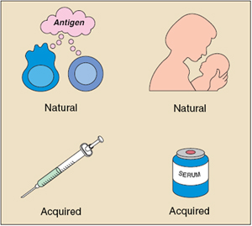
Types of Immunity
Natural: From Birth
Acquired: During Life
Passive: Mother to baby
Active: Vaccination
Specific: Organ Transplant
  Fight Rejection

Slide 14
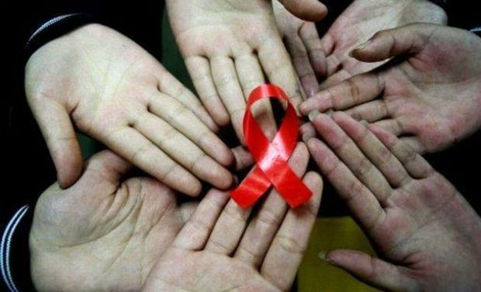
AIDS
Weakened Immune System
https://www.youtube.com/watch?v=EqlyEYOI754

Slide 15
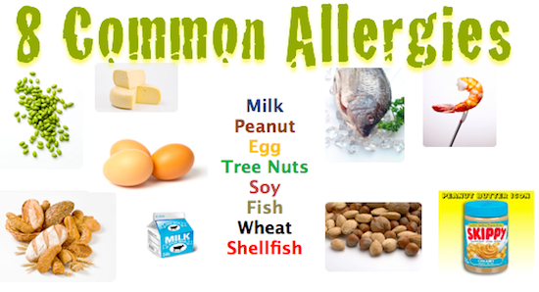
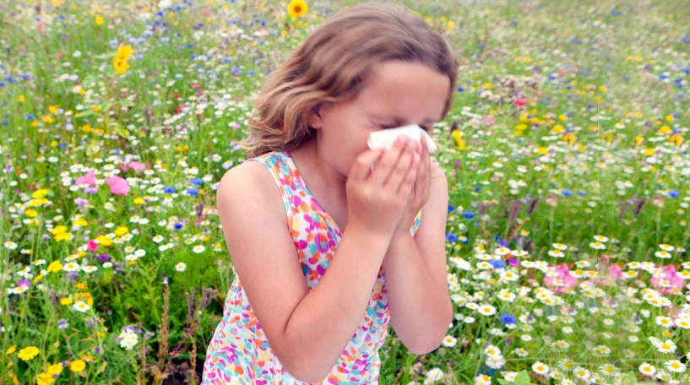
Allergies
Reaction to harmless substances
HISTAMINES: Reaction to allergies
https://www.youtube.com/watch?v=vFZlxQU0Pyk

Slide 16
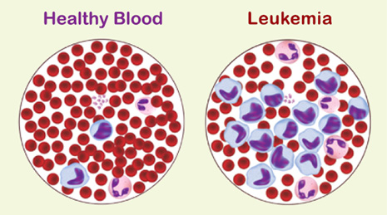
Leukemia
Cancer of the bone marrow
https://www.youtube.com/watch?v=Qje0fG_JHLY

