Slide 1
Colonial Encounters A
1750-1914
AP World History

Slide 2
A Second Wave of European Conquests
First Wave of European Colonialism | Second Wave of European Colonialism
1500s - 1600s | 1750 – 1900
In the Western Hemisphere (Americas) | In Africa and Asia
Spain and Portugal = were major players; NOT ANYMORE DUN DUN DUN | New countries involved = Germany, Italy, Belgium, the U.S., Japan
Devastated native populations | No massive devastation done to native peoples
Europeans chose the path of conquest and outright colonial rule | Europeans preferred informal control (cheaper & less likely to cause war)
Construction of 2nd-wave European empires in Africa and Asia involved military force or the threat of using it
Although they would have preferred non-violent takeovers, Europeans often had to fight in wars of conquest to create their empires
  Always won in the end → superior militaries and weapons

Slide 3
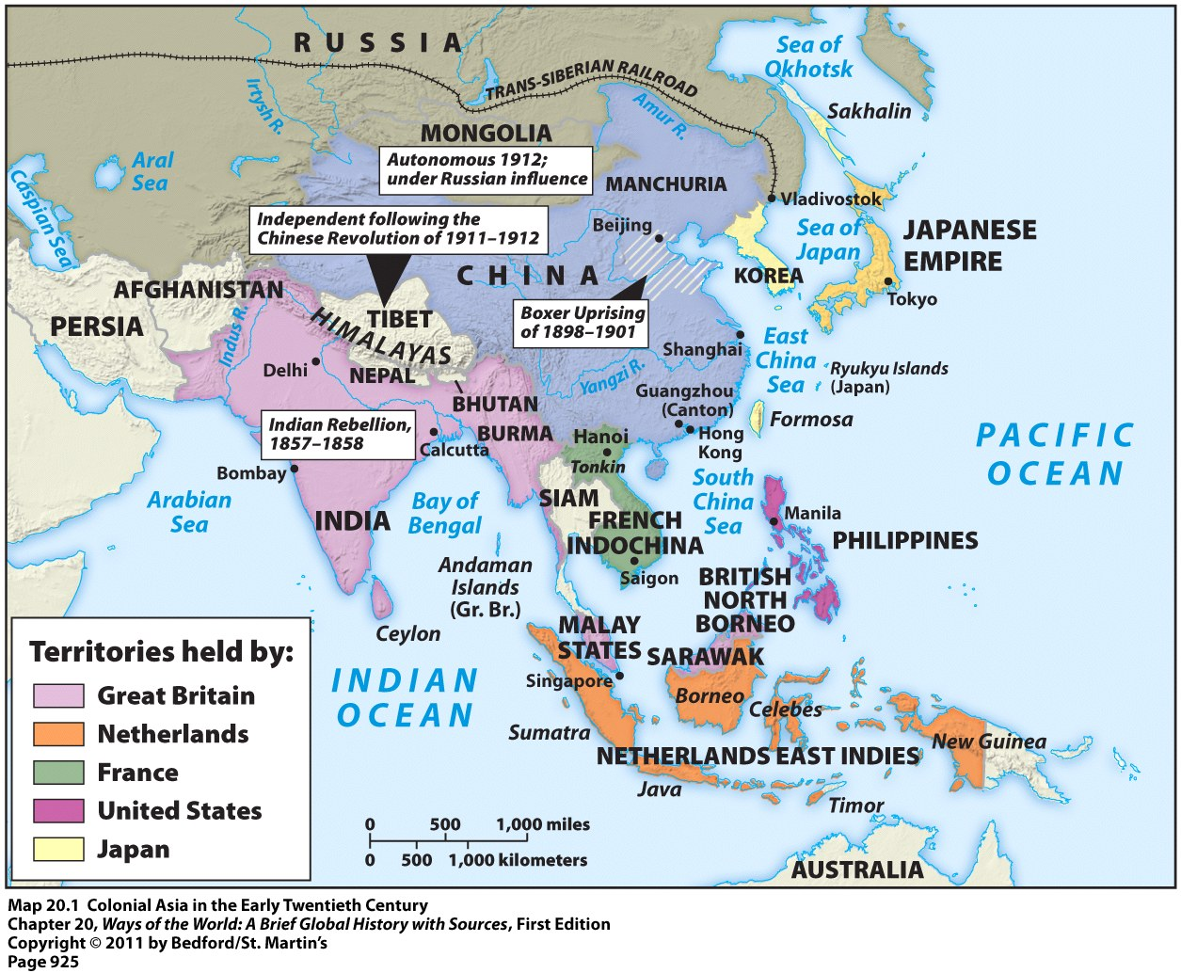
Colonial Asia in the Early 20th Century

Slide 4
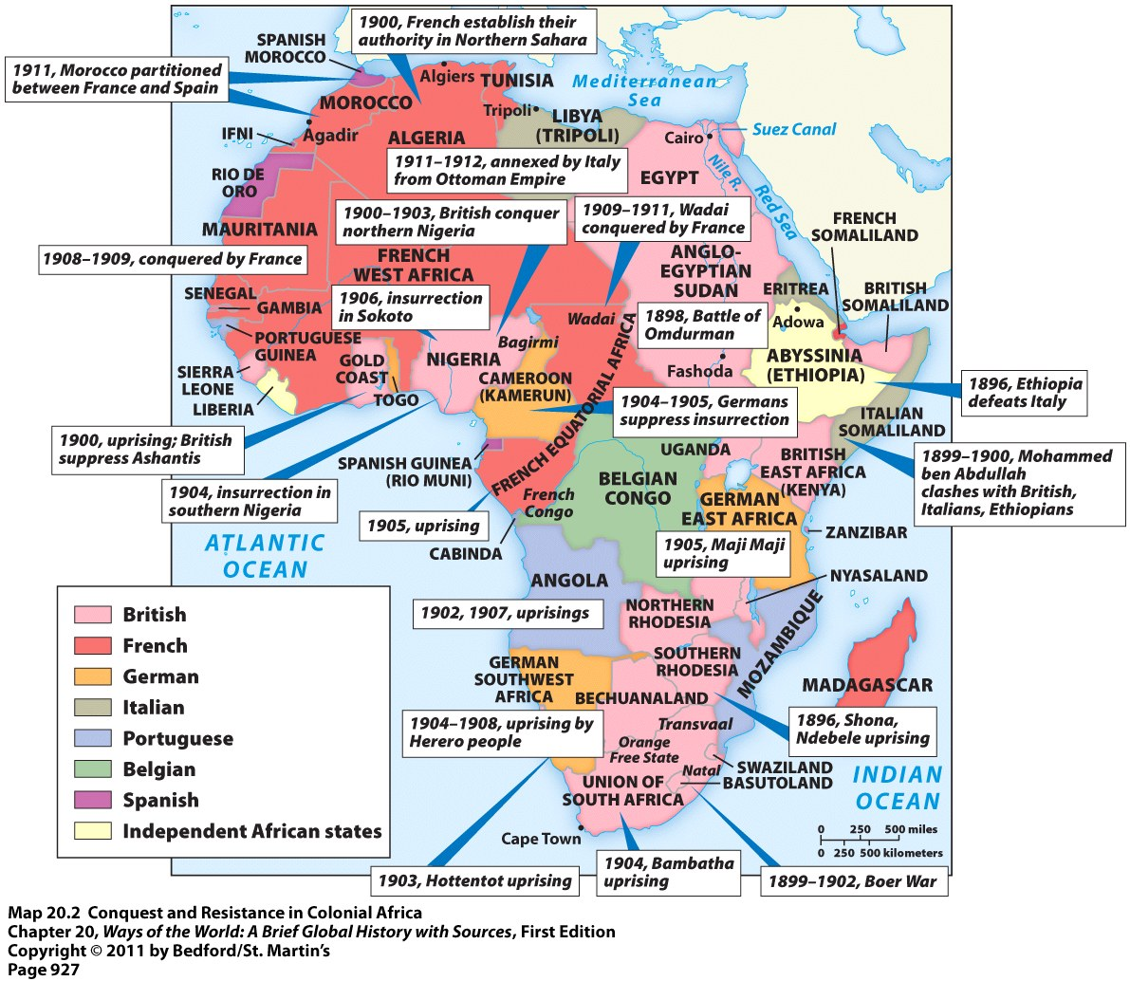
Colonial Africa in the Early 20th Century

Slide 5
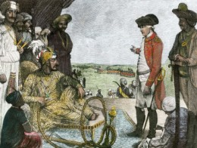
Various Paths to Colonial Status
India and Indonesia = colonial conquest grew out of earlier interactions with European trading companies
  India = became controlled by Britain
  Indonesia = became controlled by the Dutch
  Neither country had a clear-cut plan for conquest
  Conquest evolved slowly as local authorities and European traders made and unmade a variety of alliances
  Acquisition of India and Indonesia = fairly easy because both were fragmented territories with no political unity
British authorities meeting with Mughal leaders

Slide 6
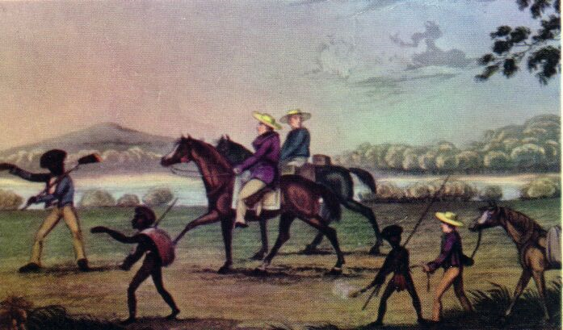
Various Paths to Colonial Status
Australia and New Zealand = both taken over by the British
  Similar to the earlier colonization of North America
  Conquest accompanied by: massive European settlement and diseases that reduced native numbers
  Became settler colonies = “neo-European” societies in the Pacific
White Settlers in Australia

Slide 7
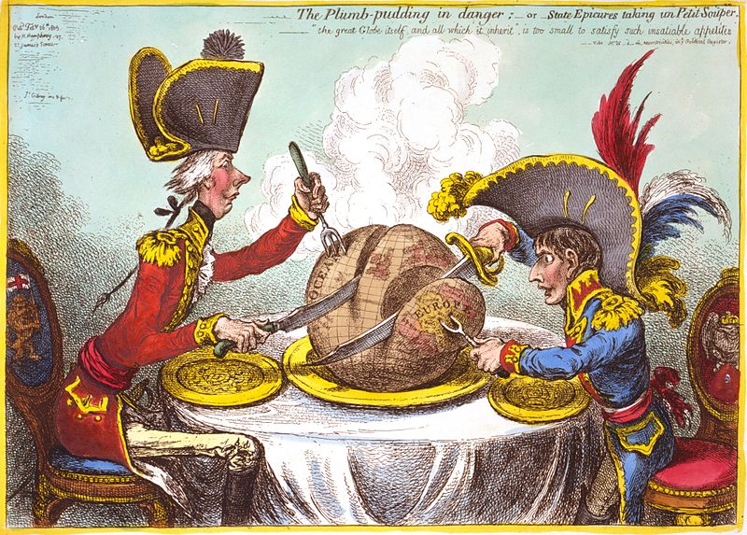
Various Paths to Colonial Status
Africa, mainland Southeast Asia, and the Pacific islands = occurred later = in the 2nd half of the 19th century
  More abruptly and deliberately than anywhere else

Slide 8
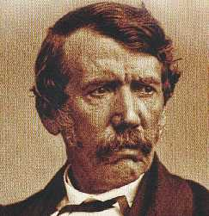
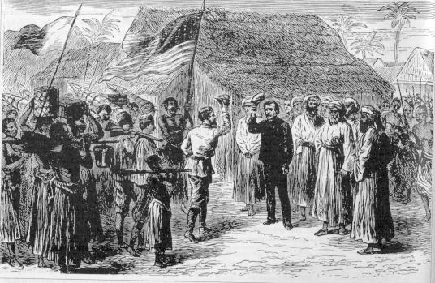
The “Scramble for Africa”
Until the 1800s = Europeans knew very little about Africa
1840 = David Livingstone went to Africa
  Traveled around and explored there for 30 years
  He lost contact with the outside world for 6 years in the 1860s
  American Journalist Henry Stanley was sent to look for him -- ended up leading several expeditions himself
Journeys of Livingstone and Stanley increased interest in Africa and its many resources
Meeting of Livingstone and Stanley

Slide 9
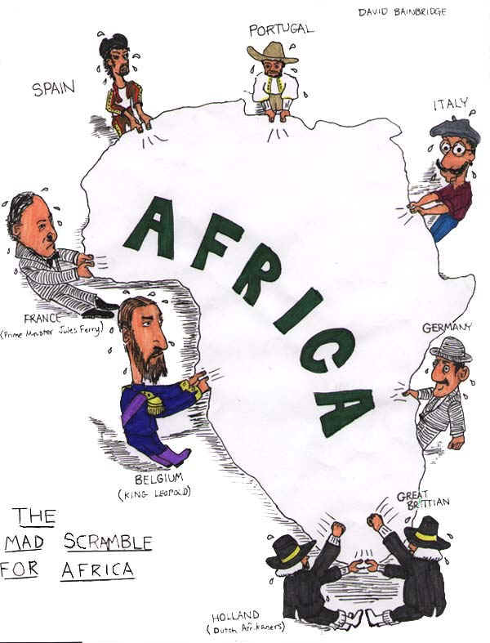
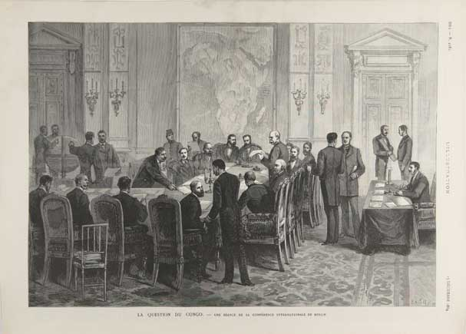
The “Scramble for Africa”
One European country after another began to claim parts of Africa
  Able to take African territories easily because they had superior weapons and a lot of money
1885 = the Berlin Conference = Several European nations met in Berlin to decide how to divide up Africa
  No African leaders invited
  Peaceful negotiations made between the European powers that officially decided “who got what”
By 1914 = Europeans controlled 90% of Africa
  European powers often had to use extensive and bloody military action to maintain control within their acquired African territories
The Berlin Conference

Slide 10
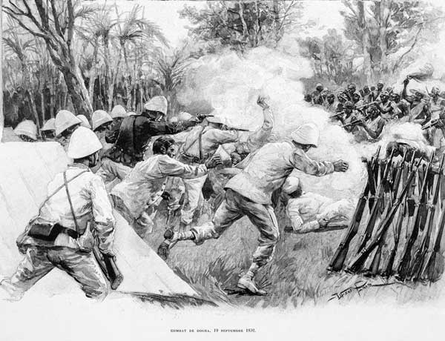
Varying Responses to European Encroachment
Some tried to enlist Europeans in their own internal struggles for power or in their external rivalries with neighboring states
Some tried to pit imperial powers against each other
Some wanted to fight back against the Europeans
Some believed resistance was futile and acceptance of the situation was the only option
Some negotiated with Europeans in an effort to keep as much independence and power as possible
African Resistance to Colonial Rule

Slide 11

Under European Rule: Cooperation
Many groups and individuals willingly cooperated with colonial authorities
Many men found employment, status, and security in the European-led armed forces
Colonial rulers = expensive, in short supply, and could rarely communicate with their subjects
  Result = local intermediaries needed
  Local intermediaries = typically from elite or governing families
  Local intermediaries = could retain their status and gain wealth by exercising authority at the local level

Slide 12
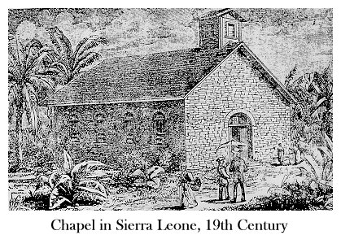
Under European Rule: Cooperation
Many found it beneficial to pursue Western education
  Western-educated class served the colonial state, European businesses, and Christian missions as teachers, clerks, translators, and lower-level administrators
  Some with even more education = became lawyers, doctors, engineers, journalists, etc.

Slide 13
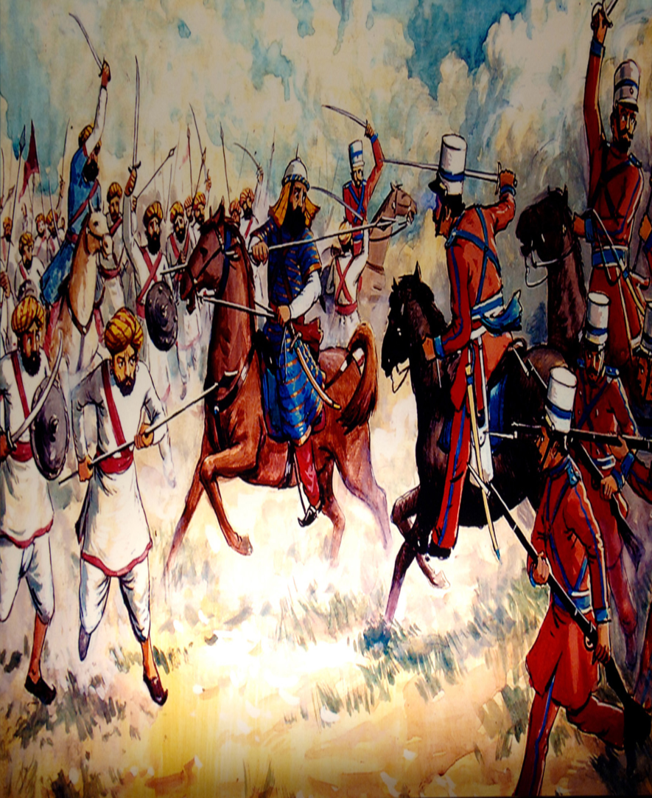
Under European Rule: Rebellion
Periodic rebellions (both big and small) = a constant problem for colonial regimes everywhere
Most famous colonial rebellion = the Indian Rebellion of 1857-1858
  Also known as: the Sepoy Rebellion or Sepoy Mutiny
  Sepoys = Indian soldiers in the service of European powers

Slide 14
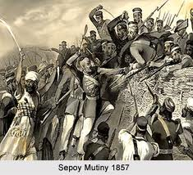
Indian Rebellion of 1857-1858
Triggered by the introduction into the colony’s forces of a new cartridge smeared with animal fat from cows and pigs
Remember: Indian troops = Hindus and Muslims
  Hindus = find cows sacred
  Muslims = regard pigs as unclean
  Both = viewed this military “innovation” as a plot to harm them and convert them to Christianity
Indian troops in Bengal mutinied against their British superiors

Slide 15
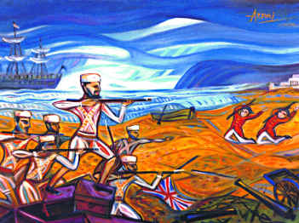
Indian Rebellion of 1857-1858
Indian Rebellion spread from Bengal to other regions and other social groups
Many social groups within India were upset with British colonial rule
  Local rulers = lost power
  Landlords = deprived of their estates and/or rent
  Peasants = overtaxed and exploited by urban moneylenders and landlords
  Weavers = unemployed (displaced by machines)
  Religious leaders = opposed to Christian missionary preaching

Slide 16
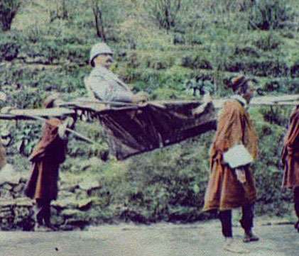
Indian Rebellion of 1857-1858
Crushed in 1858 → but important results followed:
  Widening of the racial divide in colonial India between native Indians and their British rulers → eroded British tolerance for their subjects
  British = became more conservative and cautious when it came to trying to change Indian society → didn’t want another rebellion
  British government assumed direct control over India → ended the British East India Company’s rule there

Slide 17
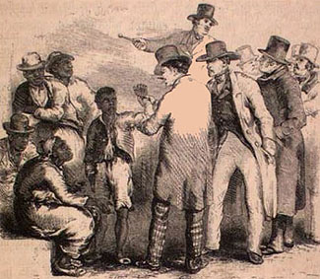
Colonial Empires with a Difference
Major factor distinguishing the rulers from the ruled = race
Education for colonial subjects = very limited
  Limited to practical subjects
  Europeans were afraid that education and knowledge would lead to power for colonial subjects

Slide 18
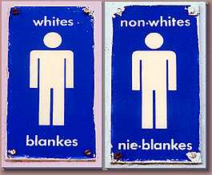
Colonial Empires with a Difference
Colonies with large European settler populations = blatant pattern of racial segregation
Example = apartheid
  Racial segregation in South Africa
  Racial system provided for separate: “homelands,” educational systems, residential areas, public facilities, etc.

Slide 19
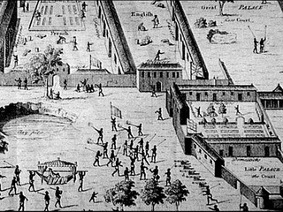
Colonial Empires with a Difference
European powers were much more involved and “hands on” with their colonial states in the 19th century
  Affected the daily lives of people far more than empires had in the past
  Centralized tax-collecting agencies
  New modes of transportation and communication
  Imposed changes in landholding patterns
  Integration of colonial economies into global trade network
  Public health and sanitation measures
European factories on the west coast of Africa

Slide 20
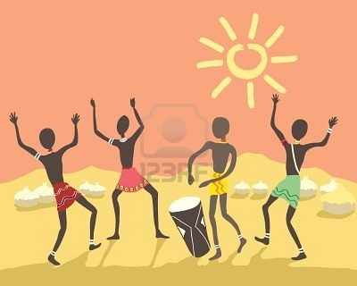
Colonial Empires with a Difference
European colonizers felt the need to count, classify, and organize their colonial subjects
  Wanted a way to manage the unfamiliar, complex, varied, and changing societies that they now controlled
  Made colonial administration easier
  Ex: In African colonies, Europeans identified and sometimes even invented distinct tribes → each with its own territory, language, customs, chief, etc.

Slide 21
Colonial Empires with a Difference
European colonial policies contradicted their own values and practices at home
European Nations | European Colonies
Becoming more democratic | Were mostly dictatorships (used to create order and stability)
Swept up in nationalism | Total opposite of national independence
Christian and Enlightenment idea of human equality | Racial divisions, ranked racial classifications, etc.
Industrialization and modernization | Modernization discouraged because Europeans did not want modernization to cause opposition to colonial rule

