Slide 1
Plant Reproduction

Slide 2
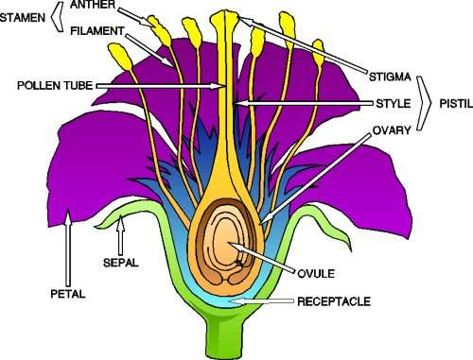
Male Plant Reproductive System
Stamen
  Contains the anther and the filament

Slide 3

Male Plant Reproductive System
Anther
  Produces Pollen

Slide 4
Male Plant Reproductive System
Filament
  Supports the anther

Slide 5
Male Plant Reproductive System
Pollen
  Male gamete (sperm)

Slide 6
Female Plant Reproductive System
Pistil
  Female part of the flower

Slide 7
Female Plant Reproductive System
Stigma
  Sticky, captures pollen

Slide 8
Female Plant Reproductive System
Style
  Holds up the stigma

Slide 9
Female Plant Reproductive System
Ovary
  Contains ovules (becomes the fruit)

Slide 10
Female Plant Reproductive System
Ovules
  Female gametes (eggs)

Slide 11
Plant Reproduction
Petals
  Attracts insects

Slide 12
Plant Reproduction
Sepals
  Protects flower

Slide 13
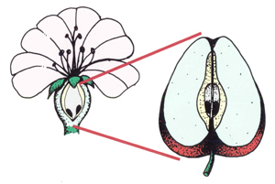
Plant Reproduction
Fruit
  Fertilized plant ovary

Slide 14
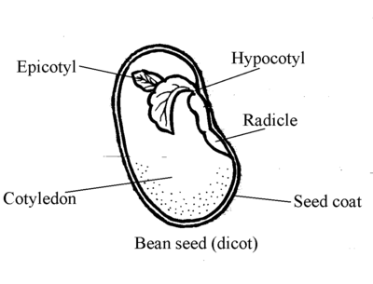
The Seed
Seed
  Plant embryo

Slide 15
The Seed
Cotyledon
  Provides nourishment

Slide 16
The Seed
Seed Coat
  Protects the seed

Slide 17
The Seed
Epicotyl
  Develops in the stems and leaves

Slide 18
The Seed
Hypocotyl
  Develops into the roots

